Slide 1
Week 6 · Lecture 2
Service quality and street priority
LEC12 · Urban Transport Systems Planning and Design · TSTU · Prof. J. Sodikov

Slide 2
What you will be able to do after today
• Calculate expected waiting time from headway and regularity
• Judge stop spacing against access and speed
• Express corridor capacity in passengers, not vehicles
• Choose between bus lanes, junction priority and BRT for a corridor
2 / 24

Slide 3
What passengers experience
• Walk to the stop, wait, ride, transfer, walk to the destination
• Waiting and walking feel longer than riding — they weigh more in mode choice (Week 5)
• Reliability: the extra time people must allow because buses are irregular
• Crowding, heat, safety and information shape the wait
• Quality of service is a passenger measure, not an operator one (TCQSM)
3 / 24

Slide 4
Waiting time and regularity
• Passengers arriving at random wait on average half a headway: h/2
• Irregular headways make it worse: E[W] = h/2 × (1 + CV²)
• CV is the coefficient of variation of headways at the stop
• Bunching: a late bus picks up more passengers and gets later still
• With long headways people time their arrival — then reliability matters most
4 / 24

Slide 5
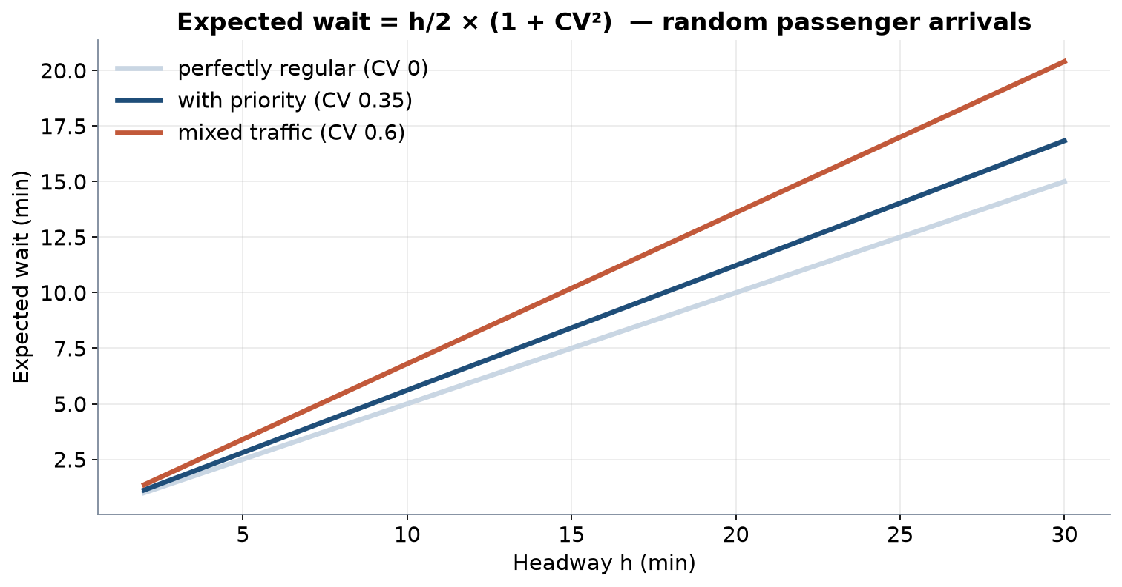
Expected wait against headway
Same headway, longer waits when service is irregular.
5 / 24

Slide 6
Making service reliable
• Measure it: headway regularity, excess waiting time, on-time performance
• Remove the causes: mixed traffic, long variable dwells, junction delay
• Control: holding at timing points, headway-based dispatching
• Protect: bus lanes and junction priority reduce variability as well as delay
6 / 24

Slide 7
Stop spacing: access against speed
• Closer stops: shorter walks, but every stop costs dwell, braking and acceleration
• Wider spacing: faster buses and more frequency from the same fleet
• Optimum depends on trip length, walking speed and how passengers value time
• Same s/4 logic as link spacing in Week 4
• Consolidate stops together with better crossings, not instead of them
7 / 24

Slide 8
Worked example: removing stops
• A route has 30 stops; each costs 30 s of dwell, braking and acceleration
• Removing 6 lightly used stops saves 3 min per direction
• On a 120 min cycle that is 6 min: at a 10 min headway, still 12 buses
• Combine with priority and the saving can release a bus
• Cost: some passengers walk up to one extra stop spacing
8 / 24

Slide 9
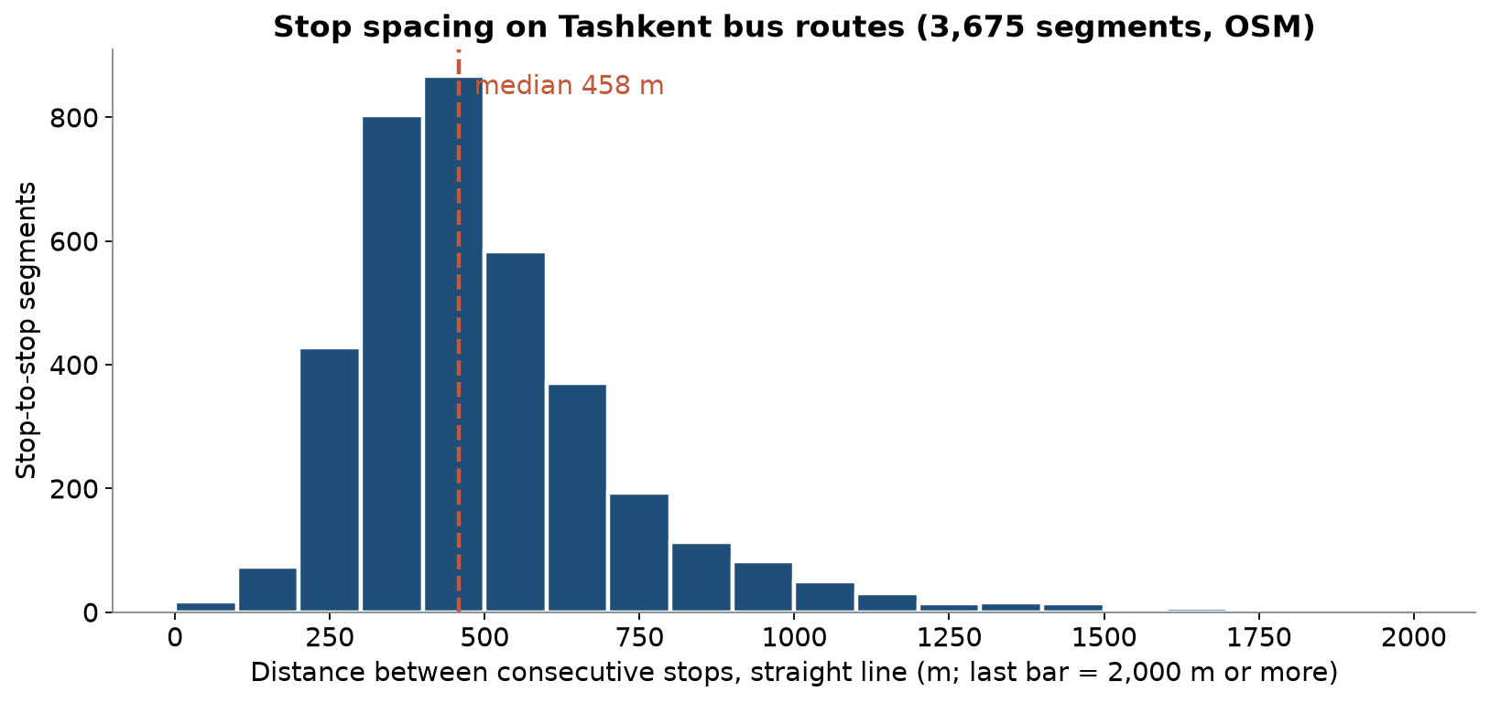
Tashkent's stop spacing
3,675 stop-to-stop segments; median 458 m.
9 / 24

Slide 10
Reading the spacing — and a local catchment rule
• Median 458 m between stops; 14% under 300 m
• SNiP norm quoted by Pulatova: 500 m (600 m in low-density areas) to the nearest stop
• Russian catchment formula: R = 55.8 or 67.0 × (10 − 0.125 × headway)
• A 10-minute headway gives a minimum catchment of 488 m: frequency extends walking catchments
10 / 24

Slide 11
Capacity measured in passengers
• Line capacity = buses per hour × places per bus × load factor
• Corridor capacity is limited by stops and junctions, not by the lane itself
• Stop capacity rises with more loading bays, level boarding and off-board fares
• Compare person throughput, not vehicles: one bus lane against one car lane
• TCQSM gives the procedures for bus stop and lane capacity
11 / 24

Slide 12
Worked example: what a lane carries
• Bus lane: 40 buses per hour × 80 places × 0.85 = 2,720 passengers per hour
• Car lane: 800 cars per hour × 1.3 persons = 1,040 persons per hour
• The bus lane needs only 40 vehicles to move more people
• Use your own counts for the car lane (Week 2) and your corridor's buses
12 / 24

Slide 13
Street priority: dedicated lanes
• Kerbside lanes: cheap and quick, but conflict with parking, loading and turning
• Median lanes: protected and faster, but need stations in the middle of the road
• Enforcement decides whether a lane works
• Corridor strategies: express, short-turn and zonal services on top
13 / 24

Slide 14
Junction priority
• Green extension and early green for an approaching bus
• Queue jumps and bus-only signal phases
• Conditional priority: only for late buses, to improve regularity
• Needs a signal inventory and controllers that can talk to buses
• TSTU's GIS inventory of Tashkent's traffic signals is a starting point
14 / 24

Slide 15
Conventional bus, bus with priority or BRT?
Option | Choose it when | Limits
Conventional bus | Moderate demand, narrow streets, coverage role | Speed and regularity follow traffic
Bus with lanes and junction priority | Overlapping routes, recurring congestion | Needs enforcement and kerb management
BRT | High trunk demand, width for median stations | Higher cost; works as a network, not a line
15 / 24

Slide 16
Tashkent: what priority would buy
• Real route lengths and stops, synthetic loads — LAB6
16 / 24

Slide 17
Route 8 with priority
• Bus lanes on half the route (25 km/h) and 22 s per stop with level boarding
• Result: priority cycle 142.1 min; fleet 34; or 3.55 min headway with 40 buses
• Either save buses or keep them and run more often
• The second option also cuts waiting time and crowding
17 / 24

Slide 18
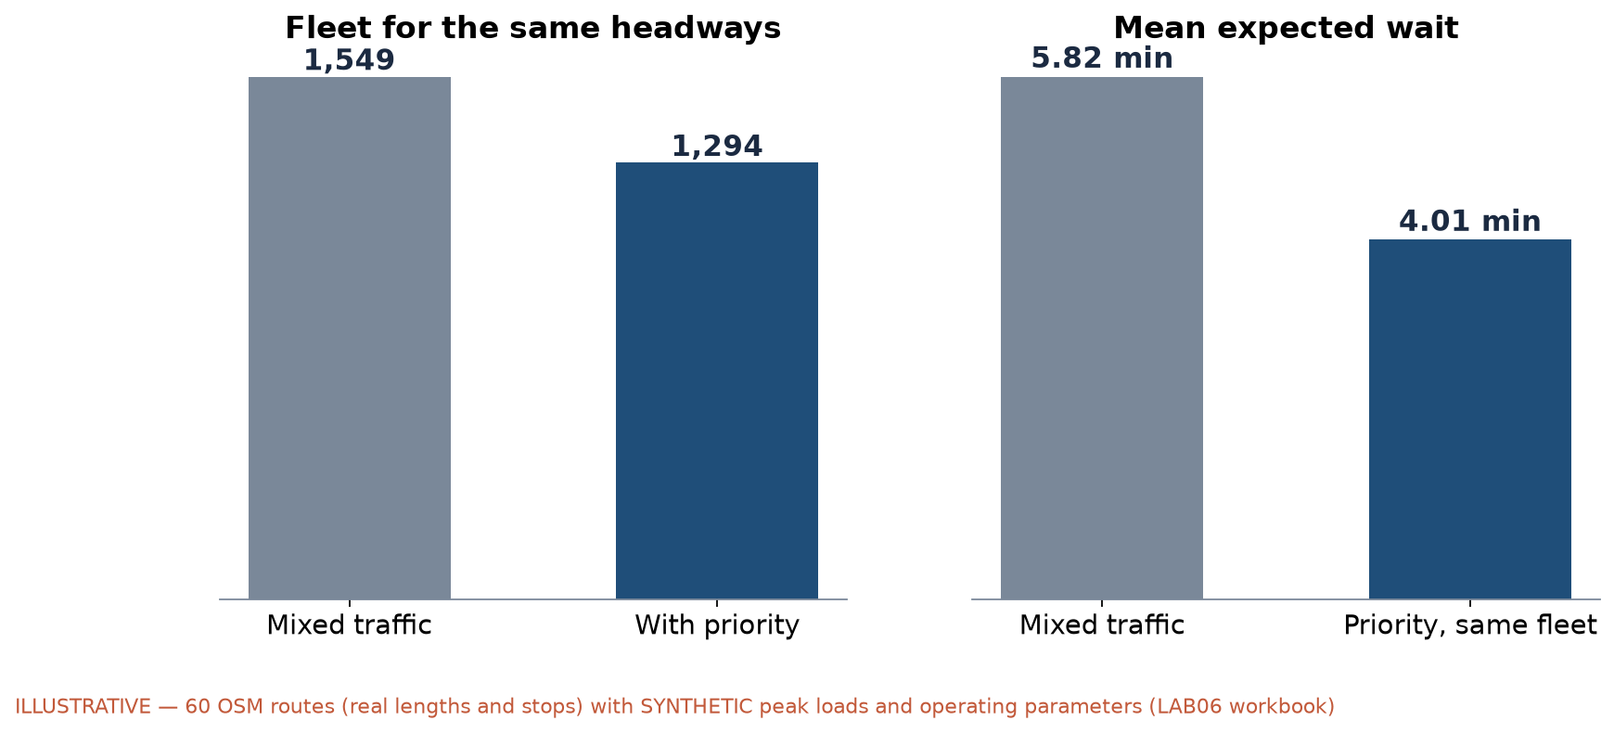
Priority across the network (illustrative)
Sixty route numbers with real OSM lengths and stops; synthetic loads and parameters.
18 / 24

Slide 19
Reading the network result
• Fleet for the same headways: 1,549 → 1,294 buses
• Mean expected wait with today's fleet: 5.82 → 4.01 min
• Both are scenario results from assumed speeds and loads — not forecasts
• The direction is robust: priority turns speed into frequency
• Compare with the concept's +17% bus-speed target
19 / 24

Slide 20
Waiting in a hot city
• Sodikov et al. walking survey: stepping from sunlit pavement into the nearest shade lowers surface temperature by a median 19.5 °C
• 78.5 km of the first-phase shade network lies close to a transit stop
• Shade, seating and real-time information make waits shorter in perception
• Stop design is part of service quality, not only street furniture
20 / 24

Slide 21
Discussion
Your corridor gets either a bus lane or junction priority this year, not both. Which one, and why?
• Use cycle time, fleet and waiting time in your answer.
21 / 24

Slide 22
Key takeaways
• Waiting time grows with headway and with irregularity
• Stop spacing trades walking against speed and fleet
• Capacity is counted in passengers; stops and junctions set the limit
• Priority converts saved minutes into frequency or saved buses
22 / 24

Slide 23
References
• Wilson, N., Sánchez-Martínez, G., & Nassir, N. (2017). 1.258J/11.541J Public Transportation Systems, Spring 2017. MIT OpenCourseWare. https://ocw.mit.edu/courses/1-258j-public-transportation-systems-spring-2017/
• Kittelson & Associates et al. (2013). Transit Capacity and Quality of Service Manual (3rd ed.), TCRP Report 165. Transportation Research Board. https://nap.nationalacademies.org/read/24766
• Ben-Akiva, M. (2008). 1.201J/11.545J Transportation Systems Analysis: Demand and Economics, Fall 2008. MIT OpenCourseWare. https://ocw.mit.edu/courses/1-201j-transportation-systems-analysis-demand-and-economics-fall-2008/
• Pulatova, Z. S. (2024). Walkability assessment of Tashkent city districts (PhD dissertation, in Uzbek; supervisor J. I. Sodikov). Tashkent State Transport University.
• van Nes, R. Designing public transport networks / Public transport service networks: design of urban and regional networks. TU Delft research portal. https://research.tudelft.nl/en/publications/designing-public-transport-networks/
• OpenStreetMap contributors (2026). Uzbekistan extract, Geofabrik GmbH (download.geofabrik.de). https://download.geofabrik.de/asia/uzbekistan.html
• Global Designing Cities Initiative & NACTO (2016). Global Street Design Guide. Island Press. https://globaldesigningcities.org/publication/global-street-design-guide/
• Sodikov, J. I., et al. (2016). GIS inventory of traffic signals on Tashkent streets (in Russian). Transport Systems of Siberia.
• Urbanik, T., et al. (2015). Signal Timing Manual (2nd ed.), NCHRP Report 812. Transportation Research Board. https://www.nap.edu/read/22097/chapter/2
• ITDP — Institute for Transportation and Development Policy. The BRT Planning Guide (4th ed.). New York: ITDP. https://brtguide.itdp.org/
• Synthetic teaching dataset generated for this course (method and random seed in each workbook's README sheet).
• Sodikov, J. I., et al. (2026). Urban heat actions of 100 global cities: Tashkent, Uzbekistan (book chapter manuscript).

Slide 24
© 2026 TSTU, J. Sodikov. CC BY-NC-SA 4.0. Adapts openly licensed material (CC BY-NC-SA 4.0) listed in the references.

