Slide 1
Week 7 · Lecture 1
Interchanges and the first and last mile
LEC13 · Urban Transport Systems Planning and Design · TSTU · Prof. J. Sodikov

Slide 2
What you will be able to do after today
• Break a public-transport trip into access, wait, ride, transfer and egress
• Judge an interchange by walking and cycling access, crossings, transfers and information
• Weigh park-and-ride against cheaper first/last-mile options
• Measure walk access to Tashkent's metro stations from open data
2 / 25

Slide 3
Where this sits: service design meets street design
• Service design treats stops and transfers as part of the service
• Route structure, corridor strategies and customer information shape what passengers experience
• This week joins the PT network (Weeks 4 and 6) to the street that carries people to it
• Design question: how far, how safe and how legible is the walk or ride to the vehicle?
3 / 25

Slide 4
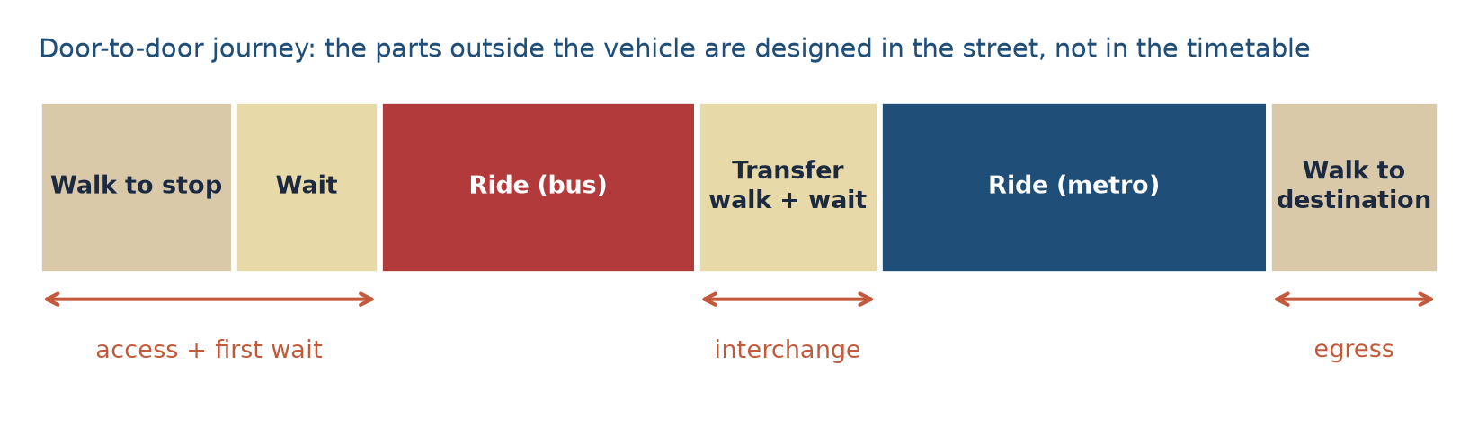
The door-to-door trip
Schematic. Access, waiting, transfer and egress happen in the street, not in the vehicle.
4 / 25

Slide 5
Why out-of-vehicle time weighs more
• Passengers value walking, waiting and transfer time more heavily than riding time
• Uncertainty makes waiting worse: an unknown wait feels longer than a known one
• Each transfer carries a penalty beyond its minutes: effort, risk of a missed connection
• So small savings at the stop can matter as much as large savings in the vehicle
5 / 25

Slide 6
Worked example: generalised journey time
• Weights (illustrative): walking and waiting × 2, riding × 1
• Walk 8 + wait 6 + ride 20 + walk 6 = 40 min on the clock
• Generalised time = 2×8 + 2×6 + 20 + 2×6 = 60 min
• A crossing that saves 3 min of walking saves 6 generalised minutes
• Real-time information that cuts perceived waiting has a similar effect
6 / 25

Slide 7
How far will people walk to a stop?
• Catchments are usually set by walking distance on the network, not by straight-line circles
• Uzbek planning norm quoted by Pulatova: stop within 500 m (600 m) of homes
• Rail attracts longer walks than buses; feeder buses and bicycles extend the catchment
• Barriers (canals, rail, wide arterials) shrink a catchment more than distance does
7 / 25

Slide 8
What makes a good interchange
Element | Design aim | Typical failure
Walking access | Direct, shaded, step-free routes from all sides | Long detours to the only entrance
Crossings | Signalised or raised crossings on desire lines | Uncontrolled crossings of multi-lane roads
Transfer | Short, level, visible walk between modes | Bus stop placed out of sight of the station
Information | Maps, line numbers, real-time departures | No information at bus stops
Cycling | Safe approach and secure cycle parking | Bicycles chained to railings
8 / 25

Slide 9
Passenger information
• Pre-trip: journey planners and open timetable data
• At the stop: network map, line numbers, timetable or headway, real-time arrivals
• On board: next-stop announcements, transfer information
• Information reduces perceived waiting and makes transfers feel safer
• Open data (GTFS) lets third parties build the tools — Tashkent has no open GTFS feed yet
9 / 25

Slide 10
Park-and-ride: location, benefits, limits
• Location: at the outer end of a fast line, before congestion begins
• Benefit: intercepts car trips from areas that buses cannot serve well
• Cost: large land take next to stations — land that could carry homes and jobs
• Risk: draws people who would otherwise walk, cycle or take a feeder bus
• Check against alternatives: feeder buses, bike-and-ride, drop-off bays
10 / 25

Slide 11
Worked example: what park-and-ride costs in land
• Assume 500 spaces at about 25–30 m² per space including aisles
• Land take ≈ 1.25–1.5 ha, all within walking distance of a station
• The same land could host housing for several hundred households
• Compare: 500 cycle-parking places fit in roughly a tenth of that area
• Ask who uses each option and what it costs per daily rider
11 / 25

Slide 12
Bike-and-ride and shared micromobility
• Bicycles widen a station catchment several times at low cost
• Needs: a safe approach route, secure parking, a short walk to the platform
• Tashkent's Qwatt e-bike share (since 2024): more than 1,300 bikes, placed around metro stations and universities
• Sharing works only if the network around the station is safe to ride
12 / 25

Slide 13
Tashkent: how people reach the metro
• Ergashova (2026) mahalla analysis, OpenStreetMap extract October 2026, Pulatova (2024) survey
13 / 25

Slide 14
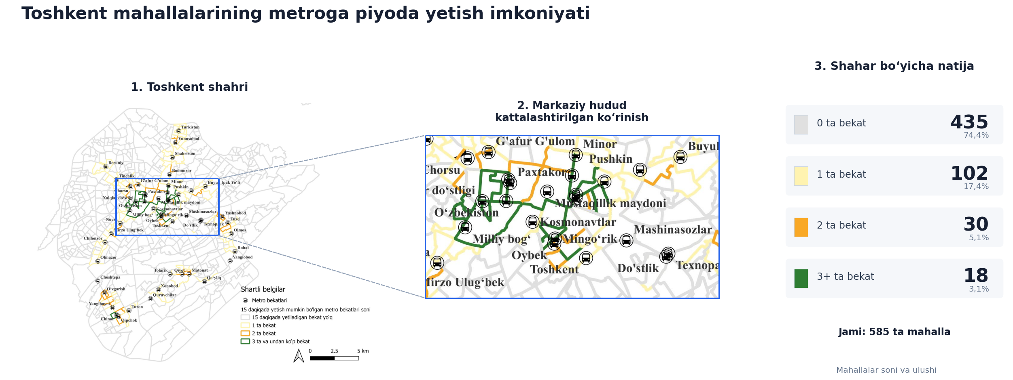
Walking access to the metro, by mahalla
Ergashova (2026): metro stations reachable within a 15-minute walk from each mahalla centre.
14 / 25

Slide 15
Most mahallas have no metro station within walking distance
• Of 585 mahallas, 74.4% have no metro station within a 15-minute walk
• 102 (17.4%) reach one station; only 18 (3.1%) reach three or more
• For most residents the metro is a bus or taxi ride away — the feeder is the interchange
• So bus–metro transfers, not walking alone, decide the metro's catchment
15 / 25

Slide 16
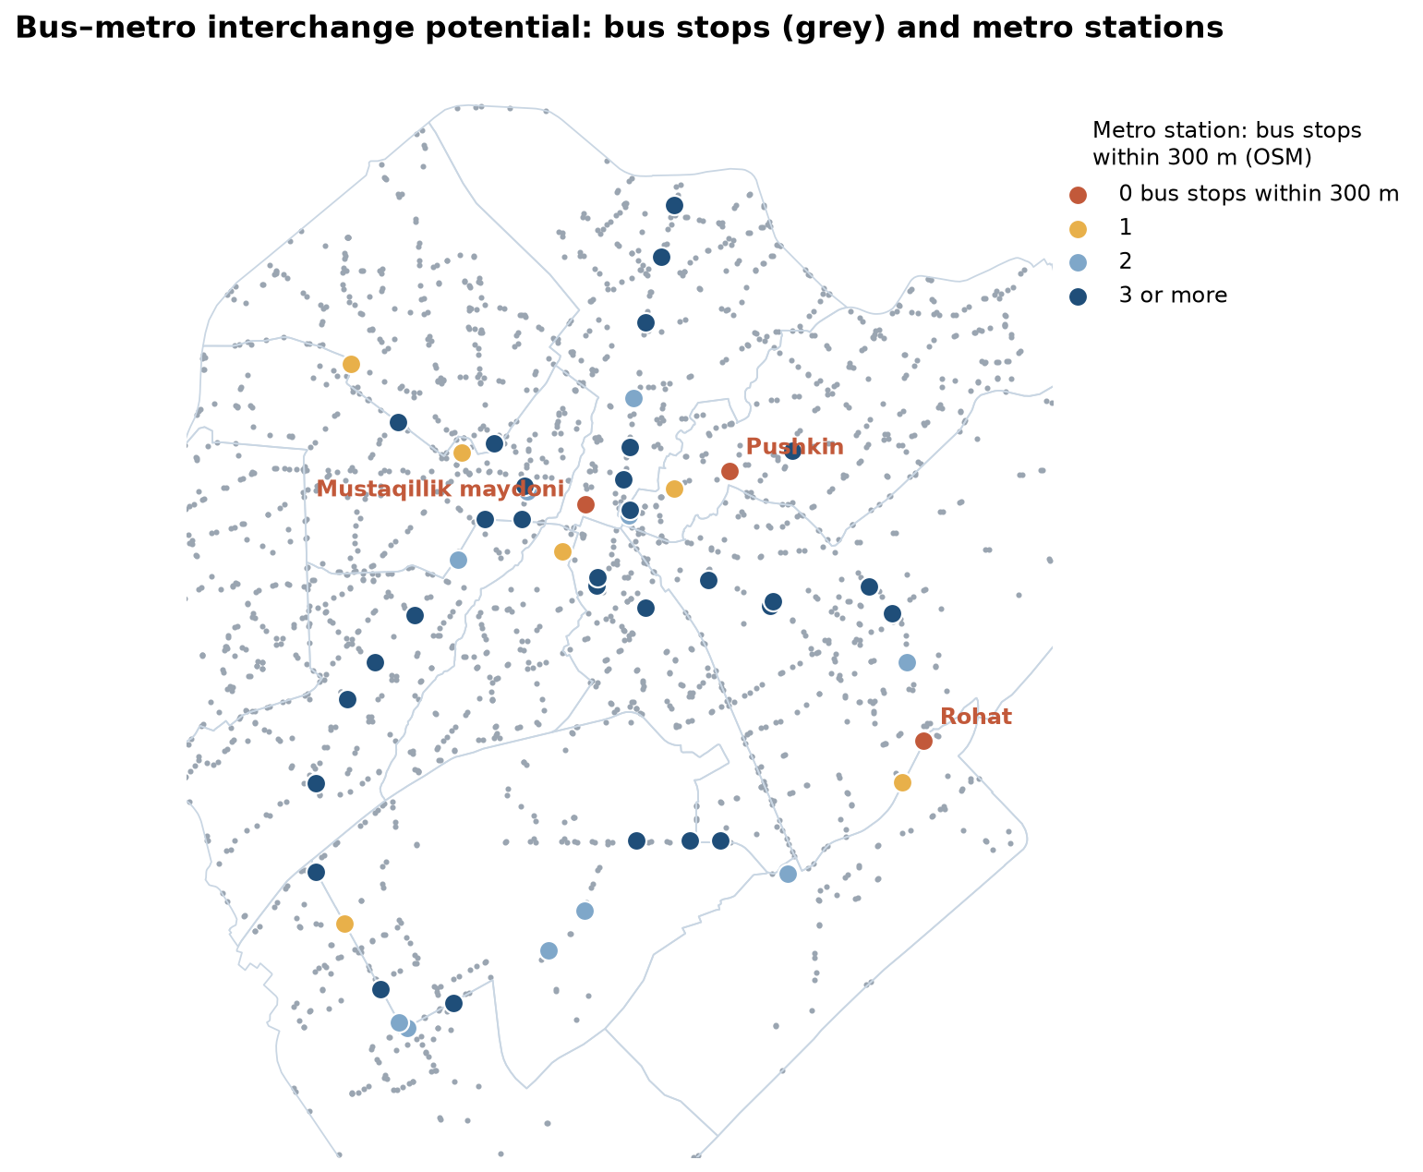
Bus–metro interchange potential
OSM, October 2026: bus stops within 300 m of each metro station node (straight line). LAB7 repeats this.
16 / 25

Slide 17
What the open data shows
• On average 3.0 bus stops within 300 m of a metro station
• 3 of 49 stations have none: Rohat, Mustaqillik maydoni, Pushkin
• Median walk to the nearest bus stop (straight line): 98 m
• 135 of 2,019 bus stops within 300 m (6.7%) of a station: feeder transfers rely on few stops
• Straight lines flatter reality: LAB7 checks network distances
17 / 25

Slide 18
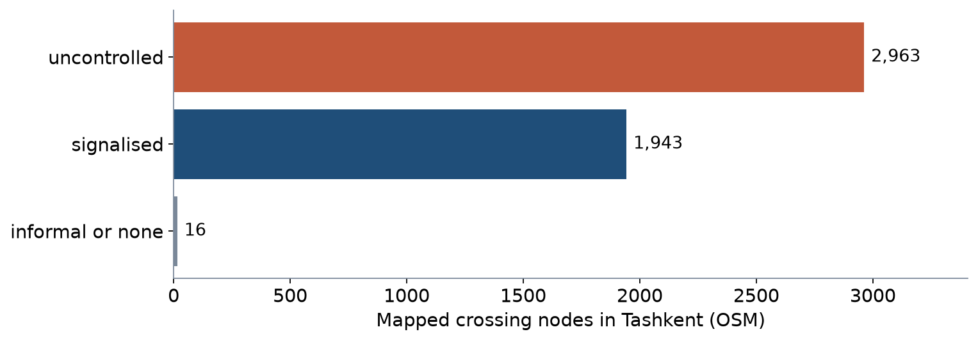
Safe crossings on the way to the station
• OSM maps 4,922 crossings: 1,943 signalised, 2,963 uncontrolled
• Near stations, 40.2% (169 of 420 crossings within 300 m) are signalised
• Pulatova's survey: 66.1% say crossings are missing; 64.2% wait a long time to cross
• Long waits push people to cross against the signal
18 / 25

Slide 19
Shade at stops is part of access
• Heat chapter: 25.1% of the central walking network has no or very little shade
• 78.5 km of that unshaded length lies within a short walk of a transit stop (of 81.7 km in Phase 1)
• Stepping from sunlit paving into the nearest shade: surfaces a median 19.5 °C cooler (field measurement points)
• A shelter roof is not enough: tree shade over the waiting area and the approach
19 / 25

Slide 20
Cycling to the metro
• 34 of 49 stations within 500 m of a field-audited cycle path
• But Tashkent's cycle paths are fragmented — a nearby path rarely means a continuous route
• Integrating walking and cycling lanes with public transport is a stated research priority at TSTU
• Design checklist: approach route, crossing, parking, shade
20 / 25

Slide 21
Discussion
Pick one metro station you know. What is the single change that would most improve the first and last mile — and who would pay for it?
• Two minutes in pairs: name the element (walking, crossing, transfer, information, cycling, shade).
21 / 25

Slide 22
Key takeaways
• Passengers judge the whole door-to-door trip, and the street holds most of the unpleasant parts
• Interchanges are designed through access routes, crossings, transfers and information
• Park-and-ride has a land cost; compare it with feeders and bike-and-ride
• In Tashkent, the metro's reach depends on feeder buses and safe crossings
22 / 25

Slide 23
Before LAB7 and P7
• Open LAB07_interchanges.gpkg in QGIS (EPSG:32642) and find the metro station nearest your corridor
• Measure the widths of your corridor's cross-section (tape on site, or a satellite image)
• Read the GDCI Global Street Design Guide chapter on transit streets
23 / 25

Slide 24
References
• TU Delft, Department of Transport & Planning. CIEM6250 Transport Systems Design — units B-1 Network Design, B-2 Service Design, B-3 Physical Infrastructure Management, B-4 Traffic Operations Management (Smart Public Transport Lab education page; MSc Civil Engineering TTE track). https://www.tudelft.nl/citg/over-faculteit/afdelingen/transport-planning/research/labs/smart-public-transport-lab/education
• Wilson, N., Sánchez-Martínez, G., & Nassir, N. (2017). 1.258J/11.541J Public Transportation Systems, Spring 2017. MIT OpenCourseWare. https://ocw.mit.edu/courses/1-258j-public-transportation-systems-spring-2017/
• Ben-Akiva, M. (2008). 1.201J/11.545J Transportation Systems Analysis: Demand and Economics, Fall 2008. MIT OpenCourseWare. https://ocw.mit.edu/courses/1-201j-transportation-systems-analysis-demand-and-economics-fall-2008/
• Pulatova, Z. S. (2024). Walkability assessment of Tashkent city districts (PhD dissertation, in Uzbek; supervisor J. I. Sodikov). Tashkent State Transport University.
• TU Delft (2013). CIE4801 Transportation and Spatial Modelling. TU Delft OpenCourseWare. https://ocw.tudelft.nl/courses/transportation-and-spatial-modelling/
• Global Designing Cities Initiative & NACTO (2016). Global Street Design Guide. Island Press. https://globaldesigningcities.org/publication/global-street-design-guide/
• OpenStreetMap contributors (2026). Uzbekistan extract, Geofabrik GmbH (download.geofabrik.de). https://download.geofabrik.de/asia/uzbekistan.html
• Salvucci, F. (2016). 1.252J/11.540J Urban Transportation Planning, Fall 2016. MIT OpenCourseWare. https://ocw.mit.edu/courses/1-252j-urban-transportation-planning-fall-2016/
• Rupprecht Consult (Ed.) (2019). Guidelines for Developing and Implementing a Sustainable Urban Mobility Plan (2nd ed.). European Commission / Eltis. https://www.eltis.org/mobility-plans/sump-guidelines
• Normukhammadov, A. (2026). Pedalling Towards Sustainability: Developing an Integrated Bicycle Network for Enhanced Urban Mobility in Tashkent City (PhD thesis draft; supervisor J. I. Sodikov). Tashkent State Transport University.
• Sodikov, J. I., et al. (2026). Sustainable urban transport: integrating pedestrian and bicycle lanes with the public transport system. AIP Conference Proceedings (2025 Int. Conf.).
• Ergashova, M. Z. (2026). 15-minute walkability of Tashkent mahallas — dissertation defence presentation, 14 Oct 2026 (in Uzbek). Tashkent State Transport University.
• Sodikov, J. I., et al. (2026). Urban heat actions of 100 global cities: Tashkent, Uzbekistan (book chapter manuscript).

Slide 25
© 2026 TSTU, J. Sodikov. CC BY-NC-SA 4.0. Adapts openly licensed material (CC BY-NC-SA 4.0) listed in the references.

