Slide 1
Week 7 · Lecture 2
Multimodal street cross-section design
LEC14 · Urban Transport Systems Planning and Design · TSTU · Prof. J. Sodikov

Slide 2
What you will be able to do after today
• Name the elements of a multimodal cross-section and what each is for
• Explain the movement and public-space functions of a street
• Compare alternatives by person throughput, not vehicle throughput
• Argue a reallocation of space on safety and capacity grounds
2 / 23

Slide 3
Where this sits: street design
• Street design: spatial capacity, traffic calming and the politics of street design
• A published course assignment asked students to redesign Massachusetts Avenue using their own counts
• Our P7 and LAB7 follow the same logic on your Tashkent corridor
• Street design is where network, service and safety decisions become visible
3 / 23

Slide 4
Two functions: movement and place
• Movement: moving people and goods through the street
• Place: staying, shopping, meeting, waiting, playing
• Every street does both, in different proportions
• GDCI: design for all users, starting with the most vulnerable
• Classify your corridor on both axes before choosing a cross-section
4 / 23

Slide 5
Elements of a cross-section
Element | Function | Design question
Footway | Walking, waiting, frontage access | Is the clear path wide enough for the flow?
Planting strip / aryk | Shade, drainage, separation | Is there soil and water for trees?
Cycle track | Protected cycling | Is it continuous through junctions and stops?
Bus lane | Reliable public transport | Enough buses per hour to justify it?
General lanes | Car and freight movement | How many lanes does the junction actually serve?
Kerbside | Parking, loading, stops | Which use earns the kerb?
5 / 23

Slide 6
The footway is a set of zones
• Frontage zone next to buildings: entrances, shop displays
• Clear path: the width actually available for walking
• Furniture and planting zone: trees, lighting, benches, signs
• Effective width = total width minus obstacles and shy distances
• Parked cars, kiosks and fences eat the clear path first
6 / 23

Slide 7
Person throughput, not vehicle throughput
• A lane's value is the people it moves per hour, not the vehicles
• Car lane: vehicles per hour of green × occupancy
• Bus lane: buses per hour × passengers per bus
• Cycle track and footway: flow per metre of usable width
• Capacity is what a section can carry; counts show what it carries
7 / 23

Slide 8
Worked example: capacity of one lane by mode
Element | Assumption (illustrative) | Persons per hour
General lane | 1,800 veh/h of green × g/C 0.45 × 1.3 persons | ≈ 1,050
Bus lane | 40 buses/h × 50 passengers | 2,000
Cycle track 2.0 m | 750 cyclists/h per metre | 1,500
Footway 3.5 m | (3.5 − 1.0) m × 1,200 pedestrians/h per metre | 3,000
8 / 23

Slide 9
When does a bus lane pay off?
• Compare people per lane: bus lane 2,000 vs car lane about 1,050 in the example
• With 15 buses/h of 50 passengers, the lane already carries 750 bus riders
• A dedicated lane also buys reliability — and reliability attracts riders
• Junction priority (Week 10) decides whether the lane's time savings survive
9 / 23

Slide 10
Safety-led reallocation
• Wide, multi-lane roads mean long crossings and high speeds
• Pedestrian strikes are 57.4% of Tashkent's 2016 police crash records (August excluded)
• Recorded death: 3.46% vs 1.08% for pedestrians vs vehicle occupants
• Narrower lanes, refuges and shorter crossings reduce exposure and speed
• Reallocation is a safety measure, not only a mode-shift measure
10 / 23

Slide 11
Tashkent: wide streets, contested space
• OpenStreetMap October 2026, Normukhammadov (2026), Pulatova (2024)
11 / 23

Slide 12
An inheritance of generous cross-sections
• Soviet-era avenues: wide carriageways, broad sidewalks, landscaped buffers
• Whole city, trunk to tertiary: 432.2 of 641.9 km of lane-tagged main-road carriageways have 3 or more lanes
• 88.2% of 3,386.9 km of speed-tagged roads are signed 60 km/h
• OSM maps only 14.3 km of dedicated busway
12 / 23

Slide 13
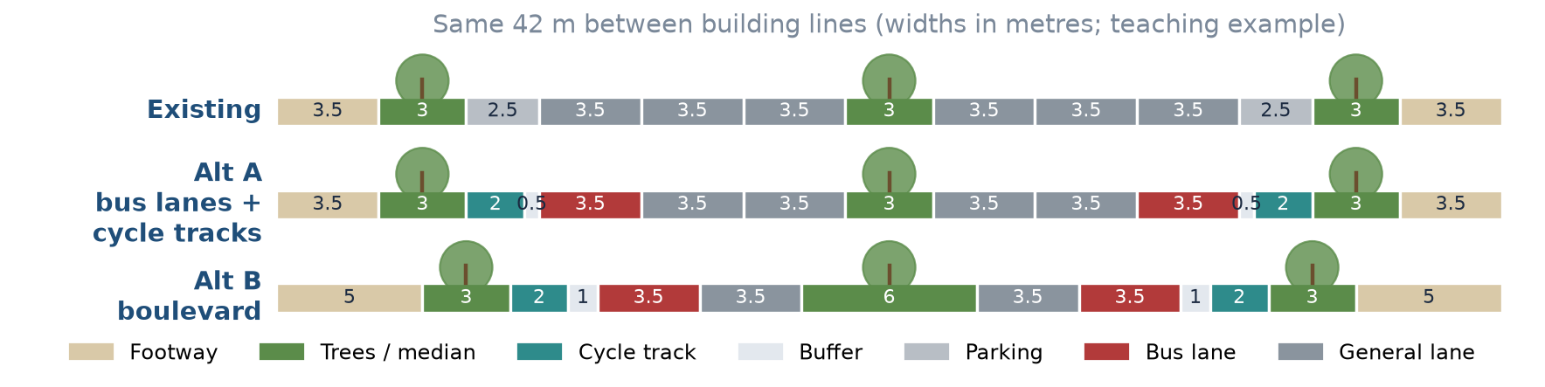
Three cross-sections, one width
Teaching example of a Tashkent arterial: Existing, Alt A (bus lanes + cycle tracks), Alt B (boulevard).
13 / 23

Slide 14
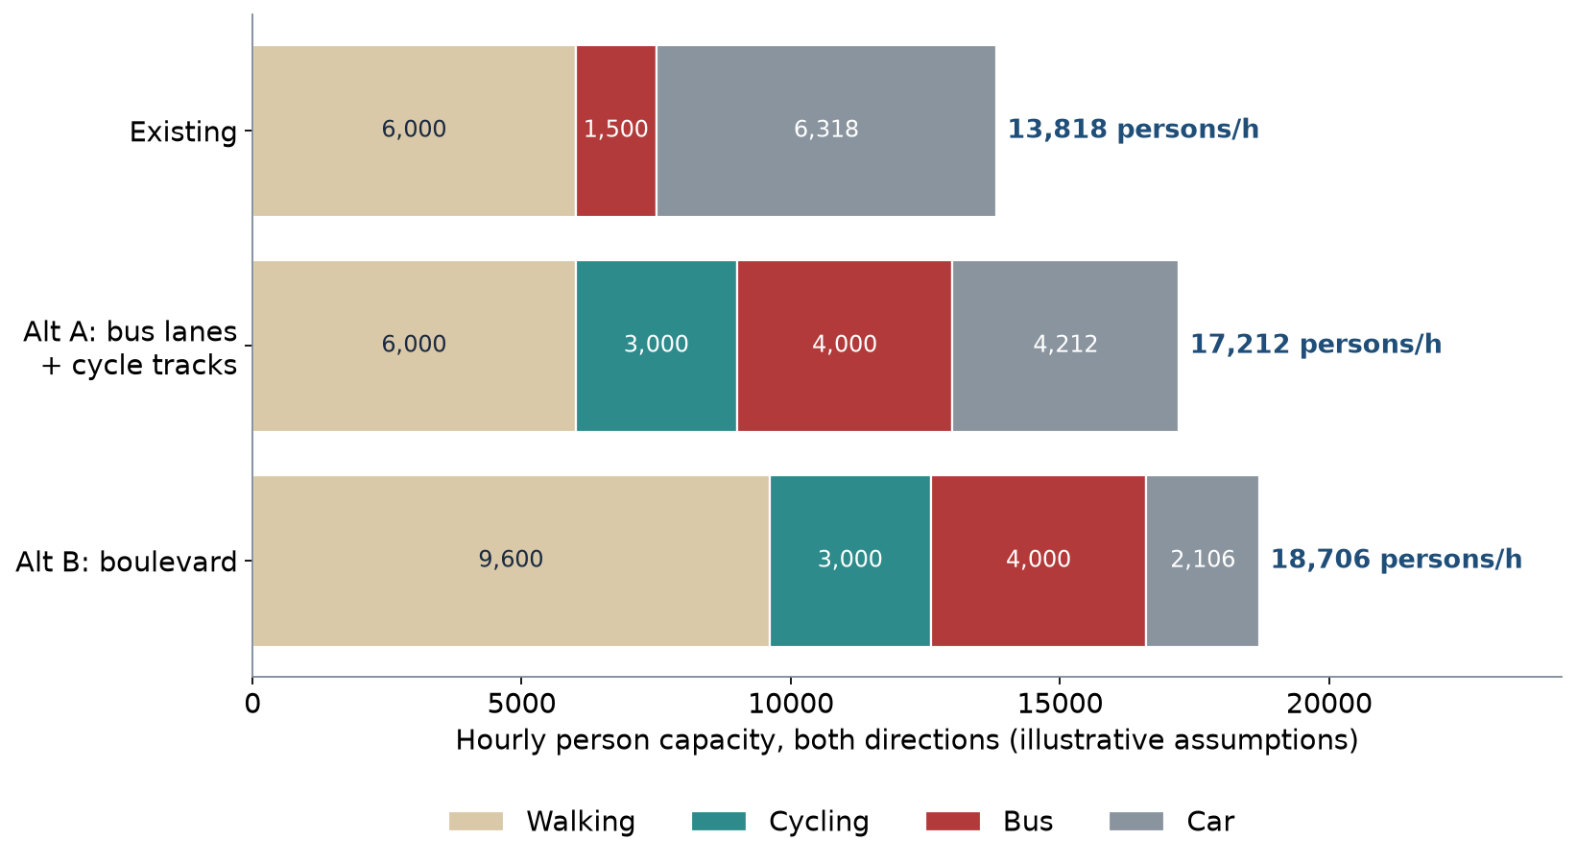
Person capacity of the three alternatives
Illustrative assumptions from LAB7; capacity, not observed flow.
14 / 23

Slide 15
Reading the result
Indicator | Existing | Alt A | Alt B
Walking + cycling + planting share of width | 38% | 48% | 62%
Car capacity (persons/h) | 6,318 | 4,212 | 2,106
Total person capacity (persons/h) | 13,818 | 17,212 | 18,706
Who loses | — | Kerbside parking, one lane each way | Two lanes each way, parking
15 / 23

Slide 16
Converting sidewalks: the cycling network's hidden cost
• 94% of the gap links that would join Tashkent's cycle paths run along existing sidewalks
• Sidewalk conversion is cheap — but takes space from pedestrians
• Keep the tree canopy: greener segments are shadier (ρ = −0.64)
• Reallocate from the carriageway first where lanes exceed what junctions serve
16 / 23

Slide 17
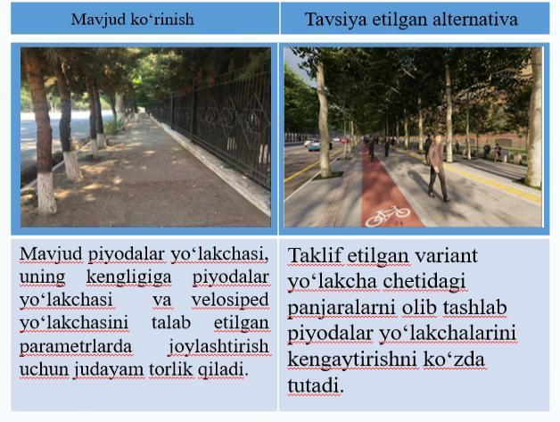
A local redesign proposal: Shahrisabz Street
• Pulatova (2024) reviewed recently reconstructed streets
• Left: footway too narrow for walking plus a cycle track
• Right: proposal — remove the fence and widen the footway
• Her list of defects: narrowed footways, raised manholes, no drainage or lighting
17 / 23

Slide 18
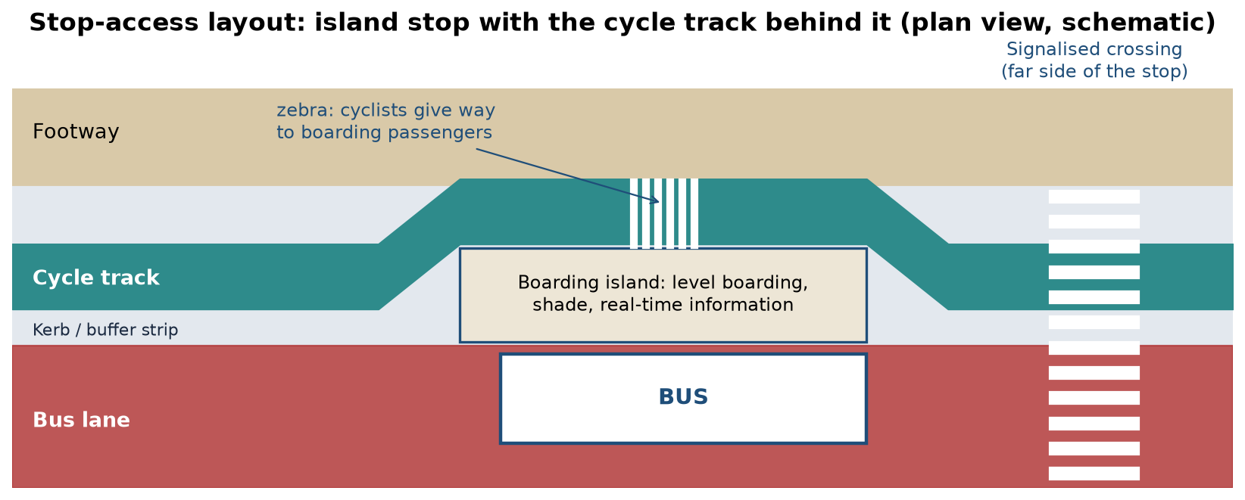
Stop-access layout
Schematic: island stop, cycle track behind it, signalised crossing on the far side. P7 asks for one for your corridor.
18 / 23

Slide 19
The politics of street space
• Every metre reallocated has a loser who notices and a winner who may not
• Shopkeepers often overestimate how many customers arrive by car
• Pilot with paint and planters, measure, then build
• Evidence (counts, crashes, heat) shifts the debate from opinion to trade-offs
19 / 23

Slide 20
Discussion
Your corridor has a fixed width between building lines. Which metre would you take back from cars first — and how would you prove it was worth it?
• Answer with a person-throughput or safety argument.
20 / 23

Slide 21
Key takeaways
• A street is a fixed width shared between movement and place
• Compare alternatives by persons per hour and by safety, not vehicles per hour
• Every reallocation has losers; state them and the evidence
• Tashkent's wide streets make reallocation possible — protect trees and pedestrians while doing it
21 / 23

Slide 22
References
• Salvucci, F. (2016). 1.252J/11.540J Urban Transportation Planning, Fall 2016. MIT OpenCourseWare. https://ocw.mit.edu/courses/1-252j-urban-transportation-planning-fall-2016/
• Global Designing Cities Initiative & NACTO (2016). Global Street Design Guide. Island Press. https://globaldesigningcities.org/publication/global-street-design-guide/
• NACTO (2013). Urban Street Design Guide. Island Press. https://nacto.org/publication/urban-street-design-guide/
• Kittelson & Associates et al. (2013). Transit Capacity and Quality of Service Manual (3rd ed.), TCRP Report 165. Transportation Research Board. https://nap.nationalacademies.org/read/24766
• Wilson, N., Sánchez-Martínez, G., & Nassir, N. (2017). 1.258J/11.541J Public Transportation Systems, Spring 2017. MIT OpenCourseWare. https://ocw.mit.edu/courses/1-258j-public-transportation-systems-spring-2017/
• Sodikov, J. I., et al. (under review). Odds of recorded death among police-recorded road-traffic casualties and register data quality in Tashkent, Uzbekistan. Traffic Injury Prevention (revision r4).
• World Health Organization (2023). Pedestrian Safety: A Road Safety Manual for Decision-Makers and Practitioners (2nd ed.). Geneva: WHO. https://www.who.int/publications/i/item/9789240072497
• OpenStreetMap contributors (2026). Uzbekistan extract, Geofabrik GmbH (download.geofabrik.de). https://download.geofabrik.de/asia/uzbekistan.html
• Normukhammadov, A. (2026). Pedalling Towards Sustainability: Developing an Integrated Bicycle Network for Enhanced Urban Mobility in Tashkent City (PhD thesis draft; supervisor J. I. Sodikov). Tashkent State Transport University.
• Pulatova, Z. S. (2024). Walkability assessment of Tashkent city districts (PhD dissertation, in Uzbek; supervisor J. I. Sodikov). Tashkent State Transport University.
• MIT Department of Urban Studies and Planning. 11.540 Urban Transportation Planning and Policy (J. Aloisi). MIT Course Catalog, Course 11 subjects. https://catalog.mit.edu/subjects/11/

Slide 23
© 2026 TSTU, J. Sodikov. CC BY-NC-SA 4.0. Adapts openly licensed material (CC BY-NC-SA 4.0) listed in the references.

