Slide 1
Week 8 · Lecture 1
Safe and comfortable pedestrian environments
LEC15 · Urban Transport Systems Planning and Design · TSTU · Prof. J. Sodikov

Slide 2
What you will be able to do after today
• Size a footway from pedestrian flow and obstacles
• Apply the Safe System idea to speed, crossings and visibility
• Design crossings and routes for children, older people and wheelchair users
• Read Tashkent's crash, survey and map evidence on pedestrian safety
2 / 24

Slide 3
Where this sits: flow theory and the Safe System
• Pedestrian flow theory treats pedestrians as a traffic flow with its own fundamental diagram
• WHO Pedestrian Safety manual (2023): a Safe System approach for decision-makers
• GDCI and GIZ SUTP: design guidance for walking and cycling in fast-growing cities
• Comfort and safety are two separate tests — a route must pass both
3 / 24

Slide 4
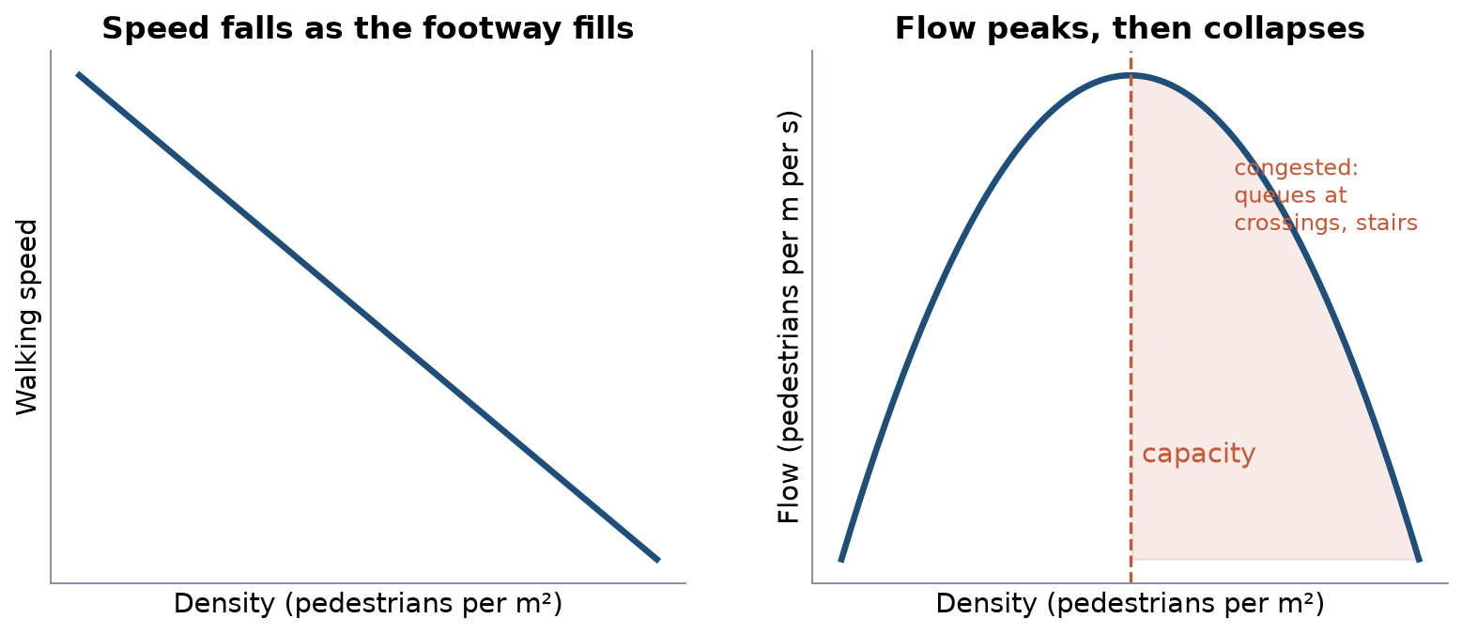
Pedestrian flow: the fundamental diagram
Schematic after pedestrian flow theory: speed falls with density; flow peaks at capacity, then collapses.
4 / 24

Slide 5
What the flow theory means for design
• Flow = density × speed; capacity is reached long before people stop moving
• Bottlenecks decide capacity: a crossing island or metro stair, not the footway
• People self-organise into lanes in two-way flow — until obstacles break the lanes
• Design for comfort (space per person), not for capacity
• Measure peak 15-minute flows at the narrowest point
5 / 24

Slide 6
Worked example: how wide should the footway be?
• Peak flow 1,800 pedestrians per hour; comfortable flow 1,200 per hour per metre
• Clear path needed = 1,800 ÷ 1,200 = 1.5 m
• Add 1.0 m for kerb, poles, trees and shop fronts → 2.5 m total
• A parked car on the footway removes about 2 m — the path disappears
• Check the narrowest point, not the average
6 / 24

Slide 7
Universal access
• Step-free routes: kerb ramps at every crossing, no steps into underpasses
• Tactile paving and audible signals for blind and partially sighted people
• Enough crossing time for slow walkers; resting places and shade
• Pulatova's survey: 73.1% see no infrastructure for people with disabilities
• OSM: 4 of 4,846 crossings (73 tagged) have tactile paving recorded — mostly unmapped
7 / 24

Slide 8
The Safe System: speed is the master variable
• People make mistakes; the system should stop mistakes from killing them
• The energy in a crash rises with the square of speed
• Where people walk and cross, keep motor-vehicle speed low
• Where speed must be high, separate people in space (barriers) or time (signals)
• Lighting, visibility and crossing distance complete the system
8 / 24

Slide 9
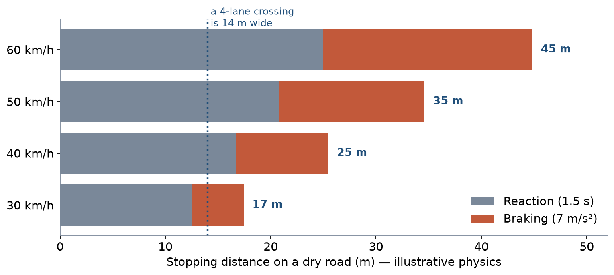
Speed and stopping distance
Illustrative physics: 1.5 s reaction, 7 m/s² braking on a dry road. At 60 km/h a driver needs about 45 m to stop.
9 / 24

Slide 10
Designing crossings
• Put crossings on desire lines: at stops, schools, metro exits, shop clusters
• Shorten exposure: kerb extensions, refuge islands, fewer lanes to cross
• Keep sightlines clear: no parking just before the crossing
• Signals: short waits, enough green for slow walkers
• Raised crossings and tables slow cars where signals are not justified
10 / 24

Slide 11
Worked example: crossing time for an older pedestrian
• Four lanes × 3.5 m = 14 m of carriageway
• At 1.2 m/s: 14 ÷ 1.2 ≈ 12 s; at 0.9 m/s (older walker): ≈ 16 s
• A central refuge splits it into two crossings of 7 m (about 8 s each)
• Signal green for pedestrians must cover the slow walker, not the average
11 / 24

Slide 12
Traffic-calming toolbox
Measure | What it does | Where it fits
Lane narrowing / road diet | Lowers speed, shortens crossings | Wide arterials with spare lanes
Raised crossing or table | Forces low speed at the crossing | Local and collector streets, school entrances
Refuge island | Two-stage crossing | Multi-lane roads
Kerb extension | Shorter crossing, better visibility | Streets with kerbside parking
Area-wide low speed limit | Lower speed everywhere | Mahalla streets, school zones
12 / 24

Slide 13
Tashkent: who gets hurt, and where
• TIP manuscript (Sodikov et al., under review), Pulatova (2024), OpenStreetMap October 2026
13 / 24

Slide 14
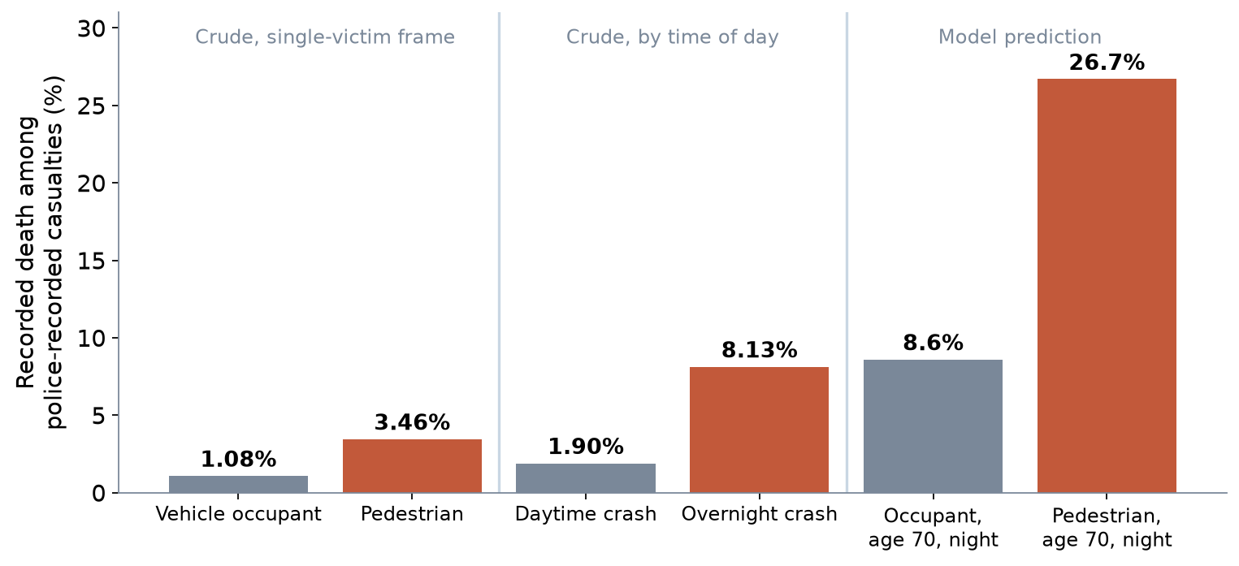
Pedestrians and the night carry the risk
• 57.4% of 2016 police crash records (August excluded) were pedestrian strikes
• Recorded death: 3.46% vs 1.08% (pedestrians vs vehicle occupants)
• Overnight: 8.13% vs 1.90%; adjusted OR 5.99 (3.91–9.19)
• Model prediction, older pedestrian at night: 26.7% vs 8.6% for an occupant
14 / 24

Slide 15
What the crash evidence asks of design
• Night risk points to lighting, speed at night and visibility at crossings
• Age effect (OR 1.35 per 10 years) points to crossing time, refuges and step-free routes
• Pedestrian odds (OR 3.89 (2.08–7.27)) point to separation and lower speed
• The register lacks speed, lighting and location — better data would sharpen every measure
15 / 24

Slide 16
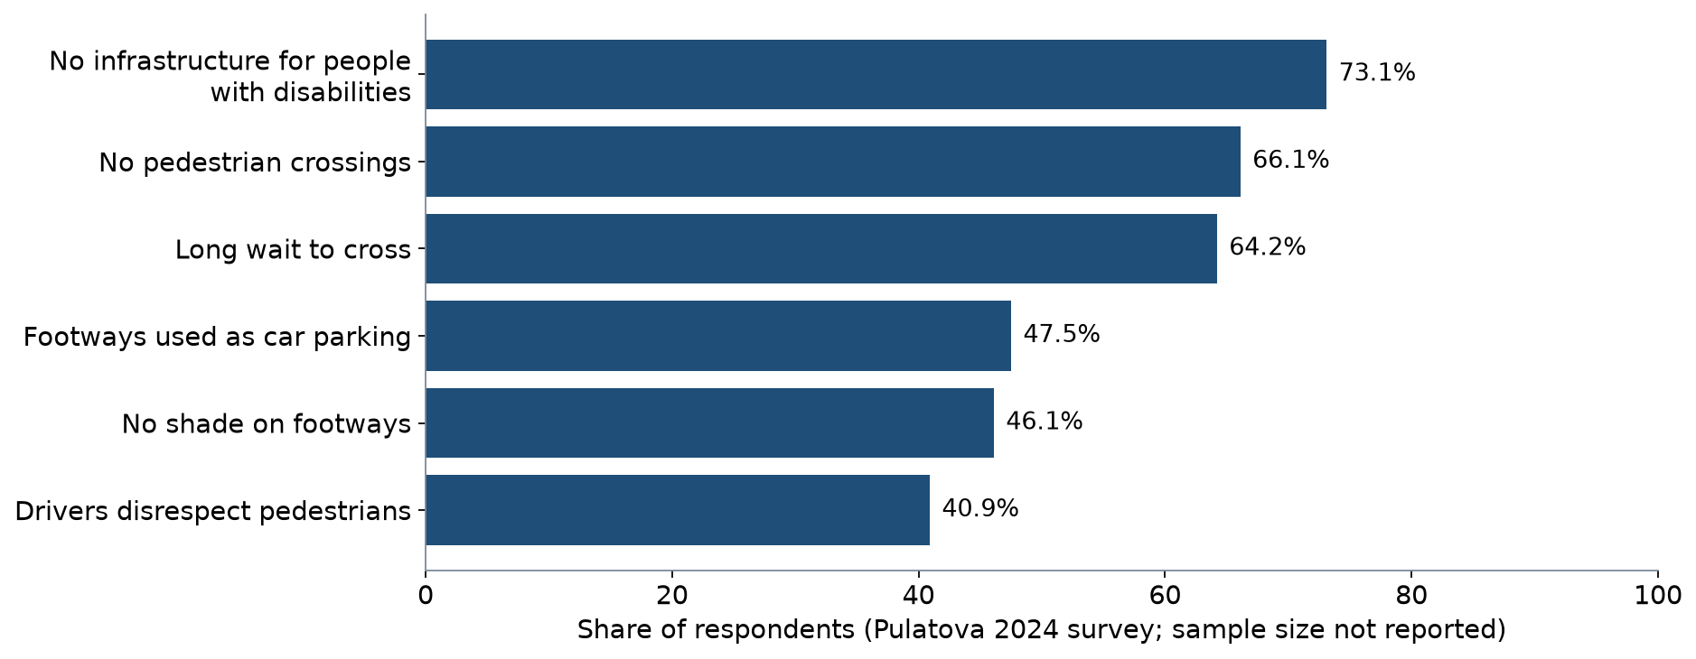
What pedestrians report
Pulatova (2024) intercept survey at district centres; sample size and dates not reported.
16 / 24

Slide 17
Gaps in the norms
• Crossing spacing is not regulated; an informal 200 m principle is not enforced
• The urban limit fell from 70 to 60 km/h — still lethal at uncontrolled crossings
• Parked cars hide pedestrians even at 40 km/h, worst on multi-lane streets
• Pulatova recommends refuge islands and pedestrian priority in street design
17 / 24

Slide 18
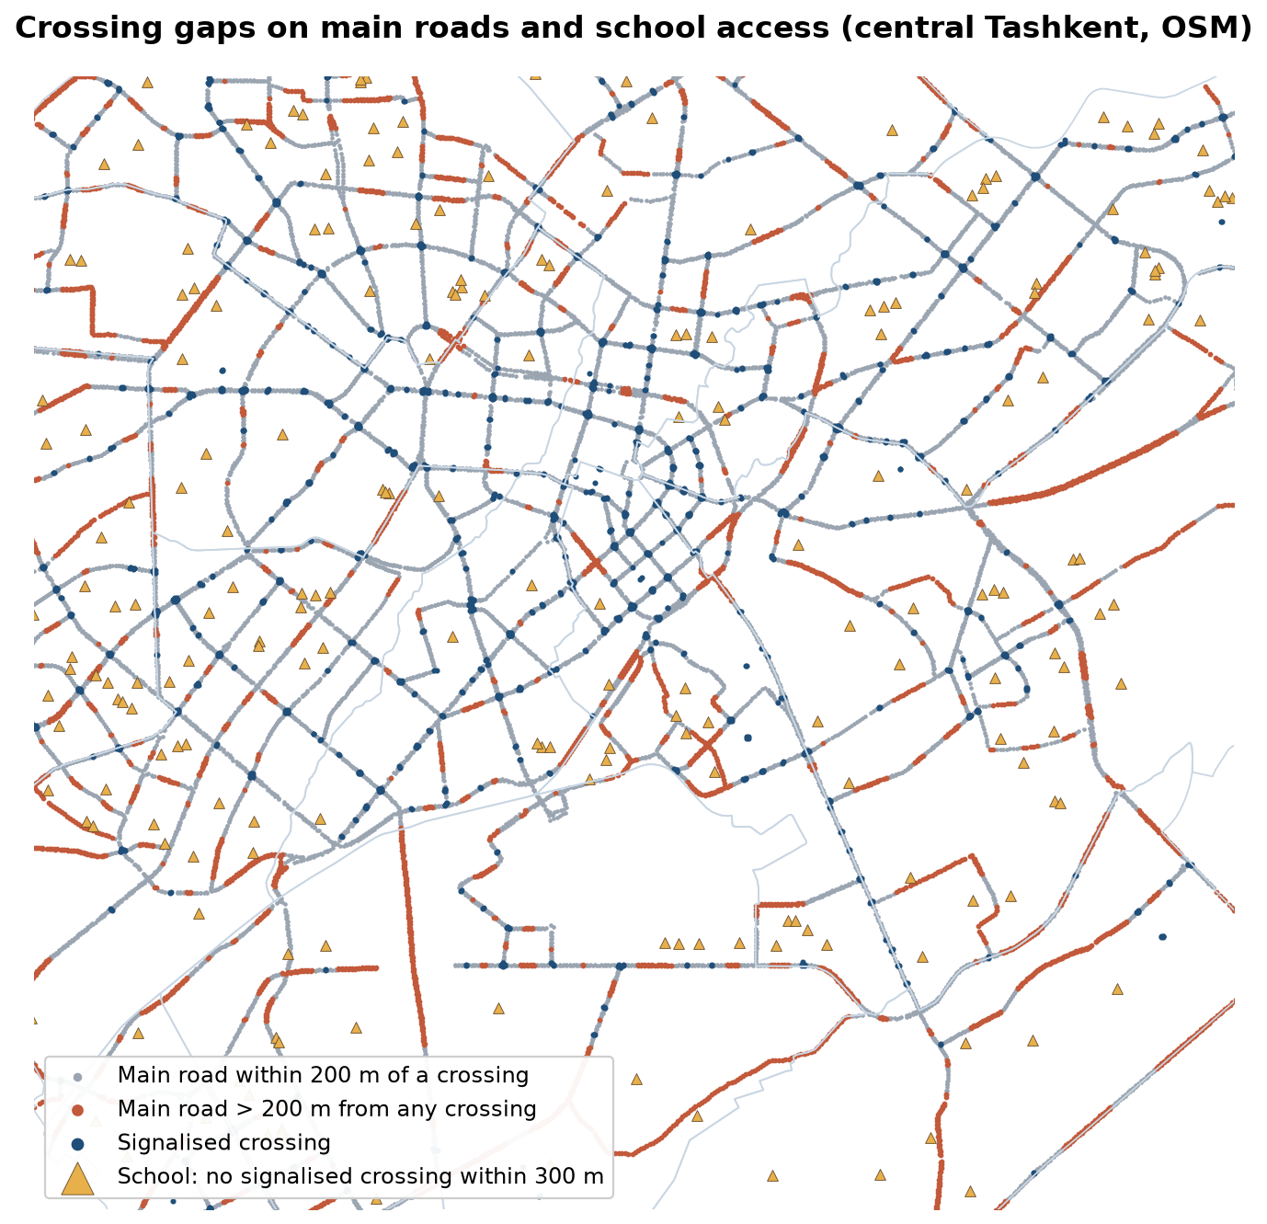
Crossing gaps and school routes
• Main road here: trunk to secondary, study districts, 1,169.6 km
• 31.1% of it lies more than 200 m from the nearest mapped crossing
• A distance to a crossing, not the informal 200 m spacing between crossings
• 287 of 486 schools have no signalised crossing within 300 m
• OSM misses crossings and schools: check the candidates in the field in LAB8
18 / 24

Slide 19
Local case: the Bo'zsuv canal
• Canals cut walking routes and concentrate crossings at a few bridges
• TSTU study of pedestrian safety and comfort along and across the Bo'zsuv canal
• Footways used as parking (47.5% in Pulatova's survey) push people into the carriageway
• Canal banks can become continuous, shaded walking routes
19 / 24

Slide 20
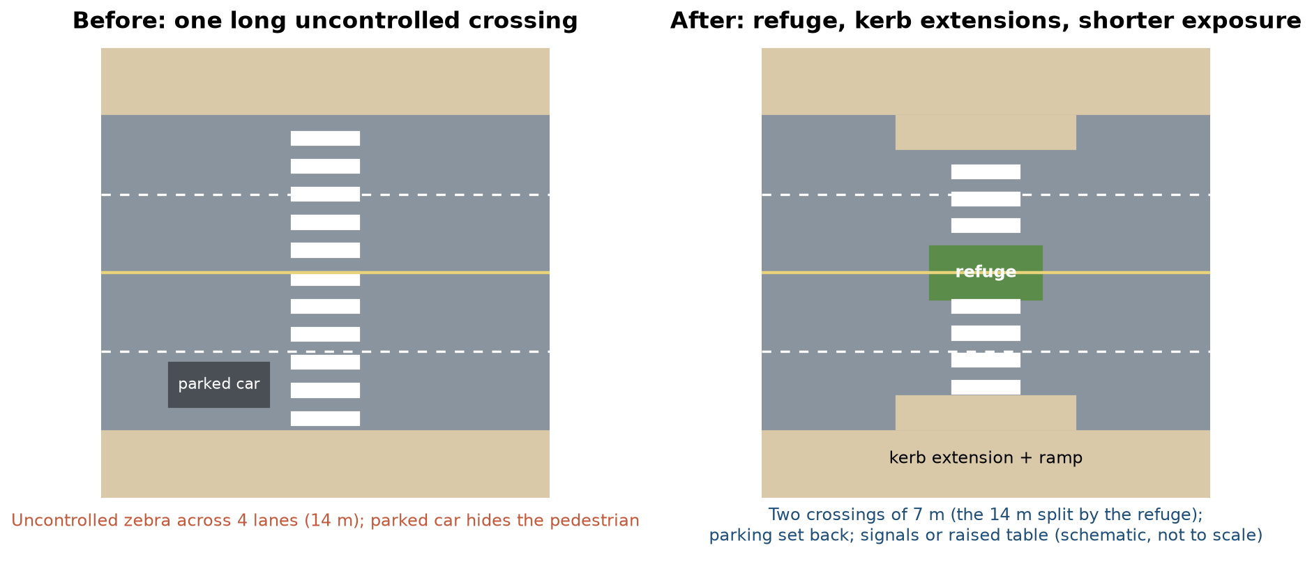
Redesigning a crossing
Schematic for P8: kerb extensions and a refuge turn one long uncontrolled crossing into two short ones.
20 / 24

Slide 21
Discussion
On your corridor, where would an older person at night be most at risk — and which single measure would you build first?
• Use the crash evidence and the crossing-gap map to justify the choice.
21 / 24

Slide 22
Key takeaways
• Size footways for comfort at the narrowest point
• Speed decides survival; crossings decide exposure
• Design for the slowest and most vulnerable walker
• Tashkent's evidence points to night, age, crossings and footway parking
22 / 24

Slide 23
References
• TU Delft (2014). CIE4821 Traffic Flow Theory and Simulation. TU Delft OpenCourseWare. https://ocw.tudelft.nl/courses/traffic-flow-theory-simulation/
• World Health Organization (2023). Pedestrian Safety: A Road Safety Manual for Decision-Makers and Practitioners (2nd ed.). Geneva: WHO. https://www.who.int/publications/i/item/9789240072497
• Global Designing Cities Initiative & NACTO (2016). Global Street Design Guide. Island Press. https://globaldesigningcities.org/publication/global-street-design-guide/
• GIZ. Sustainable Urban Transport Project (SUTP) Sourcebook modules (e.g. 1g Urban Freight; 2a Land Use Planning; 3d Non-Motorised Transport; 5e Transport and Climate Change). Eschborn: GIZ. https://www.sutp.org
• Knoop, V. L. (2021). Traffic Flow Theory: An Introduction with Exercises (3rd ed.). TU Delft OPEN Publishing. https://books.open.tudelft.nl/home/catalog/book/203
• Pulatova, Z. S. (2024). Walkability assessment of Tashkent city districts (PhD dissertation, in Uzbek; supervisor J. I. Sodikov). Tashkent State Transport University.
• OpenStreetMap contributors (2026). Uzbekistan extract, Geofabrik GmbH (download.geofabrik.de). https://download.geofabrik.de/asia/uzbekistan.html
• NACTO (2013). Urban Street Design Guide. Island Press. https://nacto.org/publication/urban-street-design-guide/
• Salvucci, F. (2016). 1.252J/11.540J Urban Transportation Planning, Fall 2016. MIT OpenCourseWare. https://ocw.mit.edu/courses/1-252j-urban-transportation-planning-fall-2016/
• Sodikov, J. I., et al. (under review). Odds of recorded death among police-recorded road-traffic casualties and register data quality in Tashkent, Uzbekistan. Traffic Injury Prevention (revision r4).
• Sodikov, J. I., et al. (2024). Navigating the urban terrain: enhancing pedestrian safety and comfort in Tashkent's Bo'zsuv canal area. Inzhener. https://engineer.tstu.uz

Slide 24
© 2026 TSTU, J. Sodikov. CC BY-NC-SA 4.0. Adapts openly licensed material (CC BY-NC-SA 4.0) listed in the references.

