Slide 1
Week 8 · Lecture 2
Cycling and micromobility infrastructure
LEC16 · Urban Transport Systems Planning and Design · TSTU · Prof. J. Sodikov

Slide 2
What you will be able to do after today
• Apply the five requirements for cycling infrastructure
• Choose a facility type from traffic speed and composition
• Design continuity through junctions and past bus stops
• Use Tashkent's measured comfort data to target upgrades
2 / 22

Slide 3
Where this sits
• A published 2006 course on urban transportation planning treated bicycle and pedestrian planning and traffic calming as core urban transport
• Network design (Week 4): cycling as its own network layer
• Dutch design guidance (CROW) supplies the requirements; GDCI the global street practice
• Today: from network (Week 4) to the facility and the junction
3 / 22

Slide 4
Five requirements for cycling infrastructure
• Coherence: the network connects all origins and destinations
• Directness: few detours and little delay
• Safety: conflicts with motor traffic and between users minimised
• Comfort: smooth surfaces, gentle gradients, low stress
• Attractiveness: pleasant, legible, socially safe — in Tashkent also shaded
4 / 22

Slide 5
Level of Traffic Stress: the weakest link
• LTS 1: tolerable for children; LTS 4: only for the 'strong and fearless'
• LTS 2 is the most stress the mainstream adult will accept
• A route is only as tolerable as its most stressful link
• So the useful network is the low-stress sub-network — check its connectivity
5 / 22

Slide 6
Choosing a facility from speed and traffic
Motor traffic | Typical choice | Notes
Low speed (about 30 km/h), low volume | Mixed traffic, cycle street | Calm the street first
Medium speed (about 50 km/h) or busy | Cycle lane or one-way track | Buffer from parked-car doors
High speed (60 km/h and above) or 3+ lanes | Protected track, physically separated | Most Tashkent arterials
Heavy bus and truck traffic | Protected track, island stops | Avoid bus–bike weaving
6 / 22

Slide 7
Continuity at junctions
• Most cycle crashes in cities happen at junctions, not on links
• Protected junction: corner islands, set-back crossing, clear sightlines
• Signals: separate or early green for cyclists where turning traffic is heavy
• A track that stops before the junction fails the coherence test
7 / 22

Slide 8
Conflicts at stops and on shared sidewalks
• Bus stops are where cyclists, boarding passengers and buses meet
• Island stops route the track behind the boarding area (Week 7 layout)
• Shared sidewalks move the conflict to pedestrians — older people feel it most
• Where space is short: narrow the carriageway before the footway
8 / 22

Slide 9
Cycle parking and micromobility
• Secure, visible parking at stations, schools, universities and shops
• E-bikes and e-scooters raise speed differences on shared paths
• Shared fleets need parking zones so footways stay clear
• Tashkent's Qwatt e-bike share: more than 1,300 bikes near metro stations and universities
9 / 22

Slide 10
Tashkent: what riding actually feels like
• Normukhammadov (2026), PhD research at TSTU: panoramic camera and sensor audit of the ridden network
10 / 22

Slide 11
Where people ride
• Audited network 1,021.4 km: cycle path 23.4%, sidewalk 64.8%, roadway 11.7%
• 66.4% of riding time was on sidewalks
• Mean speed 11.5 vs 10.5 km/h on cycle paths vs sidewalks
• Sidewalk riding is the norm — the pedestrian conflict is built in
11 / 22

Slide 12
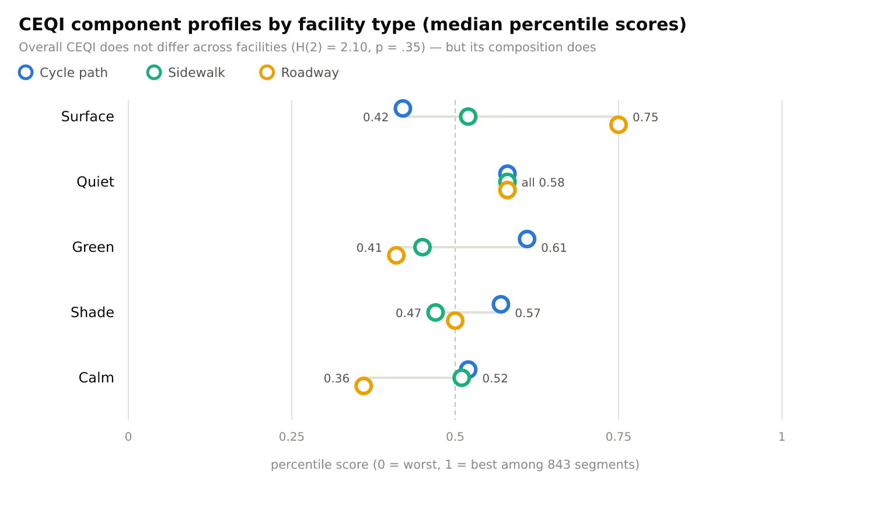
Comfort has several dimensions
Normukhammadov (2026) Fig. 3-4: Cycling Environment Quality Index (CEQI) component profiles by facility (843 scored segments).
12 / 22

Slide 13
Protected but rough, smooth but exposed
• Median vibration at typical riding speed: 6.90 / 6.02 / 1.60 m/s² (path / sidewalk / roadway)
• Cycle-path surface component 0.42 — the lowest of any facility
• Overall CEQI medians 0.52 / 0.51 / 0.52: no facility type wins
• Upgrade priority on existing paths: resurfacing, not more kilometres
13 / 22

Slide 14
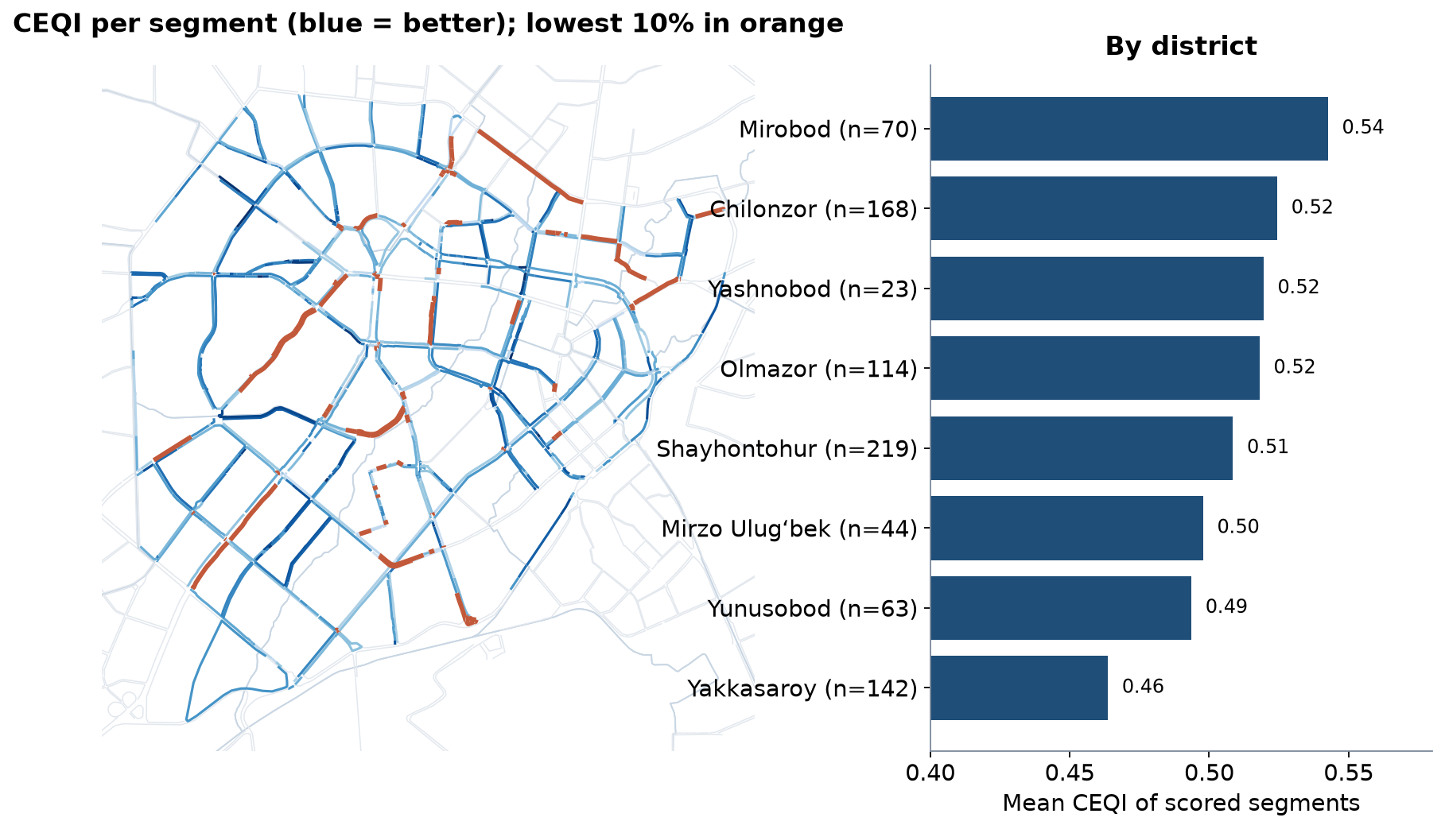
Lowest-quality links by district
Computed in LAB8 from the thesis CEQI table: segments in the lowest decile (orange) and district means.
14 / 22

Slide 15
Reading the CEQI map
• District means range from 0.46 (Yakkasaroy) to 0.54 (Mirobod)
• 85 segments at or below 0.319 form the lowest decile
• Good and bad links interleave in every district — target links, not districts
• Check each low link's weakest component: surface, noise, greenery, shade or calm
15 / 22

Slide 16
Conflicts at bus stops in Tashkent
• Ridden sidewalks within 30 m of a bus stop: 74.8 km; 1,154 of 2,019 bus stops lie next to them
• Every one is a potential cyclist–passenger conflict
• Gap closure converts sidewalks to cycle tracks — stops need island layouts at the same time
• Audit stops first when you upgrade a sidewalk route
16 / 22

Slide 17
From fragments to a network
• 149 fragments of cycle path; the largest is 31.1 km
• Bo'rijar canal route: a TSTU proposal for a continuous canal-side corridor
• Simulated survey and TOPSIS ranking of network options in Tashkent
• Network continuity (Week 4) and link quality (today) must be planned together
17 / 22

Slide 18
Method: auditing with georeferenced images
• Ride or walk the route with a camera and GPS; photos carry time and position
• QGIS imports geotagged photos as points; code each barrier and its severity
• Code by user group: who is blocked — a wheelchair user, a child, a cyclist?
• Safety first: observe from safe positions; no faces or plates in shared images
18 / 22

Slide 19
Discussion
Your corridor has a rough cycle path and a smooth, busy roadway. Do you resurface the path, protect a lane on the road, or both — and in what order?
• Argue from the five requirements and from who rides today.
19 / 22

Slide 20
Key takeaways
• Choose the facility from speed and traffic, then design the junctions
• A route is only as good as its most stressful link
• Stops and shared sidewalks are where cycling meets walking — design them together
• Tashkent's cycle paths need resurfacing and continuity more than new kilometres
20 / 22

Slide 21
References
• CROW (2016). Design Manual for Bicycle Traffic. Ede: CROW. https://www.crow.nl
• Salvucci, F., Antos, J., & Murga, M. (2006). 11.540J/1.252J/ESD.225J Urban Transportation Planning, Fall 2006. Massachusetts Institute of Technology: MIT OpenCourseWare (archived in DSpace@MIT). License: CC BY-NC-SA. https://dspace.mit.edu/handle/1721.1/107706
• TU Delft, Department of Transport & Planning. CIEM6250 Transport Systems Design — units B-1 Network Design, B-2 Service Design, B-3 Physical Infrastructure Management, B-4 Traffic Operations Management (Smart Public Transport Lab education page; MSc Civil Engineering TTE track). https://www.tudelft.nl/citg/over-faculteit/afdelingen/transport-planning/research/labs/smart-public-transport-lab/education
• Global Designing Cities Initiative & NACTO (2016). Global Street Design Guide. Island Press. https://globaldesigningcities.org/publication/global-street-design-guide/
• Normukhammadov, A. (2026). Pedalling Towards Sustainability: Developing an Integrated Bicycle Network for Enhanced Urban Mobility in Tashkent City (PhD thesis draft; supervisor J. I. Sodikov). Tashkent State Transport University.
• Mekuria, M. C., Furth, P. G., & Nixon, H. (2012). Low-Stress Bicycling and Network Connectivity (MTI Report 11-19). San José, CA: Mineta Transportation Institute. https://transweb.sjsu.edu/research/Low-Stress-Bicycling-and-Network-Connectivity
• GIZ. Sustainable Urban Transport Project (SUTP) Sourcebook modules (e.g. 1g Urban Freight; 2a Land Use Planning; 3d Non-Motorised Transport; 5e Transport and Climate Change). Eschborn: GIZ. https://www.sutp.org
• NACTO (2013). Urban Street Design Guide. Island Press. https://nacto.org/publication/urban-street-design-guide/
• Pulatova, Z. S. (2024). Walkability assessment of Tashkent city districts (PhD dissertation, in Uzbek; supervisor J. I. Sodikov). Tashkent State Transport University.
• OpenStreetMap contributors (2026). Uzbekistan extract, Geofabrik GmbH (download.geofabrik.de). https://download.geofabrik.de/asia/uzbekistan.html
• Sodikov, J. I., et al. (2024). Cycling the Bo'rijar route: infrastructure innovation for Tashkent's sustainable transit. Inzhener. https://engineer.tstu.uz
• Sodikov, J. I., et al. (2026). Improving urban bicycle network planning: evidence from a survey and TOPSIS analysis in Tashkent. Inzhener. https://engineer.tstu.uz

Slide 22
© 2026 TSTU, J. Sodikov. CC BY-NC-SA 4.0. Adapts openly licensed material (CC BY-NC-SA 4.0) listed in the references.

