Slide 1
Week 9 · Lecture 1
The transport infrastructure life cycle
LEC17 · Urban Transport Systems Planning and Design · TSTU · Prof. J. Sodikov

Slide 2
What you will be able to do after today
• Describe the life cycle of a transport asset from planning to renewal
• Define condition, service levels and maintenance needs for street assets
• Rank maintenance by condition, service importance and risk
• Compare building new infrastructure with improving what exists
2 / 22

Slide 3
Where this sits: infrastructure management
• Physical infrastructure management is the third of the course's four design perspectives
• Question: how do we keep the network's service level at the lowest life-cycle cost?
• Pavement engineering contributes deterioration and structure
• World Bank (2017) adds climate risk to road asset management
3 / 22

Slide 4
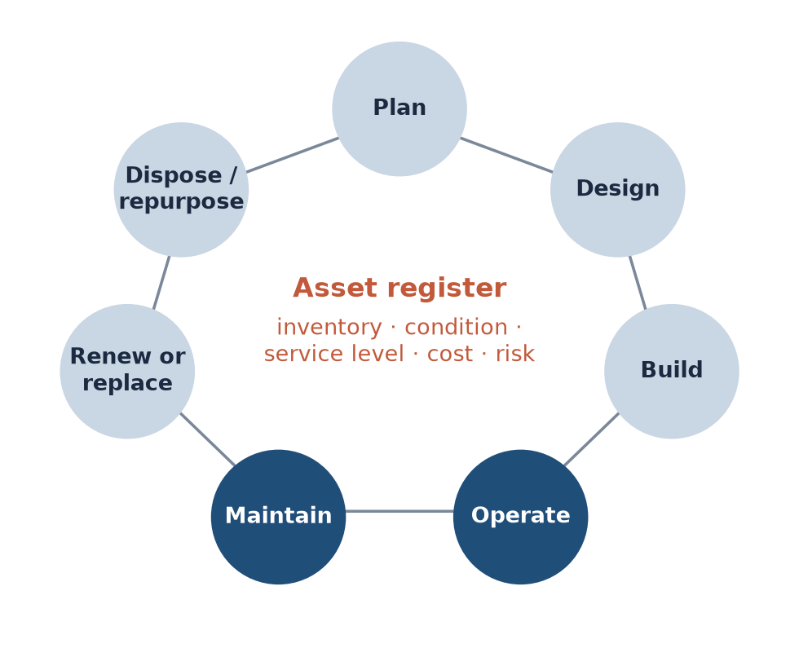
The asset life cycle
Most of an asset's life — and most of its cost to users — is in operation and maintenance.
4 / 22

Slide 5
The asset inventory
• What exists, where, of what type, built when, owned by whom
• Streets hold many asset classes: pavement, footways, cycle tracks, signals, lighting, drainage, trees
• A GIS register links each asset to its network link and functional class
• Without an inventory there is no budget argument — only complaints
5 / 22

Slide 6
Condition and service levels
• Condition: measured state — roughness (IRI) for roads, vibration for cycle paths, canopy for trees
• Service level: what users should experience — smoothness, safety, shade, continuity
• Targets should differ by functional class: arterials need more than local streets
• Maintenance need = gap between condition and the service-level target
6 / 22

Slide 7
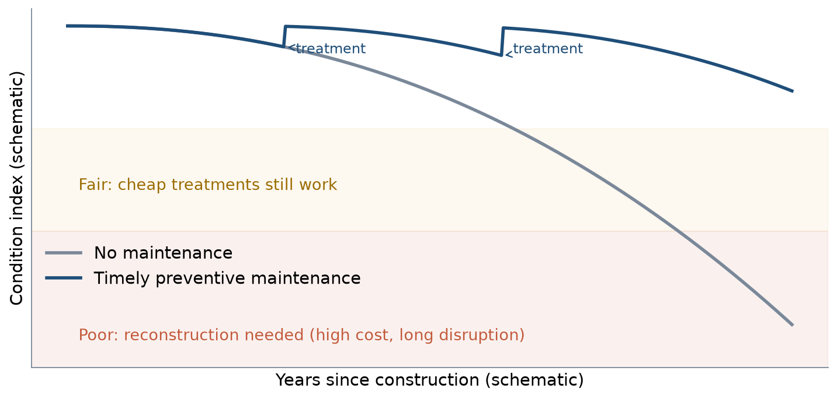
Why timing matters
Schematic: treatments applied while the asset is still good keep it out of the fair and costly poor zones.
7 / 22

Slide 8
Types of maintenance
Type | Example on a Tashkent street | Disruption
Routine | Cleaning drains and aryks, pruning, fixing signals | Low
Periodic | Resurfacing, re-marking, replacing kerb ramps | Medium
Rehabilitation | Rebuilding a footway or cycle track | High
Reconstruction | New pavement structure, new drainage | Very high
Emergency | Clearing a flooded underpass, removing fallen trees | Unplanned
8 / 22

Slide 9
Worked example: fix early or rebuild later?
• Assume a surface treatment costs 1 unit per m² while the asset is fair
• Rebuilding the same surface after failure costs 5 units per m², plus weeks of closure
• Budget of 100 units: treat 100 m² early, or rebuild 20 m² late
• Users pay too: detours, slower buses, cyclists pushed onto the road
9 / 22

Slide 10
Prioritising: condition × importance × risk
• Condition: how bad is the asset now?
• Service importance: how many people, and which users, depend on it?
• Risk: how likely is failure, and how severe — including climate hazards?
• Multiply classes (1–3 each) to rank; then check the top of the list on site
• This is P9 and LAB9
10 / 22

Slide 11
Operating costs and service disruption
• Works on a bus corridor cost passengers time every day of the closure
• Coordinate utilities: dig once, then protect the new surface
• Schedule night or summer-holiday works where demand is lowest
• Keep a safe temporary route for pedestrians and cyclists — not the carriageway
11 / 22

Slide 12
New construction or improving existing assets?
• New links add maintenance liabilities for decades
• Improving existing assets is often cheaper per user served
• Tashkent cycling: 57.2 km of gap links would join all fragments — 94% by upgrading sidewalks
• A full new network on the audited streets would need 363 km
• Compare whole-life cost and the connections gained (Week 4)
12 / 22

Slide 13
Tashkent: managing street assets
• Prof. Sodikov's road asset management research; Normukhammadov (2026); OpenStreetMap
13 / 22

Slide 14
Road asset management research at TSTU
• Road asset management systems in developing countries: the Uzbekistan case
• Functional classification as the basis of asset management
• IRI roughness requirements by functional class
• Road data collection, visualisation and analysis for data-poor agencies
• Lesson for streets: the same logic, more asset classes, more users
14 / 22

Slide 15
The data gap is the first maintenance problem
• Field audit: 238.7 km of cycle path; OpenStreetMap: 8.4 km of cycle track
• OSM maps 6,935 trees; 99 of 2,896 surveyed walking segments have a mapped tree nearby
• Asilbek's recommendation: the city should keep the audited network as its asset register
• A register needs an owner, an update cycle and open access
15 / 22

Slide 16
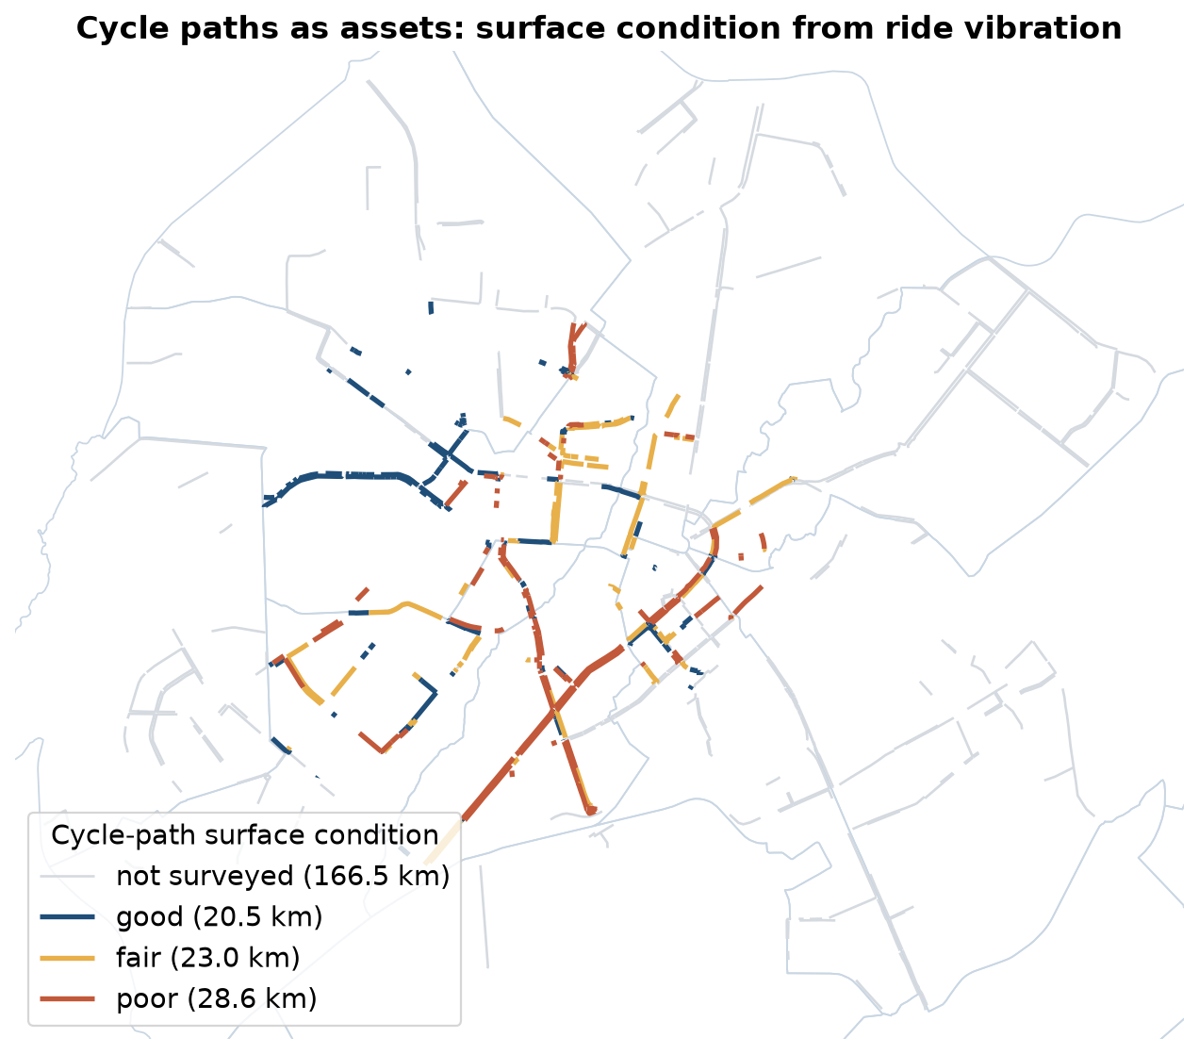
Cycle paths as assets
Surface condition class from the thesis surface score (ride vibration); LAB9 computes the lengths.
16 / 22

Slide 17
What the cycle-path condition data says
• Poor surface: 28.6 of 72.1 km of surveyed cycle path
• Cycle-path surface component 0.42 — the lowest of any facility
• Vibration on paths 6.90 vs 1.60 m/s² on the roadway (median, typical speed)
• Resurfacing existing paths is the first maintenance priority
17 / 22

Slide 18
A street's assets and what we know about them
Asset | Condition indicator | Tashkent data today
Carriageway | Roughness (IRI), cracking | Agency surveys; not open
Footway | Surface, width, obstructions | Partial OSM; field audit needed
Cycle track | Vibration, continuity | Normukhammadov (2026) audit
Street trees | Canopy, health, water supply | Heat-chapter shade survey; sparse OSM
Aryks and drains | Open, blocked, piped | Partial OSM; field check
Signals and lighting | Working, timing, lux | TSTU signal inventory (2016)
18 / 22

Slide 19
Discussion
Your district has one maintenance budget. Do you resurface a rough cycle path, replant a sunlit footway, or clear the aryks — and how do you defend the order?
• Use condition, importance and risk explicitly.
19 / 22

Slide 20
Key takeaways
• Manage assets over their whole life, not only at construction
• Condition, service level and risk together set maintenance priorities
• Early treatment is cheaper than late reconstruction — for agencies and users
• Tashkent's first task is an open, maintained register of street assets
20 / 22

Slide 21
References
• TU Delft, Department of Transport & Planning. CIEM6250 Transport Systems Design — units B-1 Network Design, B-2 Service Design, B-3 Physical Infrastructure Management, B-4 Traffic Operations Management (Smart Public Transport Lab education page; MSc Civil Engineering TTE track). https://www.tudelft.nl/citg/over-faculteit/afdelingen/transport-planning/research/labs/smart-public-transport-lab/education
• World Bank (2017). Integrating Climate Change into Road Asset Management. Washington, DC: World Bank. https://openknowledge.worldbank.org/entities/publication/0c6626a3-7fcc-5de7-9ec0-4c2234f91c8a
• Sodikov, J. I., et al. (2020). An overview of road data collection, visualization and analysis from the perspective of developing countries. IOP Conference Series: Materials Science and Engineering.
• Sodikov, J. I., et al. (2016). GIS inventory of traffic signals on Tashkent streets (in Russian). Transport Systems of Siberia.
• Sodikov, J. I. (2018). IRI roughness index requirements for highway functional classification.
• Sodikov, J. I. (2017). The role of highway functional classification in road asset management. Advances in Transportation Studies.
• Sodikov, J. I. (2015). Road asset management systems in developing countries: case study Uzbekistan.
• Wilson, N., Sánchez-Martínez, G., & Nassir, N. (2017). 1.258J/11.541J Public Transportation Systems, Spring 2017. MIT OpenCourseWare. https://ocw.mit.edu/courses/1-258j-public-transportation-systems-spring-2017/
• Normukhammadov, A. (2026). Pedalling Towards Sustainability: Developing an Integrated Bicycle Network for Enhanced Urban Mobility in Tashkent City (PhD thesis draft; supervisor J. I. Sodikov). Tashkent State Transport University.
• OpenStreetMap contributors (2026). Uzbekistan extract, Geofabrik GmbH (download.geofabrik.de). https://download.geofabrik.de/asia/uzbekistan.html
• Sodikov, J. I., et al. (2026). Urban heat actions of 100 global cities: Tashkent, Uzbekistan (book chapter manuscript).

Slide 22
© 2026 TSTU, J. Sodikov. CC BY-NC-SA 4.0. Adapts openly licensed material (CC BY-NC-SA 4.0) listed in the references.

