Slide 1
Week 9 · Lecture 2
Climate-adapted streets and service continuity
LEC18 · Urban Transport Systems Planning and Design · TSTU · Prof. J. Sodikov

Slide 2
What you will be able to do after today
• Apply a hazard–exposure–vulnerability framework to street assets
• Describe Tashkent's heat and rainfall risks from open data
• Use measured shade cooling to argue for trees on walking routes
• Select and phase adaptation measures for a corridor
2 / 23

Slide 3
Where this sits
• Infrastructure management: keep infrastructure performing over its life — now under a changing climate
• World Bank (2017): integrate climate change into road asset management
• PIARC (2015): an international adaptation framework for road infrastructure
• A published course on transportation policy: transport policy within environmental limits
3 / 23

Slide 4
Climate risk = hazard × exposure × vulnerability
• Hazard: heat waves, intense rain, flooding, mudflows
• Exposure: which assets and users are in the hazard's path
• Vulnerability: how badly they fail — and how fast they recover
• Criticality: what the network loses when that link fails
• Adaptation reduces any of the three; monitoring tells you if it worked
4 / 23

Slide 5
The PIARC adaptation framework
• Stage 1: set the scope, the climate variables and the assets at risk
• Stage 2: assess vulnerability and rank the risks
• Stage 3: develop and select adaptation responses
• Stage 4: integrate the findings into planning, design and maintenance
5 / 23

Slide 6
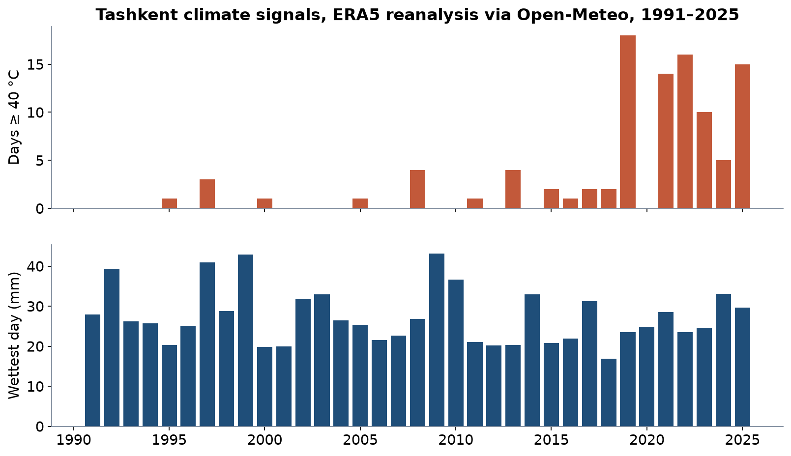
Tashkent's climate signals
ERA5 reanalysis grid point via Open-Meteo: days at or above 40 °C and the wettest day of each year.
6 / 23

Slide 7
Hotter summers, short intense rain
• Days a year at or above 40 °C rose from 0.5 (1991–2000) to 8.3 (2016–2025)
• The hottest year in the record had 18 days (2019)
• Heavy rain is rare — 3.7 days a year with 20 mm or more — but concentrated
• Wettest day 1991–2025: 43.2 mm (2009)
• Design for both: shade for long heat, drainage for short storms
7 / 23

Slide 8
Heat on walking routes
• Sodikov et al. (2026), 'Cool routes for a hot city' — shade survey and field temperature campaign
8 / 23

Slide 9
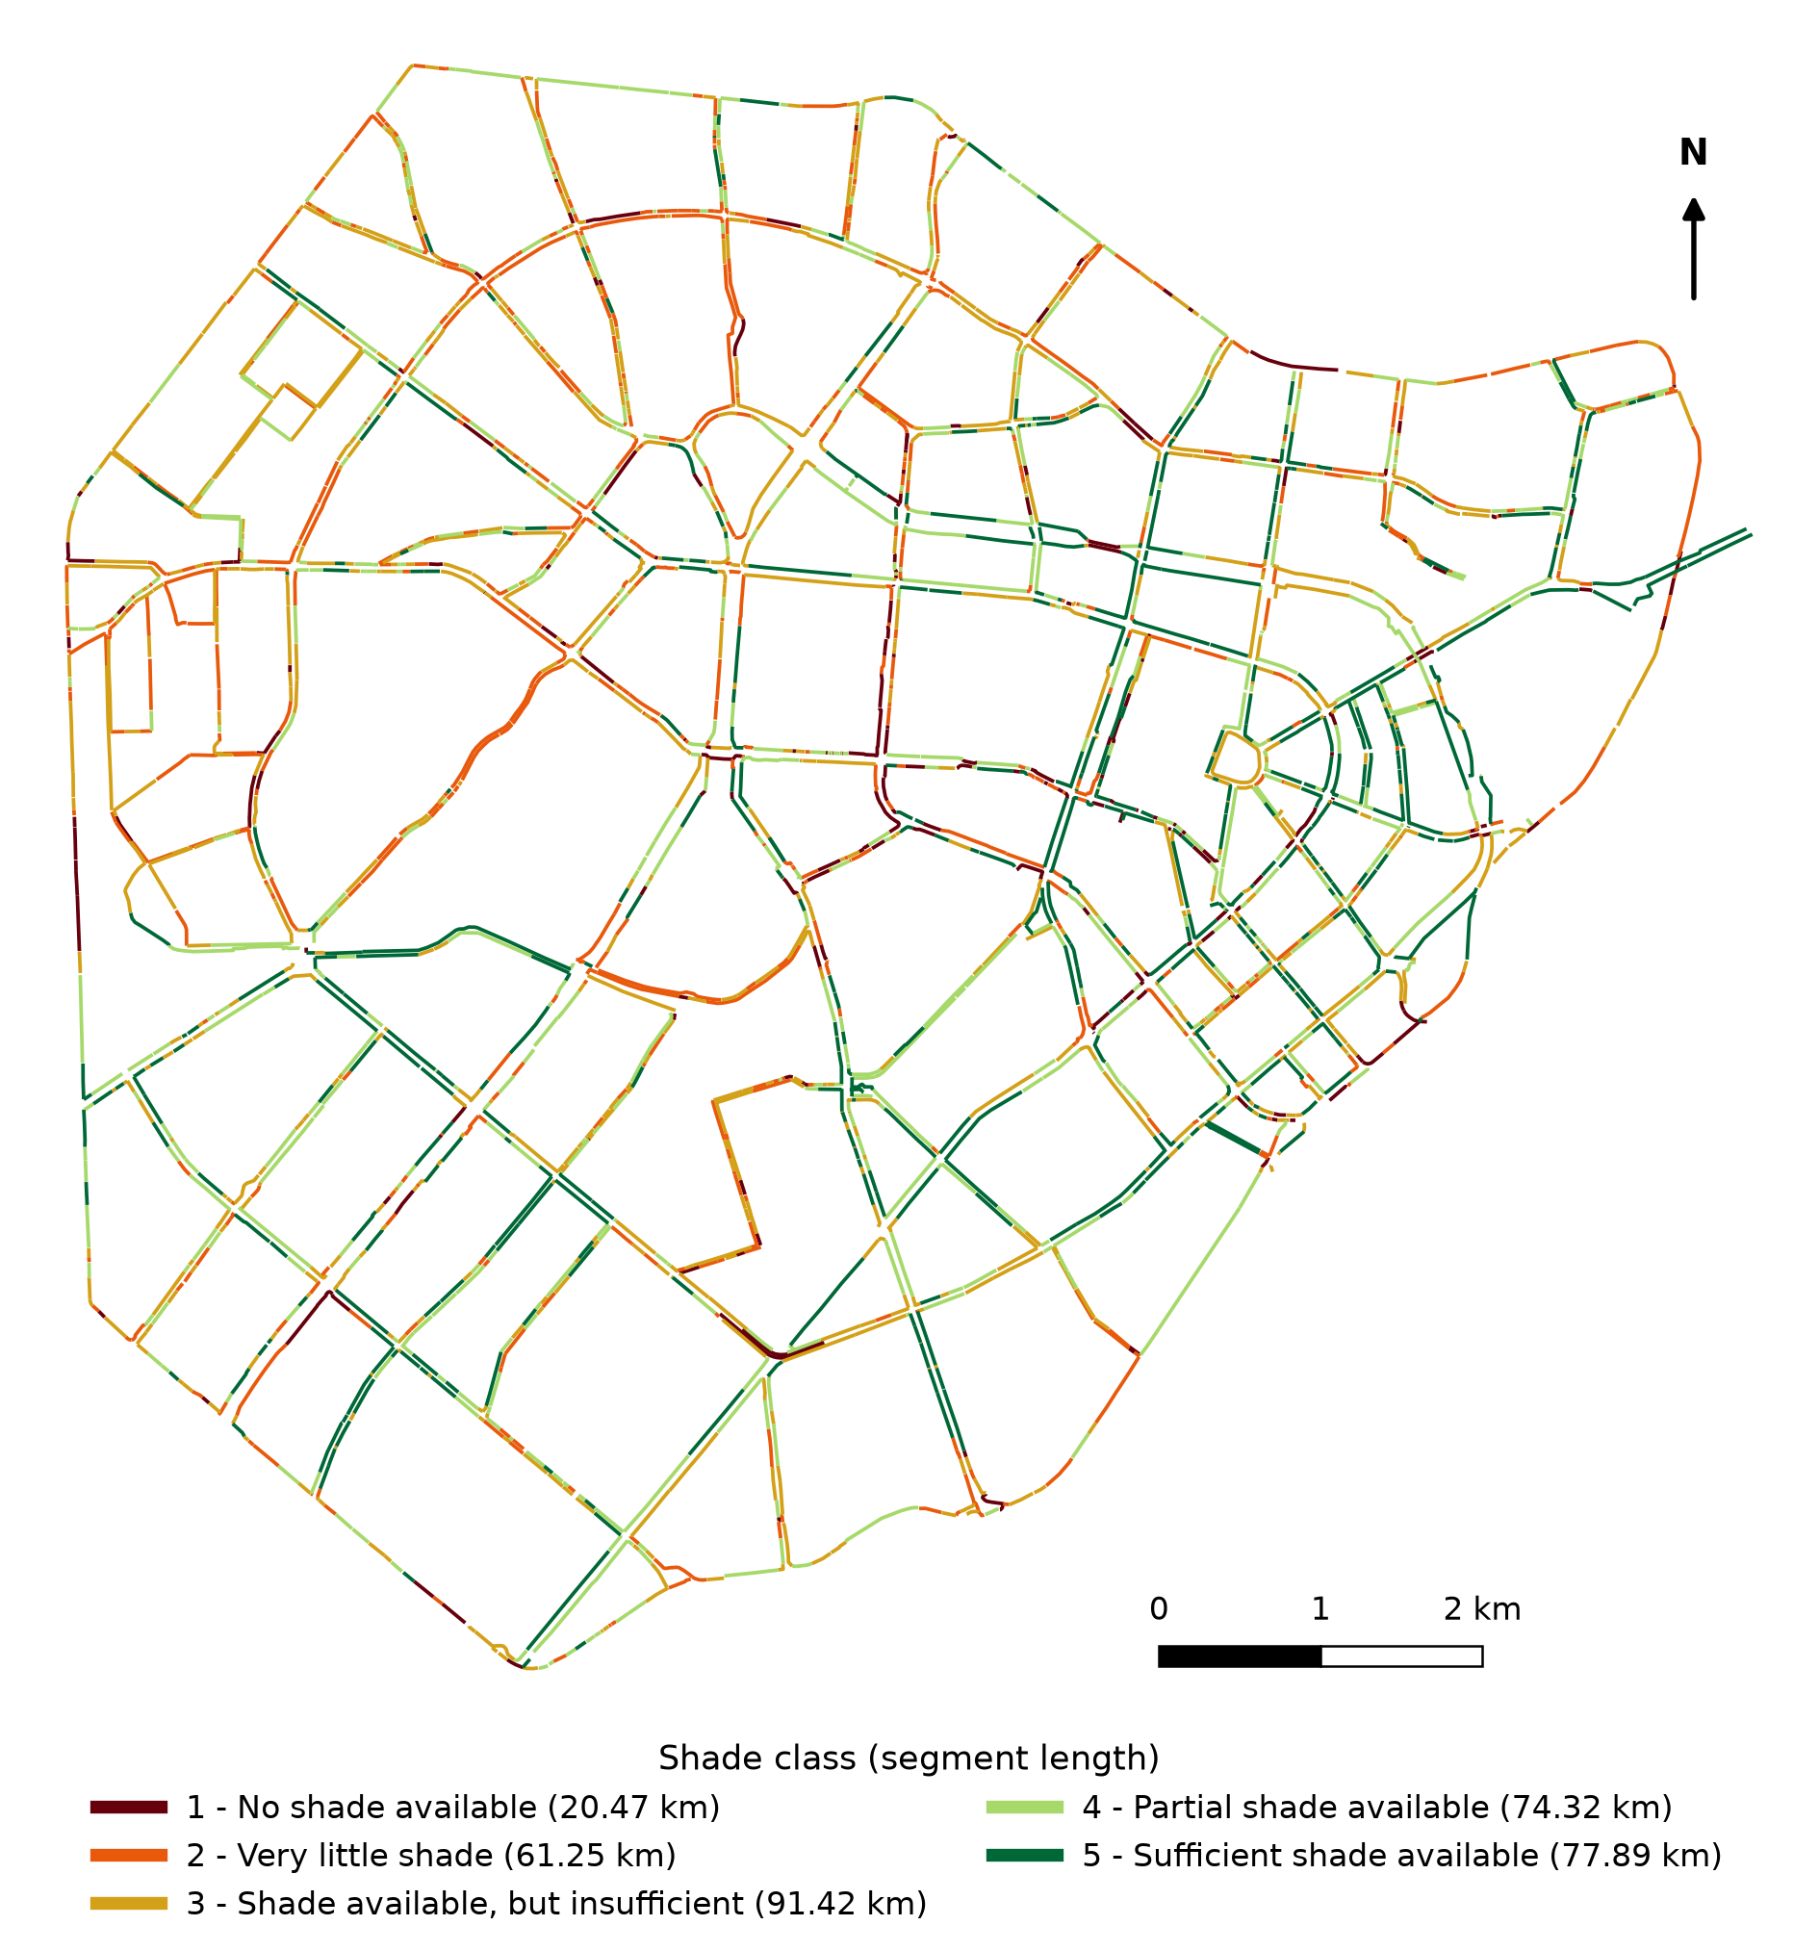
Where people can walk in the shade
Walking shade survey of central Tashkent, classes 1 (no shade) to 5 (sufficient shade). Sodikov et al. (2026) Fig. 1-2.
9 / 23

Slide 10
How hot it gets
• 325.4 km of the central walking network surveyed for shade
• 25.1% has no shade or very little shade
• Air temperature at measurement points reached 45.8 °C
• Sunlit surfaces reached 72.7 °C
10 / 23

Slide 11
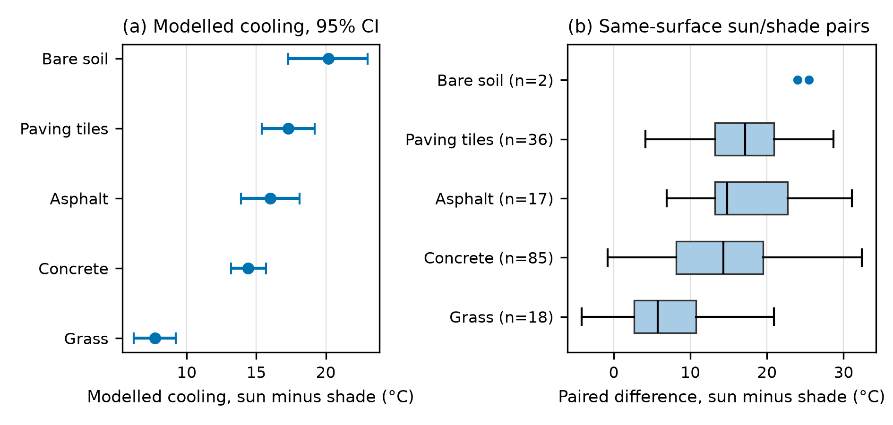
How much shade cools
Sodikov et al. (2026) Fig. 1-4: modelled cooling by surface (a) and same-surface sun/shade pairs (b).
11 / 23

Slide 12
Shade cools the street, not the air
• Full shade lowers surface temperature by 13.7 °C (12.9–14.5)
• 16.0 / 14.4 / 17.3 / 7.7 °C on asphalt / concrete / paving tiles / grass
• Air temperature differs by only 0.5 °C: shade works on the radiant load on the walker
• Landsat surface temperature hardly sees the footway: r = 0.17 with field readings
• So map shade on the ground, not heat from satellites
12 / 23

Slide 13
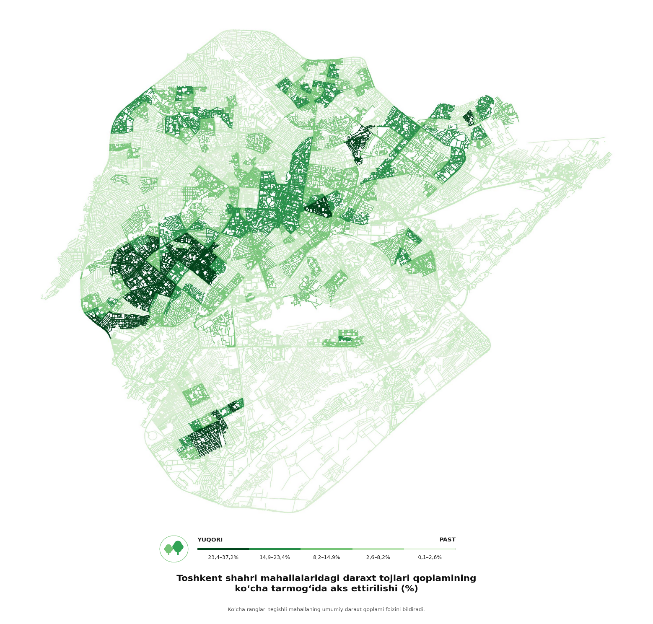
Tree canopy by mahalla
Ergashova (2026): tree-canopy share of each mahalla shown on its streets (YUQORI = high, PAST = low).
13 / 23

Slide 14
Planting is infrastructure
• Mahalla canopy ranges from 0.06–37.23%
• 46.1% of Pulatova's respondents say footways have no shade
• On the ridden cycle network, greener segments are shadier (ρ = −0.64)
• Trees need soil, water and protection during street works — budget them as assets
14 / 23

Slide 15
Rain, drainage and aryks
• Aryks — open irrigation channels — water street trees and carry runoff
• OSM maps 1,064.2 km (813.8 km of ditches, 200.2 km of canals) — far from complete
• 90.5% of the surveyed walking network has no mapped aryk within 15 m
• Low points and underpasses flood first: terrain analysis finds them
• Reconstructed streets without drainage repeat the problem (Pulatova)
15 / 23

Slide 16
Alternative routes and vulnerable links
• A link is critical when no reasonable alternative exists: bridges, underpasses, canal crossings
• For walkers, a sunlit route in July is a failed link — a shaded parallel street is the alternative
• For buses, works and floods need planned diversions, not improvised ones
• Map critical links first, then protect or duplicate them
16 / 23

Slide 17
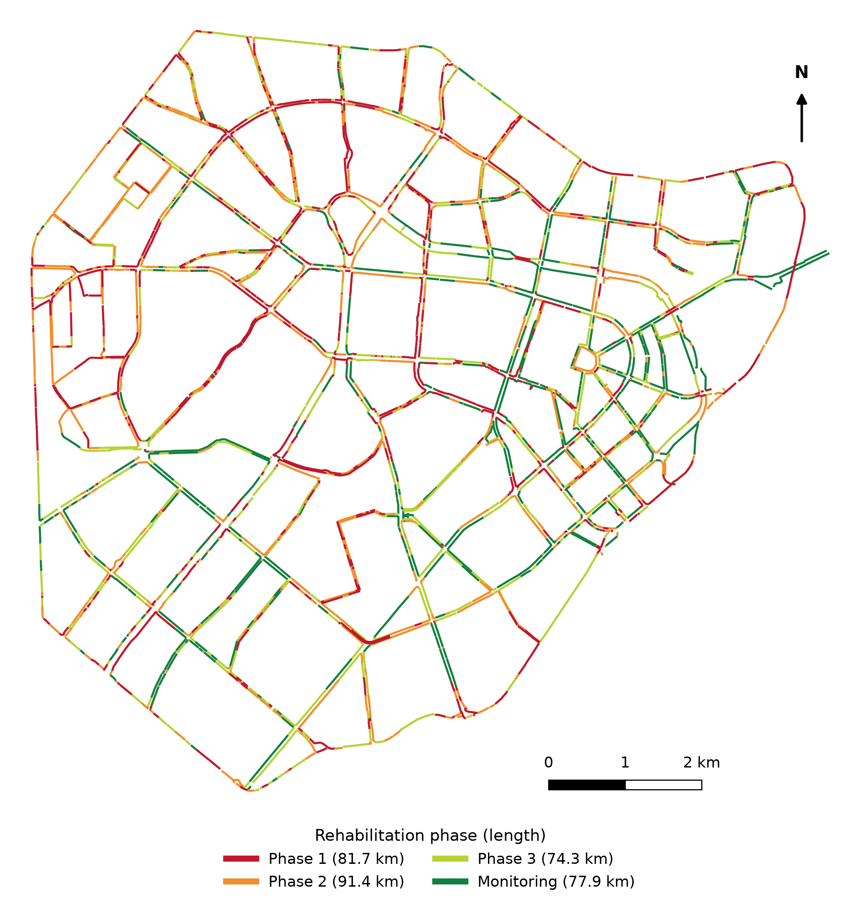
Phasing shade rehabilitation
Sodikov et al. (2026) Fig. 1-7: Phase 1 = no or very little shade; Phase 2 = insufficient; Phase 3 = partial.
17 / 23

Slide 18
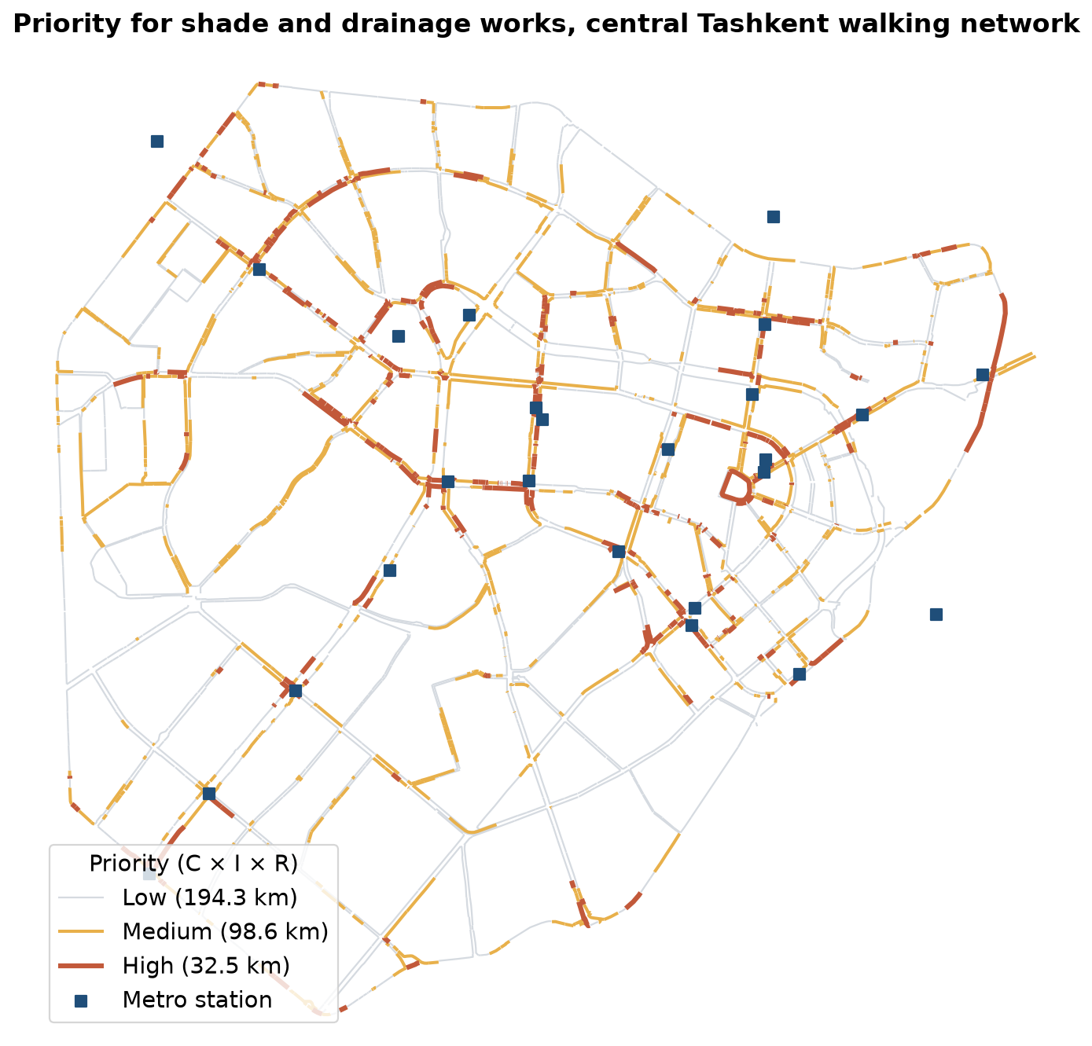
Where to start: shade where people wait and walk
• 78.5 km of the unshaded Phase 1 length lies near a transit stop
• LAB9 score: 32.5 km (356 segments) high priority, 98.6 km medium
• 20.2 km of the high-priority length lies within 400 m of a metro station
• 68.4 km need trees and a new water supply (no mapped aryk)
• Start at metro stations and schools; plant continuous rows, not single trees
18 / 23

Slide 19
Selecting adaptation measures for Tashkent
Measure | Hazard addressed | Co-benefits | Watch out for
Continuous street-tree rows | Heat | Comfort, air quality, walking | Water supply, roots vs utilities
Restored open aryks | Heat, runoff | Irrigation, cooling | Litter, maintenance
Permeable paving and swales | Rainfall | Tree roots get water | Clogging, cost
Shaded stops and shelters | Heat | Ridership, waiting comfort | Shelter roofs alone are not enough
Light-coloured paving | Surface heat | Lower surface temperature | Glare and reflected heat on walkers
19 / 23

Slide 20
Discussion
Which single link on your corridor would fail first in a July heat wave or a summer storm — and what is the alternative route?
• Name the hazard, the users exposed and the measure.
20 / 23

Slide 21
Key takeaways
• Climate risk = hazard × exposure × vulnerability; adaptation belongs in asset management
• Tashkent's heat days are rising; full shade cools walking surfaces by 13.7 °C
• Trees and aryks are infrastructure with condition, water needs and owners
• Prioritise shade and drainage where people walk and wait
21 / 23

Slide 22
References
• World Bank (2017). Integrating Climate Change into Road Asset Management. Washington, DC: World Bank. https://openknowledge.worldbank.org/entities/publication/0c6626a3-7fcc-5de7-9ec0-4c2234f91c8a
• TU Delft, Department of Transport & Planning. CIEM6250 Transport Systems Design — units B-1 Network Design, B-2 Service Design, B-3 Physical Infrastructure Management, B-4 Traffic Operations Management (Smart Public Transport Lab education page; MSc Civil Engineering TTE track). https://www.tudelft.nl/citg/over-faculteit/afdelingen/transport-planning/research/labs/smart-public-transport-lab/education
• PIARC (2015). International Climate Change Adaptation Framework for Road Infrastructure (Technical Committee E.1, report 2015R03EN). Paris: World Road Association. https://www.piarc.org/en/order-library/23517-en-International%20climate%20change%20adaptation%20framework%20for%20road%20infrastructure
• Salvucci, F., & Coughlin, J. (2004). 1.253J/11.543J Transportation Policy and Environmental Limits, Spring 2004. MIT OpenCourseWare. https://ocw.mit.edu/courses/1-253j-transportation-policy-and-environmental-limits-spring-2004/
• Open-Meteo (2026). Historical Weather API (ERA5 reanalysis), Tashkent. https://open-meteo.com/en/docs/historical-weather-api
• Sodikov, J. I., et al. (2026). Urban heat actions of 100 global cities: Tashkent, Uzbekistan (book chapter manuscript).
• Ergashova, M. Z. (2026). 15-minute walkability of Tashkent mahallas — dissertation defence presentation, 14 Oct 2026 (in Uzbek). Tashkent State Transport University.
• Pulatova, Z. S. (2024). Walkability assessment of Tashkent city districts (PhD dissertation, in Uzbek; supervisor J. I. Sodikov). Tashkent State Transport University.
• Normukhammadov, A. (2026). Pedalling Towards Sustainability: Developing an Integrated Bicycle Network for Enhanced Urban Mobility in Tashkent City (PhD thesis draft; supervisor J. I. Sodikov). Tashkent State Transport University.
• OpenStreetMap contributors (2026). Uzbekistan extract, Geofabrik GmbH (download.geofabrik.de). https://download.geofabrik.de/asia/uzbekistan.html
• Sodikov, J. I., et al. (2025). Urban terrain morphometry for transport planning: a GIS-based analysis of Tashkent using open DEMs. Vibroengineering Procedia. https://www.extrica.com

Slide 23
© 2026 TSTU, J. Sodikov. CC BY-NC-SA 4.0. Adapts openly licensed material (CC BY-NC-SA 4.0) listed in the references.

