Slide 1
Week 10 · Lecture 1
Analysing flow, capacity and congestion
LEC19 · Urban Transport Systems Planning and Design · TSTU · Prof. J. Sodikov

Slide 2
What you will be able to do after today
• Explain the speed–flow–density relationship and read a fundamental diagram
• Use shockwaves and cumulative curves to explain queues and delay
• Find the bottleneck that actually limits a corridor
• Judge vehicle capacity alongside the quality of service for people
2 / 25

Slide 3
Where this sits: the traffic-operations perspective
• Traffic operations management is the fourth of the course's four design perspectives
• Week 4 asked which links exist; Week 6 which services run; Week 9 how assets last
• This week asks how the network performs minute by minute, and how control changes it
• The open backbone: a published course on traffic flow theory and simulation, and Knoop's open textbook
3 / 25

Slide 4
Three variables, one identity
• Flow q: vehicles passing a point per hour — what a counter measures
• Density k: vehicles per kilometre of lane — what an aerial photo shows
• Speed v: space-mean speed of the vehicles on the stretch
• Identity: q = k · v holds for any stream in a stationary state
• Detectors give time-mean speed; it is higher than space-mean speed — know which you have
4 / 25

Slide 5
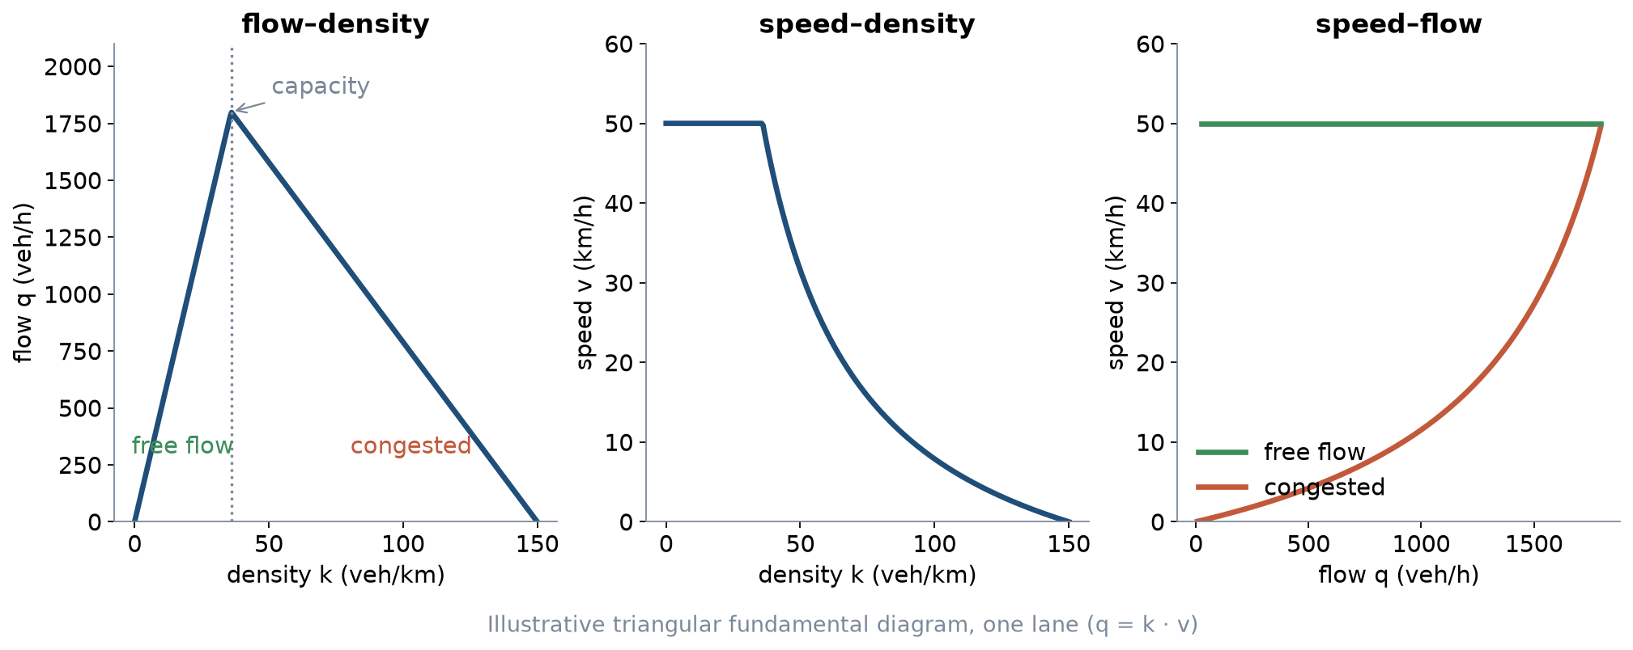
The fundamental diagram
Illustrative triangle: free speed 50 km/h, capacity 1,800 veh/h per lane, jam density 150 veh/km.
5 / 25

Slide 6
Reading the fundamental diagram
• Left branch: free flow — more vehicles, more flow, speed stays high
• Peak: capacity, reached at the critical density
• Right branch: congestion — more vehicles, less flow, lower speed
• The same flow can occur in two states: a count alone cannot tell you which
• After a queue forms, discharge flow is often below capacity (capacity drop)
6 / 25

Slide 7
Worked example: how fast does a queue grow?
• Shockwave speed between two states: w = (q₂ − q₁) / (k₂ − k₁)
• Arrivals: q₁ = 900 veh/h at k₁ = 18 veh/km; stopped queue: q₂ = 0 at k₂ = 150 veh/km
• w = (0 − 900) / (150 − 18) ≈ −6.8 km/h: the back of the queue moves upstream
• That is about 1.9 m every second of red
• When green starts, a second wave runs upstream and releases the queue
7 / 25

Slide 8
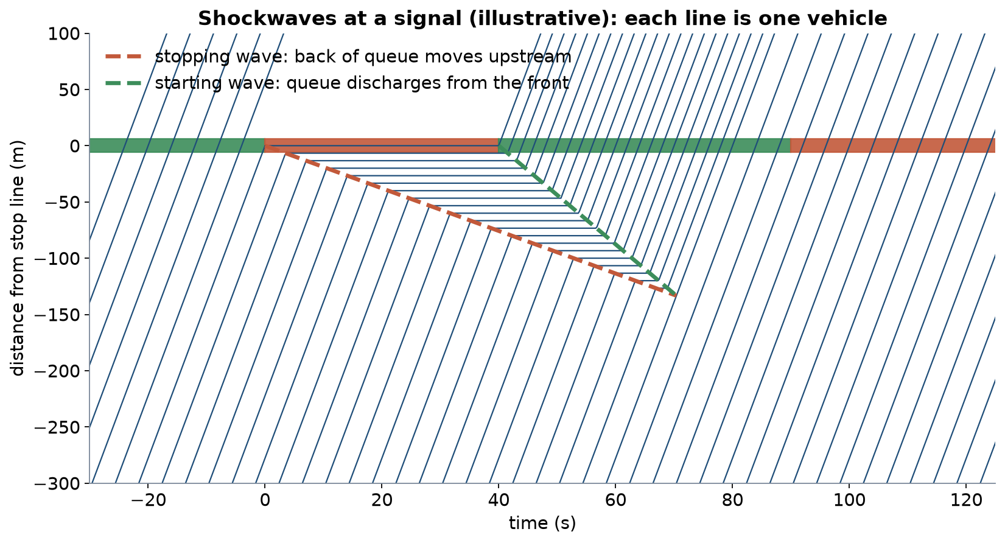
Shockwaves at a signal
Illustrative trajectories: 900 veh/h arrive, 40 s red, then green; queue stops where the two waves meet.
8 / 25

Slide 9
Bottlenecks
• A bottleneck is where capacity falls: lane drop, merge, junction, bus stop in the lane, parked cars
• Upstream: queue and congested state; downstream: free flow at the bottleneck's discharge rate
• Only the active bottleneck limits throughput — widening elsewhere changes nothing
• In cities the bottlenecks are almost always junctions and kerbside activity
• Fixing one bottleneck can move the queue to the next one
9 / 25

Slide 10
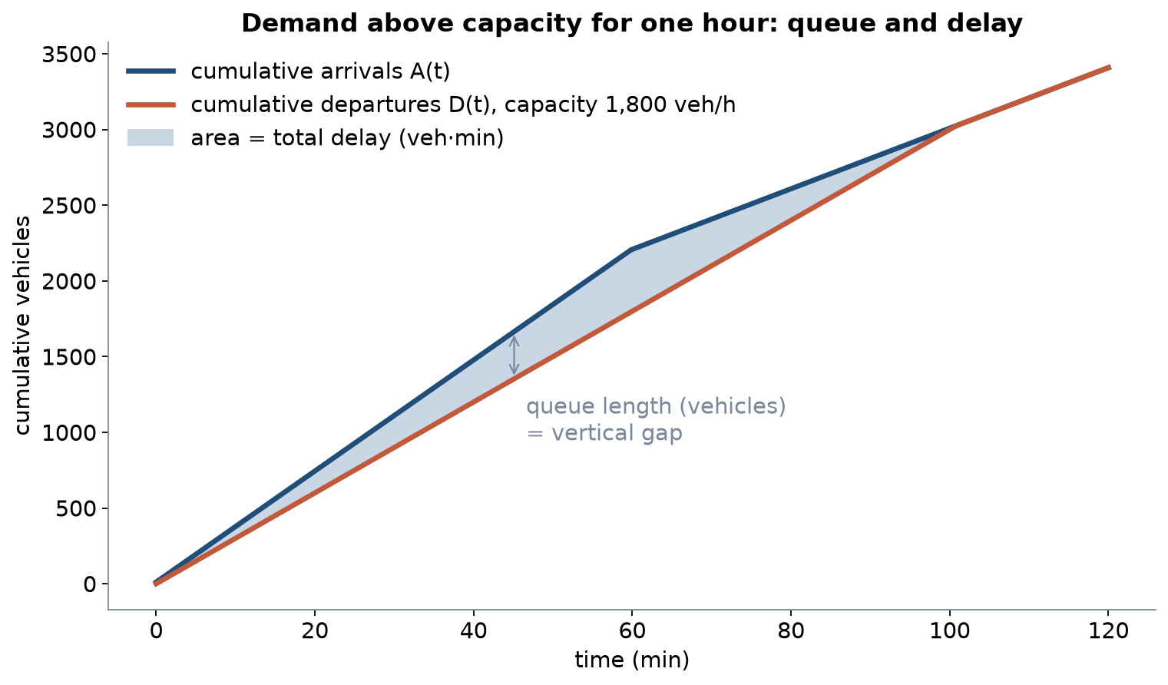
Demand above capacity: queue and delay
Illustrative: 2,200 veh/h for one hour, then 1,200 veh/h, against a capacity of 1,800 veh/h.
10 / 25

Slide 11
Worked example: demand-to-capacity ratio
• Demand 2,200 veh/h against capacity 1,800 veh/h: d/c = 1.22 for one hour
• Queue grows by 400 vehicles per hour; after the peak it shrinks at 600 veh/h
• The queue clears 40 minutes after the peak ends
• Total delay = triangle area: ½ × 400 veh × 100 min = 20,000 veh·min
• A 10% demand cut removes far more than 10% of the delay
11 / 25

Slide 12
Capacity at a signalised junction
• Saturation flow s: discharge rate of a queue during green, per lane
• Capacity of a lane group: c = s × g / C (green time g, cycle C)
• Degree of saturation: x = q / c — as x approaches 1, queues become unstable
• Saturation flow is measured, not assumed: a published course assignment counts discharge headways
• Lane width, buses, turning vehicles and pedestrians all lower s
12 / 25

Slide 13
Worked example: measuring saturation flow
• At the start of green, note the time each car crosses the stop line
• Ignore the first four vehicles: they are still accelerating
• Average headway of the rest, for example 2.0 s
• s = 3,600 / 2.0 = 1,800 vehicles per hour of green, per lane
• Repeat over at least five cycles and report the range, not one value
13 / 25

Slide 14
Vehicle capacity is not the whole story
Question | Vehicle view | Multimodal view
Capacity | Vehicles per hour | People per hour, by mode
Delay | Seconds per vehicle | Seconds per person: passengers and pedestrians
Quality | Level of service letter from vehicle delay | Bus reliability, crossing waits, comfort, safety
Success | Lower degree of saturation | Objectives of Week 1: access, safety, emissions
14 / 25

Slide 15
Tashkent: what we know about traffic operations
• OpenStreetMap signal data, the city's targets, and TSTU research
15 / 25

Slide 16
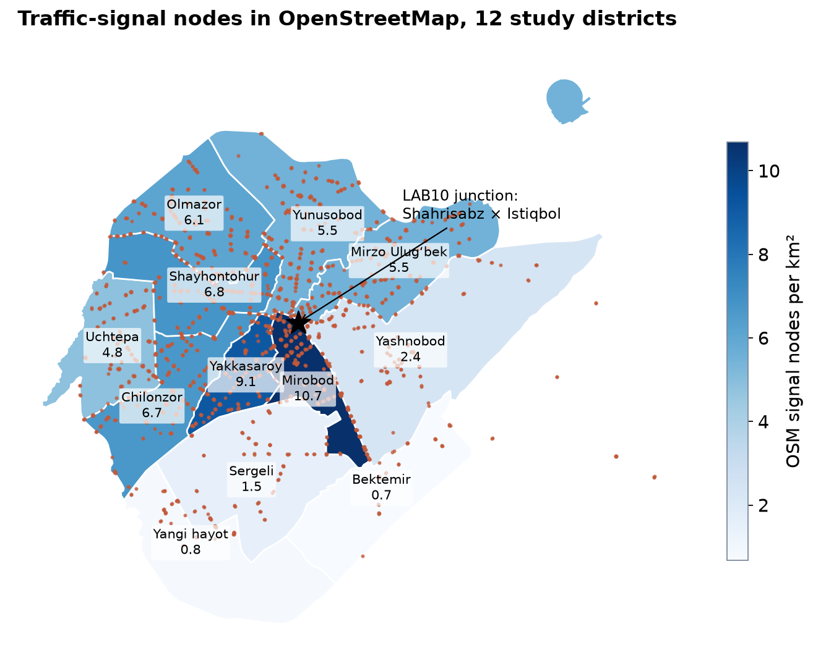
Traffic signals in OpenStreetMap
1,867 signal nodes city-wide; 1,799 in the twelve study districts (OSM extract, October 2026).
16 / 25

Slide 17
Reading the signal map
• Densest: Mirobod, 10.7 per km²; sparsest: Bektemir, 0.67 per km²
• One junction carries several nodes: merged within 60 m they form 729 clusters
• OSM records signal positions, not phases, timings or detectors
• TSTU built a GIS inventory of Tashkent's signals (Sodikov et al., 2016) — the start of a signal register
17 / 25

Slide 18
Targets that pull in different directions
• Tashkent transport concept for 2022–2025: junction vehicle capacity +15%
• Same concept: average bus operating speed +17%
• Same concept: public transport share 43%
• No pedestrian target (Pulatova, 2024)
• One junction cannot maximise all of them — the timing plan chooses
18 / 25

Slide 19
Pedestrians at Tashkent junctions
• 64.2% of surveyed pedestrians say they wait a long time to cross
• 21% say the time given to cross is not enough
• Speed limit lowered from 70 to 60 km/h — still lethal at uncontrolled crossings
• Long waits push people to cross on red: delay is also a safety problem
19 / 25

Slide 20
At the city edge: the M-41 corridor
• Entry corridors mix intercity, commuter and freight traffic
• Sodikov et al. evaluated the M-41 traffic pattern and safety with mixed methods
• Lesson: read traffic data and safety evidence together, not in separate reports
• Operations analysis that ignores safety optimises the wrong thing
20 / 25

Slide 21
Data you will need to collect
• No open traffic counts or signal timings exist for Tashkent
• Classified counts by approach in 15-minute periods, including buses
• Cycle and green times by stopwatch over several cycles
• Queue length at the end of red; pedestrian counts at each crosswalk
• Record date, time, weather and observer — Week 2 data-quality rules
21 / 25

Slide 22
Discussion
At your corridor's busiest junction, is the bottleneck the signal, the kerbside, or the junction downstream — and how would you prove it?
• Two minutes in pairs: name one observation that would settle it.
22 / 25

Slide 23
Key takeaways
• q = k · v: a count alone cannot tell free flow from congestion
• Queues grow and clear as waves; delay rises much faster than demand
• Only the active bottleneck limits throughput — find it before designing
• Report capacity and delay for people, not only for vehicles
23 / 25

Slide 24
References
• TU Delft, Department of Transport & Planning. CIEM6250 Transport Systems Design — units B-1 Network Design, B-2 Service Design, B-3 Physical Infrastructure Management, B-4 Traffic Operations Management (Smart Public Transport Lab education page; MSc Civil Engineering TTE track). https://www.tudelft.nl/citg/over-faculteit/afdelingen/transport-planning/research/labs/smart-public-transport-lab/education
• TU Delft (2014). CIE4821 Traffic Flow Theory and Simulation. TU Delft OpenCourseWare. https://ocw.tudelft.nl/courses/traffic-flow-theory-simulation/
• Knoop, V. L. (2021). Traffic Flow Theory: An Introduction with Exercises (3rd ed.). TU Delft OPEN Publishing. https://books.open.tudelft.nl/home/catalog/book/203
• Salvucci, F. (2016). 1.252J/11.540J Urban Transportation Planning, Fall 2016. MIT OpenCourseWare. https://ocw.mit.edu/courses/1-252j-urban-transportation-planning-fall-2016/
• Urbanik, T., et al. (2015). Signal Timing Manual (2nd ed.), NCHRP Report 812. Transportation Research Board. https://www.nap.edu/read/22097/chapter/2
• Kittelson & Associates et al. (2013). Transit Capacity and Quality of Service Manual (3rd ed.), TCRP Report 165. Transportation Research Board. https://nap.nationalacademies.org/read/24766
• Wilson, N., Sánchez-Martínez, G., & Nassir, N. (2017). 1.258J/11.541J Public Transportation Systems, Spring 2017. MIT OpenCourseWare. https://ocw.mit.edu/courses/1-258j-public-transportation-systems-spring-2017/
• Global Designing Cities Initiative & NACTO (2016). Global Street Design Guide. Island Press. https://globaldesigningcities.org/publication/global-street-design-guide/
• OpenStreetMap contributors (2026). Uzbekistan extract, Geofabrik GmbH (download.geofabrik.de). https://download.geofabrik.de/asia/uzbekistan.html
• Sodikov, J. I., et al. (2016). GIS inventory of traffic signals on Tashkent streets (in Russian). Transport Systems of Siberia.
• Pulatova, Z. S. (2024). Walkability assessment of Tashkent city districts (PhD dissertation, in Uzbek; supervisor J. I. Sodikov). Tashkent State Transport University.
• Sodikov, J. I., et al. (2026). Traffic pattern and safety evaluation on the M-41 corridor using mixed-methods analysis. AIP Conference Proceedings (2025 Int. Conf.).

Slide 25
© 2026 TSTU, J. Sodikov. CC BY-NC-SA 4.0. Adapts openly licensed material (CC BY-NC-SA 4.0) listed in the references.

