Slide 1
Week 10 · Lecture 2
Managing junction and network performance
LEC20 · Urban Transport Systems Planning and Design · TSTU · Prof. J. Sodikov

Slide 2
What you will be able to do after today
• Calculate a two-phase signal timing with Webster's method
• Include pedestrian crossing time and public transport priority in the timing
• Compare geometric and operational measures by who gains and who pays
• Check a model against observations and report its uncertainty
2 / 26

Slide 3
Signal-control vocabulary
• Phase: a set of movements that receive green together
• Cycle C: time for one full sequence of phases
• Split: share of the cycle given to each phase as effective green g
• Intergreen and lost time L: amber and all-red plus start-up losses
• Offset: start of green relative to the neighbouring junction
3 / 26

Slide 4
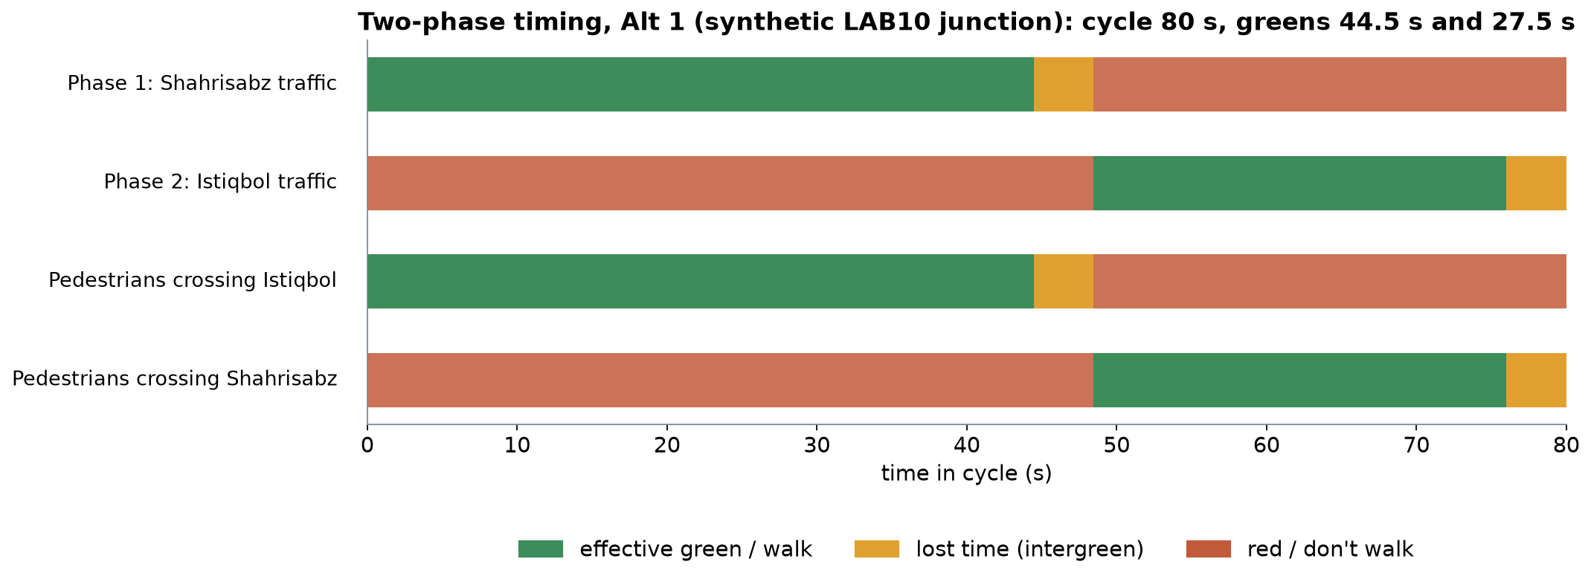
A two-phase timing plan
Synthetic LAB10 junction, Alt 1: 80 s cycle. Pedestrians cross each street while the parallel traffic has green.
4 / 26

Slide 5
Webster's method
• Flow ratio y = q / s for each lane group; the critical y per phase governs
• Y = sum of critical flow ratios; must stay below 1
• Optimum cycle C₀ = (1.5 L + 5) / (1 − Y)
• Effective greens in proportion to the critical y values
• Average delay d = 0.9 [C(1−λ)² / 2(1−λx) + x² / 2q(1−x)], λ = g/C
5 / 26

Slide 6
Worked example: the LAB10 junction
• Shahrisabz: (1,800 cars + 50 buses × 2 pcu) / (3 lanes × 1,800) = 0.35
• Istiqbol: (760 cars + 12 buses × 2) / (2 × 1,800) = 0.22
• Y = 0.57, L = 8 s → C₀ = (12 + 5) / 0.43 = 39.5 s
• Pedestrians crossing 24 m at 1.2 m/s need 7 + 20 = 27 s of green
• That needs a 78.6 s cycle → round up to 80 s
6 / 26

Slide 7
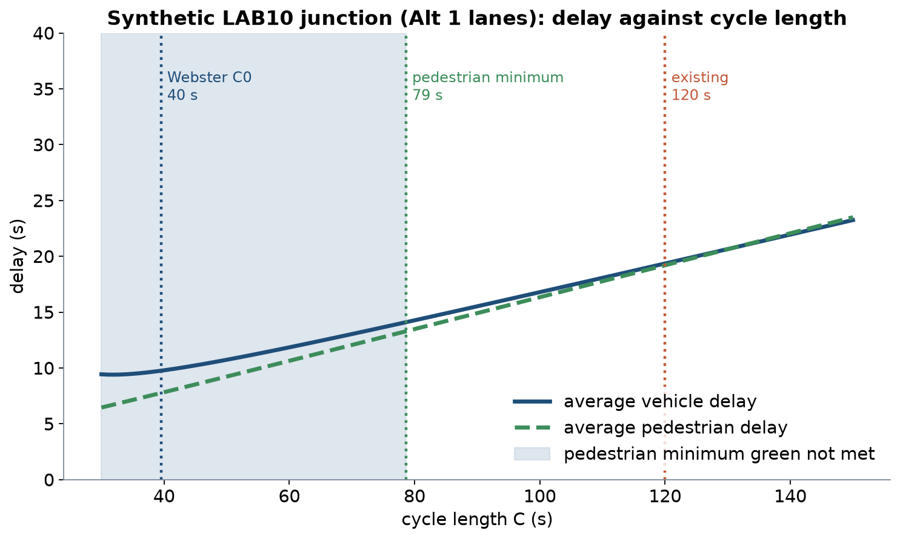
Cycle length: who pays for a long cycle?
Synthetic junction: above the pedestrian minimum cycle, vehicle and pedestrian delay both rise with cycle length; the existing 120 s cycle costs everyone.
7 / 26

Slide 8
Designing for pedestrians at signals
• Minimum green = walk time + crossing length ÷ walking speed
• Use a slower design speed where older people and children cross
• A median refuge splits a wide crossing into two shorter stages
• Leading pedestrian interval: walkers start before turning traffic
• Every second of red is pedestrian delay; long waits invite red-light crossing
8 / 26

Slide 9
Public transport priority at signals
• Passive priority: timing and progression set for bus speeds and stops
• Active priority: green extension or early green when a bus is detected
• Queue jumps and bus lanes let buses bypass the car queue
• Conditional priority: only for late buses, protects cross-street traffic
• Signal delay is a large, controllable share of bus running time
9 / 26

Slide 10
Bus lanes at junctions
• Kerbside lanes conflict with right turns, stops and loading
• Median lanes avoid the kerb but need safe pedestrian access to stops
• Pre-signals and set-back stop lines give buses the front of the queue
• Taking a lane from cars raises their degree of saturation
• Enforcement decides whether the lane works
10 / 26

Slide 11
Coordination along a corridor
• Offsets let a platoon meet successive greens: a green wave
• Works best in one direction and with regular junction spacing
• All coordinated junctions share one cycle — usually the longest one needed
• Progression speed is a policy choice: set it for safe urban speeds
• Adaptive control adjusts splits to measured demand — needs detectors and maintenance
11 / 26

Slide 12
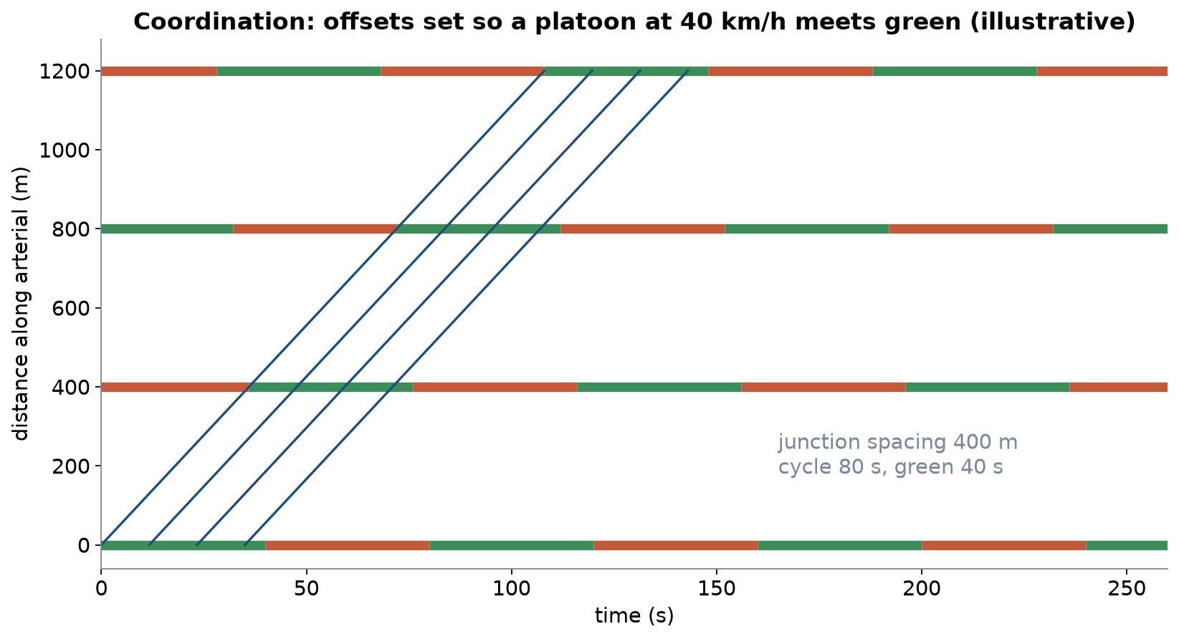
A green wave
Illustrative: junctions 400 m apart, 80 s cycle, 40 s green, progression at 40 km/h.
12 / 26

Slide 13
Geometric and operational measures
Measure | Type | What it changes | Who gains / who pays
Retiming | Operational | Cycle and splits | Most users gain; cheap, needs counts
Median refuge | Geometric | Pedestrian minimum green | Pedestrians and everyone through shorter cycles; needs width
Bus lane | Geometric | Bus queueing | Bus passengers gain; car capacity falls
Active bus priority | Operational | Green timing for buses | Bus passengers gain; cross street waits longer
Turn ban | Operational | Conflicts and phases | Through traffic gains; detours elsewhere
Coordination | Operational | Offsets along the corridor | Main-road platoons gain; side streets and pedestrians may wait
13 / 26

Slide 14
LAB10 preview: one junction, four alternatives
• Real OSM location; SYNTHETIC flows and timings, because Tashkent publishes no counts
14 / 26

Slide 15
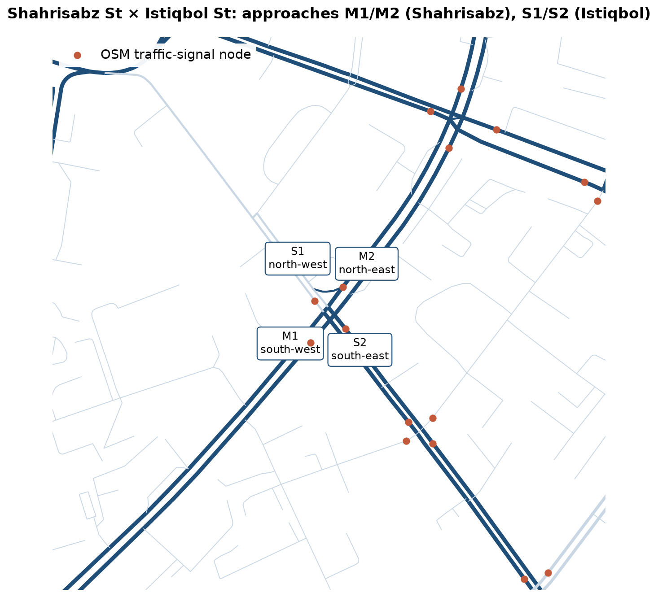
The site: Shahrisabz St × Istiqbol St
OSM geometry with 24 signal nodes within 500 m. Pulatova (2024) photographed this junction as a redesign case.
15 / 26

Slide 16
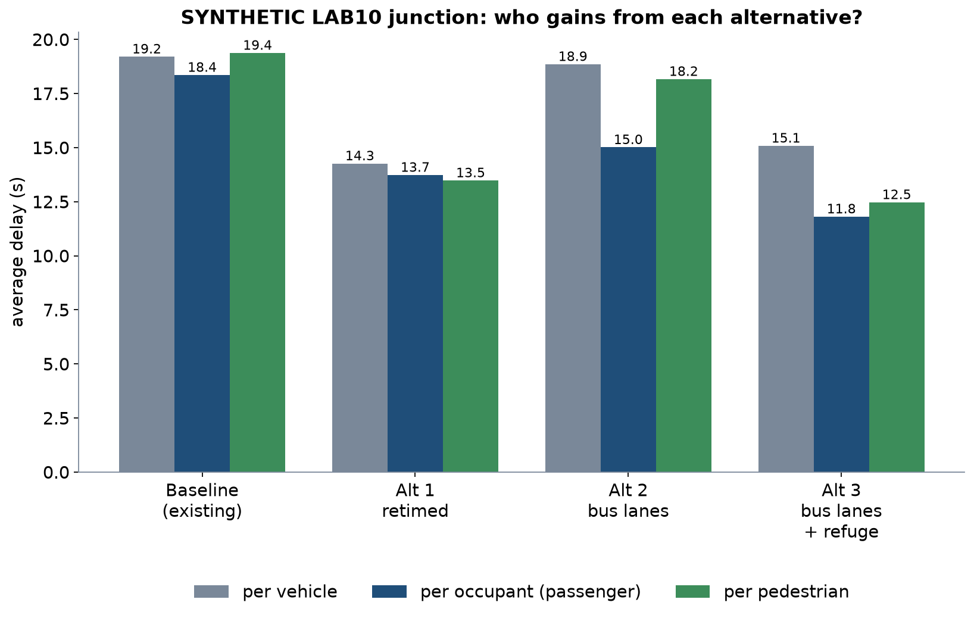
Who gains from each alternative?
SYNTHETIC results; bus occupancy assumed 55 passengers, car occupancy 1.3.
16 / 26

Slide 17
Reading the results
• Retiming alone: vehicle delay 19.2 → 14.3 s; the cycle falls from 120 to 80 s
• Bus lanes alone: bus delay 11.1 s, but the cycle grows to 100 s for pedestrians
• So passengers barely gain: 15.0 s against 13.7 s with retiming only
• Bus lanes + refuge: 65 s cycle; passengers 11.8 s, pedestrians 12.5 s; vehicle delay 15.1 s (all vehicles)
• The refuge, a geometric change, is what makes the short 65 s cycle possible
17 / 26

Slide 18
How robust is the ranking?
• Break-even bus occupancy for bus lanes alone: 120.2 passengers per bus
• With the refuge: only 10.8 — the result survives almost any occupancy
• Test saturation flow, walking speed and occupancy, one at a time
• Report the conditions under which your preferred alternative wins
18 / 26

Slide 19
Checking models against observations
• A delay formula is a model: check it before you trust its ranking
• Observed: cycle and greens by stopwatch, saturation headways, queue at end of red
• Compare predicted and observed queues for each approach
• If they disagree, recalibrate saturation flow and lost time first
• Webster assumes random arrivals and undersaturation — not valid when queues persist
19 / 26

Slide 20
Reporting uncertainty
• State every assumption next to the result it drives
• Give ranges from sensitivity tests, not one number
• Local example: the TIP crash study reports a pedestrian odds ratio of OR 2.60–3.89 across coding choices
• The conclusion held because every value in the range pointed the same way
• Do the same for delay: does the ranking survive the range?
20 / 26

Slide 21
Signals as city assets
• A timing plan is an asset: record it, date it, review it
• TSTU already mapped Tashkent's signals in a GIS inventory (Sodikov et al., 2016)
• OSM suggests about 729 signalised junction clusters to manage
• Retiming is among the cheapest measures — if the data exist
21 / 26

Slide 22
Discussion
Your corridor's junction gets one change this year. Retiming, a refuge or a bus lane — which, and what evidence would convince the city?
• Answer with vehicle, passenger and pedestrian delay — and one assumption you would test.
22 / 26

Slide 23
Key takeaways
• Webster gives a starting cycle; pedestrian crossing time often sets the real one
• Rankings change when delay is counted per person instead of per vehicle
• Geometric and operational measures work best together
• Calibrate on observations, then report the range, not a single number
23 / 26

Slide 24
Before LAB10 and P10
• Open LAB10_junction.gpkg in QGIS and LAB10_synthetic_junction.xlsx in Excel
• Read Knoop's chapters on the fundamental diagram and shockwaves
• Collect counts, cycle times and queues at one junction or crossing of your corridor
• Course project Stage 3 (street design and operational calculations) is due this week
24 / 26

Slide 25
References
• Urbanik, T., et al. (2015). Signal Timing Manual (2nd ed.), NCHRP Report 812. Transportation Research Board. https://www.nap.edu/read/22097/chapter/2
• TU Delft, Department of Transport & Planning. CIEM6250 Transport Systems Design — units B-1 Network Design, B-2 Service Design, B-3 Physical Infrastructure Management, B-4 Traffic Operations Management (Smart Public Transport Lab education page; MSc Civil Engineering TTE track). https://www.tudelft.nl/citg/over-faculteit/afdelingen/transport-planning/research/labs/smart-public-transport-lab/education
• Synthetic teaching dataset generated for this course (method and random seed in each workbook's README sheet).
• Webster, F. V. (1958). Traffic Signal Settings. Road Research Technical Paper No. 39. London: HMSO.
• Knoop, V. L. (2021). Traffic Flow Theory: An Introduction with Exercises (3rd ed.). TU Delft OPEN Publishing. https://books.open.tudelft.nl/home/catalog/book/203
• World Health Organization (2023). Pedestrian Safety: A Road Safety Manual for Decision-Makers and Practitioners (2nd ed.). Geneva: WHO. https://www.who.int/publications/i/item/9789240072497
• Global Designing Cities Initiative & NACTO (2016). Global Street Design Guide. Island Press. https://globaldesigningcities.org/publication/global-street-design-guide/
• Wilson, N., Sánchez-Martínez, G., & Nassir, N. (2017). 1.258J/11.541J Public Transportation Systems, Spring 2017. MIT OpenCourseWare. https://ocw.mit.edu/courses/1-258j-public-transportation-systems-spring-2017/
• Kittelson & Associates et al. (2013). Transit Capacity and Quality of Service Manual (3rd ed.), TCRP Report 165. Transportation Research Board. https://nap.nationalacademies.org/read/24766
• OpenStreetMap contributors (2026). Uzbekistan extract, Geofabrik GmbH (download.geofabrik.de). https://download.geofabrik.de/asia/uzbekistan.html
• Pulatova, Z. S. (2024). Walkability assessment of Tashkent city districts (PhD dissertation, in Uzbek; supervisor J. I. Sodikov). Tashkent State Transport University.
• TU Delft (2014). CIE4821 Traffic Flow Theory and Simulation. TU Delft OpenCourseWare. https://ocw.tudelft.nl/courses/traffic-flow-theory-simulation/
• Sodikov, J. I., et al. (under review). Odds of recorded death among police-recorded road-traffic casualties and register data quality in Tashkent, Uzbekistan. Traffic Injury Prevention (revision r4).
• Sodikov, J. I., et al. (2016). GIS inventory of traffic signals on Tashkent streets (in Russian). Transport Systems of Siberia.

Slide 26
© 2026 TSTU, J. Sodikov. CC BY-NC-SA 4.0. Adapts openly licensed material (CC BY-NC-SA 4.0) listed in the references.

