Slide 1

AI Transformation Strategy
Turning technical textile know-how into a measurable industrial AI advantage
Darmstaedter GmbH + Klevers GmbH & Co. KG
Executive board discussion | 2026
Darmstaedter + Klevers AI Transformation
Image source: Darmstaedter public media library
01
Notes:
Open with the business point, not the technology. Say: this is not a proposal to do random AI experiments. It is a strategy to convert our technical textile know-how, quality evidence, and process data into measurable advantage. The deck recommends one low-risk pilot first, then a staged platform only after value is proven.

Slide 2
EXECUTIVE ASK
The decision today is small, but strategically important
Approve a bounded pilot that creates the data spine for later AI transformation.
12 weeks
EUR 25k-75k
Quality cost
Low
Pilot duration
Initial budget range
Primary business target
Operating risk
Read-only data discovery and analytics
Finalized after two-week data audit
Scrap, rework, repeat defects, complaints
No machine control or ERP writeback
- Approve one cross-functional AI pilot around coating/packaging quality intelligence.
- Name one executive sponsor and one owner each from R&D, production, quality, packaging, IT, and finance.
- Grant controlled read-only access to selected ERP, inspection, QC, lab, and production evidence.
Darmstaedter + Klevers AI Transformation
02
Notes:
Make the ask concrete. Management should not feel they are approving a vague transformation program. They are approving a limited 12-week pilot with a bounded budget, no machine control, and clear owners. Emphasize that the pilot is designed to discover measurable value before any larger platform decision.

Slide 3
COMPANY-SPECIFIC INSIGHT
The company creates value through engineered combinations
The hidden AI asset is the link between materials, process, quality, certification, and application knowledge.
1
2
3
4
5
Customer need
>
Material route
>
Functional finish
>
Production window
>
Quality proof
temperature, flame, marine, automotive, PPE, insulation
glass, silica, aramid, basalt, carbon, V4A, blends
silicone, PU, vermiculite, graphite, appreture, lamination
line speed, temperature, tension, coating weight, curing
tests, certificates, complaints, approvals, release
AI becomes valuable when it connects these steps at roll, recipe, test, and customer level.
Darmstaedter + Klevers AI Transformation
Sources: Darmstaedter and Klevers company/product pages
03
Notes:
This slide explains why generic AI ideas are weak here. The company value is combinatorial: customer requirement, substrate, coating or lamination, production window, and proof. If those links are not captured, every department sees only its slice. The pilot should connect the chain, not merely add a chatbot.

Slide 4

EVIDENCE
Public evidence points to a high-mix, knowledge-heavy business
AI should target repeatability, traceability, and expert knowledge reuse.
Evidence from public sources
Strategic implication
Darmstaedter: coatings, appretures, laminations, hybrid articles
Data must connect product design to process and quality
Darmstaedter: R&D lab mirrors production at small scale
Lab-to-production scale-up is a major AI opportunity
Klevers: integrated weaving and flexible combinations
Configuration knowledge is a strategic asset
Quality: ISO, marine modules, flame classifications
AI must be source-cited and compliance-safe
Klevers: public R&D projects with RWTH Aachen ITA
Funding and research partnerships are realistic
Darmstaedter + Klevers AI Transformation
Sources: Darmstaedter Entwicklung/Qualitaet; Klevers Lieferprogramm/Projekte/Qualitaet
04
Notes:
Use this slide to show that the recommendation is not copied from another manufacturer. The public sources show a company that lives from functional combinations and proof. That means AI should not begin with full automation. It should begin by linking evidence and learning from past combinations.

Slide 5
VALUE POOLS
The largest near-term value pools sit in quality, R&D, and production
These areas share the same missing foundation: connected roll, recipe, process, and test data.
Quality
5.0
Why quality first?
R&D
5.0
- Visible to management
- Uses existing evidence
- Connects production and R&D
- Measurable within weeks
- Low operational risk
Production
4.5
Sales
3.7
Supply
3.5
Admin
2.5
Darmstaedter + Klevers AI Transformation
05
Notes:
Explain the prioritization logic. R&D and production are strategically huge, but quality is the best first wedge because it creates measurable evidence quickly. If we can show where defects come from and how roll-level data connects, the later R&D and production AI business case becomes much easier.

Slide 6
OPPORTUNITY MAP
AI opportunities cover the whole company, but not all should start now
The first wave should create reusable data assets, not isolated demos.
Function
Quick win
Long-term AI opportunity
Start
R&D
Knowledge graph
Formulation optimizer
Now
Production
Read-only process intelligence
Digital twin
Now
Quality
Roll passport + root cause AI
Predictive release
Now
Packaging
Defect mining
Vision/process feedback loop
Now
Sales
Spec-to-product search
AI sales engineer
Phase 2
Procurement
Supplier docs intelligence
Substitution recommender
Phase 2
Maintenance
Failure log assistant
Predictive maintenance
Phase 2
Finance
Margin leakage dashboard
Quote-to-margin AI
Phase 2
Darmstaedter + Klevers AI Transformation
06
Notes:
Do not let the audience interpret the map as 'we will do everything.' Say clearly: the map shows potential, but the first wave is disciplined. We start where data creates leverage for many departments: quality, production, packaging, and R&D knowledge.

Slide 7
PILOT
Recommended pilot: Quality Intelligence
A read-only pilot that turns existing evidence into root-cause and traceability insight.
Pilot scope
Pilot outputs
Why this wins
- One product family or line
- ERP/order context
- Inspection/defect evidence
- QC and lab results
- Operator and complaint notes
- Defect Pareto by roll/product
- Process-quality correlations
- Roll quality passport
- Root-cause shortlist
- Scale-up data requirements
- Measurable in 12 weeks
- Low risk: no control loop
- Useful for quality, R&D, production
- Creates data spine for platform
Darmstaedter + Klevers AI Transformation
07
Notes:
This is the main recommendation. Say that the pilot is deliberately narrow. It is not an AI platform, not a machine-control project, and not a computer vision science project. It is a practical read-only quality intelligence pilot. It should make repeated defects visible and show whether our data can support prediction.

Slide 8
PILOT ARCHITECTURE
The pilot architecture is simple and scalable
Read-only connectors feed one traceable quality model.
ERP / order
Production
Inspection
QC / lab
Complaints
customer, product, route, roll
recipe, settings, line, time
images, labels, defects
tests, release, certificates
customer feedback, CAPA
v
Roll-level quality passport + analytics dashboard
No machine control. No ERP writeback. Human-reviewed recommendations only.
Darmstaedter + Klevers AI Transformation
08
Notes:
This architecture lowers fear. Read-only means we observe and learn first. The output is a roll-level passport and dashboard. Later we can add predictive quality and process recommendations, but only after we trust the data and people trust the system.

Slide 9
R&D
R&D becomes the long-term strategic engine
The goal is a materials intelligence system, not a document chatbot.
Materials AI use cases
- Formulation and recipe optimization
- Experiment recommendation and DOE planning
- Raw material alternative search
- Supplier and patent/literature intelligence
- Failure analysis and scale-up learning
- Digital lab notebook and scientific agents
First step: capture historical experiments, lab tests, customer specs, and failed trials into a knowledge graph.
Darmstaedter + Klevers AI Transformation
Source: Darmstaedter Entwicklung; Klevers Projekte
09
Notes:
Use this slide to expand management's view beyond production automation. R&D is where proprietary advantage lives. If we capture experiment memory and connect it to production outcomes, the company can develop better coatings and hybrid articles faster, and avoid repeating old failures.

Slide 10
PRODUCTION
Production AI should earn trust in stages
This sequencing protects operations while building trust.
Stage
What AI does
Risk
When
Observe
Collects order, process, inspection, QC, energy, operator evidence
Low
Now
Explain
Shows defect drivers, drift, repeated root causes, bottlenecks
Low
Pilot
Predict
Flags quality risk before release or before next run
Medium
6-12 months
Recommend
Suggests process window or schedule changes for human approval
Medium
1-2 years
Control
Closed-loop machine adjustment
High
Only after proof
Darmstaedter + Klevers AI Transformation
10
Notes:
This slide is important for production credibility. Say that we are not proposing a black-box system to change machine parameters. The correct sequence is observe, explain, predict, recommend, and only much later control. The first pilot stays in the observe and explain stages.

Slide 11
QUALITY
Quality evolves from inspection to prevention
The company already produces proof. AI should connect that proof to causes and actions.
Inspection
Traceability
Prediction
Prevention
What defect happened?
>
Which roll, order, recipe, line, and supplier batch?
>
Which future orders are at risk?
>
Which process or material change reduces recurrence?
The strategic shift is from finding defects late to preventing repeat defects early.
Darmstaedter + Klevers AI Transformation
Source: Darmstaedter Qualitaet; Klevers Qualitaet
11
Notes:
Frame quality transformation as prevention, not more inspection. The company has tests and certificates. The next step is connecting them to process and material causes. That is how we reduce repeated defects and improve customer confidence.

Slide 12
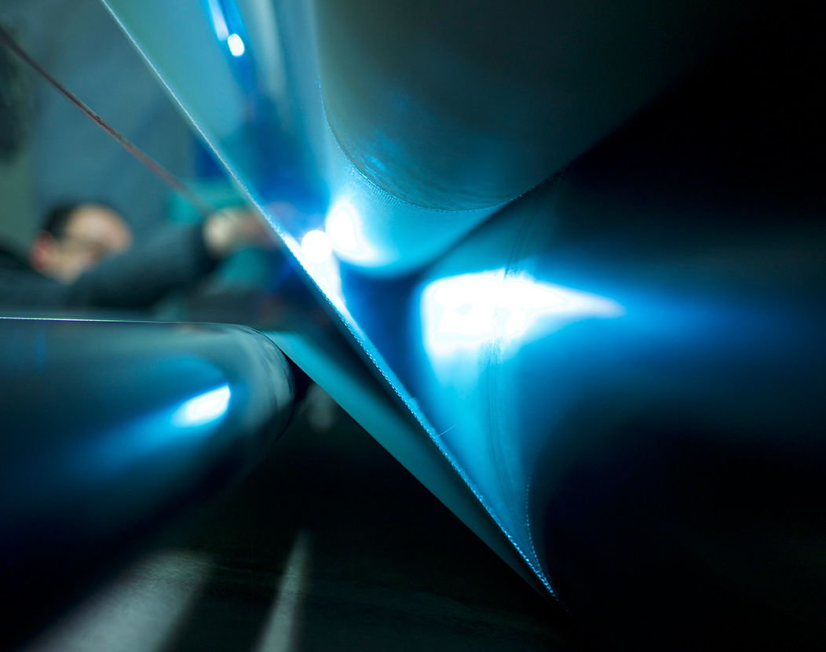
PACKAGING
Packaging inspection can become a learning system
The first question is not whether we can train computer vision. It is whether inspection data is connected.
Packaging AI project ladder
- Audit inspection data: images, labels, timestamps, roll IDs, operator decisions
- Standardize defect taxonomy and severity
- Build defect Pareto and roll quality passport
- Connect defect patterns to upstream process conditions
- Only then decide whether new computer vision models are worth deploying
Computer vision is phase 2. Data linkage is phase 1.
Darmstaedter + Klevers AI Transformation
12
Notes:
This slide protects against a common mistake. If there is already an inspection system, the fastest value may be defect mining, not training a new vision model. We should first understand exportability, labels, roll linkage, and operator decisions. That alone can create a valuable pilot.

Slide 13
KNOWLEDGE PLATFORM
A knowledge platform makes know-how reusable
The platform should answer with sources, not guesses.
Layer
Purpose
Source connectors
ERP, QC, lab, inspection, production, file shares, email exports
Document intelligence
OCR, table extraction, metadata, duplicate handling
Knowledge graph
Products, materials, processes, tests, defects, certificates, customers
RAG search
Source-cited answers across approved documents
AI applications
R&D copilot, quality copilot, sales assistant, operator support
Governance rule: no source, no answer.
Darmstaedter + Klevers AI Transformation
13
Notes:
Emphasize safety and trust. A knowledge platform is not just a chatbot. It needs connectors, document processing, a knowledge graph, retrieval, and governance. The key rule is no source, no answer. This is especially important for certificates, standards, and technical claims.

Slide 14
ROADMAP
The roadmap compounds value in staged decisions
Each phase earns the right to expand.
0-3 months
Pilot charter, data discovery, quality dashboard, knowledge assistant
3-6 months
Roll passport, defect mining, root-cause analytics, first prediction baseline
6-12 months
Data spine across lines, lab notebook, supplier docs, complaint assistant
1-3 years
Predictive quality, R&D formulation assistant, scheduling and quote intelligence
3-5 years
Industrial AI platform, digital twins, patentable materials/process intelligence
Darmstaedter + Klevers AI Transformation
14
Notes:
Show the sequence as a set of gates. We do not ask for five years of budget now. We ask for the first 12 weeks, then use the results to decide the next phase. This makes the transformation credible and controllable.

Slide 15
PRIORITIZATION
The highest-ranked projects create shared data assets
Prioritization balances ROI, time to value, risk, visibility, and knowledge creation.
Rank
Project
Score
Recommendation
1
Coating/Packaging Quality Intelligence
4.7
Start immediately
2
Roll-level quality passport
4.6
Build in pilot
3
R&D knowledge graph
4.5
Start in parallel
4
Complaint/root-cause assistant
4.3
Quick win
5
Certificate/TDS assistant
4.1
Guardrailed quick win
6
Predictive quality model
3.9
After data linkage
Darmstaedter + Klevers AI Transformation
15
Notes:
Use this slide to prevent idea overload. There are many possible AI projects, but the top projects all create shared data assets. That is the logic: build things that help several departments, rather than one-off demos.

Slide 16
FINANCIAL LOGIC
Build the financial case from company baselines
The pilot must quantify the value of reducing quality losses and decision time.
Baseline inputs to collect
Pilot ROI equation
- Annual scrap and rework cost in target family
- Defects per roll or per 1,000 meters
- Customer complaint cost and response time
- Quality release and certificate preparation time
- Downtime or delay from repeated quality issues
Value = avoided scrap + avoided rework + faster root cause + faster release + fewer repeated complaints
The pilot does not need perfect prediction. It needs enough evidence to identify controllable loss drivers.
Darmstaedter + Klevers AI Transformation
16
Notes:
Avoid fake precision. Say that we should not invent savings before seeing internal baselines. The pilot's job is to calculate the real value pool. The financial equation is simple: scrap, rework, root-cause time, release time, and complaints.

Slide 17
FUNDING
Funding should accelerate scale, not delay the pilot
Use the pilot evidence to improve grant quality.
Route
Best use
Fit
ZIM
R&D-heavy AI/materials cooperation projects
High
Forschungszulage
Technical uncertainty in formulation or predictive quality R&D
High
NRW MID-Digitalisierung
Marketable digital product using AI/ML, not internal-only process digitization
Selective
NRW MID-Assistent(in)
Hiring a graduate AI/data engineer for innovation work
Strong
BAFA EEW
Energy/resource efficiency, sensorics, management software, optimization
Conditional
Eurostars/Horizon
International R&D consortia and advanced materials/manufacturing
Later
Strategy: start internally, then fund the R&D and scale-up phases.
Darmstaedter + Klevers AI Transformation
Sources: ZIM, BSFZ, NRW.BANK MID, BAFA EEW, Eurostars, Horizon Europe
17
Notes:
The key message is that funding is a lever, not a precondition. A small internal pilot creates evidence and makes funding applications stronger. Also clarify that NRW MID-Digitalisierung changed in 2026 and is mainly for marketable digital products, so we should not rely on it for a purely internal process pilot.

Slide 18
RISK CONTROLS
Risk is manageable if the first phase stays controlled
The biggest risks are not model accuracy. They are data linkage, trust, and governance.
Data linkage fails
Hallucinated technical answer
IP leakage
Start with roll passport and data audit
No source, no answer; human approval
Private/approved tools; access control
Employee resistance
Cybersecurity
Overpromising
No surveillance framing; involve operators
Read-only connectors; audit logs
12-week pilot gates and baseline KPIs
Darmstaedter + Klevers AI Transformation
18
Notes:
This slide should make management more comfortable. We are not hiding risks. We are designing the pilot to control them. The most important controls are read-only access, source-cited answers, human approval, and no machine control in phase 1.

Slide 19
OPERATING MODEL
The operating model needs a champion and owners
AI transformation fails when it sits only in IT or only in one enthusiastic department.
Executive sponsor
Removes barriers and approves value gates
AI champion
Owns pilot narrative, roadmap, and cross-functional momentum
IT owner
Secures data access and architecture
Quality owner
Defines defects, release, CAPA, and validation
Production owner
Defines process reality and operator adoption
R&D owner
Connects experiment knowledge and formulation learning
Finance owner
Validates baseline and ROI
Darmstaedter + Klevers AI Transformation
19
Notes:
This is where you can position yourself without making the presentation self-centered. The company needs an AI champion who translates between business, R&D, quality, production, and IT. The champion does not replace functional owners. They coordinate the transformation and keep it measurable.

Slide 20
IMPLEMENTATION
The next 30 days create the pilot charter
Fast discovery prevents months of abstract debate.
Week 1
Week 2
Weeks 3-5
Weeks 6-9
Weeks 10-12
Sponsor, owners, pilot family, access rules
Data inventory, exports, quality baseline design
Roll linkage, defect taxonomy, first dashboard
Root-cause analytics, expert review, data gaps
Management demo, ROI case, scale decision
First meeting outcome: permission to inspect data, not permission to build a platform.
Darmstaedter + Klevers AI Transformation
20
Notes:
Use this to close the practical plan. The first month is about data reality. We should not promise a model before we know identifiers, exports, labels, and baselines. The first management commitment is access and ownership.

Slide 21
SUCCESS METRICS
Success metrics prevent AI theater
Every metric should be observable within the pilot scope.
Metric
Pilot target
Data linkage
Target rolls linked across order, inspection, QC/lab, and process evidence
Defect insight
Top 5 defect drivers ranked by cost or frequency
Root-cause speed
Time to first root-cause hypothesis reduced vs current workflow
Quality opportunity
Scrap/rework/complaint value pool quantified
Adoption
Production, quality, R&D, IT, and finance agree on scale/no-scale decision
Safety
No uncontrolled data movement, no source-free technical recommendations
Darmstaedter + Klevers AI Transformation
21
Notes:
This slide is a guardrail. We define success in operational terms: linkage, defect insight, speed, quantified value, adoption, and safety. Even if the first predictive model is basic, the pilot can be successful if it builds the data spine and identifies controllable losses.

Slide 22

DECISION
Approve the pilot and create the AI learning loop
A small approved start is the fastest path to a serious AI transformation.
Board decision requested
- Approve 12-week read-only pilot
- Assign sponsor and cross-functional owners
- Authorize controlled data discovery
- Review results and scale decision after pilot
- Use results for funding and long-term AI platform case
AI is no longer optional. The question is whether we learn first, or wait until competitors do.
Darmstaedter + Klevers AI Transformation
Image source: Klevers public media library
22
Notes:
Close calmly and decisively. Ask for the pilot approval, not a vague endorsement. The final sentence should land as a strategic point: the risk is not starting small; the risk is waiting until the company's knowledge advantage remains locked in documents and individual memories while competitors learn faster.

Slide 23
APPENDIX
Key public sources used for this board deck
The detailed strategy report contains the full source-backed opportunity map.
- Darmstaedter: Unternehmen, Beschichtungen, Entwicklung, Qualitaet, public media library
- Klevers: Unternehmen, Lieferprogramm, Garne und Zwirne, Glas Hochtemperatur, Beschichtungen, Qualitaet, Projekte
- Funding: ZIM, Bescheinigungsstelle Forschungszulage, NRW.BANK MID, BAFA EEW, Eurostars, Horizon Europe, EIC Accelerator
- Internal assumptions to verify: ERP/INTEX, inspection/ELSIS, PLC/HMI exports, roll/order linkage, defect label quality
Use the companion Markdown report as the detailed leave-behind after the presentation.
Darmstaedter + Klevers AI Transformation
23
Notes:
This is an appendix slide. You do not need to present it unless asked about evidence. It shows that the deck was built from public company sources and current funding sources, while clearly separating internal assumptions that need verification.

