Slide 1
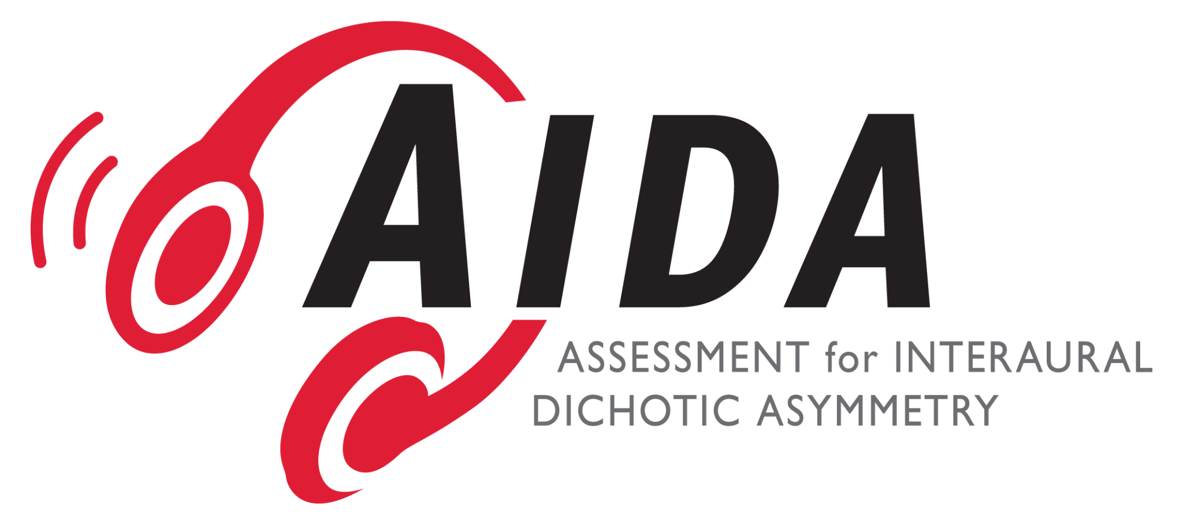
EARSLOBO
Sprint 2 Demonstration.

Slide 2
What is our project?
We’ve been tasked by our client, Deborah Moncrieff, to remake her AIDA software that helps identify hearing troubles in kids into a web application. We have also been aid in troubleshooting problems with the current software as consumers still use it.

Slide 3
SPRINT 2 GOALS
FIX LICENSING ISSUE
In renewing the ownership for her software some errors were made, and those who recently purchased the old software had invalid keys
MOCK-UP OF WHAT WE PLAN THE WEB APP TO LOOK LIKE
Create some in-depth wireframes for what we plan the application to look like based off of demo videos (as we did not have access to the software given the previously mentioned licensing issue)
Perform some user tests to get a reaction for how we have the new software designed.
FOUNDATION OF WEB APP
When the needed data was given, we would like to begin some production on the actual development of the web app.

Slide 4
DIVISION OF WORK
Lonnie Easterling - Production of wireframes and user tests
Shazeb Kazmi - Main communication with Deborah and Setting up Github/Rails environment
Wilson McGill - Troubleshooting Licensing issue as well as additional Rails development

Slide 5
SOME PROBLEMS FACED
Sectigo customer service response
Sectigo was the company that handled the liscensing renewal for the original software, and communication with them as well as the original developer proved some trouble
Creating wireframes through demo video
Because we could not access the software yet we had to base our wireframes off of demo videos
User testing outside of just our client
We needed to find people who would use the software that wasn’t our client herself
Rails environment communication
Troubleshooting the rails environment set up

Slide 6
PLAN FOR SPRINT 3
Conduct more user testing
Translate our full wireframes into the Rails environment
Implement the complete testing procedure (with audio and corresponding words)

