Slide 1
Safety-Jacket Follower Robot
YOLOv8 detector, ROS 2, Gazebo and a Hiwonder MasterPi robot
Course: Intelligent Systems and Robotics, Final Project
Student 1: Jamugisa Peter Paul (Reg. No. S25M25/008)
Student 2: Ayebare Moses (Reg. No. S25M25/003)
Programme: MSc Computer Science
Date: 30 October 2026
Fri 30th Oct 2026
Notes:
PETER: Good morning. We are Jamugisa Peter Paul and Moses. Our project is a robot that finds the person wearing a safety jacket and follows them, keeping a safe gap and speeding up when they speed up. I built and fine-tuned the jacket detector and deployed the system on the real Hiwonder MasterPi robot; Moses built the ROS 2 system and the Gazebo simulation. We will cover the problem, data, detector, ROS 2 design, simulation results, the real robot, the challenges we met, and what comes next.

Slide 2
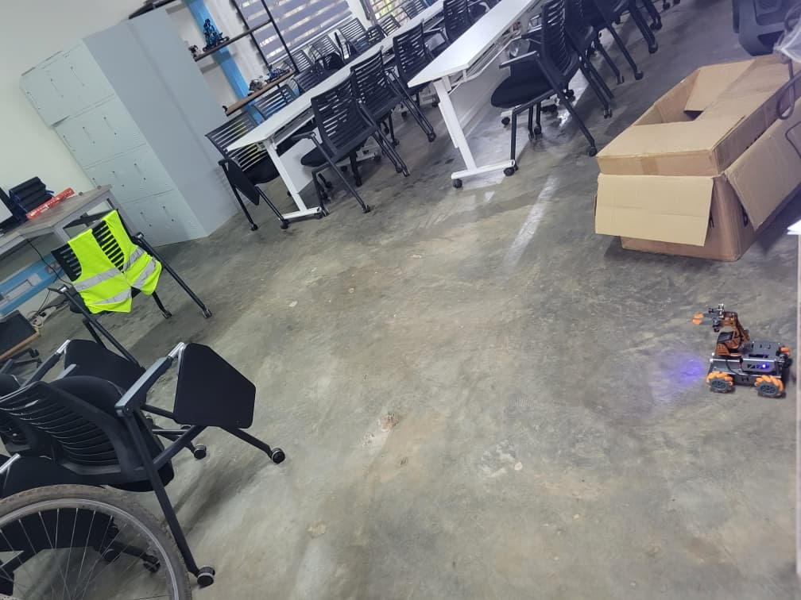
The problem: follow the worker in the jacket
Goal: the MasterPi robot finds the person wearing a hi-vis safety jacket and follows them
Speed matching: keeps a ~1.5 m gap and speeds up when the person speeds up
Search: turns to look for the jacket when it is lost; people without jackets are ignored
Safety first: stops if the camera feed stalls, an obstacle is too close, or the detection is uncertain
Target object: one class, safety_jacket (hi-vis vest with reflective bands)
Our Hiwonder MasterPi (Raspberry Pi 4B) in the lab
Arm camera
YOLOv8n jacket detector
Follower state machine
Speed + turn command
Mecanum wheels
Notes:
PETER: On a site, a robot that carries tools could follow the worker who is wearing the hi-vis jacket and ignore everyone else. Our target object is one class: the safety jacket. The robot must find it, keep about 1.5 metres behind, speed up when the person speeds up, search when it loses them, and always fail safe. The pipeline at the bottom is the whole system in one line.

Slide 3
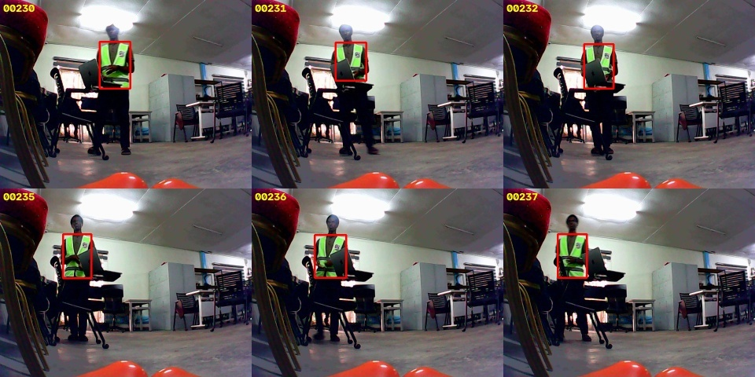
Dataset: robot frames, public vests, negatives
3,140
328
training images in total
(+115 for validation)
robot-camera frames,
auto-labelled + human-checked
1,500
700
Robot-camera frames with checked jacket labels (red boxes)
public vest photos,
human-labelled (CC BY 4.0)
people WITHOUT vests:
negatives against false alarms
Independent test set | Images
Robot camera, held-out time block | 99
Public set A (HB1204) | 242
Public set B (Vincent) | 208
Also: 284 original phone photos. One merged class, 320 px input.
Notes:
PETER: The original model had only 301 eye-level phone photos of one jacket, so it struggled on the robot's low camera. I recorded frames from the robot camera and labelled them automatically with Grounding DINO plus a hi-vis colour check, then checked them by hand. I added 1,500 human-labelled public vest photos and 700 photos of people without vests, so the model also learns what is NOT a jacket. Testing uses three sets the model never trained on, including a robot block split by time so neighbouring frames cannot leak between training and testing.

Slide 4
Detector: fine-tuning made it far more reliable
69% → 98%
robot-camera frames where
the jacket is found
0.82 → 0.93
mAP50 on the robot camera
22% → 15%
false alarms on people
without vests (set B)
YOLOv8n · 320 px · AdamW + cosine LR · early stop
(best epoch 56 of 76, 31 min on an RTX 4050)
Notes:
PETER: Here are the results on the three test sets. On the robot's own camera, mAP50 rose from 0.82 to 0.93 and the jacket is found in 98 percent of frames instead of 69. On public photos from other places it went from very poor to good, and false alarms on people without vests dropped from 22 to 15 percent. An important lesson: my first fine-tune used only robot frames and doubled the false alarms, which is why version 2 includes 700 negative images.

Slide 5
ROS 2: same nodes in Gazebo and on the robot
Camera source
detector_node
follower_node
Robot base
Gazebo camera, or
robot video bridge
YOLOv8n on GPU
15-20 ms per frame
state machine +
speed / turn control
Gazebo drive, or
real robot (UDP)
/camera/image_raw
/jacket/detections
/cmd_vel
front sonar /range_front
sim only: scenario + metrics nodes
Follower state machine
Distance: d = f · 0.45 m / box width (also from height and sonar; smallest wins)
Speed: v = 0.8 (d − 1.5) + 0.6 ḋ → faster when the person speeds up
Lock-on: 3 frames in a row, score ≥ 0.70; keep tracking down to 0.40
Fail-safe: no detector output for 1 s or sonar < 0.25 m → stop
SEARCH
CONFIRMING
FOLLOW
HOLD
TOO_CLOSE
E_STOP
stop states:
safety
Notes:
MOSES: Our ROS 2 Jazzy package has one node per job. The camera images come either from the Gazebo camera or, on the real robot, from a bridge node that reads the robot's video stream. The detector node runs YOLO on the GPU in 15 to 20 milliseconds and publishes detections. The follower node turns them into speed and turn commands with a state machine, and the commands go to Gazebo's mecanum drive or to the real robot. Because the detector and follower are identical in both worlds, what we test in simulation is what runs on the robot. The follower estimates distance from the box size, keeps 1.5 metres, and adds the rate of change of distance, which is what makes it speed up with the person.

Slide 6
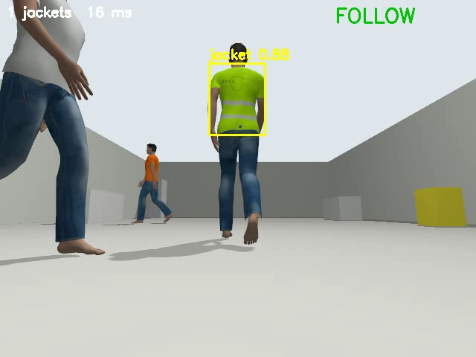
Gazebo: robot model, world and 3 scenarios
ROS 2 Jazzy + Gazebo Harmonic on Ubuntu 24.04 (WSL2)
MasterPi model: mecanum drive, arm camera 640×480 at 15 Hz, front sonar
20 × 10 m hall with desks; walking people moved by a scenario node
Ground truth from Gazebo odometry → CSV metrics for every run
S1 Normal
walk 4 m, two 90° turns, walk back
S2 Speed
0.15 → 0.35 → 0.60 m/s, stop, turn
Robot camera in scenario 3 (click to play)
S3 Challenge
view blocked, worker sprints out of sight, orange-shirt distractor
Notes:
MOSES: The simulation runs ROS 2 Jazzy with Gazebo Harmonic. I modelled the MasterPi with mecanum wheels, the arm camera and the front sonar, and built a 20 by 10 metre hall. The people are walking person models driven by a scenario node, and Gazebo's odometry gives us ground truth for every measurement. This clip is the robot's camera in the hardest scenario, with a white-shirt person crossing and an orange-shirt distractor. Scenario 1 is a normal walk with two turns, scenario 2 changes speed, and scenario 3 is the challenging one.

Slide 7
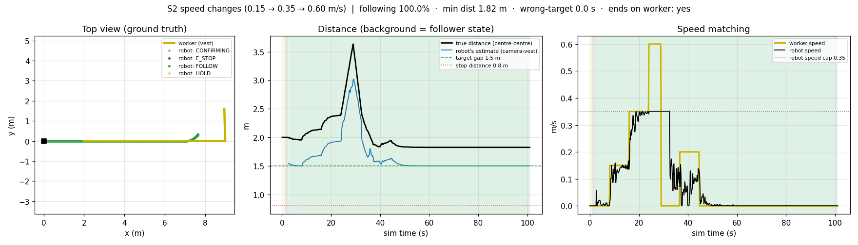
Simulation: it follows in all three scenarios
Scenario | Following | Wrong person | Closest | Ends on worker | Speed match (worker → robot)
S1 normal walk | 96% | 0 s | 1.17 m | yes | 0.30 → 0.19 m/s (incl. turns)
S2 speed changes | 100% | 0 s | 1.82 m | yes | 0.15→0.13, 0.35→0.32, 0.6→cap
S3 challenge | 70% | 0 s | 1.93 m | yes | searched 27 s, re-found the worker
S3, hysteresis off | 39% | 11 s | 1.95 m | NO | failure: followed orange shirt
Why lock-on hysteresis?
The detector scores an orange shirt ~0.55. Without the 0.70 lock-on rule the robot followed the wrong person for 11 s; with it, 0 s.
S2 ground truth: top view, true vs estimated distance, worker vs robot speed
Notes:
MOSES: These numbers come from Gazebo ground truth. The robot followed 96 to 100 percent of the time in the first two scenarios and never got closer than 1.17 metres, against a stop distance of 0.8. In scenario 2 it matches 0.15 and 0.35 metres per second and caps at its 0.35 limit when the worker runs at 0.6. In scenario 3 it searched for 27 seconds while the worker was hidden, ignored the orange shirt and found the worker again. When we switched off the lock-on hysteresis, the robot followed the orange shirt for 11 seconds: that is our failure case and the reason for the design.

Slide 8
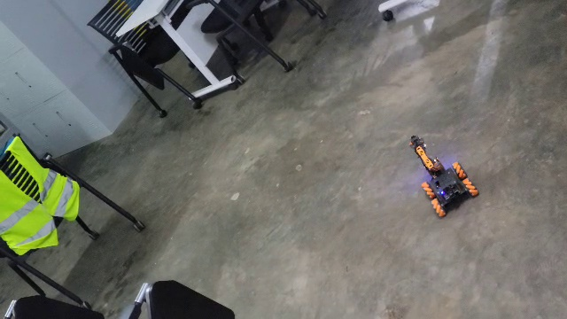
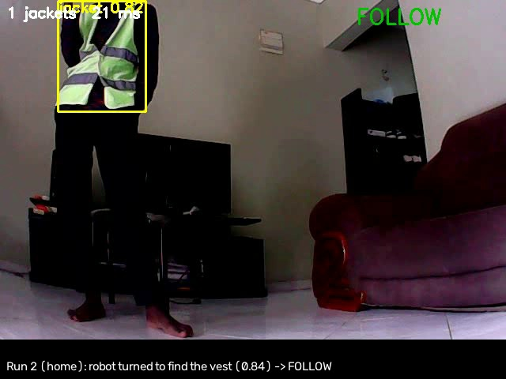
Real robot: deployed, detects and locks on
Robot: camera + motor server, 0.5 s stop watchdog Laptop: ROS 2 bridge + the same detector and follower
Phone view: robot drives towards the jacket (click to play)
Robot view: jacket found (0.70-0.85) → FOLLOW, three runs
8.5 fps
15-20 ms
10 ms
0.70-0.85
camera (standing)
detection, RTX 4050
command round trip
jacket score on robot
Notes:
PETER: I deployed the same detector and follower on the real MasterPi. The robot runs a small server that streams the camera and receives motor commands, with its own half-second stop if commands stop; a bridge node on the laptop connects it to ROS 2. On the left, a phone video of the robot in the lab turning and moving towards the jacket on the chair. On the right, the robot's own view: it finds the jacket, scores 0.70 to 0.85, and switches to FOLLOW. Standing still, the camera runs at 8.5 frames per second, detection takes 15 to 20 milliseconds and commands round-trip in 10 milliseconds.

Slide 9
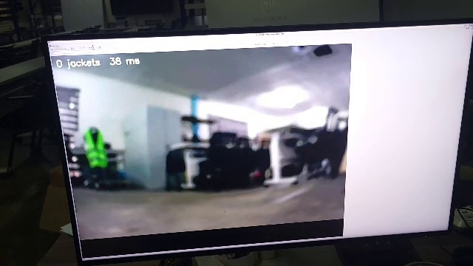
Real-robot challenges and our fixes
Battery brown-outs
Runaway after a reboot
8.0 → 6.2 V under load; the Pi rebooted mid-run
motor board kept the last speed; robot spun
Fix: volt-compensated motor power; slow arm moves
Fix: motors zeroed at every boot + 0.5 s watchdog
Blurry, dim camera
Frame rate drops while driving
Robot view while searching: jacket in view but too small and dim at 3 m
out of focus; 1.5 fps; jacket missed at 3 m
2-3 fps under motor load → late reactions
Fix: manual focus, MJPG mode (8.5 fps), camera tilt
Fix: 2 s watchdog, stop-and-look search, gentler turns
Lesson
Simulation proved the logic; the real robot is limited by power, light and motors. Fresh batteries come first.
Motor dead zone
Wi-Fi drops
no motion below ~30 % power, then sudden spins
laptop silently left the robot's hotspot
Fix: start-power model + 60 % cap (caught a 100 % bug)
Fix: auto-reconnect; robot stops itself when commands stop
Notes:
PETER: The real robot taught us more than the simulation. The batteries sagged from 8 to about 6 volts under load and the Raspberry Pi rebooted mid-run; once, the motor board kept its last speed and the robot spun on the spot, so we added a service that zeroes the motors at every boot. The camera was out of focus and dim: 640 by 480 gave 1.5 frames per second until we switched it to MJPG mode, and while driving on a weak battery it still drops to 2 or 3. The motors do nothing below about 30 percent power and then jump, so small turns overshoot. On the right, the robot's view while searching: the jacket is visible but too small and dim at 3 metres to be detected. We are still working on these, starting with fresh batteries.

Slide 10
Contributions, conclusion, next steps
Jamugisa Peter Paul S25M25/008
Ayebare Moses S25M25/003
Detector: robot data, auto-labelling, fine-tuning v1/v2, evaluation
Physical robot: server, ROS 2 bridge, calibration, safety fixes, live tests
ROS 2 package: detector, follower, bridge and scenario nodes, launch files
Gazebo: MasterPi model, hall world, people, 3 scenarios, metrics
Conclusion
Next steps
Detector: mAP50 0.82 → 0.93 on the robot camera
Gazebo: follows in all 3 scenarios; lock-on rule prevents following the wrong person
Real robot: full pipeline deployed; detects and locks on to the jacket
Fresh batteries, then repeat the following test
Test set from a new place and light
Pan-servo tracking to keep the jacket in view
Questions?
Notes:
PETER and MOSES: To conclude: the fine-tuned detector is much more reliable on the robot's camera, the robot follows in all three Gazebo scenarios and the lock-on rule stops it following the wrong person, and the full system runs on the real robot, where it detects and locks onto the jacket. Steady real following is limited by the battery, the camera and the motors, and that is our next step. Thank you, we welcome your questions.

