Slide 1
GIT
Git is a popular version control system used to manage source code and other files in software development projects.
Git allows developers to track changes made to code over time, collaborate with others on the same codebase, and easily roll back changes if needed.
Git is widely used in software development, both in open source and commercial projects, and is supported by a large ecosystem of tools and services.

Slide 2
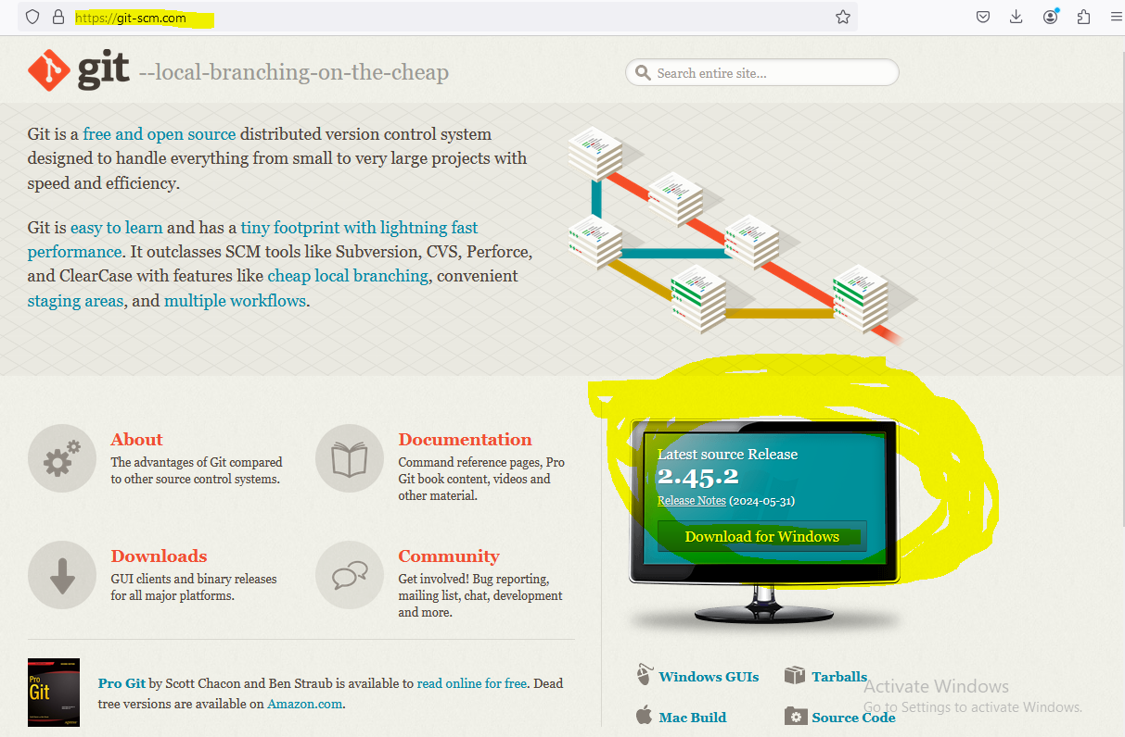
How to use git

Slide 3
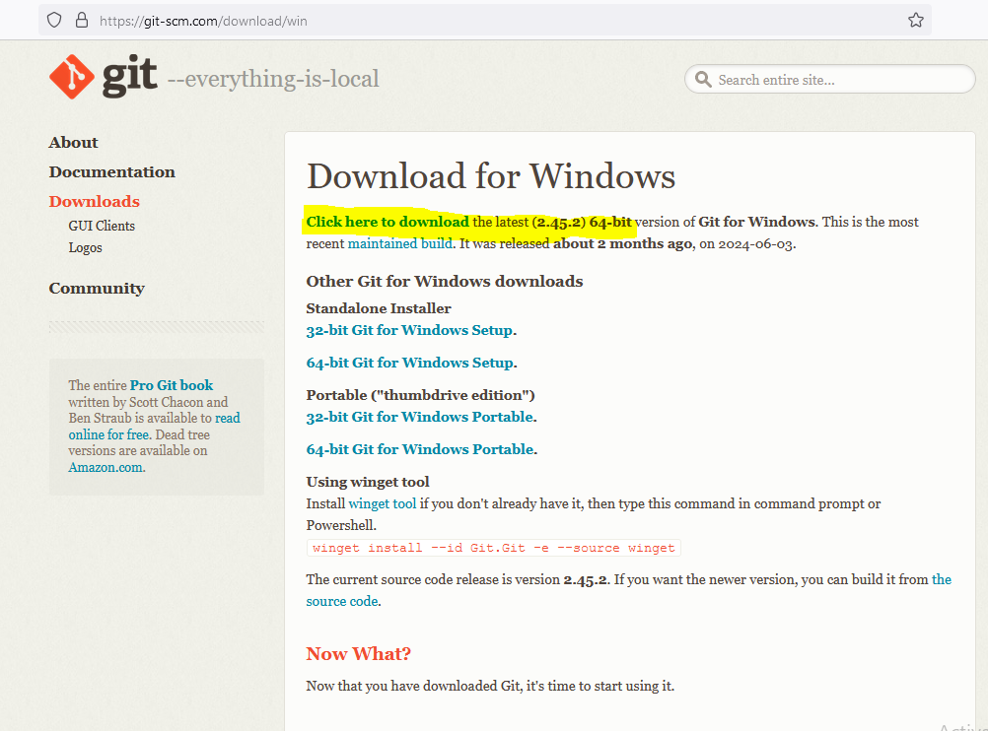

Slide 4
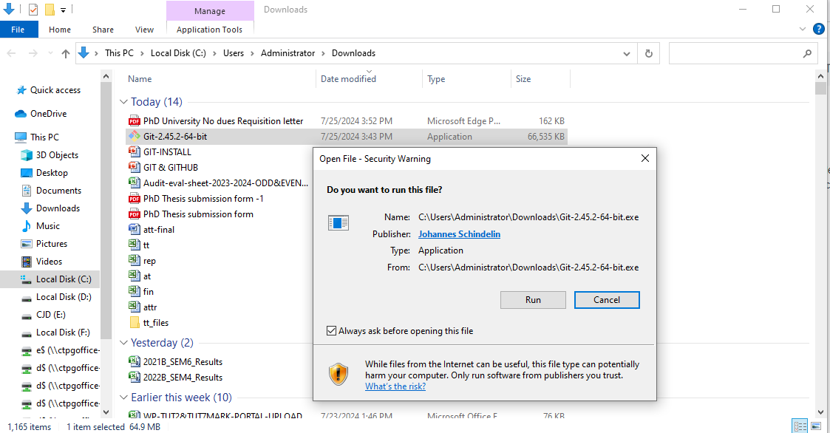

Slide 5
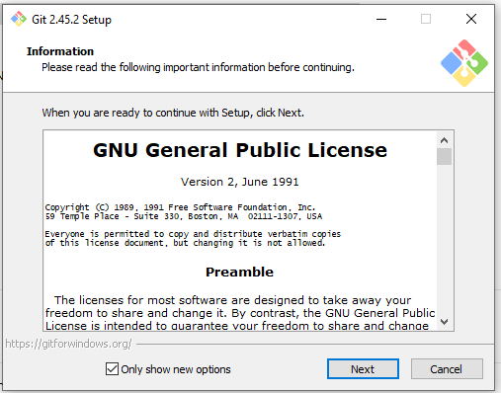
CHOOSE NEXT

Slide 6
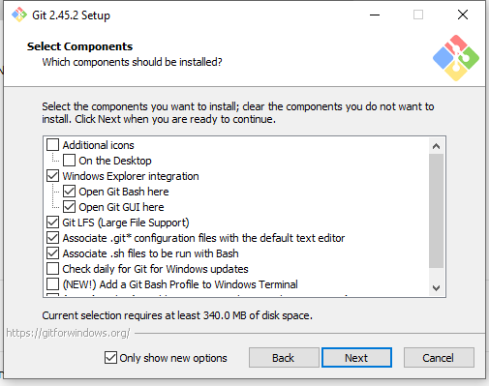
CHOOSE NEXT

Slide 7
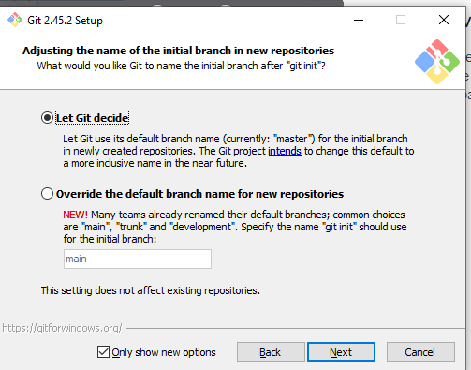
CHOOSE NEXT

Slide 8
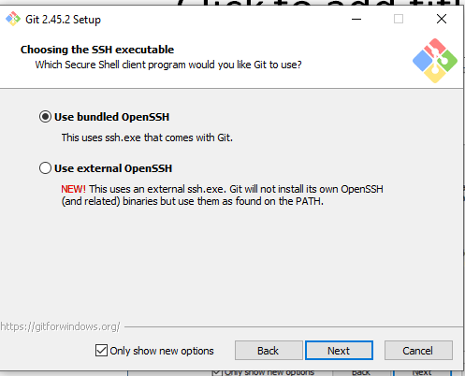
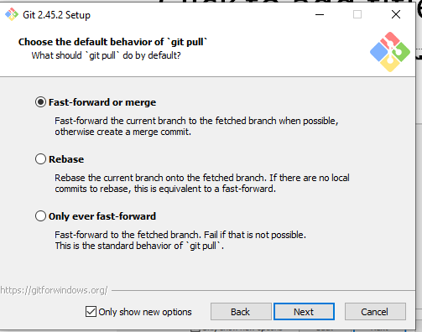
CHOOSE NEXT

Slide 9
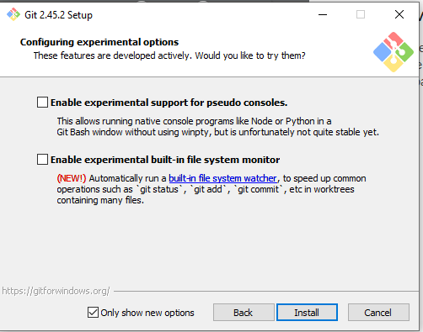
CLICK INSTALL

Slide 10
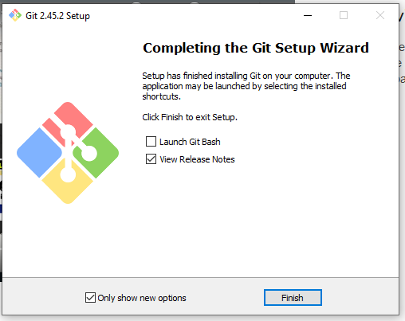
CLICK FINISH

Slide 11
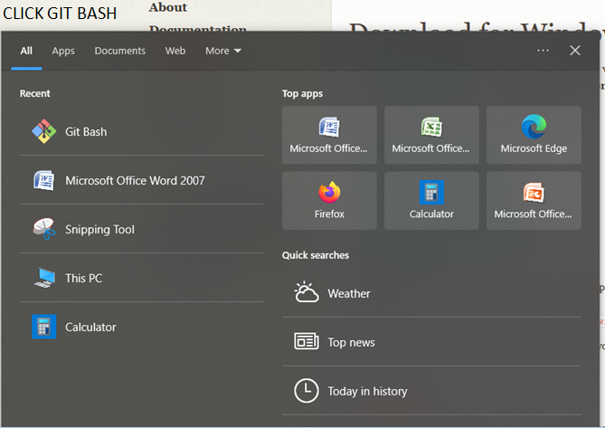
CLICK GIT BASH

Slide 12
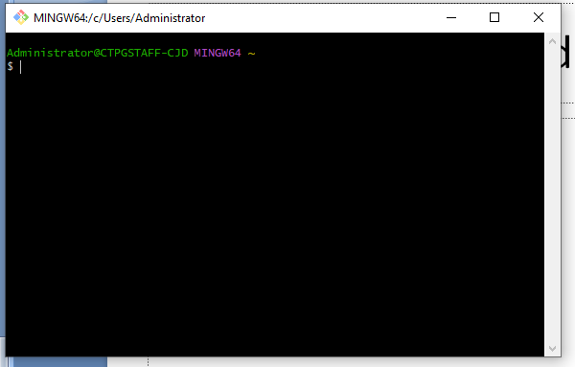
COMMAND PROMPT OPENED

Slide 13
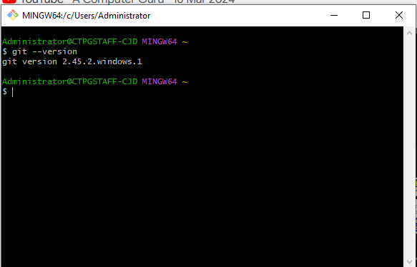
CHECK VERSION : git --version

Slide 14
GIT HUB
GitHub is a web-based platform that provides a collaborative environment for software development projects.
It is built around the Git version control system, which allows developers to track changes in their code over time and collaborate with other developers on the same codebase.
GitHub is widely used in the open-source software community, but it is also used by companies and organizations for their own internal software development projects.

Slide 15
GitHub provides features such as project management tools, issue tracking, code review, and collaboration tools, which make it easier for developers to work together on complex software projects.
It also serves as a platform for hosting code repositories, which can be shared with other developers around the world.
It has become an essential tool for modern software development, enabling developers to work more efficiently and collaboratively.

Slide 16
ADVANTAGES OF GITHUB
Community
Security
Code Review
Collaboration
Version Control

Slide 17
HOW TO USE GITHUB
Create an account: Visit GitHub's website and create a free account.
Create a repository
Upload your code
Collaborate

Slide 18

CLICK Sign up for GitHub

Slide 19
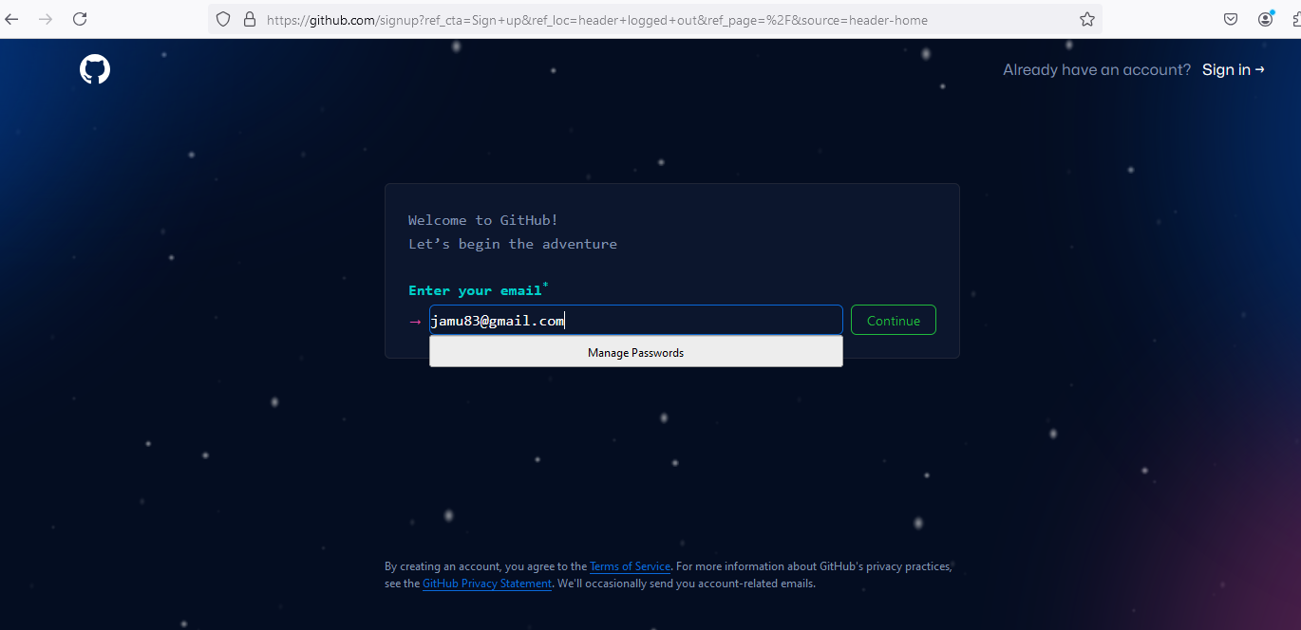
Enter your Email & Click Continue

Slide 20
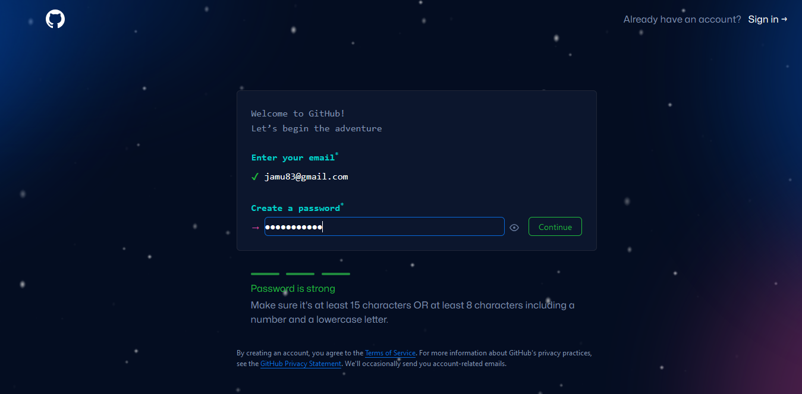
Create a Password : Make sure it's at least 15 characters OR at least 8 characters including a number and a lowercase letter.

Slide 21
CREATE USERNAME
Username may only contain alphanumeric characters or single hyphens, and cannot begin or end with a hyphen.

Slide 22
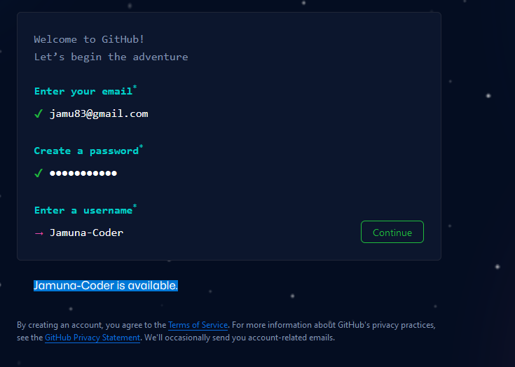
Create Username

Slide 23
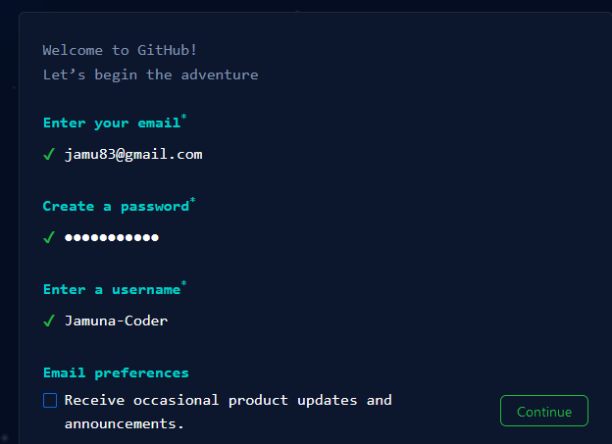
Click Continue

Slide 24
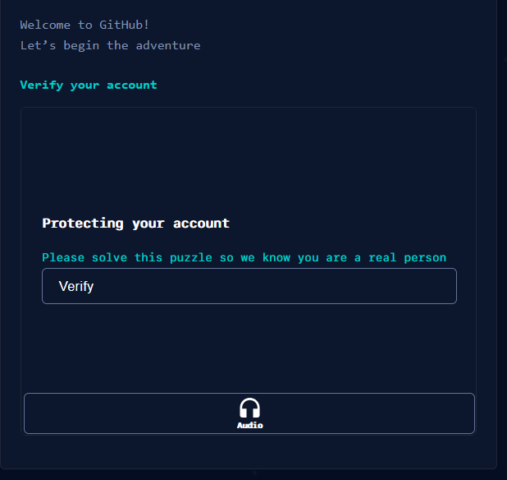
Click Verify

Slide 25
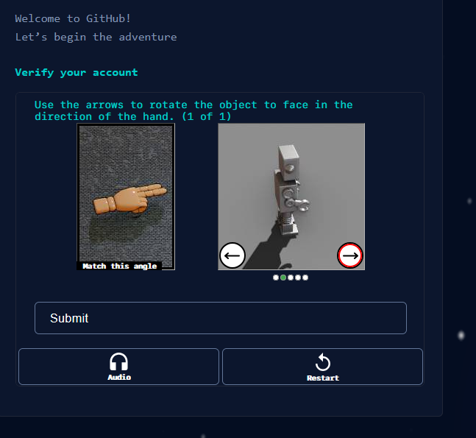
Solve Captcha

Slide 26
E-Mail Verification
GitHub launch code! Will be sent to your registered E-mail
Enter the code

Slide 27
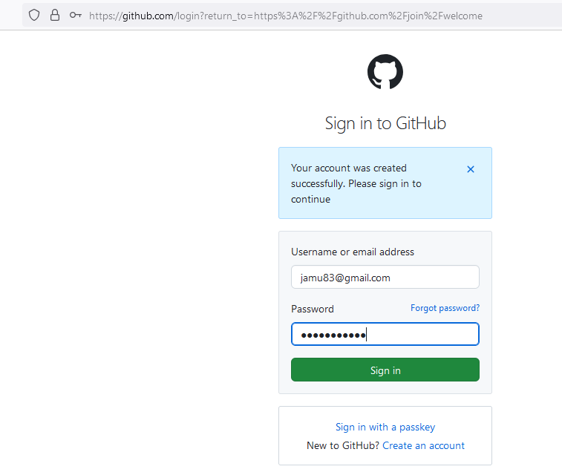
Login to your Github account

Slide 28
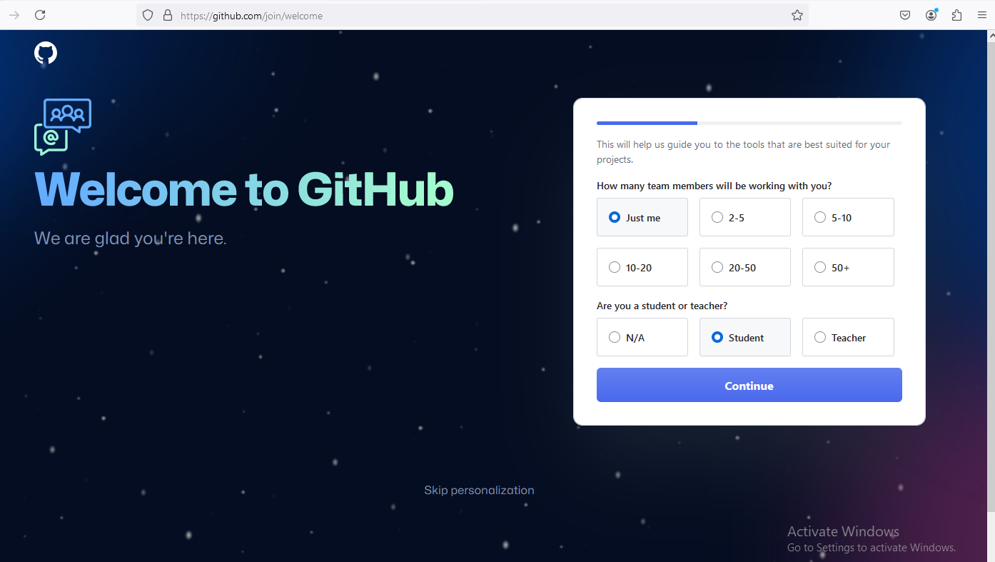
Click Just me & Student Option

Slide 29
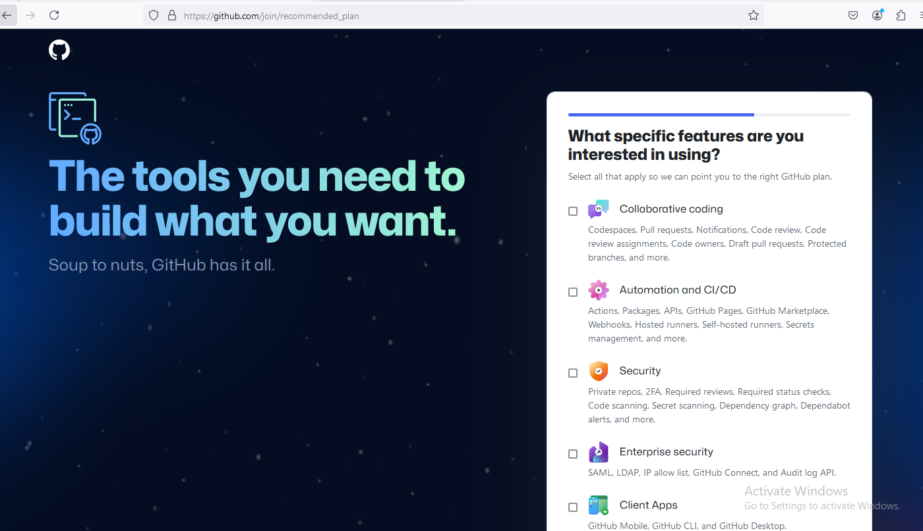
You can SKIP this page

Slide 30
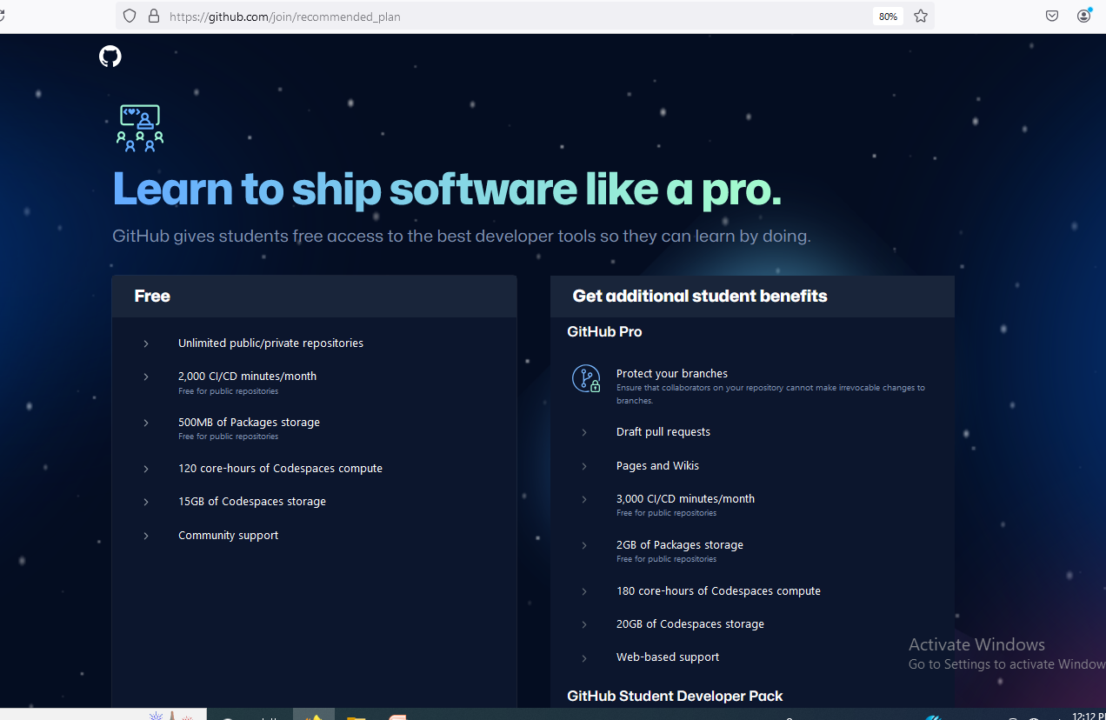
Two Pricing Plan : 1. Free 2. GitHub Pro

Slide 31

Click Continue for Free

Slide 32
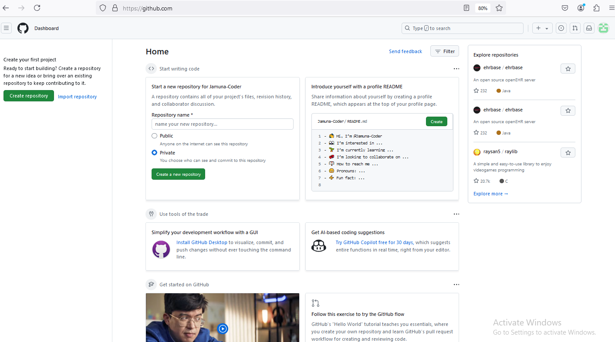
Home Page

Slide 33
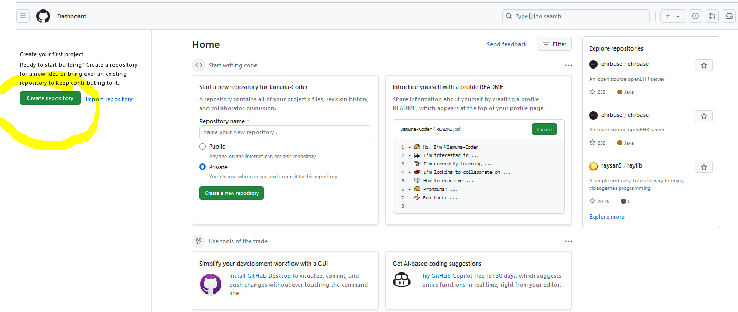
Choose Create Repository in Github

Slide 34
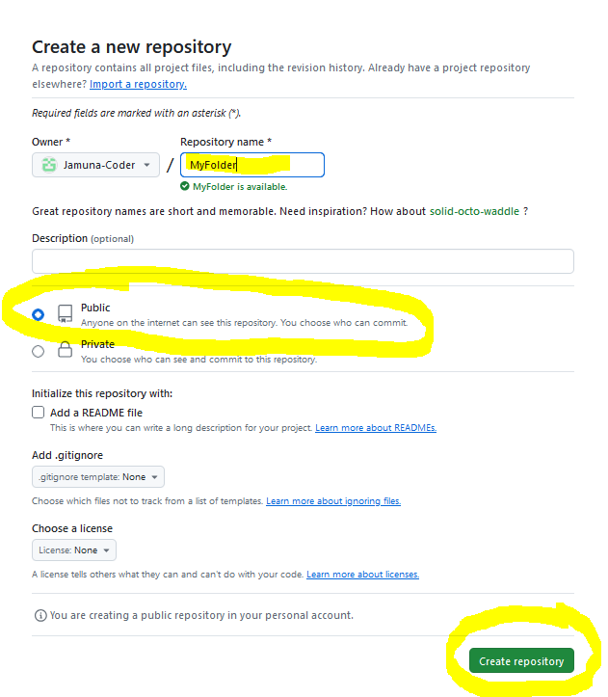
Create a new repository

Slide 35
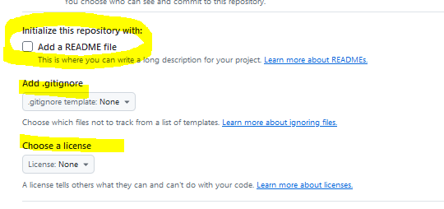
Other Options
Notes:
Add a README file : Don’t Click this , Information about project is shown here
Gitignore: File contains the names of Files and Folders that Git Wants to Omit while pushing the code( Example : if the code size is too big or helping folders- that’s need to be ignored can be included here)

Slide 36
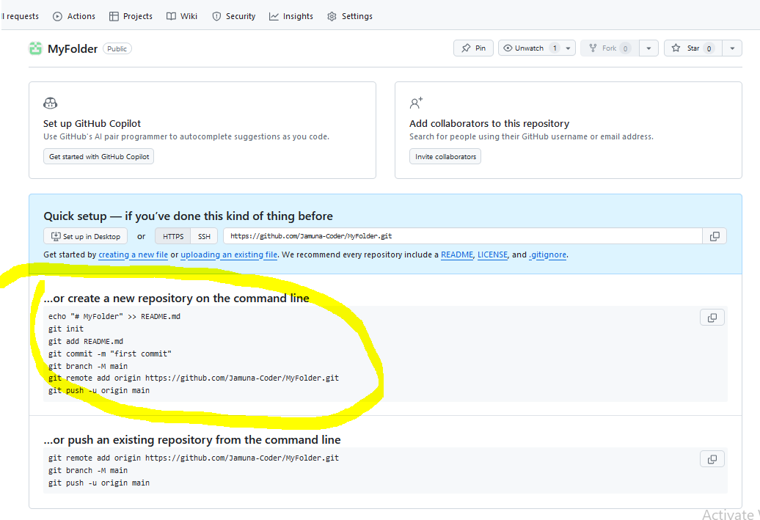
Commands to be executed In VisualStudio Code editor

