Slide 1

Study-Buddy Team – Brute Force
Members – Jamunaa Jayashree Selvaprabhu
Shubam Malankar
Manasa Gonuguntala
Shreethika Sivakumaran

Slide 2
Problem Statement
Finding study groups inside college is tough because many classes are online and remote. It is difficult to connect with people in same courses and similar interests, since we must use different platforms for each task. For example – We need to find the students in the same course from the student portal, then we should have meetings or chats in a different platform like Teams
We all face problems while studying if we didn't have proper guidance and path to study. Also, the problem is worse if we didn't have any contacts in the place of study. We have academic advisors to support us, but it is unnecessary to reach out to them in their busy schedule for minuscule doubts.
We are not able to connect with people of the same project ideas and interests.
For international students, introverts, though they are talented or interested in learning new things and experimenting. Every university have many resources and support, still students are not aware of everything.

Slide 3
Solution
A platform which will help you to connect with similar group of people and provide correct path to learn the courses.
The students at the same university will be registering in the application. We collect the user data like their project ideas and interests. When a user is trying to connect with friends, we will suggest the people with similar interests.
This platform also condenses data and resources from University websites and info groups. This platform also has alumni and existing student’s experiences blog

Slide 4
Features
Create user profiles
Create course groups
Join and participate in discussions
Student’s blogs and publications
Connect with people of similar interests
Visualizations of the alumni success path over the course
Open Q&A Forum
Announcements with notifications

Slide 5

Architecture
Study - Buddy
Web application
and
Mobile application
Data analysis and model
Python Services (Flask)
Students
DB - SQL

Slide 6
Technology Stack
Languages : Python , HTML5/CSS , Java Script, SQL
Frameworks : Flask and Angular
Database: sqlite
Libraries: Numpy, Pandas, Scikit learn, Matplotlib, sqlite3
Deployment: Azure
Mockups: Balsamiq

Slide 7
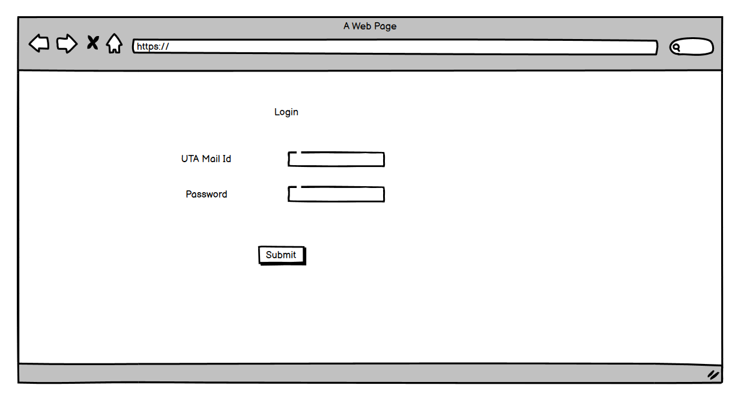
Mockups

Slide 8
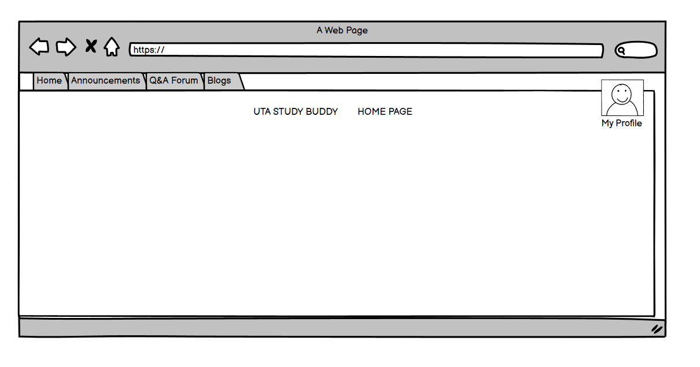

Slide 9
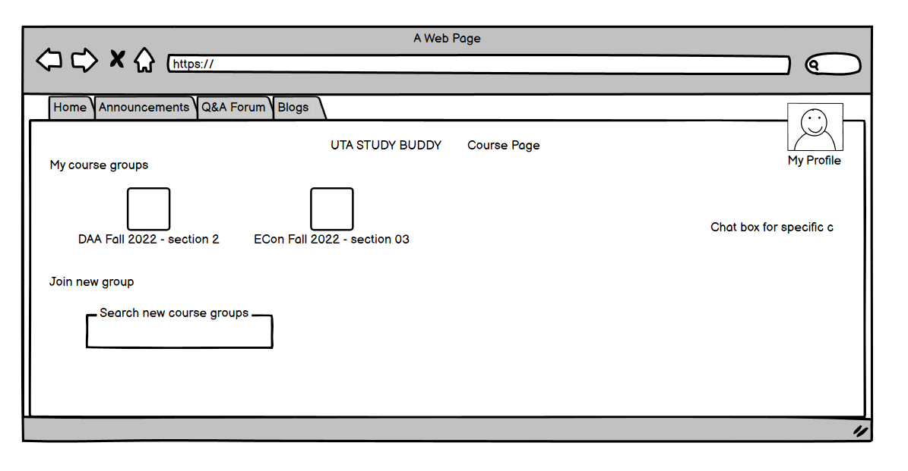

Slide 10

Thank you

