Slide 1

Predicting Stock-Values using Sentiment Analysis on Aggregated Social Media Data
Information Science – Bachelor Thesis
Jan Burger
Darmstadt 01.08.2022

Slide 2
Contents
1. Introduction
2. Research questions
3. State of the art & Related Work
4. Sentiment Analysis
5. Correlation Analysis
6. Predictive modeling
7. Conclusion
8. Future work

Slide 3
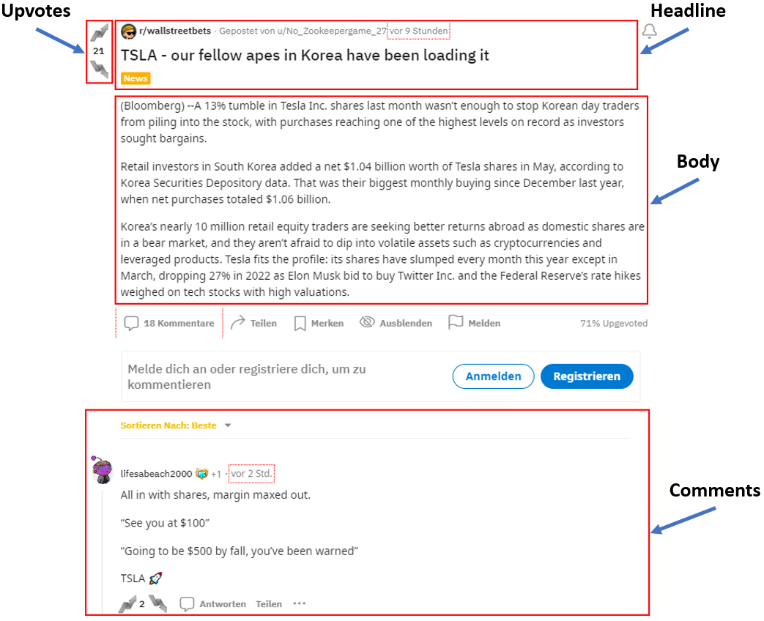
Introduction
Why stock value prediction?
Financial potential
Efficient market hypothesis
Random walk hypothesis
Why reddit?
r/wallstreetbets is one of the biggest stock discussion forums (12.4m users)
Significant factor in the short squeeze of GameStop in January 2021
Main research focus:
Sentiment Analysis
Correlation Analysis
Predictive modeling (stock return prediction)
Structure of a reddit post

Slide 4



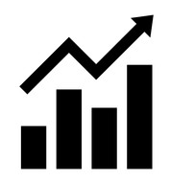

Introduction -Dataflow
Reddit
Timeframe: 01 May 2021 to 30 April 2022
Most discussed stocks during that timeframe: GME, AMC, SPY
Sentiment probabilities aggregated by day → Average sentiment probability for each day
Additional stock market data: volume, stock return, etc.
Stock return classification → positive or negative return for the upcoming day
Sentiment prediction
Positive: 0.7
Negative: 0.1
Neutral: 0.2
Stock market data
Stock market data
Stock return prediction
Positive return: 0.7
Negative return: 0.3

Slide 5
Contents
1. Introduction
2. Research questions
3. State of the art & Related Work
4. Sentiment Analysis
5. Correlation Analysis
6. Predictive modeling
7. Conclusion
8. Future work

Slide 6
Research questions
Sentiment Analysis
Correlation Analysis
Predictive modeling
”Is there a performance difference between none fine-tuned and fine-tuned pretrained Neural Network transformer models on the task of sentiment classification with posts from r/wallstreetbets? And if so, how large is the performance difference and is it statistically significant?”
“Is there a significant correlation between the sentiment of a given stock discussed on r/wallstreetbets and its returns?”
“What influence does the total number of posts about a given stock has on its returns?”
”To which extent can the sentiment of a given stock discussed on r/wallstreetbets predict its returns?”

Slide 7
Contents
1. Introduction
2. Research questions
3. State of the art & Related Work
4. Sentiment Analysis
5. Correlation Analysis
6. Predictive modeling
7. Conclusion
8. Future work

Slide 8
State of the art & Related Work
Results are difficult to comparable:
Different data sources (Twitter, News articles, etc.)
Different time frames for prediction
Different techniques → Predicting stock return for the upcoming day vs. the same day
Stock returns vs. Stock prices
Regression vs. Classification

Slide 9
Contents
1. Introduction
2. Research questions
3. State of the art & Related Work
4. Sentiment Analysis
5. Correlation Analysis
6. Predictive modeling
7. Conclusion
8. Future work

Slide 10
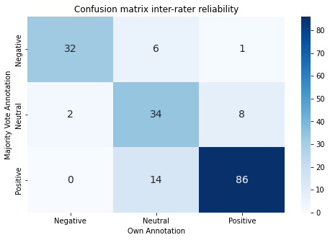
Annotation process
Positive expression | Negative expression
Call | Put
Long | Short
Buy | Sell
Bullish | Bearish
Diamond hands | Paper hands
DD (Double Down) | TDM
Hold
To the moon
1000 labeled reddit posts and comments
Labels depend on specific expressions about stocks
200 pre-labeled posts by 5 authors → Cohen`s Kappa score of 0.72 (substantial agreement)
Expressions on r/wallstreetbets
Inter-rater reliability confusion matrix
Positive | Neutral | Negative
386 | 316 | 298
Annotation results - Distribution of the classes

Slide 11
Experimental setup
Model | Base Model | Training dataset
finiteautomata/bertweet-base-sentiment-analysis | BERTweet, a RoBERTa model trained on English tweets | SemEval 2017 corpus (around 40k tweets)
ProsusAI/finbert | BERT | Financial corpus with news headlines
avichr/heBERT sentiment- analysis | BERT | A Hebrew version of OSCAR (Ortiz, 2019)
cardiffnlp/twitter-roberta- base-sentiment-latest | roBERTa-base | Trained on 124M tweets from January 2018 to December 2021
cardiffnlp/twitter-xlm- roberta-base-sentimen | XLM-roBERTa-base | Trained on 198M tweets and finetuned for sentiment analysis
5 most popular models on Huggingface
Should have 3 output classes
80% trainset, 20% testset
Lossfunction → BCEWithLogitsLoss
10 Epochs
Model saved after each epoch if new validation loss minimum is achieved → Overfitting has no effect on the final model
Overview of the selected models and their attributes

Slide 12
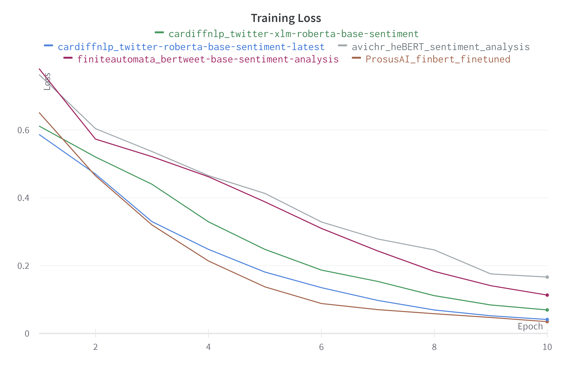
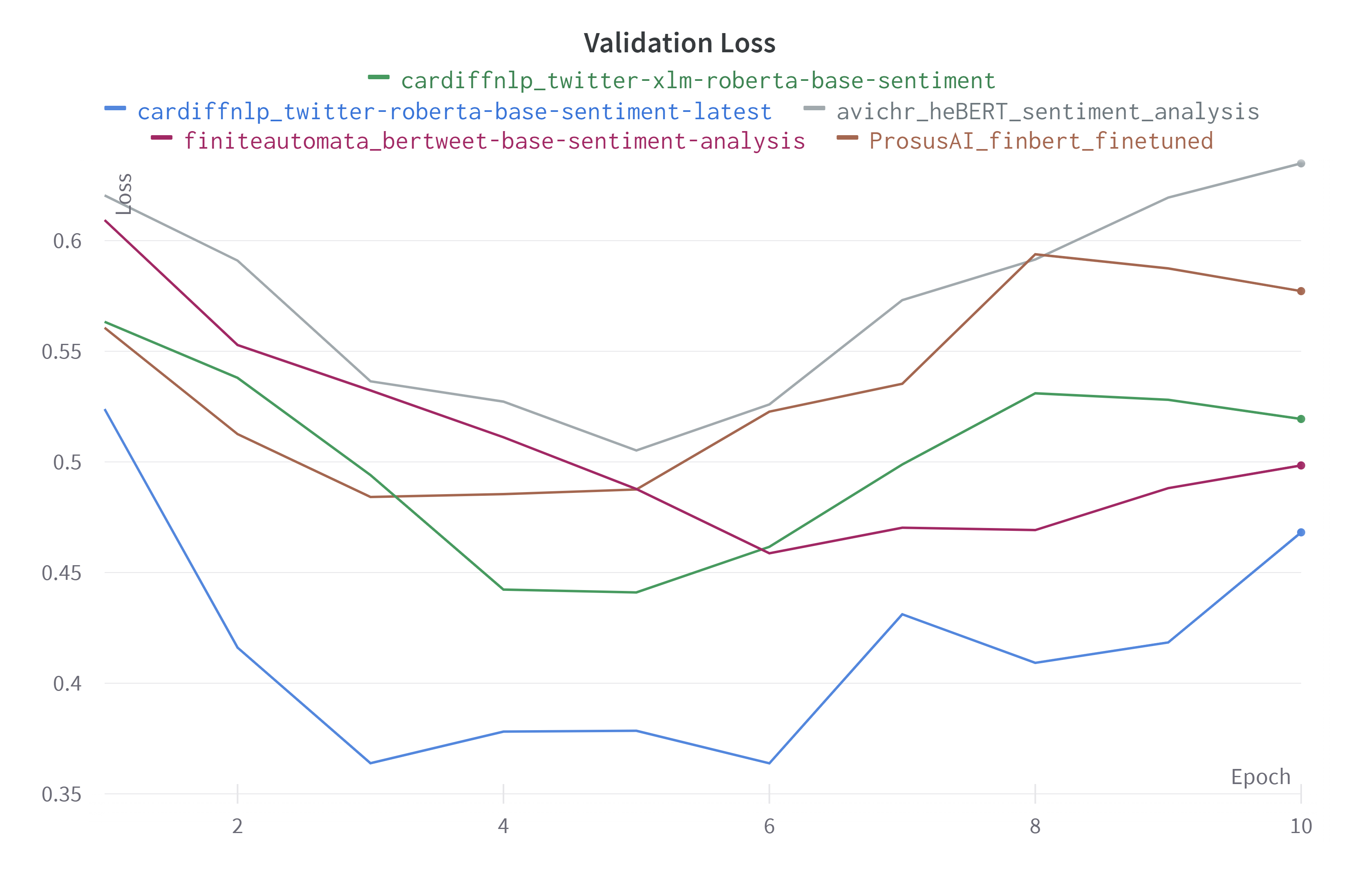
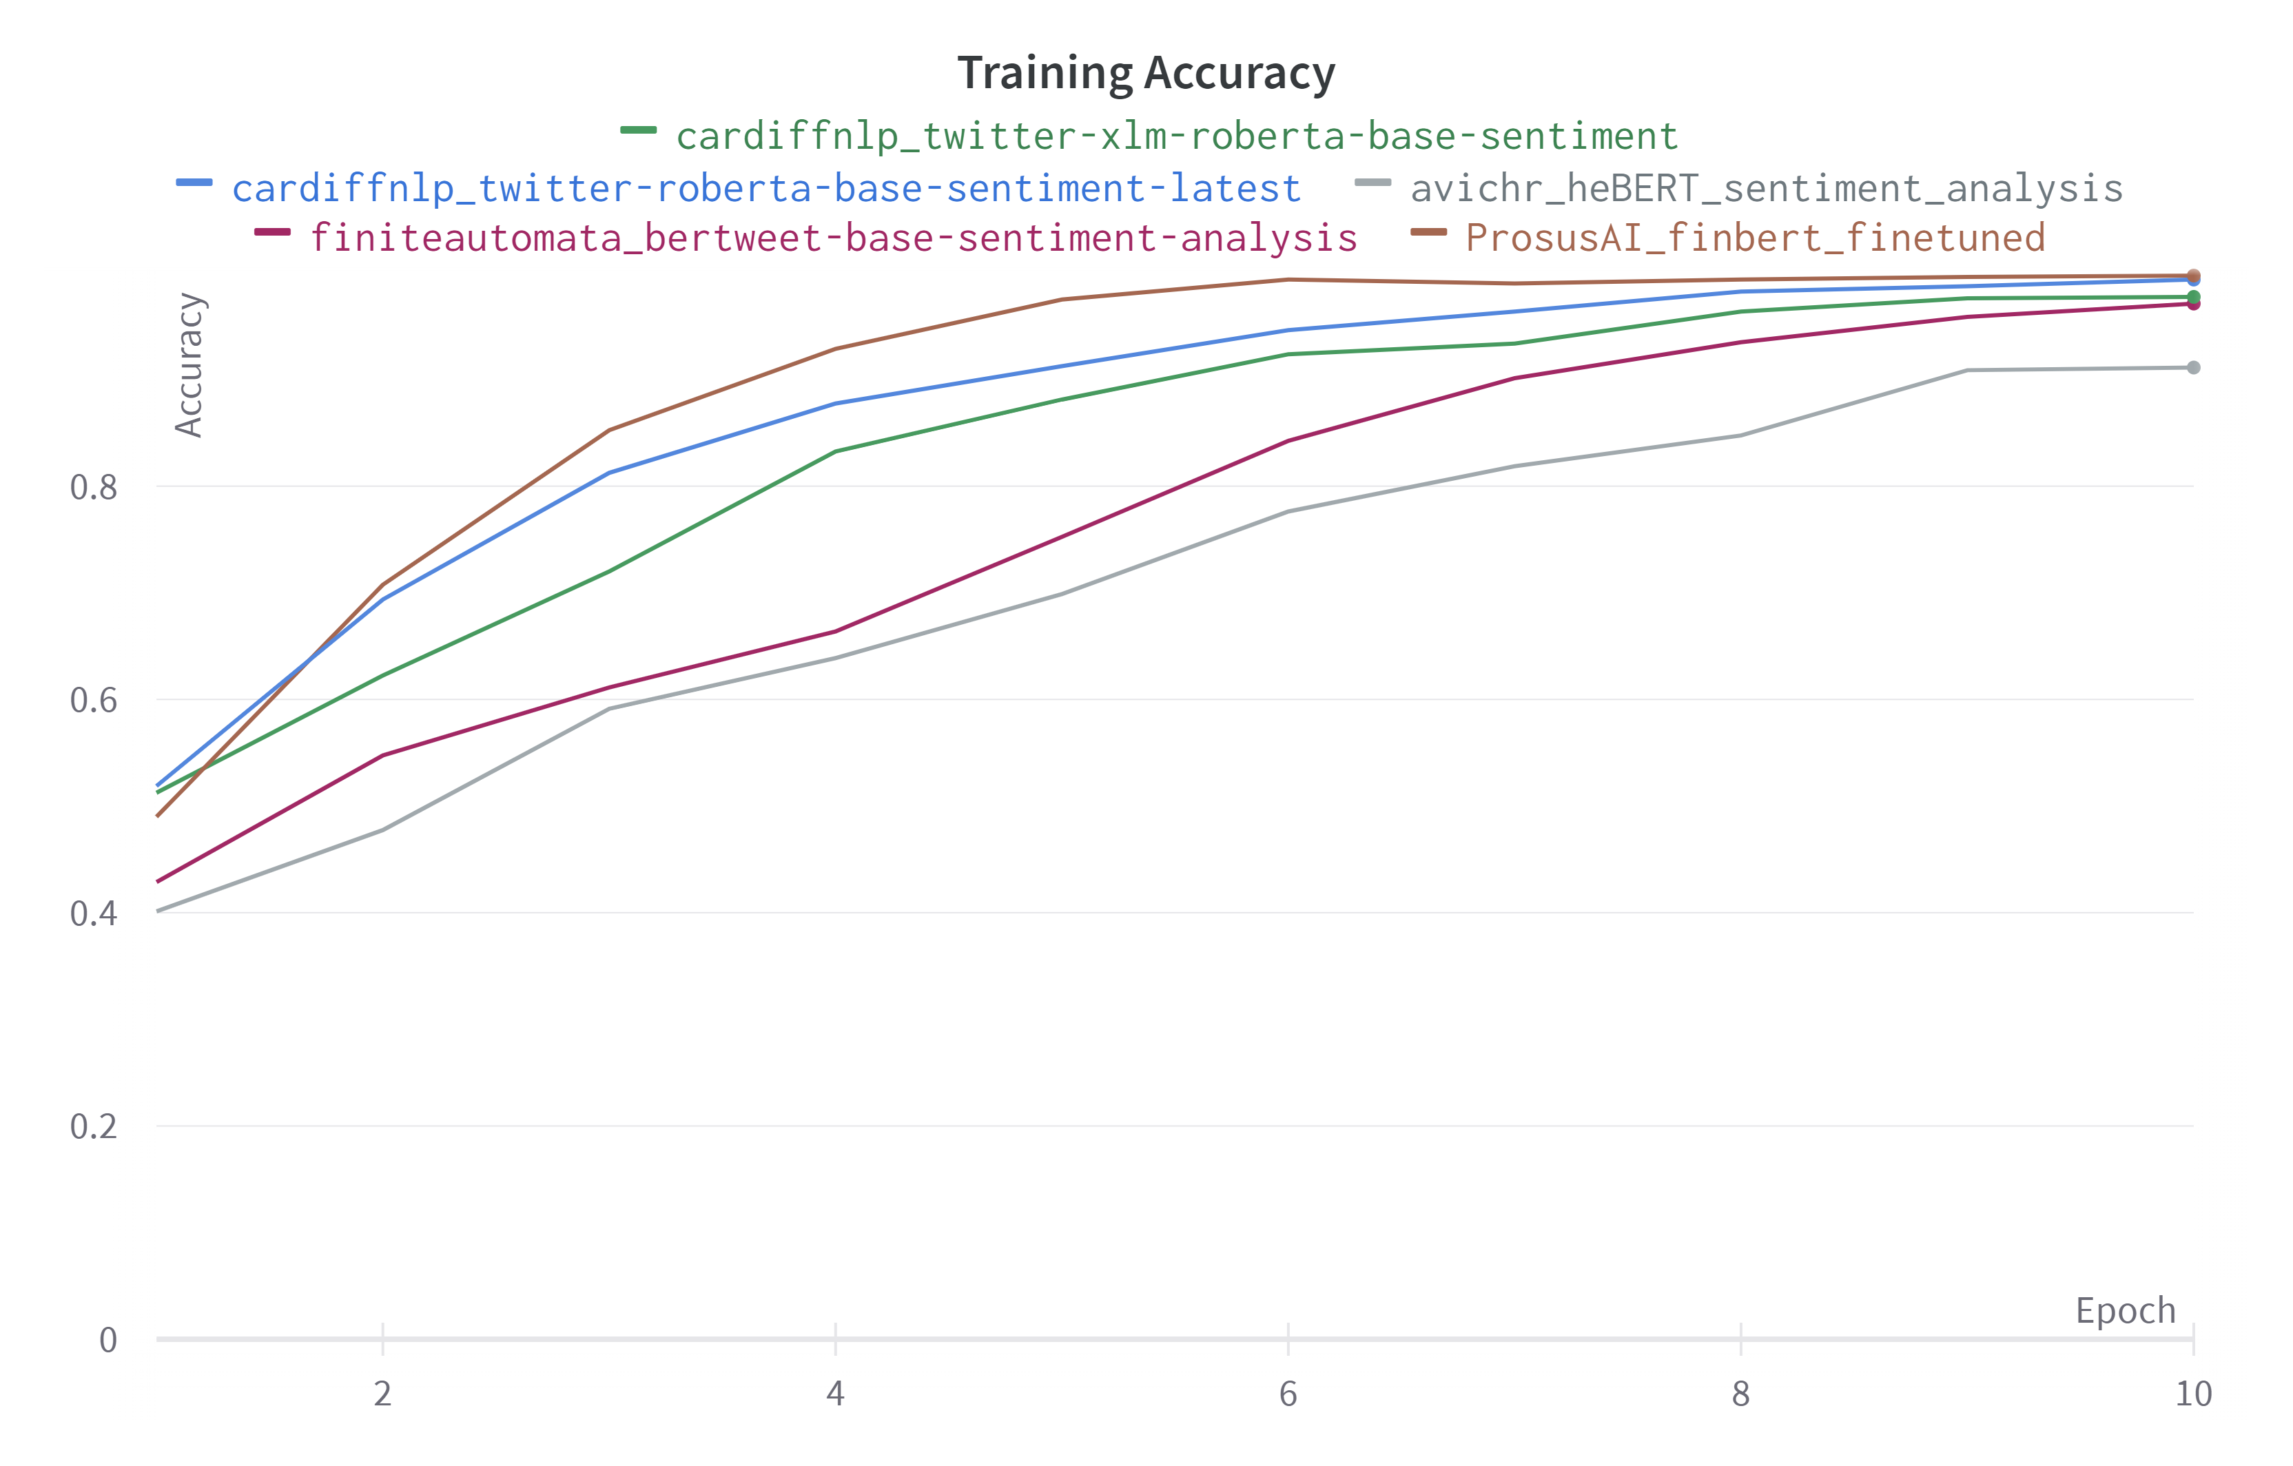
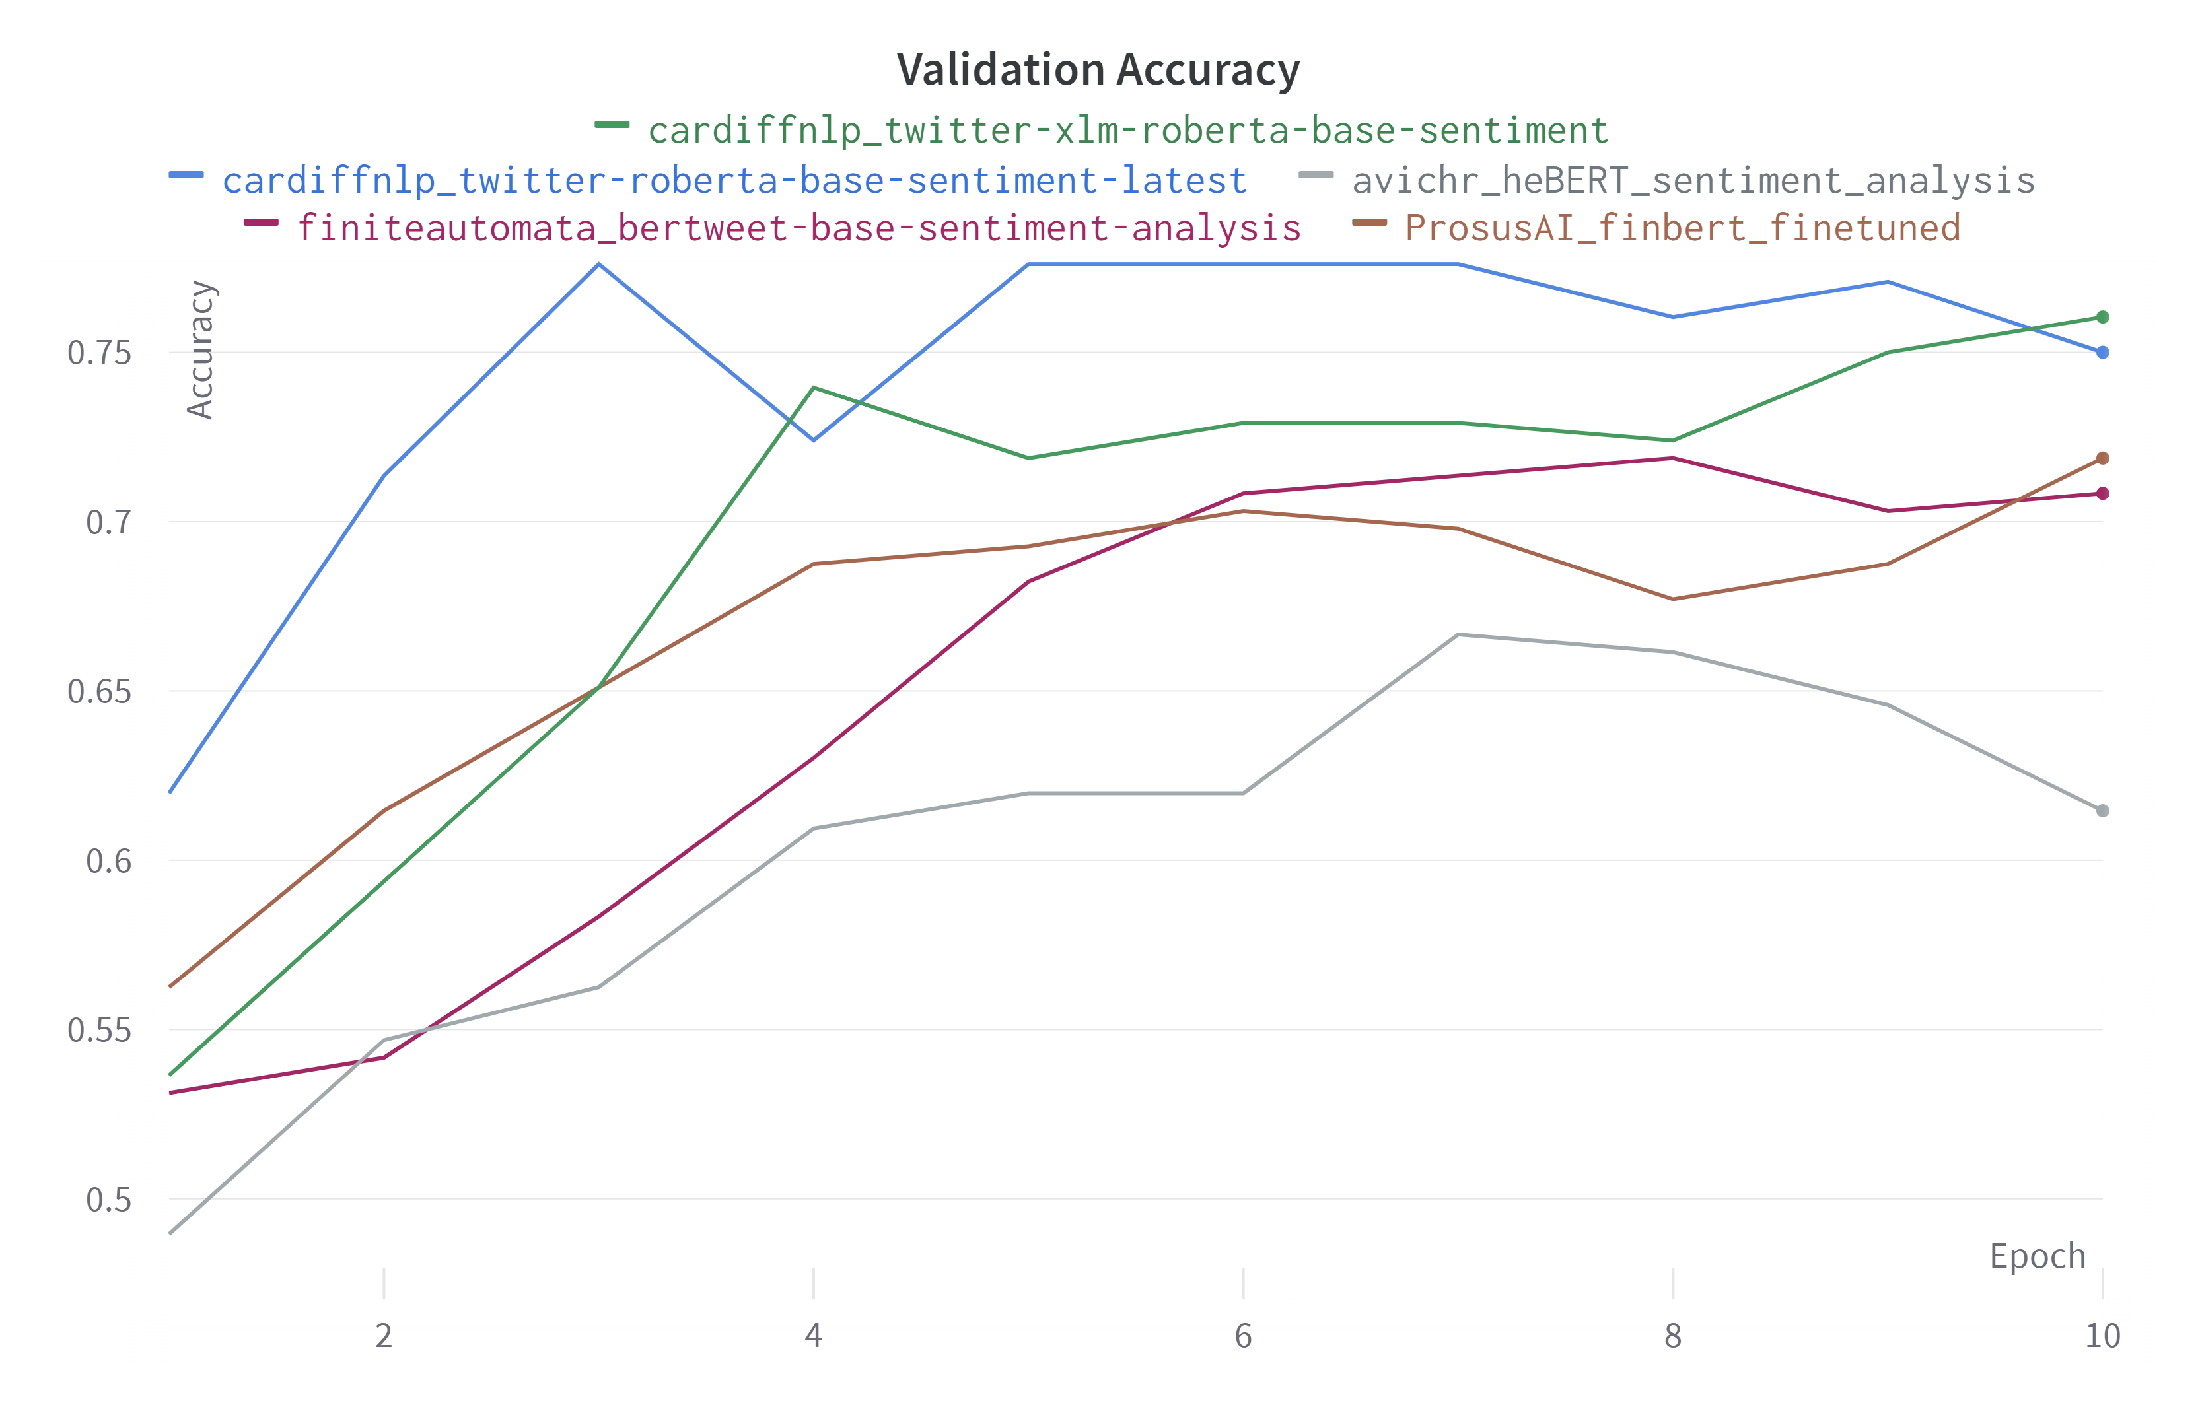
Results – Training progress
Stable learning process for all models with the training data
Validation Accuracy stagnation after epoch 4-5 for all models
Validation loss starts to increase again after epoch 4-5
Only 5 training epoch necessary → Models start to overfit
Progress of the training loss throughout the training process
Progress of the validation loss throughout the training process
Progress of the training accuracy throughout the training process
Progress of the validation accuracy throughout the training process

Slide 13
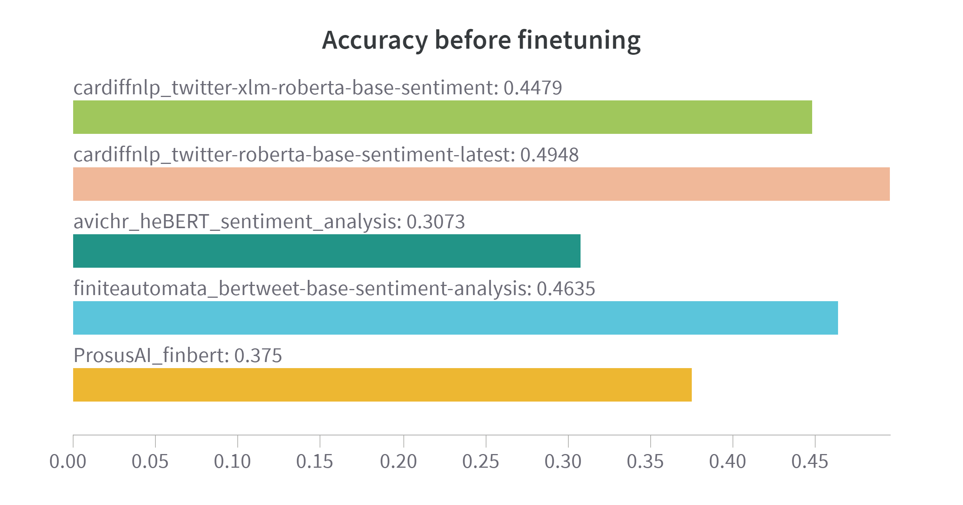
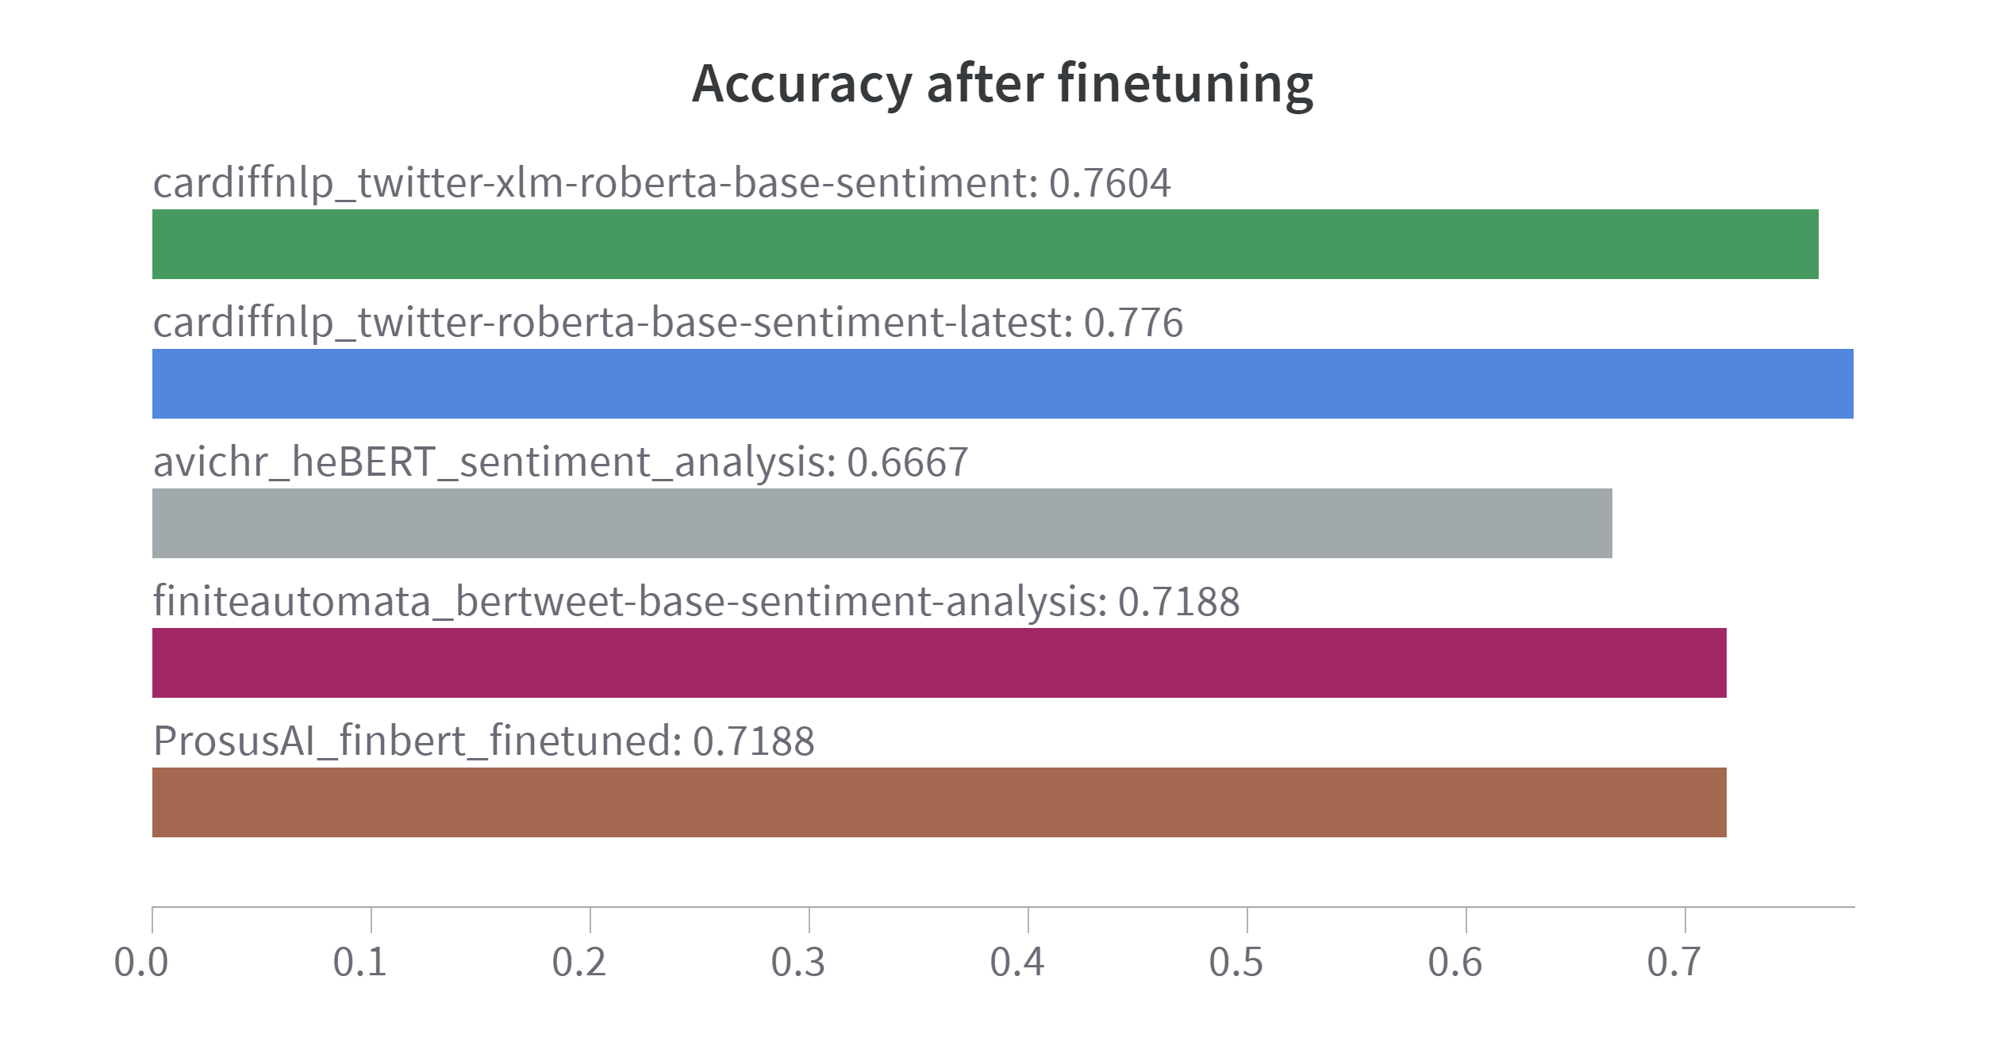
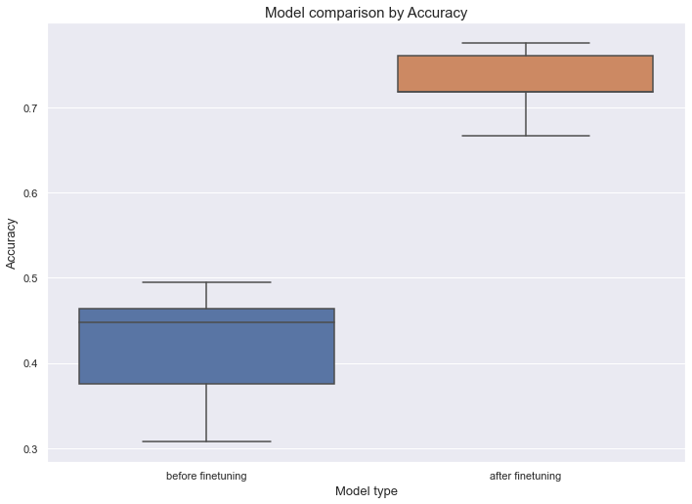
Results – Model performance comparison
Best model before and after finetuning → cardiffnlp_twitter-roberta-base-sentiment-latest → Val. Acc. of 77,6%
Top 3 models all trained on tweets → similar language to reddit
Best models take emojis into account
Mean validation accuracy before finetuning: 41,8%
Mean validation accuracy after finetuning: 72,8%
Difference of 31 percentage points → p-value of 8.7e-05 → Difference of means is statistically significant
Model performance before finetuning
Model performance after finetuning
Model performance comparison by accuracy

Slide 14
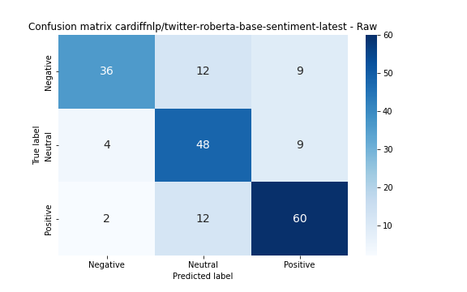
Results – Best model performance
Best model before and after finetuning → cardiffnlp_twitter-roberta-base-sentiment-latest → Val. Acc. of 77,6%
Most mistakes include predicting the Neutral class, when the actual class was positive or negative
Not many mistakes where the opposite class was predicted

Slide 15
Contents
1. Introduction
2. Research questions
3. State of the art & Related Work
4. Sentiment Analysis
5. Correlation Analysis
6. Predictive modeling
7. Conclusion
8. Future work

Slide 16
Feature extraction
Feature | Calculation
Positive, Negative, Neutral | Average sentiment probabilities for each day
Count | Number of posts per day for a particular stock
Pos_min_neg | Positve x 1 + Neutral x 0 + Negative x -1
Pos_min_neg_times_count | Pos_min_neg x Count
Pos_min_neg_diff | Pos_min_neg_diff at timepoint t - Pos_min_neg_diff at timepoint t-1
Count_diff | Count_diff at timepoint t - Count_diff at timepoint t-1

Slide 17
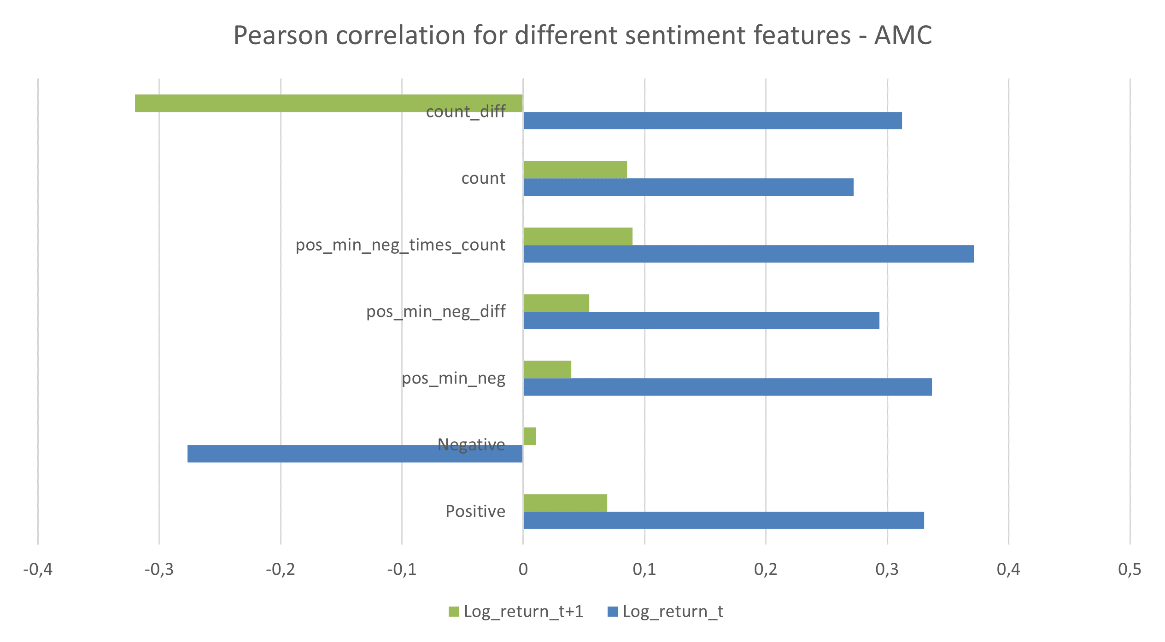
Results – AMC
Highest absolute correlation for the log return_t → Pos_min_neg_times_count with a positive correlation of 0.37
Highest absolute correlation for the log return_t+1 → count_diff with a negative correlation of 0.32 (probably by chance)

Slide 18
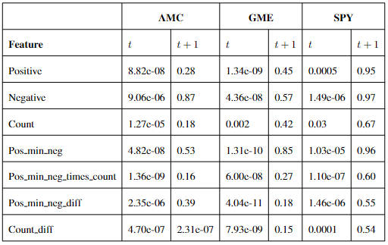
Results – P-value overview - AMC
All results are statistically significant for the log_return_t
All results except for the feature Count_diff are not statistically significant for the log_return_t+1
P-values for correlation measurements

Slide 19
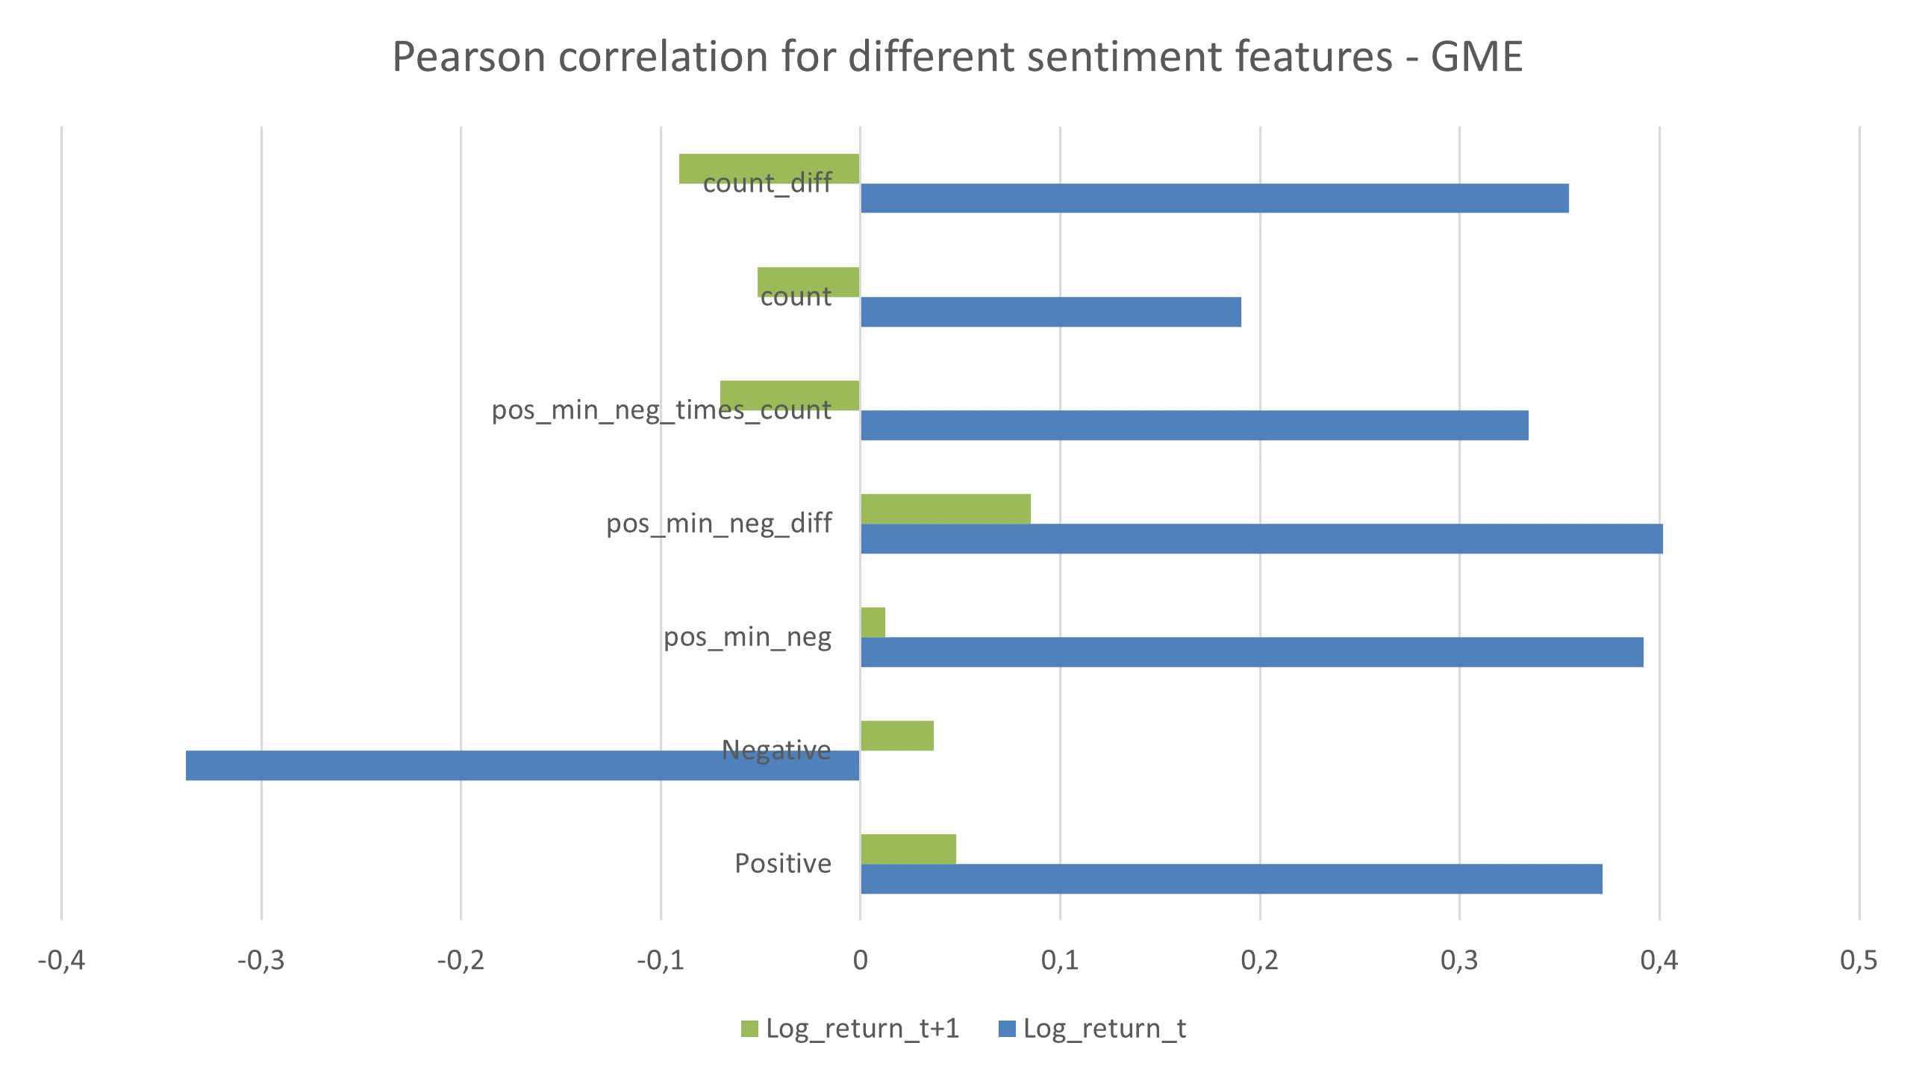
Results – GME
Highest absolute correlation for the log return_t → Pos_min_neg_diff with a positive correlation of 0.4
Highest absolute correlation for the log return_t+1 → count_diff with a negative correlation of 0.09

Slide 20
Results – P-value overview - GME
All results are statistically significant for the log_return_t
All results are not statistically significant for the log_return_t+1
P-values for correlation measurements

Slide 21
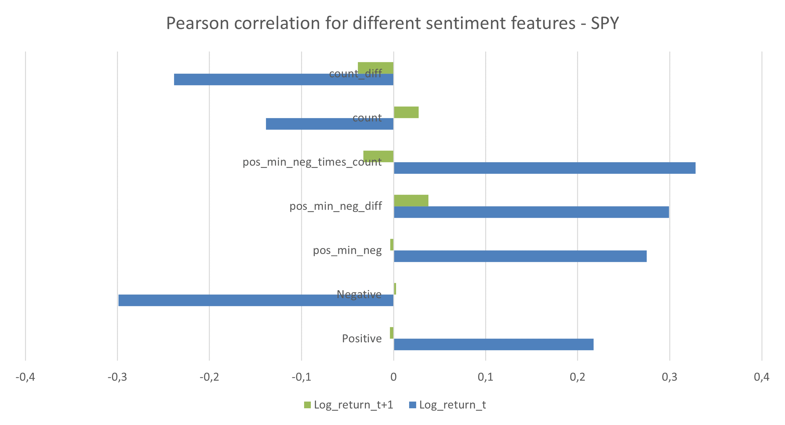
Results – SPY
Highest absolute correlation for the log return_t → Pos_min_neg_times_count with a positive correlation of 0.33
Highest absolute correlation for the log return_t+1 → count_diff with a negative correlation of 0.04

Slide 22
Results – P-value overview - SPY
All results are statistically significant for the log_return_t
All results are not statistically significant for the log_return_t+1
P-values for correlation measurements

Slide 23
Contents
1. Introduction
2. Research questions
3. State of the art & Related Work
4. Sentiment Analysis
5. Correlation Analysis
6. Predictive modeling
7. Conclusion
8. Future work

Slide 24
Experiment setup
Trainset 75%, testset 25%
Same features used as in correlation analysis
Algorithms used: Logistic Regression, Decision Tree, Random Forest, XGBoost, K-Nearest Neighbor, Neural Network
Hyperparameters are set to default values of the python libraries
Principal Component Analysis for visual inspection
Data normalization

Slide 25
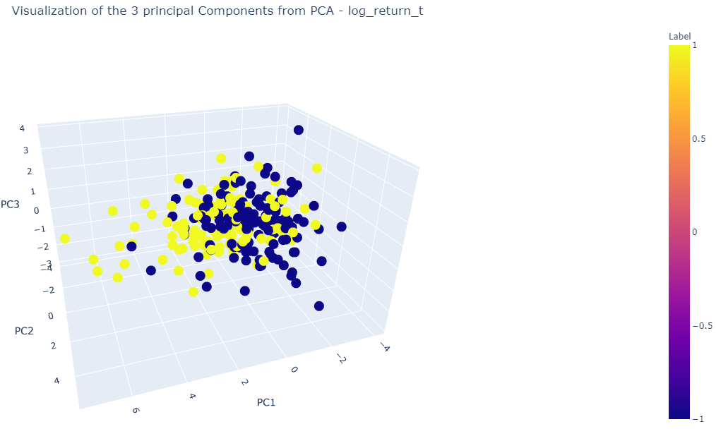
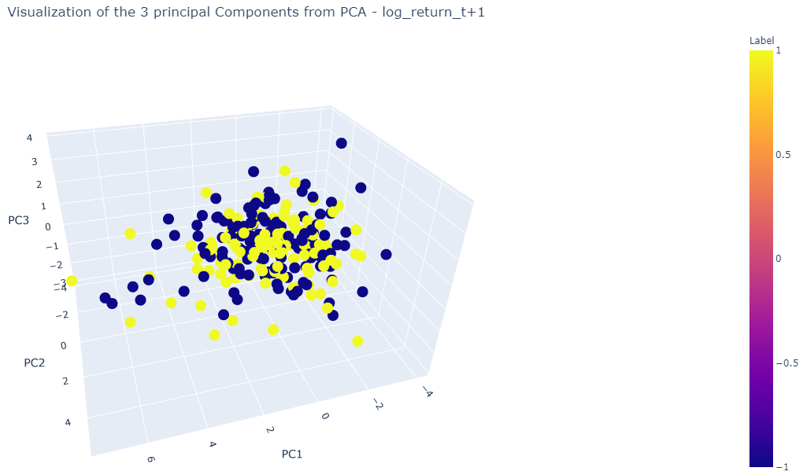
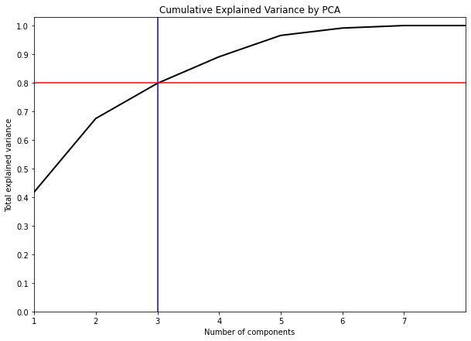
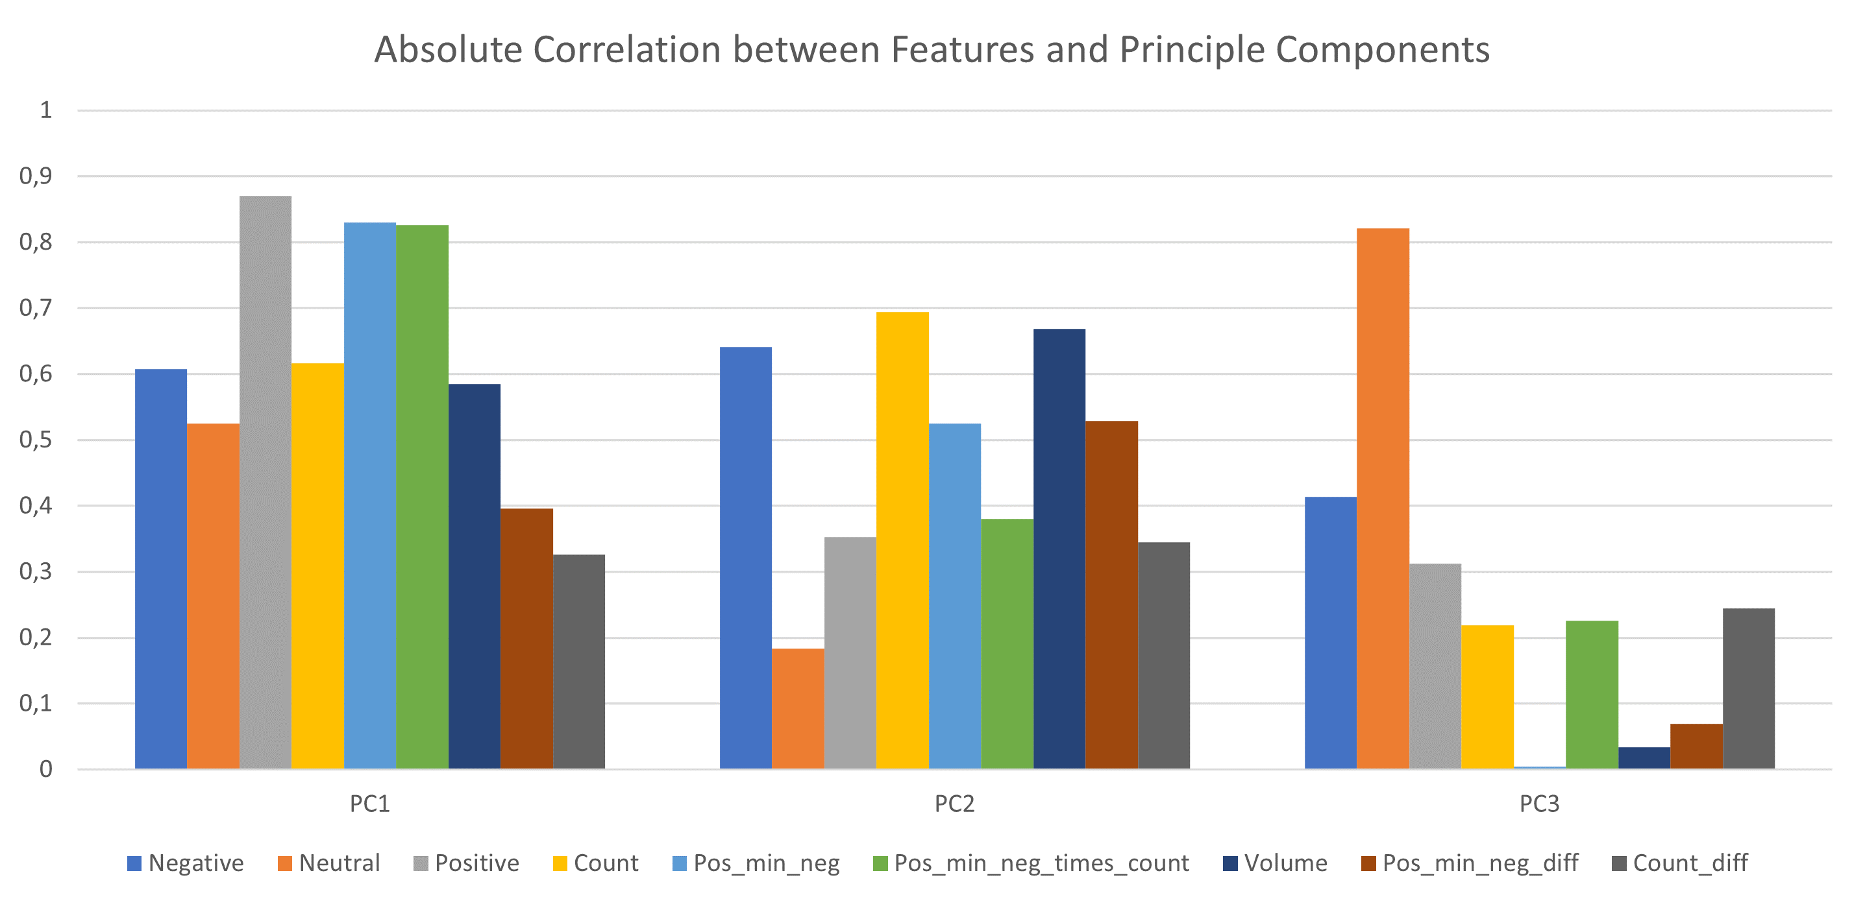
Results – Principal Component Analysis
Data for log_return_t slightly separable
Data for log_return_t+1 not separable
PC1 represents mostly the Positive sentiment feature
PC2 represents mostly the Negative sentiment feature
PC3 represents mostly the Neutral sentiment feature
Cumulative explained variance with 3 components is still 80% → Good visual representation of the actual data distribution
Visualization of the three principal components for the log return_t - GME
Visualization of the three principal components for the log return_t+1 - GME

Slide 26
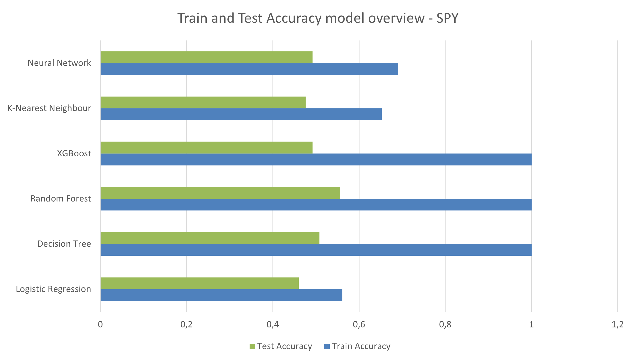
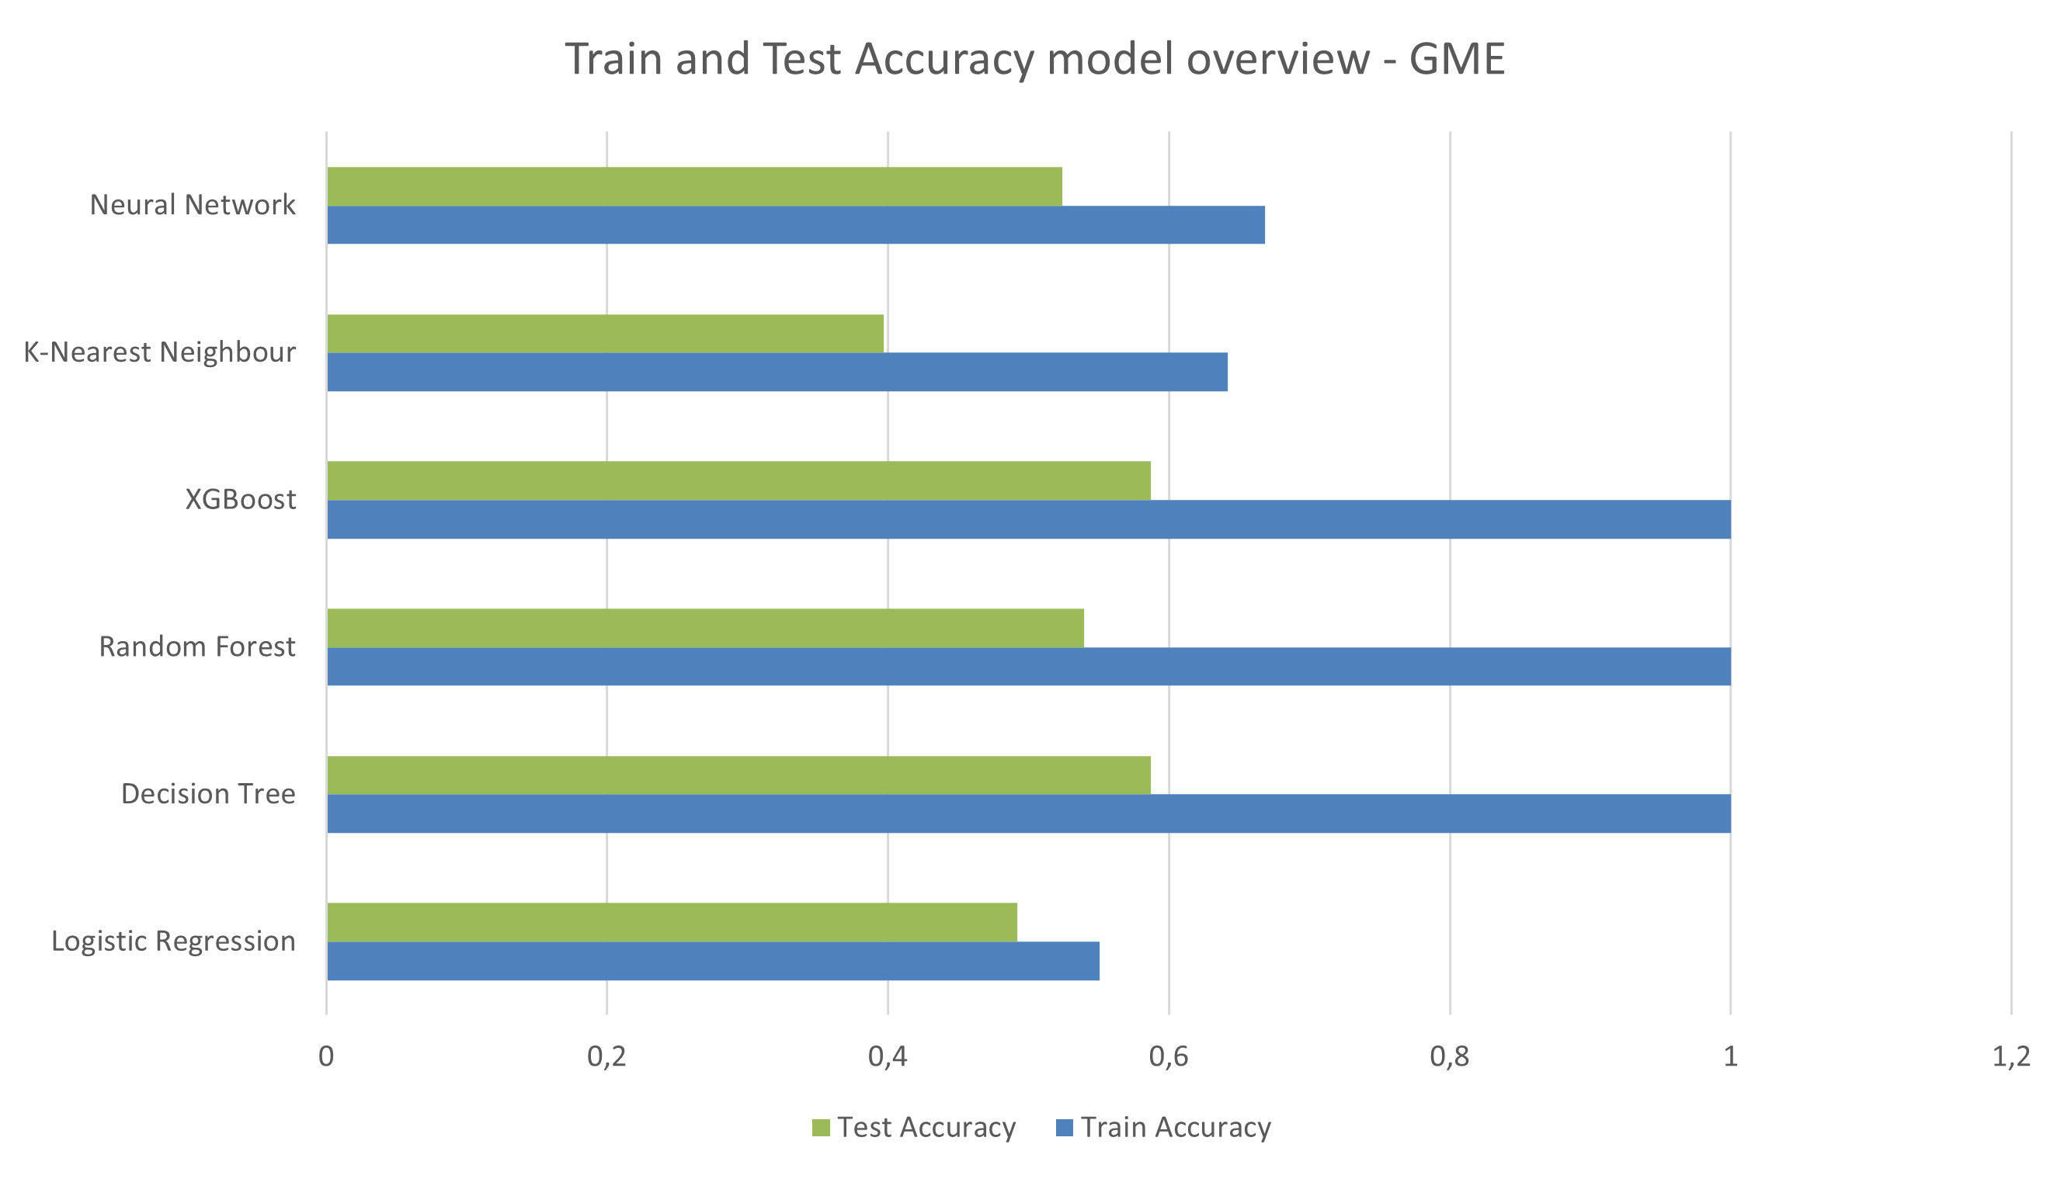
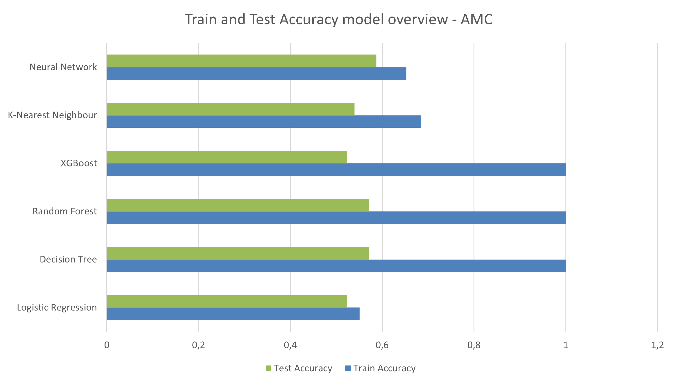
Results – Model performance overview
Best model for SPY: Random Forest with 55,5% accuracy
Best model for GME: Neural Network with 58,7% accuracy
Best model for AMC: XGBoost with 58,7% accuracy
In general, poor performance overall → Small dataset, no correlation between any feature and the target, data not separable as seen in PCA

Slide 27
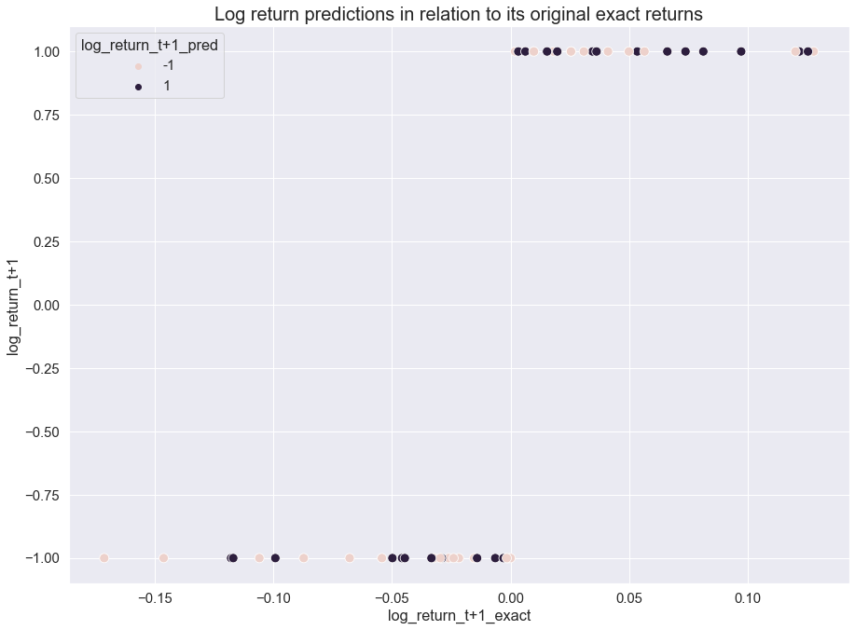
Results – Best model investigation
Model makes more mistakes when the original exact return value is close to zero
Model makes less mistakes when the original exact return value is either very positive or very negative
Limited by small sample size → view results with caution

Slide 28
Contents
1. Introduction
2. Research questions
3. State of the art & Related Work
4. Sentiment Analysis
5. Correlation Analysis
6. Predictive modeling
7. Conclusion
8. Future work

Slide 29
Conclusion
Sentiment Analysis:
Mean model performance difference before and after finetuning → 31 percentage points
P-value of 8.7e-05 → Results are statistically significant
Correlation Analysis:
Significant correlation between the sentiment features of all three stocks (AMC, GME, SPY) and their log_return_t
No significant correlation between the sentiment features of all three stocks (AMC, GME, SPY) and their log_return_t+1
Predictive Modeling:
Best model performance: 58,7% accuracy for the XGBoost model with the GME stock
PCA shows visual separation possible for log_return_t but not for log_return_t+1 with a cumulative explained variance of 80%
The sentiment of the stock discussions on r/wallstreetbets does not drive the stock returns on the upcoming day, but rather reflects the situation of the current day.

Slide 30
Contents
1. Introduction
2. Research questions
3. State of the art & Related Work
4. Sentiment Analysis
5. Correlation Analysis
6. Predictive modeling
7. Conclusion
8. Future work

Slide 31
Future work
More annotators for a more accurate labeled dataset → Annotation guidelines
Larger trainingset
Testing more different transformer models
Testing “raw” transformer models, which were not already pretrained on a sentiment classification task → language on r/wallstreetbets very specific
Hyperparameter tuning
Correlation Analysis with small traded volume stocks
Different timeframes for prediction → For example, weekly average sentiment score predicts stock return t+1
Sentiment Analysis combined with time series forecasting techniques such as ARIMA, LSTM, etc.
Stock return regression instead of classification

