Slide 1
UAE Real Estate Price Prediction
CSCI323 – Modern Artificial Intelligence
University of Wollongong Dubai | Spring 2026
A Machine Learning Approach to Automated Property Valuation
Supervised by: Asmath Famnaz Submission Date: 21 June 2026
Jan Hrusa | 8848580
Joslin Jolly | 8964178
Zobia Shaikh | 8881820
Marwa Khot | 8963186
Shazeel Ahmed | 8958932
Notes:
Briefly introduce yourselves and give a one-sentence teaser – "We built a machine learning system that can estimate UAE residential property prices in seconds, based on data from over 5,000 real listings."

Slide 2
The Problem UAE Real Estate Is Hard to Price
UAE is one of the world's most dynamic real estate markets
Prices vary enormously
Traditional valuation relies on a human appraiser
Slow (1–3 days)
Expensive (AED 1,500–5,000)
May be biased
Demand for valuations is growing
Notes:
Paint the business problem vividly. Mention Property Finder, Bayut, and Dubizzle as examples of platforms with thousands of structured listings – data that exists but isn't being used to automate valuation. The core tension is: complex market, slow manual process, growing demand.
UAE is one of the world's most dynamic real estate markets, driven by the Golden Visa, zero tax policy, and global investor interest
Prices vary enormously by location, size, furnishing, amenities, and market timing
Demand for valuations is growing faster than the supply of qualified appraisers

Slide 3
Solution Machine Learning
Traditional methods can't scale
Comparable-sales methods are inaccurate
Machine learning discovers relationships in large structured datasets automatically
Key advantages:
Scalability
Non-linearity
Explainability
Consistency
Business Objectives:
Build a high-accuracy ML model for UAE property price prediction
Deliver a usable prediction interface for non-technical users
Provide a documented, reproducible, and maintainable methodology
Notes:
Emphasize the "why AI" argument clearly – the problem is not just "can a computer do this" but "only a computer can do this at scale." Mention that feature importance metrics also give stakeholders explainable insights, unlike a black-box appraiser.
Traditional methods can't scale
A human appraiser can't evaluate 5,000 listings per second
Comparable-sales methods miss fine-grained property interactions (e.g., size × location × furnishing)

Slide 4
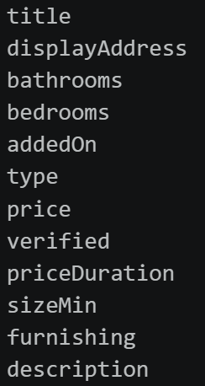
Dataset and Preprocessing
Dataset:
5,058 residential-for-sale listings scraped from UAE real estate platforms
12 raw columns
Key preprocessing steps:
Removed constant/uninformative columns
Cleaned non-numeric values ("7+" -> 7 or "studio" -> 0)
Extracted listing month from timestamp as a seasonality signal
Imputed missing values (bedrooms, bathrooms) with median (inside a pipeline to prevent leakage)
Removed top-10% outliers by price and size
One-hot encoded furnishing: NO / PARTLY / YES
Log-transformed the price target (log1p) to reduce right-skew and stabilize training
Notes:
Stress that preprocessing was the single biggest driver of model performance improvement – over 30% gain came from better data handling alone, before any model tuning. The log price transformation is a key decision that mirrors standard real estate ML practice.
Imputed bedrooms and bathrooms

Slide 5
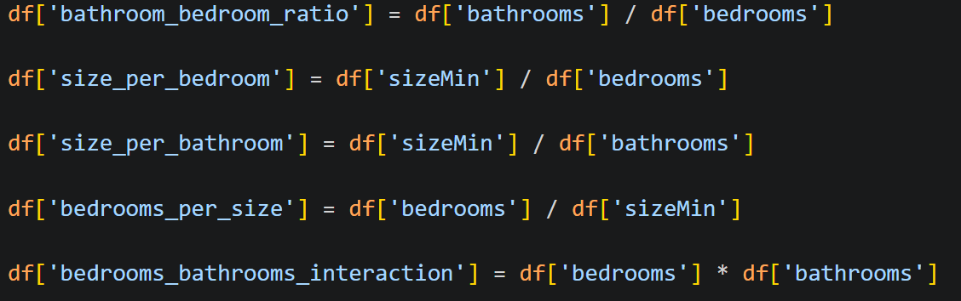
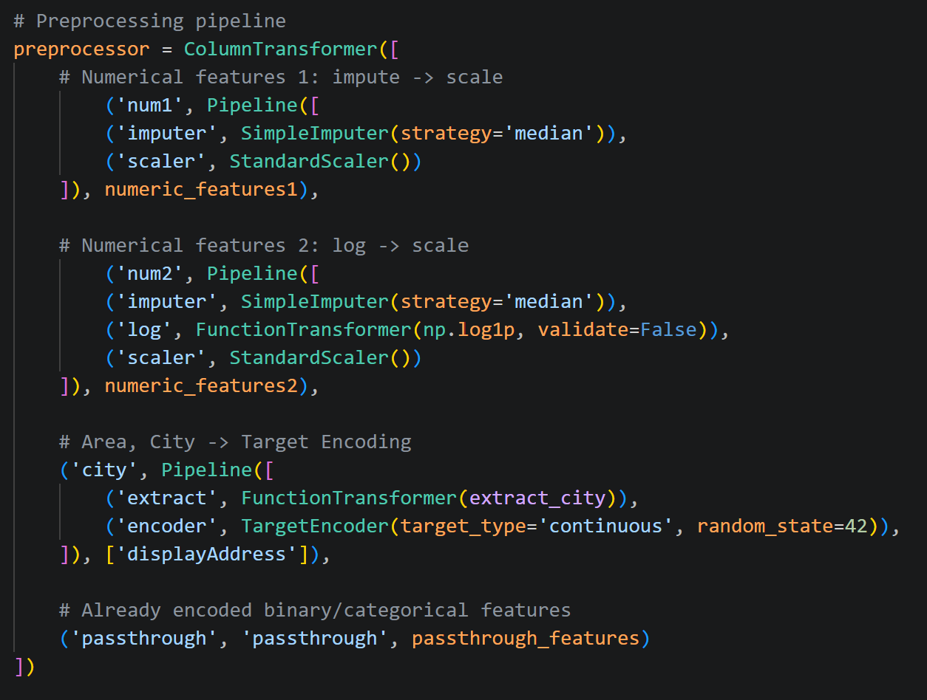
Feature Engineering & Pipeline Architecture
5 Engineered Features:
Pipeline Branches (ColumnTransformer): Numeric Group 1 (numerical features) -> Median imputation -> StandardScaler Numeric Group 2 (size features) -> Median imputation -> log1p -> StandardScaler Location (area + city) -> TargetEncoder (with cross-fitting to prevent leakage) Binary flags (verified, furnishing dummies) -> pass-through
Notes:
Explain why ratio features matter – raw bedroom count doesn't tell you if a property is spacious or cramped. The TargetEncoder for location is important: it encodes the area-city string as the mean price of similar listings but uses cross-fitting internally so training data doesn't leak into its own encoding. The entire preprocessing + model is one single sklearn Pipeline object, serialized to predictor.pkl.

Slide 6
Four Models Compared
Models selected (simple -> complex):
Ridge Regression
A „simple“ linear regression model
Random Forest
Ensemble of trees
HistGradientBoosting (HGB)
Scikit-learn's LightGBM-inspired boosting
CatBoost
Most modern and state-of-the-art model
Evaluation strategy:
5-fold cross-validation
Metric: R² on log-scale prices
80/20 stratified train/test split (stratified by price)
Notes:
Explain the design rationale – you want a spectrum from linear to complex to understand whether complexity pays off. The stratified split ensures the test set has the same price distribution as training, so you're not accidentally testing only on mid-range properties.

Slide 7
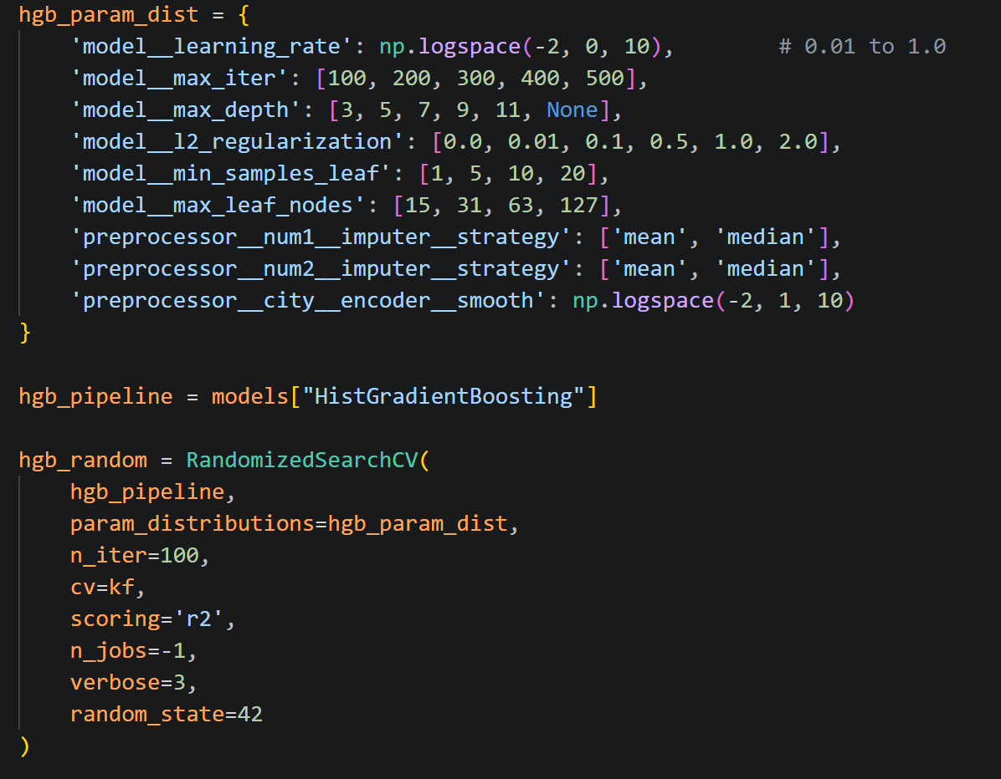
Hyperparameter Tuning
Method: RandomizedSearchCV
What was tuned:
Notes:
Emphasize that by including preprocessing choices inside the search, you got genuinely optimal end-to-end pipelines, not just optimal models with sub-optimal preprocessing. This is a best practice many teams miss.

Slide 8
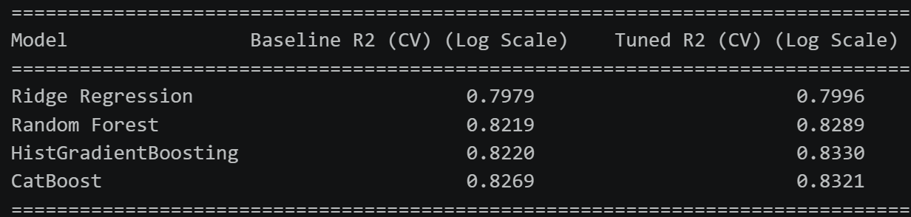
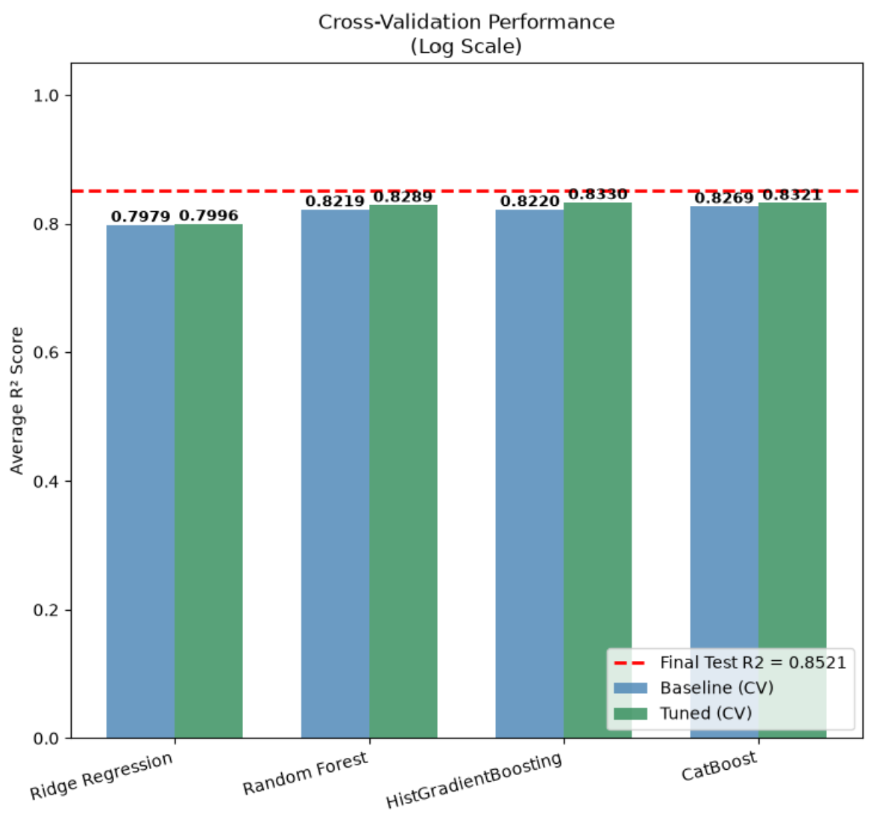
Results Model Performance
Notes:
HGB edged out CatBoost by a small margin. Explain the pictures

Slide 9
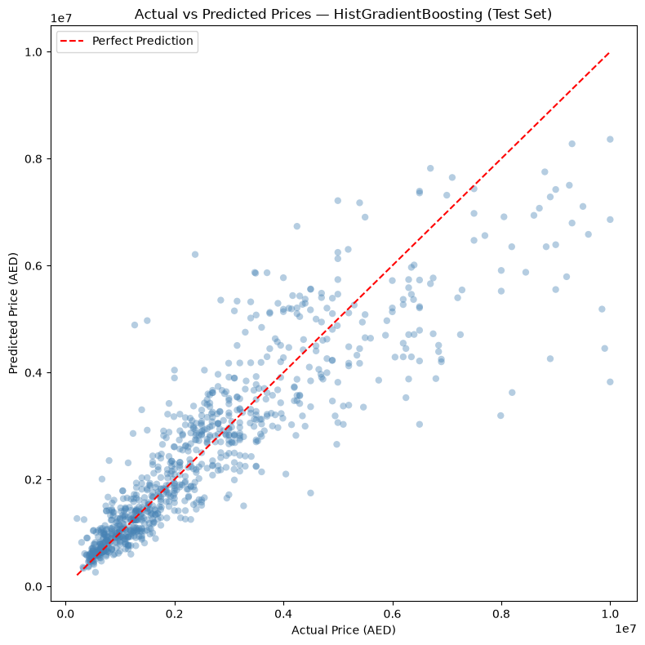
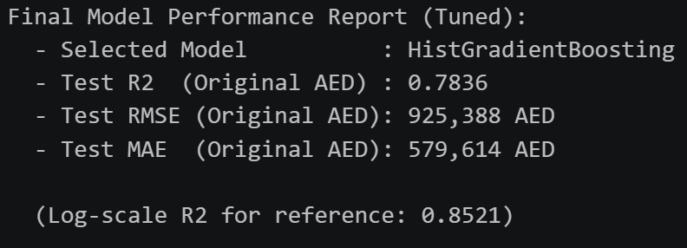
Final Test Set Performance
HGB retrained on full training set, evaluated once on held-out 20%:
Notes:
Put the RMSE in context – the median cleaned property price is AED 2.35M, so the MAE of ~AED 580k is roughly a 25% band, which is acceptable for a first-pass estimate from basic inputs. Mention the actual-vs-predicted chart and residual plot here as visual proof. Explain why the log-scale R2 was higher.
Model explains 78% of price variance on entirely unseen data
Lower-priced properties (AED 500k–3M) cluster tightly around the ideal prediction line
Higher-priced properties show more scatter

Slide 10
Business Impact
Four categories of value:
1. Time savings 2. Scale 3. Pricing guidance Agents can use MAE as a confidence band around a listing price (e.g., ±12.5% on AED 2M properties).
4. Bias reduction The model applies identical feature weightings to every property, eliminating individual agent subjectivity.
Notes:
Make this concrete for non-technical audience members. The savings are real: if a real estate portal has 10,000 listings per month and each valuation costs AED 2,000 manually, that's AED 20M per month. The model replaces that with negligible compute cost.
1. Time savings Manual appraisal takes 1–3 working days and costs AED 1,500–5,000 per property. → The model runs in under a second at near-zero marginal cost.
2. Scale One trained model handles 5,000+ valuations simultaneously — humanly impossible.
3. Pricing guidance Agents can use MAE as a confidence band around a listing price (e.g., ±12.5% on AED 2M properties).
4. Bias reduction The model applies identical feature weightings to every property, eliminating individual agent subjectivity.

Slide 11
Limitations & Challenges
Data limitations:
5,058 records is small for a market as diverse as the UAE
Dataset contains listing prices, not confirmed sale transaction prices
Missing features: floor level, view type, building age, proximity to landmarks
Technical limitations:
Property descriptions
No feature importance output from HGB
Static model
Ethical considerations:
Geographic bias
Notes:
Be honest and specific – good limitations discussion shows intellectual maturity. The listing vs. transaction price gap is a big one; DLD (Dubai Land Department) transaction records would be the fix for a production system.
5,058 records is small for a market as diverse as the UAE especially hurts TargetEncoder for rare locations
Dataset contains listing prices, not confirmed sale transaction prices — actual sale may differ significantly
Property descriptions droppedthey contain high-value signals ("Burj Khalifa view", "private pool") that NLP could extract
No feature importance output from HGB – SHAP values would be needed for individual prediction explanations
Static model: will degrade as the market evolves without periodic retraining
Geographic bias: sparse data in certain areas may cause systematic undervaluation, disadvantaging sellers in those communities

Slide 12
Lessons Learned
1. Preprocessing is everything
2. Log-transforming the target variable is essential for real estate
3. Pipeline encapsulation prevents data leakage
4. Tune preprocessing alongside model hyperparameters
5. Stratified splitting by price is essential
Notes:
Frame these as insights you'd carry into any future ML project, not just real estate. These are transferable principles – this is what the "lessons learned" section is really about.
1. Preprocessing is everything Model performance improved by over 30% through better preprocessing – before any tuning. Clean data beats clever algorithms.
2. Log-transforming the target variable is essential for real estate Without it, the model disproportionately chased rare luxury outliers and performed poorly on typical properties.
3. Pipeline encapsulation prevents data leakage Wrapping preprocessing + model in one sklearn Pipeline is non-negotiable. Any step fitted outside the pipeline is a potential leakage point.
4. Tune preprocessing alongside model hyperparameters Treating imputer strategy and TargetEncoder smooth as tunable parameters yielded better results than treating them as fixed choices.
5. Stratified splitting by price is essential A random split might accidentally oversample or undersample certain price bands, producing misleading evaluation metrics.

Slide 13
Recommendations for Deployment
Proposed architecture:
Store predictor.pkl in a versioned object store (AWS S3 / Azure Blob) with access logging
Expose a REST API endpoint (/predict) via FastAPI or Flask – accepts JSON property attributes, returns predicted price
Integrate as an "Estimated Value" widget on listing
Run A/B test on initial deployment: show model-assisted prices alongside manual prices, measure time-on-market impact
Retraining plan:
Monitor live prediction vs. eventual sale price to detect model drift early
Automate data ingestion from UAE listing platforms
Notes:
Show that you've thought beyond the notebook – a trained model is only useful if it's deployed properly. The A/B testing recommendation shows business savvy: you're not claiming the model is perfect, you're proposing a measured rollout.
Integrate as an "Estimated Value" widget on listing pages of platforms like Property Finder or Bayut
Retraining plan:
Retrain at minimum quarterly given UAE market volatility
Monitor live prediction vs. eventual sale price to detect model drift early
Automate data ingestion from UAE listing platforms to maintain a fresh training dataset

Slide 14
Future Work & Broader Applications
Proposed enhancements:
Transaction price data
NLP on descriptions
Geographic distance features
SHAP explainability
Automatic retraining pipeline
Broader applications:
GCC expansion
Commercial real estate
Rental price prediction
GridSearchCV around found RandomSearchCV parameters
Notes:
This slide shows the project has legs beyond a university submission. Emphasize that the pipeline and methodology are the real deliverable – the model can be retrained on any structured real estate dataset with minimal modification.
Transaction price data: Obtain DLD records for actual sale prices rather than listing prices
NLP on descriptions: Extract keywords like "sea view", "private pool", "Burj Khalifa view" using embedding models
Geographic distance features: Distance to Dubai Mall, DIFC, Palm Jumeirah as numeric features
SHAP explainability: Per-prediction breakdowns ("Location adds AED 200k; unfurnished reduces by AED 80k")
Automatic retraining pipeline: CI/CD for model updates triggered by data drift detection
Broader applications:
GCC expansion: Saudi Arabia, Qatar, Kuwait markets share similar data structures – minimal retraining needed
Commercial real estate: same gradient boosting approach adapts to office and retail valuation
Rental price prediction: same pipeline, different target variable
GridSearchCV around found RandomSearchCV parameters
This ensures we actually find the best value. Probalby not worth it.

Slide 15
Summary & Q&A
What we built:
A supervised ML model that explains 78% of price variance on unseen data
Interactive implementation example
Key takeaways:
Preprocessing
Meaningful business value
Limitations
Thank you. Questions?
Notes:
What we built:
A supervised ML pipeline trained on 5,058 UAE property listings
4 models compared under identical conditions; HistGradientBoosting selected as best
Final test R² of 0.7836 — explains 78% of price variance on unseen data
Interactive prediction interface in Prediction_Model.ipynb: enter property attributes, get an AED estimate in seconds
Key takeaways:
Preprocessing quality matters more than model choice
The system delivers meaningful business value: instant, scalable, consistent valuations
Limitations are known and addressable with richer data and continued development
Thank you. Questions?

