Slide 1
Natural Language Processing
Course summary

Slide 2
W5 Agenda
Assignment presentation
How to expand NLP and ML knowledge
Generative AI
Quick feedback session

Slide 3
Assignment presentation

Slide 4
Assignment summary
Are you happy with the model’s performance?
What was the biggest challenge?
Do you have any ideas how this approach could be transferred to real life business scenario?

Slide 5
How to expand NLP and ML knowledge

Slide 6
All the learning and practice is easily available online
Online courses and materials
Kaggle and pet projects
Coursera
Medium
Udemy
Kaggle – competitions and reading other people’s code
Pet projects – find some data you are interested in and do something useful with it

Slide 7
Recommended courses
All the courses from DeepLearning.AI and Andrew Ng on Coursera
I personally recommend:
Especially Machine Learning by Stanford University
DeepLearningAI’s Deep Learning Specialization
DeepLearningAI’s Natural Language Processing Specialization
Generative AI with Large Language Models DeepLearningAI&AWS
From my perspective these materials combine a good theory-to-practice ratio and really accelerate ML/NLP learning. These recommendations are based purely on my personal experience

Slide 8
No better way to learn than starting to code!
But there is no substitute for coding – ML or any area of programming is a craft and the only way to master it is to practice
Kaggle projects are nice to start as you can get inspired by code written by great engineers
Once you are off the ground it is best to do something unique – get some data that you are actually interested in and do something usefull with it
Avoid committing too much time to working with the most popular datasets like Titanic, MNIST, IMDB etc. – do something original

Slide 9
Generative AI

Slide 10
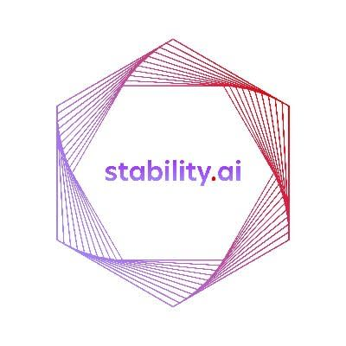
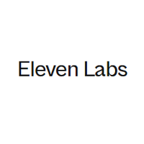

Generative AI seems to have human like capabilities
Chat GPT
Stable Diffusion
Prime Voice AI
Generate human-like conversations and answer
Answer complex queries on any topic
Great at writing and refactoring code
Text-to-image generation
Accelerates creative process
Still some way to go before replacing actual graphic designers
Mimic any voice and maintain emotions
Potential to replace lectors and dubbing

Slide 11
But it also present a wide range of issues
Intellectual property
Limitless fake news
An image generation model processes thousands of images – is it a digital age equivalent of an artist visiting The Louvre or is it actually profiting from artists’ talent for free?
Autogenerating content is nearly free, how can we control its quality? If fake news is a problem when someone has to spend time making it up, how can we handle endless, autogenerated fake news?
Cheating and plagiarism
Impersonation
Can students find information and learn faster or will they just auto-generate their homework?
Generative speech and video makes it easier to create fake videos. How will we validate if we are speaking to the actual person if his voice can be copied with a few seconds recording?
Handling these issue in the future can become a whole new industry

Slide 12
Artificial Intelligence will not replace programmers and engineers…
… but programmers leveraging AI to make their work more efficient will replace ones who don’t

Slide 13
Thanks for your attention Jan Majewski jan.majewski@resider.pl

Slide 14
Feedback session
I would really appreciate you spending 5 mins on a quick feedback form so that I can improve my future courses: https://docs.google.com/forms/d/e/1FAIpQLSfIR1ZE4iXEZop5z1Kom7FEEMBjhtH48gZ4tX4N0tv6i75BHQ/viewform

