Slide 1
Natural Language Processing
Named Entity Recognition

Slide 2
W3 Agenda
End-of-course assignments
Named Entity Recognition summary
NER data annotation
Introdution to Spacy
Classification introduction
Error analysis in classification

Slide 3
End-of-course assignments

Slide 4
To consolidate your learnings you will train your own NLP models using Spacy
Classification
Named Entity Recognition
Classify e-commerce items based on their description
Maximize f1 score for test set predictions
Evaluate model performance based on metrics and confusion matrix
Experiment to see how to improve performance
Make predictions for completely new items
Data and code snippets available in Assignment_1_Classification
Classify named entities such as people, countries, and organizations
Maximize recall for each entity
Evaluate if model performs well across all entities
Experiment to see how to improve performance
Extract named entities from new texts
Data and code snippets available in Assignment_2_NER

Slide 5
Assignment goals
In groups of 3 prepare coding assignments based on theory and code practiced during our course
Each group will present their findings during our last lesson 2023-01-26, please send you notebooks/presentations by 2023-01-25 EOD on Teams
Key goal of this assignment is to learn how to adapt code and knowledge from the course to solve new problems
Getting best possible model is important, but presenting your discovery journey and evaluating model performance is even more important
You can present everything with a notebook or prepare a few ppt slides with summary

Slide 6
How to make your work on the assignment easier
Should you divide work into chunks or focus on coding together?
Agree who will hold the master code – the task is quite linear so working in parallel will be tough
Do you understand W3 and W4 material? If not now is the good time to ask as 95% of code needed in the assignment is already there
Quickly load your data and see if you can sucessfully start model training – majority of techniccal issues happen up to this point
How do you plan improving your model? What parameters can you change in training?
How do you plan to present your results, what will you analyze?
Discuss these topics in your group and start coding – I would like to discuss these questions with each group towards the end of the lesson

Slide 7
Named entity summary

Slide 8
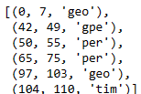

Named Entity Recognition summary
We use NER when we want to extract specific information from text
NER extract structured data from text
Single NER entity e.g. person can have thousands of instances
Position of the entity itself is important, which makes data annotation as well as processing especially challenging
geo
gpe
per
per
geo
tim
org
per
tim

Slide 9
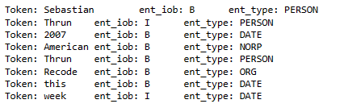
Under-the-hood NER is classifying tokens by their relations to specific entities
B
I
B
When Sebastian Thrun started working on self-driving cars at Google in 2007, few people outside of the company took him seriously. I can tell you very senior CEOs of major American car companies would shake my hand and turn away because I wasn’t worth talking to, said Thrun, in an interview with Recode earlier this week.
Spacy uses BIO labeling by default, where each token in analyzed text can get assigned the following values:
"B": Beginning of an entity
"I": Inside an entity
"O": Outside of any entity
Together with the label it also gets assigned an entity class.
From model perspective we are conducting multilabel classification for each token.
B
B
B
B
B
I

Slide 10
Difference between NER and Classification
Classification
Named Entity Recognition
Categorize the overall meaning or sentyment of a sentence or whole text
Can have multiple labels per text
It is hard to precisely locate part of text, which influenced the decision
Extract short entities (usually 1-3 words), which are important
One entity per any set of words
We have clear location within text for each predicted entity
If our Entities become too long or have unclear boundaries we might be facing an actual classification problem.
Example: „This rental offer includes total monthly costs – the additional administrative rent is paid by the owner”
Can we easily mark the „administrative_rent_included” entity or is it a classification problem?

Slide 11
NER data annotation

Slide 12
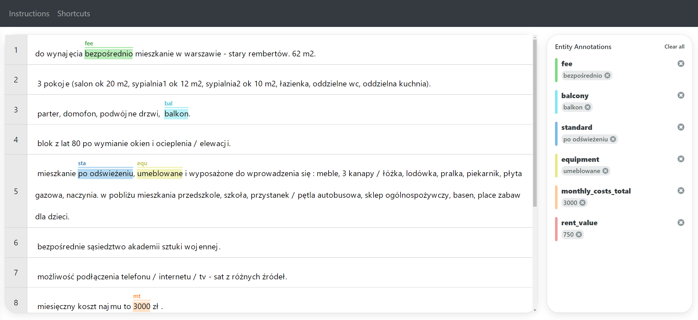
Data annotation is usually the toughest part of NER
Before you start annotation you need to define how many labels you need
Labeling above 10 labels becomes much slower as they might be harder to distinguish
If you are not able to make clear guideliness for each label, their definitions are probably too vague
If you want to mark more than 3-4 words, or event whole sentences your label might be more suitable for classification
Avoid lables, which have a lot of overlap as they will be challenging both in annotation and training
Remove html and split words, which mix chars,nums and interpunction – this will help you make sure you can always annotate whole words as an entity

Slide 13
NER data can be saved in many formats
NER data consists of text, entities and their locations
Different annotation tools have different format
Before we can train our model we often need to transform data format
Data format from AWS Sage Maker
{'workerId': 'some-random-worker-no-123',
'dataObject': {'content': 'Mr. Egeland said the latest figures show 1.8 million people are in need of food assistance - with the need greatest in Indonesia , Sri Lanka , the Maldives and India .'},
'annotationData': {'content': {'entities': [{'endOffset': 11,
'label': 'per',
'startOffset': 0},
{'endOffset': 128, 'label': 'tim', 'startOffset': 119},
{'endOffset': 134, 'label': 'per', 'startOffset': 131},
{'endOffset': 140, 'label': 'gpe', 'startOffset': 135},
{'endOffset': 155, 'label': 'geo', 'startOffset': 147},
{'endOffset': 165, 'label': 'geo', 'startOffset': 160}]}}}
Final format we need for Spacy NER
('Mr. Egeland said the latest figures show 1.8 million people are in need of food assistance - with the need greatest in Indonesia , Sri Lanka , the Maldives and India .',
{'entities': [(0, 11, 'per'),
(119, 128, 'tim'),
(131, 134, 'per'),
(135, 140, 'gpe'),
(147, 155, 'geo'),
(160, 165, 'geo')]})

Slide 14

What is Spacy
Spacy is one of the most popular libraries for NLP
It has a low barier of entry
You can build models within a few dozens lines of code in a notebook
CLI interface great for building production models and replicability

Slide 15
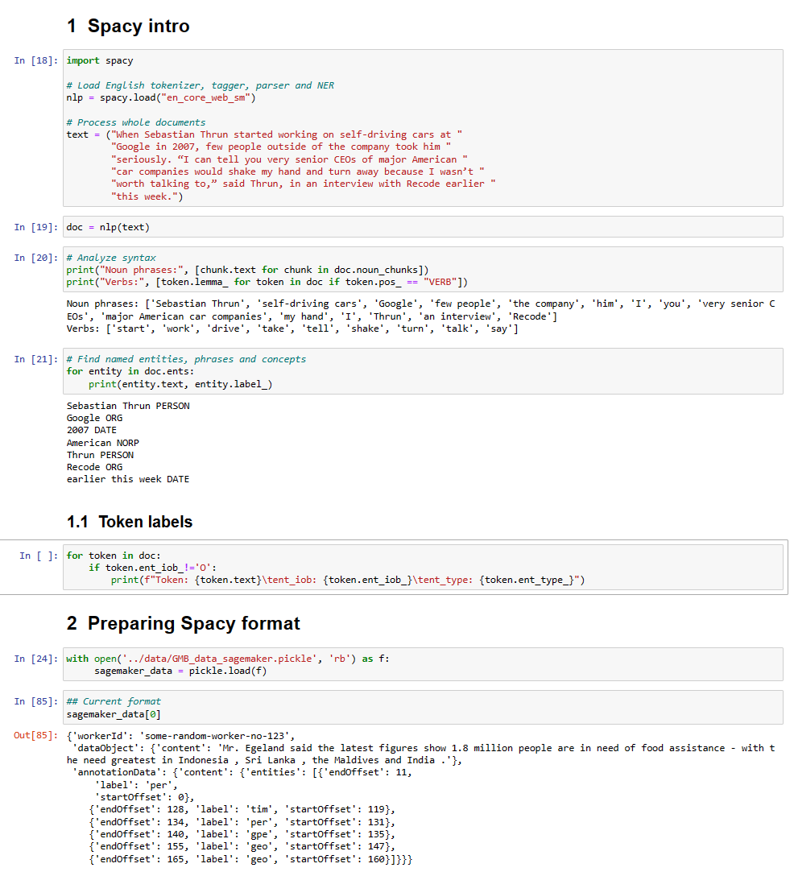
Jupyter exercise NER:
Proceed to notebook W3_NER_BLANK

Slide 16
Classification introduction

Slide 17
Text Classification
Text classification basics
Typical segmentation criteria
Text Classification aims to divide texts into clear classes
We can classify binary classes like spam vs normal email
Or multiple classes like e-commerce category
It is usually easier to work with exclusive classes but we can also have multiple classes per text
Topic e.g. classifying messages from customers
Positive vs Negative e.g. review, sentiment
Business area
Item categorization
Hate speech detection
True vs fake news
Fake accounts

Slide 18
When classification works best… and when it doesn’t
Common use cases
Other approach might work better
Spam classification
Hate speech detection
Categorization e.g. article topic, item category
Problems, where labels can be sorted e.g. sentyment analysis, where we have more than positive/negative – ordinal regression might work better
When we are looking for a high number of categories or very specific information, where we should choose NER

Slide 19
Error analysis in classification

Slide 20
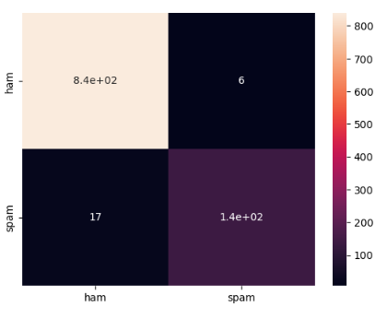
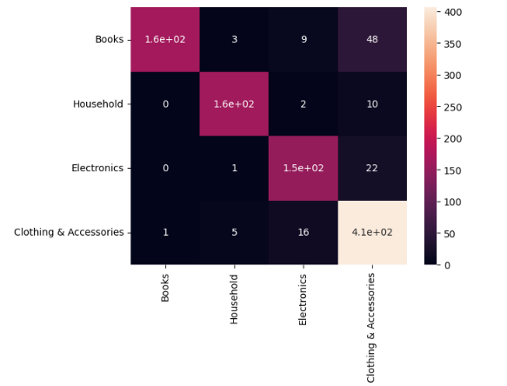
Confusion matrix
Predicted
 | Positive | Negative
Positive | True positive (TP) | False negative (FN)
Negative | False positive (FP) | True negative (TN)
Binary
True
Multi class

Slide 21
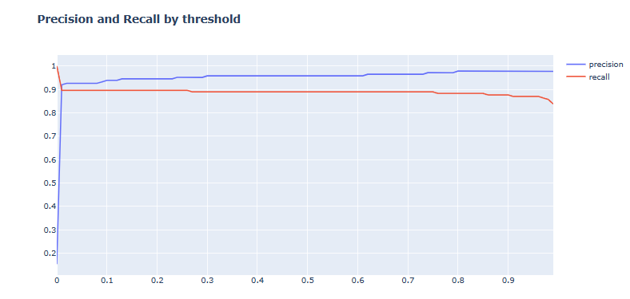


Precision and Recall
How many of our predictions are actually right?
Precision$=\frac{TP}{TP+FP}$
Recall $=\frac{TP}{TP+FN}$
What share of all the instances we were looking for did we actually find?

Slide 22
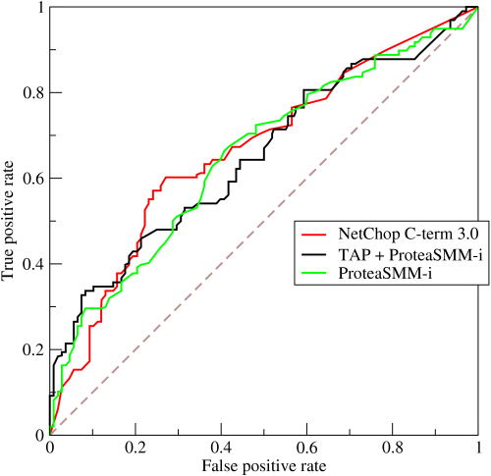
Receiver operating characteristic (ROC)
Choosing the right model and the right decision threshold can be tough – ROC curve is one of the most common evaluation criterias
We can compare multiple models, with different performances depending on threshold by analyzing the area under the curve (AUC) – larger area = better model

Slide 23
Jupyter exercise NER:
Proceed to notebook W3_Classification_BLANK

