Slide 1
Natural Language Processing

Slide 2

About me
Graduated Koźmiński University in Finance&Accounting
Self-taught Data Scientist
Currently working as Data Scientist at Samba TV
Developing Real Estate comparison engine Resider.pl as a side project
Focus on similarity exploration, pricing and working with non-homogenous data

Slide 3
Course Goals
What to expect?
What not to expect?
Exploring NLP use cases and challenges
Introduction to basic NLP theory
Introduction to Large Language Models
Learning how to build first models with popular frameworks such as spacy
Improving Python skills
Group assigment to explore one of NLP techniques at home
Building foundations and a roadmap for further learning
Extensive NLP and Machine Learning Theory lectures
Learning to code in Python from scratch
Becoming NLP expert in 20 hrs
Learning from slides alone

Slide 4
Course Agenda
W1 – Introduction to NLP
W2 – NLP Theory fundamentals
W3 – Named Entity Recognition and Classification
W4 – Introduction to Large Language Models
W5 – Course summary

Slide 5
W1 Agenda
What is NLP?
Between the Hype and everyday use cases
Most common NLP use cases
Python kick-off assignment
NLP in business – key opportunities and pitfalls

Slide 6
What is NLP?

Slide 7
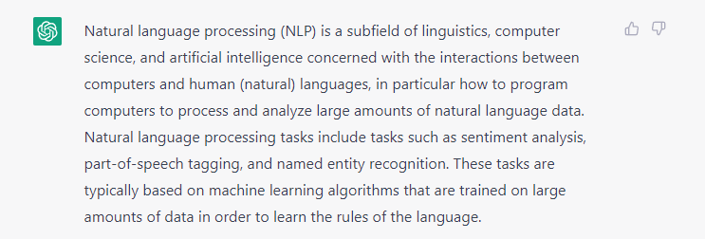

Slide 8

Can you image Artificial Intelligence without a conversation?
As speech is our primary form of communication we require this ability from an Artificial Intelligence
For decades you could communicate with a computer only by knowing how to code
Recent breakthroughs in NLP help computers grasp the human language, which increases their accessibility
Source: Stable Diffusion

Slide 9
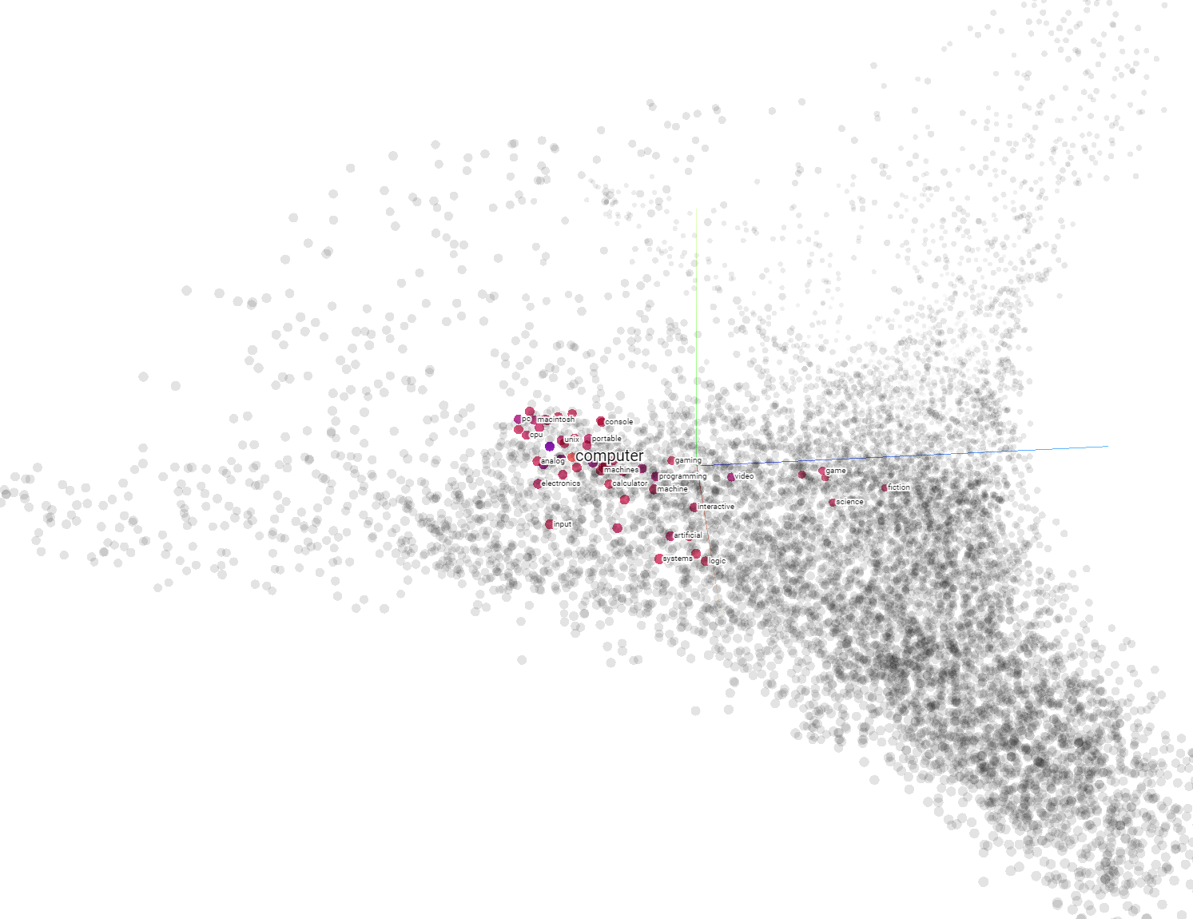
At the end of the day a computer can only understand vectors
Word2Vec vectors
Machines rely on numbers and are not able to understand characters and words
Converting words and sentences to vectors is the foundation of NLP
Even current State-of-the-art solutions, which often reach near human performance are still based on vectors
Enormous increase in computing power over the last few years fuelled rapid development of NLP in last decade

Slide 10
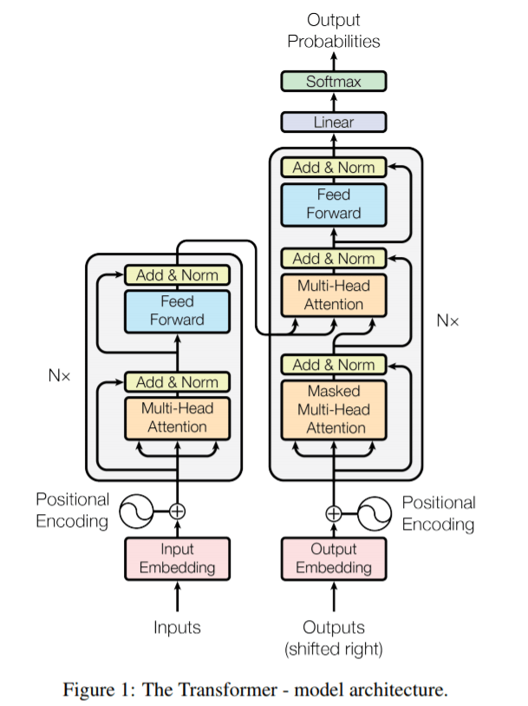
How do machines learn to convert language to vectors?
GPT3 model architecture
Computers learn to „understand” language by imitating humans – similar to a child learning new words
Predicting the most probable word in a sequence is how transformer-based NLP models are trained to convert language to vectors
This ability to learn requires complex architecture – GPT3 has about 175B parameters, and GTP4 will be 500X larger

Slide 11
Between the Hype and everyday use cases?

Slide 12

What are your first thoughts when you hear Natural Language Processing?
Photo by Kelly Sikkema on Unsplash

Slide 13
What are the NLP use cases you can think of?
Photo by Kelly Sikkema on Unsplash

Slide 14
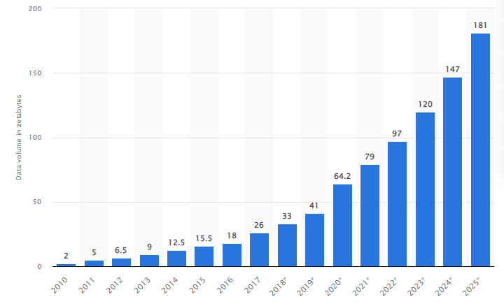
Most Big Data is not structured, that’s why we need NLP
Data created, captured, copied, and consumed worldwide [zettabytes]
Data extraction is the most common use case of NLP as it is easiest to implement with existing analytics
In most businesses NLP main goal is to extract value from the chaos of text data like emails, chats, or descriptions
In more advanced use cases NLP also helps automating repeatable tasks such as performed by customer service bots
Source: Statista
Majority of this data is either text, audio, video or images. NLP helps us extract information from both text and audio

Slide 15



Big Tech gets closer to human performance…
Speech recognition
Chatbots
Translation
Siri
ChatGPT
Creating NLP models, which are hard to distinguish from humans requires enourmous resources in terms of data, computing power and engineering.
Majority of tech breakthrough come from Big-Tech companies. Fortunately they are often open-sourced like Google BERT, which accelerates further research and enables leveraging them in different use-cases.

Slide 16
.. while most companies struggle with extracting personal data from a chat
Models performing simple, single-purpose actions are the backbone of business use cases
Most complex NLP use cases resembling Artificial Intelligence get most of the media attention
In real life business most value is brought by much simpler solutions
Well-written REGEX can often bring more value than building a model from scratch
Extracting structured data from text is still the most common use-case
Popular NLP examples
Find name and phone number in a chat
Find items with a similar description
Classify if the review is positive or negative
More complex systems often consist of multiple simpler, single-purpose models. This is also the safest way to start with NLP implementation

Slide 17
NLP breakthroughs timeline
1950
1960
1970
1980
1990
2000
2010
2020
Relase of ChatGPT in 2022, which gained 1M users in less than a week
Dialog based interface with conversational abilities
first working automatic translation system called "Georgetown-IBM experiment."
able to translate simple sentences from Russian to English.
The introduction of the concept of "word vectors" in the 1980s,
Enabler for the representation of words as numerical vectors. and performing mathematical operations on words
The creation of the "Transformer" architecture in 2017,
Google Open sourcing BERT in 2018 New architecture had ability to quickly adapt to new task with fine-tuning on new data
Release of GPT-3 model by OpenAI
Large increase in model complexity and size
Adapted with over 300 commercial applications within 9 months from launch
The development of recurrent neural networks
Their effectiveness in modeling sequences make them crucial element of NLP

Slide 18
Most common NLP use cases

Slide 19
Sentiment analysis
„The Hathaway Effect” – sentyment analysis gone wrong or a statistical anomaly?
In 2011 Dan Mirvish spotted high correlation between Anne Hathaway’s movie premieres and spikes in Berkshire Hathway stock prices.
His theory stated that automated robotic trading, which relies heavily on setiment analysis could pick up all the occurences of positive sentiment related to Hathaway.
Although not proven statistically the theory is probable and was investigated by Nobel Price winner Paul Krugman and discussed at Bekshire Hathaway shareholders meetings
Common NLP algorithm which aims to identify subjective information from text
Usefull for learning purposes, as opinion related words have clear positive/negative vector interpration
Use cases ranging from customer reviews to trading bots
Can focus on negative vs positive or focus on more specific emotions or opinions
Sarcasm, irony is most challenging to handle in Sentiment Analysis cases

Slide 20
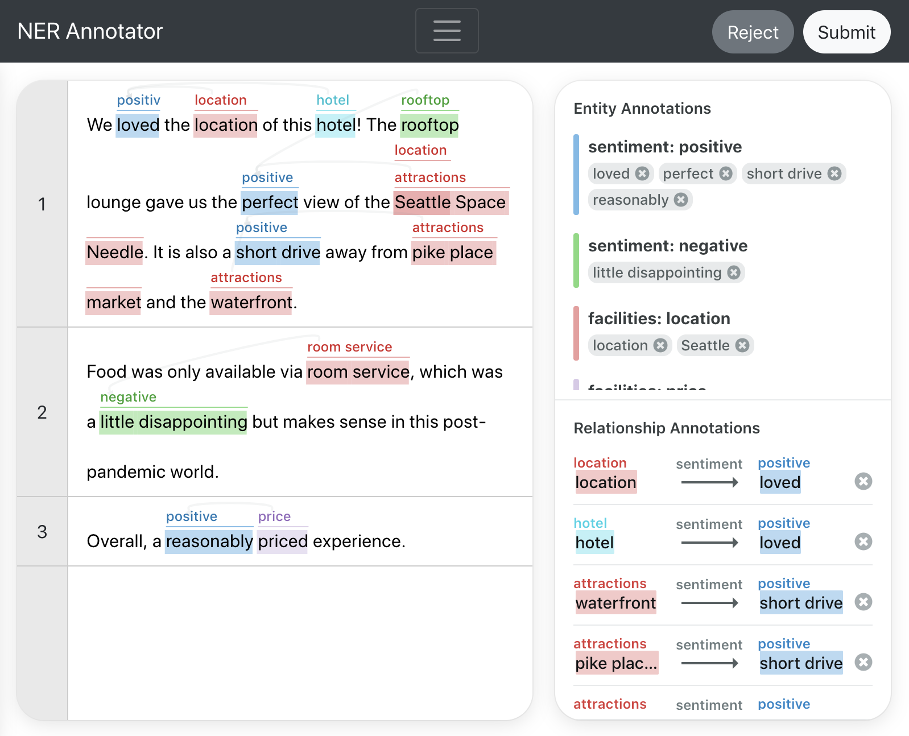
Named Entity Recognition
NLP technique used to identify and classify named entities in text
Named entities can include names, dates, job titles, brands or any other entity types, which are easily classifiable by humans within a few words
Easy to integrate with current analytics and used for data enrichment as it extracts structured data from text
One of the most explainable NLP techniques
NER data annotation is time consuming and challenging
Source: AWS Sage Maker tutorial

Slide 21
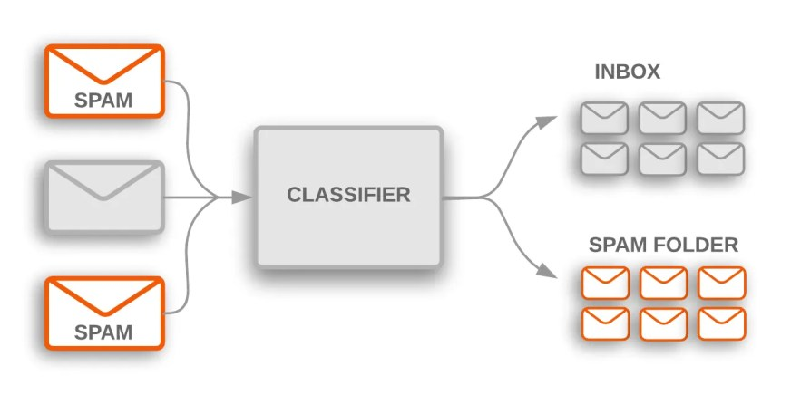
Text classification
NLP technique used to classify sentences or longer pieces of text
Use cases range from Spam or hate speech detection to article topic classification
Data labeling is reasonably easy and can rely on customer feedback loop as seen in Gmail spam classifier
Source: developers.google.com

Slide 22
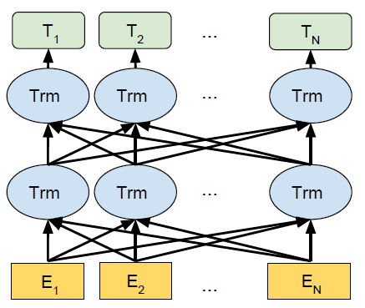
Language Translation
Bidirectorial approach is crucial translation as different languages vary in syntax and sentence order
One of first large-scale use cases of NLP, which has the benefit of reducing language barriers online
Efforts by Google resulted in the creation of BERT and accelerated Transformer based NLP development
Currently there are dozens of different translation tools as development in NLP architectures and easy access to language corpus online make training easier
Source: Devlin et al. 2019

Slide 23
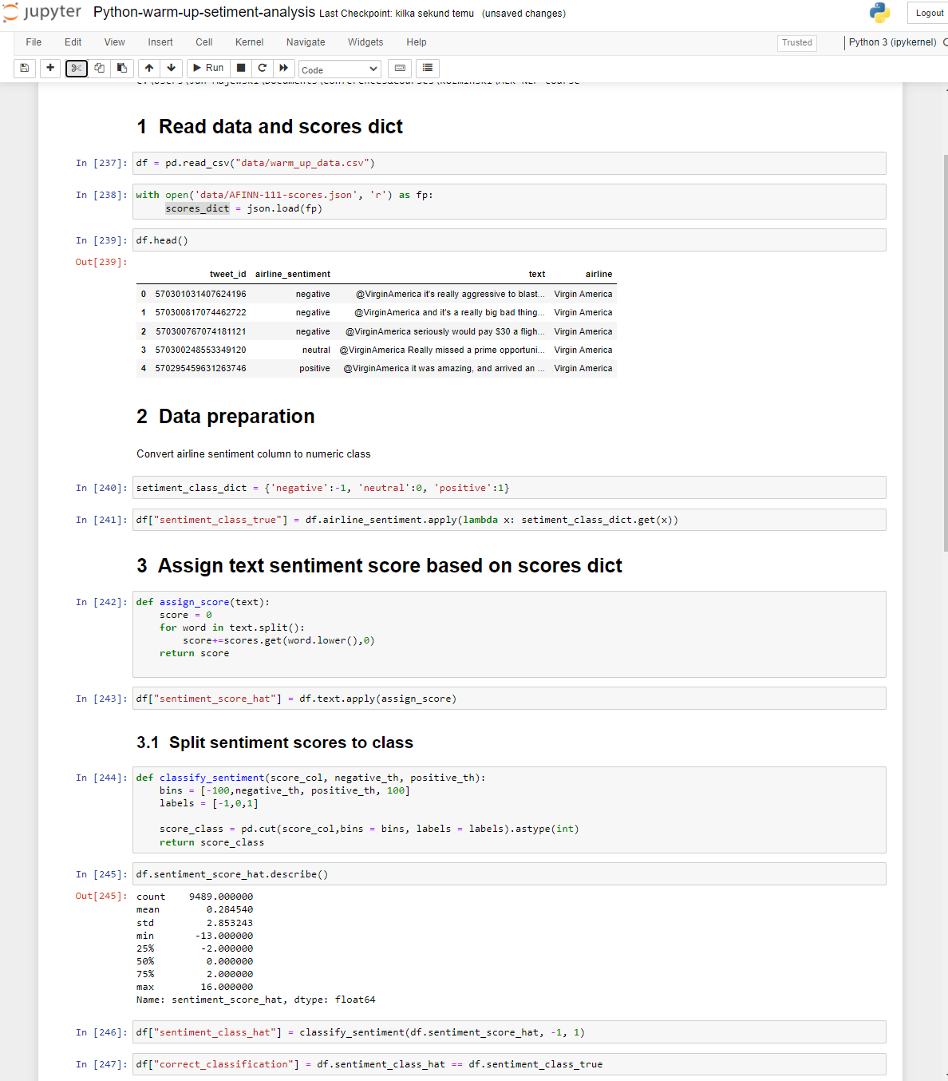
Python Warm-up Twitter sentyment analysis

Slide 24
GH link
Setup a folder for the whole course
Clone course materials: https://github.com/Jan-Majewski/ALK-NLP-course.git
Open Jupyter Notebook
Open Python-warm-up-setiment-analysis.ipynb BLANK version
Follow instructions within the notebook

Slide 25
NLP in business – key opportunities and pitfalls

Slide 26


Non-technical people have a tendency to overestimate NLP models „intelligence”
Pros
Cons
Opportunity to shine, as even easy NER seems as a model that „understands”
A lot of low hanging fruits, which cannot be extracted even with unlimited hours of Data Analysts
If NLP is not yet widely used even basic knowledge and out-of-the-box solutions can bring visible value
As a data professional you need to control their enthusiasm
Good communication is essential to avoid overpromising
Businesses might expect that NLP will handle data quality issues better than humans
LLMs like Chat GPT raised the bar in terms of expectations but are still too slow and too expensive for majority of everyday use cases

Slide 27
Majority of models you will work on will be far from „understanding” anything
At their core NLP models work as any other model
Can we compare similar items within same brand based on description?
They optimize for a given loss function
They can find common relations
Usually human performance is still far way off
They need good data to learn from
If we want to create an appearance of logical reasoning, we will probably need multiple steps guiding the logic
What steps do we actually need to Conduct?
1. We don’t have structured data so we need to train brand detection NER
2. Use NLP to create meaningful vector and define similarity – should it be price or user interest?
3. Implement Nearest Neighbor search algorithm, choose distance metric
4. Evaluate model performance, do we even have annotated data?

Slide 28
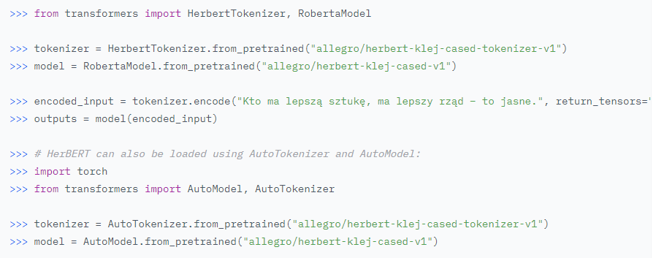
NLP accessibility exploded over last few years
While a few years back any real-life implementation needed a strong research team and tonnes of data
Now out-of-the-box solutions like Spacy make it 10x easier
Multiple models on Hugging Face with ability to easily retrain them for domain-specific data
Less popular languages such as polish finally catch-up in performance to English or Chinese
Loading HF model takes 5 lines of code
Learning how to leverage these resources is one of key goals of this course

Slide 29
Do we need other NLP methods if LLMs can handle the majority of tasks?
Find named entities within text
LLMs are very large and using them for simple tasks is a complete overkill
They are slower and more expensive than streamlined, task-specific models
In many cases precise prompt engineering takes too many tokens to be cost efficient
LLMs can be used to speed up training data for smaller models
Thunder the service dog gets sniffed on the sofa by BBC Breakfast's Charlie Stayt
Spacy
GPT 4
Response: 6ms
Costs: 6ms of compute time (next to zero)
Response: 2380 ms (400x longer)
Costs: around 1 cent

