Slide 1
Natural Language Processing
NLP Theory fundamentals

Slide 2
W2 Agenda
Text preparation and tokenization
Word embeddings and similarity
Sequence models
Attention & Transformers

Slide 3
Text preparation and tokenization

Slide 4
How to clean text before NLP tasks – text preprocessing
Use REGEX first to remove any unwanted patterns
Tokenize text into words
Simplify words with stemming
“#FollowFriday @France_Inte @PKuchly57 @Milipol_Paris for being top engaged members in my community this week, see more at https://www/randomwebsite.com”
Regex
“FollowFriday @France_Inte @PKuchly57 @Milipol_Paris for being top engaged members in my community this week, see more at”
Tokenization
['followfriday', 'for', 'being', 'top', 'engaged', 'members', 'in', 'my', 'community', 'this', 'week', ',', 'see', 'more', 'at']
Stemming
['followfriday', 'for', 'be', 'top', 'engag', 'member', 'in', 'my', 'commun', 'thi', 'week', ',', 'see', 'more', 'at']

Slide 5
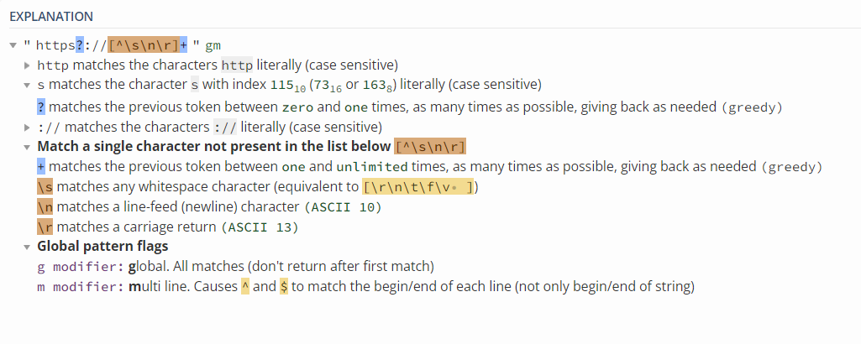
REGEX – „simple” but indispensable
Each REGEX should start with… checking stack-overflow
How to remove all hyperlinks from text with REGEX?
re.sub(r'https?://[^\s\n\r]+', ‘’, text)
Tokenization depends on generalization and some real life case text examples is not tokenizable unless small changes are applied
REGEX 101 helps with testing and interpretability
If you have a mix of characters and numbers some tokenizers will fail e.g. „Price for this appartment is 500.0zł”
Same applies to use of special characters like ["/",":", "-", "\\","+","<", ">"] when used without spaces

Slide 6
Tokenization – BERT example
SoTA Tokenizers are more complex in handling words
They will have some most common words in their vocabulary
But for less frequent ones are represented by multiple tokens
Some words can not be present in tokenizer vocab, they would et an OOV token
in BERT tokenizer case they would probably still be tokenized as chars
BERT Tokenizer example
Spell has its own token – 6297
Mispelled will be tokenized as [3335, 11880, 3709], which corresponds to [‘miss’, ‘##pel’, ‘##led’]

Slide 7
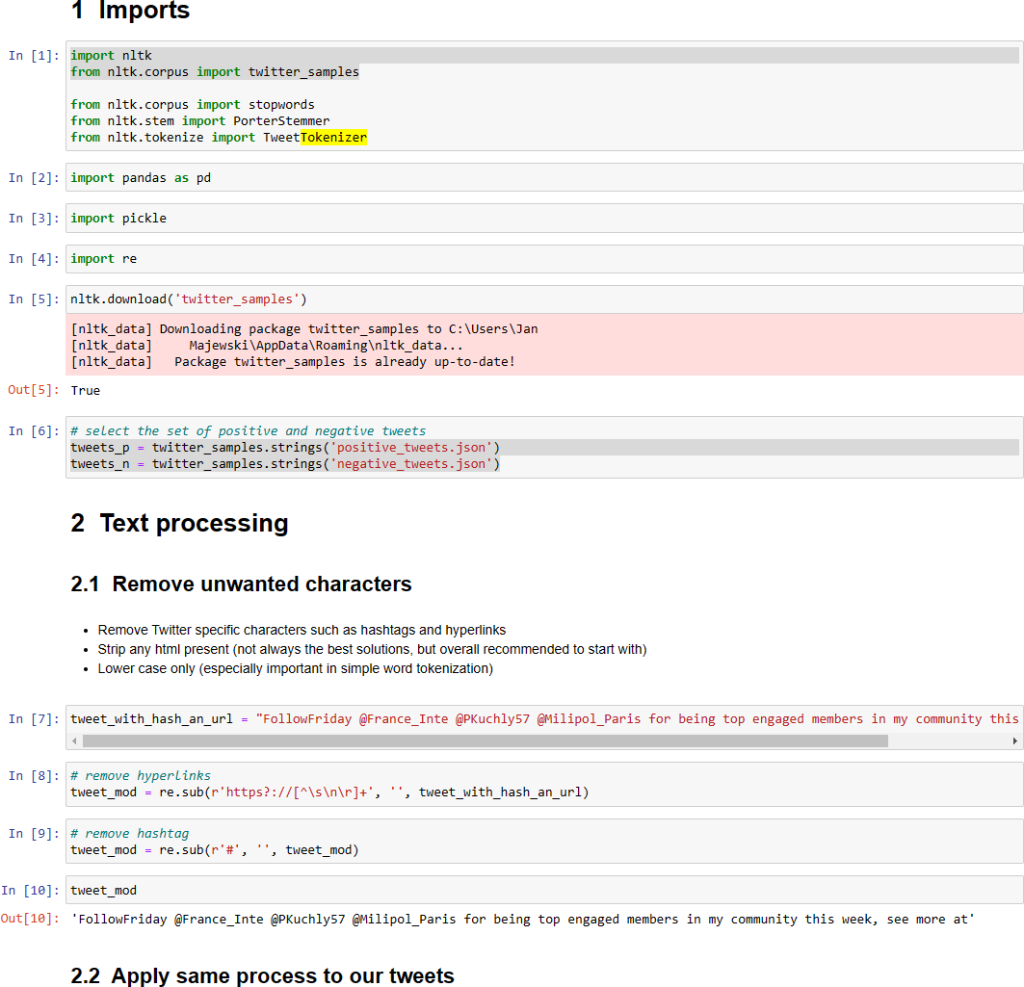
Jupyter notebook part 1:
Proceed to notebook Text- preprocessing-and-vectorization and follow steps 1-5

Slide 8
Word vectors and similarity

Slide 9
Coocurence matrix / similarity
Word by word
Word by doc
How to vectorize words
Translating words into vectors might sound abstrack at first but with a text corpus large enought we can vectorize words based on the context they appear in
We can approach word vectors by word-by-word approach if we want to classify their meaning
Or any other context e.g. word-by-doc if we want to Focus on task-specific vectors, which will allow us to use text vectorization to classify text by its domain
Data Science is popular these days
Quality of data is popular issue among companies
Co-occurrence matrix allows gives us a meaningful word vector based on words context
 | popular | science | quality
data | 2 | 1 | 1

Slide 10
How to measure similarity
Measuring vector similarity is challenging, especially in high dimensionality
While Euclidean distance is easily applicable for 2D data it performs badly with higher dimensions
Cosine distance is most popular in measuring similarity
It is based on vectors direction and ranges from -1 (opposing vectors) to 1 (proportional vectors), while orthogonal vectors have a similarity of 0.
speed
frequency in science articles
v2
velocity
v1
Euclidean distance v1-v3
Euclidean distance v2-v3
Cosine distance v1-v3
sprinter
v3
Cosine distance v2-v3
frequency in sport articles

Slide 11
Word vectors allow us to actually extract relations between words
Word vector space
If we take two word pairs – (Poland, Warsaw) and (England, London) both these pairs will create a similar vector
This is the product of similar context they are present in
If we have a large corpus of news, and articles there will be multiple coocurences of phrases like „{Warsaw/London} is the capital city of {Poland, England}”
Poland
England
Warsaw
London
Word vectors are not just some abstract conversion of words, to numbers. As they are based on words context and coocurence vectors keep some of this information

Slide 12
Classical word embedding method examples
word2vec (Google, 2013)
Continuous bag-of-words (CBOW): the model learns to predict the center word given some context words.
Continuous skip-gram / Skip-gram with negative sampling (SGNS) : the model learns to predict the words surrounding a given input word.
Global Vectors (GloVe) (Stanford, 2014) : factorizes the logarithm of the corpus's word co-occurrence matrix, similar to the count matrix you’ve used before.
fastText (Facebook, 2016): based on the skip-gram model and takes into account the structure of words by representing words as an n-gram of characters. It supports out-of-vocabulary (OOV) words.
Classical (non Deep learning) word embeddings were an important step in NLP development and are great for understanding the basics, but they are not used that much in real life use cases anymore

Slide 13
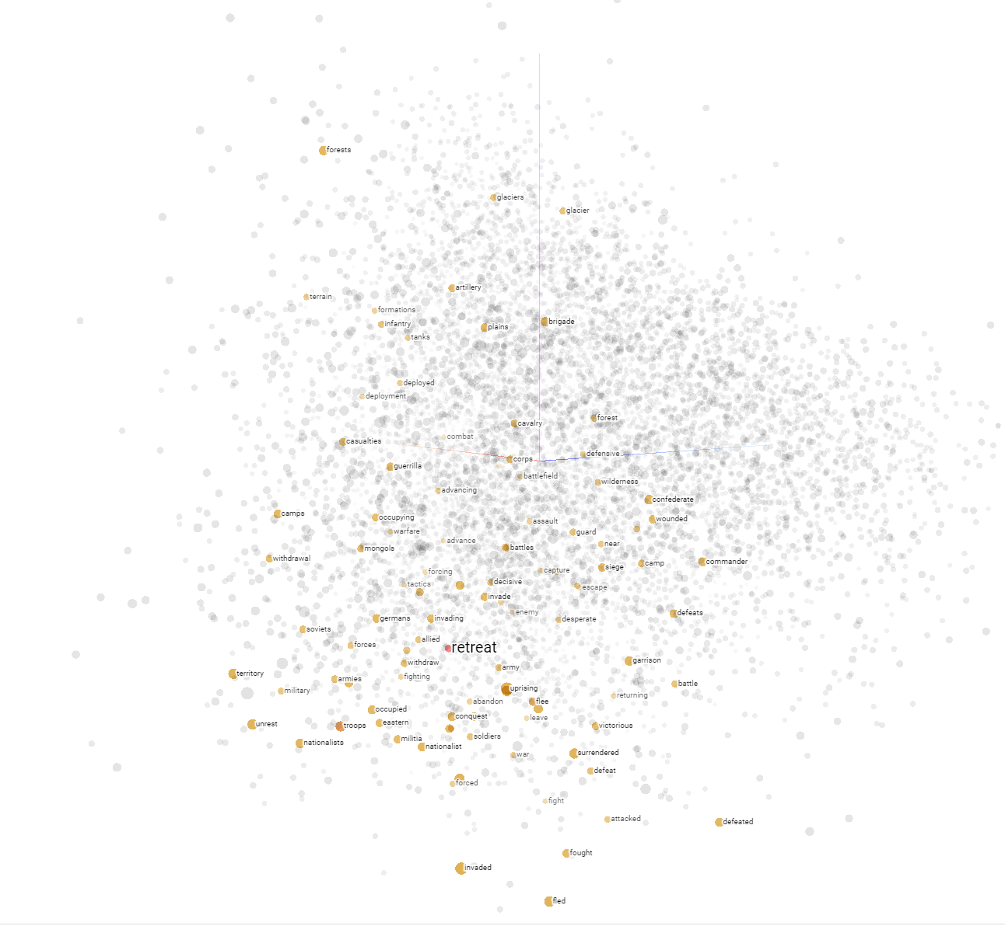
Visualizing vectors – dimensionality reduction
Multi-dimensional vectors are hard to visualize as we can see only 3D
With word vectors they tend to have hundreds of dimensions
Depending on the task, majority of the information might be hidden within ~5% of dimensions only
We use Dimensionality Reduction algorithms to visualize similarities in high-dimensional space without loosing too much information
Most commonly used algorithms include T-SNE or PCA
Explained variance represents loss of information due to dimensionality reduction
Experiment yourself on https://projector.tensorflow.org/

Slide 14
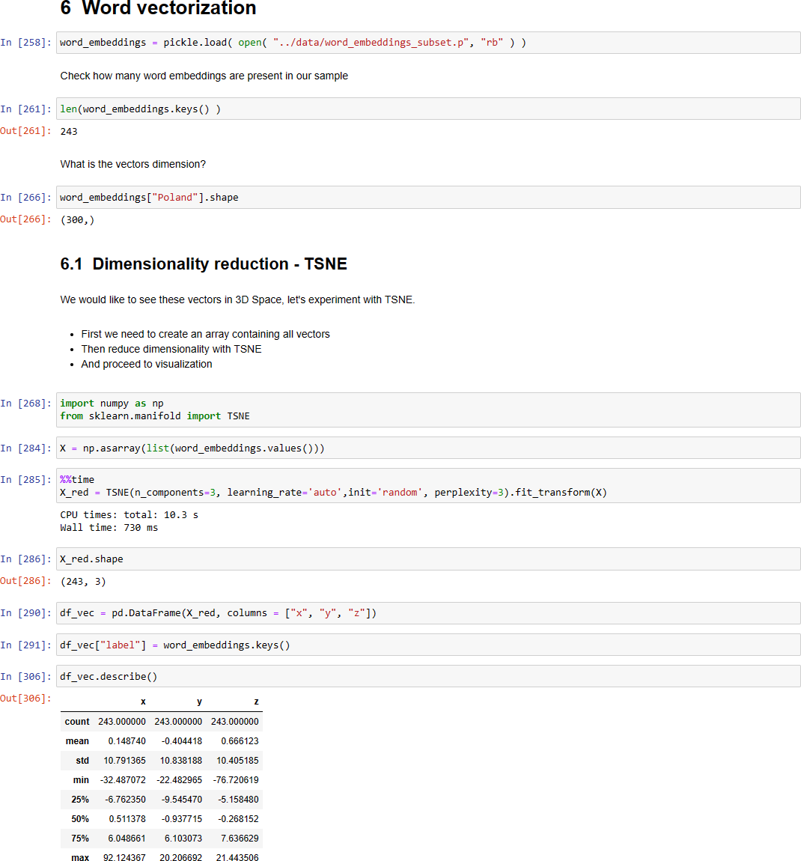
Jupyter notebook part 2:
Proceed to notebook Text-preprocessing-
and-vectorization and follow steps 6-8

Slide 15
What are N-grams?
N-grams help determining probability of words happening in specific sequence
One of their common use cases is autocorrect
Their complexity explodes once we go into higher n-values
N-grams are not used very often as sequential models and transformers perform better in the majority of cases
Their are however important fundation for NLP development
trigram
4-gram
bigram
We are learning NLP basic

Slide 16
Leveraging Neural Neutworks in embeddings
There are multiple ways of word embeddings, but leveraging Deep Learning for this task is becoming more and more common
This is an example of a self-supervised task. It is unsupervised itself, as we have no labeled data for the correct embeddings. However the corpus we use for training provides necessary contex, which has some similarities to a supervised learning problem
Embeddings are often created as by- product of a supervised NLP task, this allows us to guide our embeddings to match our specific objective
Examples of more popular DL embeddings
BERT (Google, 2018):
ELMo (Allen Institute for AI, 2018)
GPT-2 (OpenAI, 2018)
These pre-trained embeddings for the following model can be downloaded and leveraged in other tasks

Slide 17
Leveraging Neural Neutworks in embeddings
There are multiple ways of word embeddings, but leveraging Deep Learning for this task is becoming more and more common
This is an example of a self-supervised task. It is unsupervised itself, as we have no labeled data for the correct embeddings. However the corpus we use for training provides necessary contex, which has some similarities to a supervised learning problem
Embeddings are often created as by-product of a supervised NLP task, this allows us to guide our embeddings to match our specific objective
Examples of more popular DL embeddings
BERT (Google, 2018):
ELMo (Allen Institute for AI, 2018)
GPT-2 (OpenAI, 2018)
These pre-trained embeddings for the following model can be downloaded and leveraged in other tasks

Slide 18
Evaluating word embeddings
Intristic
Extrinsic
Sanity checking embeddings to see if they reflect logical/linguistic relation
Our Country->Capital example was an example of such evaluation
Clustering and Visualization can be further leveraged to see if word embeddings are correctly grouped
Not very scalable if we do not have at least some labeled data
„Trial by combat” – we test embeddings on a task like Named Entity Recognition or Part of speech tagging and compare against a baseline
Time consuming than a quick sanity check
Easier to measure – we only have better embeddings if they beat the baseline
Another degree of freedom, where the model performing the task itself effects the results

Slide 19
Sequence models

Slide 20
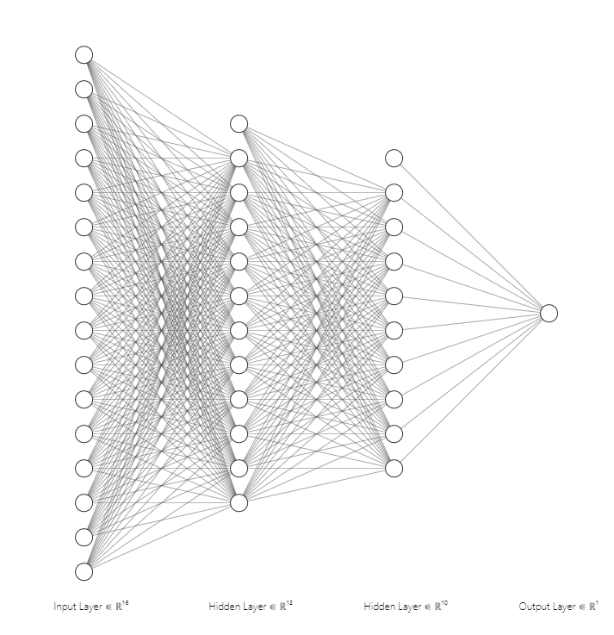
Intro to Deep Neural Networks
Deep Neural Networks can learn complex patterns and handle language data well
Another advantage of DNNs is the fact, that their training process creates langiage embeddings as a side-product
We can extract embeddings (with different dimensionality) by disecting one of hidden layers
Deep Neural Network diagram

Slide 21
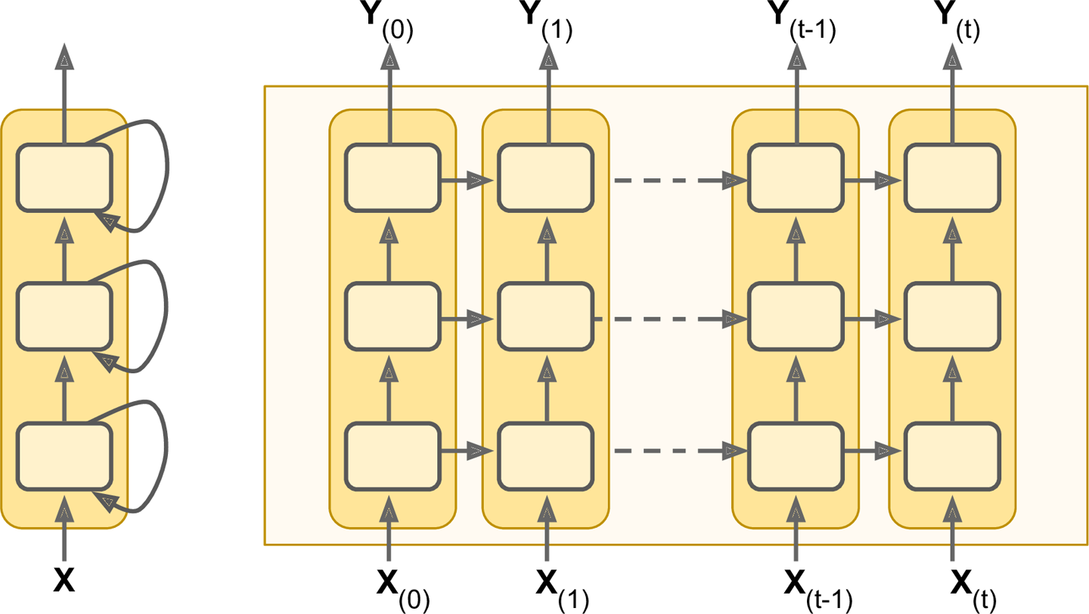
Reccurent Neural Networks
RNNs is a DNN architecture created specially for sequential data such as timeseries or language
It has the ability to „remember” outputs from previous steps
More advanced cells like LSTMs and GRUs make the „memory” aspect of Neural Networks even more robust
Recurrent Neural Networks
Source: https://www.oreilly.com/

Slide 22
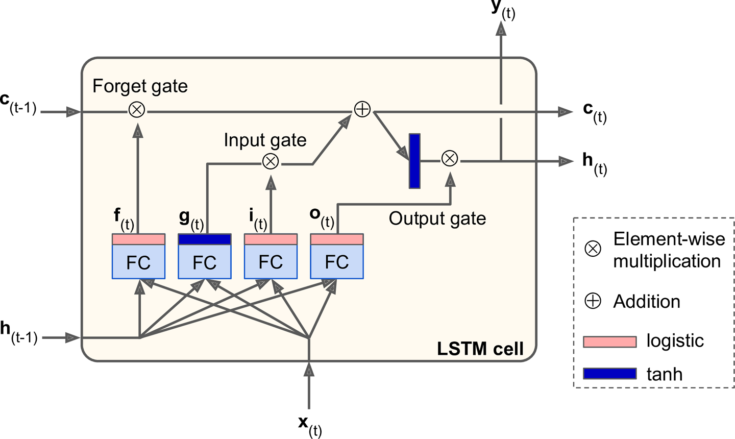
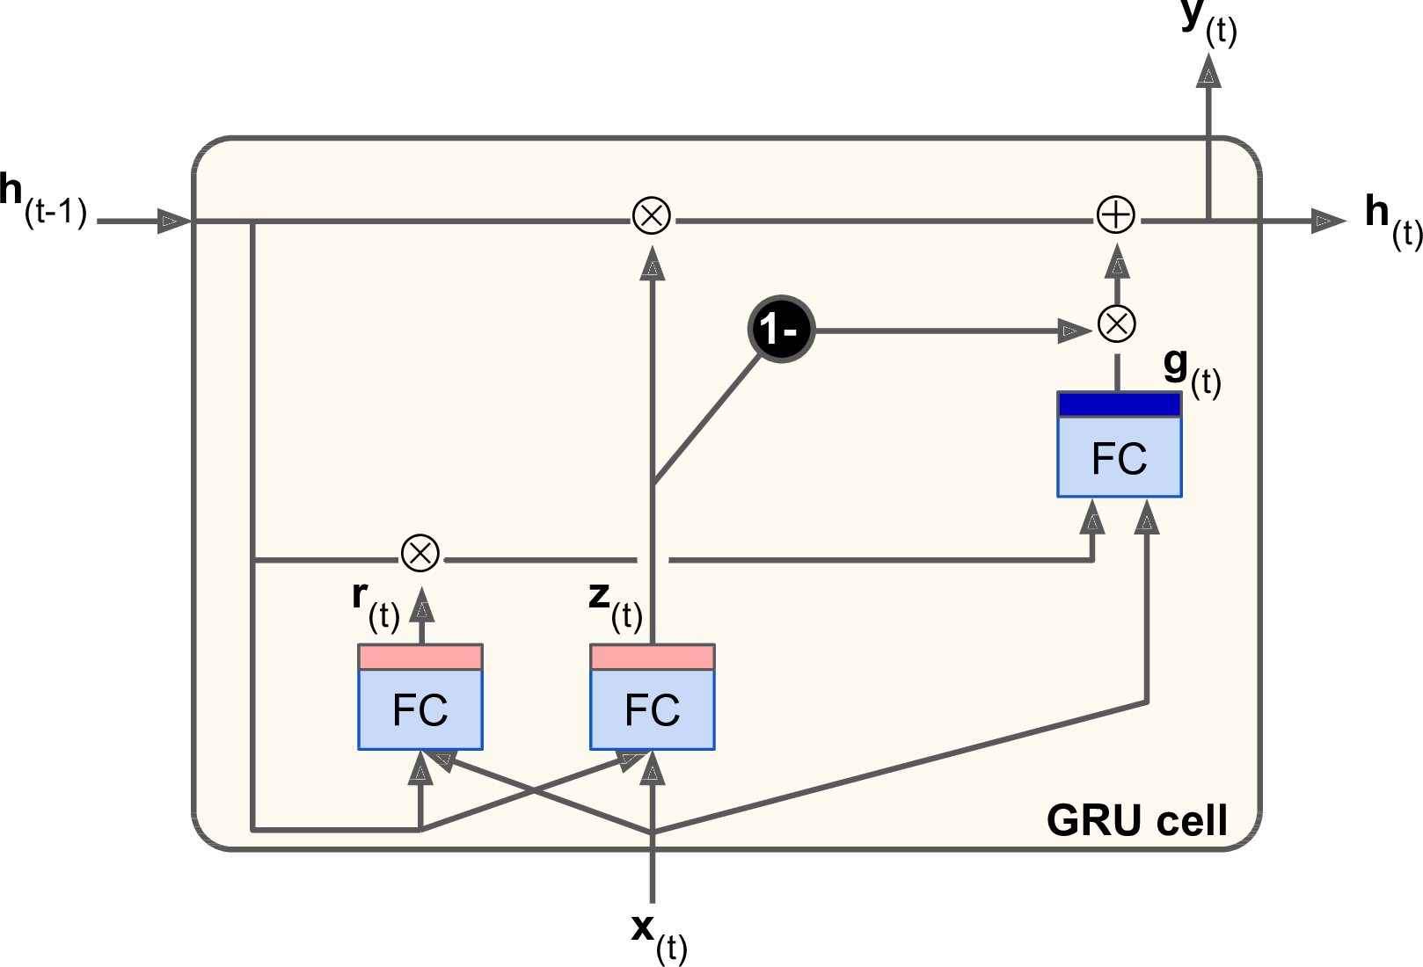
How memory aspect makes RNNs so useful
N-gram models can become extremely heavy as the possible numer of word combinations quickly explodes
RNNs are much better at grasping the context of words, which are not directly together
Furthermore LSTM and GRU cells, which are more complex than simple neuron cells have specific gates, which memorize important information
Despite their complicated appearance we can use them in place of classic RNN layers without significant changes
Long-short-term-memory cell
Gated Recurrent Unit
Source:https://www.oreilly.com/
Source: https://www.oreilly.com/

Slide 23
Attention & Transformers

Slide 24
Sequence models shortcomings
Reccurent models rely strongly on sequentiality, where output of previous state is essential for calculating next state
This makes parallelization impossible and creates issues when working with larger sequence lenghts
This sequential approach also looses information with the distance. Majority of the information at the begging of the text will be lost towards the end
Key RNN challenges
No paralel computing
Loss of information
Vanishing gradients

Slide 25
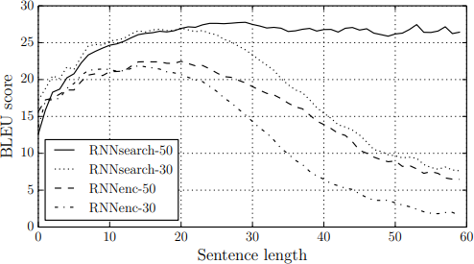
How to implement attention to sequential models
Performance on BLEU translation benchmark by sentence lenghth
One way to fix RNNs issue with longer
sequences is to apply attention mechanism
Traditionally all previous hidden states are combined into one vector
Attention mechanism allows to summarize all previous states in a more meaningfull way creating a context vector
Source: „Neural Machine Translation by Jointly Learning to Align and Translate” Dzmitry Bahdanau

Slide 26
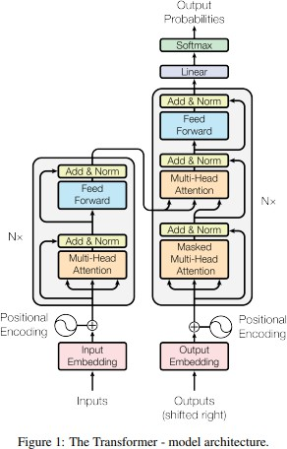
Transformers
Transformer models are a type of Neural Network architecture designed to process sequential data first introduced in "Attention Is All You Need" by Vaswani et al. in 2017.
Despite their initial use in NLP, they are very versatile and widely adapter in other areas of ML
They are able to process input sequences in paralel
Their attention mechanism allows to avoid loss of key information, even if is high distance apart within the sequence
Source „Attention Is All You Need" by Vaswani et al. in 2017.

Slide 27
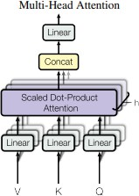
Transformers – high level overview
Encoder: Processes the input data (e.g. a sentence) and converts it into a set of attention-based representations. These representations capture the context and relationships between different elements in the input.
Decoder: Generates the output data (e.g., the translated sentence in another language) step by step. It uses the representations from the encoder and the previously generated outputs to predict the next element in the sequence.
Decoder
Encoder
Each Encoder layer consist of 2 sublayers:
Multi-head self-attention mechanism
Fully connected feed-forward
Network
Each Encoder layer consist of 2 sublayers already present in Decoder + an additional sublayer:
3. Masked Multi-Head attention to prevent positions from attending to subsequent positions
The masking together with output embeddings offset guarantees that the model does not cheat by peeking at future tokens
Source „Attention Is All You Need" by Vaswani et al. in 2017.

Slide 28
Transformers – Self Attention
This mechanism allows the model to weigh the importance of different parts of the input when processing a particular element. For example, in a sentence, the importance or relevance of other words when considering a specific word.
- Attention Scores: The model computes scores to determine how much focus to put on other parts of the input for each word in the sequence.
- Attention Weights: These scores are then normalized to form a distribution (using functions like softmax), so that they add up to one.
-Contextual Representation: Each word's representation is then updated by summing up the representations of all words, weighted by these attention weights. This process ensures that each word’s new representation is a blend of its own and others' based on their relevance.

Slide 29
Transformers – high level overview
ELMo
Embeddings from Language Model by University of Washington in 2018
Uses bi-directional LSTM, which use inputs from boths left and right of the sequence
Suffered issues with long-term dependencies as it was not a tranformer model
Order of introduction
GPT
Generative Pre-training Transformer by OpenAi in 2018
Uni-directional transformer model
BERT
Bidirectional Encoder Representations from Transformers by Google in 2018
Bidirectionality implemented into transformers
T5
Text-To-Text Transfer Transformer developed by Google in 2020
Leverages transfer-learning and transformer architecture
Designed to perform wide range of task by fine-tuning on specific datasets

Slide 30
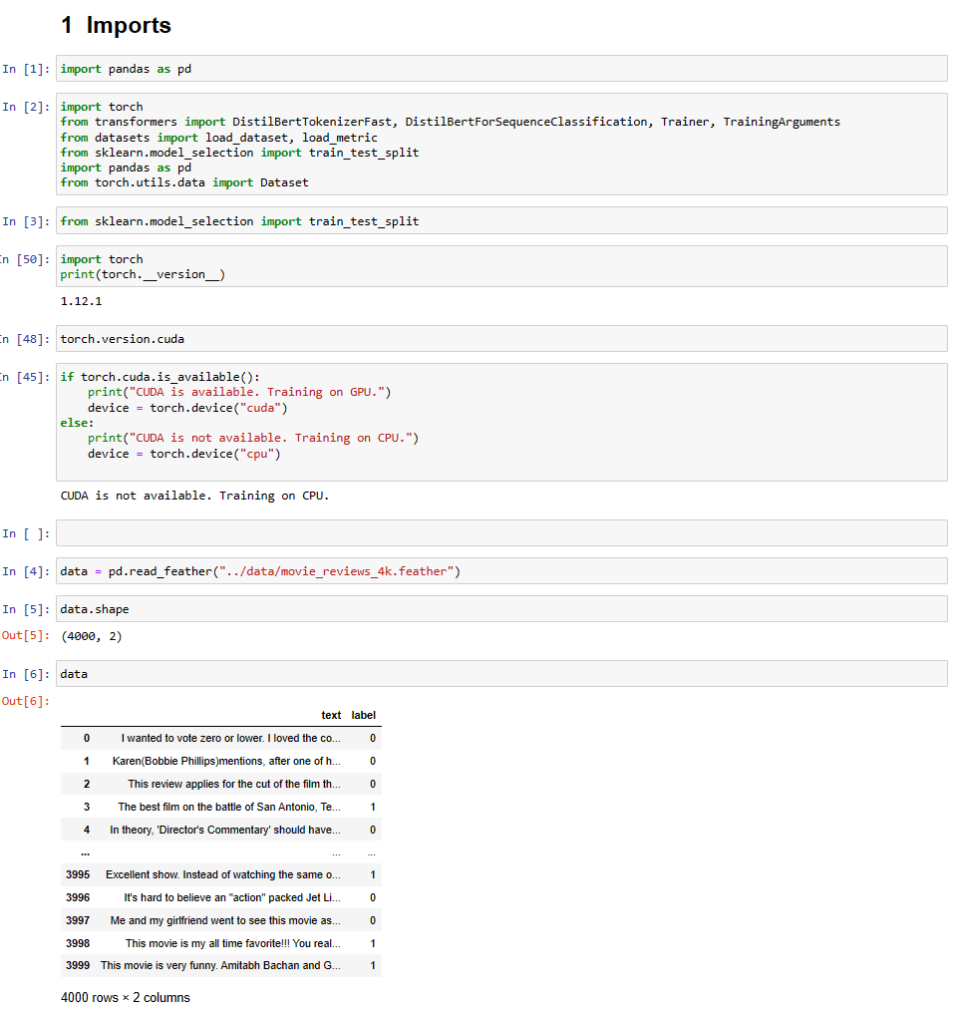
Transformer fine-tuning exercise
Go to Sentiment_classification_with_BERT.ipynb where we will leverage Transfer Learning with BERT model in our own tweet sentiment classification

