Slide 1
Natural Language Processing
Large Language Models

Slide 2
W5 Agenda
What are LLMs
Prompt Engineering
Model Fine-tuning
Retrieval Augmented Generation
Building an LMM powered App

Slide 3
What are LLMs

Slide 4
What are LLMs?
Large Language Models (LLMs) are Generative AI models designed to understand, generate, and interact with human language. They can process and generate text, answering questions, creating content, and even engaging in conversation.
LLMs are trained on vast datasets of text from the internet, including books, articles, and websites, using deep learning techniques. This training enables them to learn language patterns, grammar, and context. Despite their impressive abilities the training is still focused on next word prediction
They are used in a variety of applications such as chatbots, content creation, language translation, and sentiment analysis. LLMs are integral to enhancing human-computer interaction and automating complex language tasks.
Most popular LLMs include the pioneers in the domain such as Google’s BERT and OpenAi’s GPTs. Models from challengers such as Claude or open sourced models from Mistral AI are also catching up in performance.

Slide 5
Key LLM training steps
Data Preparation & Tokenization
Model Architecture Design
Pre Training
Fine Tuning & RLFH
Collection of a vast and diverse datasets such as books, websites, and other textual materials.
Preprocessing of this data to clean and format it for training
Tokenizing text into format procesable by models
Transformer architecture allowed rapid growth of LLMs
Different architectures and model sizes (params) have significant impact on performance
BERT uses Bidirectional Encoder only architecture
GPT uses Decoder only uni-directional architecture
T5 keeps whole Encoder-Decoder setup
The model undergoes unsupervised learning, where it learns to predict the next word in a sentence by being fed large amounts of text.
This stage is critical for the model to learn language patterns, grammar, context, and general world knowledge.
Model is further trained on specific tasks and datasets in supervised learning setup
The model receives feedback from human trainers to correct mistakes and improve its understanding.
This iterative process helps in refining the model's responses and reducing biases.

Slide 6
Reinforced learning from human feedback
Reinforced learning logic
Reinforced learning logic
Agent
Intruct fine-tuned LLM
Rank different answers from trained models
Maximize helpfulness and relevance
Minimize harm
Avoid dangerous topics
Human Feedback
State change
Reward
Action
Environment
Human aligned LLM

Slide 7
Memory requirements
Approximate GPU RAM to train 1B params
Memory needed to train model - weights, optimizer, calculating backpropagation
GPT 3.5:
175 billion -> 4 200 GB
GPT 4:
1.76 trillion parameters -> 42 240 GB
24GB
Memory needed to store model
4GB

Slide 8
How LLMs changed ML
LLM Development
Classic ML
No ML expertise needed
No training examples and clear loss function
Reasonable output without training
All communication with model based on natural language prompt
Model aims to follow prompt instructions - loss function is not that clear and easy to change
ML expertise needed to get started
Training samples needed
Needs to be trained for a specific task
All communication with model based on natural language prompt
Model aims to minimize a loss function

Slide 9
Evaluating LLM performance

Slide 10
Human labeled benchmark datasets
GLUE (General Language Understanding Evaluation) and SuperGLUE Benchmarks:
Designed to evaluate natural language understanding (NLU).
Includes a series of tasks like sentiment analysis, question answering, and textual entailment.
SuperGLUE is an advanced version of GLUE with more challenging tasks.
BLEU (Bilingual Evaluation Understudy) Score for Translation Tasks:
Commonly used for evaluating the quality of machine-translated text compared to human translations.
Focuses on how many words and phrases in the machine translation appear in the human translation.
Commonly used for text translation
ROUGE (Recall-Oriented Understudy for Gisting Evaluation)
Set of metrics for evaluating automatic summarization and machine translation software in natural language processing.
It compares an automatically produced summary or translation against a set of reference summaries, typically human-generated, using measures such as the overlap in unigrams, bigrams, trigrams, and longest common subsequences.
Commonly used for summarization tasks

Slide 11
Massive models bechmark
Massive Multitask Language Understanding (MMLU)
Big-Bench
Comprehensive evaluation framework designed to assess the performance of language models across a wide range of subjects and tasks.
It includes over 50 different tasks covering a diverse set of topics such as science, humanities, social sciences, and professional domains, aimed at testing the depth and breadth of a model's understanding.
MMLU is known for its challenging nature, requiring models to not only understand the nuances of human language but also to demonstrate knowledge and reasoning abilities across various disciplines.
BIG-bench (Beyond the Imitation Game Benchmark) is an extensive benchmark designed to evaluate and push the limits of large-scale language models in areas like reasoning, creativity, and understanding.
It encompasses a diverse range of tasks, over 200 in total, that cover a wide array of domains including mathematics, common sense reasoning, linguistics, and even ethical judgment.
BIG-bench is unique in its focus on tasks that are challenging for current models, aiming to identify the limitations of existing AI and guide future research in natural language understanding and generation.

Slide 12
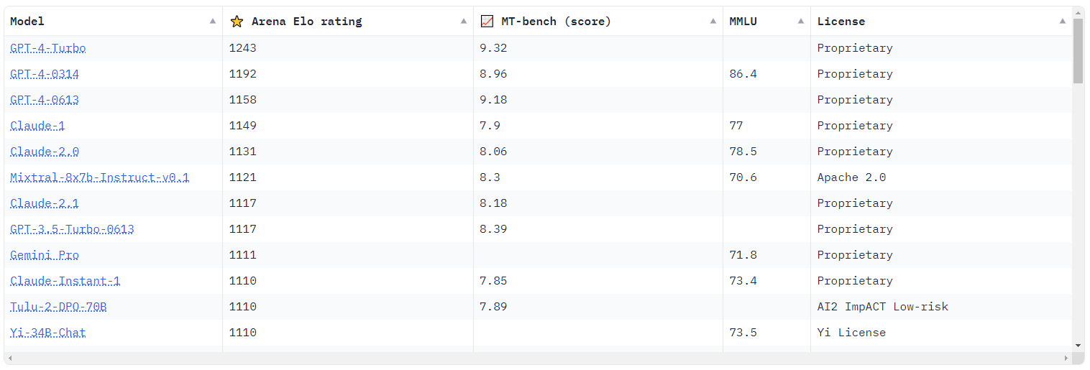




Chatbot Arena
https://huggingface.co/spaces/lmsys/chatbot-arena-leaderboard
Chatbot ELO (2024-01-07)

Slide 13
Prompt Engineering

Slide 14
What is a prompt?
Prompt text is the key model input for LLMs - it contains all the instructions together with conversation history and any additional context such as RAG
Despite being dominated by Natural Language prompt can implement coded structures such as html like syntax
While designing a prompt you should provide as detailed instructions and context as possible
Prompt does not need to be equal to what we see in the chat window, additional elements can be appended such as:
initial model instructions
domain information from RAG
conversation history
In context learning allows to help format model outputs by few-show-learning through prompting

Slide 15


https://chat.openai.com/c/507051a7-dc8a-4789-864c-e87fcfb2b1b2
Popular prompting templates
Question + Instruction
Instructions + Input data (zero-shot learning example)

Slide 16
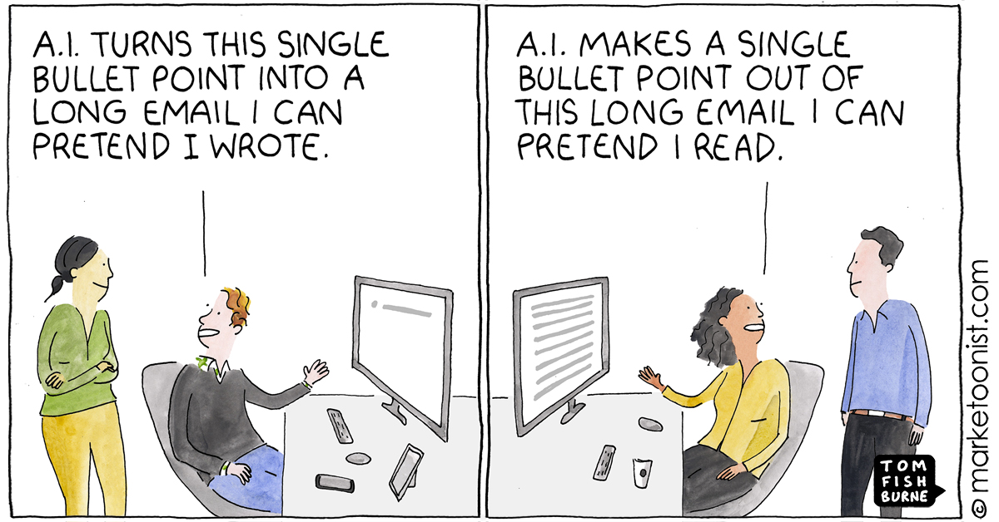

Slide 17

Popular prompting templates
Question + Examples

Slide 18
What is Prompt engineering
Prompt engineering aims to create prompts in a more programmatic, reproducible way
It involves carefully designing and structuring the input given to the model to effectively guide it towards generating the desired output or response.
Temperature is one of the key hyperparams controlling how varied and creative each models response is - even with the exact same prompt
Prompt Engineering can be more structured by leveraging libraries such as LangChain

Slide 19
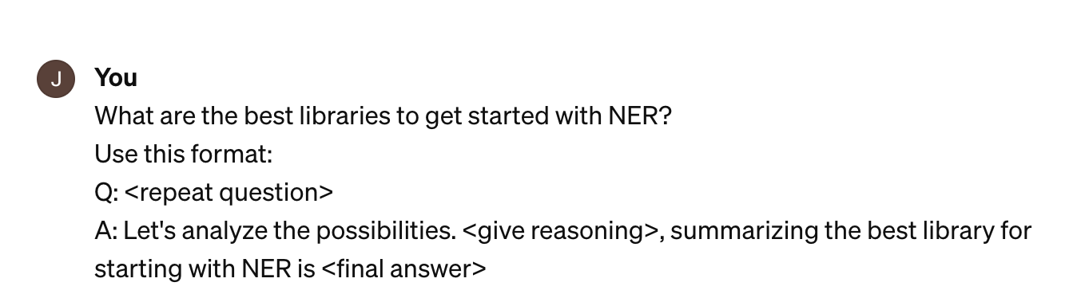
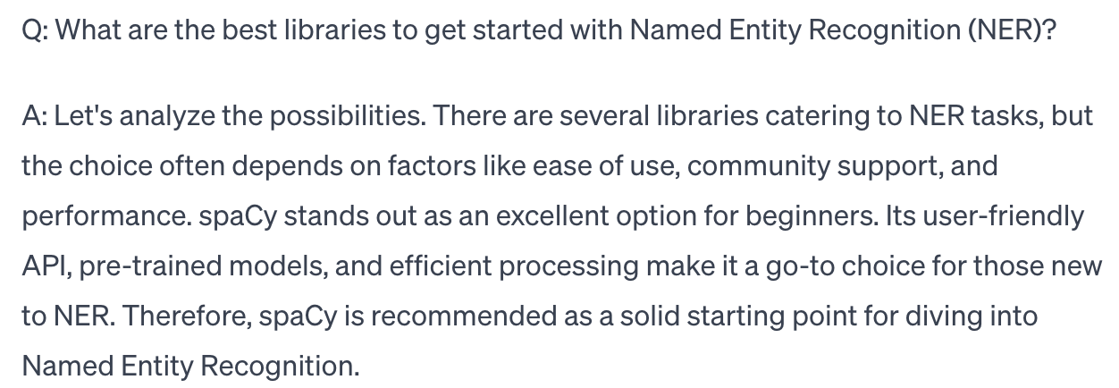
Chain-of-thought reasoning
Chain-of-thought prompting: Encourages model to be factual and precise by explaining its reasoning

Slide 20
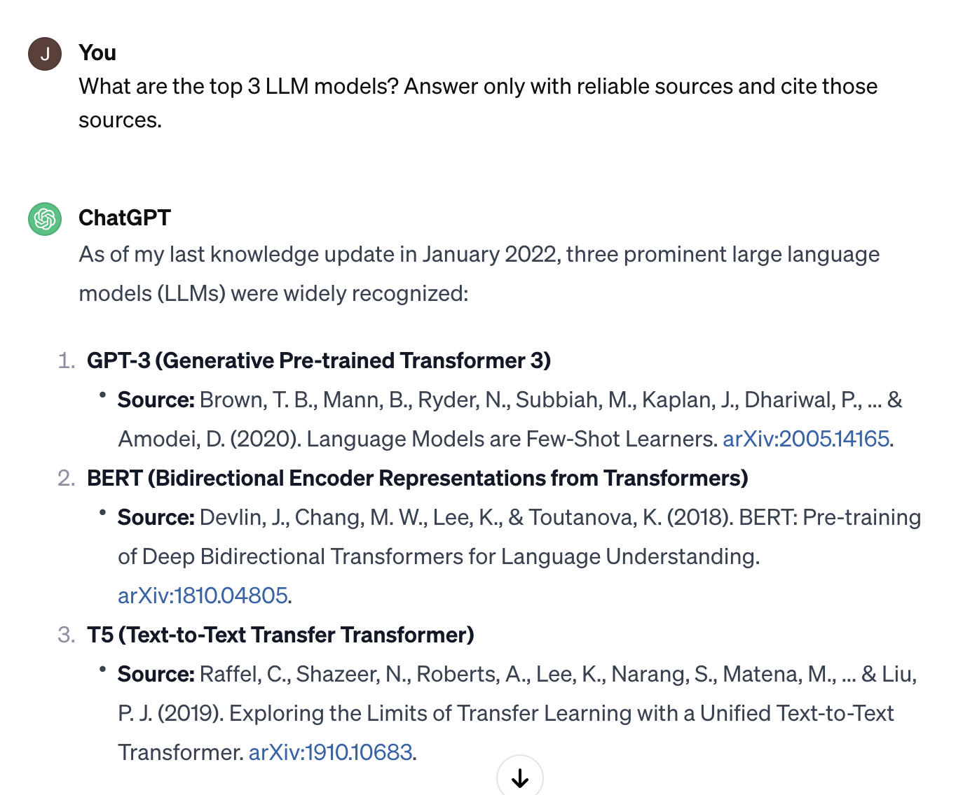
Citing sources
Warning!
LLM can still make up sources, but at least you can check if they exists

Slide 21
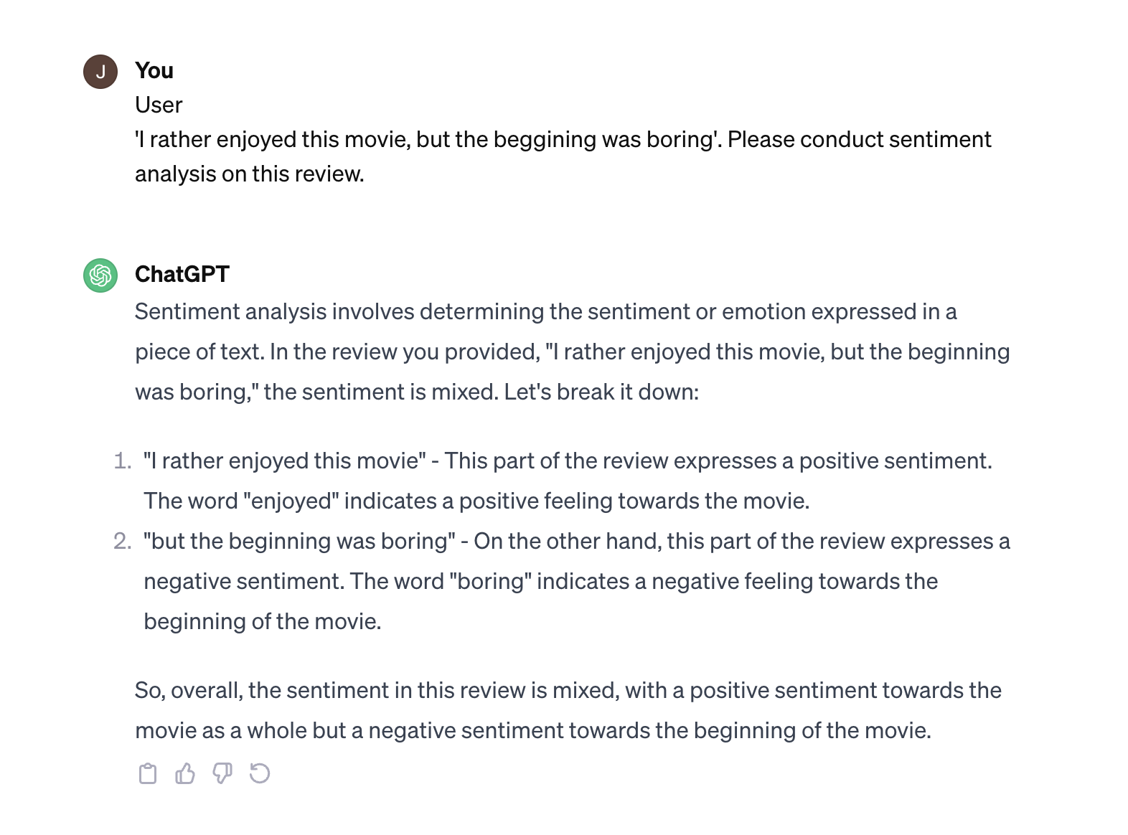
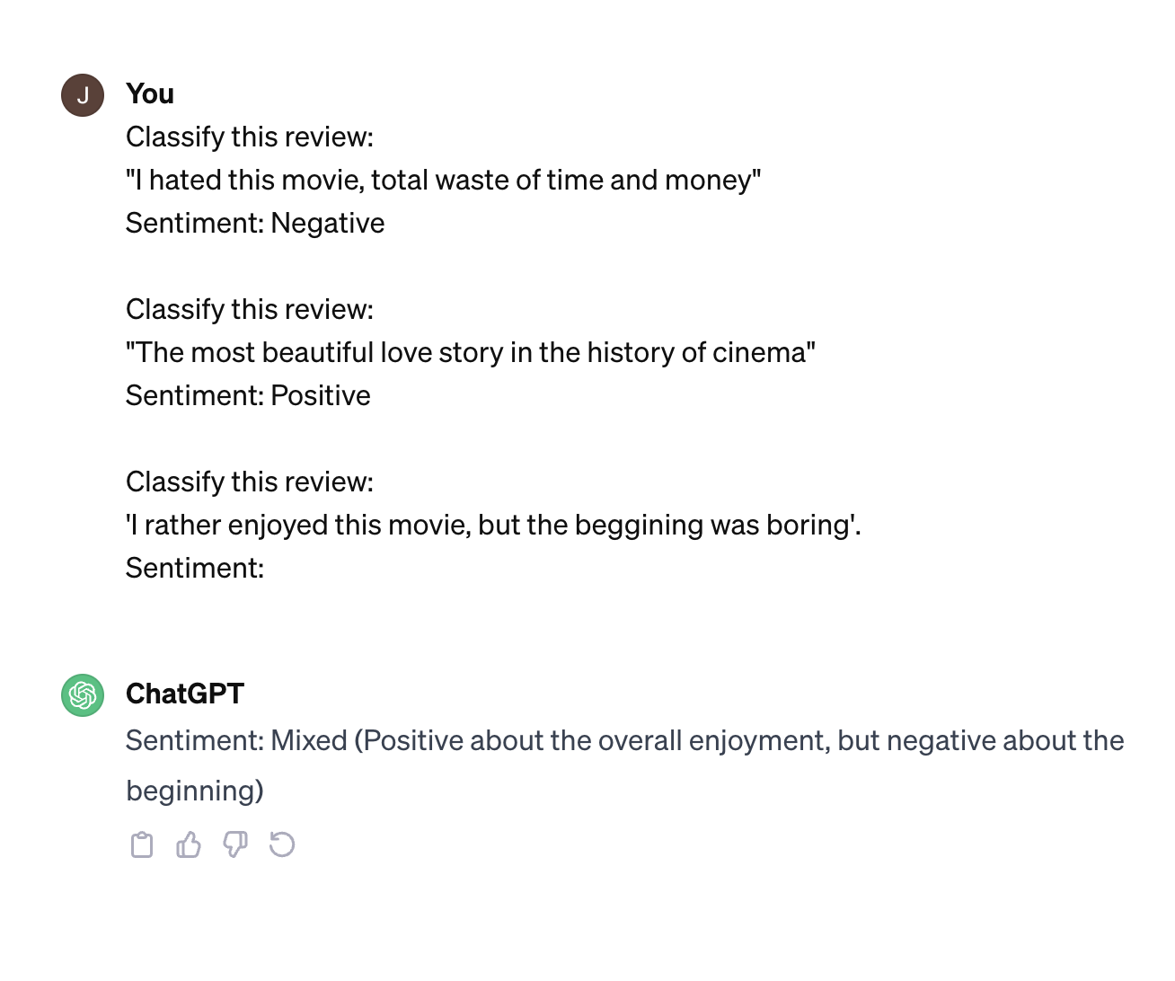
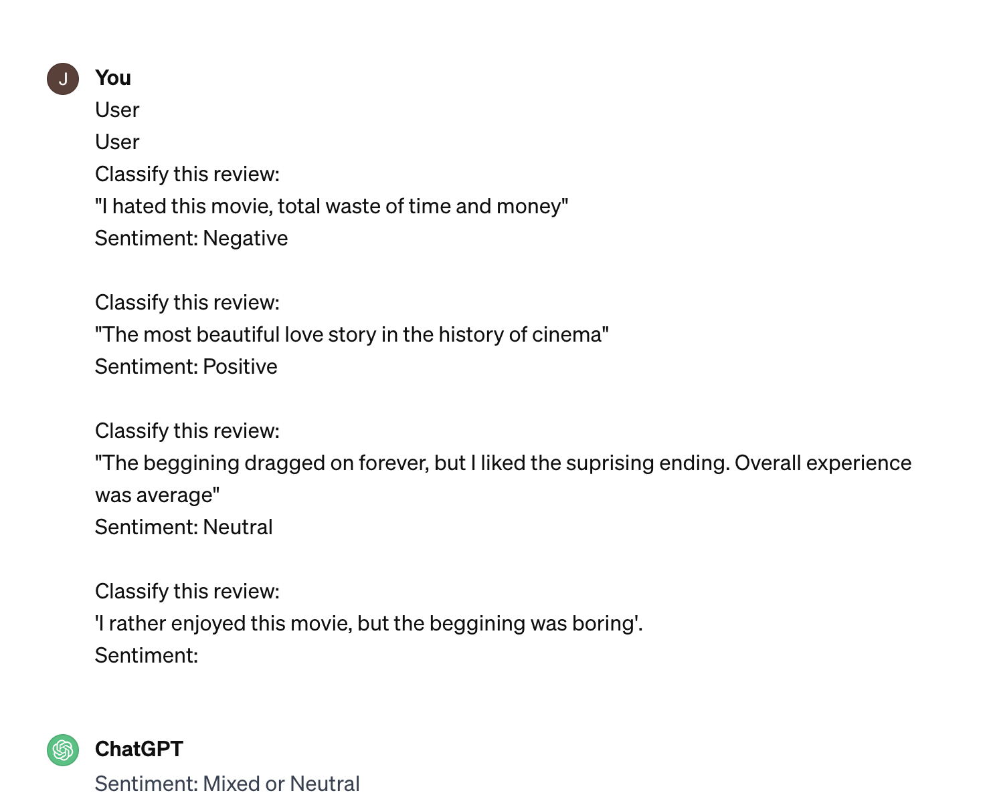
Few shot learning
Zero-shot
Two-shot
Three-shot

Slide 22
Tuning LLMs

Slide 23
Model Fine-tuning
Single task fine tuning
Parameter Efficient Fine Tuning (PEFT)
Retraining all model params on task specific data
Possible with as little as 1k examples
Requires significant compute resources and creates a completely separate model for each task
May lead to catastrophic forgetting, which is basically an equivalent of overfitting
Retraining specific part of model params, with keeping majority of model frozen
Significantly less compute intensive, 90% of params remain frozen and the remaining <10% can be stored for each task and swapped at inference
Combines general knowledge with new task, reduces risk of catastrophic forgetting

Slide 24
PEFT methods
Reparametrization
Additive
Retrain part of models params using lower dimension
LoRA is one of most popular use-cases combining model base params, with ones trained for a specific task
Add trainable layers or parameters to model
In “Soft Prompts” prompt tuning additional training happens at input level
Adapters add additional model layers fine-tuned for specific task, while the backbone models are frozen

Slide 25
LoRA: Low Rank Adaption of LLMs
Training
Freeze original model weights
Replace part of original weight with 2 rank decomposition matrices (with lower dimensionality)
Train weights only for the smaller matrices
Inference:
Multiply low rank matrices, to get a matrix with same dimenstions as original weights
Add product of this multiplication to original weights
Encoder
Training
B
A
Original weights
A X B
Embeddings

Slide 26
Soft prompts fine tuning
Add additional embeddings, which do not correspond to any token representation
They will form context embeddings, which help to guide input prompt toward desired outcomes
Analysing their vector representation in relation to actual words can provide some basic context
Soft-Prompts Trained embeddings, not representing actual tokens
Embeddings from tokenized text
x_{a}
x_{b}
x_{c}
x_{d}
x_{e}
x₁
x₂
x₃
x₄
x_{n}
+
…

Slide 27
Retrieval Augmented Generation (RAG)

Slide 28
What is RAG?
Retrieval-Augmented Generation (RAG) represents a significant advancement in language model technology.
I allows expanding and updating models knowledge with external data, which improves information accuracy and relevance
This approach broadens the use-cases of LLMs, making them more effective in fields like research, fact-checking, and detailed question-answering
Despite quite complex structure at its core the additional information is still added to prompt in text form, which can have negative impact on tokens count, costs and performance

Slide 29
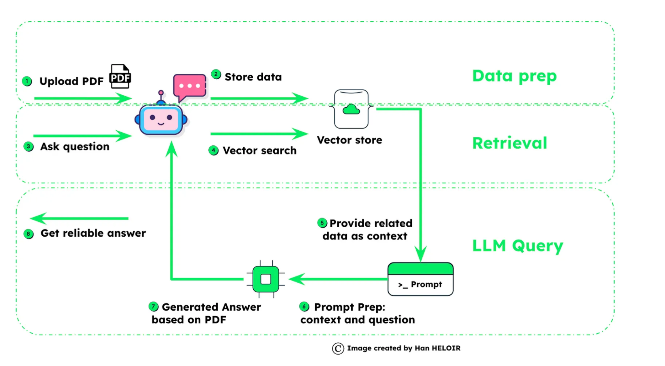
RAG diagram
Source: Han Heloid Medium

