Slide 1
Generative AI

Slide 2
W4 Agenda
On Premise LLMs
  Why local LLMs are important?
  How to launch LLM locally?

Slide 3
On Premise LLMs

Slide 4
Why local LLMs are important?

Slide 5


Local LLMs – Pros and Cons
Full data privacy
Can work offline
Ability to use underutilzed infrastructure e.g. Priv GPUs
Usually limited to smaller models, with 3-20B params on normal GPUs
Much slower than SaaS solutions
Needs very high utilization and optimization to be actually cheaper than small SaaS LLMs

Slide 6
LLMs you can run locally on a private GPU 12-16 GB (with some quantization)
Gemma 3 12B
LLaMA 13B
Falcon 7B
Bielik-11B-v2

Slide 7
What is Quantization??
Definition
Converting model weights from higher-precision (e.g. FP16 or FP32)
down to fewer bits (e.g. 8-bit, 4-bit) to reduce memory usage and computational overhead
Why It Matters
Lower VRAM Requirements: Fits larger models on smaller GPUs.
Faster Inference: Fewer bits to process speeds up forward passes.
Energy Efficiency: Reduced compute demands save power.
Approaches
Uniform Quantization: Single scale factor per block of weights.
Advanced “K-Quant” Methods: Multiple scales or per-channel scaling for better accuracy at the same bit depth.
Trade-Offs
Size vs. Accuracy: Fewer bits can degrade model performance.
Implementation Complexity: Complex quantization methods often require specialized tooling.

Slide 8
Deploying LLMs locally

Slide 9
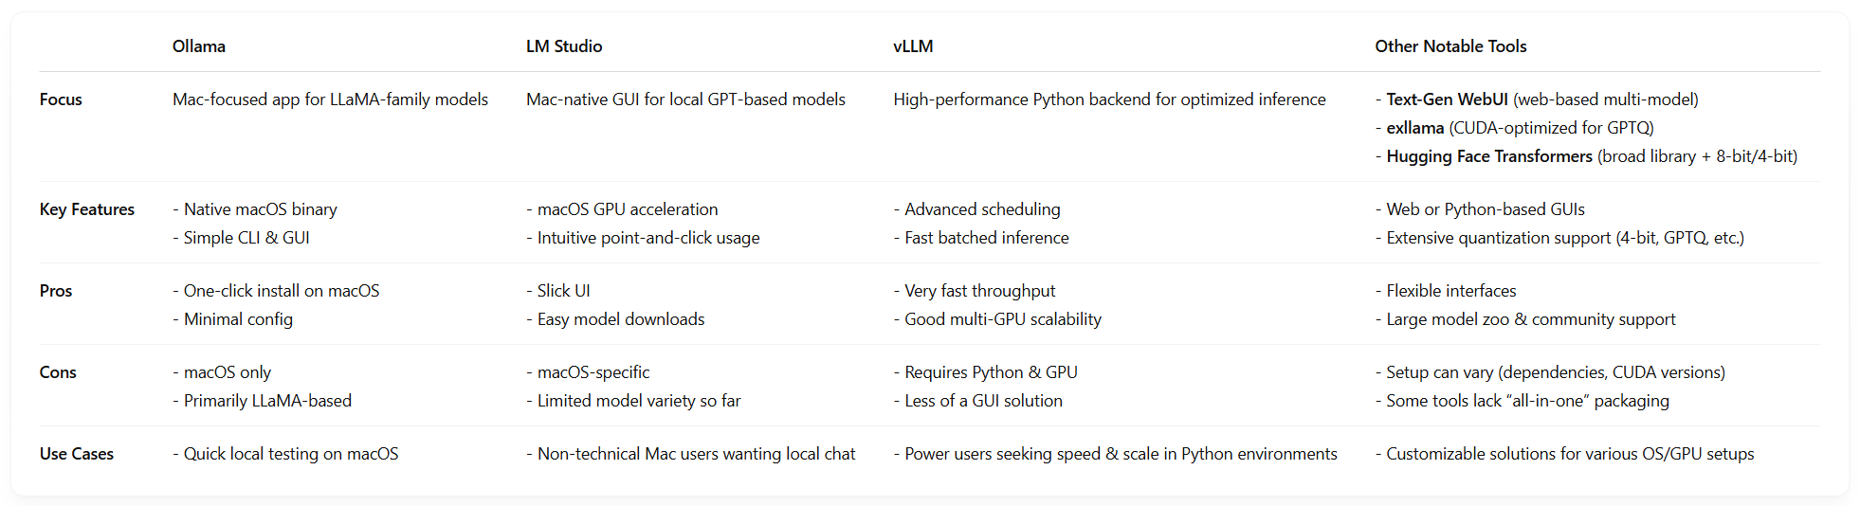
How can you run LMMs locally?

Slide 10
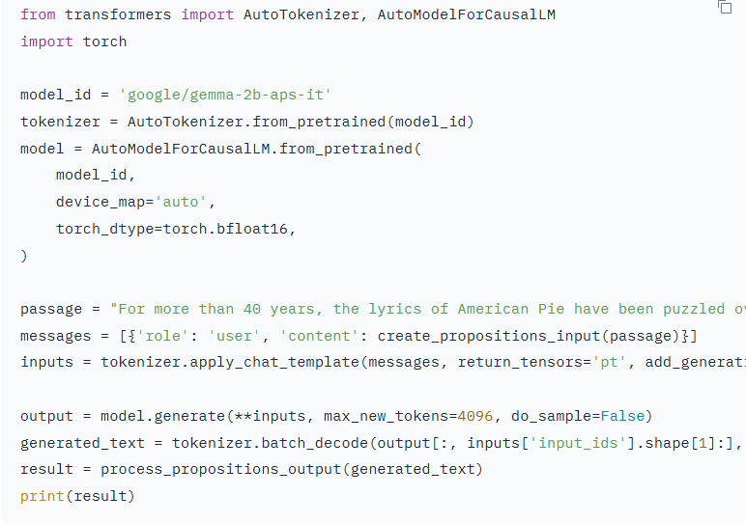
Hugging face transformers example

Slide 11
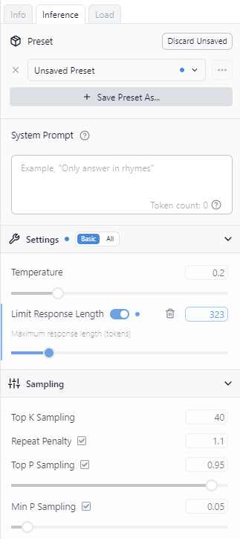
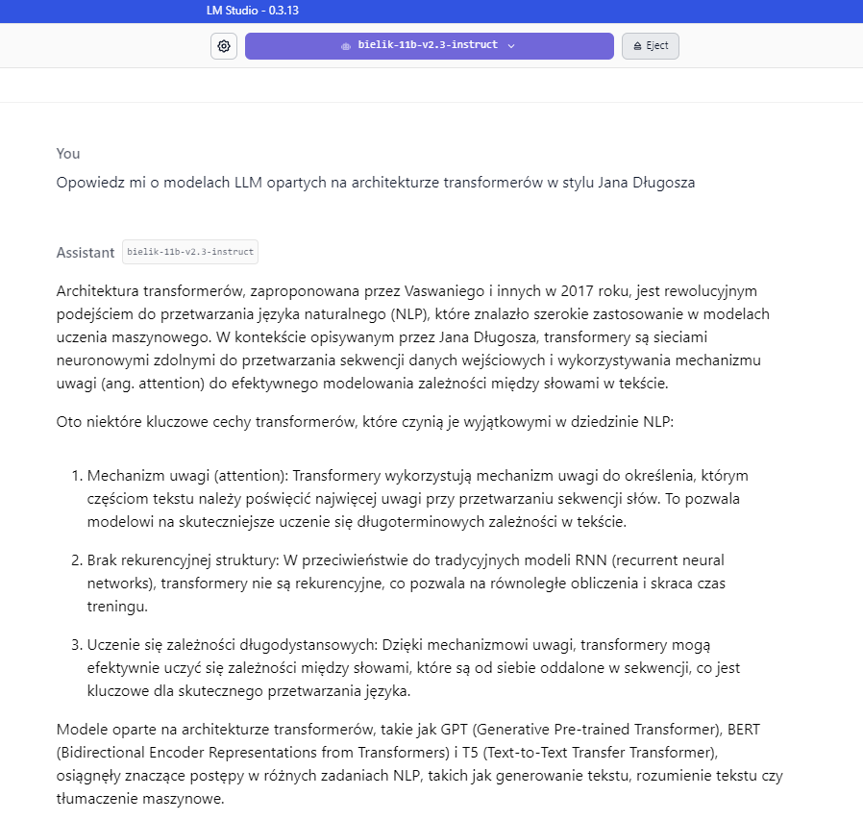
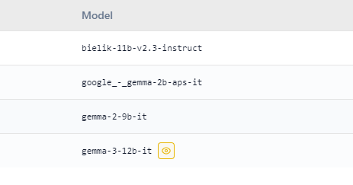
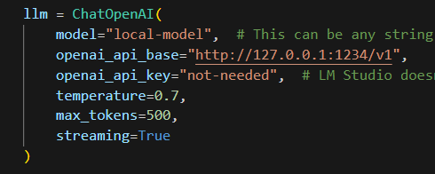
LM Studio example
Choose model
Setup hyperparams
Chat using API or UI

Slide 12
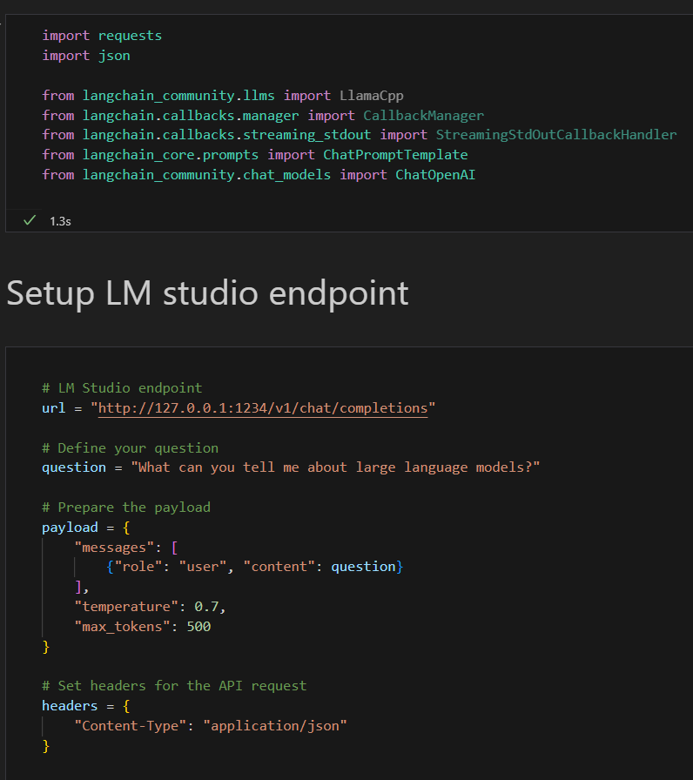
LM Studio exercise
Start with Bonus-on-premise-LLMs.py

