Slide 1
Exams 1 – Milestone2
Team: Enrollments 1
Vojto Gáborík , Veronika Kavanová, Jan Novák, Vojtěch Štěpán

Slide 2
Administrator wants to change the database
Veronika Kavanová

Slide 3
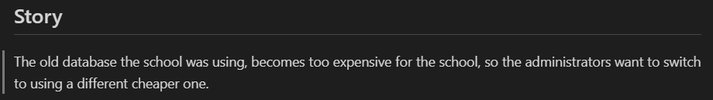
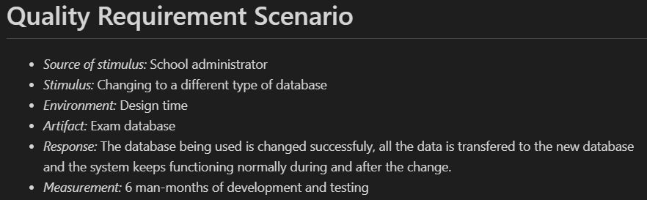
Requirement description
Veronika Kavanová
Modifiability requirement

Slide 4
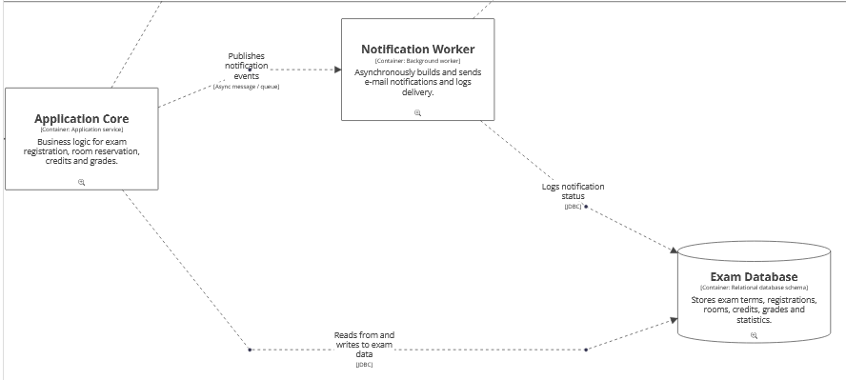
Existing architecture – container view
Veronika Kavanová

Slide 5
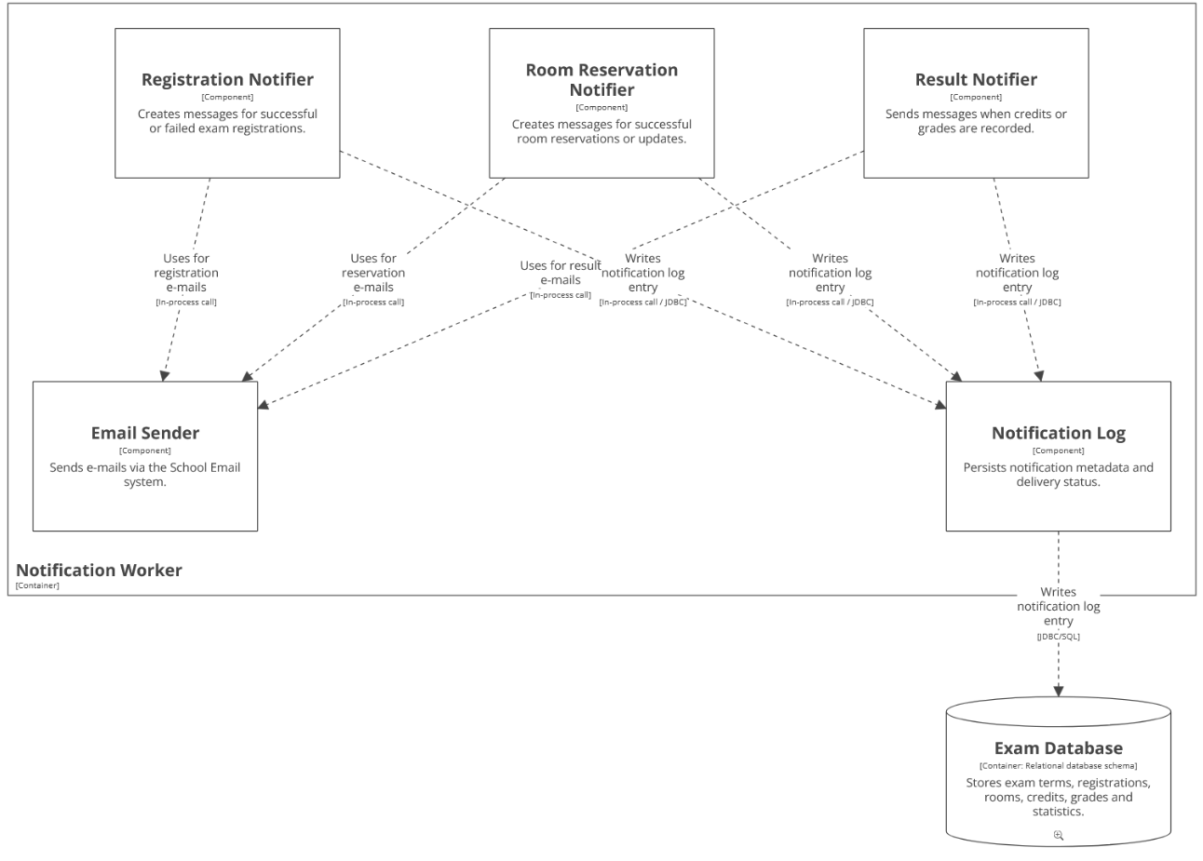
Notification Worker -> Exam database
Veronika Kavanová
All communication goes through Notification Log
This allows for easy changes.
Notification Log can be changed to work with the new database or both of them during the change

Slide 6
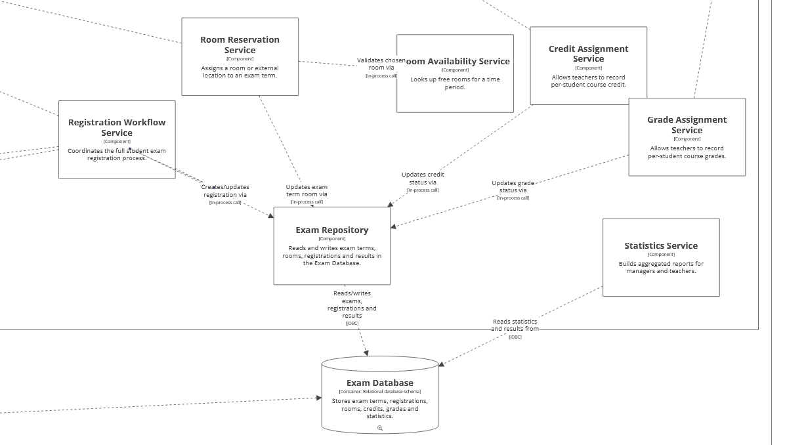
Application Core -> Exam Database
Veronika Kavanová
Most communication goes through Exam Repository
Database access is abstracted

Slide 7
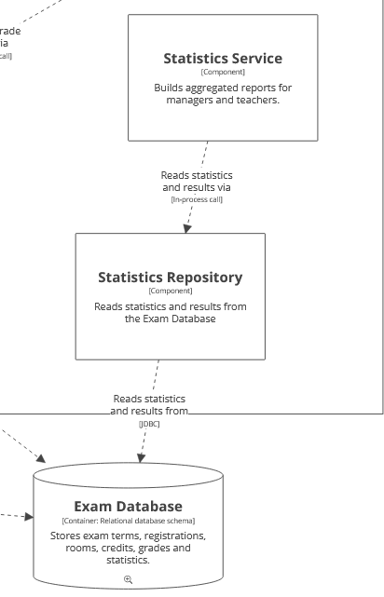
Change: Statistics service
Veronika Kavanová
Split Statistics Service into two components:
Statistics Service now only deals with business logic – calculating results and building reports
Statistics Repository deals with the communication with the Exam Database
Database access is again abstracted and easily changed

Slide 8
School Information System requests data for room availability
Jan
Novák

Slide 9
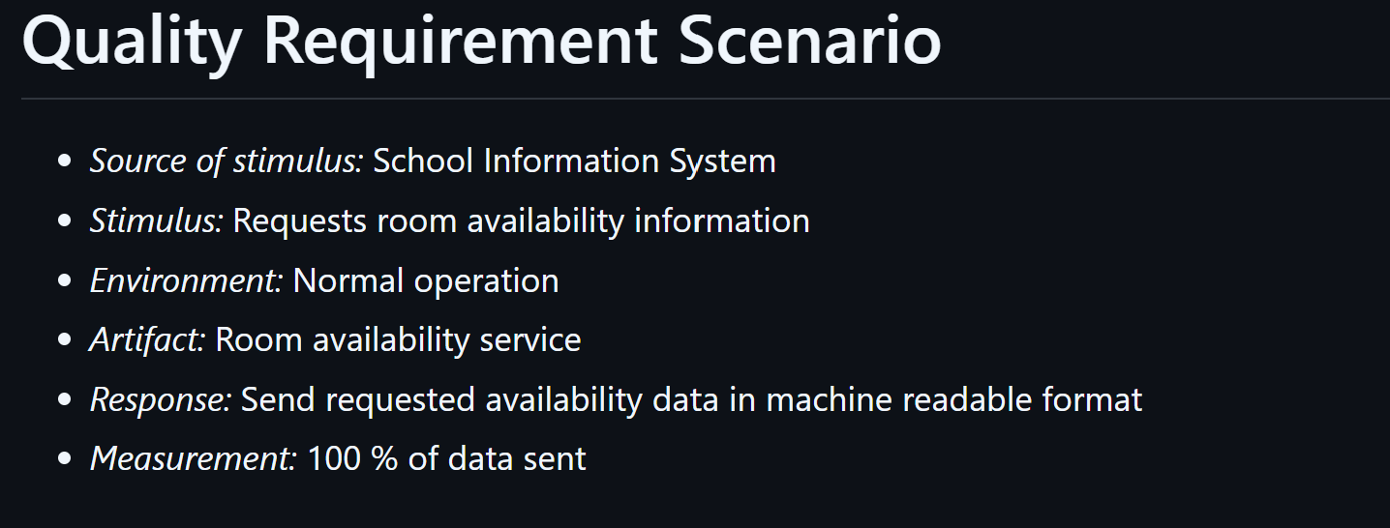
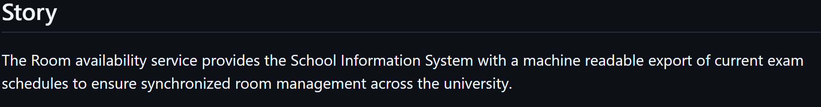
Requirement description
Jan
Novák
Interoperability requirement

Slide 10
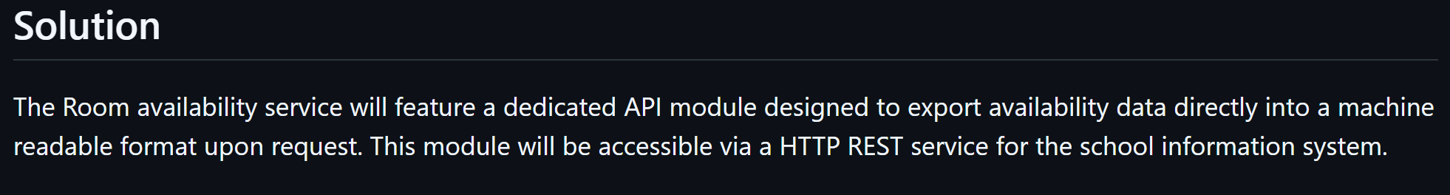
Jan
Novák

Slide 11
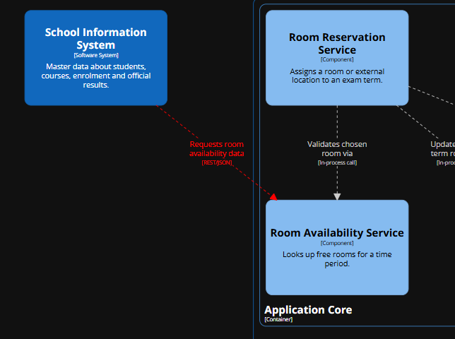
Jan
Novák
Existing architecture – container view
changes happen mainly on L4
from the container point of view we only add new interaction between SIS and Application core
SIS fetches data from Room Availability Service component

Slide 12
Notification worker require log into database
Vojtěch
Štěpán

Slide 13
Requirement description
Vojtěch
Štěpán
Source of stimulus: Notification worker
Stimulus: Unable to write log
Enviroment: Normal operation
Artifact: Exam database
Response: Recover log
Meassurement: 24 hours downtime

Slide 14
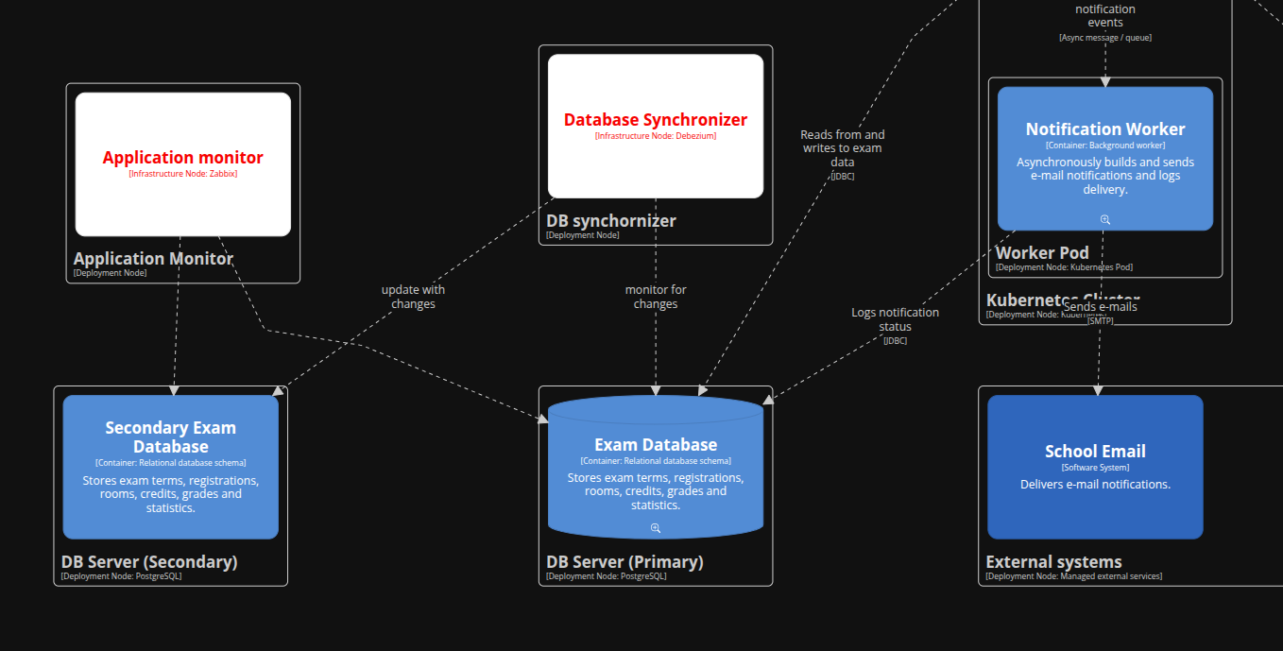
Solution
Vojtěch
Štěpán

Slide 15
Vojtech Gáborík
Requirement description
Source of stimulus: Student
Stimulus: School Information System (SIS) becomes unavailable orresponds too slowly (timeouts).​
Enviroment: Normal operation (peak usage, exam-period week)​
Artifact: Application Core​
Response: EXA continues to serve exam registration and exam-termbrowsing using the last known SIS master-data snapshot; if a requireddatum is missing, EXA fails fast with a clear “SIS temporarily unavailable”message.​

Slide 16
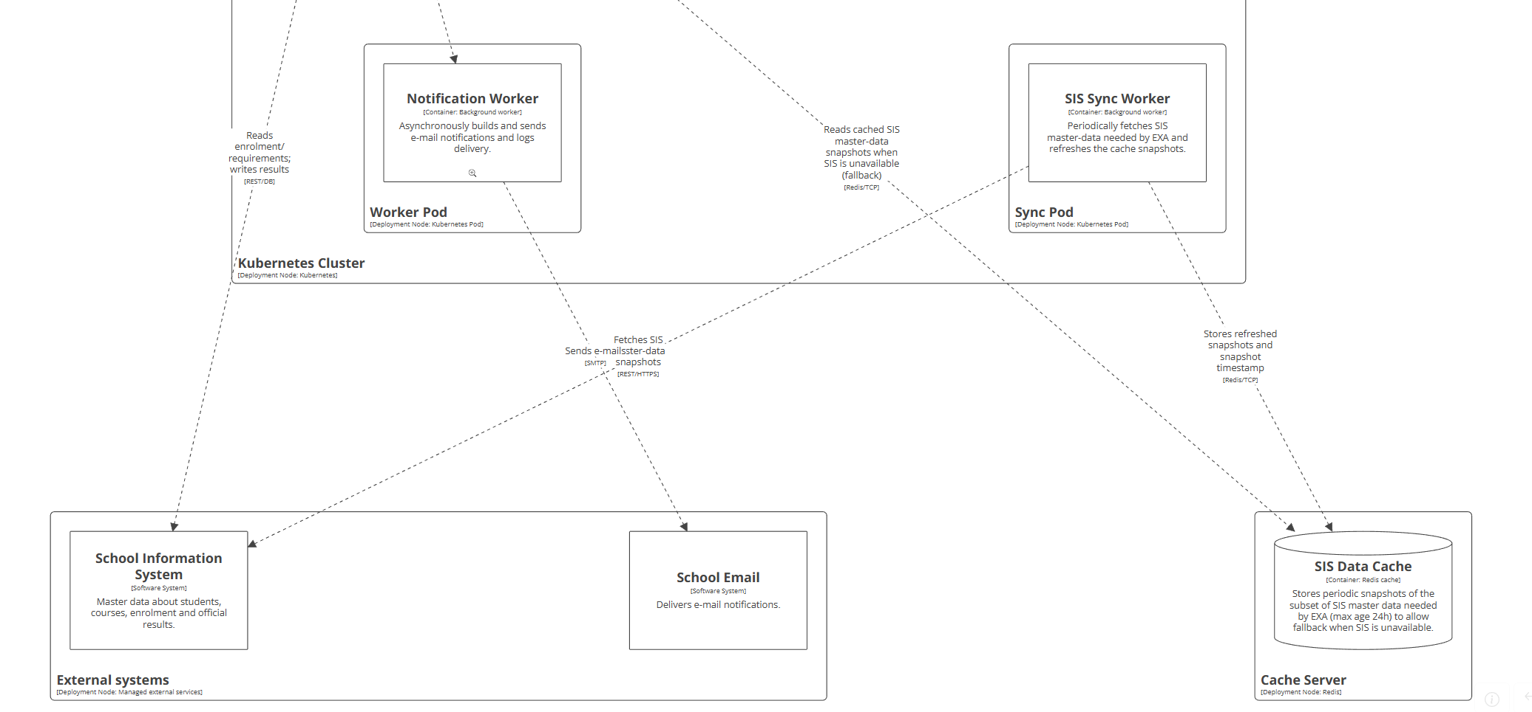
Vojtech Gáborík
Solution

Slide 17
Vojtech Gáborík
Requirement description
Source of stimulus: School management / product owner
Stimulus: Add a new notification delivery channel (e.g., SMS or push notifications) in addition to e-mail
Enviroment: Design time
Artifact: Notification Worker (notification subsystem)
Response: The new delivery channel is implemented and enabled without modifying the existing notifiers. Existing e-mail notifications keep working unchanged.
Meassurement: ​
≤ 1 man-month of development + testing

Slide 18
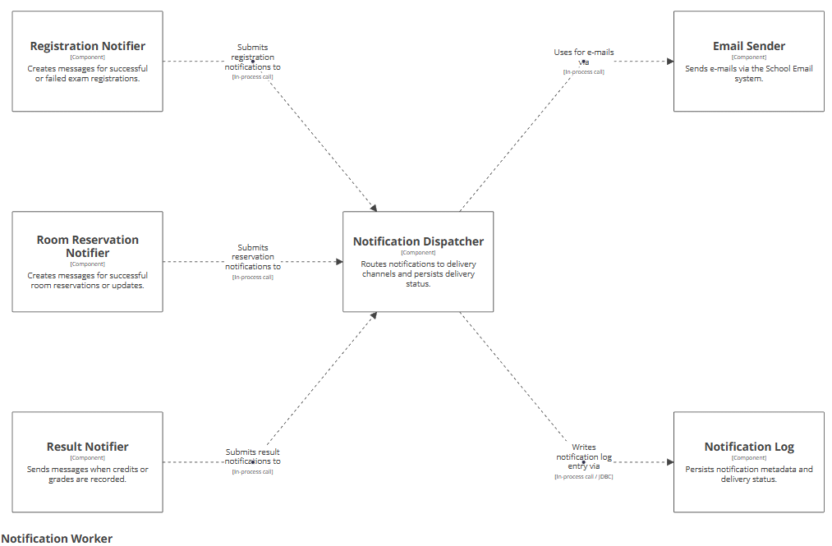
Vojtech Gáborík
Solution

