Slide 1
Enrollment system
Vojto Gáborík, Veronika Kavanová, Jan Novák, Vojtěch Štěpán

Slide 2
Features

Slide 3
Feature: Student enrollment
Worked on by Veronika Kavanová and Jan Novák

Slide 4
Feature: Student enrollment cancellation
Worked on by Vojtěch Štěpán and Vojto Gáborík

Slide 5
Feature: Student enrollment management
Worked on by Jan Novák and Vojtěch Štěpán

Slide 6
Feature: Setting enrollment conditions
Worked on by Vojto Gáborík and Veronika Kavanová

Slide 7
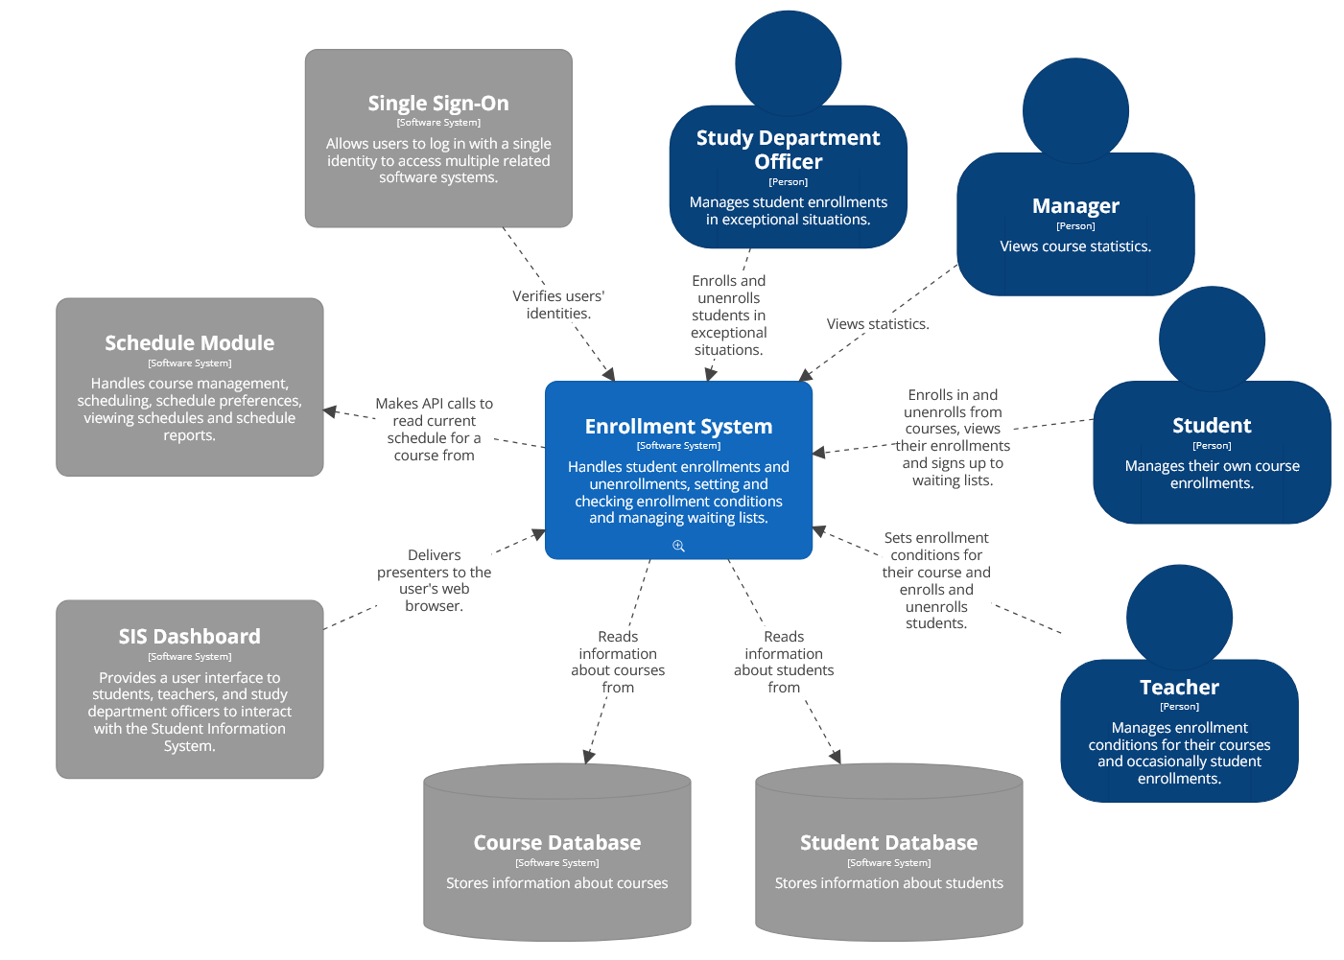
Architecture – L1 layer

Slide 8
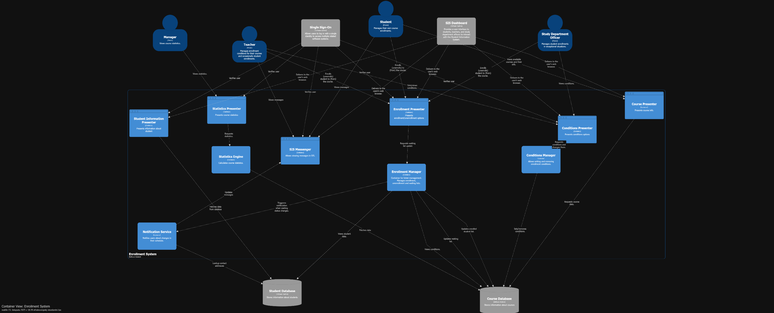
Architecture – L2 layer

Slide 9
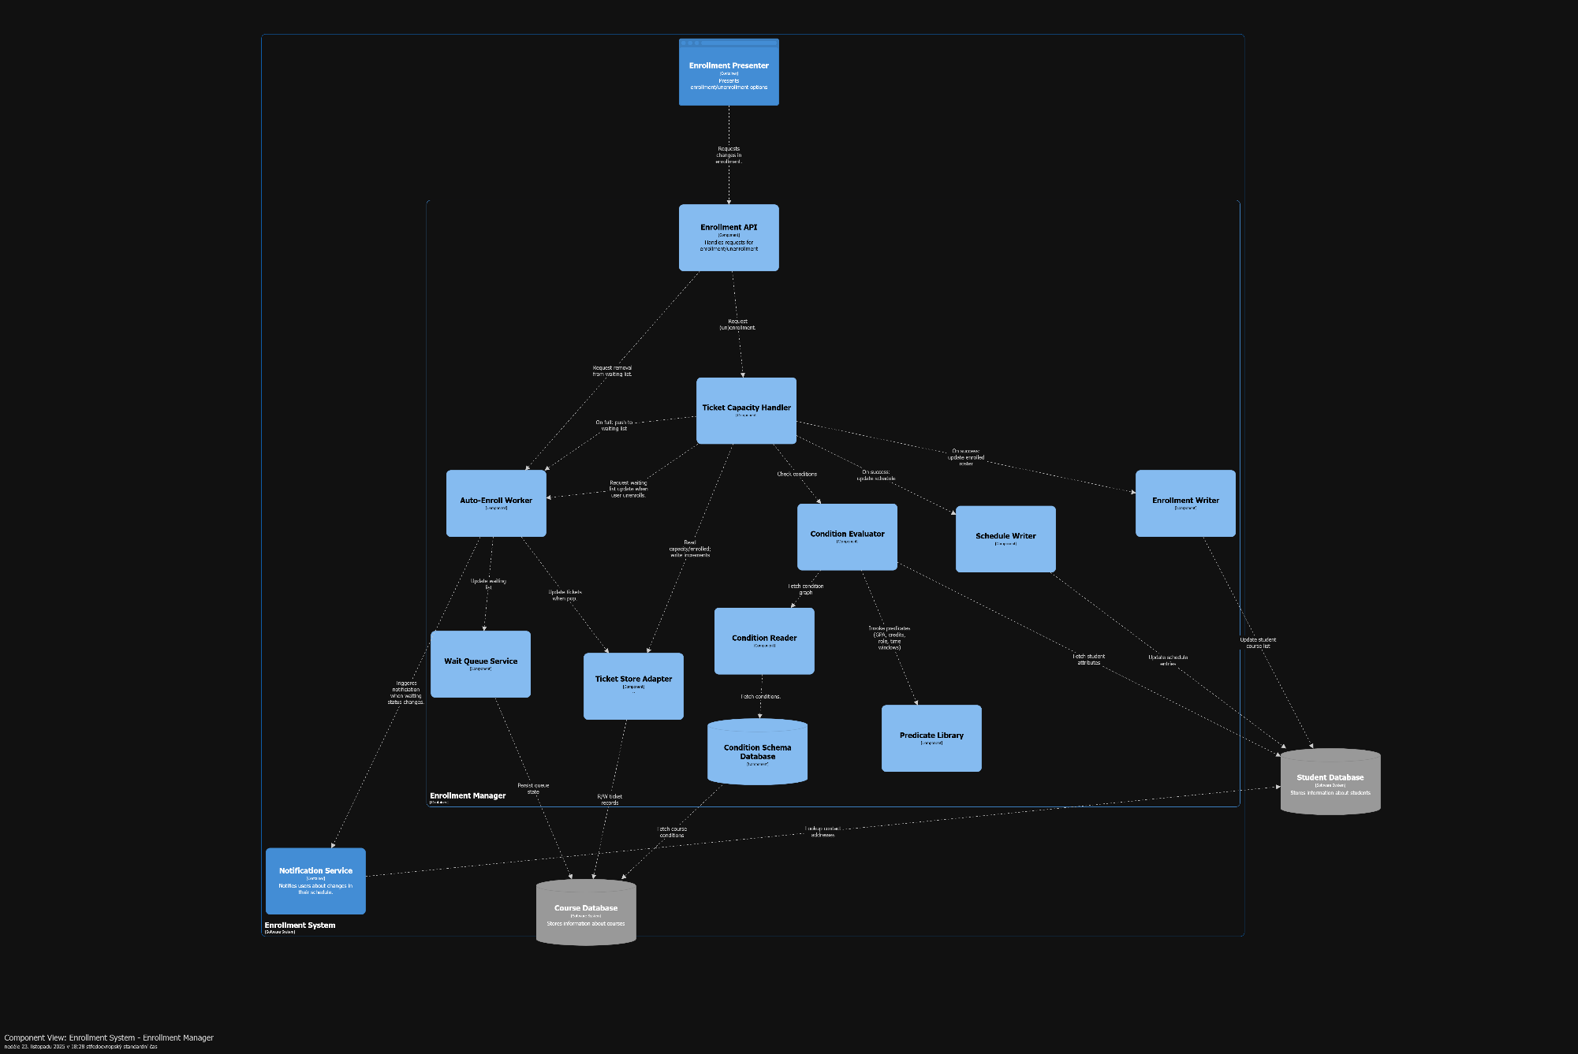
Architecture – L3 enrollment manager components

Slide 10
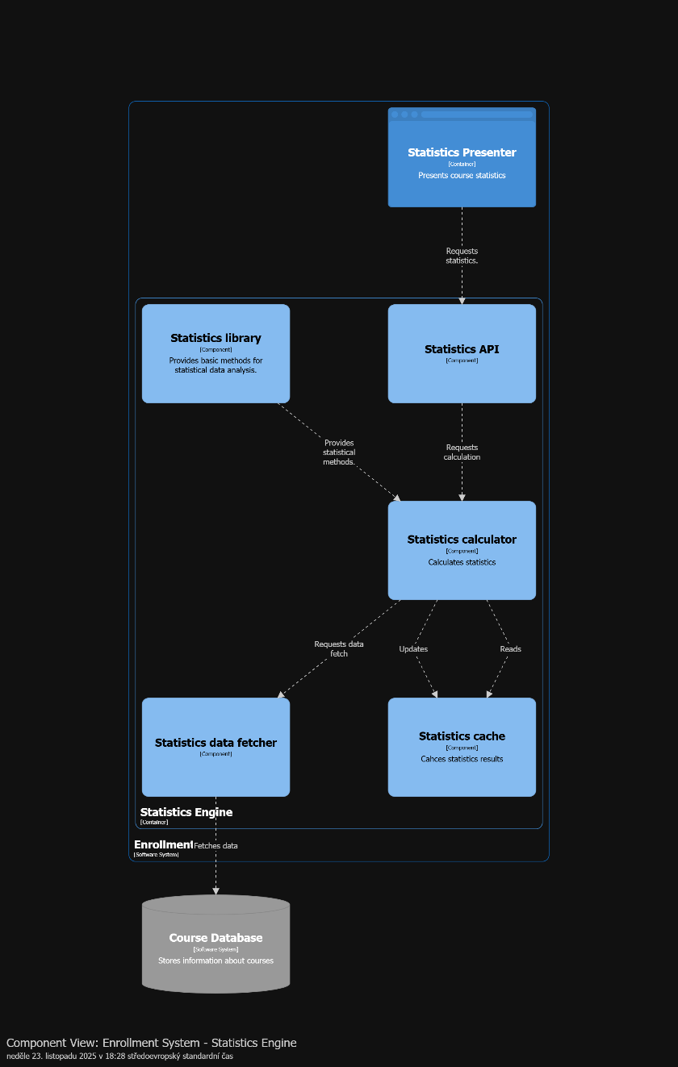
Architecture – L3 statistics engine components

Slide 11
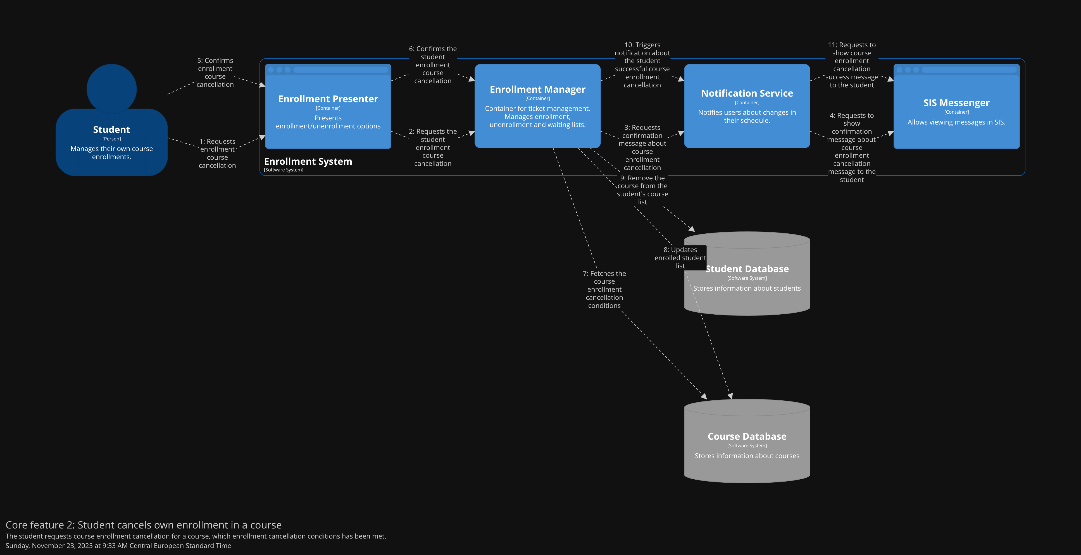
Dynamic diagrams

Slide 12
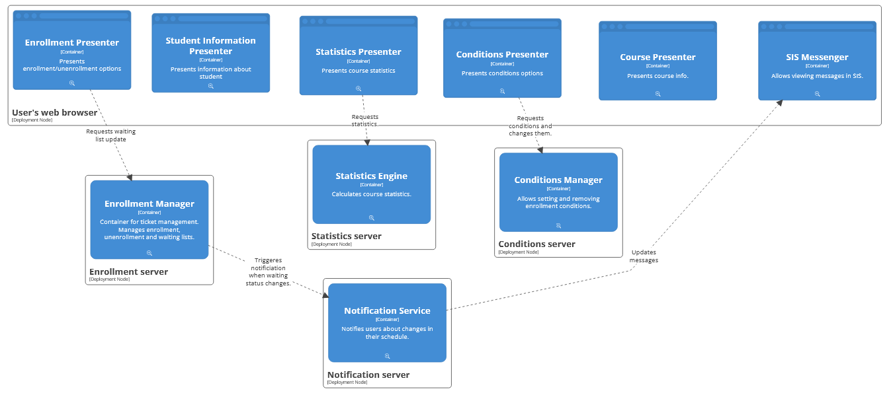
Deployment diagram
Worked on by Veronika Kavanová

