Slide 1
PaymentService Microservice – Präsentations-Guideline
Fokus: PaymentService/ (Model, Domain, RestApi, WebGUI)
Präsentation: 10./12. Dez. | erstellt am 21.12.2025

Slide 2
Agenda (3 Teilpräsentationen)
Teil 1 (Boris): Architektur, Schichten, Dependency Injection
Teil 2 (Maxl): Domain/Services & Wiederverwendbarkeit (Repository Pattern)
Teil 3 (Ole): Views & Live-Demo + Tests (inkl. Backup-Screenshots)

Slide 3
Teil 1 – Boris: Warum Schichten?
Trennung von Verantwortung: UI/API vs Business vs Datenmodell
Wartbarkeit: Änderungen bleiben lokal in einer Schicht
Testbarkeit: Domain kann ohne UI/DB getestet werden (Fake Repository)
Wiederverwendbarkeit: Domain wird von RestApi und WebGUI genutzt

Slide 4
Teil 1 – Boris: Schichten & Dependency-Fluss
WebGUI
MVC View + Controller
RestApi
HTTP API + Swagger
Domain
Services + Repositories
SQLite
payment.dev.db
Model
Entities + DbContext
Notes:
Erkläre: WebGUI und RestApi hängen von Domain+Model ab. Domain hängt nur von Model ab. DB ist SQLite und wird beim Start automatisch erstellt.

Slide 5
Teil 1 – Boris: DI in RestApi (Program.cs) – Auszug
using Domain.Interfaces; using Domain.Repositories; using Domain.Services; using Microsoft.EntityFrameworkCore; using Model.Configuration; using Model.Entities; var builder = WebApplication.CreateBuilder(args); builder.Services.AddControllers(); builder.Services.AddEndpointsApiExplorer(); builder.Services.AddSwaggerGen(); builder.Services.AddDbContext<PaymentDbContext>(options => options.UseSqlite(builder.Configuration.GetConnectionString("PaymentDB"))); // Repository + Domain service registrations (style aligned with Fitness sample) builder.Services.AddScoped<IRepositoryAsync<Payment>>(sp => { var context = sp.GetRequiredService<PaymentDbContext>(); return new PaymentRepository(context); }); builder.Services.AddScoped<Domain.Services.PaymentService>(); var app = builder.Build(); // ...
Notes:
Zeige AddDbContext(UseSqlite), Repository-Registrierung, PaymentService-Registrierung, Swagger + EnsureCreated.

Slide 6
Teil 1 – Boris: DI in WebGUI (Program.cs) – Auszug
using Domain.Interfaces; using Domain.Repositories; using Domain.Services; using Microsoft.EntityFrameworkCore; using Model.Configuration; using Model.Entities; var builder = WebApplication.CreateBuilder(args); builder.Services.AddControllersWithViews(); builder.Services.AddDbContext<PaymentDbContext>(options => options.UseSqlite(builder.Configuration.GetConnectionString("PaymentDB"))); builder.Services.AddScoped<IRepositoryAsync<Payment>>(sp => { var context = sp.GetRequiredService<PaymentDbContext>(); return new PaymentRepository(context); }); builder.Services.AddScoped<Domain.Services.PaymentService>(); var app = builder.Build(); if (!app.Environment.IsDevelopment()) { app.UseExceptionHandler("/Home/Error"); // ...
Notes:
Zeige, dass WebGUI die gleiche Domain nutzt wie RestApi (gleiche DB/Repo/Service Registrierung).

Slide 7
Teil 2 – Maxl: Domain = Wiederverwendbare Businesslogik
Repository Pattern abstrahiert Persistenz (austauschbar)
`IRepositoryAsync<T>` als Vertrag
`ARepositoryAsync<T>` liefert Standard-CRUD
`PaymentService` implementiert Regeln (Validation, Status)

Slide 8
Teil 2 – Maxl: IRepositoryAsync – Auszug
using System.Linq.Expressions; namespace Domain.Interfaces; public interface IRepositoryAsync<TEntity> where TEntity : class { Task<TEntity> CreateAsync(TEntity t); Task<List<TEntity>> CreateRangeAsync(List<TEntity> list); Task UpdateAsync(TEntity t); Task UpdateRangeAsync(List<TEntity> list); Task<TEntity?> ReadAsync(int id); Task<List<TEntity>> ReadAsync(Expression<Func<TEntity, bool>> filter); Task<List<TEntity>> ReadAsync(int start, int count); Task<List<TEntity>> ReadAllAsync(); Task DeleteAsync(TEntity t); }

Slide 9
Teil 2 – Maxl: ARepositoryAsync – Auszug
using System.Linq.Expressions; using Domain.Interfaces; using Microsoft.EntityFrameworkCore; namespace Domain.Repositories; public abstract class ARepositoryAsync<TEntity> : IRepositoryAsync<TEntity> where TEntity : class { protected readonly DbContext _context; private readonly DbSet<TEntity> _table; protected ARepositoryAsync(DbContext context) { _context = context; _table = _context.Set<TEntity>(); } public async Task<TEntity> CreateAsync(TEntity t) { _table.Add(t); await _context.SaveChangesAsync(); return t; } public async Task<List<TEntity>> CreateRangeAsync(List<TEntity> list) { await _table.AddRangeAsync(list); await _context.SaveChangesAsync(); // ...

Slide 10
Teil 2 – Maxl: PaymentService (Domain) – Auszug
using Domain.Interfaces; using Model.Entities; namespace Domain.Services; public class PaymentService { private readonly IRepositoryAsync<Payment> _paymentRepository; public PaymentService(IRepositoryAsync<Payment> paymentRepository) { _paymentRepository = paymentRepository; } public async Task<Payment> ProcessPaymentAsync(int participantId, decimal amount, bool confirmPayment = true) { if (participantId <= 0) { throw new ArgumentOutOfRangeException(nameof(participantId), "ParticipantId must be greater than zero."); } if (amount <= 0) { throw new ArgumentOutOfRangeException(nameof(amount), "Amount must be greater than zero."); } var success = confirmPayment; var payment = new Payment { ParticipantId = participantId, Amount = amount, Status = success ? "Completed" : "Failed", CreatedAt = DateTime.UtcNow // ...
Notes:
Wichtig: Validation, Status 'Completed/Failed', Speicherung via Repository, History-Query.

Slide 11
Teil 3 – Ole: Views, Demo & Tests
WebGUI: Payment anlegen + History laden
RestApi: Swagger – POST/GET Endpunkte
Live-Demo + Backup-Screenshots (hidden slides)
Unit-Tests: 10 Tests (Validation, Status, History)

Slide 12
Teil 3 – Ole: WebGUI PaymentController – Auszug
using Domain.Services; using Microsoft.AspNetCore.Mvc; using WebGUI.Models.Payments; namespace WebGUI.Controllers; public class PaymentController : Controller { private readonly PaymentService _paymentService; private readonly ILogger<PaymentController> _logger; public PaymentController(PaymentService paymentService, ILogger<PaymentController> logger) { _paymentService = paymentService; _logger = logger; } [HttpGet] public async Task<IActionResult> Index(int? participantId) { var vm = new PaymentPageViewModel { ParticipantId = participantId, Message = TempData["Message"] as string }; if (participantId.HasValue && participantId.Value > 0) { vm.Payments = await _paymentService.GetPaymentHistoryAsync(participantId.Value); } return View(vm); // ...

Slide 13
Teil 3 – Ole: View (Index.cshtml) – Auszug
@model WebGUI.Models.Payments.PaymentPageViewModel @{ ViewData["Title"] = "Payments"; } <div class="container mt-4"> <h2 class="mb-3">💳 Payments</h2> @if (!string.IsNullOrWhiteSpace(Model.Message)) { <div class="alert alert-info">@Model.Message</div> } <div class="card mb-4"> <div class="card-header"> Create payment </div> <div class="card-body"> <form asp-action="Create" method="post"> @Html.AntiForgeryToken() <div class="row g-3"> <div class="col-md-4"> <label class="form-label">ParticipantId</label> <input class="form-control" name="ParticipantId" value="@(Model.ParticipantId?.ToString() ?? "")" /> // ...

Slide 14
Teil 3 – Ole: RestApi PaymentController – Auszug
using Domain.Services; using Microsoft.AspNetCore.Mvc; using Model.Entities; using RestApi.Dtos; namespace RestApi.Controllers; [ApiController] [Route("api/[controller]")] public class PaymentController : ControllerBase { private readonly PaymentService _paymentService; private readonly ILogger<PaymentController> _logger; public PaymentController(PaymentService paymentService, ILogger<PaymentController> logger) { _paymentService = paymentService; _logger = logger; } [HttpPost] public async Task<ActionResult<ReadPaymentDto>> CreateAsync([FromBody] CreatePaymentDto dto) { var payment = await _paymentService.ProcessPaymentAsync(dto.ParticipantId, dto.Amount, dto.ConfirmPayment); _logger.LogInformation("Created payment {PaymentId} for participant {ParticipantId} ({Status})", payment.PaymentId, payment.ParticipantId, payment.Status); return CreatedAtAction(nameof(GetByIdAsync), new { id = payment.PaymentId }, payment.ToReadDto()); } // ...

Slide 15
Model Layer: PaymentDbContext – Auszug
using Microsoft.EntityFrameworkCore; using Model.Entities; namespace Model.Configuration; public class PaymentDbContext : DbContext { public PaymentDbContext(DbContextOptions<PaymentDbContext> options) : base(options) { } public DbSet<Payment> Payments => Set<Payment>(); protected override void OnModelCreating(ModelBuilder modelBuilder) { base.OnModelCreating(modelBuilder); modelBuilder.Entity<Payment>(entity => { entity.ToTable("Payments"); entity.HasKey(e => e.PaymentId); entity.Property(e => e.PaymentId) .HasColumnName("PaymentId") .ValueGeneratedOnAdd(); entity.Property(e => e.ParticipantId) .HasColumnName("ParticipantId") .IsRequired(); // ...

Slide 16
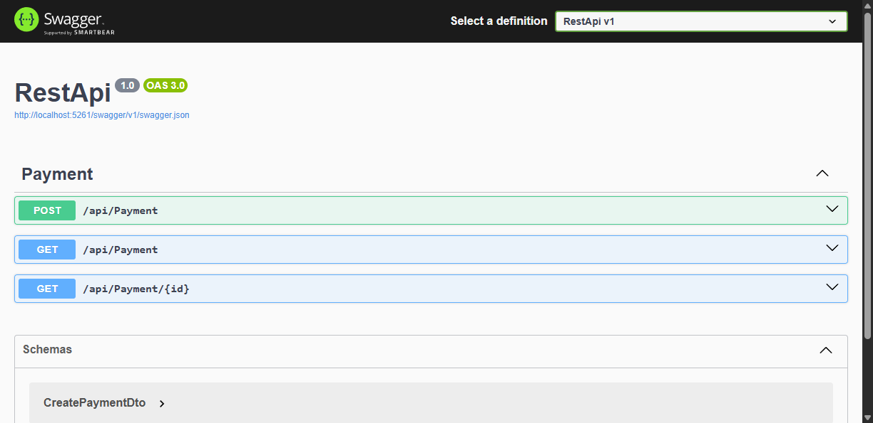
BACKUP (Hidden): Swagger Screenshot

Slide 17
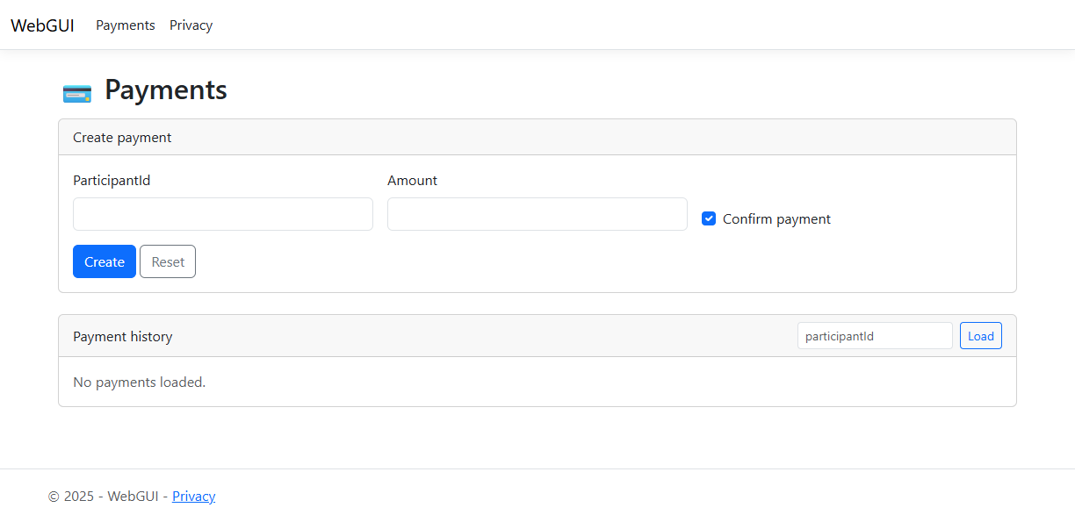
BACKUP (Hidden): WebGUI Screenshot

Slide 18
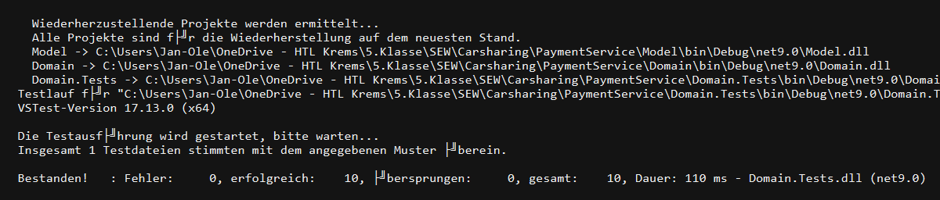
BACKUP (Hidden): Unit Tests Screenshot

