Slide 1
Innovative Projects Using Raspberry Pi (ECE2011) Phase –I Review Presentation (26th Sept to 27th Sept 2024) Comprehensive Deep Sea Exploration Analysis Platform
By
IPR-235
Under the supervision of
Ms. Raesa Razeen Assistant Professor
Department of CSE ,
Name | Roll Number
NISHIT SINGH | 20231IST0108
JANANI RAVI | 20231CSE0057
HIMANSHU KUMAR | 20231CSE0035
GOWREESH S | 20231CSG0152
SAGNIK ROY CHOWDHURY | 20231IST0061
MOHAMMAD AYAAN | 20231EEE0022

Slide 2
Comprehensive Deep Sea Exploration Data Analysis Platform Problem Statement Description:
Demands for real time data observation and analysis of oceanographic data has increased the difficulty of obtaining, viewing, and understanding essential environmental variables.
The current systems available are typically expensive, complicated to use or do not allow movement making it difficult to get them widely used.

Slide 3
Proposed Solution :
A website for the analysis and visualization of ocean data that utilizes real time data.
We would be using Raspberry Pi Pico and ESP32 for cost efficient hosting.

Slide 4
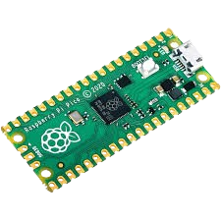
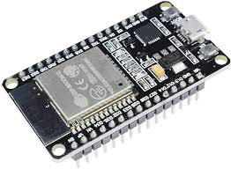
Technical Approach
Technical Approach for Deep Sea Exploration Data Analysis Platform
Hardware Components:
Raspberry Pi Pico
Power Supply
Wi-Fi module
ESP-32
Software Requirements:
HTML
CSS
JavaScript
API's(depending on the availability)

Slide 5
Impact and Benefits
Enhanced Real-Time Monitoring: Provides a low-cost, efficient platform for real-time ocean data analysis, improving the ability to monitor critical environmental metrics like temperature, salinity, and currents.
Sustainable and Scalable: By utilizing energy-efficient Raspberry Pi Pico and ESP32, the project promotes sustainability in ocean data collection, with the potential for wide-scale deployment in remote or low-resource areas.
Accessible Data Visualization: Offers an intuitive, web-based interface for users to easily interpret complex oceanographic data, aiding in research, environmental monitoring, and educational purposes.
Cost-Effective Solution: The use of affordable hardware reduces the need for expensive infrastructure, making ocean data analysis accessible to smaller organizations, researchers, and educational institutions.

Slide 6
Project Timeline
Phase 2
Deployment and evaluation:
Development and testing:
Research and planning:
Phase 1
Phase 3
-Design the overall structure of the platform.
-Define the specific goals and objectives of the platform.
-Development of almost 50 percent of the project.(webpage that features analysis and visualisation)
-Testing and rectifying bugs and issues.
-Hosting the page using hardware components.
-In this phase we would have a working model of our project which would have all the desired functionalities.

Slide 7
Q&A

Slide 8
Thank you !!

