Slide 1
Introduction to Data Science with Python
Chapter 2
July 28, 2023

Slide 2
Topics of the course
1. Chapter
2. Chapter
3. Chapter
Python Fundamentals
Data Wrangling & Simple visualizations
Visualizations & Modelling
Basic concepts, Variables, basic data structures, functions
How to process data with pandas and visualize it with matplotlib
More plots with matplotlib and seaborn and an introduction to modelling

Slide 3
What you learn in this Chapter...
… how to use Python libraries
… work with data in a DataFrame
… filter, merge and group your data
… visualize data with simple plots

Slide 4
Data Wrangling & Visualization
Libraries

Slide 5



Libraries
A collection of functions is bundled in a library
we import these libraries and can use the defined functions
Some libraries come with a Python installation, some need to be installed
… for plotting and visualization
… for working with tabular data (Excel-files, csv-files,...)
… creating machine learning models

Slide 6

Libraries
lists []
dictionary {}
for-loop
datatypes

Slide 7

Libraries
lists []
dictionary {}
for-loop
datatypes

Slide 8
Function & Methods
Functions
a = function_name(parameter)

Slide 9
Function & Methods
Functions
Methods
a = function_name(parameter)
a = "a string!"
a = a.upper() # ‘A STRING!’

Slide 10
Import Libraries
import library
a = library.function_name()

Slide 11
Import Libraries
import library as l
a = l.function_name()

Slide 12
Data Wrangling & Visualization
Arrays with Numpy

Slide 13
NumPy - library
Library for scientific computing
Work with lists, matrices or higher dimensional structures
NumPy lists have much more functionality than usual lists
import numpy as np
a = np.array([1,2,3,4])

Slide 14
NumPy - library
Library for scientific computing
Work with lists, matrices or higher dimensional structures
NumPy lists have much more functionality than usual lists
import numpy as np
a = np.array([1,2,3,4])
a.sum() # 10
a.mean() # 2.5
a.std() # 1.118...

Slide 15
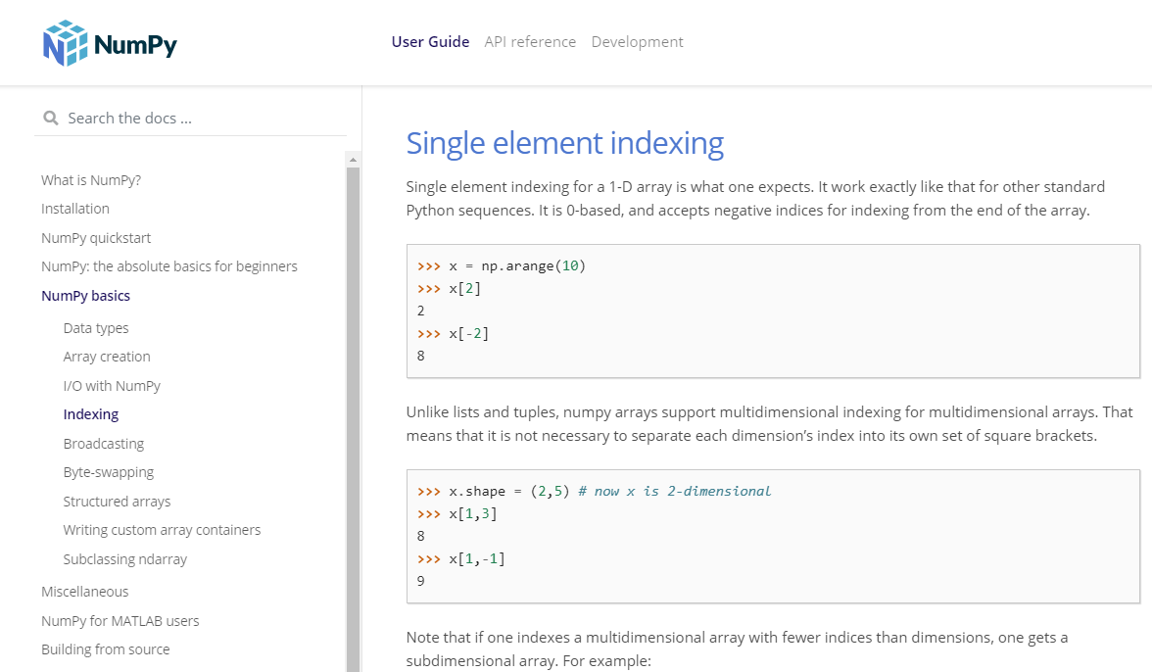
Documentation
Explanations to the methods and functions
Often include examples and tutorials
https://numpy.org/doc/

Slide 16
NumPy - Append
import numpy as np
a = np.array([1,2,3,4])
np.append(a, [5,6,7]) # array([1, 2, 3, 4, 5, 6, 7])

Slide 17
NumPy - Append
import numpy as np
a = np.array([1,2,3,4])
np.append(a, [5,6,7]) # array([1, 2, 3, 4, 5, 6, 7])
a = np.append(a, [5,6,7])

Slide 18
Compute with arrays - Broadcasting
import numpy as np
a = np.array([1,2,3])
a * 2 # array([2, 4, 6])
a ** 2 # array([1, 4, 9])
a - 1 # array([0, 1, 2])

Slide 19
Compute with arrays
import numpy as np
a = np.array([1,2,3])
b = np.array([1,1,1])
a + b # array([2, 3, 4])

Slide 20
Indexing
import numpy as np
a = np.array([1,2,3,4])
a[0:2] # array([1,2])

Slide 21
Boolean Indexing
import numpy as np
a = np.array([1,2,3,4])
a[[True,True,False,False]] # array([1,2])

Slide 22
Boolean Indexing
import numpy as np
a = np.array([1,2,3,4])
a <= 2 # [True, True, False, False]

Slide 23
Boolean Indexing
import numpy as np
a = np.array([1,2,3,4])
a <= 2 # [True, True, False, False]
a[a<=2] # array([1,2])

Slide 24
Exercise 1
import numpy as np
a = np.array([1,2,3,4])
a = np.append(a, [5,6,7])# [1,2,3,4,5,6,7]
a[a<=2] # [1,2] (boolean indexing)
a.sum() # 28

Slide 25
Data Wrangling & Visualization
Tabular Data with Pandas

Slide 26
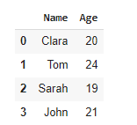
- library
import pandas as pd
data = { "Name":["Clara","Tom","Sarah","John"],
"Age” :[20,24,19,21]}
df = pd.DataFrame(data)

Slide 27
DataFrame - data structure
idx
...
Column 1 | Columns 2 | …. | Column N
 |  | ...
... | ... | ... | ....
 |  | ...
 |  | ...
Row 1 →
Row 2 →
Row N →
DataFrame
Index
Series

Slide 28
Read data
Pandas can read data from files
Various data formats possible
df = pd.read_csv(‘path_to_file’)
df = pd.read_excel(‘path_to_file’)
df = pd.read_sql_table(‘postgres://db’)
Notes:
Lots of methods in pandas. And you ask yourself how should I know all of this?
Show documentation and mention that it’s normal not to know everything right away
It’s like with names at a party - sometimes you forget the names five times. Luckily in programming you have the documentation.

Slide 29
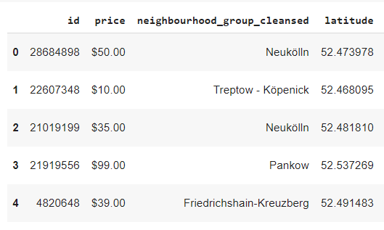
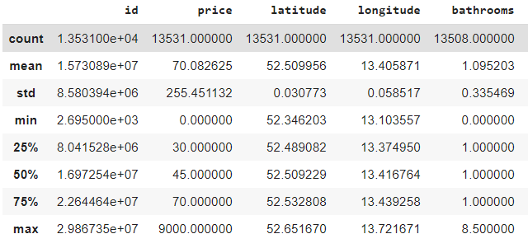
First look at the data
df.head()
df.describe()

Slide 30
Select Data

Slide 31
Select data in a DataFrame
Name | Age
Clara | 20
Tom | 24
Sarah | 19
John | 21
idx
0
1
2
3
df = pd.DataFrame(data)

Slide 32
Select data in a DataFrame
Name | Age
Clara | 20
Tom | 24
Sarah | 19
John | 21
idx
0
1
2
3
df = pd.DataFrame(data)
df["Name"]

Slide 33
Select data in a DataFrame
Name | Age
Clara | 20
Tom | 24
Sarah | 19
John | 21
idx
0
1
2
3
df = pd.DataFrame(data)
df.iloc[0:3]

Slide 34
Add data to a DataFrame
Name | Age | Grade
Clara | 20 | 1
Tom | 24 | 2
Sarah | 19 | 3
John | 21 | 4
idx
0
1
2
3
df["Grade"] = [1,2,3,4]

Slide 35
Compute with data in a DataFrame
Name | Age | Grade
Clara | 20 | 2
Tom | 24 | 3
Sarah | 19 | 4
John | 21 | 5
idx
0
1
2
3
df["Grade"] = df["Grade"] + 1

Slide 36
Drop data
Name | Age | Grade
Clara | 20 | 1
Tom | 24 | 2
Sarah | 19 | 3
John | 21 | 4
idx
0
1
2
3
# Drop column
df = df.drop(column="Grade")
Notes:
Notice that instead of just writing “Grade” we need to specify what we want to drop - column in this case!

Slide 37
Drop data
Name | Age | Grade
Sarah | 19 | 3
John | 21 | 4
idx
2
3
# Drop column
df = df.drop(column="Grade")
# Drop row
df.drop([0,1], inplace=True)
Notes:
inplace=True so you keep the “idx”, if inplace = False → returns a copy of the altered dataframe.

Slide 38
Filter data

Slide 39
Filter data - select a subset of the data
Name | Age | Grade
Clara | 20 | 2
John | 21 | 5
idx
0
2
keep_rows = [True, False,
True,False]
df[keep_rows]
Notes:
Filter: give an array with boolean/True & False values.
Only keeps rows that evaluate to true

Slide 40
Filter data - select a subset of the data
Name | Age | Grade
Clara | 20 | 2
Tom | 24 | 3
Sarah | 19 | 4
John | 21 | 5
idx
0
1
2
3
df["Age"] <= 20
→ [True, False, True, False]
Notes:
Remember “boolean indexing” from earlier: logic operator will return an array with True/False values for a column
We can take advantage of that!

Slide 41
Filter data - select a subset of the data
Name | Age | Grade
Clara | 20 | 2
John | 21 | 5
idx
0
2
df[ df["Age"] <= 20 ]
[True, False, True, False]
Notes:
Let’s merge these two techniques: boolean indexing and filtering

Slide 42
Filter data - select a subset of the data
Name | Age | Grade
Clara | 20 | 2
idx
0
df[
(df["Age"] <= 20) &
(df["Grade"] < 3)
]
Notes:
And we can be more complex, like boolean indexing for two different columns and using “&” and “|”

Slide 43
Filter data - select a subset of the data
Name | Age | Grade
Clara | 20 | 2
Sarah | 19 | 4
idx
0
2
df[
(df["Age"] == 20) |
(df["Grade"] == 4)
]

Slide 44
Combine filtering with other methods
Name | Age | Grade
Clara | 20 | 2
John | 21 | 5
idx
0
2
df[df["Age"] <= 20]
This is again a DataFrame

Slide 45
Combine filtering with other methods
Name | Age | Grade
Clara | 20 | 2
John | 21 | 5
idx
0
2
df[df["Age"]<=20]["Age"].mean()

Slide 46
Exercise 2
import pandas as pd
df = pd.DataFrame(data) # create dataframe
df[’new_column’] = [1,2,3]
df.sort_values(by=’column_name’) # sort
df[df[’age’]<=20] # filter data

Slide 47
Pandas methods

Slide 48
Apply pandas methods
Pandas has large amount of commonly used methods
Can be applied to single column or whole data frame
df["Grade"].mean()
df["Grade"].std()
df["Grade"].sum()

Slide 49
Often used methods
df["Grade"].mean()
df["Grade"].sum()
df["Grade"].value_counts()
df.sort_values(by="Grade")
df.groupby(by="Grade").sum()
df1.merge(df2)
df.drop(colums=["Grade"])
df["Grade"].replace(5,"Failed")
Notes:
Note: You can concatenate methods. See: groupby and then sum()

Slide 50
Group-By
Name | Age | Gender
Clara | 20 | F
Tom | 24 | M
Sarah | 19 | F
John | 21 | M
idx
0
1
2
3
What is the average age per gender?
Notes:
When calculating by hand: We first group all the female entries and compute the average.
Same goes here.
You can concatenate methods!

Slide 51
Group-By
df.groupby(by=’Gender’).mean()
F
Clara 20
Sarah 19
Name | Age | Gender
Clara | 20 | F
Tom | 24 | M
Sarah | 19 | F
John | 21 | M
idx
0
1
2
3
M
Tom 24
John 21

Slide 52
Group-By
df.groupby(by=’Gender’).mean()
F
Clara 20
Sarah 19
Name | Age | Gender
Clara | 20 | F
Tom | 24 | M
Sarah | 19 | F
John | 21 | M
19.5
idx
0
1
2
3
M
Tom 24
John 21
22.5

Slide 53
Merge DataFrame’s
Name | Age | Grade
Clara | 20 | 2
Tom | 24 | 3
Sarah | 19 | 4
Name | Subject
Sarah | Physics
Tom | Politics
John | English

Slide 54
Merge DataFrame’s
Name | Age | Grade
Clara | 20 | 2
Tom | 24 | 3
Sarah | 19 | 4
Name | Subject
Sarah | Physics
Tom | Politics
John | English
Name | Age | Grade | Subject
Tom | 24 | 3 | Politics
Sarah | 19 | 4 | Physics

Slide 55
Merge DataFrame’s
Name | Age | Grade
Clara | 20 | 2
Tom | 24 | 3
Sarah | 19 | 4
Name | Subject
Sarah | Physics
Tom | Politics
John | English
df1.merge(df2, on='Name')
Name | Age | Grade | Subject
Tom | 24 | 3 | Politics
Sarah | 19 | 4 | Physics
Notes:
Notice that for the Parameter name we need the keyword “on” followed by an “=” sign (explain shortly why - maybe show the documentation)
But wait - what happened to “Clara” and “John”?

Slide 56
Merge DataFrame’s
Name | Age | Grade
Clara | 20 | 2
Tom | 24 | 3
Sarah | 19 | 4
Name | Subject
Sarah | Physics
Tom | Politics
John | English
df1.merge(df2,how='left',
on='Name')
Name | Age | Grade | Subject
Tom | 24 | 3 | Politics
Sarah | 19 | 4 | Physics
Clara | 20 | 2 | -

Slide 57
Exercise 3
import pandas as pd
df = df.groupby(by=’column_name’)
df = df.merge(df2,on=’column_name’,how=’left’)

Slide 58
Data Wrangling & Visualization
Visualizations with Matplotlib

Slide 59
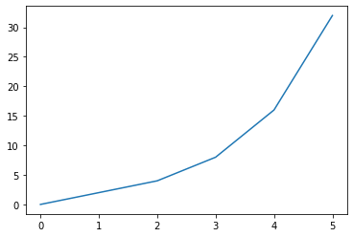
- library
data visualization tool
generate highly customizable plots
good integration with pandas
import matplotlib.pyplot as plt
x = [0,1,2,3,4,5]
y = [0,2,4,8,16,32]
plt.plot(x,y)
Plot:
Notes:
Dokumentation zeigen

Slide 60
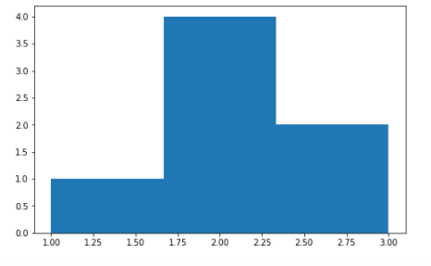
Histogram
import matplotlib.pyplot as plt
x = [1,2,2,2,2,3,3]
plt.hist(x, bins=3)

Slide 61
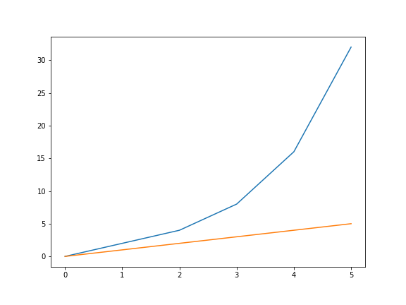
Customize plots
import matplotlib.pyplot as plt
x = [0,1,2,3,4,5]
y = [0,2,4,8,16,32]
y2 = [0,1,2,3,4,5]
plt.plot(x,y)
plt.plot(x,y2)

Slide 62
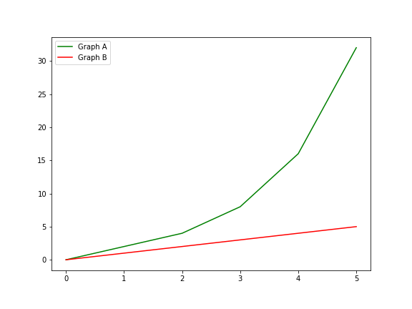

Customize plots
import matplotlib.pyplot as plt
x = [0,1,2,3,4,5]
y = [0,2,4,8,16,32]
y2 = [0,1,2,3,4,5]
plt.plot(x,y, color='green', label='Graph A')
plt.plot(x,y2, color='red', label='Graph B')
plt.legend()

Slide 63
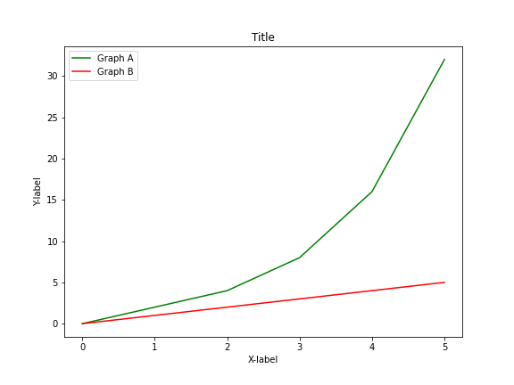
Customize plots
import matplotlib.pyplot as plt
x = [0,1,2,3,4,5]
y = [0,2,4,8,16,32]
y2 = [0,1,2,3,4,5]
plt.plot(x,y, color='green', label='Graph A')
plt.plot(x,y2, color='red', label='Graph B')
plt.legend()
plt.xlabel("X-label")
plt.ylabel("Y-label")
plt.title("Title")

Slide 64
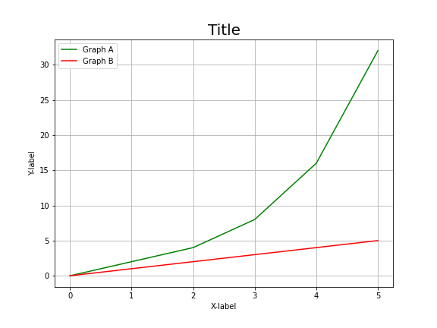
Customize plots
import matplotlib.pyplot as plt
x = [0,1,2,3,4,5]
y = [0,2,4,8,16,32]
y2 = [0,1,2,3,4,5]
plt.plot(x,y, color='green', label='Graph A')
plt.plot(x,y2, color='red', label='Graph B')
plt.legend()
plt.xlabel("X-label")
plt.ylabel("Y-label")
plt.title("Title",
{'fontname':'DejaVu Sans', 'size':'20'})
plt.grid()

Slide 65
pandas & matplotlib
Pandas and matplotlib work very well together
We can pass columns of a DataFrame to matplotlib
import matplotlib.pyplot as plt
df = pd.DataFrame(data)
plt.hist(df["Age"])

Slide 66
Exercise 4
import matplotlib.pyplot as plt
df = pd.DataFrame(data)
plt.hist(df["Age"])

Slide 67
Data Wrangling & Visualization
Clean Data with Pandas

Slide 68
Clean data
Data comes often in an untidy form, therefore some data cleaning is necessary
Name | Town
Clara | Frankfurt a.M.
Sarah | Frankfurt am Main
John | Berlin
df1['Town'].str.replace(
'a.M.',
'am Main', inplace=True)

Slide 69
Clean data
Data comes often in an untidy form, therefore some data cleaning is necessary
Name | Subject
Clara | Physics
Sarah | physics
John | Math
df1[’Subject’].str.lower(inplace=True)

Slide 70
Working with dates

Slide 71

What kind of data type is this : "27-03-2021" ?
integer b) float c) string d) date

Slide 72
Transform string to datetime object
df[’Birthday’] = pd.to_datetime(df[’Birthday’])
Name | Birthday
Clara | “20/10/1995”
Sarah | “10/01/1999”
John | “05/03/2001”

Slide 73
Transform string to datetime object
df[’Birthday’] = pd.to_datetime(df[’Birthday’], format=”%d/%m/%y”)
Name | Birthday
Clara | “20/10/1995”
Sarah | “10/01/1999”
John | “05/03/2001”

Slide 74
Transform string to datetime object
df[’Birthday’] = pd.to_datetime(df[’Birthday’], format=”%m-%d-%y”)
Name | Birthday
Clara | “10-10-1995”
Sarah | “10-01-1999”
John | “05-03-2001”

Slide 75
Transform string to datetime object
df['day'] = df['Birthday'].dt.day
df['weekday'] = df['Birthday'].dt.weekday
df['month'] = df['Birthday'].dt.month
Name | Birthday | day | weekday | month
Clara | “10-10-1995” | 10 | 1 | 10
Sarah | “10-01-1999” | 1 | 4 | 10
John | “05-03-2001” | 3 | 3 | 5

Slide 76
Set date as index
date | City | Temperature
“20-04-2021” | Frankfurt | 10
“20-04-2021” | Berlin | 11
“20-04-2021” | Munich | 12
“21-04-2021” | Frankfurt | 11
“21-04-2021” | Berlin | 13
“21-04-2021” | Munich | 14
“22-04-2021” | Frankfurt | 9
“21-04-2021” | Berlin | 10
df = df.set_index(['date'])

