Slide 1
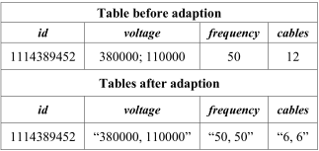
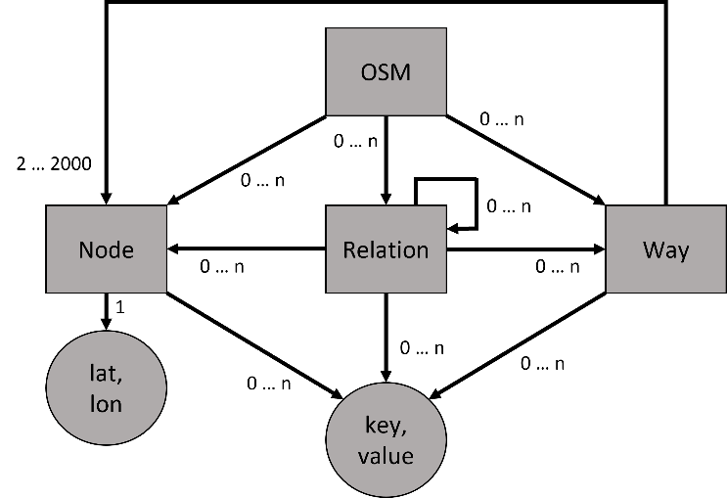
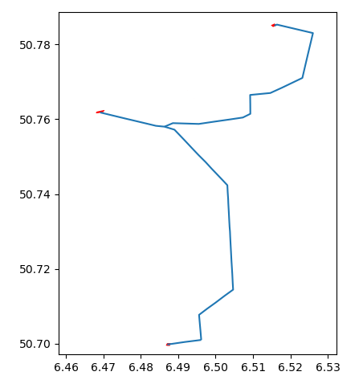

Open Electrical Grid Model for Regional Transmission Networks
Derk Gonschor, Jan Schmitt, Alion Alushi
Abstract – This paper aims at addressing the challenges associated with open electrical grid models to advance load flow simulations required for the transition toward a sustainable energy system. This paper presents a Python-based open electrical grid model generator by using OpenStreetMap data as the input to increase the availability of open-source models for regional transmission networks. The method is based on the existing open electrical grid tool osmTGmod and consists of two main steps presented in detail. First of all, a new state-of-the-art OpenStreetMap filter is researched and implemented. It converts Open Street Map data to CSV data categorized by the corresponding object classes. Following this, missing data is populated by a Python Script depending on different heuristics. The software and packages are presented, and one example of a regional transmission network is described to provide insight into the method.
INTRODUCTION
3. Theory of the Python Script
As decentralization of generation of electricity is going forward as sustainable energy is in focus more than ever, more electrical grid models are needed, e.g. to simulate power flow. Countries of the global south and especially Africa could gain much from this transition and models, which brings the need of public, open-source models being available. This project makes a step forward contributing to this issue by using OSM data and Python as a programming language to develop an existing open grid model for the German transmission network into an open tool for creating electrical grid models.
Existing German model: The existing German model “osmTGmod” uses several programming languages SQL, PostgreSQL and pl/pgSQL, Python as well as software and databases, which are no longer state-of-the-art and increase computing time. Therefore, in this project, there is a state-of-the-art approach with the programming language Python, which allows the reduction of the software and computing time needed.
The task is to add missing data of the components (e.g. substations) through derivations and correlations of existing data, surrounding networks and assumptions for certain characteristics.
1. Read in the generated CSV-Data as Pandas DataFrame and partly split it up. For example, the ways Table is separated in substations and lines/cables.
2. Adjustment of the data of the respective tags. Therefore, the data types of same values are unified.
3. Missing data can be added and errors can be removed.
Scenario: Missing Frequency/Cable Value
If a frequency value is missing, the frequency value of a member of the same circuit is considered and partly used. Therefore, all neighbours are stored in a DataFrame. If a line has the same start- or endpoint and one value of the voltage levels is the same, it is considered as a neighbour. Similar procedures are also used for all
missing values such as voltage levels or the number of cables. The adaption of a frequency and cable value is illustrated in the following table.
1. OpenStreetMap (OSM)
OSM is the biggest open-source geodatabase worldwide, where everyone can contribute with their input by adding or adapting information.
As it is showed in Figure 1, the main components of the OSM-Database are
Nodes, which are composed of a set of coordinates, represent point objects: in terms of the electrical grid, power poles.
Ways, which represent line objects and connect the Nodes (connection of power poles)
Table 1: Example of the adaption of frequency and cables
4. Application and outlook
Relations, which represent the correlation between different objects, consisting of a list of members such as Nodes and Ways, but also other Relations
Key-Value pairs, which is called a Tag. Each Tag defines the property an object, such as the voltage level, frequency, number of cables and wires per voltage, number of circuits.
The electrical grid model generation is initiated by reading the OSM-data of a region (for NRW the data size is around 700 MB).
The filtering process takes place, which produces 80000 Nodes, 13000 Ways and 1000 Relations.
Power Script is executed to populate missing data, without implementing the routing of power circuits yet.
After completing the power data of the region, the routing by power lines, e.g. between substations, is executed, as it is shown in Figure 2.
Figure 1: Simplified representation of the OpenStreetMap data model. 0 … n means that an element may occur 0 to n times
Figure 2: Plot of substation (red) connected by power lines (blue) in a section of North Rhine Westphalia
2. Theory and Application of the Filter
The OSM data includes all data of the selected region. Hence the data must be filtered to sort out unnecessary objects like streets and bus lines. For that three Iterations are used:
1. Objects of the class Relation with the value “power” for the tag “route” are saved as a Python tuple object.
2. Objects of the class Ways with the tag “power” or if the Way object can be found in the before saved list of Relations. Also, all Nodes listed in this Way object are saved.
3. Objects of the class Nodes are considered. Here, only the Nodes are needed, that are part of the Node tuple created in the second iteration.
These results are converted to a Pandas DataFrame and stored in a separate CSV-File for each Object.
5. Conclusions
The developed tool in this project offers an approach to an open-source electrical grid model generator using Python as a programming language and OSM-geodatabase as a data source.
Python makes the tool being replicatable in any computer system and reduces strongly software dependency and installation time.
Next step is further development of the tool based on osmTGmod, such as grid calculations, which will open the way to the realization and full potential of the developed tool.
Contact: Prof. Dr. xx
Tel.: +49 221-8275-xx
Cologne University of Applied Sciences,
Betzdorfer Straße 2, 50679 Köln, Germany
Contact: XX
Tel.: +49 221-8275-xx
Cologne University of Applied Sciences,
Betzdorfer Straße 2, 50679 Köln, Germany

