Slide 1
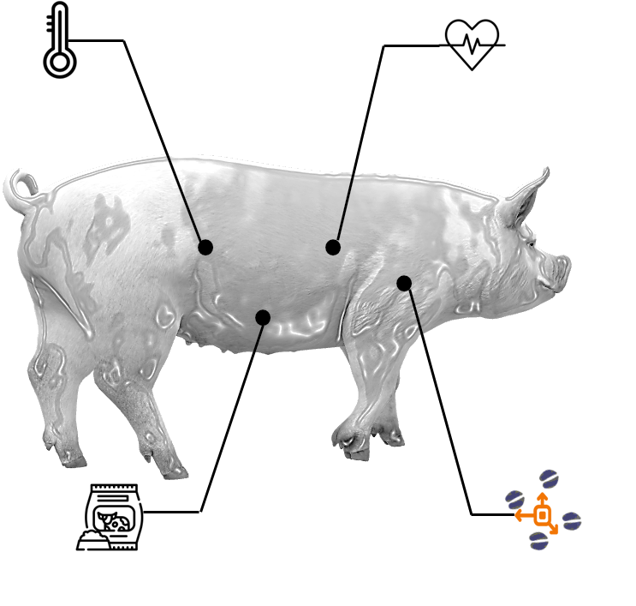
EnergyTag: A Wearable Software Sensor for Online Monitoring of Animal’s Dynamic Energy Expenditure
Jan Aarts, Kristina Vodorezova, Yajing Tang, Marcel Heetkamp, Bjorge Laurenssen, Ali Youssef
ECPLF 2024
11 Sep. 2024

Slide 2


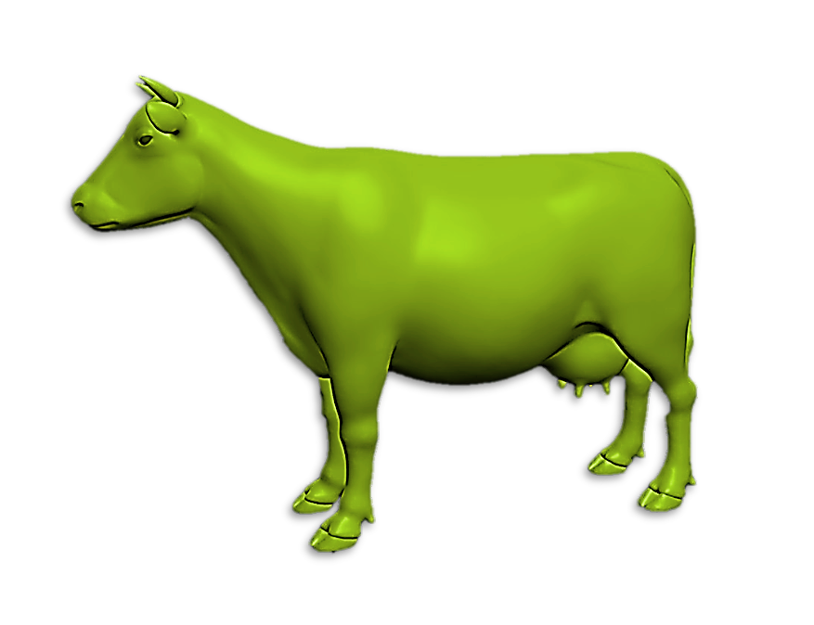
Why Energy Expenditure (EE)?
now
Animal Health/welfare status
Health indicator
Insight in animal physiology
Early signs of changes
predicted failure
x
Time
$$EE(t)={{\{E}_{Basal met}+E_{heat balance}+{E_{growth}+E_{movement}+E}_{mental state}\}}_{t}$$
“Physiological”
“Mechanical”
“Mental”

Slide 3
How to measure Energy Expenditure
Gold standard: Climate Respiration Chamber (CRC)
Challenges: expensive, confined area, no group behaviour

Slide 4

Alternative solution: Software sensor
Software sensor
Target variable(s)
Hardware sensor(s)
Model (software)
Quantified animal technologies (Wearables)
Dynamic energy expenditure

Slide 5


Alternative: Software sensor
Heart rate
Heat flux
Temperature
Activity
MODEL
Energy Expenditure
Core temperature

Slide 6
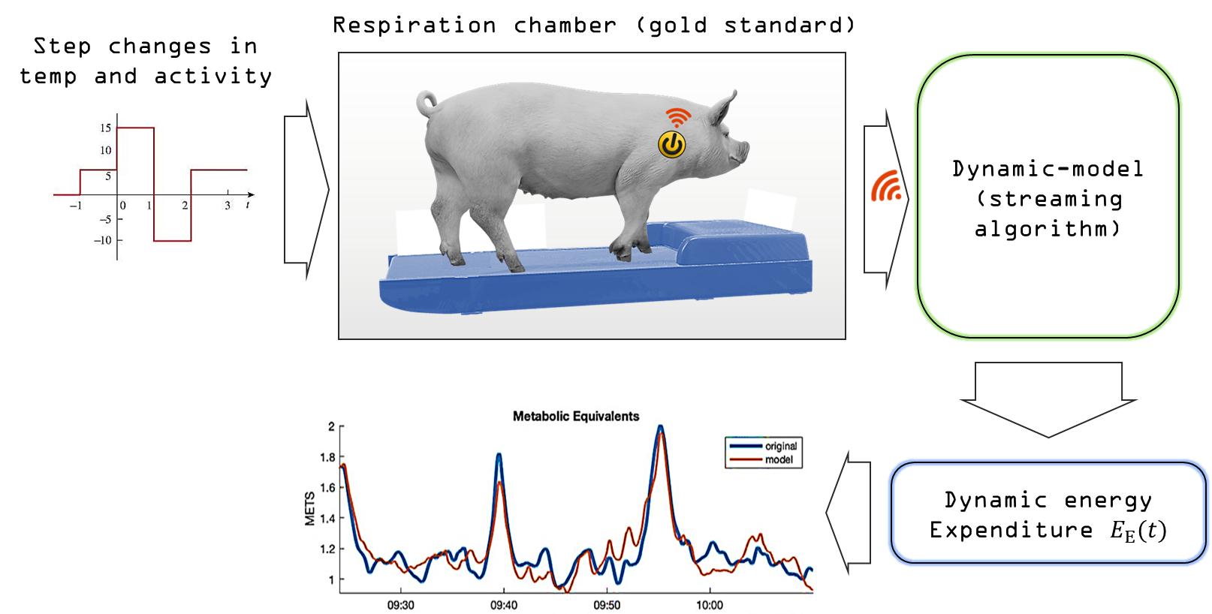
EnergyTag: Experimental Setup

Slide 7
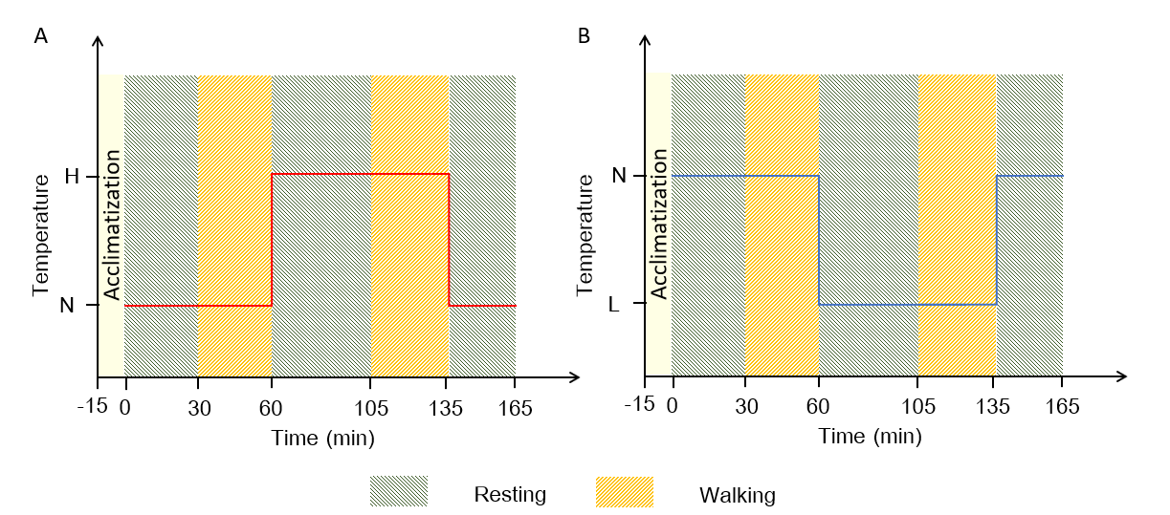
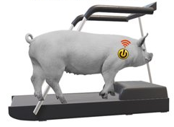
EnergyTag initial experimental plan

Slide 8
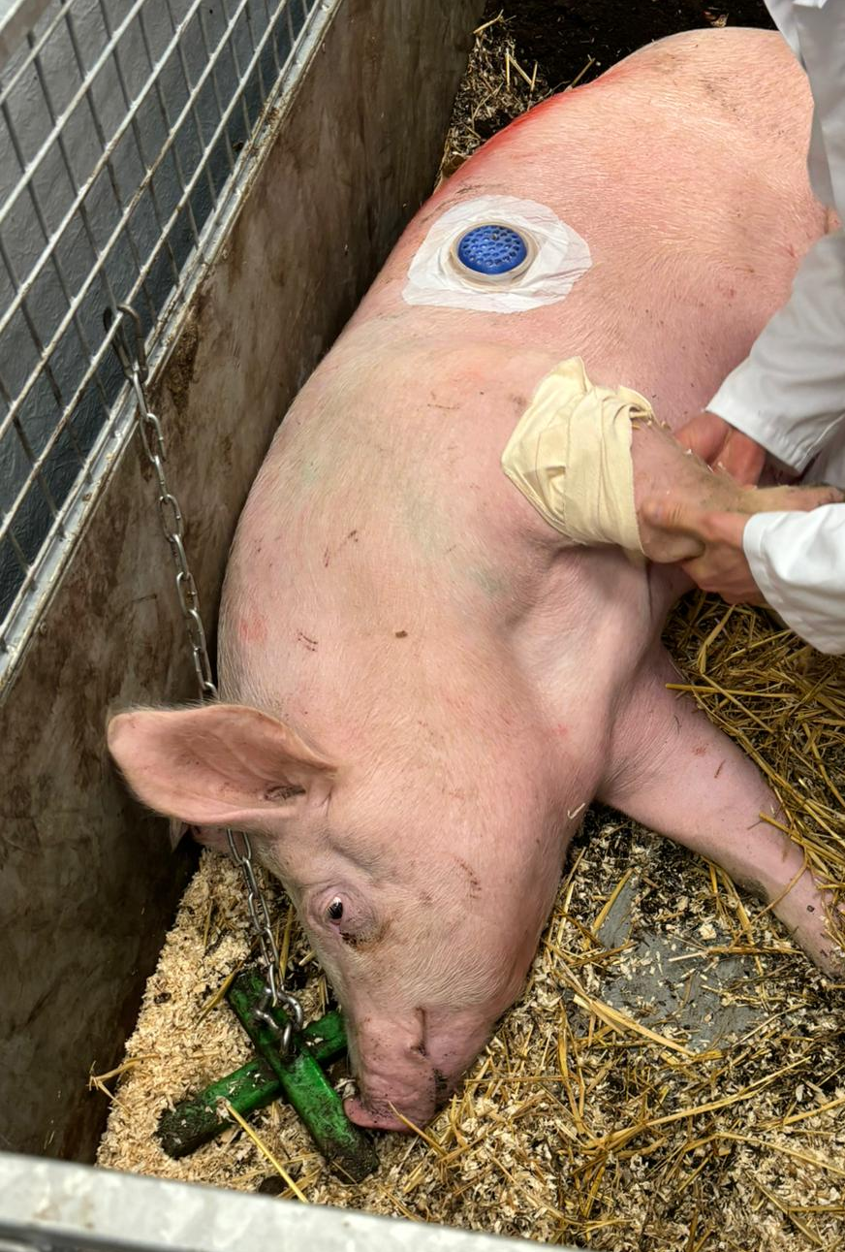
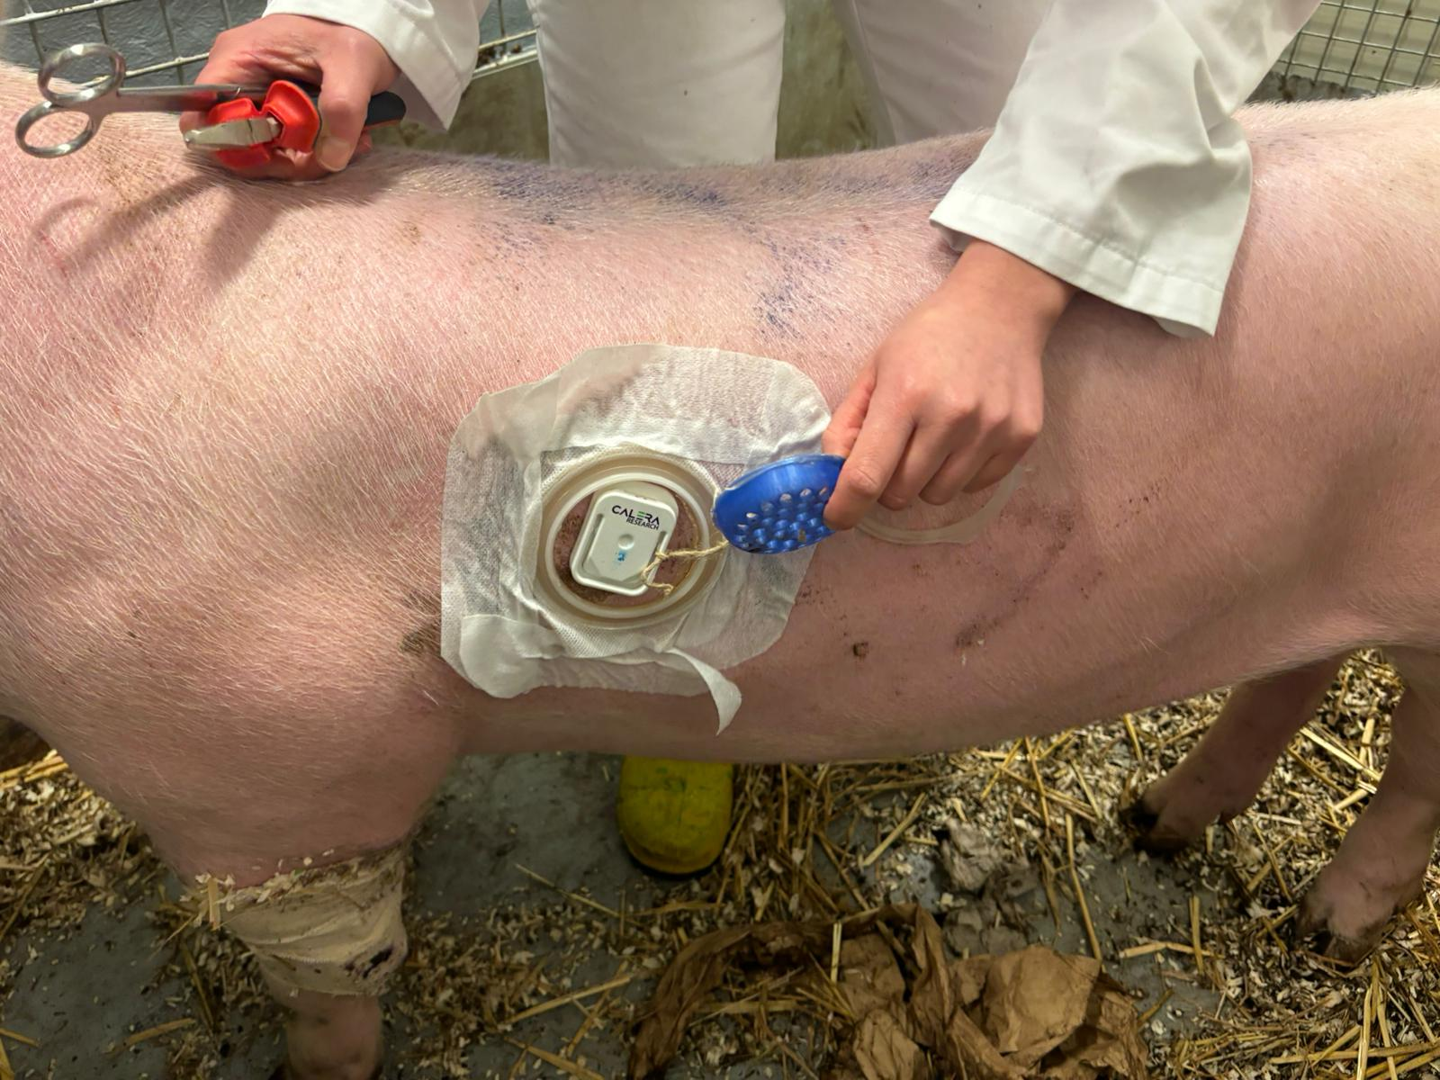
EnergyTag: Wearable sensors

Slide 9
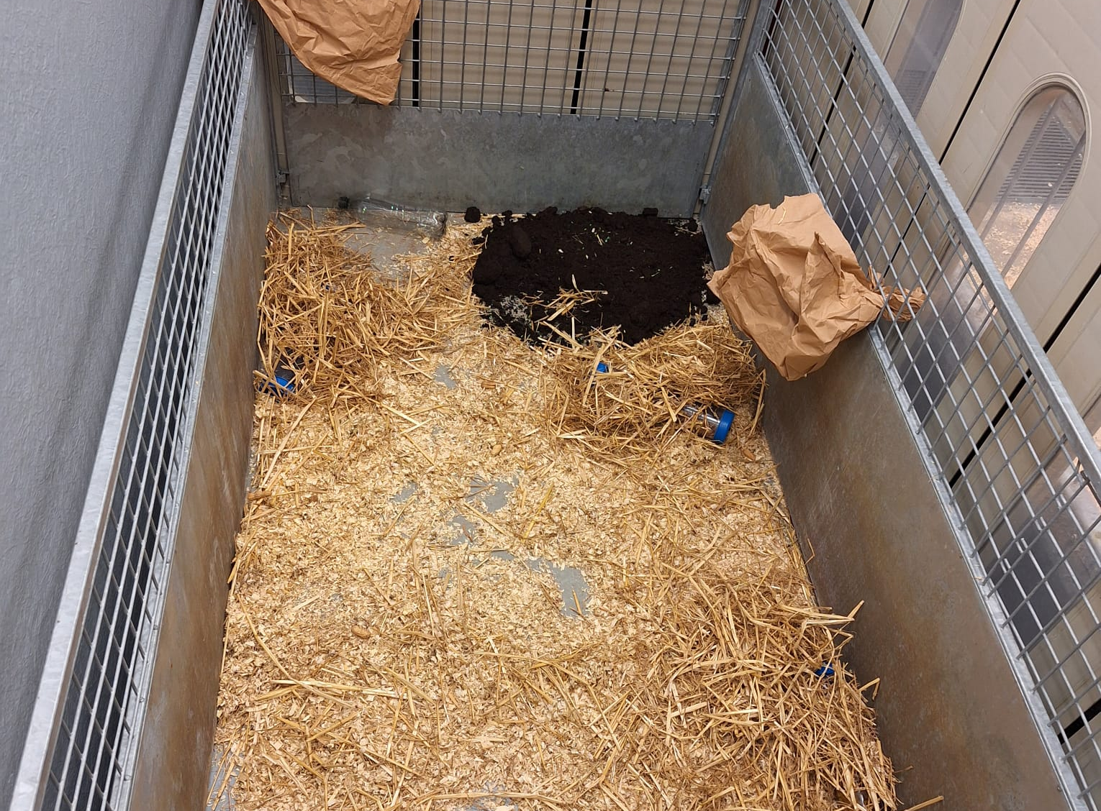
EnergyTag experimental setup

Slide 10
Preprocessing
Train split
Test split
Blocks
Divide data into blocks corresponding to CRC measurements.
For each block calculate features:
Heat flux: mean, slope.
Skin temperature: mean, slope.
Overall Dynamic Body Acceleration (ODBA): min, max, mean.

Slide 11
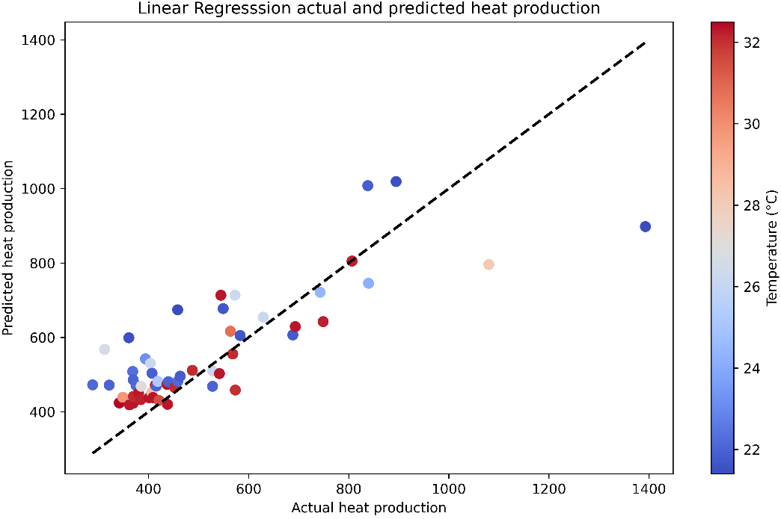
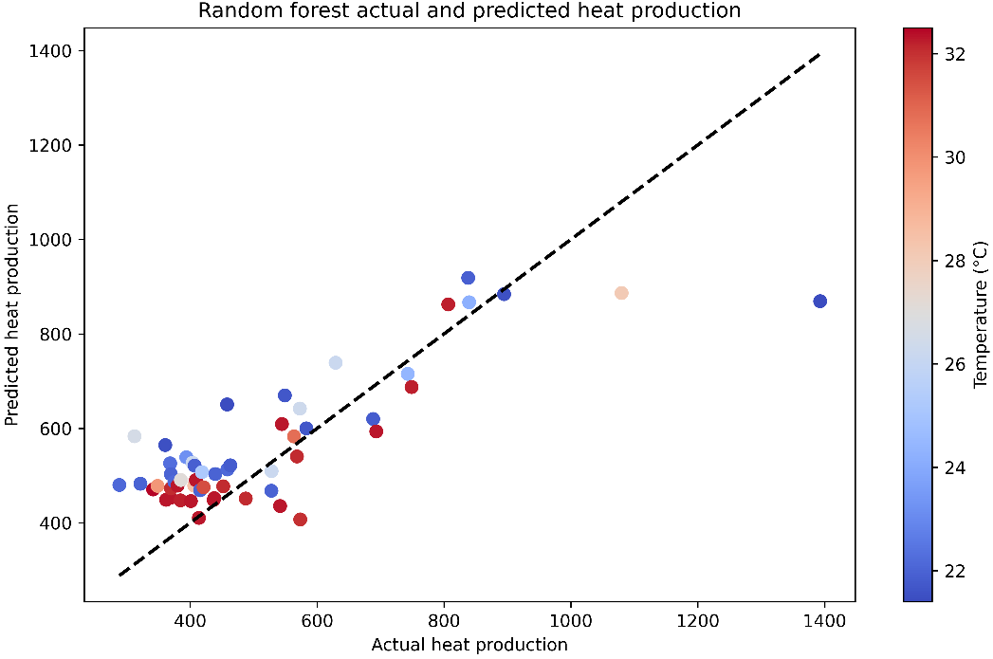
Results
Linear regression
Random forest regression

Slide 12
Discussion: Challenges
Extrapolation to the future is difficult
Large portion of energy expenditure is spend on movement
Measured energy expenditure follows an eratic pattern

Slide 13
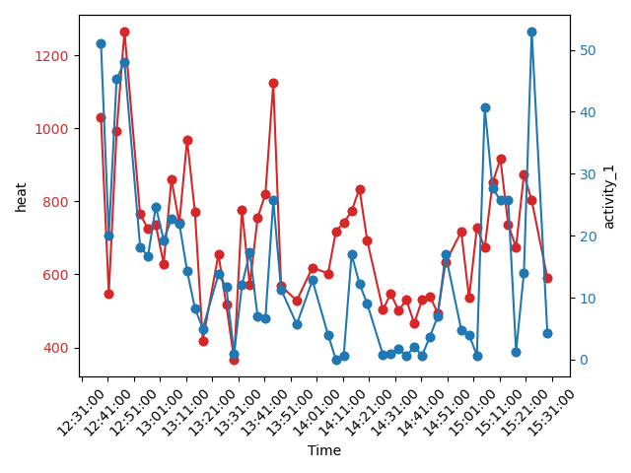
Discussion
Heat production shows high correlation with activity. Which makes it difficult to extract energy expended on thermoregulation.

Slide 14
Future prospects
Currently working on a high resolution dataset.
Higher resolution data shows much smoother curves in energy expenditure
Combined with our high resolution acceleration data I hope to be able to separate energy expended on activity from energy expended on thermoregulation

Slide 15

Questions

