Slide 1
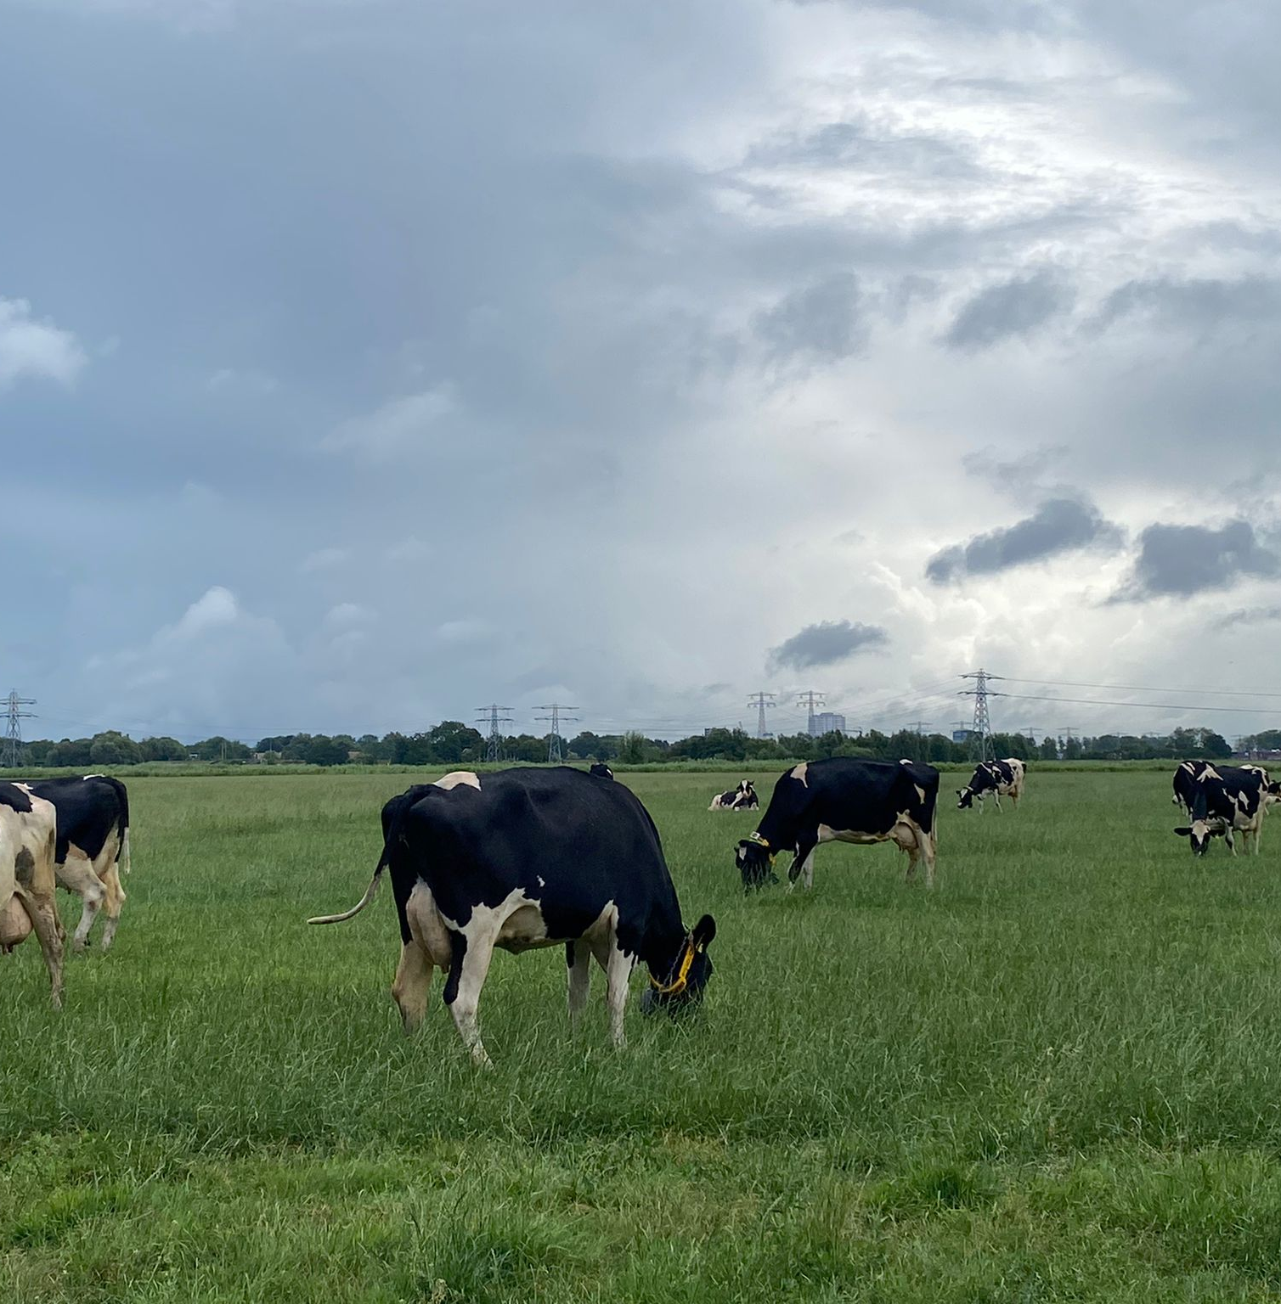
Comparative Machine Learning for predicting late-lactation milk yield in dairy cows
08-09-2026
Y. Aarts, E. Burgers, E. Saccenti, R. Torres, R. Goselink & A. van Knegsel

Slide 2
Aim: Predict which cows are likely to maintain milk production in late-lactation.

Slide 3
Why?
Late lactation performance as proxy for extended lactation management
Conventional Cycle
Frequent calving and associated risks
Extended lactation
Fewer calvings
Sustained production becomes important
Selection challenge
Cows differ
Long forecasting window

Slide 4
Research question
Which time-series classifier best predicts a late-lactation production outcome using the daily milk yield from the first 60 days in lactation?
Input
Outcome
Class 1
Milk yield
Decision threshold -> 21.25 kg/day
Class 0
60
DIM
250-257

Slide 5
Why time-series classification?
Methods can emphasize different patterns encoded in time-series
Distance based
Interval based
Shapelet based
Dictionary based
Hybrid
K-Nearest Neighbour Time Series Classifier
(KNN)
Time Series Forest Classifier
(TSF)
Learning Shapelet Classifier
(LS)
Bag of Patterns transformation + Random Forest Classifier
(BOP + RF)
Hierarchical Vote Collective of Transformation-based Ensembles V2
(HIVE-COTE)
The Elastic Ensemble of Time Series Distance Measures
(EE)
Ensemble of Bag of Symbolic Fourier Approximation Symbols
(BOSS)

Slide 6


Dataset
Cow identification number
Farm identification number
Date of milking
Start of milking
End of milking
Weight of milk milked
SUM Milk production >= 170 in DIM 250-257 then 1 else 0
27 farms
7507 cows
 | Day 1 | Day 2-59 | Day 60 | Outcome
Lactation 1 | 9 | …, …, …, | 45 | 1
Lactation 2 | 5 | …, …, …, | 33 | 0
…
7932 lactations

Slide 7
Study design
1
2
3
4
5
6
7
Dataset
1
2
3
4
5
6
7
Training
Testing
5-Fold cross validation
1
2
3
4
5
1
2
3
5
4
1
2
4
5
3
…
…
…
…
…

Slide 8
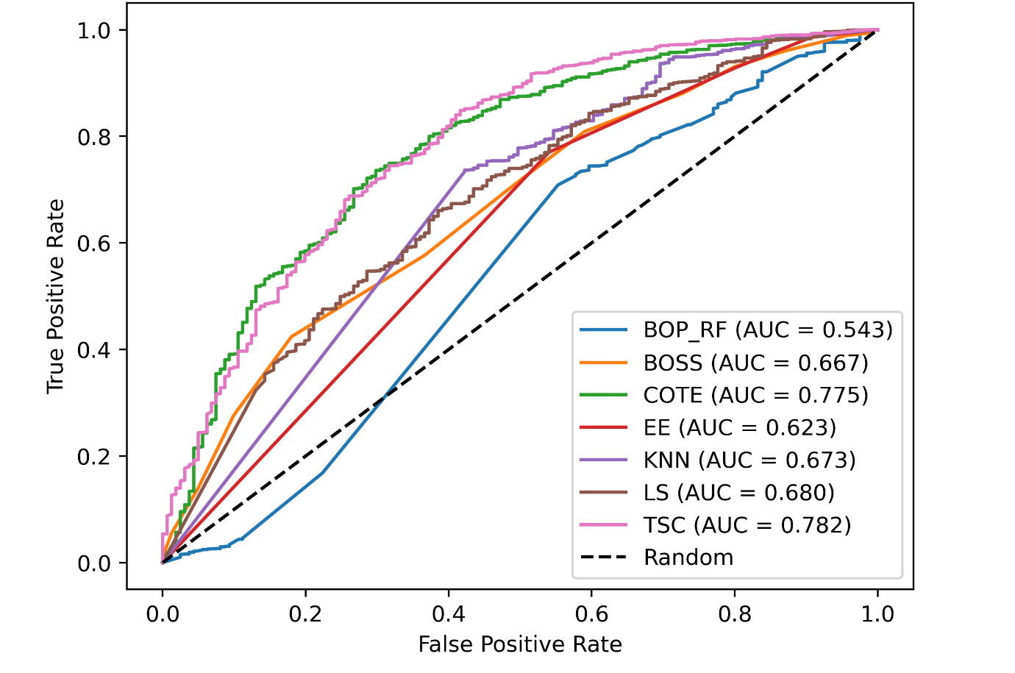
TSF performs best
Model | AUC | Brier loss | Accuracy | F1-macro
KNN | 0.673 | 0.100 | 0.83 | 0.59
EE | 0.623 | 0.115 | 0.86 | 0.57
TSF | 0.782 | 0.075 | 0.88 | 0.67
LS | 0.680 | 0.086 | 0.90 | 0.56
BOP + RF | 0.543 | 0.097 | 0.79 | 0.53
BOSS | 0.667 | 0.089 | 0.77 | 0.56
HIVE-COTE | 0.775 | 0.077 | 0.87 | 0.64
TSF

Slide 9
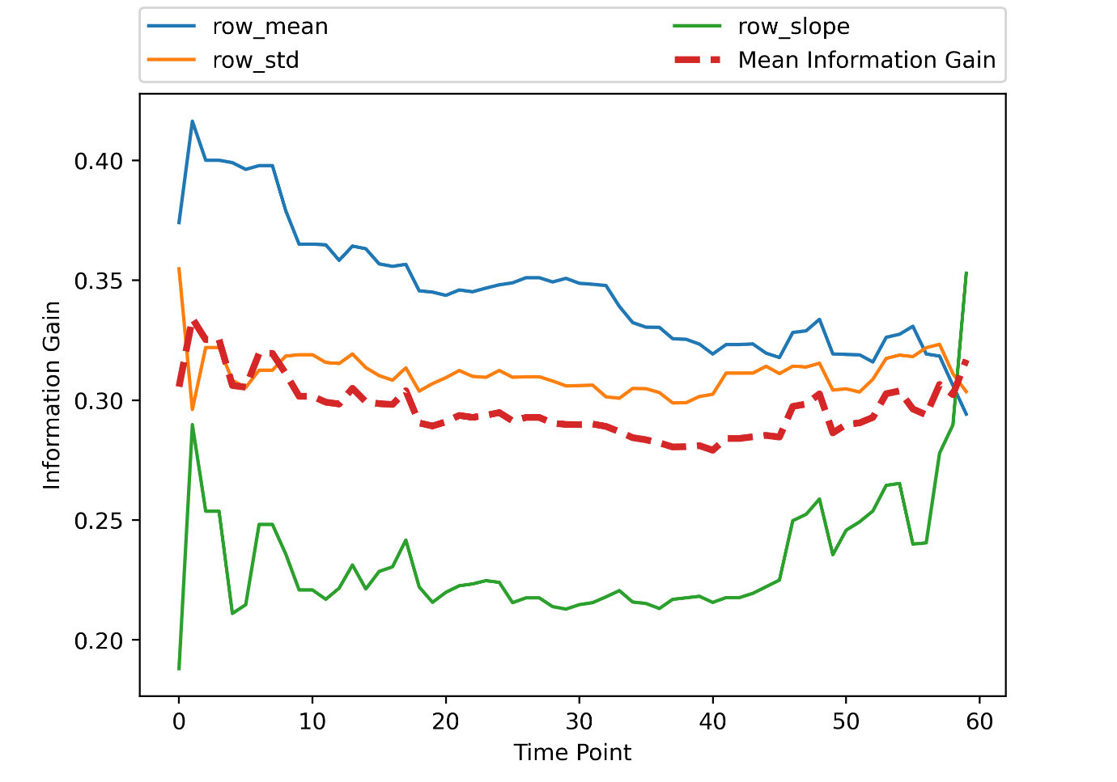
Temporal importance based on TSF
Key takeaway: Overall mean of the interval is most informative. Near peak production slope of interval is most important.

Slide 10
Conclusion
Time-Series Forest Classifier outperforms
Univariate prediction with daily milk already yields good discrimination (AUC 0.78)
Extend the TSF by adding more features: LnVar, Autocorrelation
Multivariate approach with added: parity, milking duration and milking interval.

Slide 11
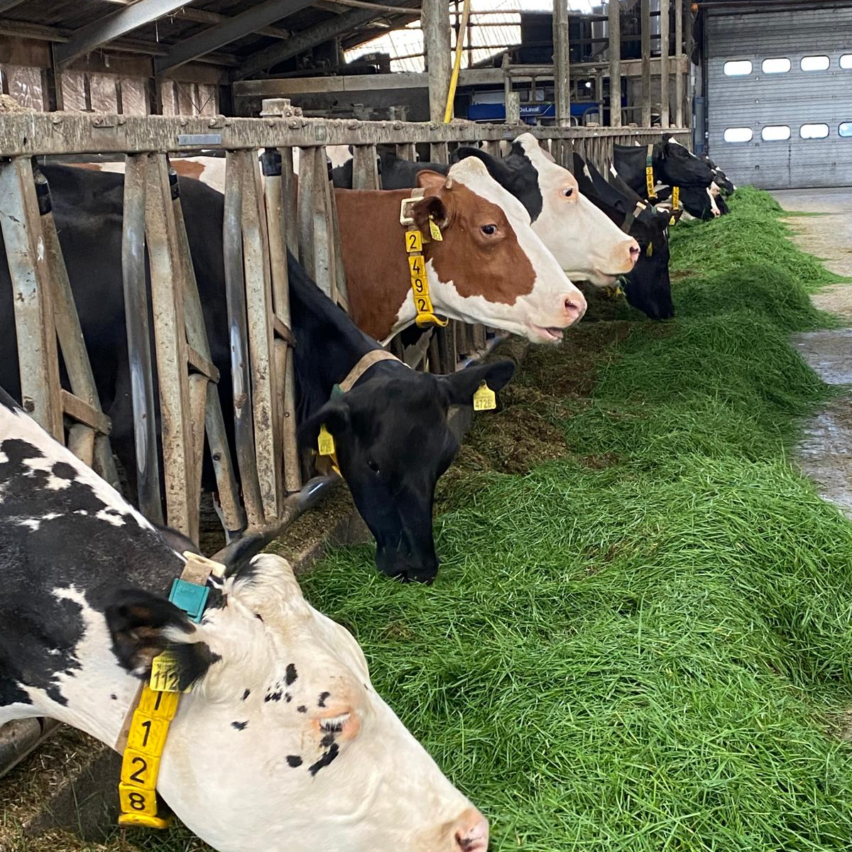






Questions?

Slide 12
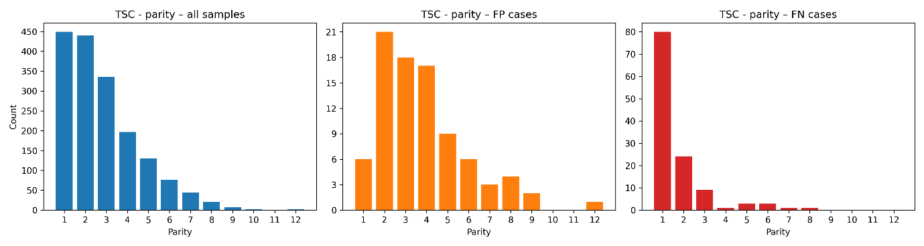
Parity is important
Input data
False Positive cases
False Negative cases

