Slide 1


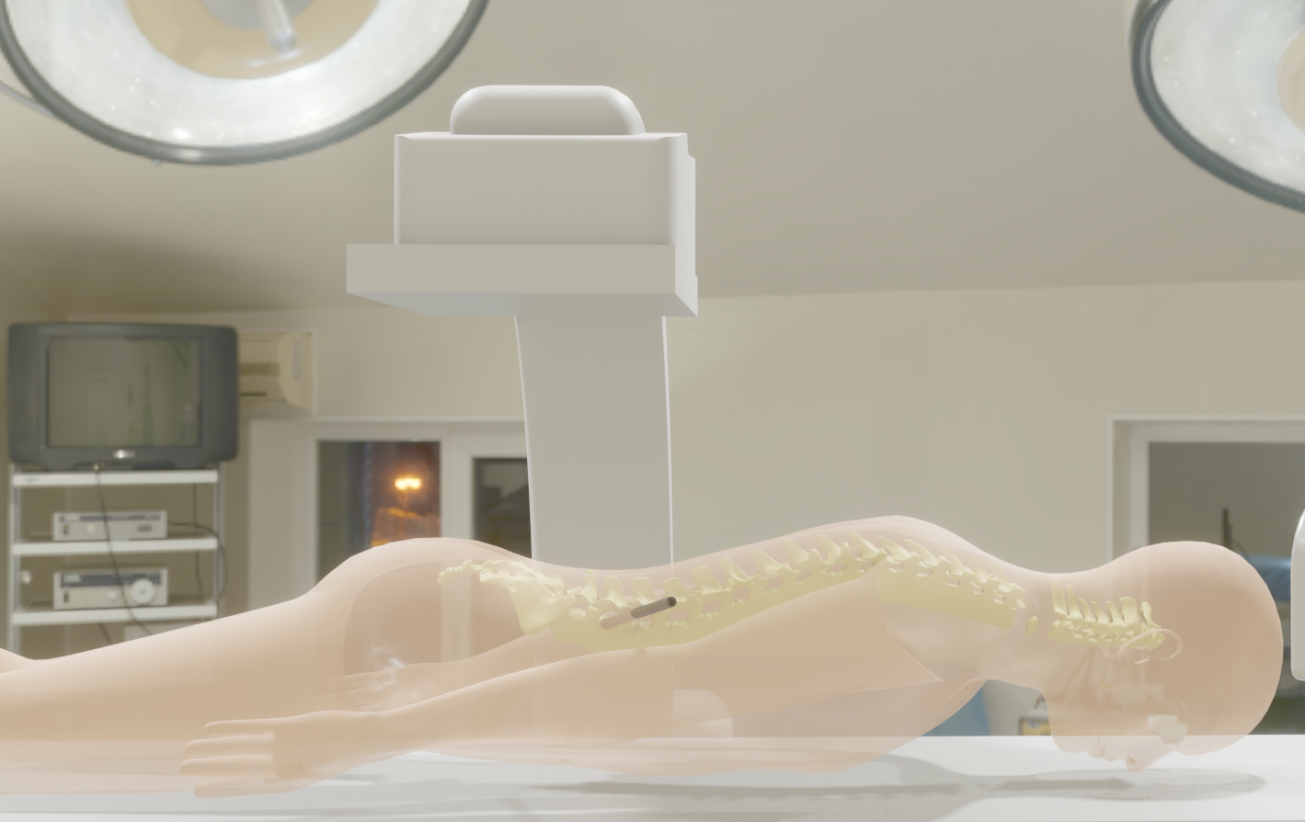
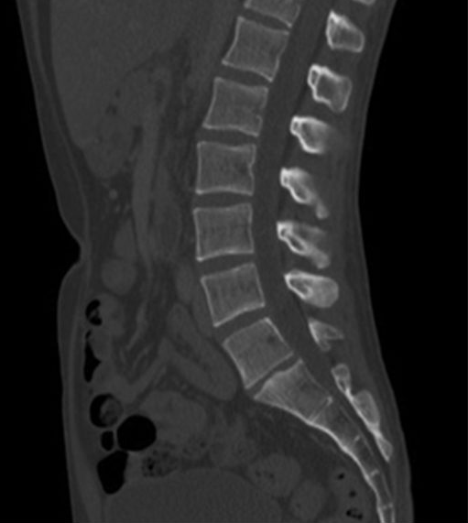
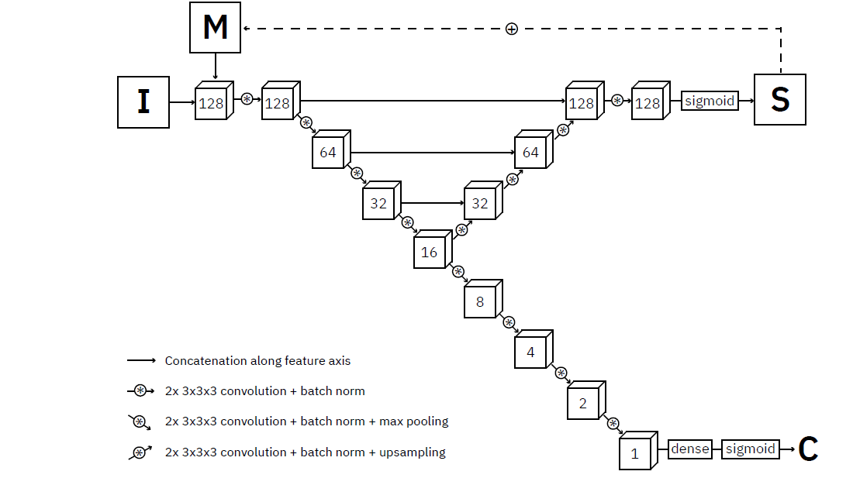
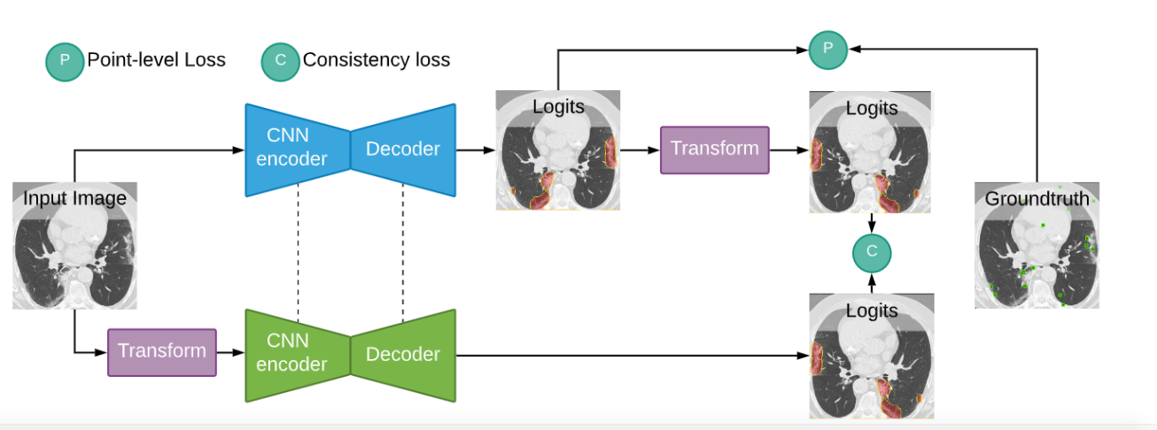
Spine Vertebrae segmentation in 3D CT scan images
Jan Alexander
Promotors: dr. J. Roels & dr. ir. B. Vankeirsbilck
Problem motivation
Available datasets
Approach
CT scan segmentation
5 datasets:
359 images, 242 patients
Xxx male, xxx female, 22 unknown
Average age: xxx
Comparison with fully segmented model
Automatization of CT scan interpretation of pathology diagnosis and surgical intervention.
Convert full segmentation to point supervision
Compare weakly supervised model with fully supervised model, brained on same dataset:
Different backbones: ResNet, VGG16 & upsampling, U-net
Different loss functions: Consistency, WISe
Use of priors: 2D+, instance memory
Dataset | Images | annotation
USiegen | 17 | Full
xVertSeg | 25 | Full
PLoS | 22 | Full
MyoSeg | 53 | Full
Uwash | 242 | Point
Weak supervision
Existing model architectures
References
Data labelling costly and time consuming
What could we do with less?
Instance segmentation model trained on point supervised data can strongly reduce cost.
Fully supervised model (reference)
Lessmann architecture:
3D U-net
More complicated inference algorithm
Project objective
Construction and analysis of point supervised instance segmentation mode of the lumbar spine.
Comparison of the performance of point supervised models with fully supervised reference model.
Based on available data.
Point supervision techniques
Consistency loss
Aknowledgement
The original project idea occured to me due to the VLAIO – REISS project, a joint effort of Verhaert New Products and Services & Ugent IMEC.
The REISS project is led by dr. Ir. B. Braeckman

