Slide 1


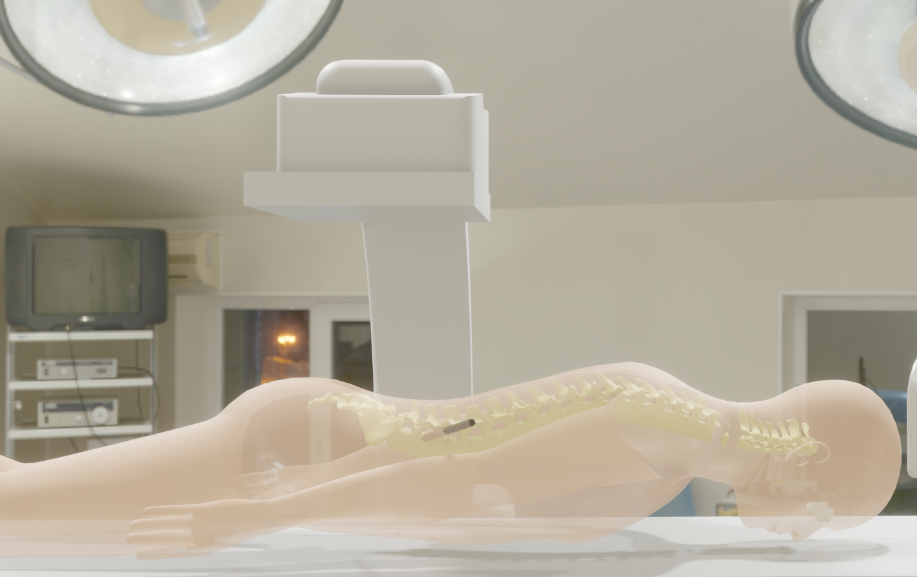
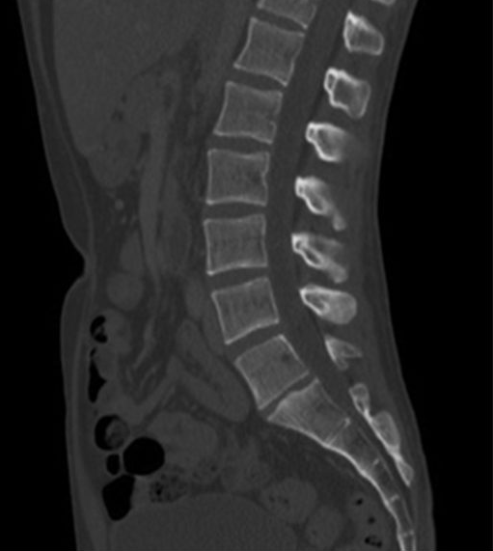
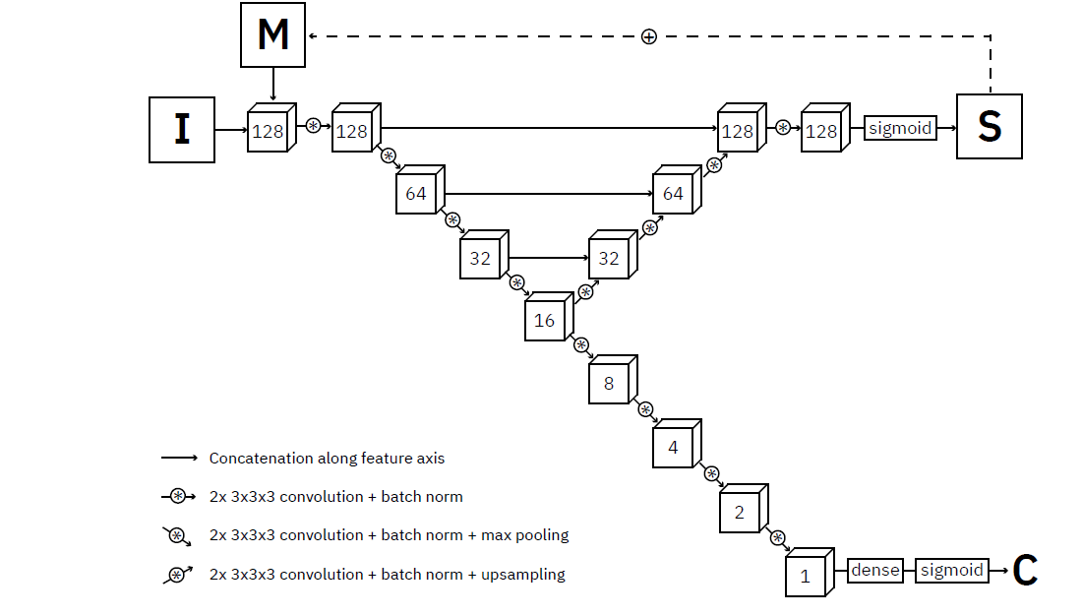
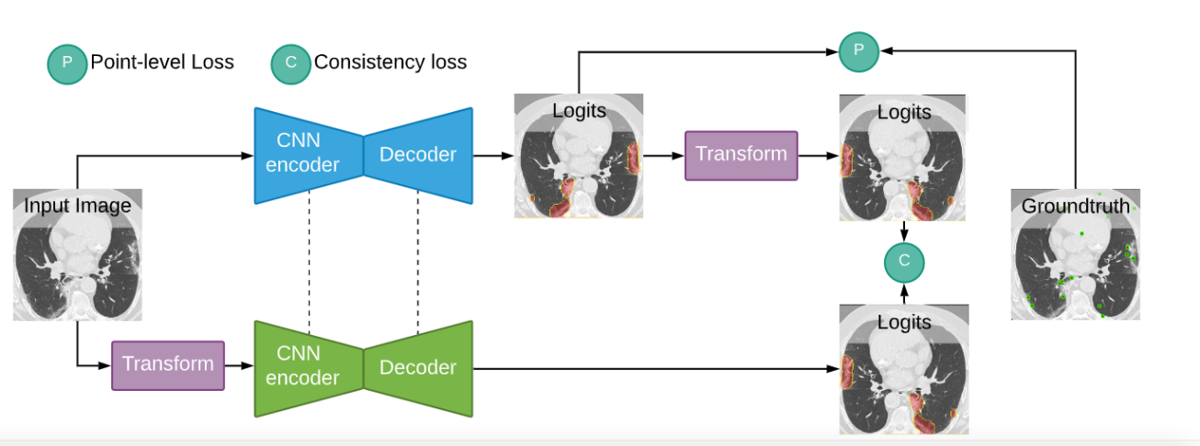
Spine Vertebrae segmentation in 3D CT scan images
Jan Alexander
Promotors: dr. J. Roels & dr. ir. B. Vankeirsbilck
Problem motivation
Available datasets
Approach
CT scan segmentation
5 datasets [2-7,13] :
359 images, 242 patients
Xxx male, xxx female, 22 unknown
Average age: xxx
Comparison with fully segmented model
Automatization of CT scan interpretation of pathology diagnosis and surgical intervention.
Convert full segmentation to point supervision
Compare weakly supervised model with fully supervised model, brained on same dataset:
Different backbones: ResNet, VGG16 & upsampling, U-net
Different loss functions: Consistency, WISe
Use of priors: 2D+, instance memory
Train best model with UW data and evaluate again.
Dataset | Images | annotation
USiegen | 17 | Full
xVertSeg | 25 | Full
PLoS | 22 | Full
MyoSeg | 53 | Full
Uwash | 242 | Point
Weak supervision
Existing model architectures
References
Data labelling costly and time consuming
What could we do with less?
Instance segmentation model trained on point supervised data can strongly reduce cost [1] .
[1]Bearman, A., Russakovsky, O., Ferrari, V., & Fei-Fei, L. (2015, jun). Whatś the Point: Semantic Segmentation with Point Supervision. Retrieved from http://arxiv.org/abs/1506.02106
[2]Burian, E., Rohrmeier, A., Schlaeger, S., Dieckmeyer, M., Diefenbach, M., Syväri, J., . . . Baum, T. (2019, 04). Lumbar muscle and vertebral bodies segmentation of chemical shift encoding-based water-fat MRI: The reference database MyoSegmenTUM spine. BMC Musculoskeletal Disorders, 20. doi:10.1186/s12891-019-2528-x
[3]Chu, C., Belavý, D. L., Armbrecht, G., Bansmann, M., Felsenberg, D., & Zheng, G. (2015, 11). Fully Automatic Localization and Segmentation of 3D Vertebral Bodies from CT/MR Images via a Learning-Based Method. PLOS ONE, 10, 1-22. doi:10.1371/journal.pone.0143327
[4]Glocker, B., Feulner, J., Criminisi, A., Haynor, D. R., & Konukoglu, E. (n.d.). Automatic Localization and Identification of Vertebrae in Arbitrary Field-of-View CT Scans. Tech. rep.
[5]Glocker, B., Zikic, D., Konukoglu, E., Haynor, D. R., & Criminisi, A. (n.d.). Vertebrae Localization in Pathological Spine CT via Dense Classification from Sparse Annotations. Tech. rep.
[6]Ibragimov, B., Likar, B., Pernuš, F., & Vrtovec, T. (2014, April). Shape Representation for Efficient Landmark-Based Segmentation in 3-D. IEEE Transactions on Medical Imaging, 33, 861-874. doi:10.1109/TMI.2013.2296976
[7]Korez, R., Ibragimov, B., Likar, B., Pernuš, F., & Vrtovec, T. (2015, Aug). A Framework for Automated Spine and Vertebrae Interpolation-Based Detection and Model-Based Segmentation. IEEE Transactions on Medical Imaging, 34, 1649-1662. doi:10.1109/TMI.2015.2389334
[8]Laradji, I. H., Rostamzadeh, N., Pinheiro, P. O., Vazquez, D., & Schmidt, M. (2019, jun). Instance Segmentation with Point Supervision. Retrieved from http://arxiv.org/abs/1906.06392
[9]Laradji, I. H., Rostamzadeh, N., Pinheiro, P. O., Vazquez, D., & Schmidt, M. (2020). Proposal-Based Instance Segmentation With Point Supervision. 2126-2130. doi:10.1109/icip40778.2020.9190782
[10]Laradji, I. H., Vazquez, D., & Schmidt, M. (2019, jul). Where are the Masks: Instance Segmentation with Image-level Supervision. Retrieved from http://arxiv.org/abs/1907.01430
[11]Laradji, I., Rodriguez, P., Mañas, O., Lensink, K., Law, M., Kurzman, L., . . . Nowrouzezahrai, D. (2020, jul). A Weakly Supervised Consistency-based Learning Method for COVID-19 Segmentation in CT Images. Retrieved from http://arxiv.org/abs/2007.02180
[12]Lessmann, N., van Ginneken, B., de Jong and Pim, A., & Išgum, I. (2018, apr). Iterative fully convolutional neural networks for automatic vertebra segmentation and identification. doi:10.1016/j.media.2019.02.005
[13]Zukić, D., Vlasák, A., Egger, J., Hořínek, D., Nimsky, C., & Kolb, A. (2014, 03). Robust Detection and Segmentation for Diagnosis of Vertebral Diseases Using Routine MR Images. Computer Graphics Forum, 33. doi:10.1111/cgf.12343
Fully supervised model (reference)
Lessmann architecture [12] :
3D U-net
Complicated inference algorithm
Project objective
Construction and analysis of point supervised instance segmentation mode of the lumbar spine.
Comparison of the performance of point supervised models with fully supervised reference model.
Based on available data.
Point supervision techniques
Consistency loss[9]
Aknowledgement
The original project idea occured to me due to the VLAIO – REISS project, a joint effort of Verhaert New Products and Services & Ugent IMEC.
The REISS project is led by dr. Ir. B. Braeckman

