Slide 1
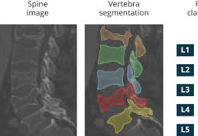
Jan Alexander Point-supervised segmentation of human spine

Slide 2
Progress since last meeting
Posterpresentation
Semantic segmentation: Based on consistency loss
Writing during training time
Instance segmentation: first models

Slide 3
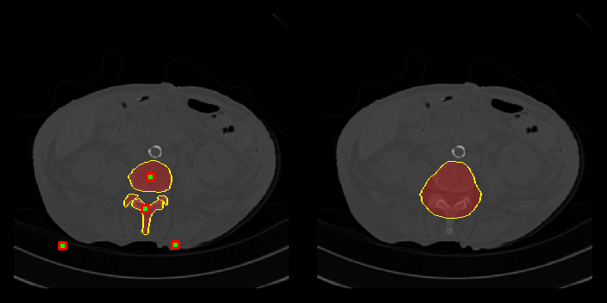
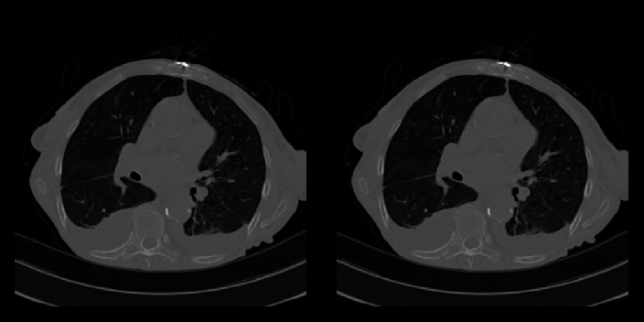
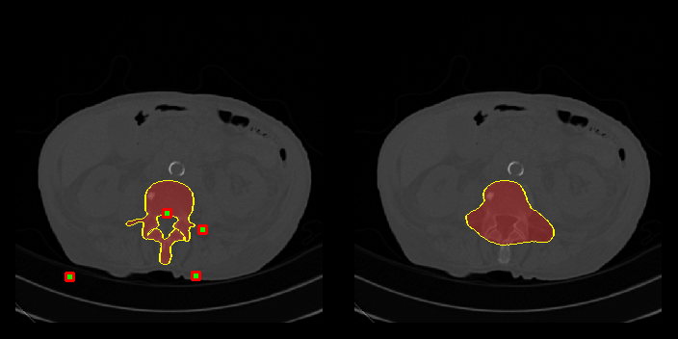
Semantic segmentation (transverse) Good separation of thoracal and abdominal slices

Slide 4
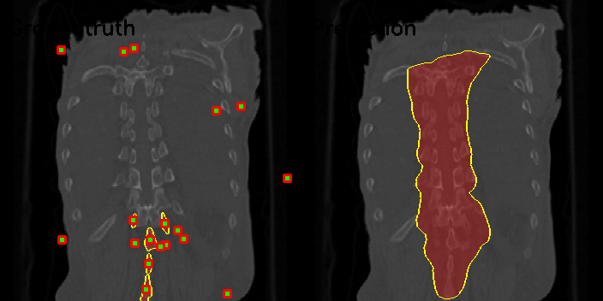
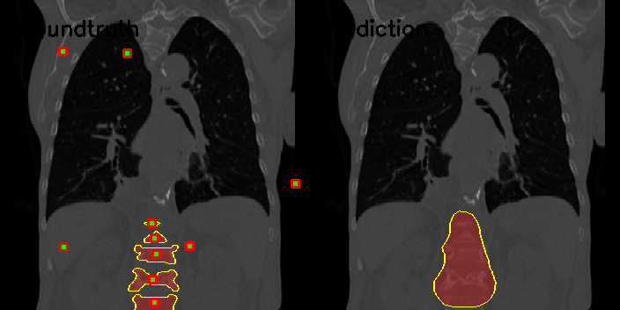
Semantic segmentation (frontal)
Variable performance.
Possible explanation: lung visibility

Slide 5
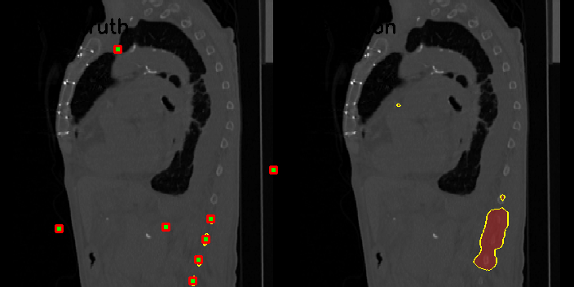
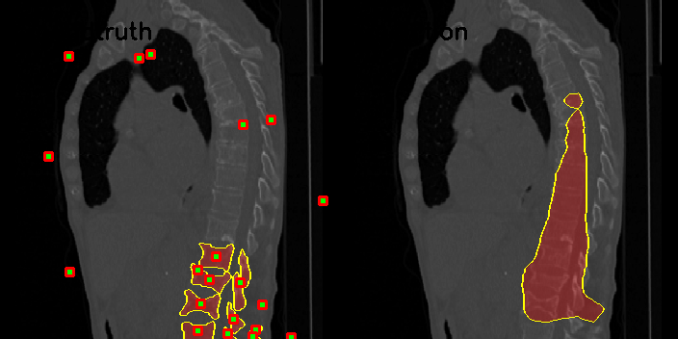
Semantic segmentation (Sagittal)
Comparable performance to frontal performance

Slide 6
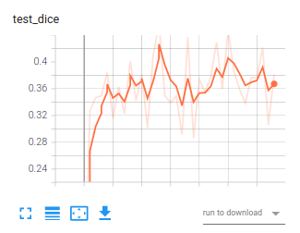
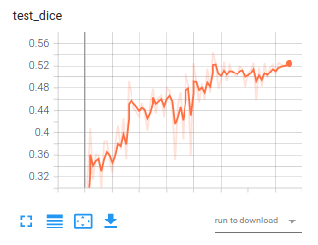
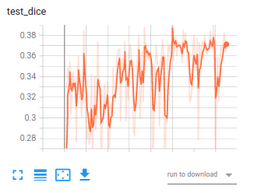
Dice score performance
For transverse slice: dice up to 50%
Other two planse: ~35%
Only center points
Only trained on xVerSeg dataset
Only trained with flip transformation
No rotation
No elastic transformations

Slide 7
Improve performance
1 Voxel is part of 3 perpendicular slices. Can you increase performance by combining 2 or 3 slice segmentations?
3x or 2x the labelling cost.
Labelling cost full mast <> hint decreases with factor 12, so there is still a gain.
Use more points
Use better positioned points: choose background points close to objects to segment

Slide 8
Instance segmentation
Same approach as for 2 classes (class + background) but now for 6 classes (5 vertebrae + background) -> model outputs 6 channels
Sequential approach (Lessmann): Train network to segment next lumbar vertebra. Extra input layer with already segmented vertebra is passed to the network
Perform semantic segmentation (2 channel output), but encourage separation of masks. Separate system to identify segments

Slide 9
Experiment matrix
Parameter:
Backbone: VGG11 – VGG16 – VGG 19 – ResNet – Unet
# points:
1 per instance center
1 @ random
n @ random
n with preference for border region

Slide 10
Planning:
By april 25: Finish 5 channel code
By may 9: Sequential code
By may 16: Different point extractions + backbones
By may 23: Add datasets + assure good experiment dict function
May 30: start running experiment matrix

