Slide 1
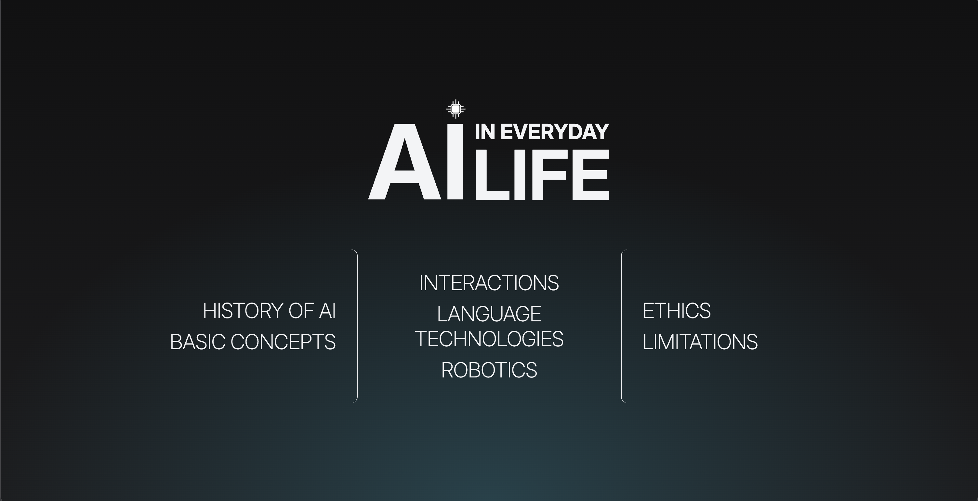

Slide 2
Proposed delivery plan
01
02
03
04
Content
Design
Build
Review
Agree on article scope
and responsibilities.
Confirm page layouts
and shared CSS.
Create pages and
connect navigation.
Check links, readability
and mobile layouts.
Notes:
From last time
We’re now between step 3 and 4. (describe what we’ve covered very briefly)

Slide 3
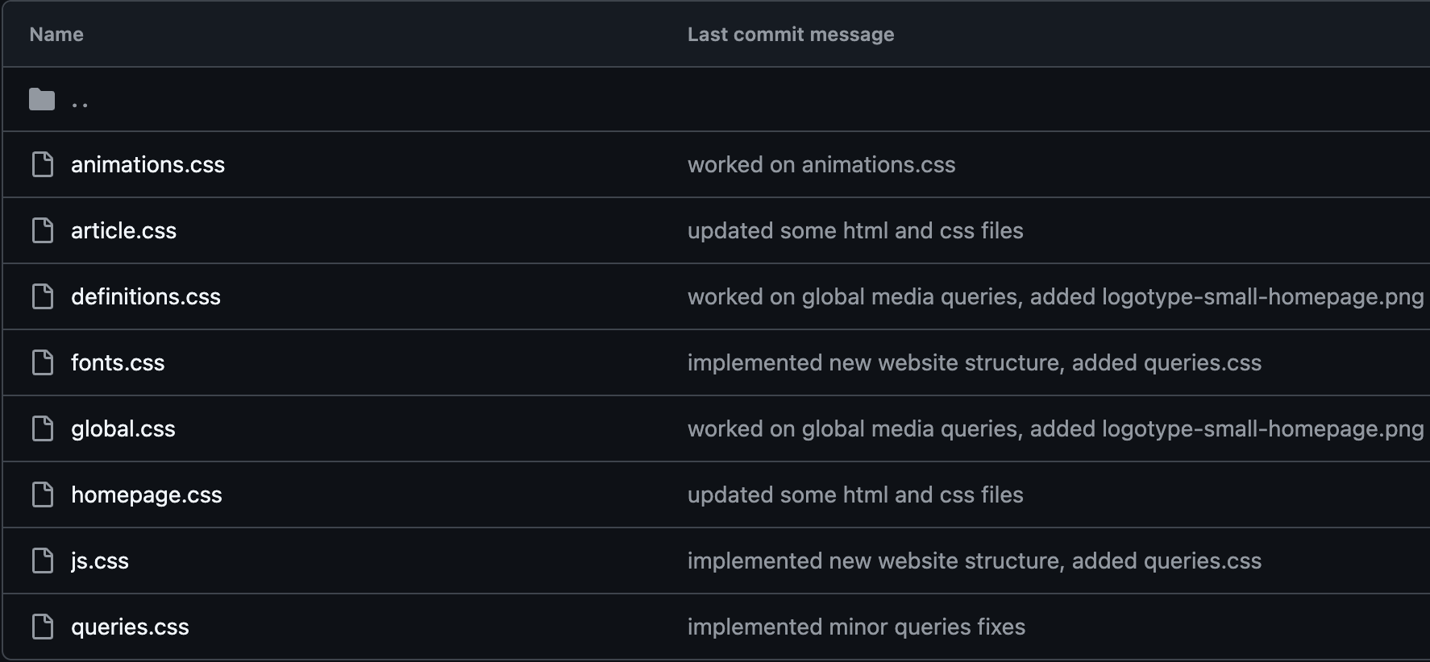
Our progress in raw numbers
1,051
Lines of shared CSS written
8 stylesheets

Slide 4
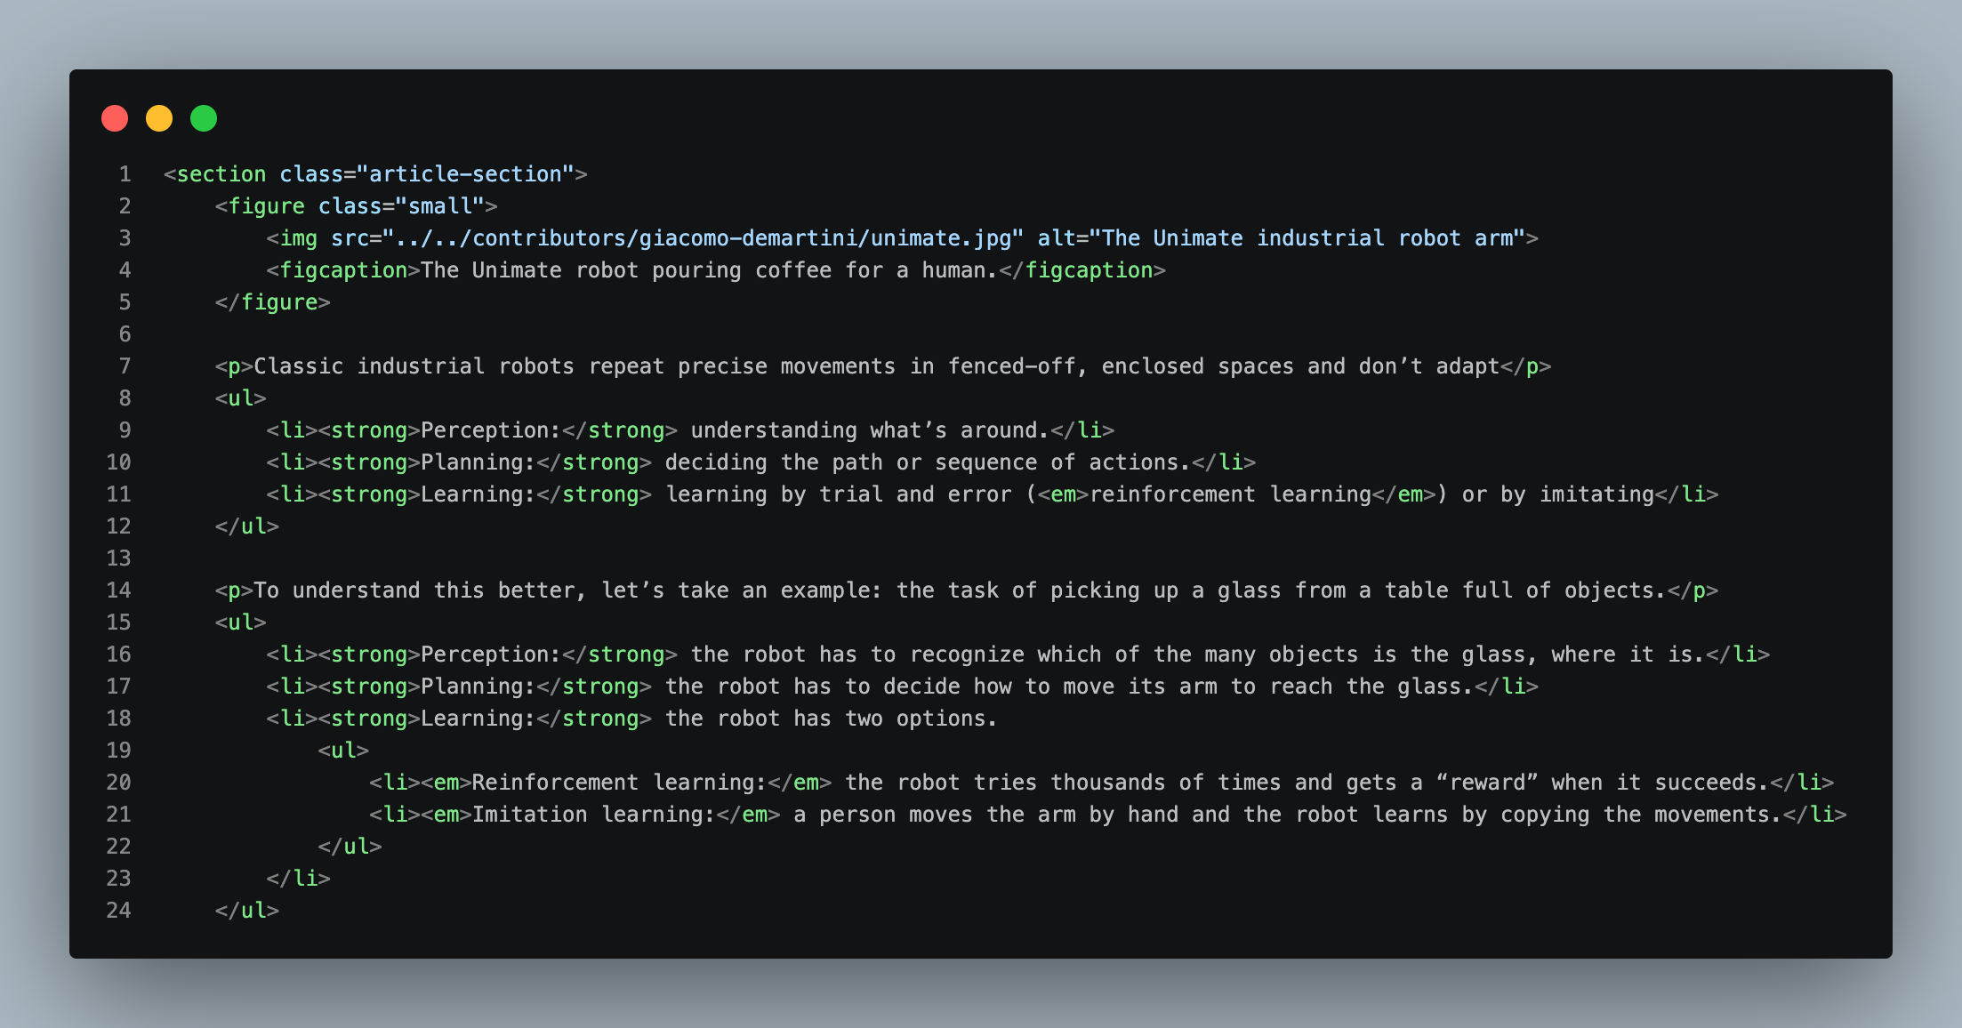
Our progress in raw numbers
8
Articles already in HTML
11,000+
Words written

Slide 5

The overall design

Slide 6
The homepage
Notes:
A “router page” to all 3 sections and 7 subtopics.
Each subtopic’s color changes on hover based on its main topic’s assigned color.
It also features an animated gradient background done in CSS only.

Slide 7
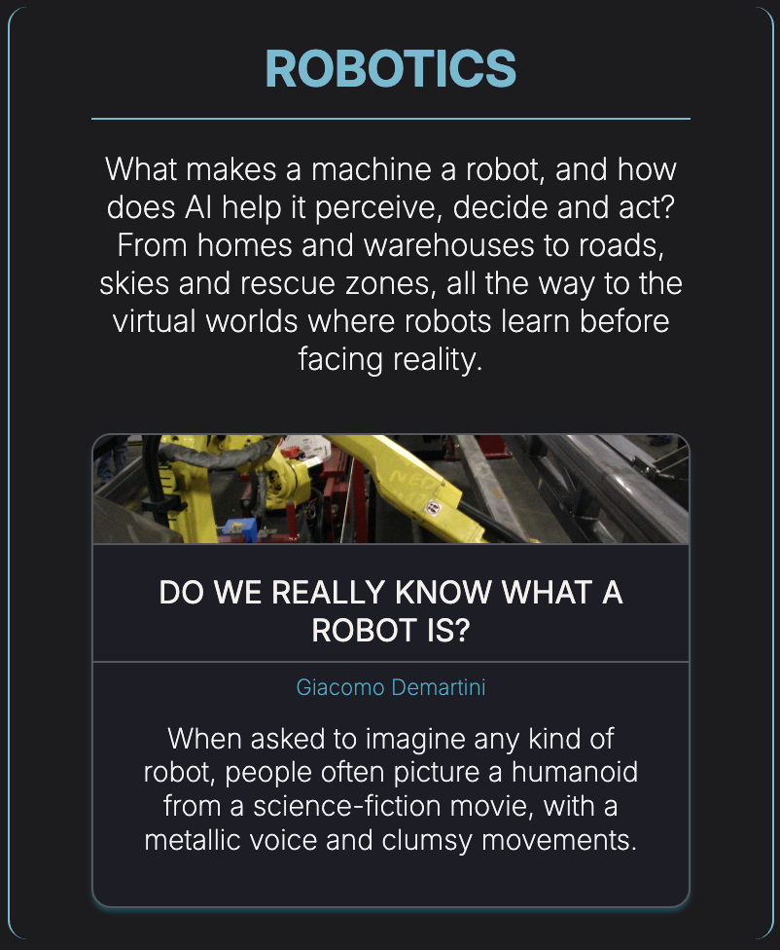
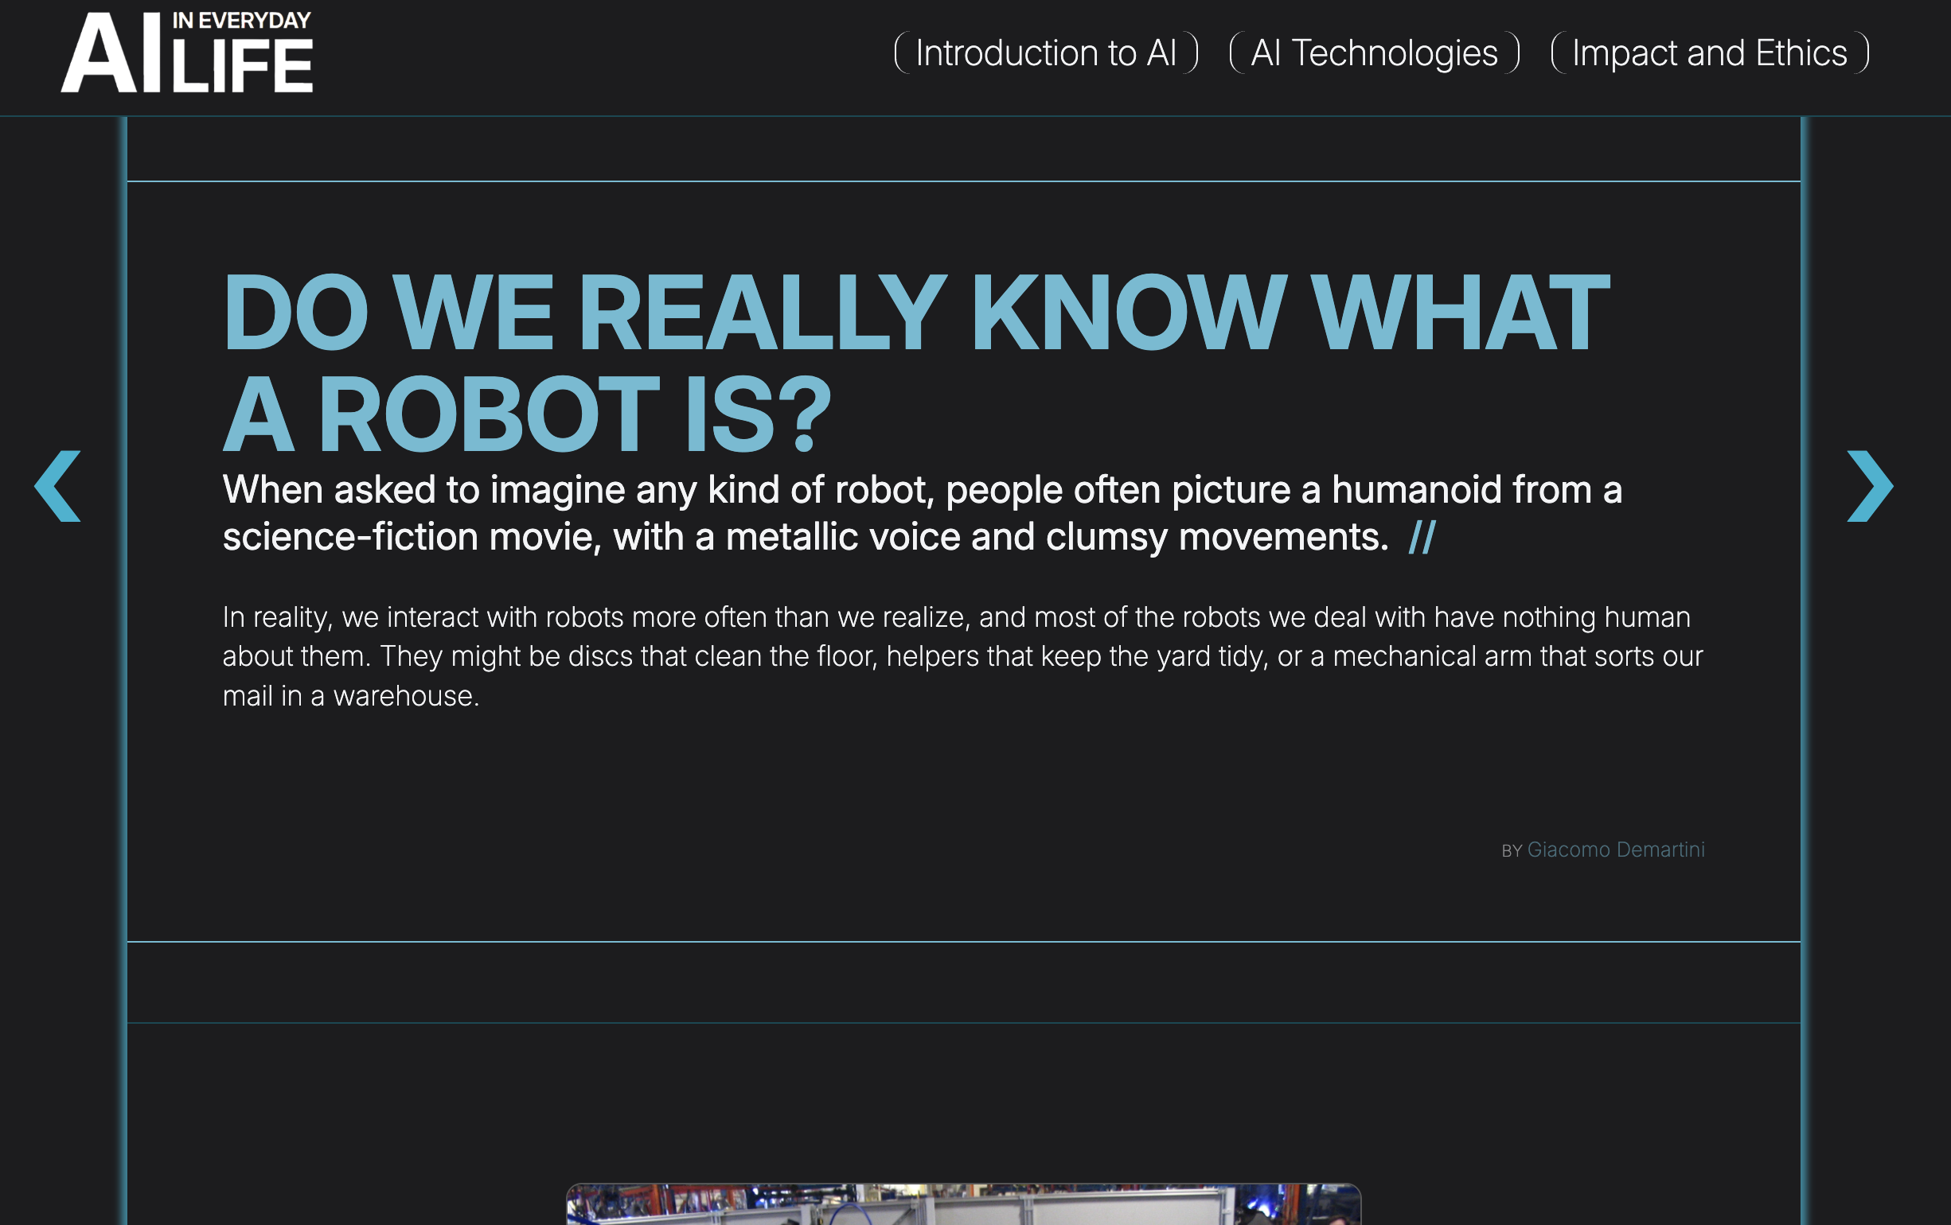
Articles
Notes:
You can list through all the articles using the side arrows.
To feature a new or important article, you can create an article card that will make an article featured on the home page.
The color scheme also stays consistent with the topic assigned to each article.

Slide 8
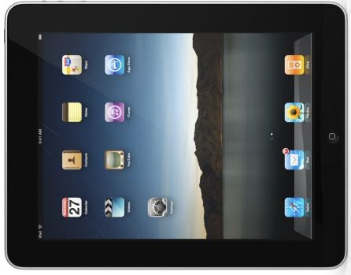
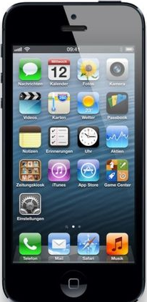
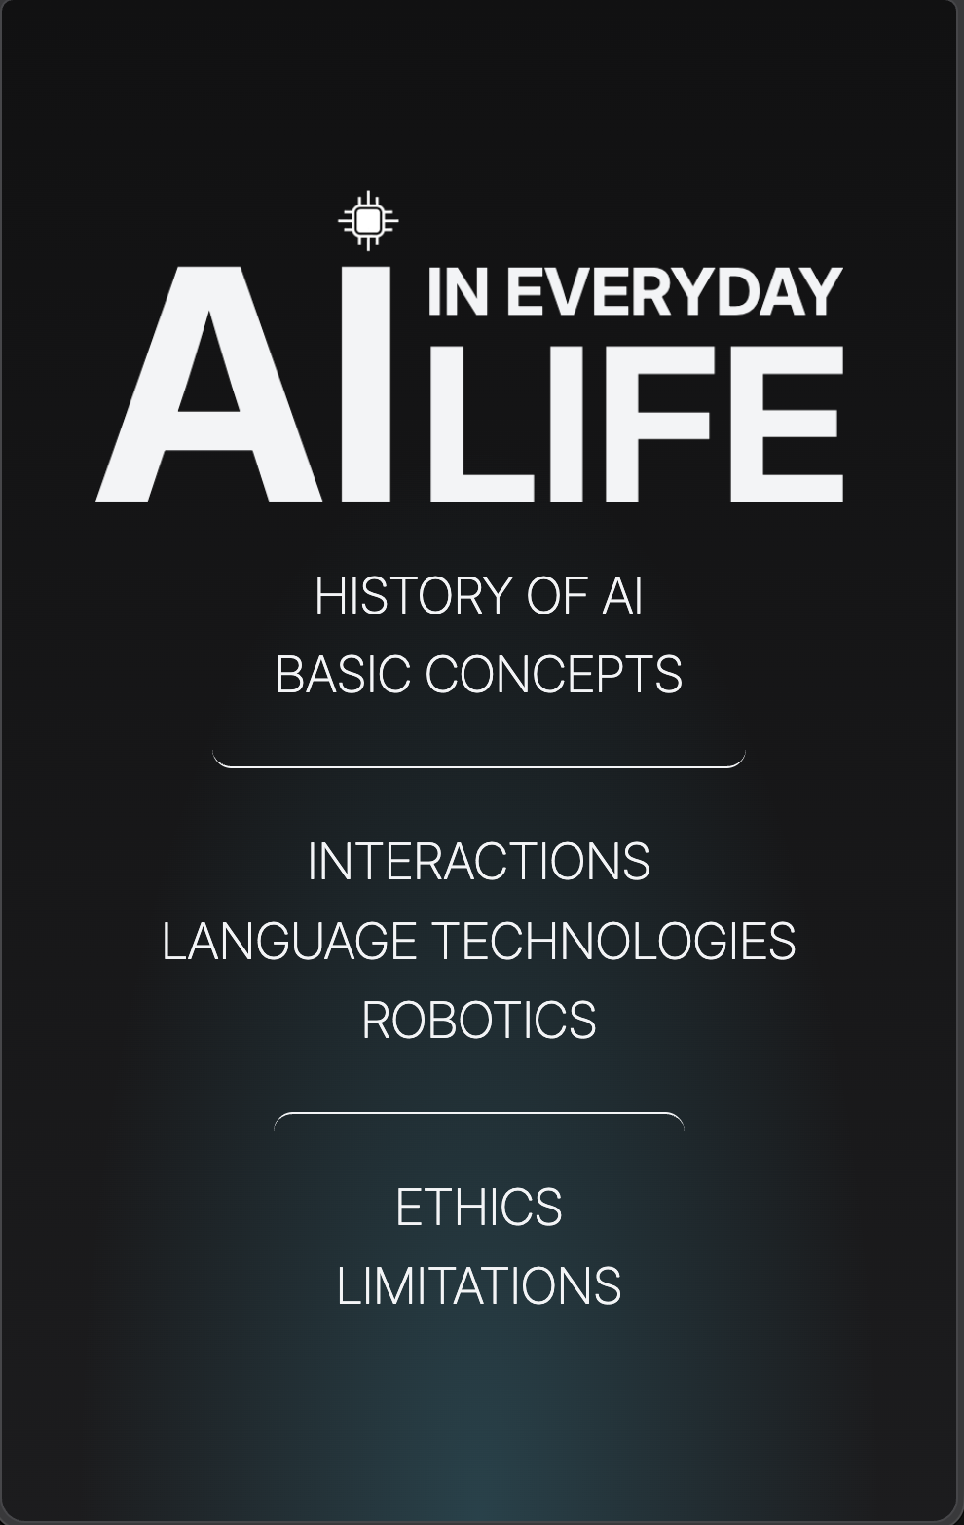
Responsiveness
Notes:
For mobile, the whole homepage is laid out vertically.
The navigation arrows for articles disappear and the “Back to top” text gets transferred into a simple arrow. (specific examples of responsiveness)

Slide 9
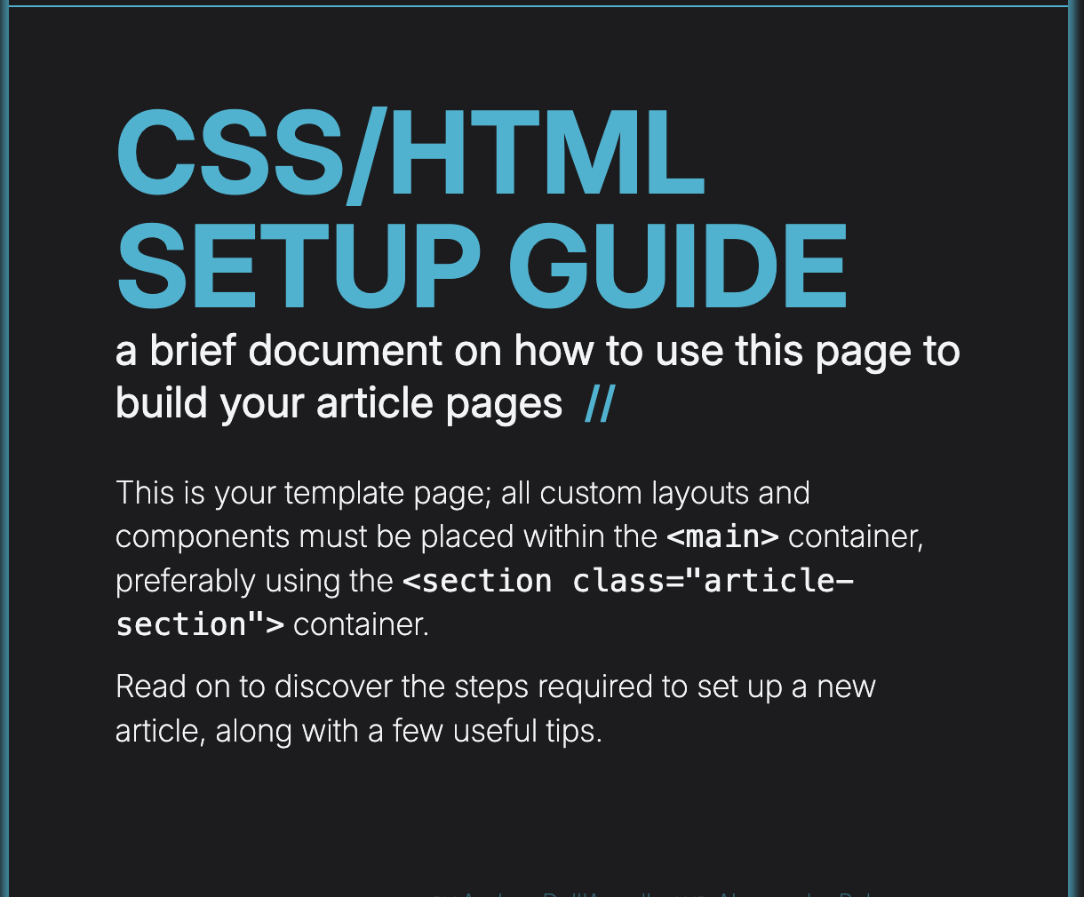
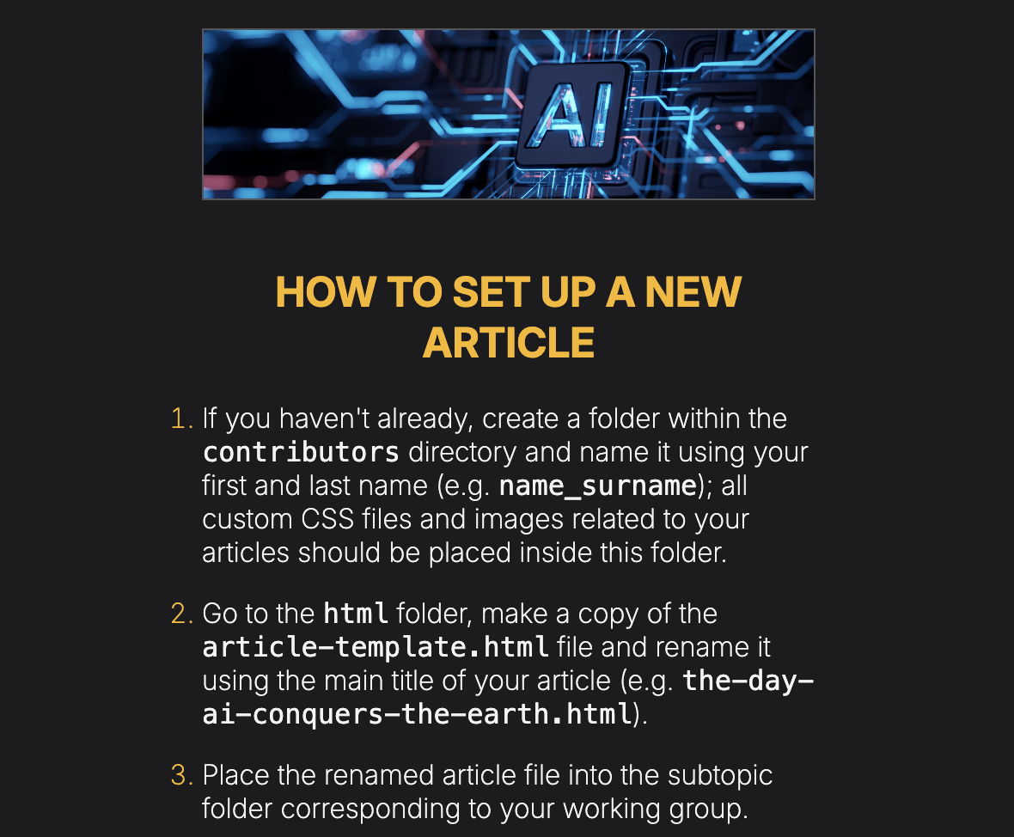
Style guide
Notes:
A quick guide created by our CSS leaders to ensure that people maintain style consistency through the whole web.
Includes 10 steps on how to use the template. – for example, how to use certain tags, where to put your files, how to put an article card to the homepage,…

Slide 10
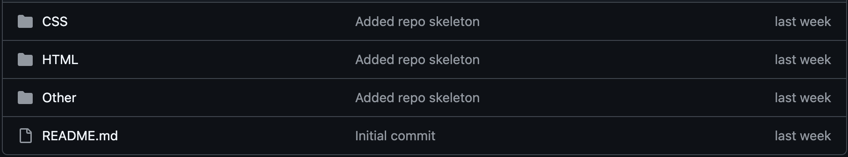
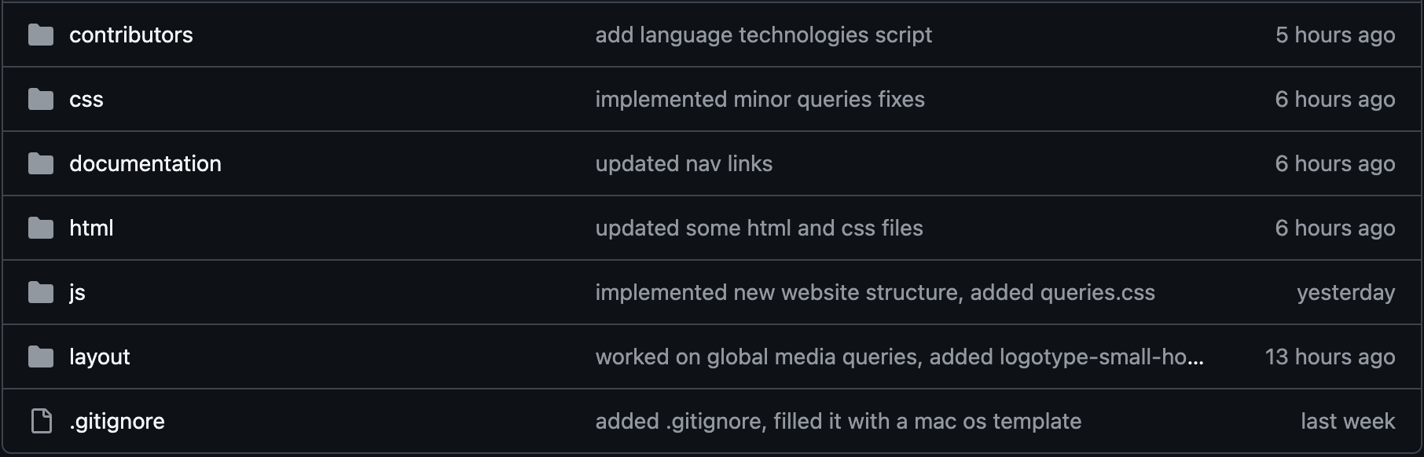
The repository
Last time
Now
Notes:
We restructured the repository to match the assignment’s given structure, added .gitignore to cause less merge conflicts.
One of the biggest changes is also the “contributors” folder where each contributor gets their own subdirectory for better assets structure.
Also, we finally have main + 4 separate branches.

Slide 11
Our plan for next week
01
02
03
04
Content
Design
Build
Review
Agree on article scope
and responsibilities.
Confirm page layouts
and shared CSS.
Create pages and
connect navigation.
Check links, readability
and mobile layouts.
Notes:
(Now just explain what comes next)

Slide 12
Thank you

Slide 13
References
https://osxdaily.com/2010/02/16/the-ipad-background-picture/
https://www.chip.de/test/Apple-iPhone_5-Handy-Test_139889904.html
https://www.gettyimages.com/photos/close-up-of-paintbrush-painting-on-canvas

