Slide 1

Mathematical institute of Charles University
Jan Benda
Machine learning for recognition of simple physical systems
A defence of bachelor thesis
3rd April 2024
Jan Benda
ML for recognition of simple physical systems
3.4.2024
Notes:
Good morning. My name is Jan Benda and welcome to my presentation about recognizing physiscal systems using machine learning.

Slide 2

Introduction
Overview
We want to find out the properties of physical system from data
Inverse problem$⟹$ hard to solve
Our approach – Direct Poisson Neural Network¹ (DPNN) by Martin Šípka et al.
I will
Explain the core idea behind DPNN
Show some of its results
Tell you about some of my improvements of it
¹ Martin Šípka et al 2023 J. Phys. A: Math. Theor. 56 495201
Jan Benda
ML for recognition of simple physical systems
3.4.2024
Notes:
Suppose that we have some either measured or simulated data and we would like to somehow extract the properties of the underlaying physical systém from them. This type of problém, called an inverse problém, is typically rather hard to solve. One possible approach is to use machine learning, specifically neural networks. Network we are focusing on in my thesis and in this presentation was developed by Michal Pavelka and collective and was dubbed Direct Poisson Neural Network or DPNN for short. In this presentaion I will explain the core idea behind DPNN, show how well it performs on some simple sysetms and lastly I will tell you about some of my improvements to it.

Slide 3
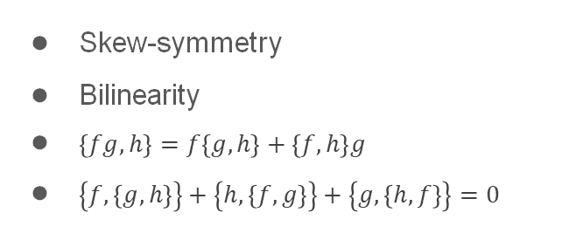



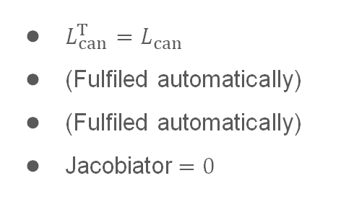
Hamiltonian systems
Canonical systems
Recall Hamilton’s equations of motion
$${\dot{q}}_{i}=\frac{∂H}{∂p_{i}}, {\dot{p}}_{i}=−\frac{∂H}{∂q_{i}}$$
$\left\{f,g\right\}={\left(∇_{z}f\right)}^{T}⋅L_{can}⋅∇_{z}g, L_{can}=\left(\begin{matrix}0 & I_{n} \\ −I_{n} & 0\end{matrix}\right)$
$$\dot{f}=\left\{f,H\right\}+\frac{∂f}{∂t}$$
Denote $z=(q_{1},…,q_{n},p_{1},…,p_{n})$
$$\dot{z}=\left\{z,H\right\}=L_{can}⋅∇_{z}H$$
Recall key properties of Poisson brackets
Skew-symmetry
Bilinearity
$\left\{fg,h\right\}=f\left\{g,h\right\}+\left\{f,h\right\}g$
$\left\{f,\left\{g,h\right\}\right\}+\left\{h,\left\{f,g\right\}\right\}+\left\{g,\left\{h,f\right\}\right\}=0$
$L_{can}^{T}=L_{can}$
(Fulfiled automatically)
(Fulfiled automatically)
Jacobiator$=0$
Jan Benda
ML for recognition of simple physical systems
3.4.2024

Slide 4


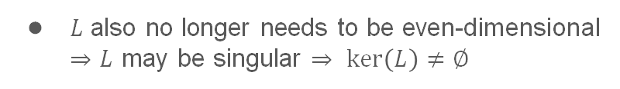



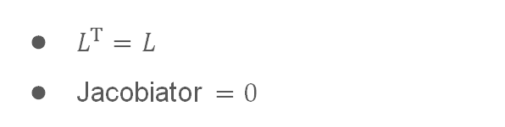


Hamiltonian systems
Hamiltonian systems
We will allow for $L:ℝ^{n}⟶ℝ^{n×n}$
It still needs to fulfil
$$\dot{z}={\left\{z,H\right\}}_{L}=L\left(z\right)⋅∇H$$
$L^{T}=L$
Jacobiator $=0$
$$J^{ijl}=L^{kl}\frac{∂L^{ij}}{∂z^{k}}+L^{kj}\frac{∂L^{li}}{∂z^{k}}+L^{ki}\frac{∂L^{jl}}{∂z^{k}}=0$$
We still have the conservation of energy
$$\dot{H}={\left\{H,H\right\}}_{L}=−{\left\{H,H\right\}}_{L}=0$$
$L$ also no longer needs to be even-dimensional
$⇒L$ may be singular $⇒ ker\left(L\right)≠∅$
$$⇒∃ ∇C∈C\left(ℝ^{n}\right):L⋅∇C=0$$
Such $C$ is called Casimir function
$${\left\{f,C\right\}}_{L}={\left(∇f\right)}^{T}⋅L⋅∇C=0$$
$$\dot{C}={\left\{C,H\right\}}_{L}=0$$
Jan Benda
ML for recognition of simple physical systems
3.4.2024

Slide 5


Hamiltonian systems
3D Hamiltonian systems
$L∈ℝ^{3×3}$ is always singular
There exists an isomorphism $L=\left(\begin{matrix}0 & {−J}_{3} & J_{2} \\ J_{3} & 0 & {−J}_{1} \\ {−J}_{2} & J_{1} & 0\end{matrix}\right)↔J=\left(J_{1},J_{2},J_{3}\right)$
Jacobi's identity becomes $J⋅\left(∇×J\right)=0$
$$⇒J=φ∇C$$
$C$ is by design Casimir function of $L$
$L$ constructed from such $J$ always satisfies Jacobi's identity
Also $\dot{z}=L⋅∇H=J×∇H=\left(φ∇C\right)×∇H$
Jan Benda
ML for recognition of simple physical systems
3.4.2024

Slide 6
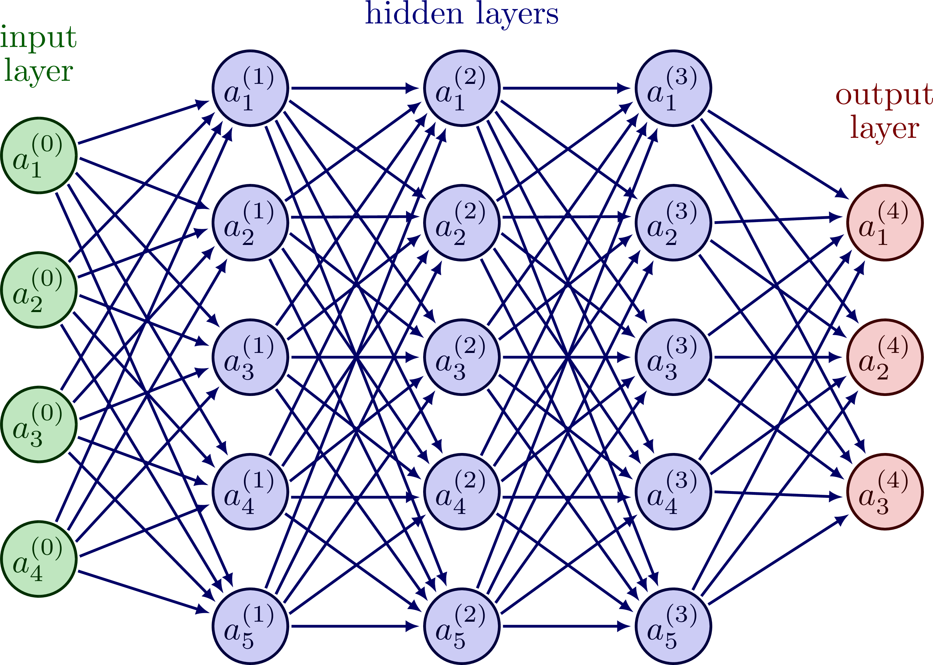
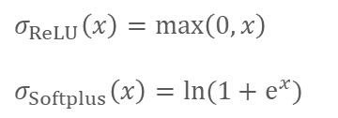

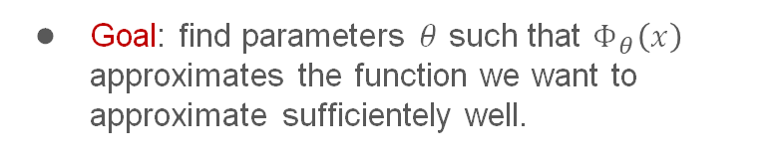



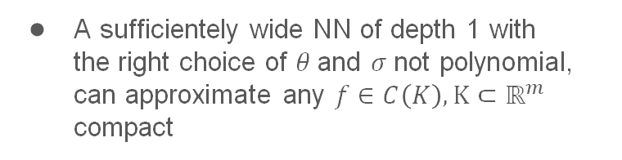
Introduction to deep learning
Neural networks
Neurons
$$y=σ\left(w^{T}x+b\right)$$
$$σ_{ReLU}\left(x\right)=\max\left(0,x\right)$$
$$σ_{Softplus}\left(x\right)=ln(1+e^{x})$$
are organised into FC layers
$$x_{(i+1)}=σ\left(W_{(i)}^{T}x_{(i)}+b_{(i)}\right)$$
$W_{(i)}^{T},b_{(i)}$ are parameters to be learnt
Universal approximation theorem²
A sufficientely wide NN of depth 1 with the right choice of $θ$and $σ$not polynomial, can approximate any $f∈C\left(K\right), K⊂ℝ^{m}$ compact
$${\left\|Φ_{θ}−f\right\|}_{L^{∞}\left(K\right)}<ε$$
Goal: find parameters $θ$ such that $Φ_{θ}\left(x\right)$ approximates the function we want to approximate sufficientely well.
An example of a neural network tikz.net/neural_networks/
² Cybenko, G. (1989). "Approximation by superpositions of a sigmoidal function". Mathematics of Control, Signals, and Systems. 2 (4)/
Jan Benda
ML for recognition of simple physical systems
3.4.2024

Slide 7

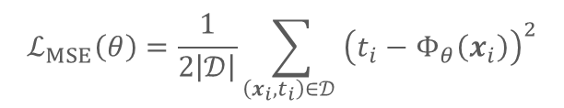
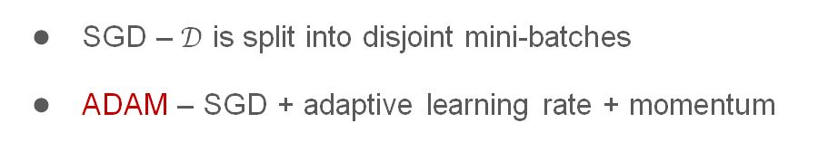

Introduction to deep learning
Training and loss function
Training is done over dataset $\left(x_{i},t_{i}\right)∈𝒟$
Goal: minimize some $ℒ\left(θ\right)$
$$ℒ_{MSE}\left(θ\right)=\frac{1}{2\left|𝒟\right|}\sum_{\left(x_{i},t_{i}\right)∈𝒟 }{{\left(t_{i}−Φ_{θ}\left(x_{i}\right)\right)}^{2}}$$
The most basic algorithm: Gradient descent
$$θ_{i+1}=θ_{i}−λ∇_{θ}ℒ\left(θ_{i}\right)$$
There are usually some heuristice applied
SGD – $𝒟$ is split into disjoint mini-batches
ADAM – SGD + adaptive learning rate + momentum
Jan Benda
ML for recognition of simple physical systems
3.4.2024

Slide 8
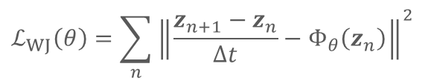
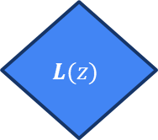



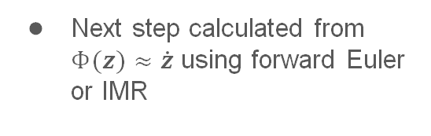


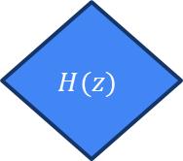
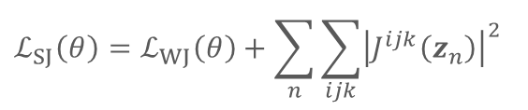
Direct Poisson Neural Network
Our architectures
3 flavours of DPNN
$$L(z)$$
$$H(z)$$
Without Jacobi
Soft Jacobi
Implicit Jacobi
Without Jacobi
Soft Jacobi
Implicit Jacobi
Skew-symmetrization
Autograd
Next step calculated from $Φ(z)≈\dot{z}$ using forward Euler or IMR
$$L$$
$$∇H$$
$$Φ(z)≈\dot{z}$$
$$@$$
64 nodes wide, FC layers, softplus activation
$$ℒ_{WJ}\left(θ\right)=\sum_{n}{{\left\|\frac{z_{n+1}−z_{n}}{∆t}−Φ_{θ}\left(z_{n}\right)\right\|}^{2}}$$
$$ℒ_{SJ}\left(θ\right)=ℒ_{WJ}\left(θ\right)+\sum_{n}{\sum_{ijk}{{\left|J^{ijk}\left(z_{n}\right)\right|}^{2}}}$$
$$J^{ijl}=L^{kl}\frac{∂L^{ij}}{∂z^{k}}+L^{kj}\frac{∂L^{li}}{∂z^{k}}+L^{ki}\frac{∂L^{jl}}{∂z^{k}}=0$$
Jan Benda
ML for recognition of simple physical systems
3.4.2024

Slide 9

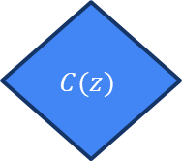
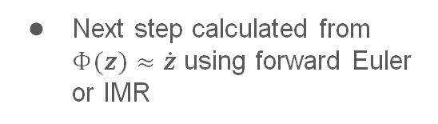



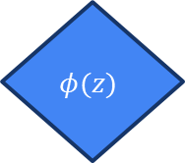
Direct Poisson Neural Network
Our architectures
3 flavours of DPNN
$$C(z)$$
$$H(z)$$
Without Jacobi
Soft Jacobi
Implicit Jacobi
Autograd
Autograd
Next step calculated from $Φ(z)≈\dot{z}$ using forward Euler or IMR
$$J=φ∇C$$
$$∇H$$
$$Φ(z)≈\dot{z}$$
$$×$$
Recall $\dot{z}=J×∇H, J=φ∇C$
$$φ(z)$$
$$ℒ_{IJ}\left(θ\right)=ℒ_{WJ}\left(θ\right)$$
Jan Benda
ML for recognition of simple physical systems
3.4.2024

Slide 10
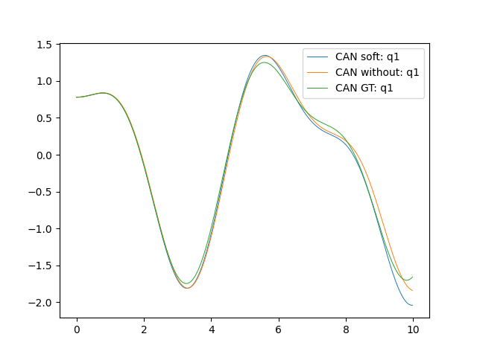
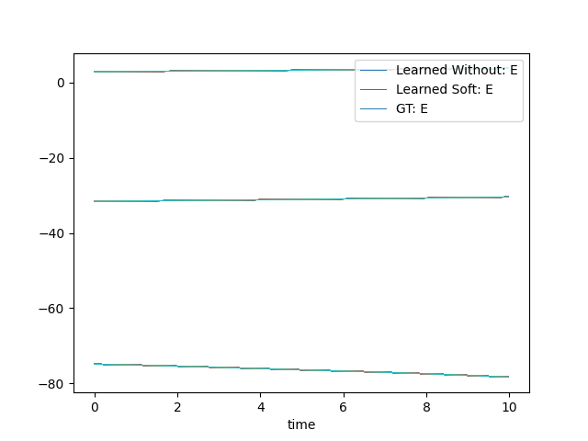

Direct Poisson Neural Network
2D Harmonic oscillator
$H=\frac{1}{2}p_{1}^{2}+\frac{1}{2}p_{2}^{2}+\frac{1}{4}q_{1}^{2}+q_{2}^{2}+\frac{1}{2}{(q_{1}−q_{2})}^{2}$
5 layers
16 epochs
dt = 0.01
1000 steps
~ 11 / 25 minutes of learning for WJ / SJ resp.
Jacobi's identity $⇒L :ℝ^{2×2}→ℝ$ is always constant
Jan Benda
ML for recognition of simple physical systems
3.4.2024

Slide 11
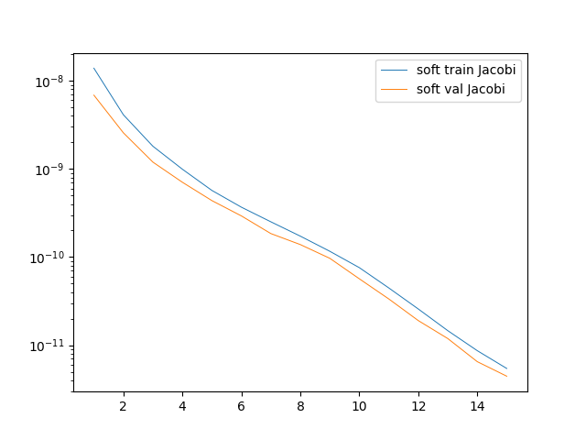
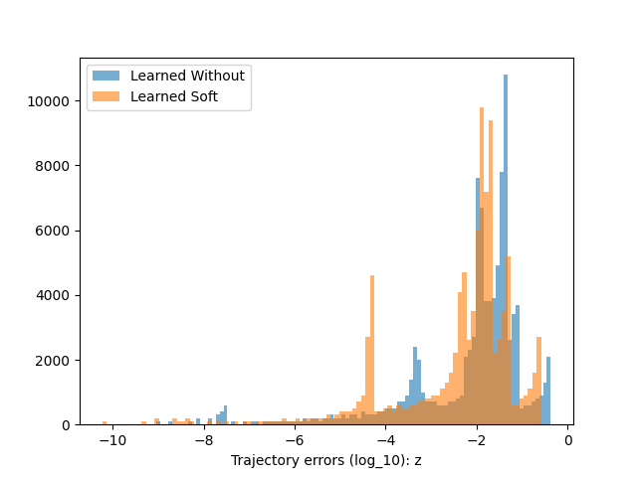
Direct Poisson Neural Network
2D Harmonic oscillator
$H=\frac{1}{2}p_{1}^{2}+\frac{1}{2}p_{2}^{2}+\frac{1}{4}q_{1}^{2}+q_{2}^{2}+\frac{1}{2}{(q_{1}−q_{2})}^{2}$
Jacobi's identity $⇒L :ℝ^{2×2}→ℝ$ is always constant
Jan Benda
ML for recognition of simple physical systems
3.4.2024

Slide 12
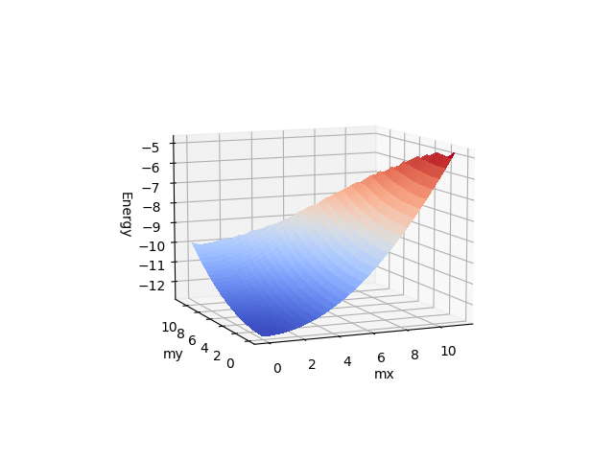
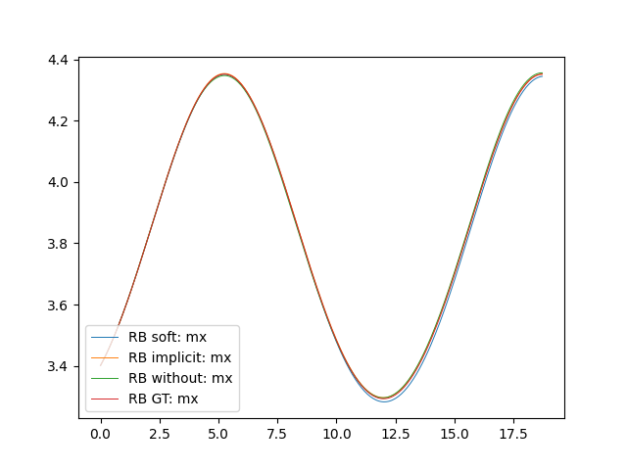
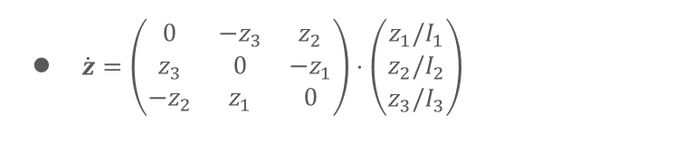
Direct Poisson Neural Network
Freely rotating rigid body
$\dot{z}=\left(\begin{matrix}0 & {−z}_{3} & z_{2} \\ z_{3} & 0 & −z_{1} \\ {−z}_{2} & z_{1} & 0\end{matrix}\right)⋅\left(\begin{matrix}z_{1}/I_{1} \\ z_{2}/I_{2} \\ z_{3}/I_{3}\end{matrix}\right)$
3 layers
100 epochs
dt = 0.06
300 steps
~ 12 / 26 / 20 minutes of learning for IJ / SJ / WJ resp.
Jan Benda
ML for recognition of simple physical systems
3.4.2024

Slide 13
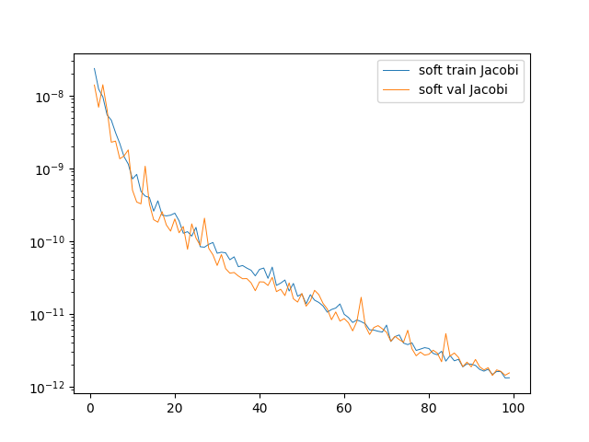
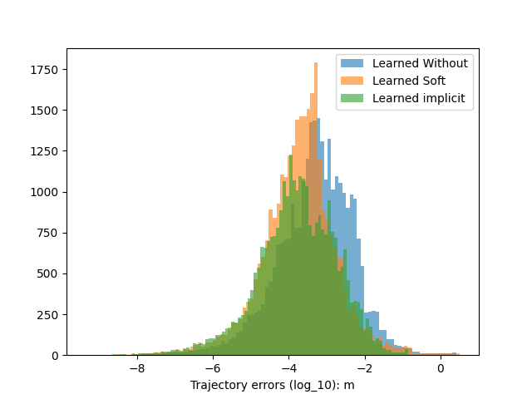
Direct Poisson Neural Network
Freely rotating rigid body
$\dot{z}=\left(\begin{matrix}0 & {−z}_{3} & z_{2} \\ z_{3} & 0 & −z_{1} \\ {−z}_{2} & z_{1} & 0\end{matrix}\right)⋅\left(\begin{matrix}z_{1}/I_{1} \\ z_{2}/I_{2} \\ z_{3}/I_{3}\end{matrix}\right)$
Jan Benda
ML for recognition of simple physical systems
3.4.2024

Slide 14
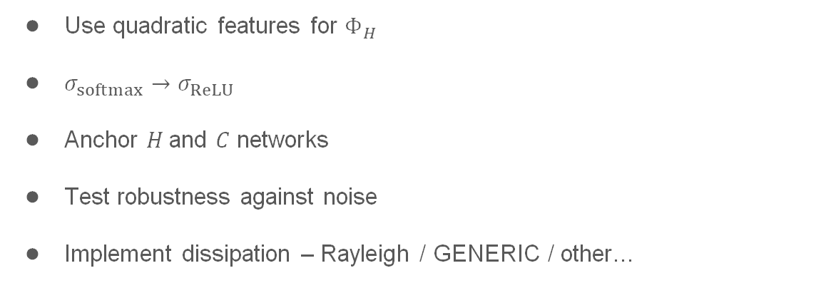
Direct Poisson Neural Network
Plans for the future month
Use quadratic features for $Φ_{H}$
$σ_{softmax}→σ_{ReLU}$
Anchor $H$and $C$ networks
Test robustness against noise
Implement dissipation – Rayleigh / GENERIC / other…
Jan Benda
ML for recognition of simple physical systems
3.4.2024

Slide 15
Recapitulation
We can train neural networks on simulated or measured data from physical systems
Trained networks can be used later to simulate the system
Trained Hamiltonian and Poisson bivector can yield valuable information about the system
There are few improvements underway to make DPNN faster and more robust
That is all from me. Thank you for your time.
Do you have any questions?
Jan Benda
ML for recognition of simple physical systems
3.4.2024

