Slide 1

Mathematical institute of Charles University
Jan Benda
Machine learning for recognition of simple physical systems
A defence of bachelor thesis
3rd April 2024
Jan Benda
ML for recognition of simple physical systems
3.4.2024

Slide 2
Introduction
1
2
Jan Benda
ML for recognition of simple physical systems
3.4.2024
Notes:
Mention DPNN as the work of Michal Pavelka et.al. Learns the dynamics of the system from provided data

Slide 3
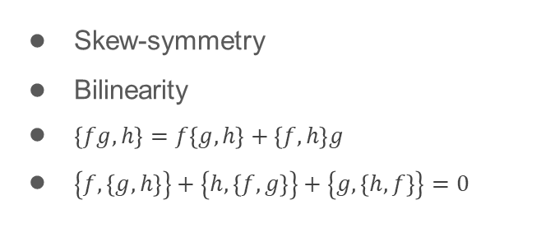



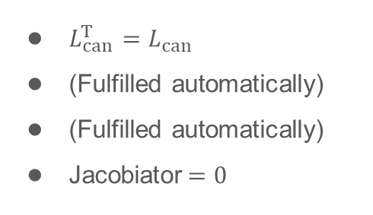

Hamiltonian systems
Canonical systems
Recall Hamilton’s equations of motion
$${\dot{q}}_{i}=\frac{∂H}{∂p_{i}}, {\dot{p}}_{i}=−\frac{∂H}{∂q_{i}}$$
$\left\{f,g\right\}={\left(∇_{z}f\right)}^{T}⋅L_{can}⋅∇_{z}g, L_{can}=\left(\begin{matrix}0 & I_{d} \\ −I_{d} & 0\end{matrix}\right)$
$$\dot{f}=\left\{f,H\right\}+\frac{∂f}{∂t}$$
Denote $z=(q_{1},…,q_{n},p_{1},…,p_{n})$
$$\dot{z}=\left\{z,H\right\}=L_{can}⋅∇_{z}H$$
Recall key properties of Poisson brackets
Skew-symmetry
Bilinearity
$\left\{fg,h\right\}=f\left\{g,h\right\}+\left\{f,h\right\}g$
$\left\{f,\left\{g,h\right\}\right\}+\left\{h,\left\{f,g\right\}\right\}+\left\{g,\left\{h,f\right\}\right\}=0$
$L_{can}^{T}=L_{can}$
(Fulfilled automatically)
(Fulfilled automatically)
Jacobiator$=0$
$$\underset{→}{conditions on L }$$
Jan Benda
ML for recognition of simple physical systems
3.4.2024

Slide 4


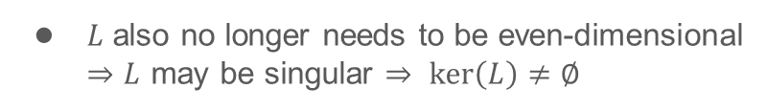



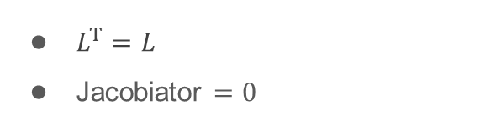


Hamiltonian systems
Hamiltonian systems
We will allow for $L:ℝ^{n}⟶ℝ^{n×n}$
It still needs to fulfill
$$\dot{z}={\left\{z,H\right\}}_{L}=L\left(z\right)⋅∇H$$
$L^{T}=L$
Jacobiator $=0$
$$J^{ijl}=L^{kl}\frac{∂L^{ij}}{∂z^{k}}+L^{kj}\frac{∂L^{li}}{∂z^{k}}+L^{ki}\frac{∂L^{jl}}{∂z^{k}}=0$$
We still have the conservation of energy
$$\dot{H}={\left\{H,H\right\}}_{L}=−{\left\{H,H\right\}}_{L}=0$$
$L$ also no longer needs to be even-dimensional
$⇒L$ may be singular $⇒ ker\left(L\right)≠∅$
$$⇒∃ ∇C∈C\left(ℝ^{n}\right):L⋅C=0$$
Such $C$ is called Casimir function
$${\left\{f,C\right\}}_{L}={\left(∇f\right)}^{T}⋅L⋅∇C=0$$
$$\dot{C}={\left\{C,H\right\}}_{L}=0$$
Jan Benda
ML for recognition of simple physical systems
3.4.2024

Slide 5


Hamiltonian systems
3D Hamiltonian systems
$L∈ℝ^{3×3}$ is always singular
There exists an isomorphism $L=\left(\begin{matrix}0 & {−J}_{3} & J_{2} \\ J_{3} & 0 & {−J}_{1} \\ {−J}_{2} & J_{1} & 0\end{matrix}\right)↔J=\left(J_{1},J_{2},J_{3}\right)$
Jacobi's identity becomes $J⋅\left(∇×J\right)=0$
$$⇒J=φ∇C$$
$L$ constructed from such $J$ always satisfies Jacobi's identity
Also $\dot{z}=L⋅∇H=J×∇H=\left(φ∇C\right)×∇H$
Jan Benda
ML for recognition of simple physical systems
3.4.2024

Slide 6
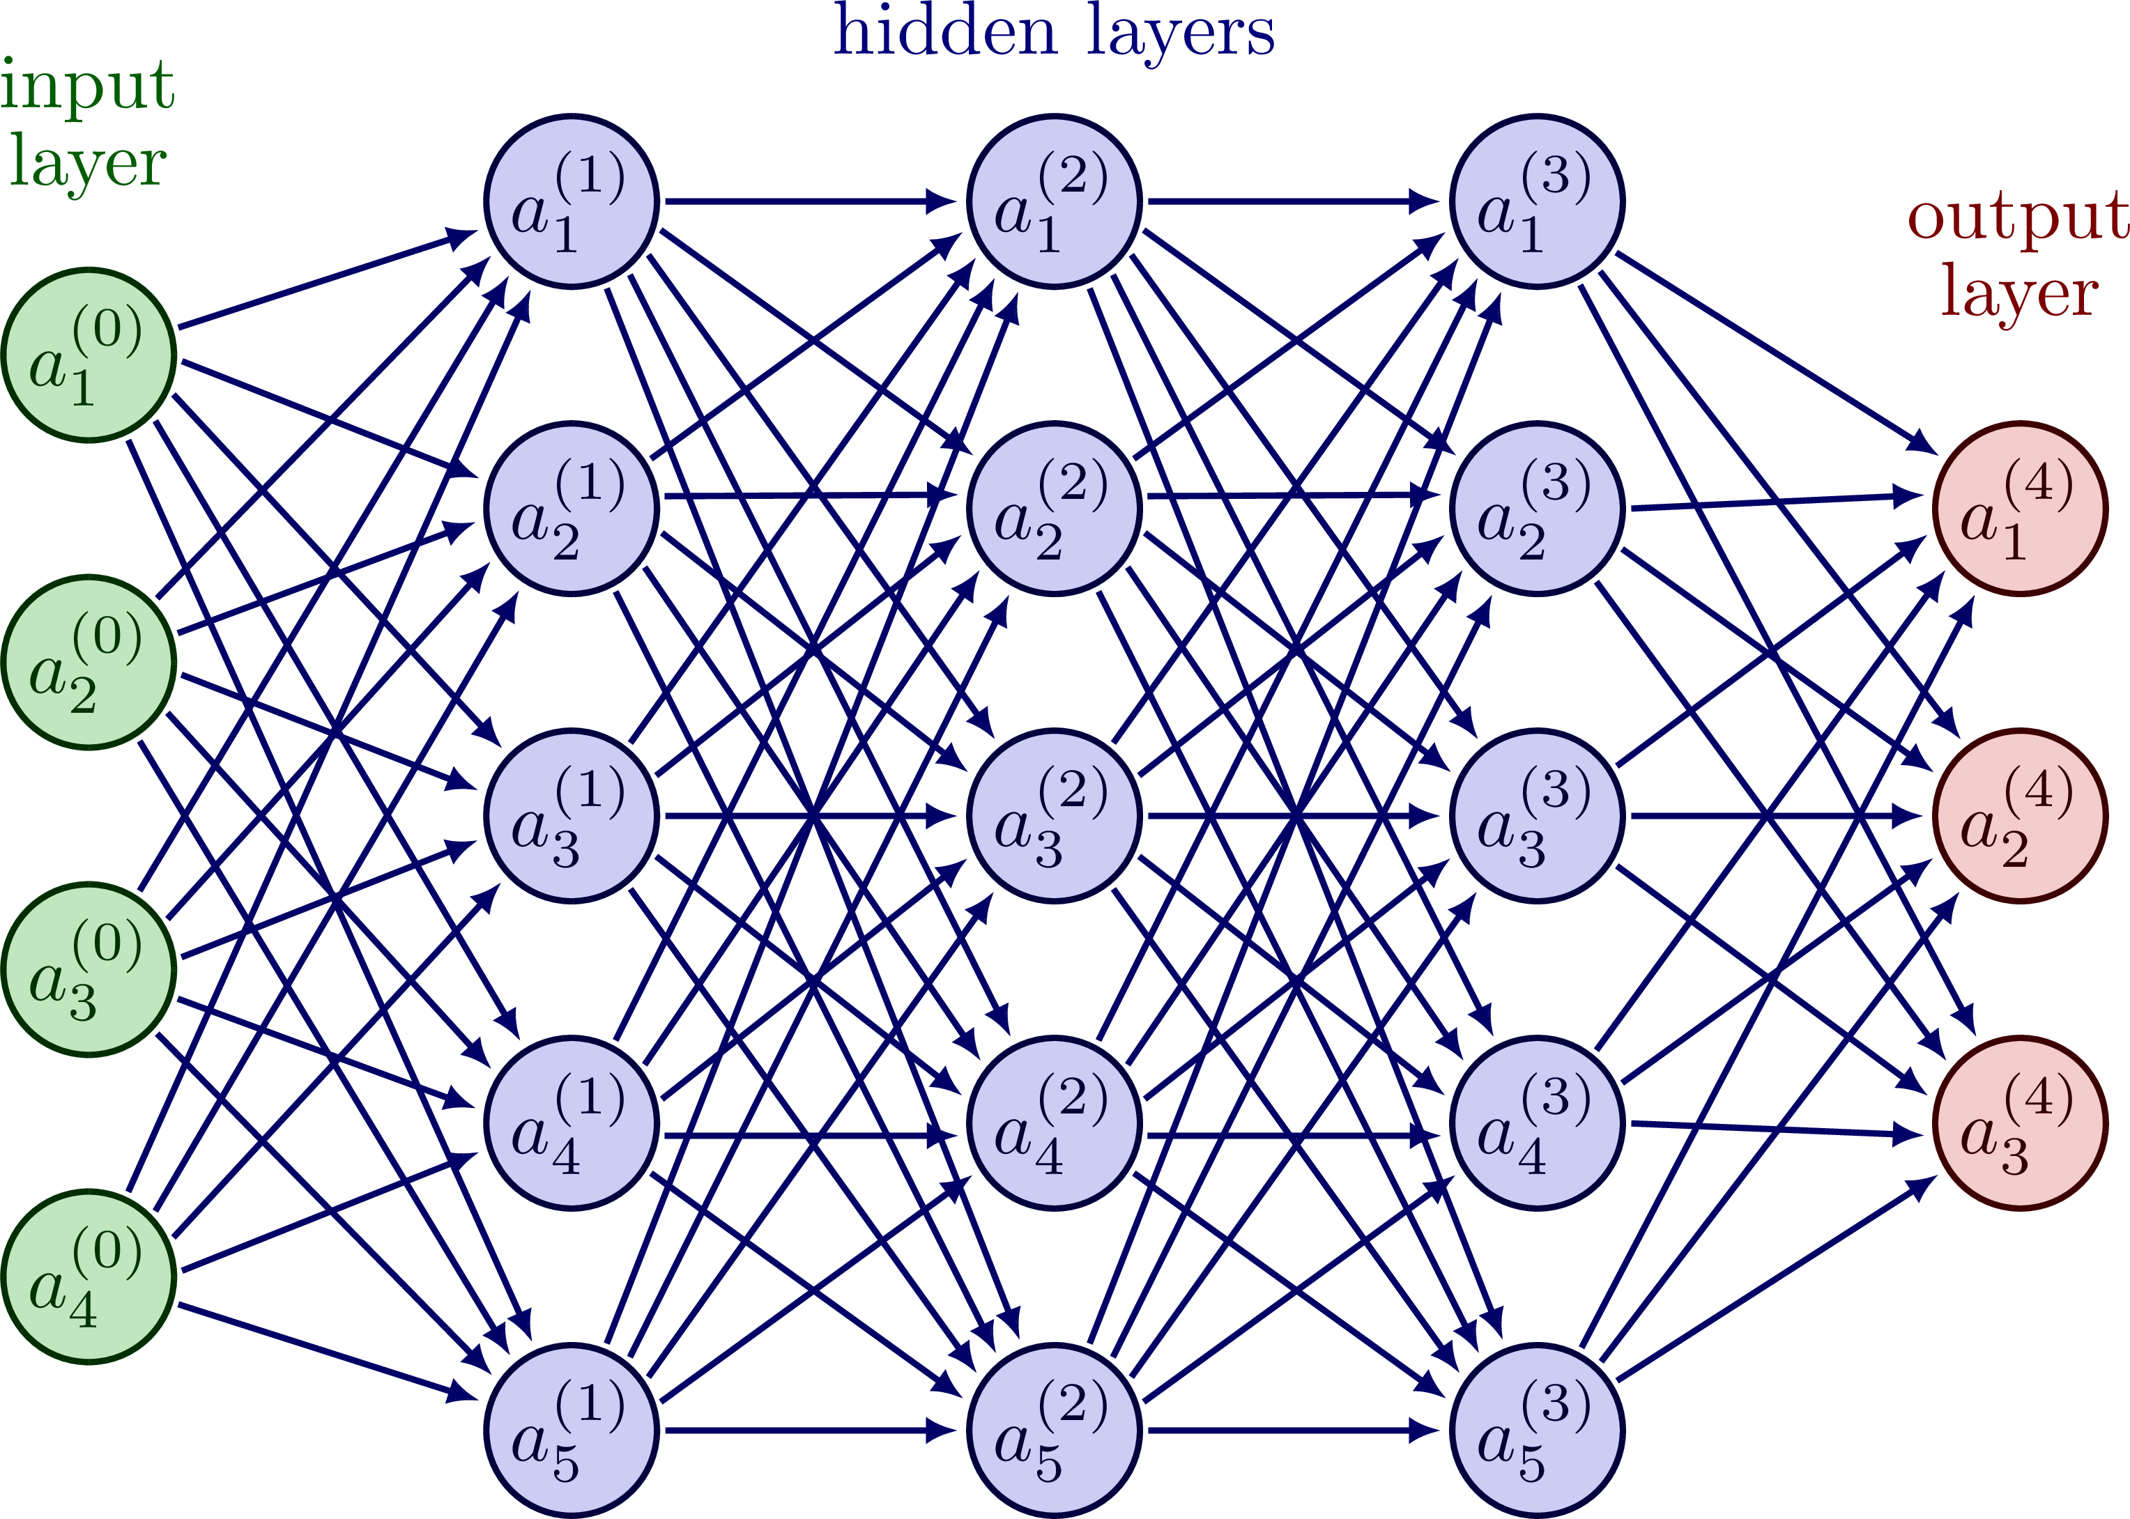
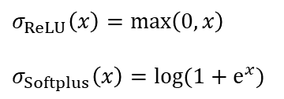

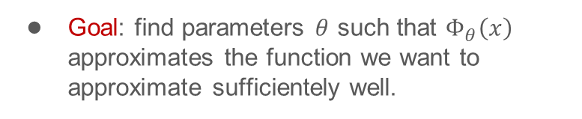



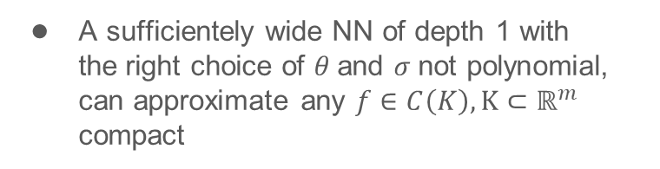
Introduction to deep learning
Neural networks
Neurons
$$y=σ\left(w^{T}x+b\right)$$
$$σ_{ReLU}\left(x\right)=\max\left(0,x\right)$$
$$σ_{Softplus}\left(x\right)=log(1+e^{x})$$
are organised into layers
$$x_{(i+1)}=σ\left(W_{(i)}^{T}x_{(i)}+b_{(i)}\right)$$
$W_{(i)}^{T},b_{(i)}$ are parameters to be learnt
Universal approximation theorem
A sufficientely wide NN of depth 1 with the right choice of $θ$and $σ$not polynomial, can approximate any $f∈C\left(K\right), K⊂ℝ^{m}$ compact
$${\left\|Φ_{θ}−f\right\|}_{L^{∞}\left(K\right)}<ε$$
Goal: find parameters $θ$ such that $Φ_{θ}\left(x\right)$ approximates the function we want to approximate sufficientely well.
Jan Benda
ML for recognition of simple physical systems
3.4.2024

Slide 7

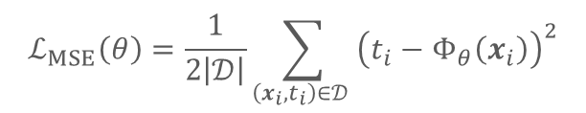
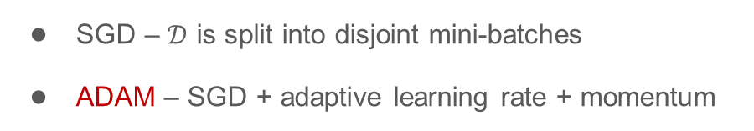

Introduction to deep learning
Training and loss function
Training is done over dataset $\left(x_{i},t_{i}\right)∈𝒟$
Goal: minimize some $ℒ\left(θ\right)$
$$ℒ_{MSE}\left(θ\right)=\frac{1}{2\left|𝒟\right|}\sum_{\left(x_{i},t_{i}\right)∈𝒟 }{{\left(t_{i}−Φ_{θ}\left(x_{i}\right)\right)}^{2}}$$
The most basic algorithm: Gradient descent
$$θ_{i+1}=θ_{i}−λ∇_{θ}ℒ\left(θ_{i}\right)$$
There are usually some heuristice applied
SGD – $𝒟$ is split into disjoint mini-batches
ADAM – SGD + adaptive learning rate + momentum
Jan Benda
ML for recognition of simple physical systems
3.4.2024

Slide 8
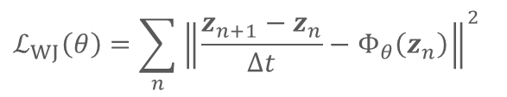



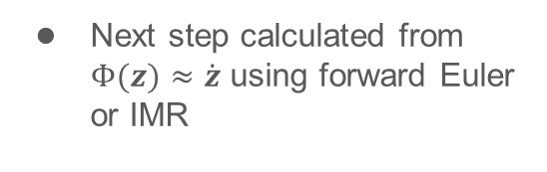



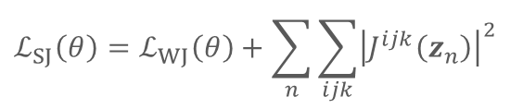
Direct Poisson Neural Network
Our architectures
3 flavours of DPNN
$$L(z)$$
$$H(z)$$
Without Jacobi
Soft Jacobi
Implicit Jacobi
Skew-symmetrization
Autograd
Next step calculated from $Φ(z)≈\dot{z}$ using forward Euler or IMR
$$L$$
$$∇H$$
$$Φ(z)≈\dot{z}$$
64 nodes wide, softplus activation
$$ℒ_{WJ}\left(θ\right)=\sum_{n}{{\left\|\frac{z_{n+1}−z_{n}}{∆t}−Φ_{θ}\left(z_{n}\right)\right\|}^{2}}$$
$$ℒ_{SJ}\left(θ\right)=ℒ_{WJ}\left(θ\right)+\sum_{n}{\sum_{ijk}{{\left|J^{ijk}\left(z_{n}\right)\right|}^{2}}}$$
$$J^{ijl}=L^{kl}\frac{∂L^{ij}}{∂z^{k}}+L^{kj}\frac{∂L^{li}}{∂z^{k}}+L^{ki}\frac{∂L^{jl}}{∂z^{k}}=0$$
Jan Benda
ML for recognition of simple physical systems
3.4.2024

Slide 9

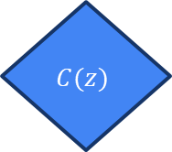
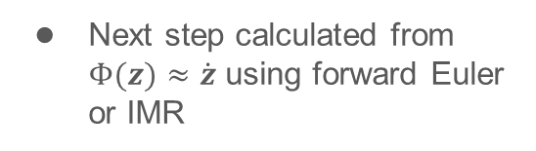



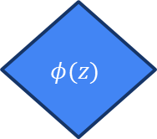
Direct Poisson Neural Network
Our architectures
3 flavours of DPNN
$$C(z)$$
$$H(z)$$
Without Jacobi
Soft Jacobi
Implicit Jacobi
Autograd
Autograd
Next step calculated from $Φ(z)≈\dot{z}$ using forward Euler or IMR
$$J=φ∇C$$
$$∇H$$
$$Φ(z)≈\dot{z}$$
$$×$$
Recall $\dot{z}=J×∇H, J=φ∇C$
$$φ(z)$$
$$ℒ_{IJ}\left(θ\right)=ℒ_{WJ}\left(θ\right)$$
Jan Benda
ML for recognition of simple physical systems
3.4.2024

Slide 10
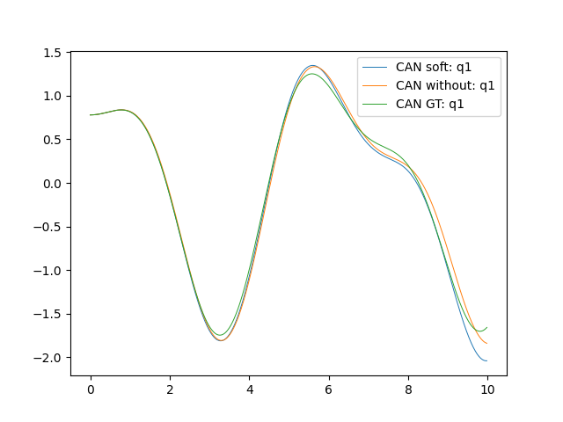
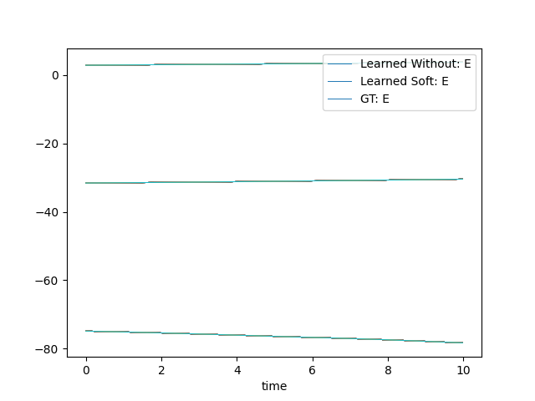

Direct Poisson Neural Network
2D Harmonic oscillator
$H=\frac{1}{2}p_{1}^{2}+\frac{1}{2}p_{2}^{2}+\frac{1}{4}q_{1}^{2}+q_{2}^{2}+\frac{1}{2}{(q_{1}−q_{2})}^{2}$
Jacobi's identity $⇒L :ℝ^{2×2}→ℝ$ is always constant
Jan Benda
ML for recognition of simple physical systems
3.4.2024

Slide 11
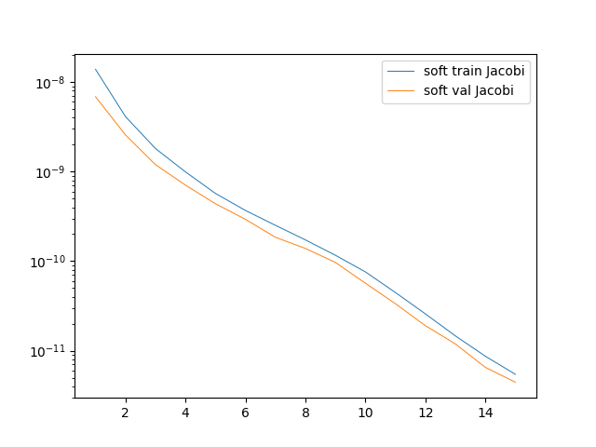
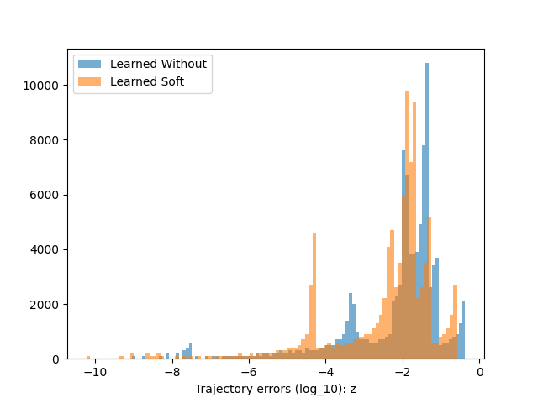
Direct Poisson Neural Network
2D Harmonic oscillator
$H=\frac{1}{2}p_{1}^{2}+\frac{1}{2}p_{2}^{2}+\frac{1}{4}q_{1}^{2}+q_{2}^{2}+\frac{1}{2}{(q_{1}−q_{2})}^{2}$
Jacobi's identity $⇒L :ℝ^{2×2}→ℝ$ is always constant
Jan Benda
ML for recognition of simple physical systems
3.4.2024

Slide 12
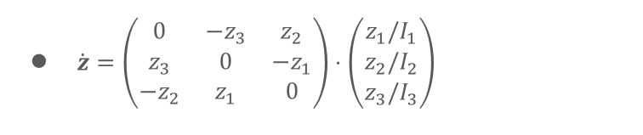
Direct Poisson Neural Network
Freely rotating rigid body
$\dot{z}=\left(\begin{matrix}0 & {−z}_{3} & z_{2} \\ z_{3} & 0 & −z_{1} \\ {−z}_{2} & z_{1} & 0\end{matrix}\right)⋅\left(\begin{matrix}z_{1}/I_{1} \\ z_{2}/I_{2} \\ z_{3}/I_{3}\end{matrix}\right)$
Jan Benda
ML for recognition of simple physical systems
3.4.2024

Slide 13

Direct Poisson Neural Network
Plans for the future month
Use quadratic features for $Φ_{H}$
$σ_{softmax}→σ_{ReLU}$
Implement dissipation – Rayleigh / GENERIC / other…
Jan Benda
ML for recognition of simple physical systems
3.4.2024

Slide 14
Recapitulation
We can train neural networks on simulated or measured data from physical systems
Trained networks can be used later to simulate the system
Trained Hamiltonian and Poisson bivector can yield valuable information about the system
There is are few improvements underway to make DPNN faster and more robust
That is everything, thank you for your time.
Do you have any questions?
Jan Benda
ML for recognition of simple physical systems
3.4.2024

