Slide 1

Mathematical institute of Charles University
Jan Benda
Machine learning for recognition of simple physical systems
A defence of bachelor thesis
3rd April 2024
Jan Benda
ML for recognition of simple physical systems
3.4.2024

Slide 2
Introduction
1
2
Jan Benda
ML for recognition of simple physical systems
3.4.2024
Notes:
Mention DPNN as the work of Michal Pavelka et.al. Learns the dynamics of the system from provided data

Slide 3
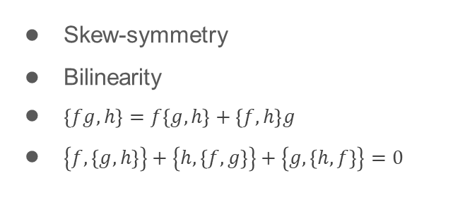



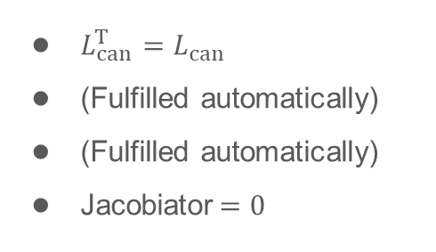

Hamiltonian systems
Canonical systems
Recall Hamilton’s equations of motion
$${\dot{q}}_{i}=\frac{∂H}{∂p_{i}}, {\dot{p}}_{i}=−\frac{∂H}{∂q_{i}}$$
$\left\{f,g\right\}={\left(∇_{z}f\right)}^{T}⋅L_{can}⋅∇_{z}g, L_{can}=\left(\begin{matrix}0 & I_{d} \\ −I_{d} & 0\end{matrix}\right)$
$$\dot{f}=\left\{f,H\right\}+\frac{∂f}{∂t}$$
Denote $z=(q_{1},…,q_{n},p_{1},…,p_{n})$
$$\dot{z}=\left\{z,H\right\}=L_{can}⋅∇_{z}H$$
Recall key properties of Poisson brackets
Skew-symmetry
Bilinearity
$\left\{fg,h\right\}=f\left\{g,h\right\}+\left\{f,h\right\}g$
$\left\{f,\left\{g,h\right\}\right\}+\left\{h,\left\{f,g\right\}\right\}+\left\{g,\left\{h,f\right\}\right\}=0$
$L_{can}^{T}=L_{can}$
(Fulfilled automatically)
(Fulfilled automatically)
Jacobiator$=0$
$$\underset{→}{conditions on L }$$
Jan Benda
ML for recognition of simple physical systems
3.4.2024

Slide 4


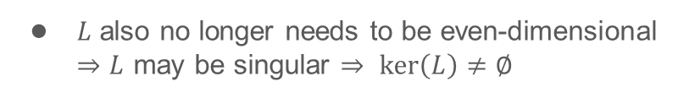



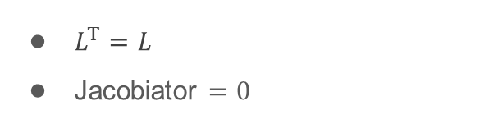


Hamiltonian systems
Hamiltonian systems
We will allow for $L:ℝ^{n}⟶ℝ^{n×n}$
It still needs to fulfill
$$\dot{z}={\left\{z,H\right\}}_{L}=L\left(z\right)⋅∇H$$
$L^{T}=L$
Jacobiator $=0$
$$J^{ijl}=L^{kl}\frac{∂L^{ij}}{∂z^{k}}+L^{kj}\frac{∂L^{li}}{∂z^{k}}+L^{ki}\frac{∂L^{jl}}{∂z^{k}}=0$$
We still have the conservation of energy
$$\dot{H}={\left\{H,H\right\}}_{L}=−{\left\{H,H\right\}}_{L}=0$$
$L$ also no longer needs to be even-dimensional
$⇒L$ may be singular $⇒ ker\left(L\right)≠∅$
$$⇒∃ ∇C∈C\left(ℝ^{n}\right):L⋅C=0$$
Such $C$ is called Casimir function
$${\left\{f,C\right\}}_{L}={\left(∇f\right)}^{T}⋅L⋅∇C=0$$
$$\dot{C}={\left\{C,H\right\}}_{L}=0$$
Jan Benda
ML for recognition of simple physical systems
3.4.2024

Slide 5


Hamiltonian systems
3D Hamiltonian systems
$L∈ℝ^{3×3}$ is always singular
There exists an isomorphism $L=\left(\begin{matrix}0 & {−J}_{3} & J_{2} \\ J_{3} & 0 & {−J}_{1} \\ {−J}_{2} & J_{1} & 0\end{matrix}\right)↔J=\left(J_{1},J_{2},J_{3}\right)$
Jacobi‘s identity becomes $J⋅\left(∇×J\right)=0$
$$⇒J=φ∇C$$
$L$ constructed from such $J$ always satisfies Jacobi's identity
Also $\dot{z}=L⋅∇H=J×∇H=\left(φ∇C\right)×∇H$
Jan Benda
ML for recognition of simple physical systems
3.4.2024

Slide 6
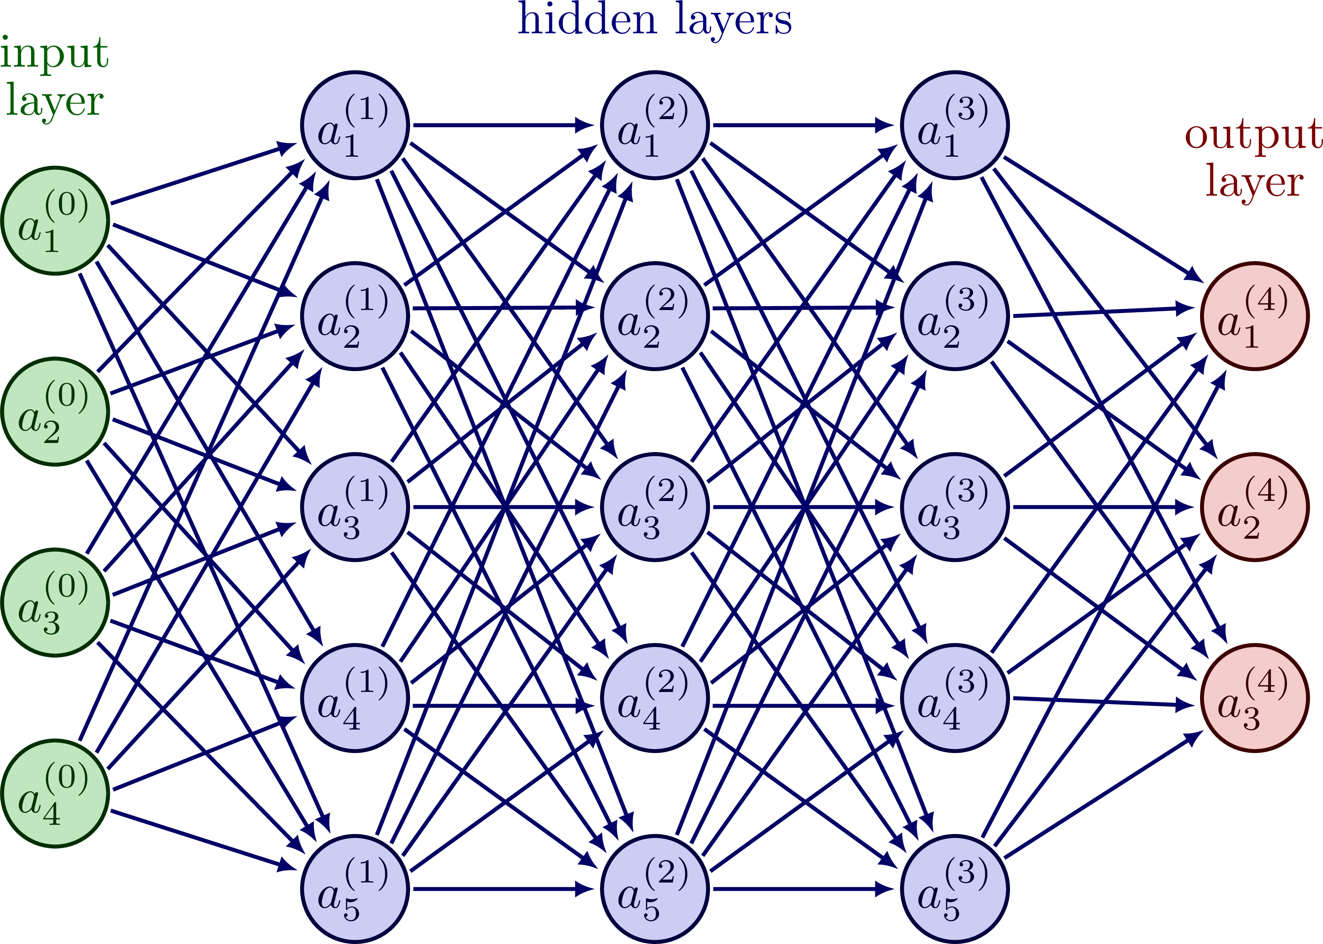
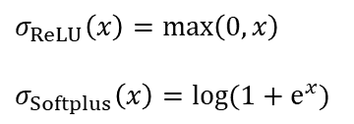

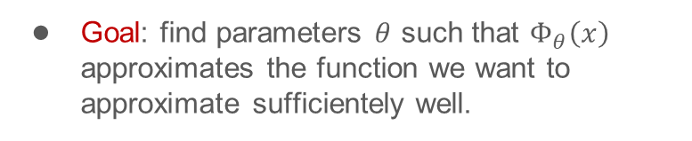



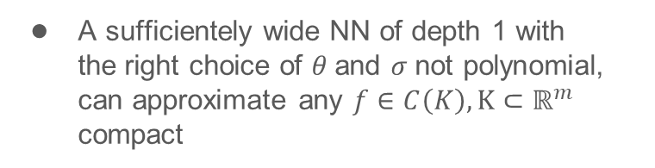
Introduction to deep learning
Neural networks
Neurons
$$y=σ\left(w^{T}x+b\right)$$
$$σ_{ReLU}\left(x\right)=\max\left(0,x\right)$$
$$σ_{Softplus}\left(x\right)=log(1+e^{x})$$
are organised into layers
$$x_{(i+1)}=σ\left(W_{(i)}^{T}x_{(i)}+b_{(i)}\right)$$
$W_{(i)}^{T},b_{(i)}$ are parameters to be learnt
Universal approximation theorem
A sufficientely wide NN of depth 1 with the right choice of $θ$and $σ$not polynomial, can approximate any $f∈C\left(K\right), K⊂ℝ^{m}$ compact
$${\left\|Φ_{θ}−f\right\|}_{L^{∞}\left(K\right)}<ε$$
Goal: find parameters $θ$ such that $Φ_{θ}\left(x\right)$ approximates the function we want to approximate sufficientely well.
Jan Benda
ML for recognition of simple physical systems
3.4.2024

Slide 7

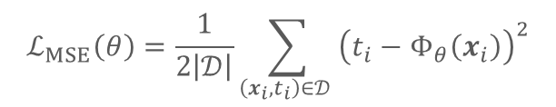
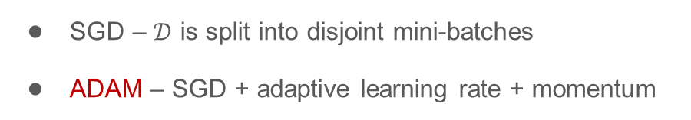

Introduction to deep learning
Training and loss function
Training is done over dataset $\left(x_{i},t_{i}\right)∈𝒟$
Goal: minimize some $ℒ\left(θ\right)$
$$ℒ_{MSE}\left(θ\right)=\frac{1}{2\left|𝒟\right|}\sum_{\left(x_{i},t_{i}\right)∈𝒟 }{{\left(t_{i}−Φ_{θ}\left(x_{i}\right)\right)}^{2}}$$
The most basic algorithm: Gradient descent
$$θ_{i+1}=θ_{i}−λ∇_{θ}ℒ\left(θ_{i}\right)$$
There are usually some heuristice applied
SGD – $𝒟$ is split into disjoint mini-batches
ADAM – SGD + adaptive learning rate + momentum
Jan Benda
ML for recognition of simple physical systems
3.4.2024

Slide 8
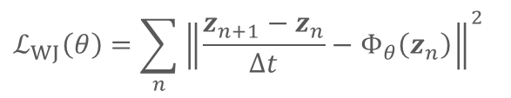



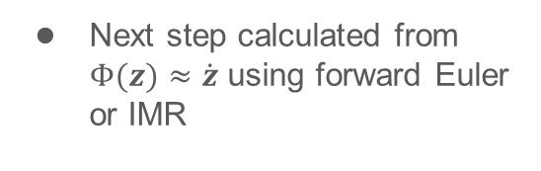



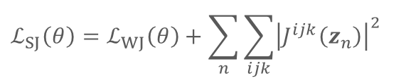
Direct Poisson Neural Network
Our architectures
3 flavours of DPNN
$$L(z)$$
$$H(z)$$
Without Jacobi
Soft Jacobi
Implicit Jacobi
Skew-symmetrization
Autograd
Next step calculated from $Φ(z)≈\dot{z}$ using forward Euler or IMR
$$L$$
$$∇H$$
$$Φ(z)≈\dot{z}$$
$$ℒ_{WJ}\left(θ\right)=\sum_{n}{{\left\|\frac{z_{n+1}−z_{n}}{∆t}−Φ_{θ}\left(z_{n}\right)\right\|}^{2}}$$
$$ℒ_{SJ}\left(θ\right)=ℒ_{WJ}\left(θ\right)+\sum_{n}{\sum_{ijk}{{\left|J^{ijk}\left(z_{n}\right)\right|}^{2}}}$$
$$J^{ijl}=L^{kl}\frac{∂L^{ij}}{∂z^{k}}+L^{kj}\frac{∂L^{li}}{∂z^{k}}+L^{ki}\frac{∂L^{jl}}{∂z^{k}}=0$$
Jan Benda
ML for recognition of simple physical systems
3.4.2024

Slide 9

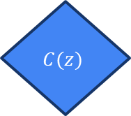
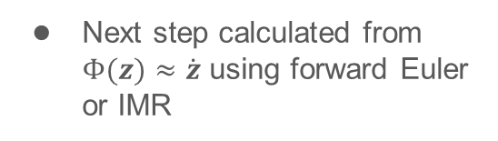



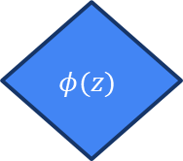
Direct Poisson Neural Network
Our architectures
3 flavours of DPNN
$$C(z)$$
$$H(z)$$
Without Jacobi
Soft Jacobi
Implicit Jacobi
Autograd
Autograd
Next step calculated from $Φ(z)≈\dot{z}$ using forward Euler or IMR
$$J=φ∇C$$
$$∇H$$
$$Φ(z)≈\dot{z}$$
$$×$$
Recall $\dot{z}=J×∇H, J=φ∇C$
$$φ(z)$$
$$ℒ_{IJ}\left(θ\right)=ℒ_{WJ}\left(θ\right)$$
Jan Benda
ML for recognition of simple physical systems
3.4.2024

