Slide 1


Covariant Conversions (CoCo):
A Design Pattern for Type-Safe Modular Software Evolution in Object-Oriented Systems
George Heineman
(WPI)
Boris Düdder
(DIKU)
Jan Bessai
(TU Dortmund)

Slide 2
CoCo: Covariant Conversions
New Design Pattern to solve the Expression Problem
  add methods and classes without casts or modification of existing code
Fully Type-safe
Works out of the box in Java, Scala, C#, …
  no language extensions or code-generators needed!
Support for side-effects via setters
Allows to merge branching extensions
Acceptable amount of overhead

Slide 3
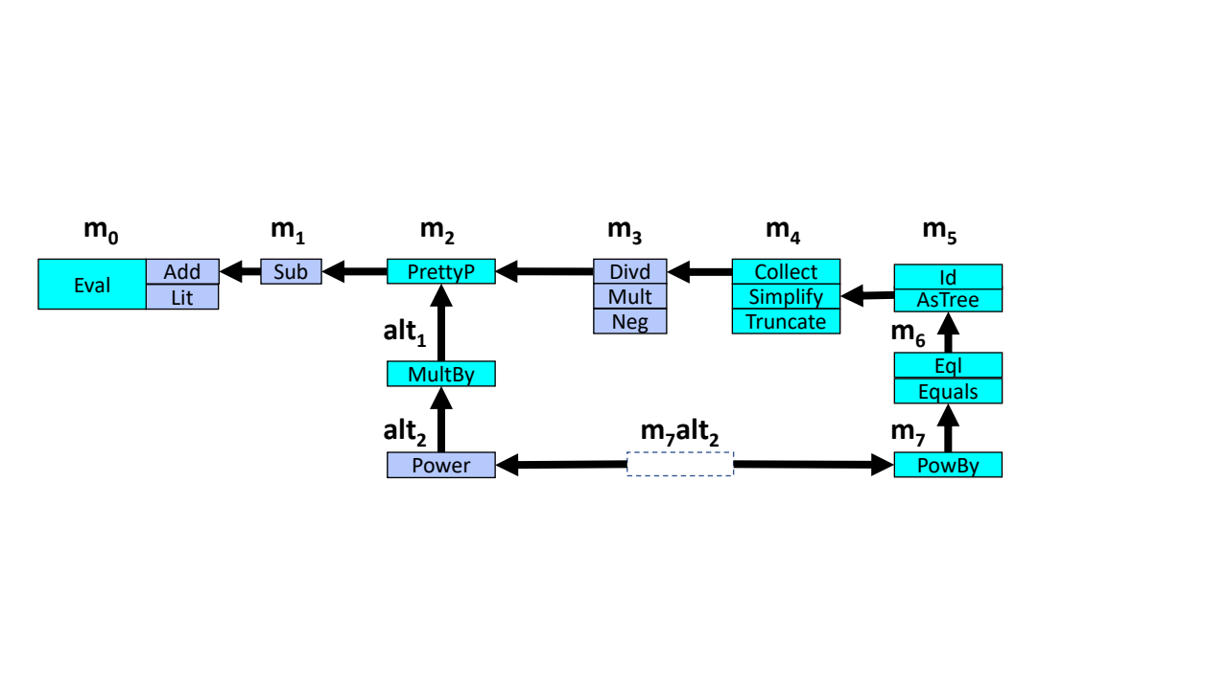
More in the Paper + Artifact
More Examples (Java, Scala, C#)
Merging of branches
Support for multiple subdomains
Techniques for boilerplate reduction
Benchmarks

