Slide 1
Ghent business opportunity
Where to start a new business in the city centre of Ghent

Slide 2
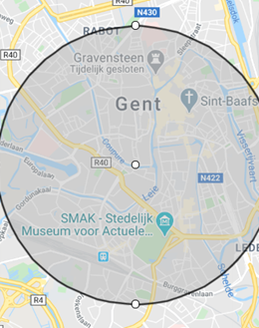
Introduction
Finding a location for a business in Ghent
Finding the right type of venue
Inside of the city centre which is very touristic
Finding an area that lacks a specific type of business
Trying to get as many tourist that are in need of a type of business

Slide 3
Necessary data
All restaurants/pubs in order to find which places are touristic hotspots
Developing a logic that finds the ‘best locations’ for each type of restaurant
By combining the touristic hotspots and ‘best locations’ will decide which popular type of pubs/restaurant is ‘missing’ somewhere
Main sources of data are Foursquare API and Wikipedia

Slide 4
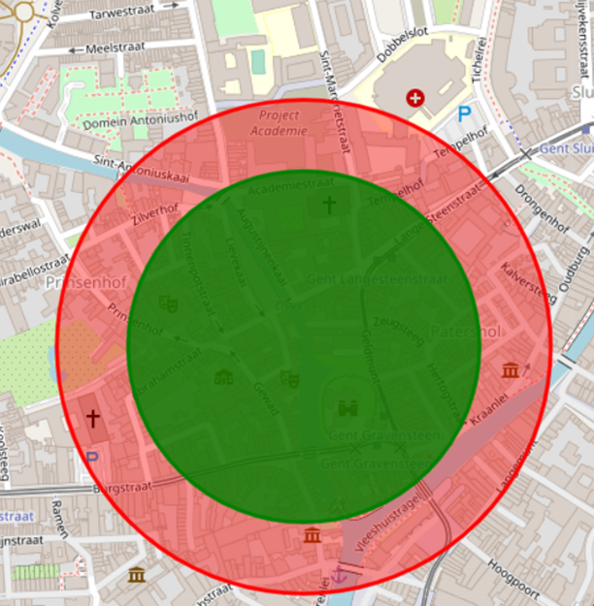
Methodology
First the city is dived in a raster of points (200m)
For each point there is a call to the API in order to find how many businesses are present in a 250m range
Based on the result a cut-off of popular areas is chosen as a selection of regions that are popular enough to start a new business
For those selected locations a nearby (200m) and long range (280m) scan is done
For every selected location the short and far scan are compared
From the comparation venues that are present in far scan but not in short scan are chosen
The result gives an answer to the problem that was initially stated

Slide 5
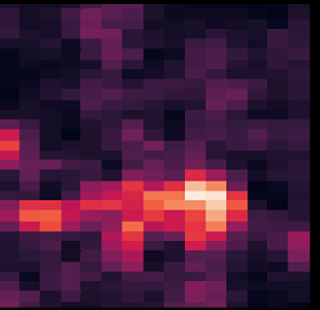
Results
The first part is the selection of which areas of Ghent are popular
can be seen on a heatmap that shows the main touristic areas
The heatmap is more abstract but shows the idea
This popularity is linked to neighbourhoods

Slide 6
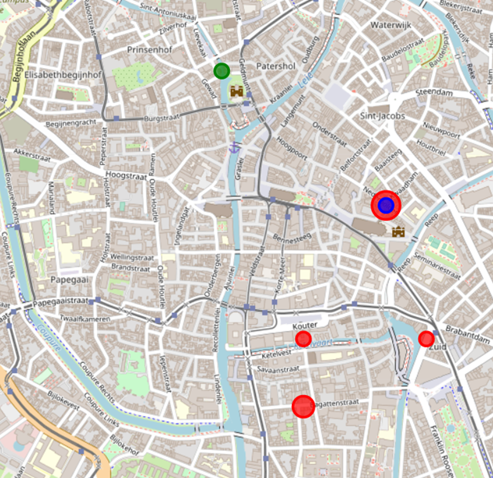
Geospatial result
The main result can be visualized on the Folium map of Ghent.
Red dots where Bars should be placed
Blue dot for a Nightclub could have its place
Green dot is missing a Pub

Slide 7
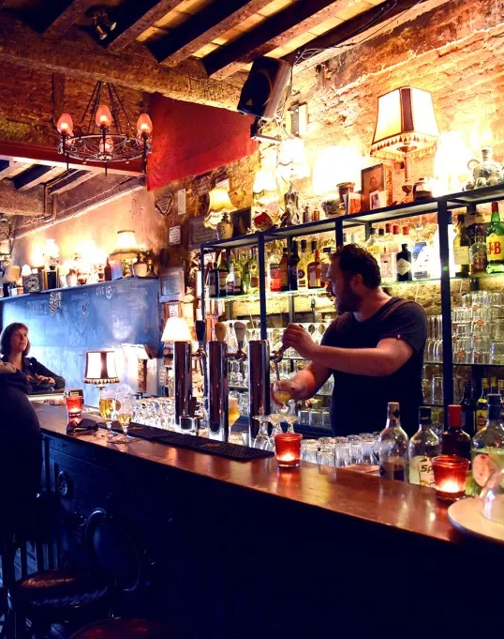
Conclusion
There are 5 business opportunity locations based on the used algorithm.
They can be found on the maps, there are 3 locations for a bar, one location for a bar or nightclub and one location suited for a Pub.
The best location would be around Kouter in Ghent to start a bar.
Be fast before the locations are filled!!

