Slide 1
reckon
Gives every codebase a memory.
CLI · MCP Server · IBM Bob Integration · Rust
Solution by Jan

Slide 2
PROBLEM
Your team fixed this bug before.
IR-117
312
Then they fixed it again.
Developers forget why critical code exists. When someone refactors it, they unknowingly revert a hard-won fix — re-opening incidents, causing real damage.
customers double-charged
$48,000 refunded manually
Root cause: a refactor removed two lines of code.
No one remembered they guarded a live incident.

Slide 3
ROOT CAUSE
The knowledge lives in developers' heads —
not in the codebase.
git blame tells you WHO
Wikis go stale instantly
Oral tradition fails at scale
It shows the last person to touch a line. It can't tell you why the line exists, what incident it guards, or what was tried and rejected.
Documentation that lives outside the repo drifts. When code changes, the wiki stays wrong. Nobody reads it before refactoring.
The engineer who fixed IR-117 left the team. The knowledge left with them. The next engineer couldn't know what they didn't know.

Slide 4
SOLUTION
Reckon
Persistent, version-controlled memory — committed next to your code.
MEMOIR.md
Tripwires
Auto-generated per module. Grounded in commits, PRs, tickets, and postmortems. Both machine-readable (tripwires) and human-readable (rationale).
Guard specific code regions tied to past incidents. When a diff touches a guarded region, Reckon fires a warning — before the code ships.
reckon why
Bob Integration
Answers "why is this code like this?" with a full decision trail — commits, linked PRs, incident refs, and rejected alternatives.
Runs inside IBM Bob's Review Mode as an MCP server. Every staged diff is automatically checked against the tripwire registry.

Slide 5
HOW IT WORKS
Three commands. Zero ceremony.
reckon memoir <path> [--auto]
Generate Memory
01
Reads git history, PRs, issues, and postmortems for the module. Writes a MEMOIR.md with tripwires and rationale. Committed to the repo.
reckon memoir src/
reckon why <path>:<line[-end]>
Explain Any Line
02
reckon why payments/retry.py:27-28
Answers "why does this exist?" with the full decision trail — which incident caused it, what was tried and rejected, and who approved the fix.
reckon check [--diff <file>] [--ci]
Block Regressions
03
Matches the staged diff against the tripwire registry. If a change touches a guarded region, Reckon fires a warning before the commit ships.
reckon check

Slide 6
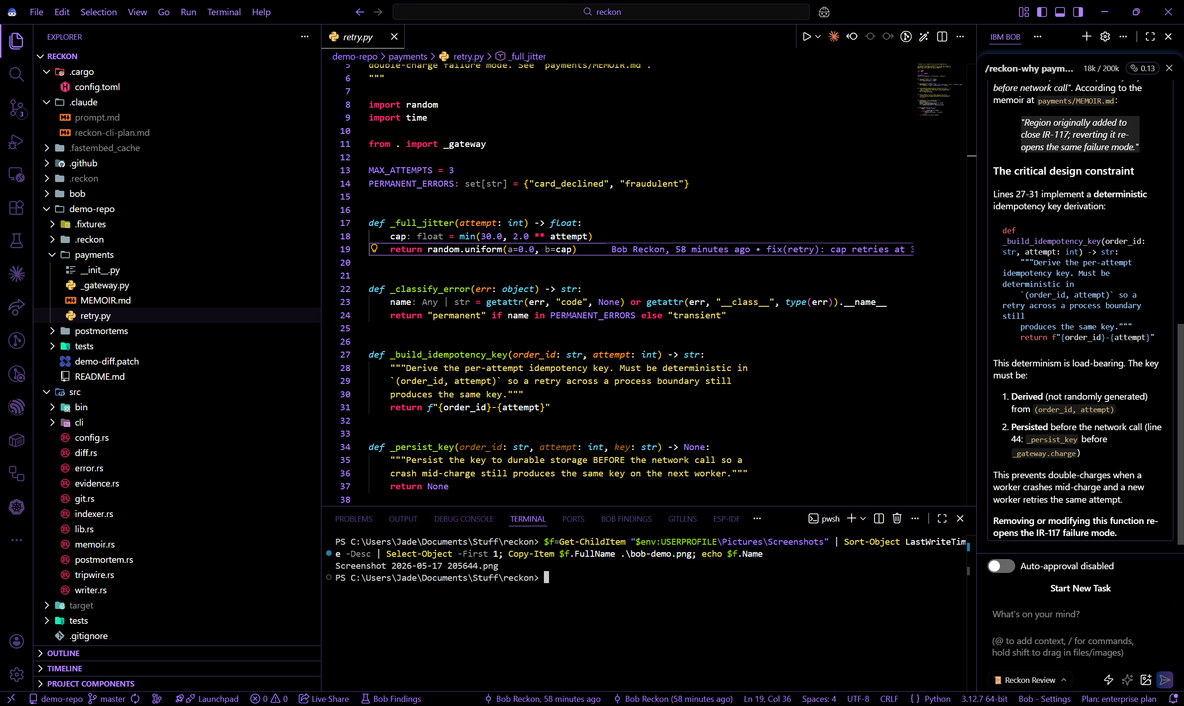
DEMO
Live in IBM Bob — reckon.explain answers why this code exists
reckon.explain called via MCP · IR-117 decision trail surfaced in real time · payments/retry.py:27-28

Slide 7
TECHNOLOGY
Built to last — not to demo.
Rust
MCP (stdio)
IBM Bob
CLI + MCP server in a single library crate. Memory-safe, zero-overhead, ships as static binaries.
Hand-rolled JSON-RPC over stdio. Compatible with Bob, Claude Desktop, Cursor, and Continue — no SDK lock-in.
Native Review Mode integration. Bob calls reckon.check_diff on every staged hunk automatically.
SQLite
ONNX / MiniLM
Git-native
Evidence store — caches artifacts, traces, and postmortem embeddings locally. Atomic writes, no data loss.
Local semantic search over postmortems. No API calls, no latency, no cost per query.
MEMOIR.md committed next to the module. History, blame, and CI checks work without any extra tooling.

Slide 8
MARKET
A massive market with no memory.
TAM
SAM
$29B+
~$3B
Global developer tools market
(IDC, 2024)
AI-assisted developer tools
(growing 35% YoY)
Every team with a git repo is a potential customer.
Teams using AI coding agents need context tools to match.
As AI agents write more code, the need to explain and guard that code grows with them.

Slide 9
REVENUE
Open core → SaaS → Enterprise.
Open-Source CLI
Free
Team SaaS
$15/seat/mo
The reckon CLI is free and open-source. Drives adoption, builds trust, creates the install base.
MEMOIR hosting, shared postmortem corpus, team dashboards, and audit logs — all in the cloud.
Enterprise On-Prem
Custom
IDE Marketplace
Revenue share
Air-gapped deployment, SSO, compliance exports, SLA. Target: fintech, healthcare, and defense.
Reckon Review Mode as a first-class IBM Bob plugin. Distribution through the Bob plugin registry.

Slide 10
COMPETITION
No one else prevents historical regressions.
Tool
Explains why?
Blocks regressions?
Git-native?
Incident-aware?
Reckon
✅
✅
✅
✅
git blame
❌
❌
✅
❌
Swimm
Partial
❌
Partial
❌
Graphite
❌
❌
✅
❌
Confluence
❌
❌
❌
❌
USP: Reckon is the only tool that ties code regions to incident postmortems and actively blocks their regression.

Slide 11
ROADMAP
Scalable impact — from one repo to the enterprise.
Now
v1.0
v2.0
CLI + MCP server
VS Code & Cursor plugins
Cross-repo incident linking
IBM Bob Review Mode
GitHub Actions CI step
AI-drafted postmortems
90-second demo fixture
SaaS MEMOIR hosting
Enterprise SSO + audit
28 passing tests
Team dashboards
Public API

Slide 12
Stop forgetting.
Start reckoning.
reckon · for bob — gives every codebase a memory.
It writes the history down, commits it next to the code,
and stops you from forgetting it.
GitHub Repo
Live Demo
reckon install bob

