Slide 1

Physics informed deep networks based on High Fidelity septum magnet model for the real-time monitoring
Akademia Górniczo-Hutnicza im. Stanisława Staszica w Krakowie
AGH University of Krakow
By Jan Gorczyński

Slide 2
Purpose of the project
High fidelity numerical model is very slow, it takes few hours to conduct a single simulation
We aim to train neural networks to make a faster substitute for the numerical model in certain domains
We chose oscillations of the magnet, as first domain to explore

Slide 3
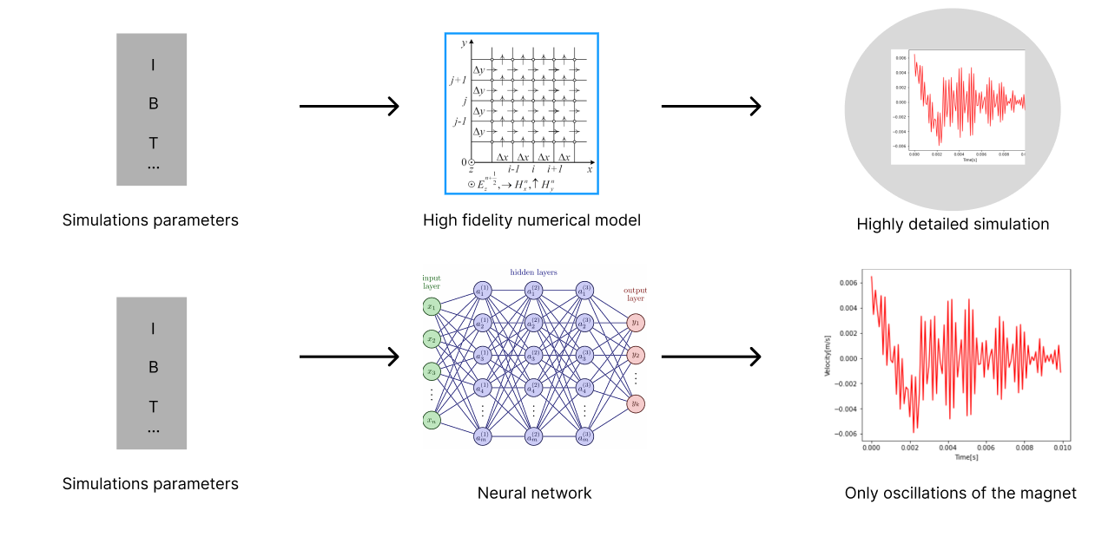
Purpose of the project

Slide 4
Challenges with data collection
Due to very long simulation times, we do not have enough data for training the model to correctly simulate oscillations based on parameters
I decided to just train the model to fit the output of a single simulation and explore different approaches.

Slide 5
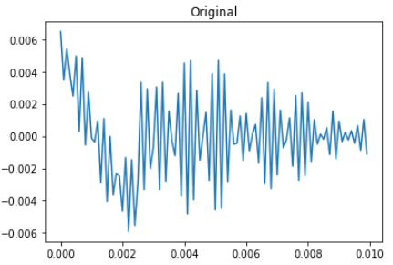
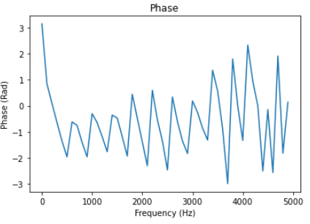
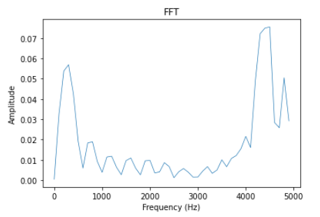
Fourier series

Slide 6
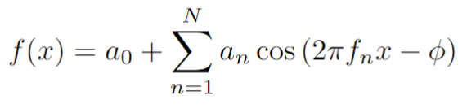
Fourier series
Cosine form of Fourier series is:
We can approximate any function by finding amplitude and phase for each of the n functions
This will be the task for our neural network
We applied Fourier transform over 50 data points, so we have 100 parameters to find, amplitude and phase for each function

Slide 7
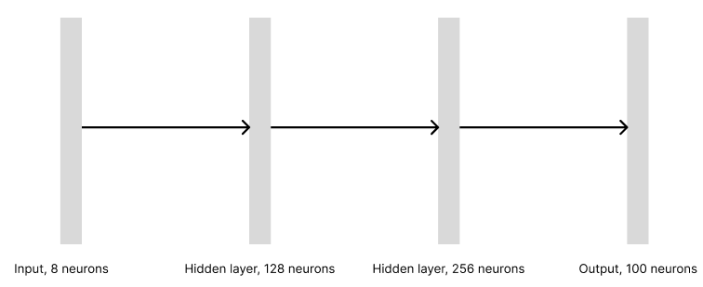
Model1

Slide 8
Model1 loss function
Loss functions measures the difference between true data and predicted data, neural networks work by minimizing value of this function
In model we calculate value of the loss functions by comparing Fourier series parameters predicted by neural network to the ones we got from Fourier transform

Slide 9
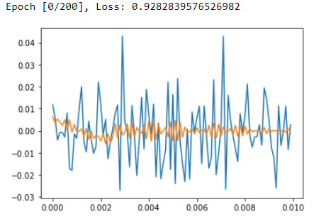
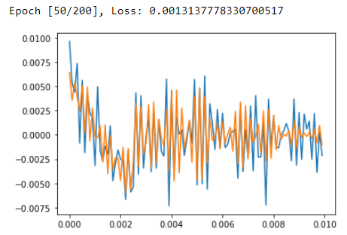
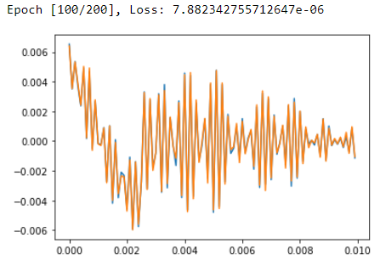
Model1 training

Slide 10
Model2

Slide 11
Model2 loss function
In this model loss function is calculated not by comparing Fourier series parameters directly, but by comparing the resulting function

Slide 12
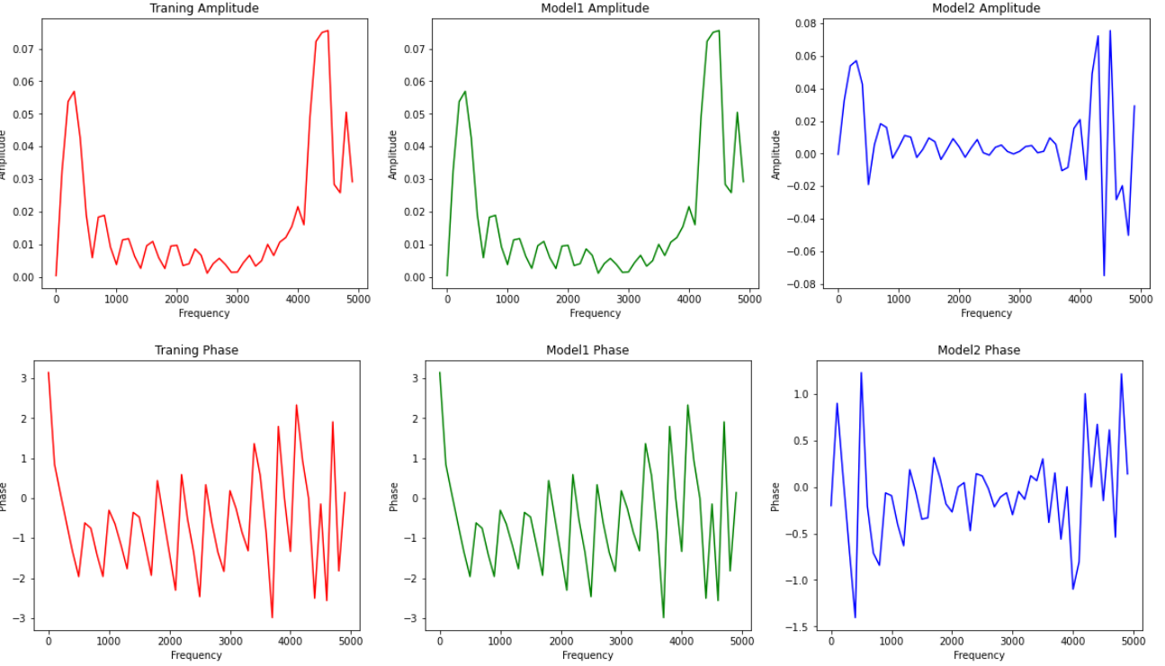
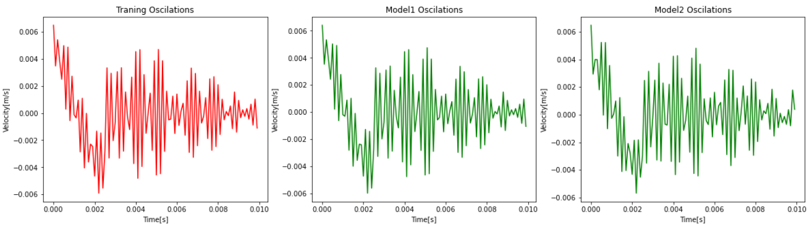

Slide 13
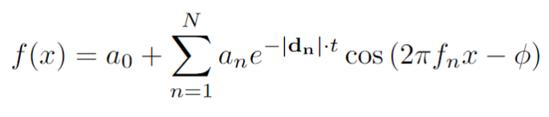
Adding damping factor to Fourier Series
By adding trainable damping factor to our series we can represent the fact that physically this system resembles many dumped harmonic oscillators
Our modified formula looks like this:
Now we have N*3 trainable parameters, so for 50 functions we have output size of 150

Slide 14
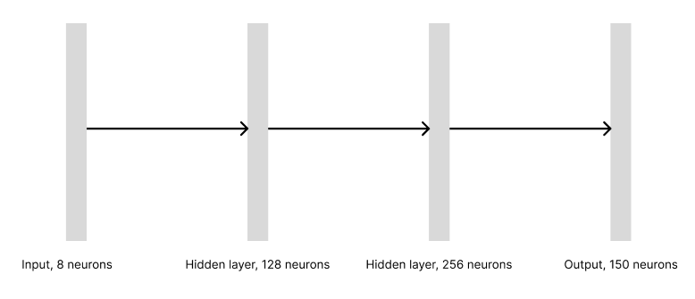
Model3

Slide 15
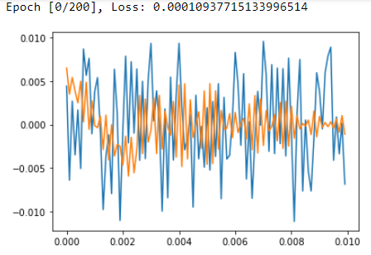
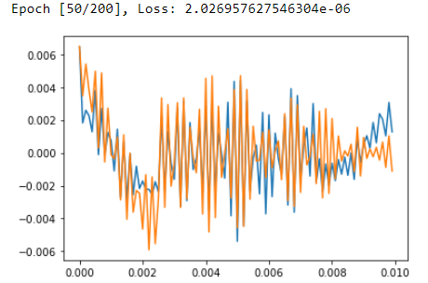
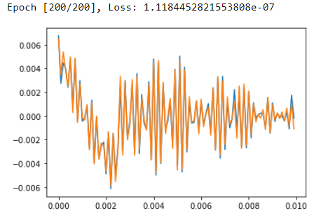
Model3 training

Slide 16
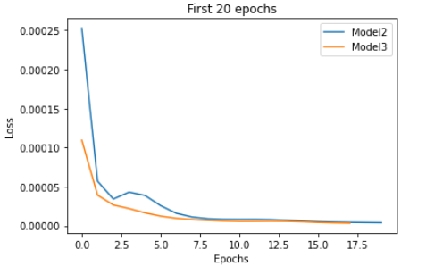
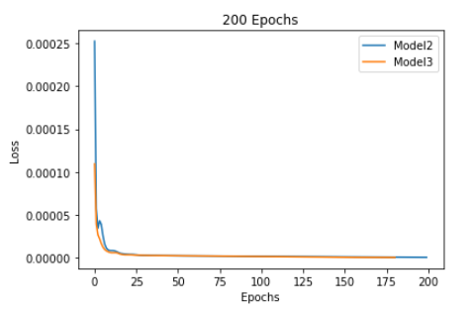
Model2 and Model3 training history comparison

Slide 17
Questions and suggestions

Slide 18
Thank you for your attention!

