Slide 1

Physics informed deep networks based on High Fidelity septum magnet model for the real-time monitoring
Akademia Górniczo-Hutnicza im. Stanisława Staszica w Krakowie
AGH University of Krakow
By Jan Gorczyński

Slide 2
Purpose of the project
High fidelity numerical model is very time-consuming, it takes few hours to conduct a single simulation
We aim to train neural networks as faster surveillance models in certain domains
We chose oscillation velocity of the magnet, as the first domain to explore
Our initial plan was to use physics informed neural networks (PINNs), but we were not able to implement them
We used a Fourier series based model for this problem

Slide 3
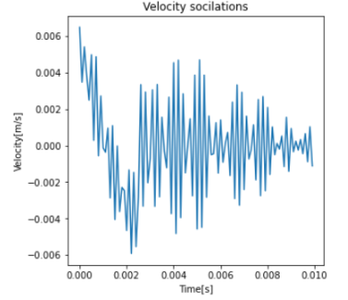
Data overview
Input for our models is a set of simulation parameters such as damping ratio of the spring, maximum current, etc.
Our desired output is a a velocity function during magnets power cycle

Slide 4
Fourier series
A solution that we found was neural networks based on the Fourier series
Our model predicts Fourier series parameters based on the initial simulation parameters
At the input, the model takes 8 simulation parameters, such as initial current, spring constant, etc., and outputs 50 amplitudes and 50 phases for 50 frequencies

Slide 5
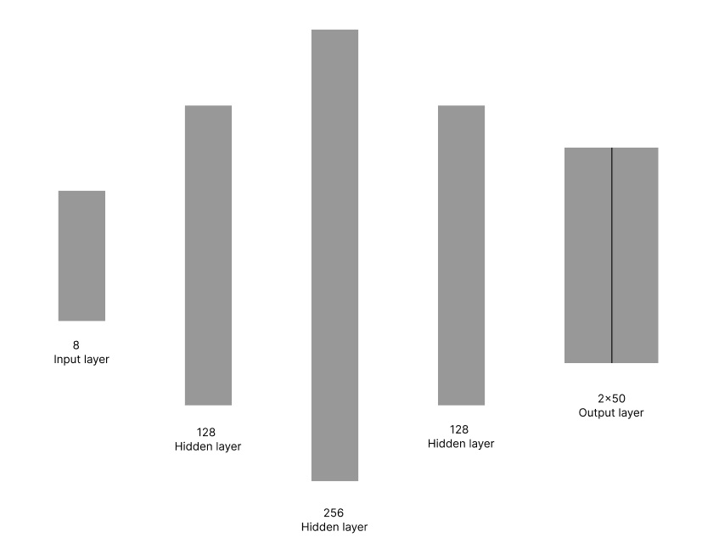
Model
The model consists of 8 input layers, 3 hidden fully connected layers of sizes 128, 256, and 128, and an output of size 2 by 50
The activation function in all hidden layers is RELU, in the output layer, it's linear

Slide 6

Cost function
Our cost function works by assembling Fourier series parameters into a time-velocity function using this formula:
After assembling the function, we apply it over all time points and calculate the mean squared error with respect to ground truth

Slide 7
Training proces
Due to the limited amount of data, we used a technique called leave-one-out cross-validation, which means we take one of the examples out of the training data and train on the rest
To increase our model's accuracy, we used data augmentation. By adding noise to examples from the training set, we were able to artificially create more data
We also trained 2 models for each set of parameters, one from the beginning and one after the initial pulse. In total, we trained 30 models, 2 for each of the 15 parameter sets

Slide 8
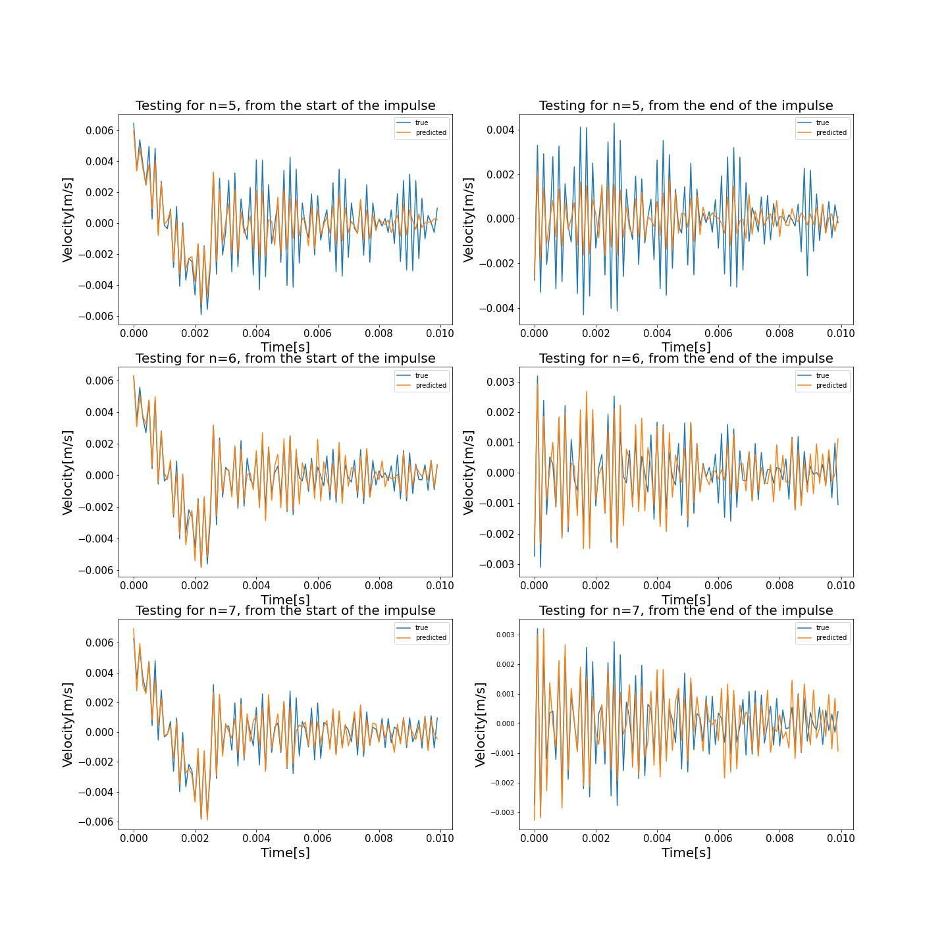
Results

Slide 9
Conclusion
The Fourier series based model managed to simulate the behavior quite well even without much work put into hyperparameter tuning
The advantage of this model is its ability to predict the whole function at once, as opposed to models that take time as input and output a single value
This work could be expanded to similar models utilizing parameterized functions

Slide 10
Questions

Slide 11
Thank you for your attention!

