Slide 1
Time Evolution in Lattice Gauge Theories using Quantum Computers
Project: Solving Problems on Quantum Hardware Workshop
Organizer: JProf. Fred Jendrzejewski

Slide 2
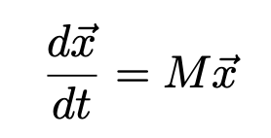

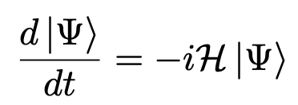
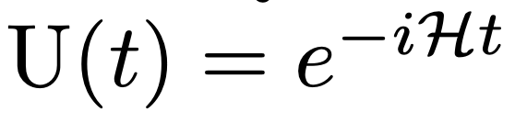
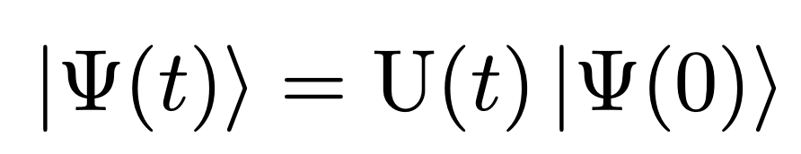
Calculating Time Evolution
Dynamics governed by differential equation in matrix form:
→ formal solution
Quantum Mechanics:
gives time evolution operator
Then solution is
Not feasible for systems of interest because Hilbert space becomes too large!!

Slide 3
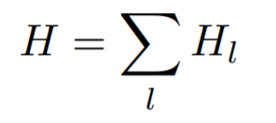

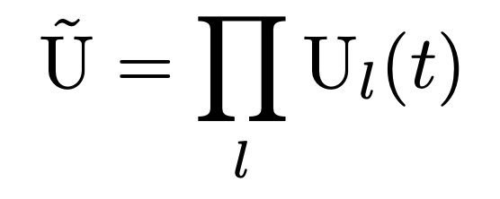
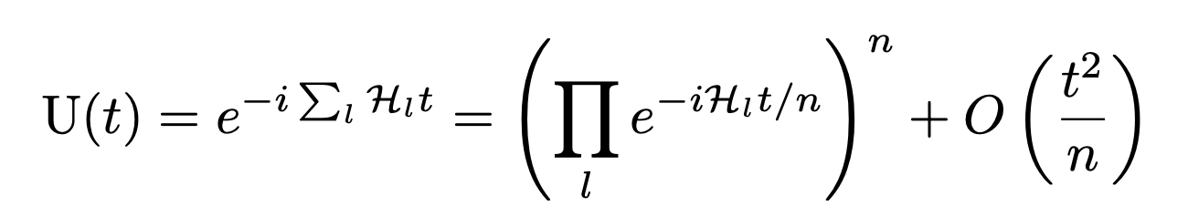
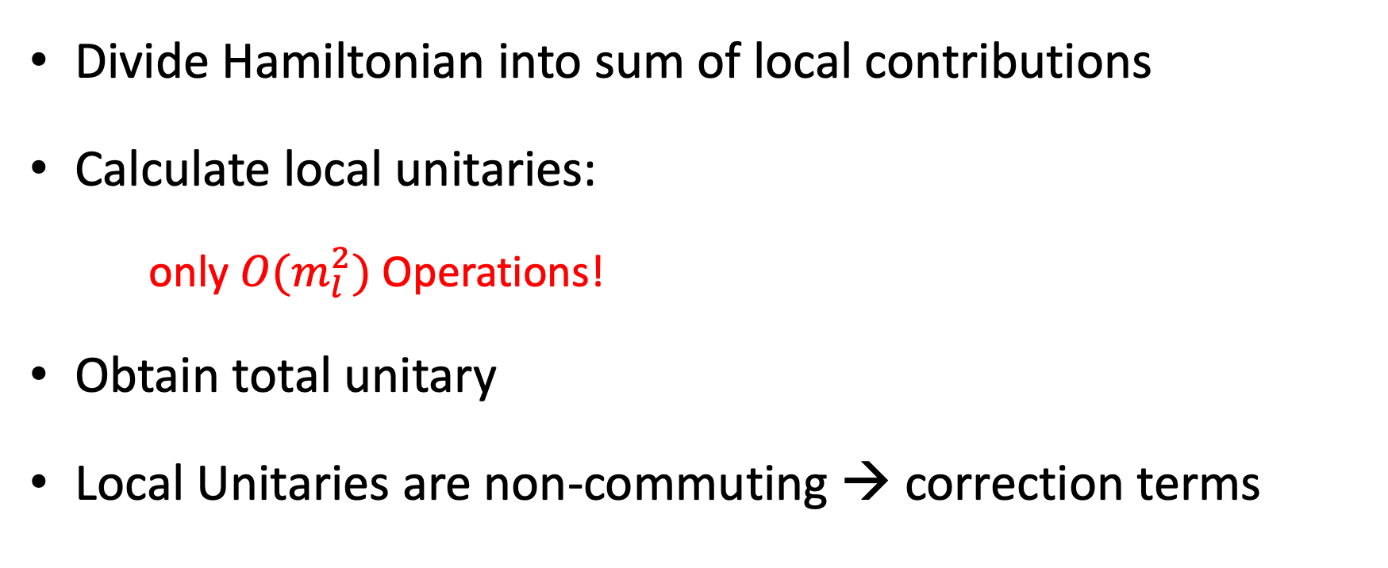
Suzuki-Trotter Expansion of Time Unitary
Divide Hamiltonian into sum of local contributions
Calculate local unitaries:
only $O(m_{l}^{2})$ Operations!
Obtain total unitary
Local Unitaries are non-commuting → correction terms

Slide 4
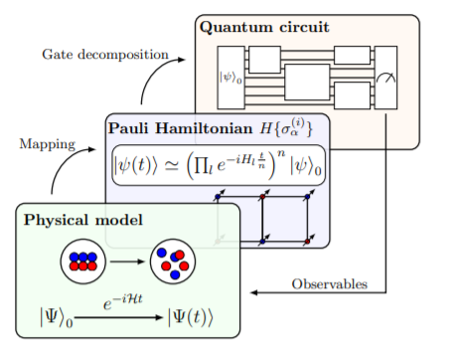
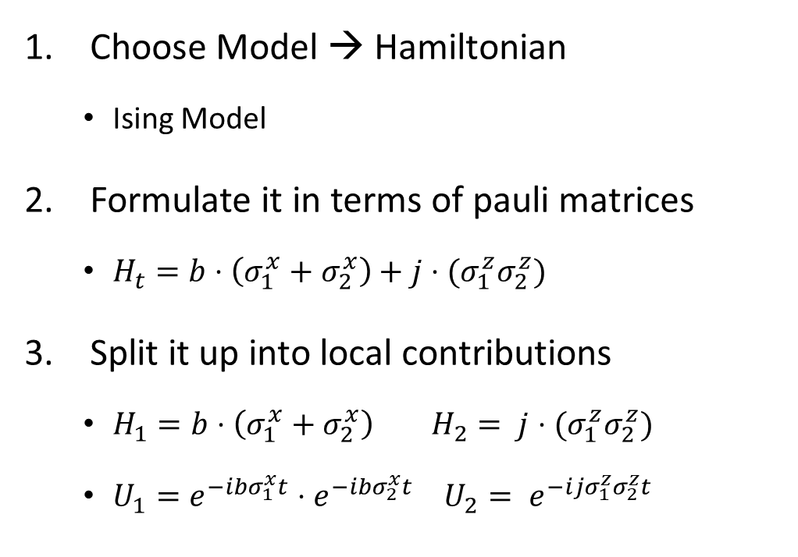
Implementation on a Quantum Computer
Choose Model → Hamiltonian
Ising Model
Formulate it in terms of pauli matrices
$H_{t}=b⋅\left(σ_{1}^{x}+σ_{2}^{x}\right)+j⋅(σ_{1}^{z}σ_{2}^{z})$
Split it up into local contributions
$H_{1}=b⋅\left(σ_{1}^{x}+σ_{2}^{x}\right) H_{2}= j⋅(σ_{1}^{z}σ_{2}^{z})$
$U_{1}=e^{−ibσ_{1}^{x}t}⋅e^{−ibσ_{2}^{x}t}$ $U_{2}= e^{−ijσ_{1}^{z}σ_{2}^{z}t}$

Slide 5
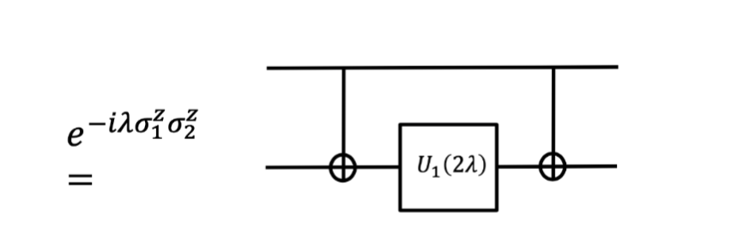
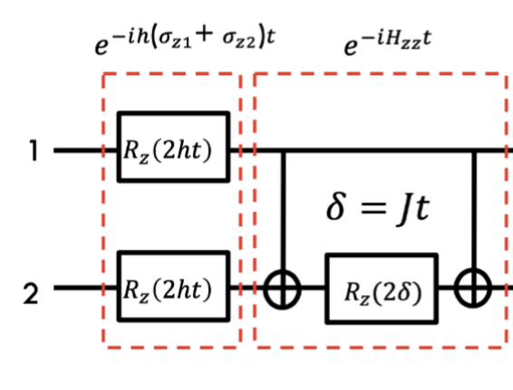


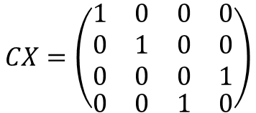
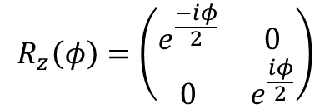
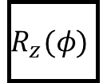

Implementation on a Quantum Computer
$$U_{1}\left(φ\right)=\left(\begin{matrix}1 & 0 \\ 0 & e^{iλ}\end{matrix}\right)$$
Translate each unitary time evolution into sequence of quantum gates
Add initial configuration & set of measurements
$$R_{z}\left(φ\right)=\left(\begin{matrix}e^{\frac{−iφ}{2}} & 0 \\ 0 & e^{\frac{iφ}{2}}\end{matrix}\right)$$
$$e_{}^{−ihσ_{z}}$$
$$=$$
$$e^{−ihJσ_{1}^{z}σ_{2}^{z}t}$$
$$R_{z}(φ)$$
$$CX=\left(\begin{matrix}\begin{aligned}1 \\ 0 \\ 0\end{aligned} & \begin{aligned}0 \\ 1 \\ 0\end{aligned} & \begin{aligned}0 \\ 0 \\ 0\end{aligned} & \begin{aligned}0 \\ 0 \\ 1\end{aligned} \\ 0 & 0 & 1 & 0\end{matrix}\right)$$

Slide 6
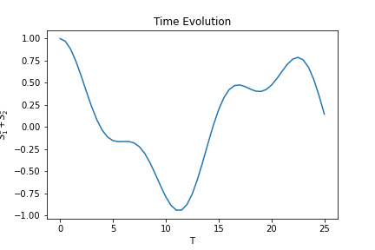
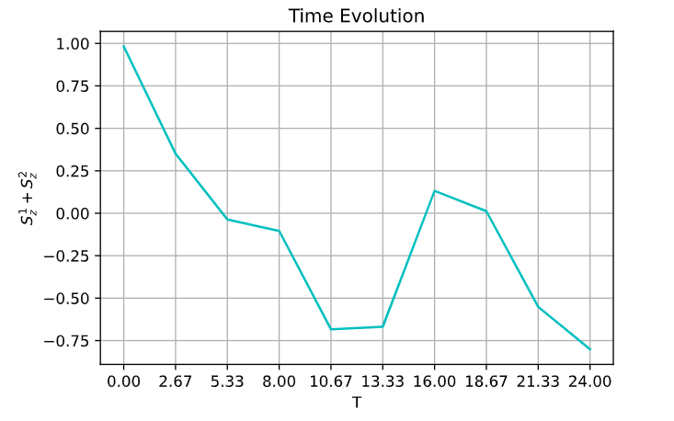

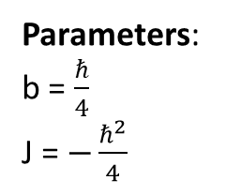


Ising Model Time Evolution
Analytical Solution
Quantum Computer
$$S_{z}^{1}+S_{2}^{z}$$
Hamiltonian:
Parameters:
b = $\frac{ℏ}{4}$
J = $−\frac{ℏ^{2}}{4}$
Deviation from T = 10 onwards is a result of Trotterization error ( $∝t$ ²) !
$H_{t}=b⋅\left(σ_{1}^{x}+σ_{2}^{x}\right)+J⋅(σ_{1}^{z}σ_{2}^{z})$

Slide 7
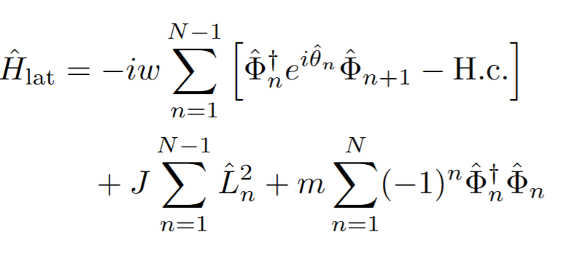
Lattice Gauge Theory & Schwinger Model
Kogut-Susskind Hamiltonian:
Gauge theory on a discretized lattice
Example: Schwinger Model
1 + 1 dimensional Quantum Electrodynamics
Particle-Antiparticle Creation
Energy of Gauge Field
Mass Energy

Slide 8
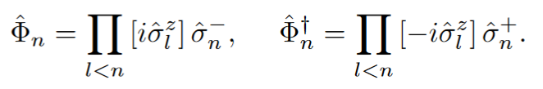
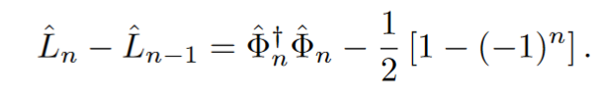
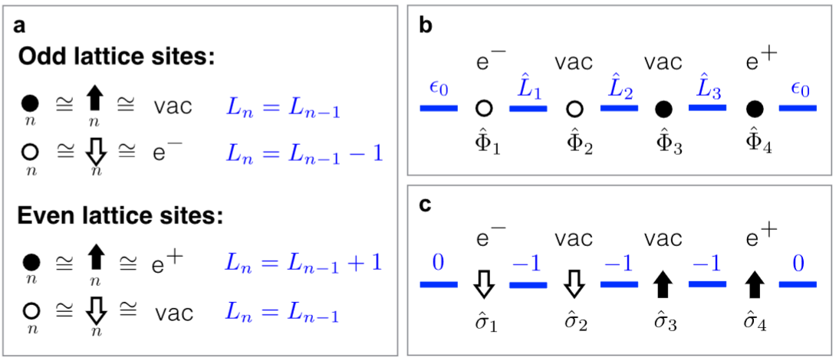
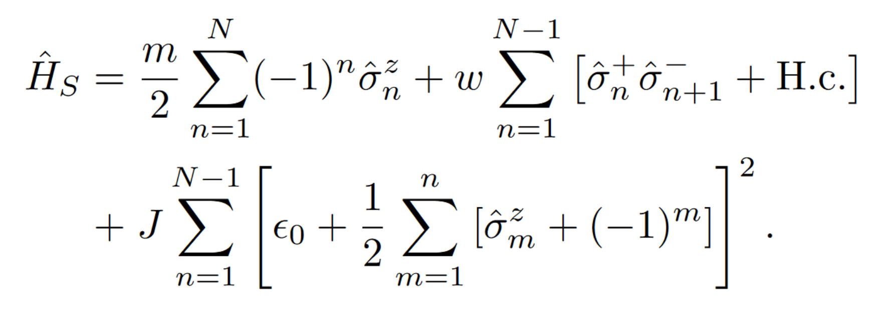
Schwinger Model
Gauss Law:
Jordan-Wigner Transformation
Spin-Hamiltonian

Slide 9
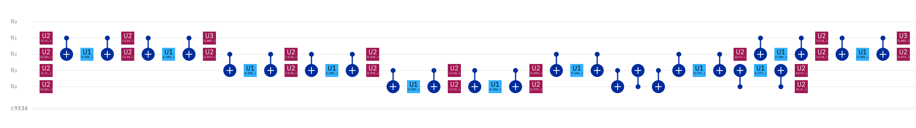
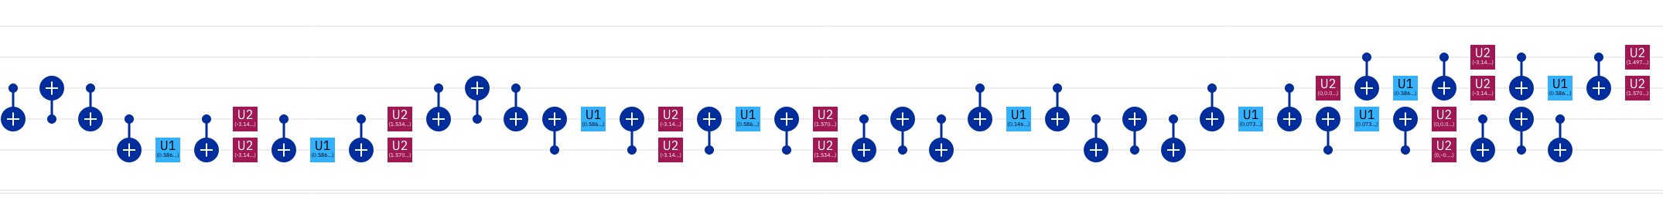
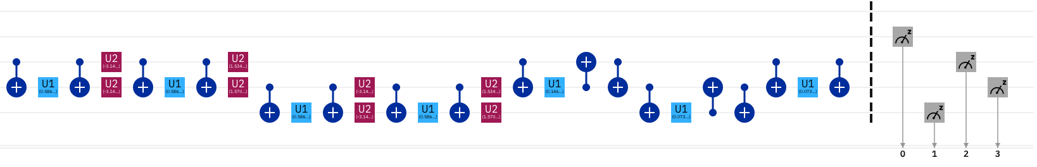
Schwinger Model Circuit

Slide 10
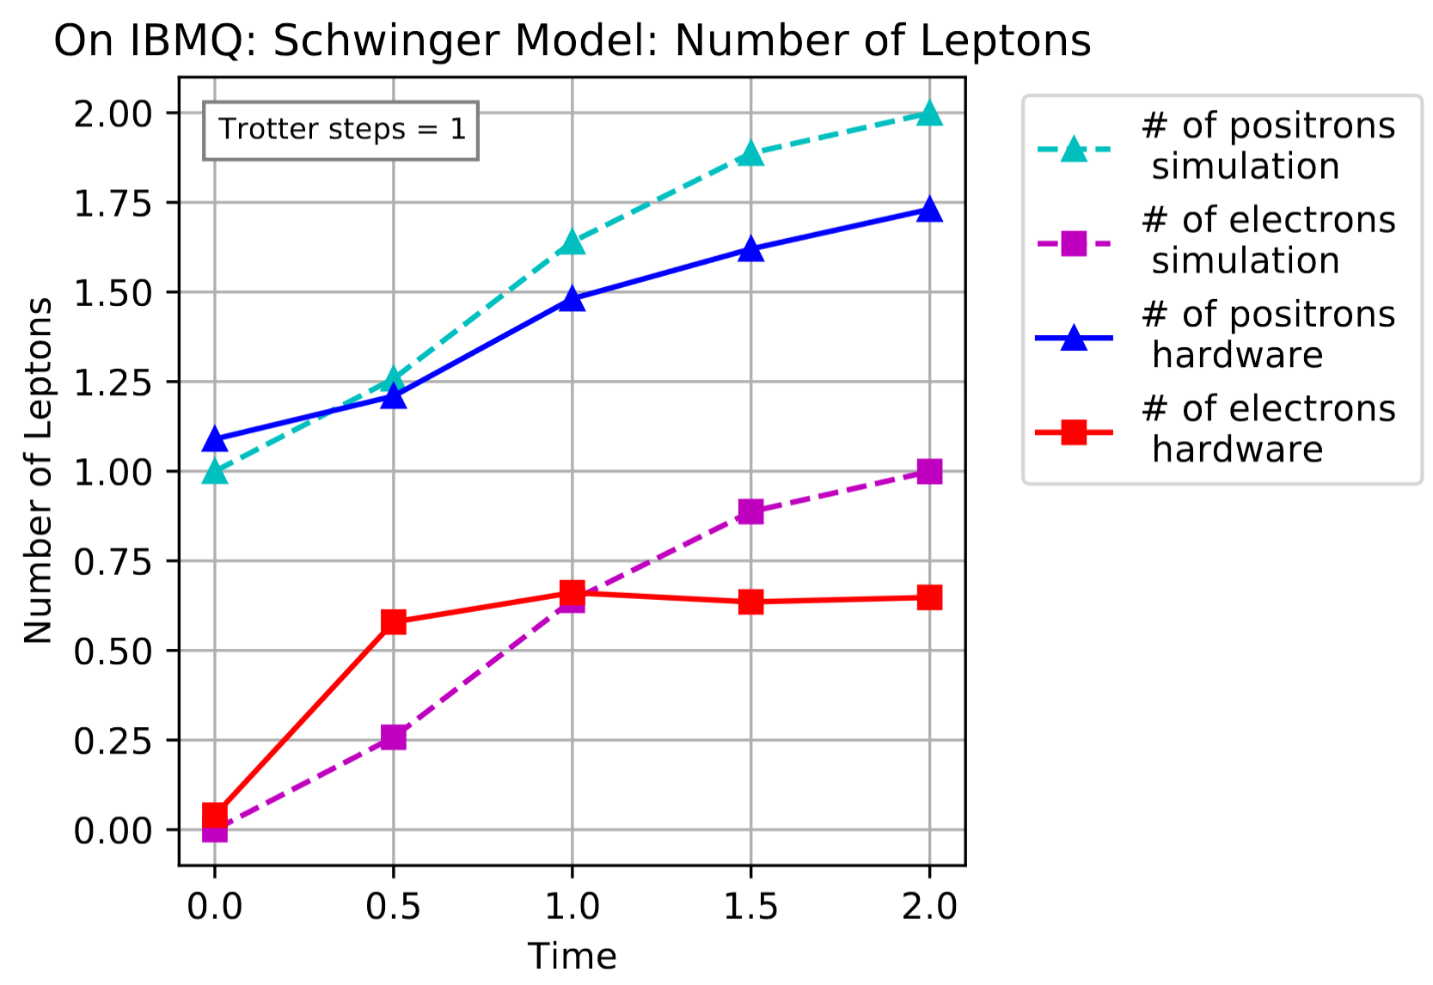
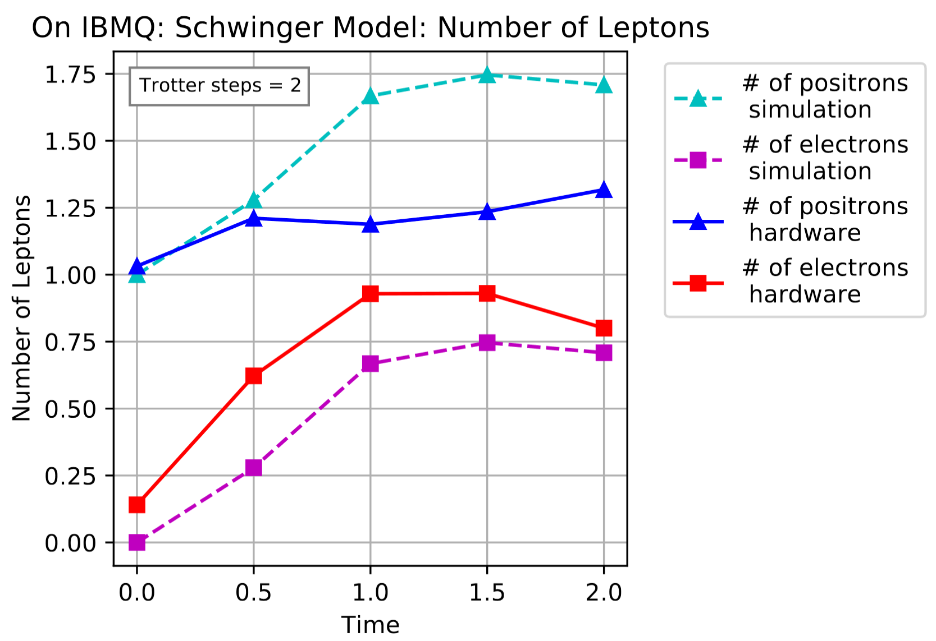
Schwinger Model Time Evolution Simulation

Slide 11
References
Martinez, E. A.; Muschik, C.; Schindler, P.; Nigg, D.; Erhard, A.; Heyl, M.; Hauke, P.; Dalmonte, M.; Monz, T.; Zoller, P. & Blatt, R. Real-time dynamics of lattice gauge theories with a few-qubit quantum computer https://arxiv.org/pdf/1605.04570.pdf
Tacchino, F.; Chiesa, A.; Carretta, S. & Gerace, D. Quantum computers as universal quantum simulators: state-of-art and perspectives https://arxiv.org/pdf/1907.03505.pdf
Qiskit: An Open-source Framework for Quantum Computing 2019

