Slide 1
Meta-Analysis of the Genes Ubiquitously Associated with Human Uterine Leiomyoma Development in Healthy Humans Using the Gene Expression Omnibus Data
Janis Corona
2019

Slide 2


Description of Uterine Leiomyoma
What is a uterine leiomyoma (UL)?
Notes:
UL are benign tumors of the myometrium of the uterus in females. Females can get more than one UL and can grow in different layers of the uterus, such as the subserosal, submucosal, and intramural layers of the uterus.
Symptoms of UL heavier than normal menstruation, irregular menstruation cycles that last longer than normal or are more frequent than a normal menstrual cycle. Other symptoms include painful cramping, and obvious abdominal growth or enlargement as the UL grows.

Slide 3
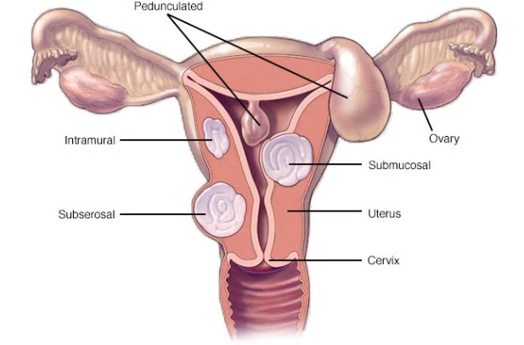
Uterine Leiomyoma in Different Uterine Layers
Mayo Clinic, 2019
Notes:
This is an image of how a UL can grow in different layers of a uterus. The submucosal layer UL projects into the uterus, the subserosal layer UL projects outwards from the uterus, and the intramural UL is in the muscle layer of the uterus.

Slide 4
Description of Uterine Leiomyoma
What are the symptoms of UL?
Notes:
Symptoms of UL heavier than normal menstruation, irregular menstruation cycles that last longer than normal or are more frequent than a normal menstrual cycle. Other symptoms include painful cramping, and obvious abdominal growth or enlargement as the UL grows.

Slide 5

Description of Uterine Leiomyoma
What are risk factors of UL?
Who can get UL?
Notes:
Female mammals such as humans and mice get UL.
Risk factors for UL include: having a low age at menarche, being of child-birthing age, being pre-menopausal, being black, being obese, drinking alcohol, and having a disease such as kidney disease, endometrial cancer in stage III or IV, and having a thyroid dysregulation.

Slide 6
Description of Uterine Leiomyoma
What is the treatment for UL?
How do UL develop?
Notes:
Treatment for UL involves an estrogen analogue to inhibit gonadotropin hormone production such as Leuprolide, or an estrogen antagonist like cetrolexin to compete with the estrogen binding sites on a UL. These all stop the UL from growing, but the only treatment to end the symptoms of UL is a myomectomy or a hysterectomy. Removal of the UL (myomectomy) does not keep the UL from coming back.
UL development is still being researched, but there are six genes ubiquitous to the UL risk within populations.

Slide 7
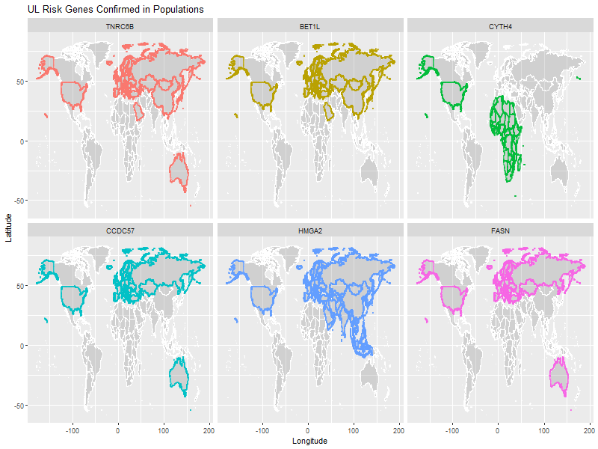
UL Risk in Population Studies: TNRC6B, BET1L,and CYTH4 as Top UL Risk Genes
R, version 3.6, 2019
Notes:
TNRC6B: UL risk factor for all above, but also associated with volume or the size of the UL in Chinese and European Americans.
BET1L: UL risk factor for all above, but also associated with the number of fibroids in Chinese and the location of the fibroid as either sub, sera, or intra-mucosal of the uterus in European and European Americans. CYTH4: UL risk in AA populations.

Slide 8
UL Risk in Population Studies: CCDC57, HMGA2, and FASN as Next Best UL Risk Genes
R, version 3.6, 2019
Notes:
FASN: UL risk in EA, Austr., Icelandic, and other Europeans.
CCDC57: UL risk for EA, Austr. , Icel., other Euro.
HMGA2: same as other two

Slide 9
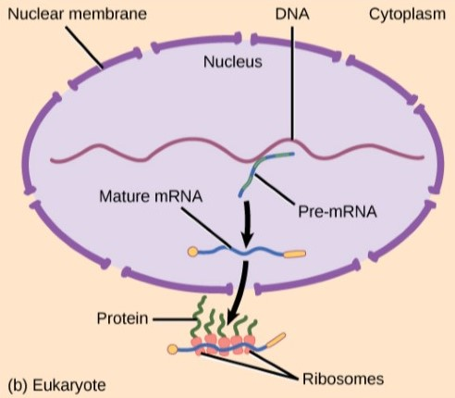
Gene Regulation: Transcription and Translation
Rye, Wise, Jurukovski, DeSai, Choi, & Avissair (2017) Biology: OpenStax
Notes:
Gene translation: Outside of the nucleus after transcription of RNA is exported from nucleus to the cytoplasm of the cell, ribosomes translate RNA to proteins, cis-acting elements, promotors of genes, repressors of genes, 5’ to 3’ translation region, recoil by RNA binding proteins upstream, downstream, along coding region, millions of base pairs away, external stimuli effects gene expression.

Slide 10
Gene Regulation: Gene Expression
What affects gene expression of RNA?
Where can the gene expression of RNA be influenced?
Notes:
Gene expression can be affected by heat, UV light, environmental disturbances, chemical disturbances, and other stresses.
Gene expression of RNA can be influenced from transcription throughout translation during any of those processes. Gene expression of the microarray samples across UL and non-UL samples could indicate some gene targets for treating or further researching UL risk to begin alternative therapies to treat UL symptoms or prevent UL pathogenesis from occuring.

Slide 11
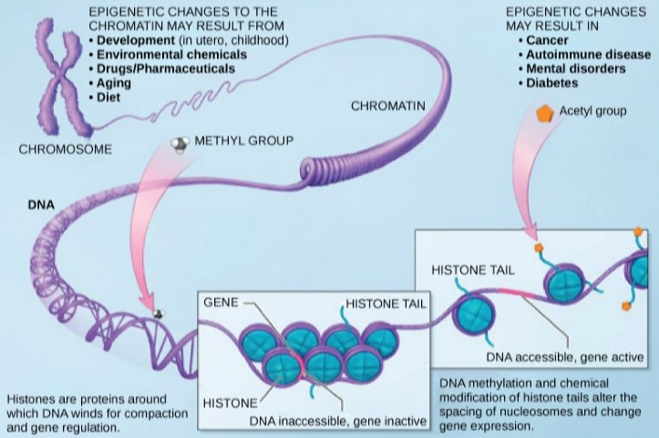
Gene Regulation: Transcription
Rye, Wise, Jurukovski, DeSai, Choi, & Avissair (2017) Biology: OpenStax
Notes:
Gene transcription: Each of 23 chromosomes is tightly packed into the nucleus of every cell in the body, when it becomes unwound it is for gene duplication. Gene expression is altered so that DNA in every chromosome is able to be duplicated in the body as needed. Stresses from the environment can cause changes in more or less production of a gene to maintain health or in response to stress. There is a forward and a reverse strand in DNA that genes reside paired by their nucleotide base pairs. Some genes can be millions of base pairs away from other genes and interact in transcription. The gene is duplicated in the cytoplasm once the ribosomes copy the DNA genes needed and export it from the nucleus of the cell to the cytoplasm of the cell where it can be translated from mRNA into RNA. RNA expires if it is in the cytoplasm, and excess gene production can be caused by transcription in the nucleus creating more mRNA of RNA marked to expire soon.

Slide 12
Gene Expression through Linkage Disequilibrium
What is linkage disequilibrium (LD)?
Notes:
During the process of gene expression there are opportunities in transcription where genes upstream or downstream from right next to the gene to up to millions of base pairs away from a target gene where the DNA being transcribed into RNA can recoil onto itself and produce or inhibit production of genes. RNA binding proteins inside the nucleus transcribing the RNA can bind to more genes that they are associated with when the chromatin is loosened around the histones making the nucleosomes accessible. Many studies have investigated this linkage disequilibrium (LD) and looked at either neighboring genes along the chromosome, or chromosomes with LD scores above a certain threshold. LD is The non-random association between alleles at different loci that don’t follow the same statistical associations if the alleles were sampled independently and randomly based solely on allele frequency. LD analysis is important to finding peaks in loci of genes on chromosomal regions with genes that have been significantly associated with other diseases making it possible to link genes having pathogenesis to UL

Slide 13
Objective of this Research
Uncover whether gene expression results can lead to gene targets in the UL samples compared to non-UL samples using the cytoband locations of the six UL risk genes and the universe of all genes to find the genes with the most change in mean values, and fold change.
Uncover any relationships by cytoband, majority of genes expressed per cytoband that UL risk gene resides, show the data of 10 genes with most change in cytoband locations of six UL risk genes and adding those genes
Compare this data set of results to other scenarios of gene expression data to draw a conclusion as to whether gene expression data is accurate in using to find gene targets that can predict UL, thus prove associated with UL pathogenesis in some manner
Notes:
Gene expression is a result of changes at the transcription or translational process of protein creation and is a result of stress in the environment.
Current UL risk studies have examined gene expression data and found gene targets to be TNRC6B, BET1L, HMGA2, CYTH4, CCDC57, and FASN as hereditary determinants of UL predisposition and as targets of UL pathogenesis. Not all these genes are significant for UL risk in each population.

Slide 14
Objective of this Research
Does gene expression data lead to gene targets in UL risk and UL pathogenesis?
Seek out a way to find a relationship between genes originating from the same cytobands as the UL risk genes and expand to the universe of all genes
Use machine learning on the data derived from these scenarios to test UL prediction of gene targets discovered
Confirm if gene expression data of the six UL risk genes is enough to predict UL in a UL sample that is not from a specific population study
Notes:
Gene expression is a result of changes at the transcription or translational process of protein creation and is a result of stress in the environment.
Current UL risk studies have examined gene expression data and found gene targets to be TNRC6B, BET1L, HMGA2, CYTH4, CCDC57, and FASN as hereditary determinants of UL predisposition and as targets of UL pathogenesis. Not all these genes are significant for UL risk in each population.

Slide 15
Methods: Genes Belonging to Same Cytoband Locations as Six Genes Ubiquitous to UL Risk Studies Isolated
All GEO data combined from five studies in R
There were a total of 12,173 genes in common after removing duplicates
This became 130 genes after removing those not in neighborhood of UL risk genes
Notes:
The data was filtered to only include the cytoband locations of the genes in question so that a neighborhood marker of those genes could be used as predictors in predicting UL samples using machine learning, and to map out those genes on the chromosomes of the genes ubiquitous to UL risk studies.

Slide 16
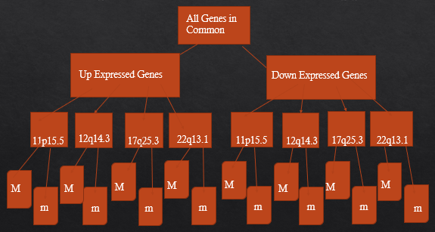
Methods: Gene Cytoband Locations of the Six Genes Ubiquitous to UL Risk Studies Mapped Out
M
m
m
m
Notes:
That data set of 130 genes that reside in the same cytoband locations as the six ubiquitous genes was made, then divided into subsets of genes up or down regulated in UL, then further divided into subsets in the up or down group of each chromosome by being a part of the majority (M) of genes that are expressed more or up regulated in UL compared to non-UL samples or the minority (m).
Gviz was used to develop visualizations showing the locus of genes and the neighboring genes along chromosomal links of each of the six ubiquitous gene’s cytoband address in the chromosome. These images show only those genes in the subset of 130 genes and if the gene of the six genes belonging to chromosomes 11, 12, 17, or 22 are in the majority or minority of genes expressed in UL samples for that chromosome.

Slide 17
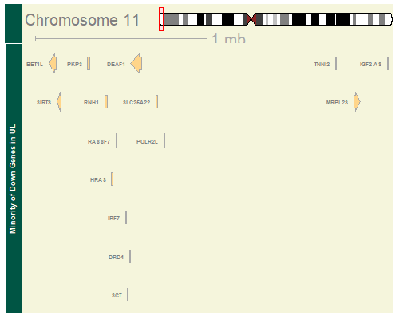
Results: Gviz Map of Genes Over-expressed as a Minority of Genes on Cytoband p15.5 of Chromosome 11
Notes:
These genes show BET1L on chromosome 11 as being part of the minority of genes on this chromosome that were over-expressed in UL compared to non-UL samples. Some genes have arrows pointing left to show they are on the reverse strand, others point right to indicate they are on the forward strand, and some don’t have any arrows because the width of the gene is too small for Gviz to place in the same window size on the chromosomal layout map. The chromosomes each have a forward and reverse strand. This map shows which strand each gene is on the chromosome when being transcribed to exit the nucleus. Gene expression is done in the nucleus on the chromosome when stress or environmental influences loosen up the chromatin along the chromosome and bind to the nucleotide sequence of the gene to create more of it or bind to it to suppress it and keep the gene from being expressed. BET1L is on the reverse strand of chromosome 11 and it is being expressed more in UL, but it is also a part of the group of genes that are in the minority of genes on that chromosome that change in UL. The majority of genes on chromosome 11 that change in UL are under expressed in UL compared to non-UL samples. BET1L and these genes are expressed more in UL than non-UL samples and marked as being part of the minority of genes that change expression values on chromosome 11. There could be a connection between UL and non-UL tissue by looking at how certain genes that change in UL don’t change expression values the same as other genes. This could indicate that BET1L is being expressed more because other genes aren’t recognizing BET1L as a gene that is linked to harmful UL pathogenesis. Some population studies have shown BET1L creates more UL in Chinese patients and show a UL location in the uterus in one of three layers of the uterus of European Americans (Liu et al., 2018; Edwards, et al., 2013).

Slide 18
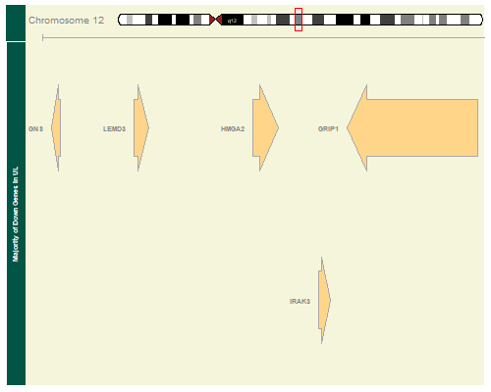
Results: Gviz Map of Genes Under-expressed as a Majority of Genes on Cytoband q14.3 of Chromosome 12
Notes:
There weren’t many genes on Chromosome 12 in common between those UL and non-UL samples. But HMGA2 is part of the majority of genes that as a whole were under-expressed in UL samples compared to non-UL samples. The majority of genes expressed in UL compared to non-UL on chromosome 12 show that most of these genes are expressed more in UL. Since HMGA2 is also expressed more in UL on chromosome 12 it has been categorized as part of the majority of genes being expressed differently in UL than non-UL samples. HMGA2 was found to have properties related to UL risk in Europeans and European Americans in cell cultures that involved translocation of sequencing on chromosome 12 (Hodge, et al., 2012). This gene is part of the forward strand as indicated by the arrow pointing right and the size of the arrow indicates it spans more base pairs of nucleotides than the other genes to it’s left. That this gene is under-expressed in UL compared to non-UL samples shows it has potential as a gene target of UL pathogenesis.

Slide 19
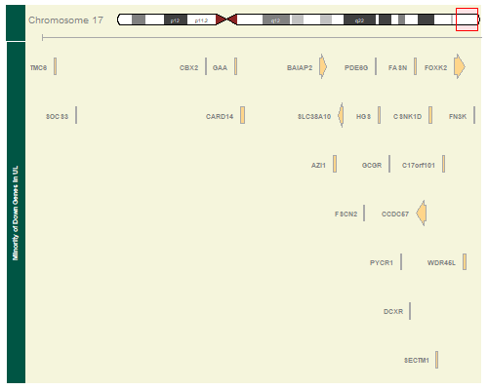
Results: Gviz Map of Genes Under-expressed as a Minority of Genes on Cytoband q25.3 of Chromosome 17
Notes:
FASN and CCDC57 are in the same linkage block of cytoband q25.3. FASN doesn’t have a large enough span in width to be imaged with an arrow pointing at the reverse or forward strand of Chromosome 17. But CCDC57 does have a large enough span of nucleotides to provide an arrow indicating which strand of Chromosome 17 it is. CCDC57 points left indicating it is on the reverse strand of Chromosome 17. The data table for FASN shows that this gene also points left indicating FASN is also on the reverse strand. Because most genes on Chromosome 17 are over-expressed in UL compared to non-UL, and CCDC57 and FASN are on Chromosome 17 but expressed less in UL compared to non-UL samples, they are part of the minority of genes showing changes in UL.

Slide 20
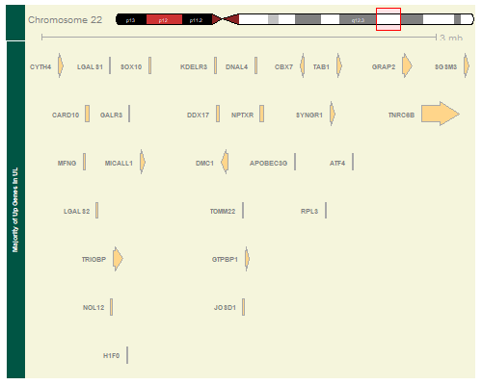
Results: Gviz Map of Genes Over-expressed in UL as a Minority of Genes on Cytoband q25.3 of Chromosome 22
Notes:
Two of the genes ubiquitous to UL risk are CYTH4 upper left of image and TNRC6B in the upper right of image in cytoband q.13.1 of chromosome 22. Many genes between these two genes, but all are expressed more in UL compared to non-UL samples as a majority of the genes on chromosome 22. The majority of genes expressed differently in UL compared to non-UL samples are over expressed, while the genes being expressed less on Chromosome 22 in UL are part of the minority of genes showing changes in gene expression in UL samples. The width or span of the genes along Chromosome 22 is wide enough for Gviz to draw an arrow in the window. The arrow points right for both genes, indicating that both genes are on the forward strand of Chromosome 22. If they pointed left, this would indicate the genes were part of the reverse strand of Chromosome 22. Some genes in the image have no arrow because they don’t span enough nucleotide base pairs to draw an arrow in the window size available.

Slide 21
Methods: A Lattice Pairwise Comparison of Genes Expressed Least or Most in UL by Cytoband Location
The R package lattice was used for the splom() on data belonging to those up or down expressed and further divided by those in the group majority of gene expression changes in UL
Notes:
A lattice R package ‘splom()’ plot was created for no more than four genes at a time for divisions of up or down expressed further divided into those groups by being a part of the majority or minority of genes expressed.
Could the genes on each group in the minority or majority of genes on each cytoband location of the six genes ubiquitous to UL risk studies have a correlation to other genes in the same group they belong?

Slide 22
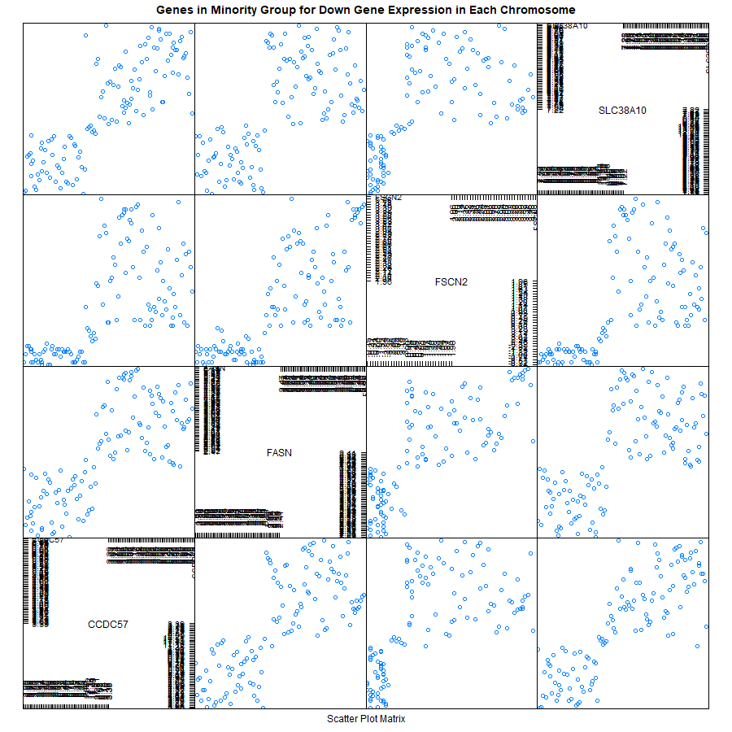
Results: A Lattice Pairwise Comparison of Chromosome 17 Minority of Genes Expressed Least
Notes:
A lattice R package ‘splom()’ plot showing four of the genes least expressed in UL on chromosome 17. Two of the ubiquitous genes, FASN and CCDC57 are listed. The scatters outside of the 45 degree diagonal indicate differences between gene expression values. No real patterns, as medium to high values of FASN for FSCN2, CCDC57, and SLC38A10 show expressions of also medium to high. Many of the splom pairwise comparison plots produced similar results that couldn’t pin point visually any relationships or correlations between genes. This type of comparison wasn’t useful to targeting gene targets to UL pathogenesis.

Slide 23
Method: TOP16 Genes Data Preparation
In R, the universe of all genes in common were filtered for those genes only along the same cytoband location as the six ubiquitous genes,
Notes:
The method for grabbing the top 10 differentially expressed genes by magnitude and adding the six genes ubiquitous to UL risk studies was to build a data table that would show how well the six ubiquitous genes compare to the genes along the same cytoband location they reside to see if they can produce good machine learning results on predicting a sample as UL or not. A total of 130 genes reside in the same cytoband locations as the six genes ubiquitous to UL risk studies from a universe of 12,173 genes in common.

Slide 24
Method: TOP16 Genes Data Preparation
UL Means
Non-UL Means
Difference in Means
Magnitude of Difference in Means.
Notes:
The R package dplyr created new fields for UL and non-UL means of the subset of 130 genes common to the same cytoband locations as the six ubiquitous UL risk study genes and including those six genes. The difference in the two as Differentially Expressed, and the magnitude of those values were two additional fields added, so that when ordering most to least expressed, those genes having very low expression weren’t discarded.

Slide 25
Method: TOP16 Genes Data Preparation
The ten most differentially expressed in magnitude were selected
The six genes ubiquitous to UL risk added
The data table was then prepared for machine learning in R by rearranging the samples as observations and genes as columns while also removing non-numeric field and adding a TYPE field for if the observation is UL or non-UL to test the machine learning algorithms on.
Notes:
The gene ID field was saved as a vector of 130 genes as character values to be the column names of the data table once transposed. The fields other than the sample ID were removed and ordered to be the first 51 non-UL samples and the next 70 samples of UL from the total set and labeled with ‘ul’ at the end by sample type. This table was transposed so that it had 121 samples as row observations and 130 genes as column values after relabeling the header names with the Gene ID names saved first. Then a field was added labeled ‘TYPE’ that indicated whether the sample was a non-UL or UL sample by using a data frame vector to repeat ‘nonUL’ 51 times, then add to it a data frame vector of ‘UL’ repeated 70 times. This produced a machine learning data table that was 121 samples as rows by 131 columns for the 130 genes and 1 TYPE field of UL or non-UL.

Slide 26
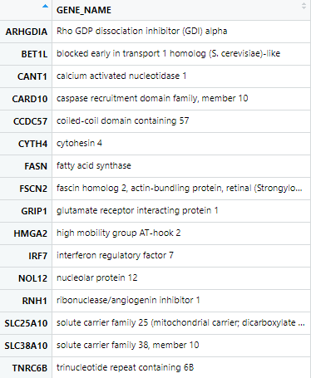
Results: TOP16; Top 10 Genes of Highest Magnitude of Change in UL and the 6 Genes Ubiquitous to Current UL Risk Studies

Slide 27
Methods: Discover if Majority Plays a Role in UL Pathogenesis by Comparing Simulated UL and Non-UL Means of TOP16 Genes
Does being a part of the majority of genes expressed differently in UL show if each gene of the six genes ubiquitous to UL risk studies is a phenomenon to the genes that change the most in UL tissue compared to non-UL samples?
A bootstrap simulation of the TOP16 genes was made using R
A plot of the TOP16 was made to show where each gene is as a color aesthetic for being a part of the majority or not
Notes:
Since gene expression changes in UL are significant for being inhibited more or expressed more, how well could the data set of the ten most expressed genes and the six genes ubiquitous to UL risk studies show why these six genes are or are not part of the majority of genes that express less or more in UL?

Slide 28
Method: TOP16 Genes with Simulated Means Data Preparation
Bootstrap simulated results were done to each of these 16 genes
Notes:
Bootstrap results, time consuming to do for each UL and non-UL of each gene with standard errors, were added to the data of TOP16 Genes.
This was to see how well these samples could represent the population of genes in UL and non-UL samples.

Slide 29
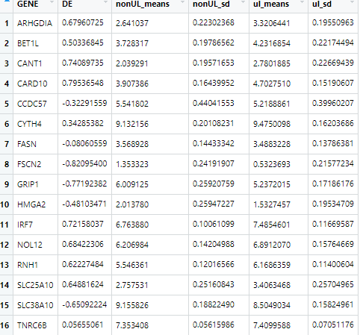
Results: Table of Simulated Means of TOP16, Differential Expression, and Standard Errors
Notes:
This is a table of those 16 genes in the TOP16 after running bootstrap simulations on each gene for the UL and the non-UL means, the difference in means (DE), and the standard error (sd).

Slide 30
Method: TOP16 Genes with Simulated Means Histograms Produced Each
Histograms of each of the TOP16 Genes Simulated Means was made
Notes:
Histograms to show how symmetric each of the TOP16 genes were in the population using the Bootstrap simulated means in R was done, to lead up to how well these genes would be as predictors of UL

Slide 31
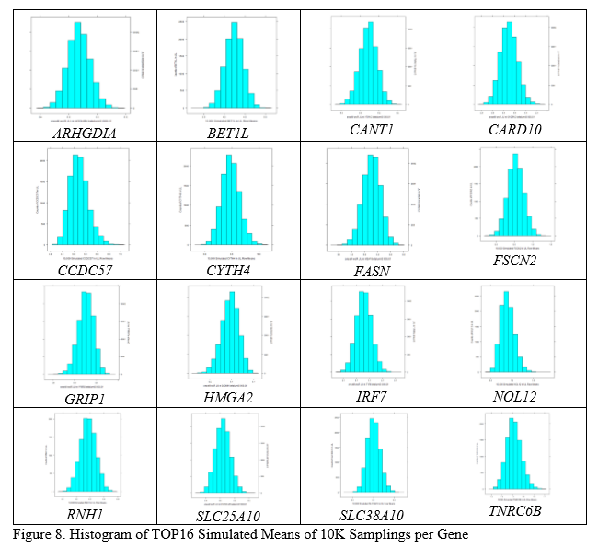
Results: Histograms for Each TOP16 Gene’s Simulated Means for the Population
Notes:
Most of the TOP16 (10 most DE+6 ubiquitous genes) are symmetrical, but some are skewed where the median is on the right or left of the mean making the tail point the opposite direction, such as with GRIP1 it is left skewed (third moments) having the median on the left of the mean and BET1L is almost perfectly symmetrical.

Slide 32
Methods: Use ggplot2 of TOP16 Genes as Majority or Not that Compares UL to Non-UL Simulated Means
Use of majority grouping as decision for TOP16 genes being good gene targets for UL pathogenesis
Notes:
Create a visualization that could help decide if there are some gene targets in the majority or minority of genes in the TOP16 genes when comparing UL and non-UL simulated means of the population.

Slide 33
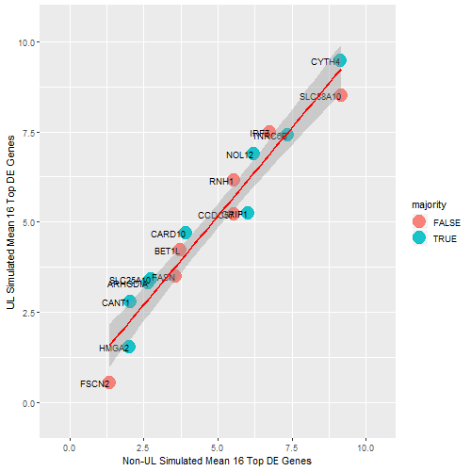
Results: Plot in ggplot2 of TOP16 Genes as Majority or Not When Comparing UL to Non-UL Simulated Means
Notes:
The 10,000 simulated means from bootstrap sampling on the TOP16 genes is shown comparing the x-axis of non-UL means to the y-axis of UL means for each of the 16 TOP16 genes. A categorical factor for whether the gene is a part of the majority (blue) or not (red) was added to show that most of the genes (9) are part of the majority, but the other minority (7) are close to the best fit linear regression line between the simulated means of the UL and non-UL genes. The TNRC6B and BET1L genes are confirmed UL risk gene targets, but BET1L is part of the minority of genes being expressed on its cytoband location, and it is expressed more in UL simulated results than non-UL simulations. TNRC6B is equally expressed in both and part of the majority of genes expressed on it’s cytoband location.
This result didn’t provide much to the table on whether or not these genes and other top expressed/inhibited genes are UL risk targets. No meaningful relationship can be developed from looking at the simulated means of each type and whether the gene is part of the majority of genes being expressed differently in UL.

Slide 34
Method: Visualize How the UL and Non-UL Means Compare for TOP16 genes
A visualization would be great to see how these TOP16 genes simulated means compare by chromosomal location.
Notes:
A visualization of the TOP16 genes by chromosomal location was needed to see how the simulated means of the UL and non-UL means compare, and to see where each of the chromosomal genes is above or below the line in comparison. This was to see if there was an indication of chromosomal location being higher in magnitude of change for UL than non-UL in the population based on this sample.
This would show that there is a good reason to look further into these chromosomes and uncover whether some other genes in the same neighborhood of these genes play a role in UL pathogenesis.

Slide 35
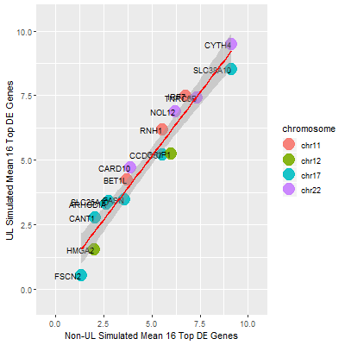
Results: Plot Using ggplot2 showing TOP16 Genes and the Chromosome Each Lives Comparing Simulated UL and Non-UL Means of Each Gene
Notes:
This plot was made using ggplot2 in R. It shows the 16 genes of 10 most DE and 6 ubiquitous genes to UL risk studies in the subset of 130 genes living in the same cytoband locations as the six ubiquitous genes, or the TOP16 genes for short. All of chromosome 11 and 22 genes have higher expression means than the non-UL means from the 10,000 simulations and all genes on chromosome 12 have higher non-UL simulated means than UL means. Chromosome 17 shows simulated means mixed for UL and non-UL means.
True results show that these same four genes of chromosome 17 were expressed less than UL from the Gviz image of Chromosome 17 in Results.
This result of the simulated means between UL and nonUL samples would point to FSCN2 as a possible gene target for UL pathogenesis because it is expressed more in non-UL than UL for the simulated population means. This could mean it is inhibited in UL and is either a defense the body uses to stop producing as much FSCN2 or is not produced as much because some other gene is blocking it’s production.

Slide 36
Methods – Machine Learning Algorithms
The data sets that were derived were then each trained (70 per cent of samples) and tested (30 per cent of samples) using seven machine learning algorithms in R, and a combined model
Latent Dirichlet Allocation method of caret package in R (LDA)
Random Forest method of caret package in R (RF)
Generalized Boosted Regression Models method of caret package in R (GBM)
Random Forest package in R called randomForest (RF2)
K Nearest Neighbor (KNN) method of caret package in R
Recursive Partitioning and Regression Trees (Rpart) from the rpart package in R
Generalized Linear Regression Model (GLM) from the MASS package in R
Combined Model using the ‘gam’ method in caret package of R on all seven algorithms above
Notes:
These algorithms are produced in R, mostly with the caret package. The LDA method is a collapsed Gibbs sampling method, the RF and RF2 algorithms use a decision tree method to classify samples categorically, the GBM model uses the Adaboost and gradient boosted regression models that rely on least squares, logistic, poisson, quantile, multi-nomial logistic, and t-distribution loss methods. The K Nearest Neighbor uses the centroid of groups of data as unsupervised data points or non-categorized data to keep samples in the group of other samples closest to their characteristic groupings. The Rpart method uses decision trees by recursive partitioning of the data. GLM is a generalized linear regression model. The combined model uses the outcomes from all algorithm results as a dataframe to select the most frequent prediction or best prediction.

Slide 37
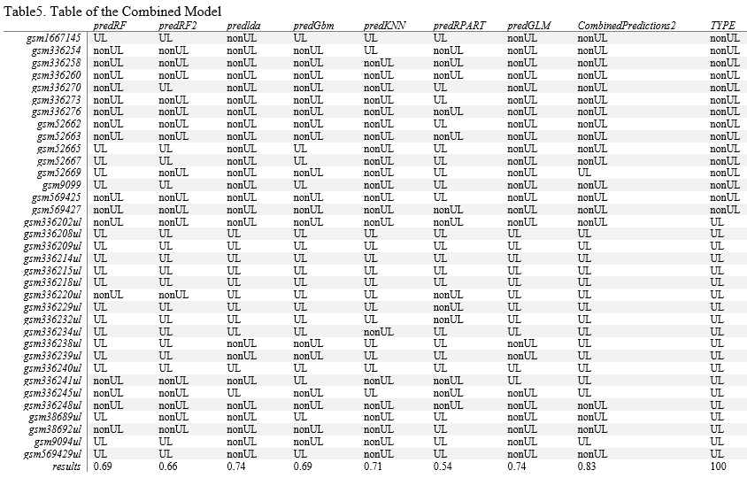
Results: Machine Learning TOP16 Outcomes
Notes:
Results above are for the TOP16 genes in the subset of 130 genes belonging to the same cytoband locations as the six genes ubiquitous to UL risk studies. The combined prediction model scored the best with an accuracy of 83 per cent and the next best algorithm is the LDA with a score of 74 per cent accuracy in predicting UL or non-UL for the TYPE of sample. The furthest left column is the sample name in GEO. The last column is the true value of the sample as UL labeled ‘UL’ or non-UL labeled ‘nonUL.’ The header is the name of the algorithm used in R. predRF is the caret random forest, predRF2 is the randomForest package, the predlda is the caret Latent Dirichlet Allocation algorithm, the predKNN is the K-nearest neighbor algorithm in caret, the predRPART is the recursive partitioning and regression tree algorithm in the rpart package, the predGLM is the generalized linear model of MASS package, and the CombinedPredictions2 is the caret packages best results of all algorithms used in R.

Slide 38
Methods – Data Sets Derived from 130 Genes Common to Cytobands of UL Risk Studies
DE16_most_130_results
Highest magnitude of change in expression/inhibition in UL from cytobands of six genes ubiquitous to UL risk studies
Machine learning used the same on this data set as done on the TOP16 genes to compare different genes in the machine learning algorithms and exclude some genes from being UL target genes
Notes:
GEO data from five studies on UL risk analyzed and combined to one set of 12,173 genes universally in common. Then, this data set was then used to gather a subset of 130 genes that are in common among the five studies but also only on the same chromosomal locations as the six genes ubiquitous to UL risk in current studies. All data sets had the same fields for means, magnitude, but also fold change added other than the first dataset, TOP16. The same machine learning methods were applied to each to convert observations to samples and columns as genes, while adding the TYPE category for UL or non-UL when using the algorithms to predict. This was to see if there were other ways of predicting UL, and using gene expression in general for most fold change or magnitude of change, regardless of the UL risk genes already identified in UL risk studies. Partitions were made of this data so that 70 per cent was trained on the model, and the other 30 percent of the samples was used to test the models in identifying if the sample is a UL or non-UL accurately.
"FSCN2" "CARD10" "GRIP1" "CANT1" "IRF7" "ARHGDIA" "NOL12"
### "SLC25A10" "SLC38A10" "RNH1" "SYNGR1" "TALDO1" "FN3K" "POLR2F"
### "LLPH" "SMCR7L"

Slide 39
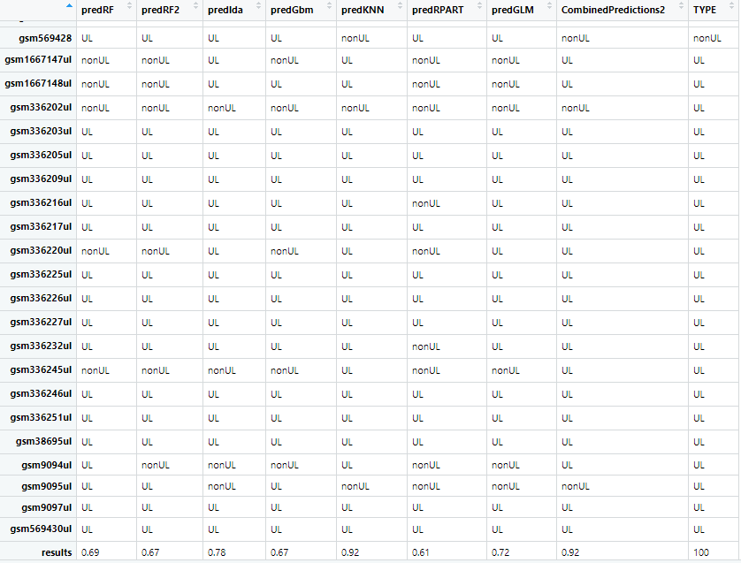
Results – DE16_most_130_results
Notes:
The results using highest expression/inhibition of subset 130 cytoband genes was 92% combined and best of 92% using KNN, this leads to belief there are some good gene targets in this set that don’t include the 6 genes ubiquitous to UL risk studies. Shows some other genes in the cytoband location also associate to UL risk in some way.

Slide 40
Methods – Overview of Data Sets Derived from 130 Genes Common to Cytobands of UL Risk Studies
DE16_least_130_results
Use as a limit of machine learning algorithms to see if the genes expressed/inhibited the least in UL also do well in predicting UL with the machine learning algorithms used
Machine learning used the same on this data set as done on the TOP16 genes to compare different genes in the machine learning algorithms and exclude some genes from being UL target genes
Notes:
The least DE were used in UL to non-UL to test if the machine learning algorithms were just good on all genes or are worse as expecting for the genes with the least change in UL to non-UL.
"PSMD13" "DNAL4" "ATHL1" "CDHR5" "SIGIRR" "MRPL23" "FOXK2"
### "RASSF7" "SIRT3" "GRAP2" "AATK" "TH" "TMEM184B" "WDR45L"
### "KDELR3" "GCGR"

Slide 41

Results – DE16_least_130_results
Notes:
The least DE of subset 130 genes in cytobands scored poorly as expected, with a combined score of 72% and best score of 58% using rpart. Not a good choice to use as UL risk gene targets.

Slide 42
Methods – Overview of Data Sets Derived from 130 Genes Common to Cytobands of UL Risk Studies
FOLD16_130_results
Fold change added to get the 16 genes with the most fold change in the cytobands of the six ubiquitous genes, including those six genes
Machine learning used the same on this data set as done on the TOP16 genes to compare different genes in the machine learning algorithms and exclude some genes from being UL target genes
Notes:
The cytoband 130 genes having the most fold change and including the top 6 ubiq genes is used to test UL risk gene targets
"CANT1" "ARHGDIA" "SLC25A10" "ATF4" "CARD10" "MRPL12" "BET1L" "RNH1" "NOL12" "IRF7" "DRD4" "TNRC6B" "CYTH4" "CCDC57" "FASN" "HMGA2"

Slide 43

Results – FOLD16_130_results
Notes:
The fold change results from the cytoband genes of 130 showed a combined score of 78% with the best score of 72% for GLM and LDA. Algorithms. This isn’t good enough to use as predictors for these genes.

Slide 44
Methods – Overview of Data Sets Derived from 130 Genes Common to Cytobands of UL Risk Studies
majority_10_results
This data set was used from the top 5 expressed and top 5 inhibited genes in the cytoband genes subset of 130 to use as a measure against the TOP16 genes in predicting UL
Machine learning used the same on this data set as done on the TOP16 genes to compare different genes in the machine learning algorithms and exclude some genes from being UL target genes
Notes:
The majority 10 are the 5 up and 5 down expressed in the majority, excluding the 6 genes and the minority
"GRIP1" "TALDO1" "ASCL2" "HMGA2" "PNPLA2" "CARD10" "CANT1" "ARHGDIA" "NOL12" "SLC25A10"

Slide 45

Results – majority_10_results
Notes:
The predictors in the subset of cytoband genes for majority expressed most scored 83% combined, and 81% best using GLM and LDA. These could be decent predictors for UL risk, but there could be better predictors in the other data sets of genes tested.

Slide 46
Methods – Data Sets Derived from the Universe of All Genes in Common
The data sets that were derived to test the best machine learning results for UL prediction on the 12,173 universe of genes in common (none include the six UL risk genes):
universe16_fold_results
universe16_DE_most_results
universe16_DE_least_results
Notes:
GEO data from five studies on UL risk analyzed and combined to one set of 12,173 genes universally in common. The same means, magnitude, and additional fold change field was added as all the 130 gene data sets excluding the TOP16 data set. The data was transposed like all other data sets to make them each ready to be analyzed with machine learning algorithms. Where a 70 per cent partition trains the data on that model, and the remaining 30 per cent of data is used to test if the sample is UL or not using the added TYPE field to the header of genes when transposed with the samples as observations.

Slide 47
Methods – Data Sets Derived from the Universe of All Genes in Common
universe16_fold_results
Notes:
Those genes having the most fold change in all the genes in common are used as predictors in a data set with the same training/testing ratio of 70/30 from the samples.
"HSPB1" "DSTN" "S100A6" "CNN1" "ACTG2" "VIM" "SPARCL1" "TPM2" "ACTA2" "PCP4" "TAGLN" "DES" "RAMP1" "CYR61" "UBC" "ACTB"

Slide 48

Results –universe16_fold_results
Notes:
The results of those genes having the most fold change in all 12,173 genes in common between UL and non-UL samples showed a combined model score of 92 per cent accuracy and the best model scored 86% for RF, RF2, LDA, KNN, and Rpart. These genes are good gene target to use in UL risk.

Slide 49
Methods – Data Sets Derived from the Universe of All Genes in Common
universe16_DE_most_results
Notes:
The genes inhibited/expressed most in all genes excluding top 6 ubiquitous genes is used as a predictive model data set to test how well these predictors score.
"HSPB1" "DSTN" "S100A6" "CNN1" "ACTG2" "VIM" "SPARCL1"
### "TPM2" "ACTA2" "PCP4" "TAGLN" "DES" "RAMP1" "CYR61" "UBC" "ACTB"

Slide 50

Results –universe16_DE_most_results
Notes:
The most expressed/inhibited genes in all genes of 12,173 in common comparing UL to non-UL samples showed a combined model score of 86 per cent, and the best model of LDA scored 81%. These are good gene targets to use for the samples.

Slide 51
Methods – Data Sets Derived from the Universe of All Genes in Common
universe16_DE_least_results
Notes:
This is the universe of 12,173 genes in common that are expressed the least and made ready for machine learning with the same 70-30 training/testing ratio of the samples tested in each of the machine learning algorithms used on the TOP16 data set.
“USP32P2" "RCVRN" "SYNGR3" "MORC1" "KLK2" "SUV39H1" "LIG4"
### "KLHDC4" "GRIK4" "FABP1" "TLX3" "LAMB4" "DNTT" "VN1R1" "LEFTY1"
### "C7orf64"

Slide 52

Results –universe16_DE_least_results
Notes:
The least expressed in all genes comparing UL to non-UL samples showed 58% accuracy using rpart as the best algorithm, but a combined model score of 75% accuracy. There is not a need to consider any of the least expressed genes as gene targets for UL pathogenesis.

Slide 53
Methods: Machine Learning All Data Set Outcomes
The next analysis method used a table to compare the various data sets used in each of the machine learning algorithms used on the TOP16 gene results earlier
To do this the results of each of the eight data tables were extracted in R and added to one table of solely results for each algorithm
Notes:
The header to the next table is the prediction algorithm used and the first column is the name abbreviated for each type of data set used, the last column is the true value of the sample being UL or not. Anything with 130 is the subset of genes only on the same chromosomes as the six genes ubiquitous to UL risk studies, and the abbreviated names with ‘universe’ in it are the entire set of 12,173 genes in common being evaluated. None of the universal data sets or the data sets with ‘130’ genes include the six genes in question. The TOP16 and majority do include the six genes ubiquitous to UL risk studies.

Slide 54
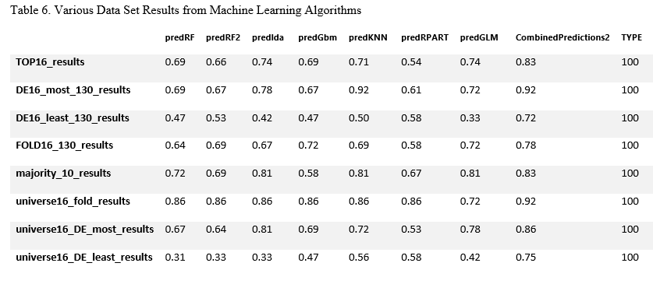
Results: Machine Learning All Data Set Outcomes
Notes:
This analysis put together all of the results of the entire study to show conclusively whether the six genes ubiquitous to UL pathogenesis studies are good predictors of UL risk by gene expression of UL compared to non-UL samples.
Results above are the results from machine learning predictions made on all data sets derived. The combined model of all seven algorithms performed best with an accuracy of 92 per cent on two separate files of data sets named DE16_most_130_results.csv and the universe16_fold_results.csv. These two data sets do not include the six genes ubiquitous to UL risk studies. Those genes having the most change in magnitude as observed in UL samples compared to non-UL samples in the DE16_most_130_results is from the subset of 130 genes in common along the same cytoband locations as the six UL risk studies’ genes. The universe16_fold_results data set is from all of the genes in the universe of genes these five GEO studies had in common having the most fold change in UL samples compared to non-UL samples. The next best data sets for best accuracy in prediction scores is from the universe16_DE_most_results with 86 per cent accuracy. It is data on the top 16 genes with the highest magnitude of change between UL and non-UL samples in the universe of combined genes between these five GEO studies. Both data sets that chose the 16 genes having the least change in magnitude scored the worst, making it likely none of these genes are suitable to associate with UL risk. The TOP16 and majority group of genes that contains five expressed more in UL and five expressed less in UL from the subset of 130 in common by cytoband location both scored 83 per cent accuracy, which is pretty good on a scale of accuracy compared to the least expressed genes.

Slide 55
Conclusions
Five studies from GEO using microarray gene expression data was analyzed to see if the six genes ubiquitous to current UL risk studies make good predictors of UL by first sub-setting the 12,173 gene data to only those 130 genes in the same cytobands as the six UL risk genes
Then, the majority of genes expressed along the same cytobands as six UL risk genes was used to see if the genes in question lead to other gene targets using chromosomal maps of the location of each gene in its cytoband majority or minority of up or down expression. No firm conclusions made. But there were many other genes in these regions
A data set of the top10 highest change genes plus the six genes ubiquitous to UL risk was made called TOP16
Bootstrap simulations of TOP16 genes made to confirm these genes represent the population well
When comparing simulated means by majority there wasn’t any noticeable relationship, but by cytoband location (chromosome) there were a few gene targets like FSCN2 far from diagonal
Notes:
The data from five different UL studies of microarray gene expression data was combined from GEO and used to derive a TOP16 data set to analyze UL risk genes by majority of expression, bootstrap simulations to show how the population looks showed good symmetry, but comparing means didn’t show any strong relationships, nor by chromosome location which was actually the cytoband location of those six genes significant for UL risk.

Slide 56
Conclusions
Seven other data sets were built and used to test whether the six genes were good predictors of UL or if the machine learning algorithms were better on the most expressed genes in the samples in fold change or DE
Results showed 83 per cent accuracy on the six genes and 10 most expressed/inhibited genes in TOP16
Results also showed 92 per cent accuracy for the most expressed genes in DE or fold change out of all genes the five studies had in common
Results also showed the least expressed genes out of all genes in DE and fold change made the worst predictors
This could mean there is a need to keep looking at the most expressed genes and to keep the six genes ubiquitous to UL risk studies as gene targets for UL pathogenesis, as only including the genes found on the same cytoband locations as the six genes ubiquitous to UL risk studies scored worse than the top genes in all chromosomes
Notes:
The data from five different UL studies of microarray gene expression data was combined from GEO and used to derive eight different data sets that could be used to determine if the six genes ubiquitous to current research studies can make an accurate prediction of a sample being UL or non-UL. When including these six genes and the next genes that were the top genes expressed in UL by most magnitude of change an accuracy of 83 per cent was achieved with a first run on a 30 per cent partition (36/121) UL and non-UL samples trained on the other 70 per cent partition (85/121).

Slide 57
Conclusions
Results also showed 92 per cent accuracy for the most expressed genes in DE or fold change out of all genes the five studies had in common
Results also showed the least expressed genes out of all genes in DE and fold change made the worst predictors
This could mean there is a need to keep looking at the most expressed genes and to keep the six genes ubiquitous to UL risk studies as gene targets for UL pathogenesis
Notes:
Results were better for most expressed and worse for least expressed universally for DE and magnitude. This indicates that gene expression makes a good approach to identifying UL risk gene targets, and that the current UL risk genes show they have enough influence to predict with good accuracy if a sample is UL or not.

Slide 58
Conclusions
Implications of this study:
This could mean there is a need to keep looking at the most expressed genes and to keep the six genes ubiquitous to UL risk studies as gene targets for UL pathogenesis. However, exclusively looking only at the genes that reside on the same cytoband location as the six UL risk genes is not better than looking at the most expressed genes in magnitude or fold change of all genes in UL.
Limitations of this study:
Some genes in the middle range of changes in gene expression in UL compared to non-UL samples were ignored, some of these genes could offer clues into UL risk.
Notes:
There is no need to rule out the six ubiquitous genes to predicting UL samples and associating with UL pathogenesis based on previous UL risk studies. The genes having the most or least gene expression in UL compared to non-UL measured by fold change or differential expression in magnitude make good predictors in machine learning algorithms. Since the best accuracy was obtained by a combined model of algorithms that involved unsupervised or non-categorical groupings (KNN) it proves the machine learning algorithms are useful for predicting outcomes in a given data set. Also, the least expressed genes do show little connection to UL risk or onset.
Testing the middle range of genes’ change in gene expression could have been done to see how well those genes closer to a mid-line of least and highest expressed genes could make for predicting UL.

Slide 59
Conclusions
Future extensions to this study:
These genes that were targeted in the data sets of all genes should be further evaluated and described in a way that could connect how these genes fill the role of UL pathogenesis.
Making a dataset of those genes that were in the K-Nearest Neighborhood of genes of each of the six genes associated with UL risk
Notes:
Testing the most differentially expressed genes and highest fold change genes in all genes was best at predicting UL and locating gene targets for UL pathogenesis. Defining the logic for how or why these gene expression changes in all data set combinations show UL risk is a further extension to this study.
These UL risk gene locations could have been selected manually so that a data set of UL risk genes and the closest neighboring genes on the same strand or opposite strand in each cytoband could have been tested to see if they make good predictors of UL, and improve the accuracy of the six UL risk genes to focus in on those genes’ cytoband address as being the real target to UL pathogenesis or not. The Gviz generated plots show what genes those are. There would be a total of 24 genes along the cytobands of UL risk genes that are closer to the location of the UL risk genes in the chromosome and not the genes most expressed/inhibited

Slide 60
Remaining Questions
It is apparent that gene expression data was able to predict up to 92 per cent accuracy of a sample being UL or not.
Studies have suggested through peak linkage analysis that certain genes along chromosomes have associations to other genes in some type of onset to disease, a thorough study of those genes SLK in Japanese by Cha et al. (2011) and THSD7B in European Americans by Aissani et al. (2015) would indicate whether these genes also play a role in UL pathogenesis?
What specific role does each gene play in UL pathogenesis if any when expressed less or more in UL compared to non-UL samples?
Notes:
The many ways that gene expression can be altered from transcription to translation mean that those genes expressed less in UL could be associated with UL pathogenesis and how the body regulates UL development by inhibiting those genes’ production. And for the genes expressed more in UL, it could mean that the body needs more of these genes to protect the body from other diseases that could be related to UL, though no current study this research encountered has observed a UL being a predisposition to later cancers or diseases. Current studies have associated diseases to developing UL but not the inverse, and also having thyroid dysfunction associate with having a UL when using CYTH4 as a gene target. It is also possible that RNA stability is off set in the post-transcription process of the gene production outside of the nucleus of the cell and the genes expressed more in UL are being expressed more because of RNA instability which could be a reason UL grow as the gene target TNRC6B is linked to many populations as doing. Much more work in UL risk gene targeting needs to be done, with more sampling, more ruling out of genes that could be associated with UL risk, more testing for significance of gene targets already established as having UL pathogenesis in some populations but not in few others. Gene expression does play a pivotal role in how our bodies protect themselves from stresses in the environment and UL development has shown that many genes do change in gene expression values in UL samples compared to non-UL samples. There is enough evidence of this in the predictive models that showed up to 92 per cent accuracy in predicting UL. There is no reason to stop screening microarray gene expression samples to find gene targets to UL risk.

Slide 61
References
Aissani, B., Zhang, K., and Wiener, H. (2015). Evaluation of GWAS candidate susceptibility loci for uterine leiomyoma in the multi-ethnic NIEHS uterine fibroid study. Frontiers in Genetics, 6, 241. DOI:10.3389/fgene.2015.00241
Bondagji, N., Morad, F., Al-Nefaei, A., Khan, I., Elango, R., Abdullah, L., ..., Shaik, N. (2017). Replication of GWAS loci revealed the moderate effect of TNRC6B locus on susceptibility of Saudi women to develop uterine leiomyomas. Journal of Obstetrics and Gynaecology, 43(2):330-338. DOI:10.1111/jog.13217
Cha, P, Takahashi, A., Hosono, N., Low, S., Kamatani, N., Kubo, M., & Nakamura, Y. (2011) A genome-wide association study identifies three loci associated with susceptibility to uterine fibroids. Nature Genetics 43(5).
Dvorská1, D., Braný, D., Danková, Z., Halašová, E., & Višňovský, J. (2017). Molecular and clinical treatment of uterine leiomyomas. Tumor Biology, 39(6). DOI: 10.1177/1010428317710226.

Slide 62
References
Edwards, T., Hartmann, K., & Edwards, D. (2013). Variants in BET1L and TNRC6B associate with increasing fibroid volume and fibroid type among European Americans. Human Genetics, 132(12). DOI:10.1007/s00439-013-1340-1
Eggert, S., Huyck, K., Somasundaram, P., Kavalla, R., Stewart, E., Lu, A., … Morton, C. (2012) Genome-wide linkage and association analyses implicate FASN in predisposition to uterine leiomyomata. American Journal of Human Genetics, 91(4), 621–628. DOI: 10.1016/j.ajhg.2012.08.009
Hellwege, et al. (2017) A multi-stage genome-wide association study of uterine fibroids in African Americans. Human Genetics, 136(10), 1363–1373. DOI:10.1007/s00439-017-1836-1
Hodge, J.C., Kim, T., Dreyfuss, J.M., Somasundaram, P., Christacos, N.C., Rouselle, M., … Morton, C.C. (2012). Expression profiling of uterine leiomyomata cytogenetic subgroups reveals distinct signatures in matched myometrium: transcriptional profiling of the t (12;14) and evidence in support of predisposing genetic heterogeneity. Human Molecular Genetics, 21, 102312–2329. DOI:10.1093/hmg/dds051

Slide 63
References
Liu, B., Wang, T., Jiang, J., Li, M., Ma, W., Wu, H., & Zhou, Q. (2018). Association of BET1L and TNRC6B with uterine leiomyoma risk and its relevant clinical features in Han Chinese population. Scientific Reports, 8,7401. DOI:10.1038/s41598-018-25792-z
Mayo Clinic (2019) Uterine Fibroids: Overview. Retrieved July 15, 2019 from https://www.mayoclinic.org/diseases-conditions/uterine-fibroids/symptoms-causes/syc-20354288
R, version 3.6 (2019) Ggplot2 Package for world map plotting of genes
Rafnar et al. (2018) Variants associating with uterine leiomyoma highlight genetic background shared by various cancers and hormone-related traits. Nature Communications, 9:3636. DOI:10.1038/s41467-018-05428-6
Rye, Wise, Jurukovski, DeSai, Choi, & Avissair (2017) ‘Eukaryotic Epigenetic Gene Regulation.’ Biology: OpenStax. Retrieved from: https://cnx.org/contents/jVCgr5SL@15.43:5cz8bfb2@10/16-3-Eukaryotic-Epigenetic-Gene-Regulation

