Slide 1
Meta-Analysis of the Genes Ubiquitously Associated with Human Uterine Leiomyoma Development in Healthy Humans Using the Gene Expression Omnibus Data
Janis Corona
2019

Slide 2
Description of Uterine Leiomyoma
What is a uterine leiomyoma (UL)?
What are the symptoms of UL?
What are risk factors of UL?
Who can get UL?
What is the treatment for UL?
How do UL develop?
Notes:
UL are benign tumors of the myometrium of the uterus in females. Female mammals such as humans and mice get UL. Risk factors for UL include: having a low age at menarche, being of child-birthing age, being pre-menopausal, being black, being obese, drinking alcohol, and having a disease such as kidney disease, endometrial cancer in stage III or IV, and having a thyroid dysregulation. Treatment for UL involves an estrogen analogue to inhibit gonadotropin hormone production such as Leuprolide, or an estrogen antagonist like cetrolexin to compete with the estrogen binding sites on a UL. These all stop the UL from growing, but the only treatment to end the symptoms of UL is a myomectomy or a hysterectomy. Removal of the UL (myomectomy) does not keep the UL from coming back. UL development is still being researched, but there are six genes ubiquitous to the UL risk within populations.

Slide 3
UL Risk in Population Studies
TNRC6B:
UL risk gene target in Saudi Arabians, Japanese, Chinese, European Americans, and Europeans including the Icelandic and UK populations specifically
BET1L:
UL risk for Japanese, Chinese, Europeans, European Americans, and Saudi Arabians (only when TNRC6B also shows UL risk)
CYTH4:
UL risk only for African Americans
FASN:
UL risk for European Americans, Australians, Icelandic, and other Europeans
CCDC57:
UL risk for European Americans, Australians, Icelandic, and other Europeans
HMGA2:
UL risk for European Americans, Europeans, Australians, and Asian Americans
Notes:
TNRC6B: UL risk factor for all above, but also associated with volume or the size of the UL in Chinese and European Americans.
BET1L: UL risk factor for all above, but also associated with the number of fibroids in Chinese and the location of the fibroid as either sub, sera, or intra-mucosal of the uterus in European and European Americans.

Slide 4
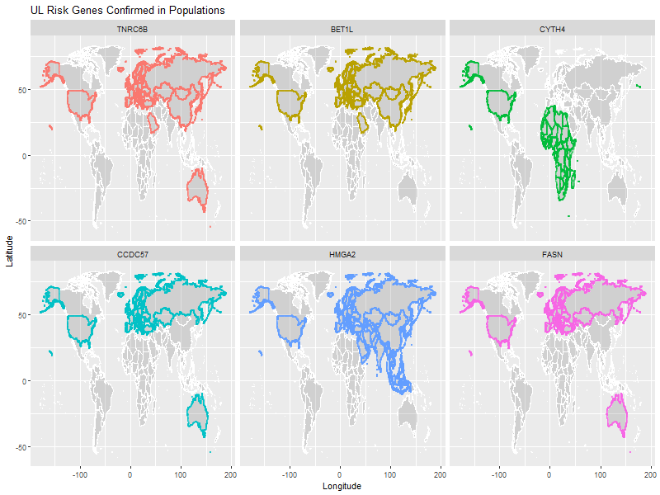
Map of the Population Studies Genes for UL Risk
Notes:
The six genes ubiquitous to current UL risk studies as those having population statistical significance for UL development as seen in the faceted global images of each genes verified UL risk with in each population.

Slide 5
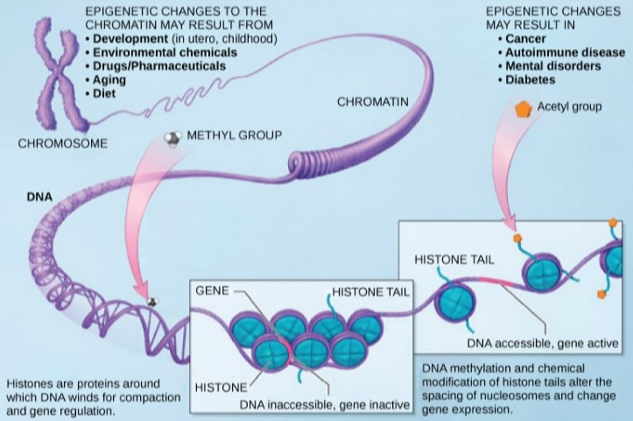
Gene Regulation: Transcription
Rye, Wise, Jurukovski, DeSai, Choi, & Avissair (2017) Biology: OpenStax
Notes:
. Gene transcription: Chromosome, chromatin, histone, nucleosomes, introns and exons post-transcription, moving to cytoplasm

Slide 6
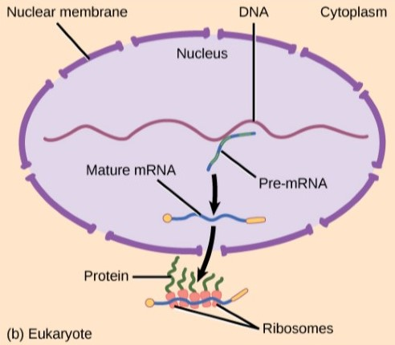
Gene Regulation: Transcription and Translation
Rye, Wise, Jurukovski, DeSai, Choi, & Avissair (2017) Biology: OpenStax
Notes:
Gene translation: Outside of the nucleus after transcription of RNA is exported from nucleus to the cytoplasm of the cell, ribosomes translate RNA to proteins, cis-acting elements, promotors of genes, repressors of genes, 5’ to 3’ translation region, recoil by RNA binding proteins upstream, downstream, along coding region, millions of base pairs away, external stimuli effects gene expression.

Slide 7
Gene Regulation: Gene Expression
What affects gene expression of RNA?
Where can the gene expression of RNA be influenced?
Notes:
Gene expression can be affected by heat, UV light, environmental disturbances, chemical disturbances, and other stresses.
Gene expression of RNA can be influenced from transcription throughout translation during any of those processes. This is why looking at the gene expression of the microarray samples across UL and non-UL samples could indicate some gene targets for treating or further researching UL risk to begin alternative therapies.

Slide 8
Objective of this Research
Meta-analysis of those six genes and/or a combination of the other top genes showing the most change in DE or fold change in UL compared to non-UL microarray samples from five GEO studies are good predictors for determining a sample as UL or non-UL. Thus, indicating the gene is a possible gene target for UL pathogenesis treatment through further research of those genes with good accuracy in prediction for UL.
Notes:
Gene expression is a result of changes at the transcription or translational process of protein creation and is a result of stress in the environment.
Current UL risk studies have examined gene expression data and found gene targets to be TNRC6B, BET1L, HMGA2, CYTH4, CCDC57, and FASN as hereditary determinants of UL predisposition and as targets of UL pathogenesis. Not all these genes are significant for UL risk in each population.

Slide 9
Methods - Overview
Universal data set of 12,173 genes from GEO’s five UL risk studies using microarray gene expression data
Subset of 130 genes from GEO that only belong to Chromosomes 11, 12, 17, or 22
R, combining data, plotting data, machine learning, and all analysis is completed using R
Bioinformatics, Gviz package, both use R to generate the chromosome plots of genes
Different data sets were prepared to use machine learning on and decide which genes were better predictors.
Notes:
GEO data from five studies on UL risk analyzed and combined to one set of 12,173 genes universally in common. Then, this data set was then used to gather a subset of 130 genes that are in common among the five studies but also only on the same chromosomal locations as the six genes ubiquitous to UL risk in current studies

Slide 10
Methods – Linkage Disequilibrium Visualizations
Gviz, a Bioconductor R package was used to visually see where peak links between gene regions could lie on the chromosome.
Notes:
The following five slides demonstrate what LD is and show visualizations that map out the neighborhood of genes and the locus of genes along the gene’s cytoband location

Slide 11
Gene Expression through Linkage Disequilibrium
What is linkage disequilibrium (LD)?
Why is LD analysis important to finding gene targets to UL risk?
Notes:
During the process of gene expression there are opportunities in transcription where genes upstream or downstream from right next to the gene to up to millions of base pairs away from a target gene where the DNA being transcribed into RNA can recoil onto itself and produce or inhibit production of genes. RNA binding proteins inside the nucleus transcribing the RNA can bind to more genes that they are associated with when the chromatin is loosened around the histones making the nucleosomes accessible. Many studies have investigated this linkage disequilibrium (LD) and looked at either neighboring genes along the chromosome, or chromosomes with LD scores above a certain threshold. LD is The non-random association between alleles at different loci that don’t follow the same statistical associations if the alleles were sampled independently and randomly based solely on allele frequency. LD analysis is important to finding peaks in loci of genes on chromosomal regions with genes that have been significantly associated with other diseases makes it possible to link genes having pathogenesis to UL

Slide 12
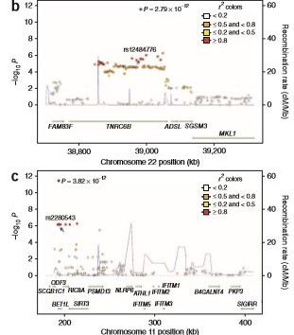
LD Plot Showing Genes Spanning Chromosomes 11 and 22
Cha et al. (2011) Nature Genetics
Notes:
Cha et al., (2011) found three genes, SLK (not shown), TNRC6B (top), BET1L (bottom) loci all have significant UL risk for Chinese populations.

Slide 13
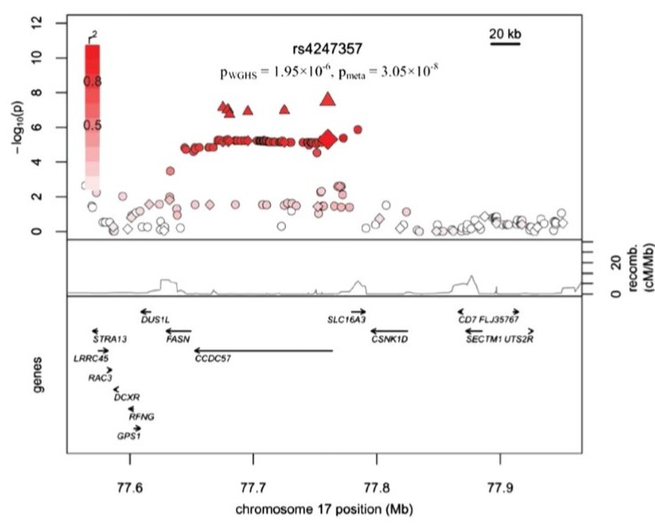
Eggert et al. (2012) American Journal of Human Genetics
LD plot for FASN along same Span as CCDC57 gene
Notes:
This study examine FASN and CCDC57 among European Americans. In the image above there is a linkage peak with FASN and CCDC57.

Slide 14
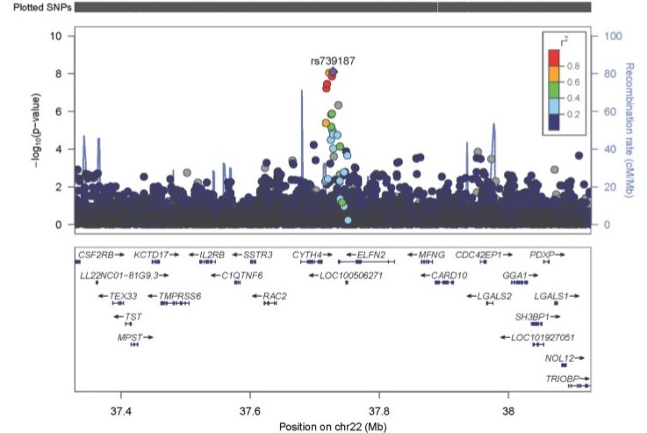
LD Plot Spanning Chromosome 22
Hellwege, et al. (2017) Human Genetics
Notes:
CYTH4 is shown next to other links with genes not one of the six ubiquitous genes to UL risk in current UL risk studies

Slide 15
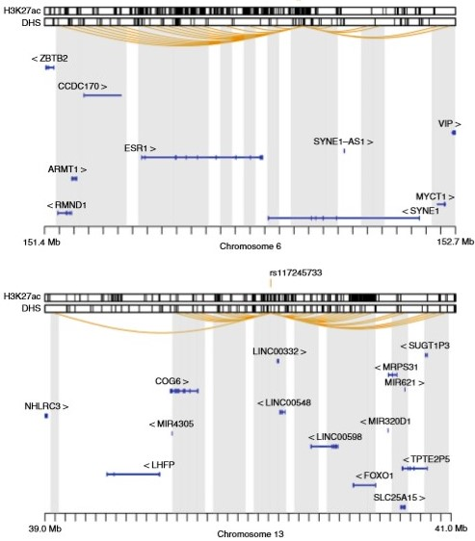
LD Plot Showing Chromosomes 6 and 13
Rafnar et al. (2018) Nature Communications
Notes:
This study evaluated the cancerous gene markers and UL risk in having a pre-existing condition of cancer. These chromosomes are not part of the locus of chromosomal locations for the six genes ubiquitous to UL risk in the UL risk studies. This is a different image of peak linkage between gene spans indicated by the yellow curved bars above each chromosome map.

Slide 16
Methods – Data Sets Derived
The data sets that were derived to test the best machine learning results for UL prediction were as follows:
The universe of all genes:
universe16_fold_results
universe16_DE_most_results
universe16_DE_least_results
The subset of 130 genes belonging only to same chromosomes (11,12,17, 22) as the six genes ubiquitous to UL risk studies:
TOP16_results
DE16_most_130_results
DE16_least_130_results
FOLD16_130_results
majority_10_results
Notes:
GEO data from five studies on UL risk analyzed and combined to one set of 12,173 genes universally in common. Then, this data set was then used to gather a subset of 130 genes that are in common among the five studies but also only on the same chromosomal locations as the six genes ubiquitous to UL risk in current studies

Slide 17
Methods – Machine Learning Algorithms
The data sets that were derived were then each tested using seven machine learning algorithms in R, and a combined model
Latent Dirichlet Allocation method of caret package in R (LDA)
Random Forest method of caret package in R (RF)
Generalized Boosted Regression Models method of caret package in R (GBM)
Random Forest package in R called randomForest (RF2)
K Nearest Neighbor (KNN) method of caret package in R
Recursive Partitioning and Regression Trees (Rpart) from the rpart package in R
Generalized Linear Regression Model (GLM) from the MASS package in R
Combined Model using the ‘gam’ method in caret package of R on all seven algorithms above
Notes:
These algorithms are produced in R, mostly with the caret package. The LDA method is a collapsed Gibbs sampling method, the RF and RF2 algorithms use a decision tree method to classify samples categorically, the GBM model uses the Adaboost and gradient boosted regression models that rely on least squares, logistic, poisson, quantile, multi-nomial logistic, and t-distribution loss methods. The K Nearest Neighbor uses the centroid of groups of data as unsupervised data points or non-categorized data to keep samples in the group of other samples closest to their characteristic groupings. The Rpart method uses decision trees by recursive partitioning of the data. GLM is a generalized linear regression model. The combined model uses the outcomes from all algorithm results as a dataframe to select the most frequent prediction or best prediction.

Slide 18
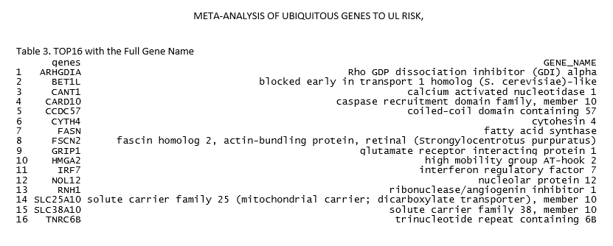
Results: TOP16; Top 10 Differentially Expressed (DE) and the 6 Genes Ubiquitous to Current UL Risk Studies

Slide 19
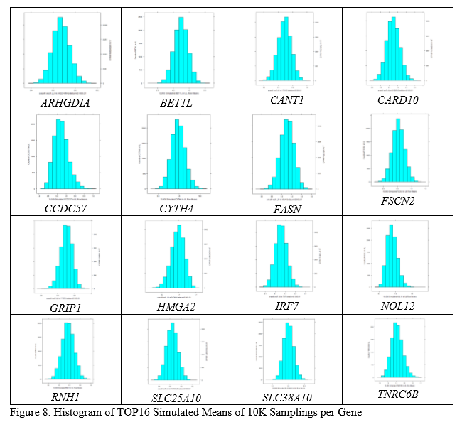
Results: TOP16; 10,000 Simulated Bootstrap Histograms for Each TOP16 Gene
Notes:
Most of the TOP16 (10 most DE+6 ubiquitous genes) are symmetrical, but some are skewed where the median is on the right or left of the mean making the tail point the opposite direction, such as with GRIP1 it is left skewed (third moments) having the median on the left of the mean and BET1L is almost perfectly symmetrical.

Slide 20
Results: Linkage Disequilibrium Visualizations
Gviz, a Bioconductor R package was used to visually see where peak links between gene regions could lie on the chromosome.
The next four slides are graphic in nature to where these genes live in the chromosomal cytobands and the links between neighboring genes.
Notes:
The results from using Gviz to develop visualizations showing the locus of genes and the neighboring genes along chromosomal links of each of the six ubiquitous gene’s cytoband address in the chromosome. These images that follow are graphic in nature, by showing only those genes in the subset of 30 genes and if the gene of the six genes belonging to chromosomes 11, 12, 17, or 22 are in the majority or minority of genes expressed in UL samples for that chromosome.

Slide 21
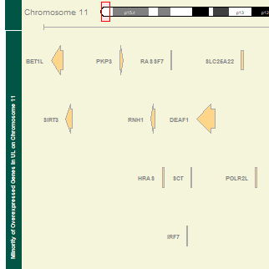
Gviz Map of Genes Over-expressed as a Minority of Genes on Cytoband p15.5 of Chromosome 11
Notes:
These genes show BET1L on chromosome 11 as being part of the minority of genes on this chromosome that were over-expressed in UL compared to non-UL samples

Slide 22
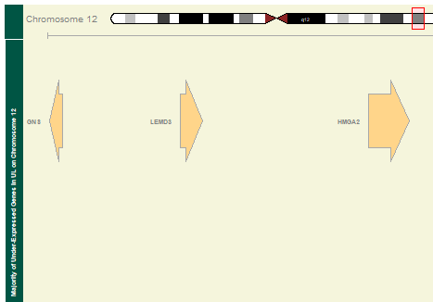
Gviz Map of Genes Over-expressed as a Majority of Genes on Cytoband q14.3 of Chromosome 12
Notes:
There weren’t many genes on Chromosome 12 in common between those UL and non-UL samples. But HMGA2 is part of the majority of genes that as a whole were over-expressed in UL samples compared to non-UL samples.

Slide 23
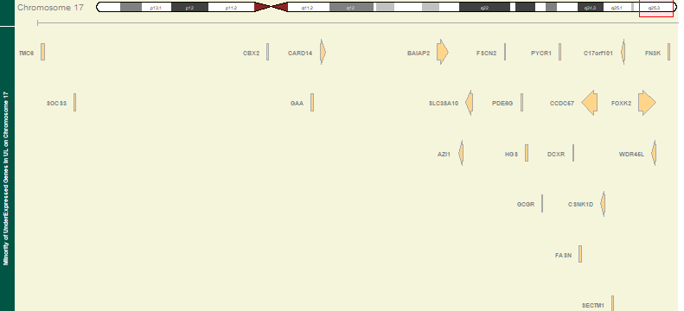
Gviz Map of Genes Under-expressed as a Minority of Genes on Cytoband q25.3 of Chromosome 17
Notes:
FASN and CCDC57 are in the same linkage block of cytoband q25.3. These genes are those genes in a subset of genes only on the chromosomes the six ubiquitous genes are located that are under-expressed in UL compared to non-UL samples on that chromosome as a minority compared to the genes in the majority that are over-expressed in UL.

Slide 24
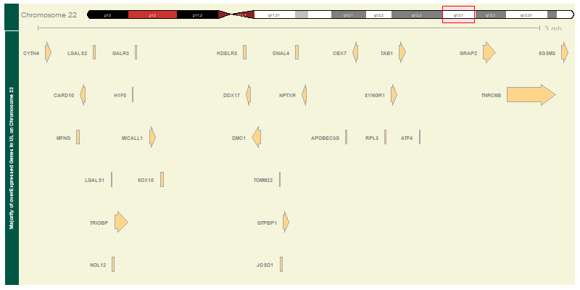
Gviz Map of Genes Under-expressed as a Minority of Genes on Cytoband q25.3 of Chromosome 22
Notes:
Two of the genes ubiquitous to UL risk are CYTH4 upper left of image and TNRC6B in the upper right of image in cytoband q.13.1 of chromosome 22. Many genes between these two genes, but all are expressed less in UL compared to non-UL samples as a majority of the genes on chromosome 22.

Slide 25
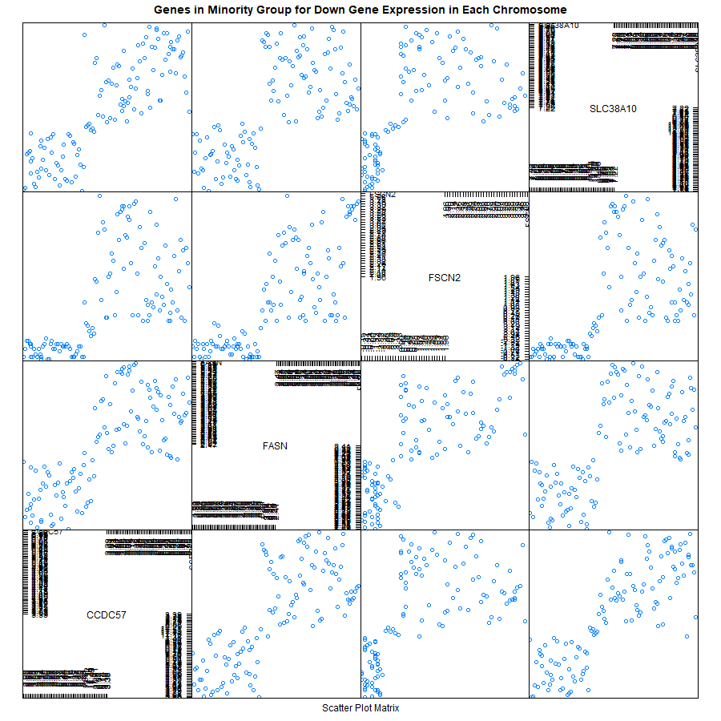
Results: A Lattice Pairwise Comparison of Chromosome 17 Minority of Genes Expressed Least
Notes:
A lattice R package ‘splom()’ plot showing four of the genes least expressed in UL on chromosome 17. Two of the ubiquitous genes, FASN and CCDC57 are listed. The scatters outside of the 45 degree diagonal indicate differences between gene expression values. No real patterns, as medium to high values of FASN for FSCN2, CCDC57, and SLC38A10 show expressions of also medium to high.

Slide 26
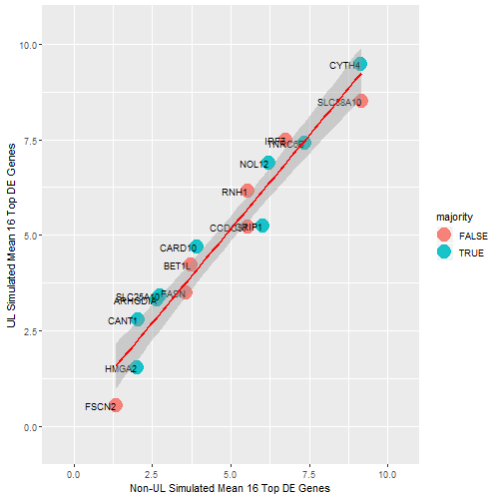
Results: Plot in ggplot2 of TOP16 Genes as Majority or Not When Comparing UL to Non-UL Simulated Means
Notes:
The 10,000 simulated means from bootstrap sampling on the TOP16 genes is shown comparing the x-axis of non-UL means to the y-axis of UL means for each of the 16 TOP16 genes. A categorical factor for whether the gene is a part of the majority (blue) or not (red) was added to show that most of the genes (9) are part of the majority, but the other minority (7) are close to the best fit linear regression line between the simulated means of the UL and non-UL genes.

Slide 27
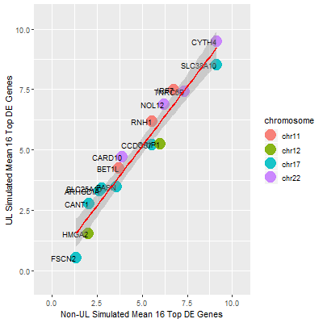
Results: Plot Using ggplot2 showing TOP16 Genes and the Chromosome Each Lives Comparing Simulated UL and Non-UL Means of Each Gene
Notes:
This plot was made using ggplot2 in R. It shows the 16 genes of 10 most DE and 6 ubiquitous genes to UL risk studies in the subset of 130 genes living in the same cytoband locations as the six ubiquitous genes, or the TOP16 genes for short. All of chromosome 11 and 22 genes have higher expression means than the non-UL means from the 10,000 simulations and all genes on chromosome 12 have higher non-UL simulated means than UL means. Chromosome 17 shows simulated means mixed for UL and non-UL means. True results show that these same four genes of chromosome 17 were expressed less than UL from the Gviz image of Chromosome 17 in Results.

Slide 28
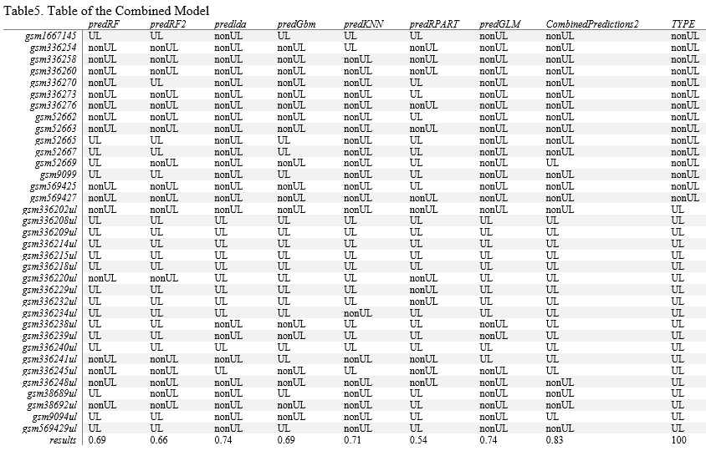
Results: Machine Learning TOP16 Outcomes
Notes:
Results above are for the TOP16 genes in the subset of 130 genes belonging to the same cytoband locations as the six genes ubiquitous to UL risk studies. The combined prediction model scored the best with an accuracy of 83 per cent and the next best algorithm is the LDA with a score of 74 per cent accuracy in predicting UL or non-UL for the TYPE of sample. The

Slide 29
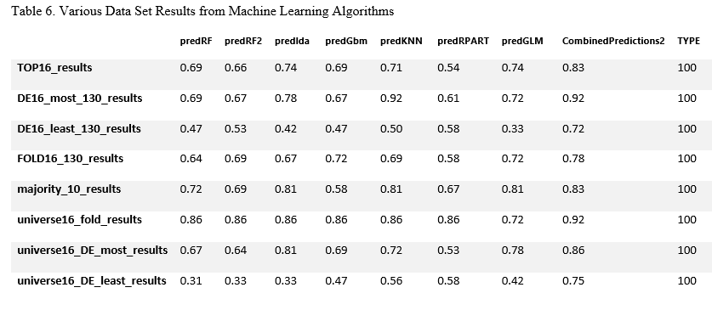
Results: Machine Learning All Data Set Outcomes
Notes:
Results above are the results from machine learning predictions made on all data sets derived. The combined model of all seven algorithms performed best with an accuracy of 92 per cent on two separate files of data sets named DE16_most_130_results.csv and the universe16_fold_results.csv. These two data sets do not include the six genes ubiquitous to UL risk studies. Those genes having the most change in magnitude as observed in UL samples compared to non-UL samples in the DE16_most_130_results is from the subset of 130 genes in common along the same cytoband locations as the six UL risk studies’ genes. The universe16_fold_results data set is from all of the genes in the universe of genes these five GEO studies had in common having the most fold change in UL samples compared to non-UL samples. The next best data sets for best accuracy in prediction scores is from the universe16_DE_most_results with 86 per cent accuracy. It is data on the top 16 genes with the highest magnitude of change between UL and non-UL samples in the universe of combined genes between these five GEO studies. Both data sets that chose the 16 genes having the least change in magnitude scored the worst, making it likely none of these genes are suitable to associate with UL risk. The TOP16 and majority group of genes that contains five expressed more in UL and five expressed less in UL from the subset of 130 in common by cytoband location both scored 83 per cent accuracy, which is pretty good on a scale of accuracy compared to the least expressed genes.

Slide 30
Conclusions
Five studies from GEO using microarray gene expression data was analyzed to see if the six genes ubiquitous to current UL risk studies make good predictors of UL
Eight data sets were built and used to test whether the six genes were good predictors of UL or if the machine learning algorithms were better on the most expressed genes in the samples in fold change or DE
Results showed 83 per cent accuracy on the six genes and 10 most DE genes in TOP16
Results also showed 92 per cent accuracy for the most expressed genes in DE or fold change out of all genes the five studies had in common
Results also showed the least expressed genes out of all genes in DE and fold change made the worst predictors
This could mean there is a need to keep looking at the most expressed genes and to keep the six genes ubiquitous to UL risk studies as gene targets for UL pathogenesis
Notes:
The data from five different UL studies of microarray gene expression data was combined from GEO and used to derive eight different data sets that could be used to determine if the six genes ubiquitous to current research studies can make an accurate prediction of a sample being UL or non-UL. When including these six genes and the next genes that were the top genes expressed in UL by most magnitude of change an accuracy of 83 per cent was achieved with a first run on a 30 per cent partition (36/121) UL and non-UL samples trained on the other 70 per cent partition (85/121).

Slide 31
Conclusions
Results also showed 92 per cent accuracy for the most expressed genes in DE or fold change out of all genes the five studies had in common
Results also showed the least expressed genes out of all genes in DE and fold change made the worst predictors
This could mean there is a need to keep looking at the most expressed genes and to keep the six genes ubiquitous to UL risk studies as gene targets for UL pathogenesis
Notes:
Results were better for most expressed and worse for least expressed universally for DE and magnitude

Slide 32
Conclusions
Implications of this study:
This could mean there is a need to keep looking at the most expressed genes and to keep the six genes ubiquitous to UL risk studies as gene targets for UL pathogenesis
Limitations of this study:
Only one data set had exon information to screen for genotypes and gene variants, so this method of finding the gene targets in UL by genotype variations was not used
Future extensions to this study:
Test the most differentially expressed genes and highest fold change genes and see if any linkage or cytoband locus of genes could indicate UL pathogenesis other UL risk studies didn’t find
Notes:
There is no need to rule out the six ubiquitous genes to predicting UL samples and associating with UL pathogenesis based on previous UL risk studies. The genes having the most or least gene expression in UL compared to non-UL measured by fold change or differential expression in magnitude make good predictors in machine learning algorithms. Since the best accuracy was obtained by a combined model of algorithms that involved unsupervised or non-categorical groupings it proves the machine learning algorithms are useful for predicting outcomes in a given data set. Also, the least expressed genes do show little connection to UL risk or onset.

Slide 33
Remaining Questions
It is apparent that gene expression data was able to predict up to 92 per cent accuracy of a sample being UL or not.
What genes can be included along other chromosomes to indicate UL pathogenesis?
What specific role does each gene play in UL pathogenesis if any when expressed less or more in UL compared to non-UL samples?
Notes:
The many ways that gene expression can be altered from transcription to translation mean that those genes expressed less in UL could be associated with UL pathogenesis and how the body regulates UL development by inhibiting those genes’ production. And for the genes expressed more in UL, it could mean that the body needs more of these genes to protect the body from other diseases that could be related to UL, though no current study this research encountered has observed a UL being a predisposition to later cancers or diseases. Current studies have associated diseases to developing UL but not the inverse, and also having thyroid dysfunction associate with having a UL when using CYTH4 as a gene target. It is also possible that RNA stability is off set in the post-transcription process of the gene production outside of the nucleus of the cell and the genes expressed more in UL are being expressed more because of RNA instability which could be a reason UL grow as the gene target TNRC6B is linked to many populations as doing. Much more work in UL risk gene targeting needs to be done, with more sampling, more ruling out of genes that could be associated with UL risk, more testing for significance of gene targets already established as having UL pathogenesis in some populations but not in few others. Gene expression does play a pivotal role in how our bodies protect themselves from stresses in the environment and UL development has shown that many genes do change in gene expression values in UL samples compared to non-UL samples. There is enough evidence of this in the predictive models that showed up to 92 per cent accuracy in predicting UL. There is no reason to stop screening microarray gene expression samples to find gene targets to UL risk.

Slide 34
References
Aissani, B., Zhang, K., and Wiener, H. (2015). Evaluation of GWAS candidate susceptibility loci for uterine leiomyoma in the multi-ethnic NIEHS uterine fibroid study. Frontiers in Genetics, 6, 241. DOI:10.3389/fgene.2015.00241
Bondagji, N., Morad, F., Al-Nefaei, A., Khan, I., Elango, R., Abdullah, L., ..., Shaik, N. (2017). Replication of GWAS loci revealed the moderate effect of TNRC6B locus on susceptibility of Saudi women to develop uterine leiomyomas. Journal of Obstetrics and Gynaecology, 43(2):330-338. DOI:10.1111/jog.13217
Cha, P, Takahashi, A., Hosono, N., Low, S., Kamatani, N., Kubo, M., & Nakamura, Y. (2011) A genome-wide association study identifies three loci associated with susceptibility to uterine fibroids. Nature Genetics 43(5).
Dvorská1, D., Braný, D., Danková, Z., Halašová, E., & Višňovský, J. (2017). Molecular and clinical treatment of uterine leiomyomas. Tumor Biology, 39(6). DOI: 10.1177/1010428317710226.

Slide 35
References
Edwards, T., Hartmann, K., & Edwards, D. (2013). Variants in BET1L and TNRC6B associate with increasing fibroid volume and fibroid type among European Americans. Human Genetics, 132(12). DOI:10.1007/s00439-013-1340-1
Eggert, S., Huyck, K., Somasundaram, P., Kavalla, R., Stewart, E., Lu, A., … Morton, C. (2012) Genome-wide linkage and association analyses implicate FASN in predisposition to uterine leiomyomata. American Journal of Human Genetics, 91(4), 621–628. DOI: 10.1016/j.ajhg.2012.08.009
Hellwege, et al. (2017) A multi-stage genome-wide association study of uterine fibroids in African Americans. Human Genetics, 136(10), 1363–1373. DOI:10.1007/s00439-017-1836-1
Hodge, J.C., Kim, T., Dreyfuss, J.M., Somasundaram, P., Christacos, N.C., Rouselle, M., … Morton, C.C. (2012). Expression profiling of uterine leiomyomata cytogenetic subgroups reveals distinct signatures in matched myometrium: transcriptional profiling of the t (12;14) and evidence in support of predisposing genetic heterogeneity. Human Molecular Genetics, 21, 102312–2329. DOI:10.1093/hmg/dds051

Slide 36
References
Liu, B., Wang, T., Jiang, J., Li, M., Ma, W., Wu, H., & Zhou, Q. (2018). Association of BET1L and TNRC6B with uterine leiomyoma risk and its relevant clinical features in Han Chinese population. Scientific Reports, 8,7401. DOI:10.1038/s41598-018-25792-z
Rafnar et al. (2018) Variants associating with uterine leiomyoma highlight genetic background shared by various cancers and hormone-related traits. Nature Communications, 9:3636. DOI:10.1038/s41467-018-05428-6
Rye, Wise, Jurukovski, DeSai, Choi, & Avissair (2017) ‘Eukaryotic Epigenetic Gene Regulation.’ Biology: OpenStax. Retrieved from: https://cnx.org/contents/jVCgr5SL@15.43:5cz8bfb2@10/16-3-Eukaryotic-Epigenetic-Gene-Regulation

