Slide 1
Newly Constructed Network Models of Different WNT Signaling Cascades Applied to Breast Cancer Expression Data
Michaela Bayerlova, Florian Klemm, Frank Kramer, Tobias Pukrop, Tim Beißbarth, Annalen Bleckmann
2015
PLoS ONE 10(12):e0144014

Slide 2
Importance of WNT Signaling
Normal Functions
Regulates embryonic development
Maintains adult tissue homeostasis
Involved in tissue repair after injury
Abnormal Functions
Initiation and progression of cancers
Neurodegeneration

Slide 3
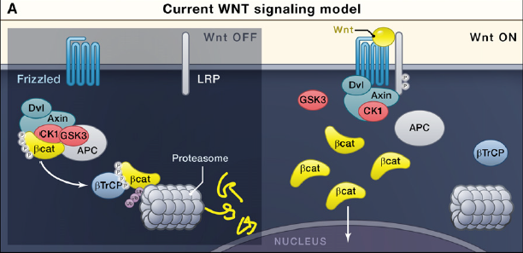
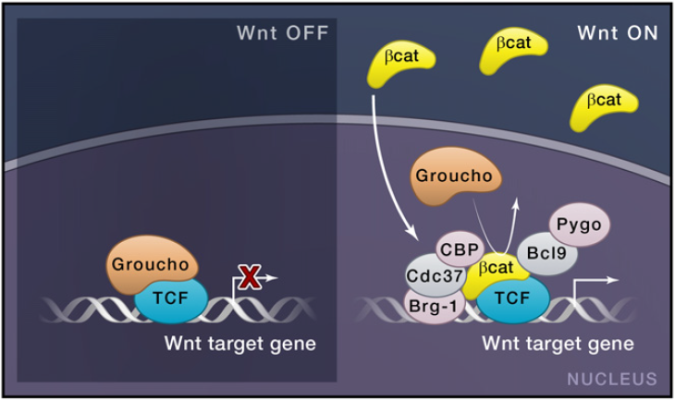
Canonical WNT Signaling
Clevers and Nusse (2012) Cell

Slide 4
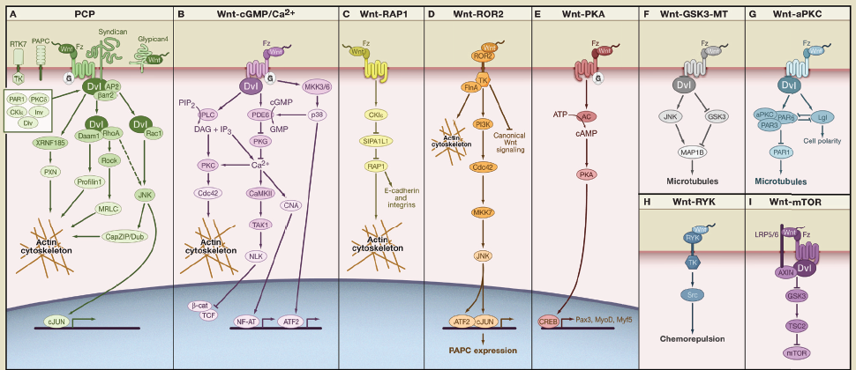
Non-Canonical WNT Signaling
Semenov et al. (2007) Cell

Slide 5
Overlap Between WNT Pathways
19 WNTs in humans – either canonical or non-canonical roles
Receptors and co-receptors for ligands – either canonical or non-canonical
Downstream – overlapping set of target genes
Modification of signals in both by DVL
Transcriptional level, non-canonical pathway factors can inhibit β-catenin

Slide 6
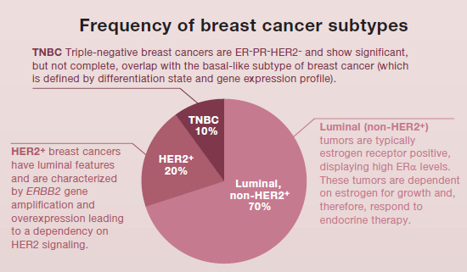
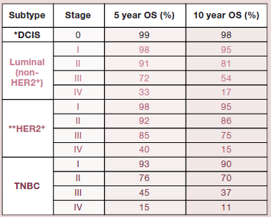
Breast Cancer and WNT
Diverse breast tumors fall into 5 categories (by molecular standards): Basal-like (overlap with TNBC), ERBB2 (HER2)-overexpressing, Luminal A and B, normal-breast-like
Types associate with different clinical diagnosis
Basal-like subtype has enrichment of WNT associated factors
Polyak and Filho (2012) Cancer Cell

Slide 7
Objectives of Study
The authors aimed to use previously published data about the WNT signaling pathways to develop signaling networks
Networks could be stratified into canonical and non-canonical pathways
Gene expression data from two representative cancer samples were compared to the networks to determine which pathway(s) were associated with invasiveness
Results were validated with another gene expression data set

Slide 8
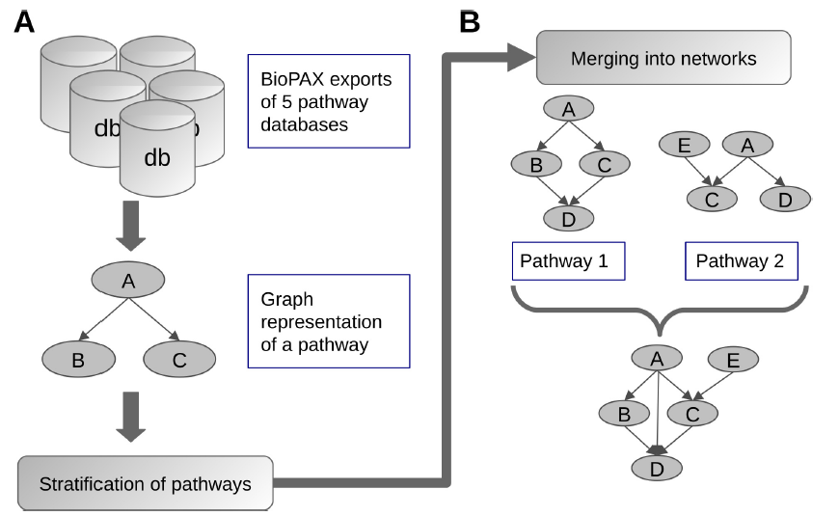
Construction of Networks

Slide 9
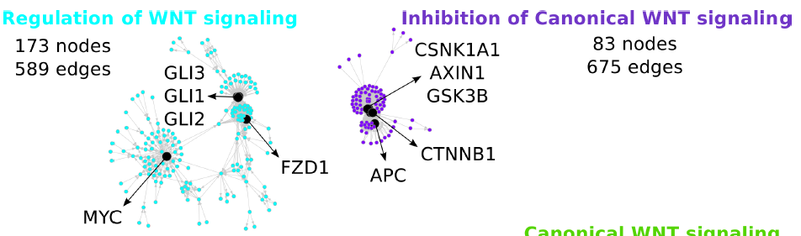
Sub-pathway Networks

Slide 10
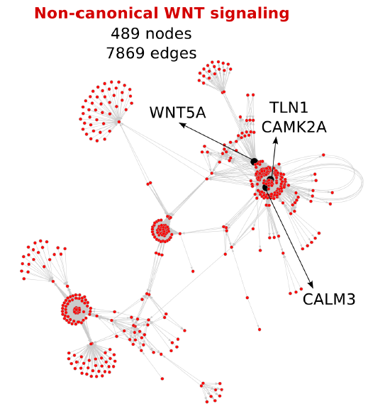
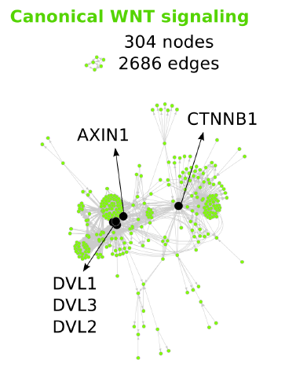
Sub-pathway Networks

Slide 11
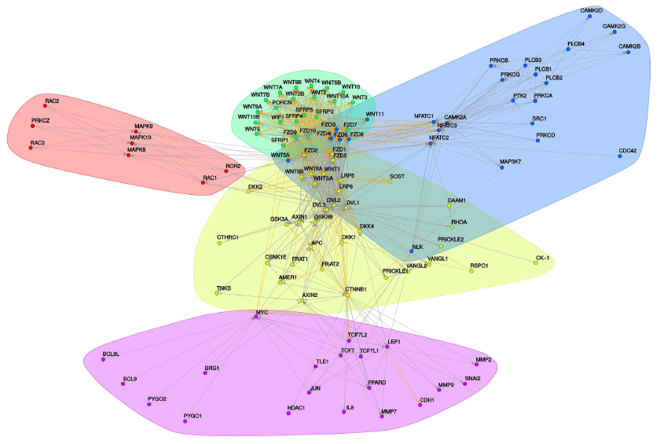
Network Test: 121 Known Genes
WNT, secreted ligands
WNT/Ca2+
PCP
Both canonical and
non-canonical
Transcriptional effectors,
Target genes

Slide 12
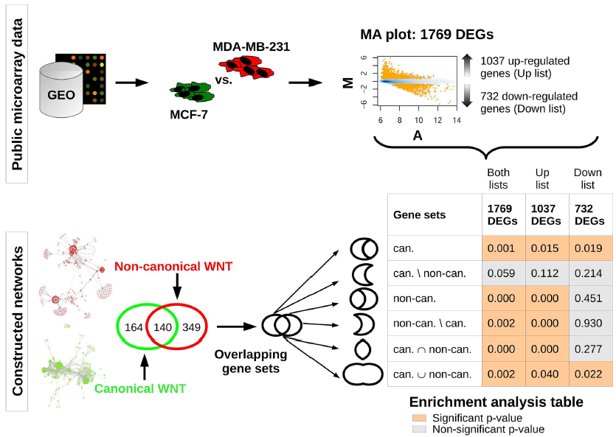
Comparison of Gene Expression with Networks

Slide 13
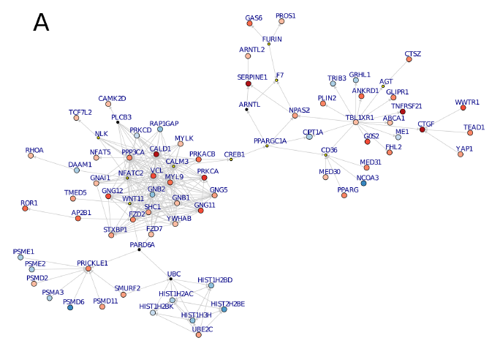

Differential Expression – Non-canonical

Slide 14
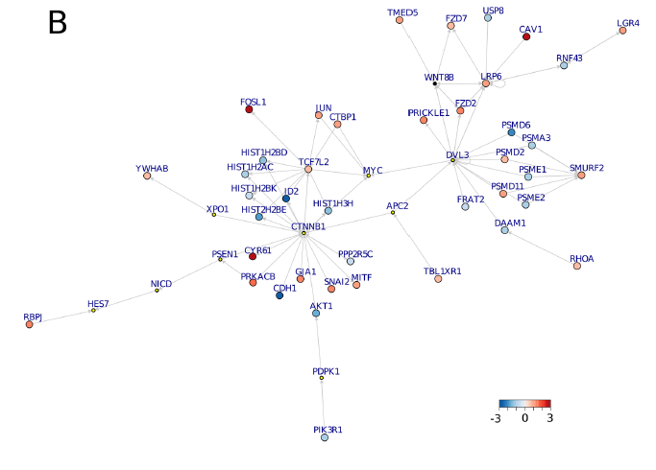
Differential Expression – Canonical

Slide 15
Validation – RNA-Seq Dataset
Transcriptome sequencing using MCF-7 and MDA-MB-231 cells
6638 DEGs between the two samples
1344 DEGs overlapped with previous microarray datasets
Significant enrichment in non-canonical WNT signaling in MDA-MB-231
Non-canonical
75.6% node overlap, 59.5% edge overlap, correlation 0.81
14 Steiner nodes in original set: 8 Steiner nodes in validation, 2 as significantly DEGs
Canonical
78.4% node overlap, 70.8% edge overlap, correlation 0.81
10 Steiner nodes in original set: 5 Steiner nodes in validation, 4 DEGs

Slide 16
Conclusions
Networks were constructed based on previous knowledge
Networks were validated based on previous studies
Testing of minimally invasive versus highly invasive breast cancer microarray sets highlighted importance of non-canonical signaling
Validation with RNA-seq transcriptome analysis
Re-capitulates microarray data, plus more (sensitivity of assay)
Steiner nodes: importance of connecting factors that may not be directly changed in terms of expression, but could have big impact

Slide 17
Remaining Questions
Networks built on data saying factors are related, but not how they are related
Could more information about interplay (such as PPI) change the topography of the networks?
Changes in activation status of proteins (such as phosphorylation status) will not be reflected in transcript-driven data sets – can a dynamic model be built?
The same cell types were used for the training set (original modules) and the validation (validation modules)
Would similar results be seen with other examples of invasive/non-invasive cells?
Cell lines tend to be relatively uniform, while “real” tumors contain many different cells. How could the “real” situation be applied to this assay?
Can an approach like this be used as a diagnostic tool?

Slide 18
References
Clevers and Nusse (2012) Wnt/β-Catenin Signaling and Disease. Cell 149: 1192.
Polyak and Filho (2012) SnapShot: Breast Cancer. Cancer Cell 22 DOI 10.1016/j.ccr.2012.06.021
Semenov, Habas, MacDonald, He (2007) SnapShot: Noncanonical Wnt Signaling Pathways. Cell 131 DOI 19.1016/j.cell.2007.12.011

