Slide 1
Personalized Financial Sentiment System
What we have today
Company sentiment scored once, then personalized to each investor by deterministic rules
Notes:
Engineering thesis project. This deck covers what exists in code and data today, and what is still open.

Slide 2
Where we are
29
1
2
4
3
1
Complete
In review
Ready
Queued
Proposed
Rejected
39 tracked work items
Core API, pipeline, storage and data are built
Scheduling, observability and production LLM scoring are still open
2
Notes:
Counts come from the feature registry (FEATURES.yaml). 29 complete, 1 in review (on-demand ingestion), 2 ready, 4 queued, 3 proposed, 1 rejected.

Slide 3
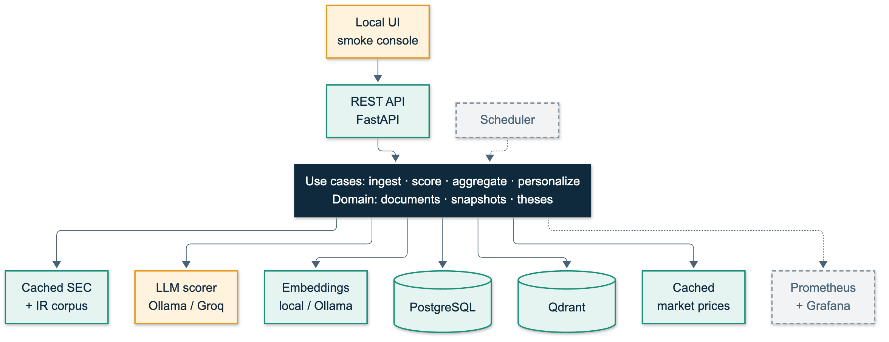
Architecture
Working
Partial / in review
Not done
Modular monolith, hexagonal core
3
Notes:
Domain and use cases are independent of FastAPI, PostgreSQL, Qdrant and provider SDKs. Everything external sits behind a port. Scheduler and Prometheus/Grafana are not implemented yet.

Slide 4
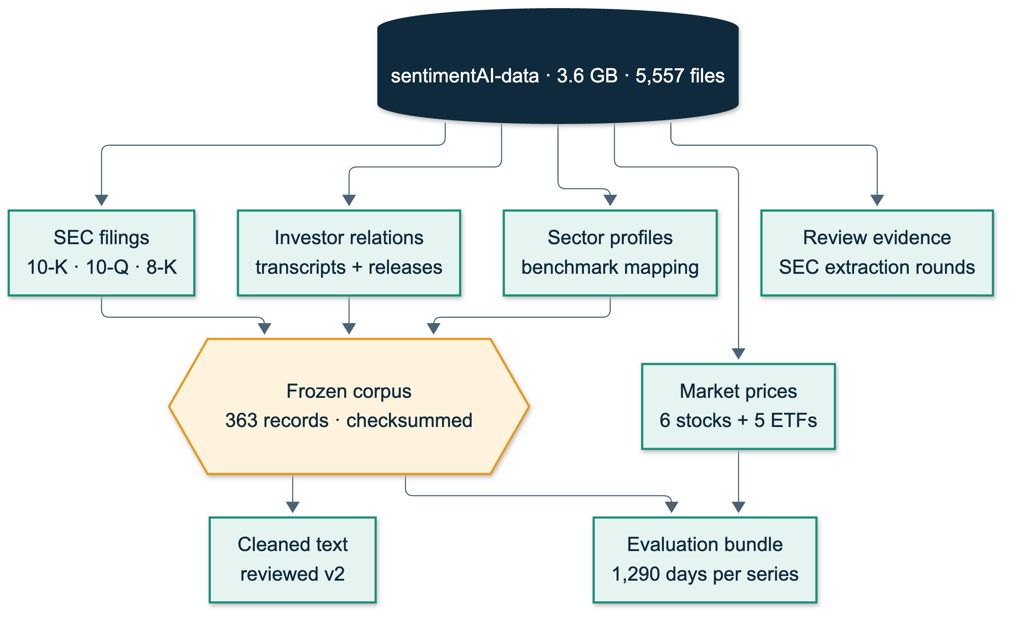
The data we have
6
core companies: META, CRM, V, DIS, WHR, T
363
frozen source records
11
daily price series, 2021 to 2026
4
Notes:
Data lives in a separate repository, pinned by research-data.lock.json. The cache also holds AMAT, AMD, ADBE and AMZN history, and the approved company registry lists more tickers. The six-company sample is the research core.

Slide 5
Frozen research corpus
Development
Held-out
2021-08-27
2024-08-27
2026-08-27
363
147
20
records, all checksummed
held-out records
call transcripts per company
Per company: 5 10-Ks, about 15 10-Qs, about 20 earnings releases
5
Notes:
Window 2021-08-27 to 2026-08-27. Development ends 2024-08-27; the first held-out publication is 2024-08-28. The split is fixed before evaluation and never tuned. SEC text was re-cleaned with a reviewed implementation (v2) after nine extraction review rounds.

Slide 6
From document to prediction
1
2
3
4
›
›
›
Raw document
Clean + gate
Chunks
Embeddings
SEC + IR text
quality checked
3 sentences, no overlap
local model, Qdrant
5
6
7
8
›
›
›
LLM chunk score
Aggregation
Snapshots
Thesis rules
polarity, importance, confidence
importance × confidence × recency
30 / 90 / 365 days
no LLM call, then prediction
Steps 1 to 7 are investor-independent; only the thesis rules (8) use the investor
Working
Partial / in review
Not done
6
Notes:
Stage one is investor-independent: the LLM scores each chunk for polarity, importance and confidence. Stage two applies the thesis deterministically with no further LLM call. Step 5 is marked partial: the standard scoring variant works, while contextual RAG and durable resumable jobs are not built.

Slide 7
Personalization: rules, not another LLM call
Horizon
Style
Risk tolerance
picks the windows
sets the weights
sets the thresholds
short term
active
low
30d + 90d
0.7 short / 0.3 long
neg ≤ 0.30, pos ≥ 0.70
long term
passive
medium
90d + 365d
0.3 short / 0.7 long
neg ≤ 0.40, pos ≥ 0.60
high
neg ≤ 0.45, pos ≥ 0.55
Personalized score = weighted mean of two snapshot scores. The free-text thesis description is never used by the algorithm.
7
Notes:
Rule version aggregation-personalization-v1, fixed before held-out evaluation. Sensitivity variants (half-life, importance exponent, style weights, threshold shifts) are pre-registered for the development period only.

Slide 8
API endpoints
Account and thesis
Prediction
POST /user/account
POST /user/strategy
PUT /user/strategy/{id}
GET /user/strategy
GET /user/strategy/{company}
GET /companies/{c}/prediction
GET /user/history/{user_id}
Ingestion
POST /companies/{c}/ingest
POST /companies/{c} (fixture)
Batch
POST /batch/run
System
Evaluation
GET /health
/metrics (no custom metrics)
/ui (local console)
GET /evaluation/reports/{id}
8
Notes:
12 API routes plus the mounted Prometheus app and static UI. Thesis and history routes take the api_key as a query parameter; there is no production authentication, by design for the thesis scope.

Slide 9
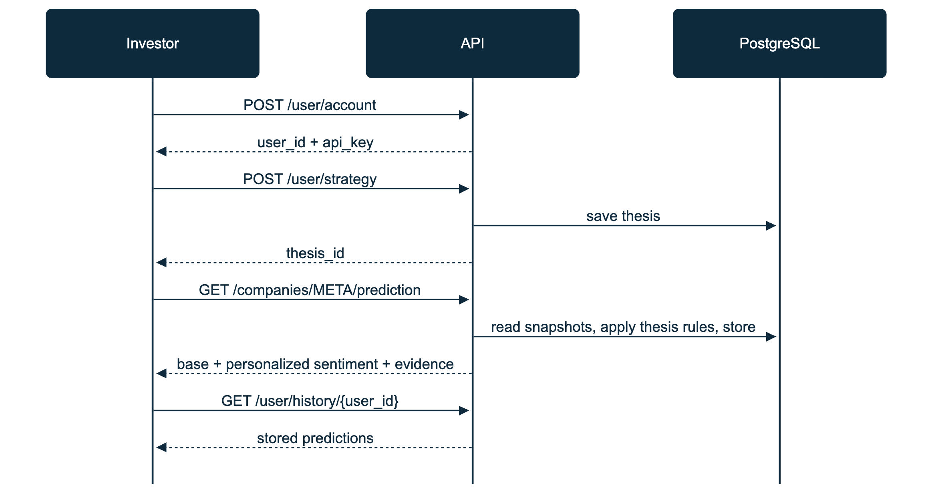
Flow: account, thesis, prediction
1
API key issued once
2
Thesis is structured fields
3
Latest completed run only
9
Notes:
A prediction is built from the latest completed scoring run and returns both base and personalized sentiment with ranked evidence, rule version and run metadata. If no completed run exists the call returns 404; the desired behaviour for that case is still an open decision.

Slide 10
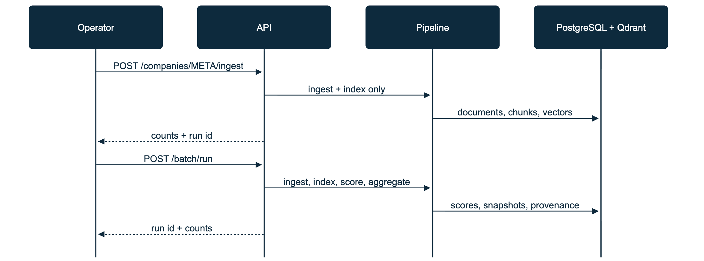
Flow: ingestion and batch
Stages: ingest, index, score, aggregate, exclusion sync
Scope: operational cache or frozen corpus; only documents published before the as-of date
10
Notes:
Every run stores its configuration, stage status and provenance (prompt, model, embedding config, source lineage). Failed runs are recorded with the failing stage. The batch runs synchronously inside the HTTP request today; durable, resumable jobs are queued work.

Slide 11
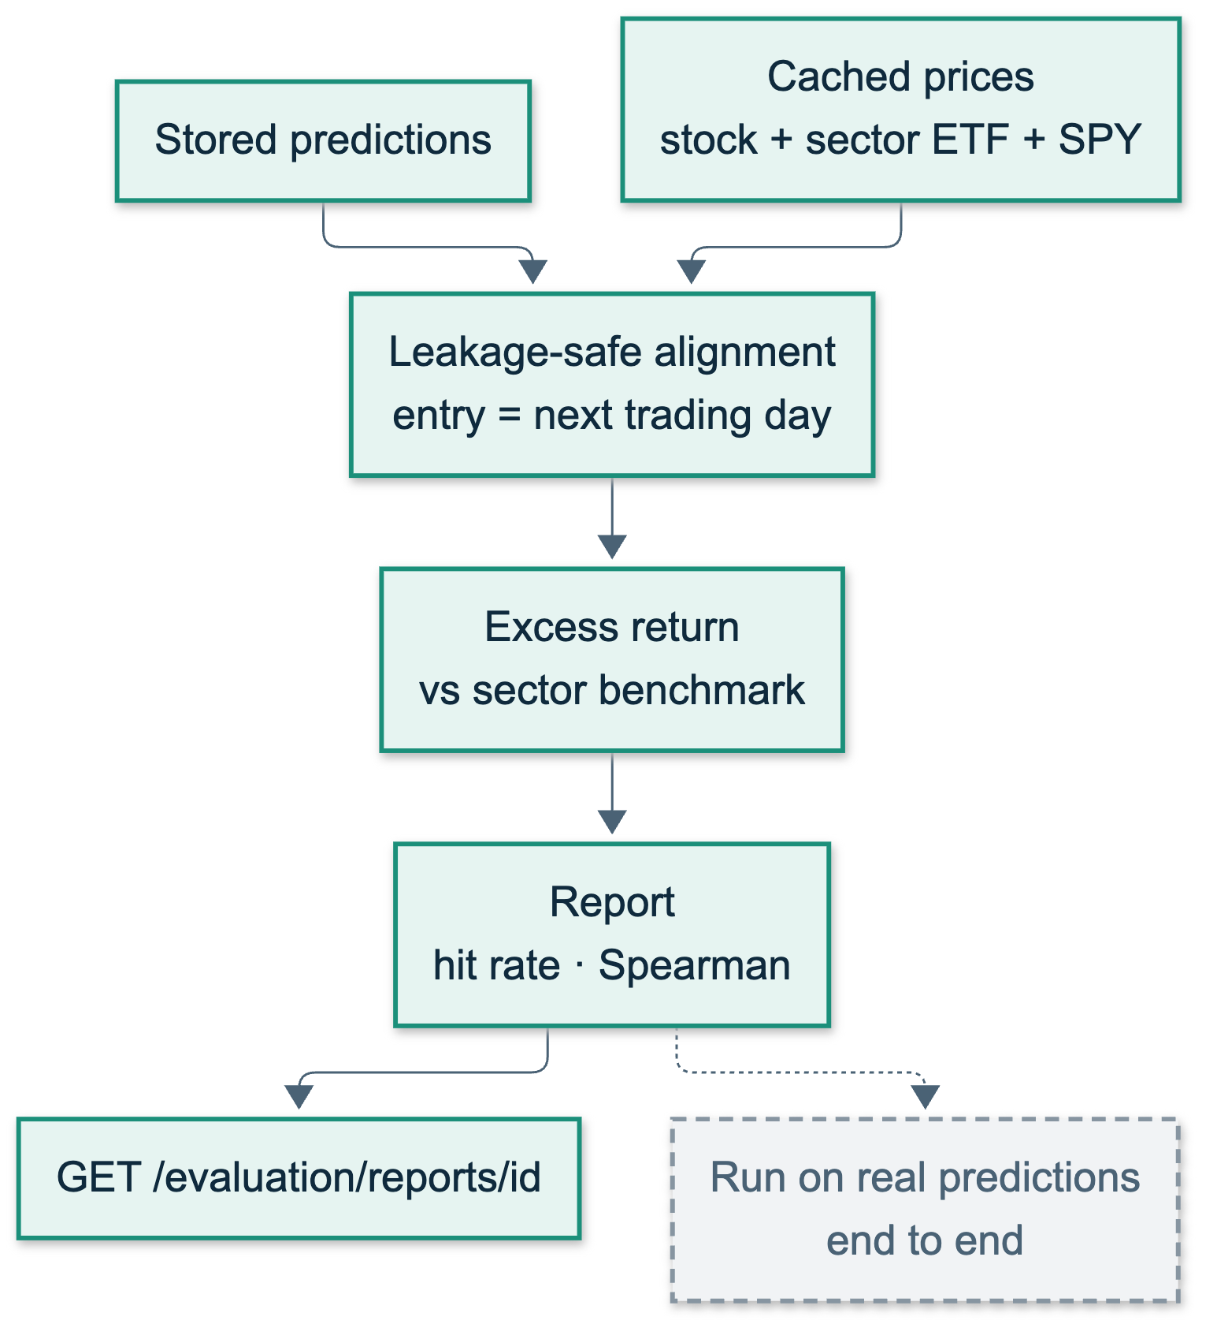
Evaluation setup
11
Notes:
Entry is the first trading day after publication, so there is no look-ahead. Sector ETF benchmarks (XLC, XLK, XLF, XLY) with SPY as fallback and sensitivity. Variants: base, personalized, keyword baseline and no-signal baseline. Market data is a frozen Nasdaq snapshot with checksums, close prices only, not total return. Longer horizons have fewer complete outcomes because recent filings lack future prices.

Slide 12
What is real, what is not
Cached SEC and IR corpus, market prices
Real
PostgreSQL and Qdrant persistence
Real
Embeddings: local model or Ollama
Real
LLM scoring: Ollama or Groq-compatible API
Real adapter
Deterministic scorer, mock embeddings
Test only
Fixture documents (AAPL sample)
Test only
Scheduler, Prometheus and Grafana metrics
Not built
Research results require real embeddings; mock components exist only for tests and quick demos.
12
Notes:
Research mode rejects the deterministic scorer. The Groq demo launcher uses fixtures, ephemeral storage and mock embeddings by default, so it demonstrates the flow, not research results.

Slide 13
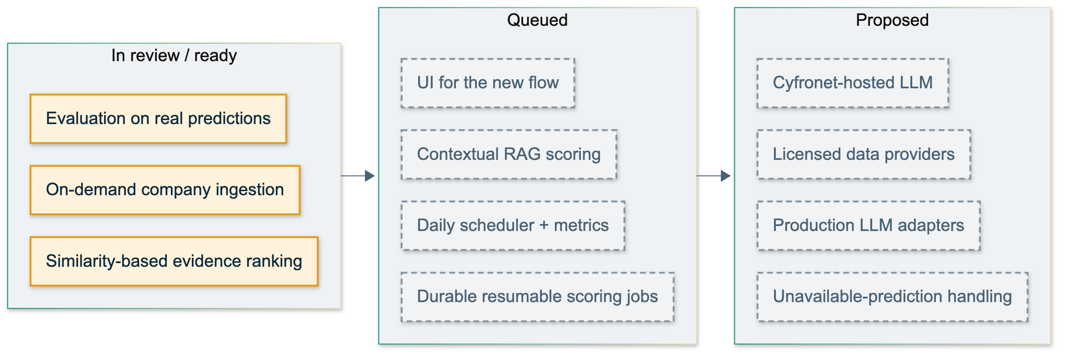
What is not done yet
Working
Partial / in review
Not done
13
Notes:
In review or ready: on-demand company ingestion, evaluation on real predictions, similarity-based evidence ranking. Queued: contextual RAG scoring, durable resumable scoring jobs, daily scheduler with metrics, UI for the new flow. Proposed: production LLM adapters, Cyfronet-hosted LLM, licensed data providers, handling of unavailable predictions.

