Slide 1

Storysketch / Walkthrough
Bo@cean

Slide 2
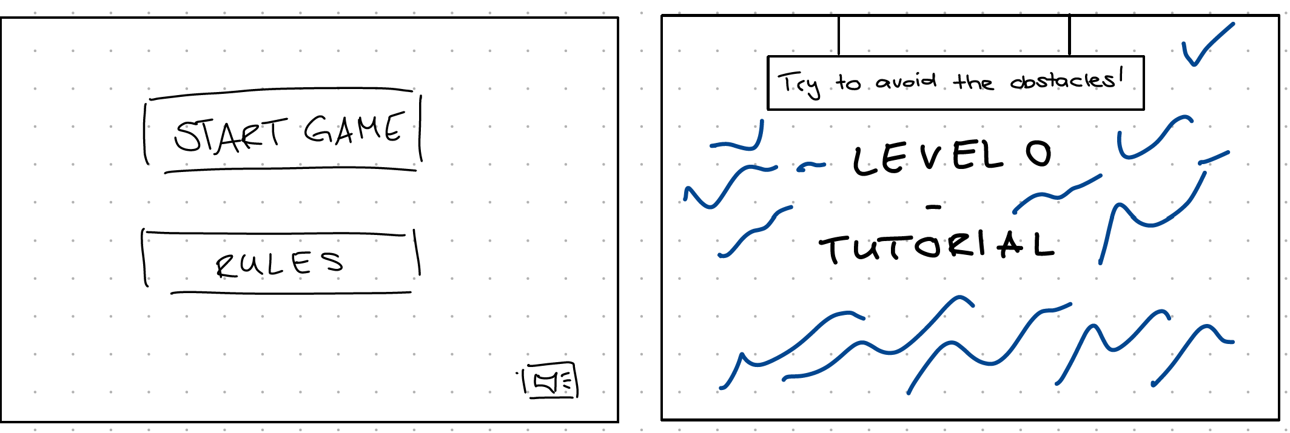
Game Start

Slide 3
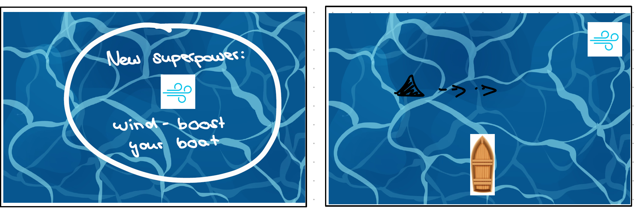
Obstacle: Shark. Superpower: Wind

Slide 4
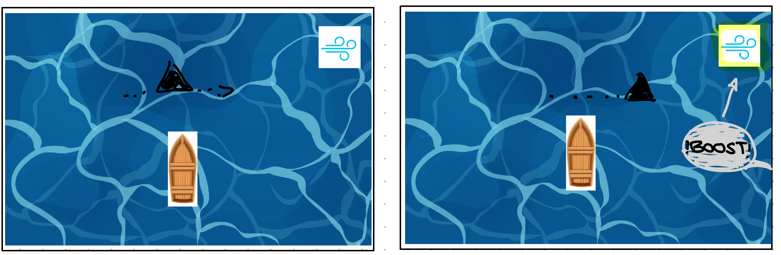
Obstacle: Shark. Boost your boat

Slide 5
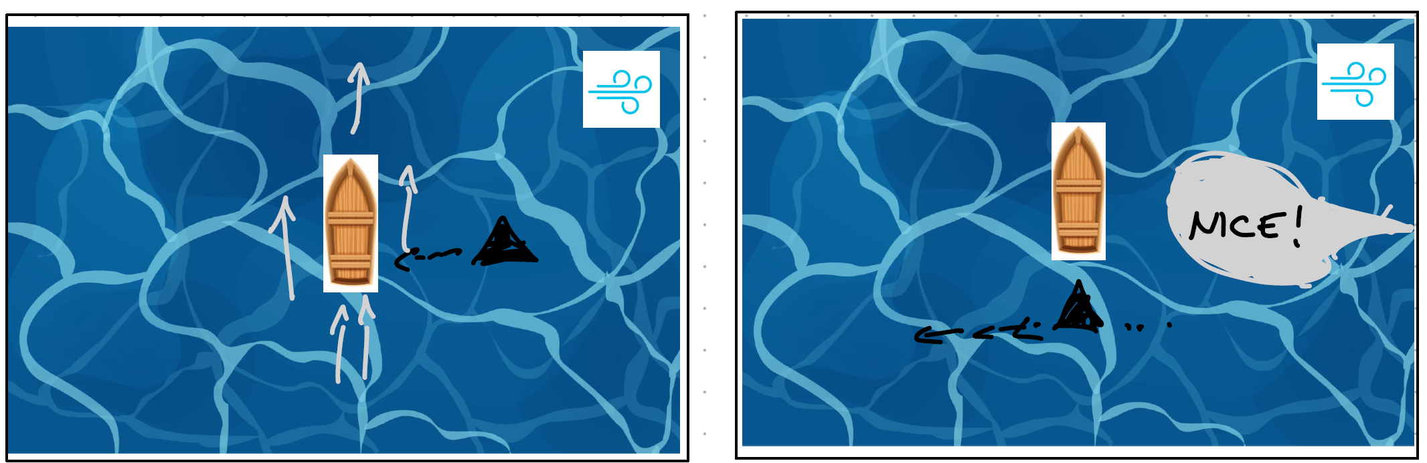
Obstacle: Shark. Boost your boat

Slide 6
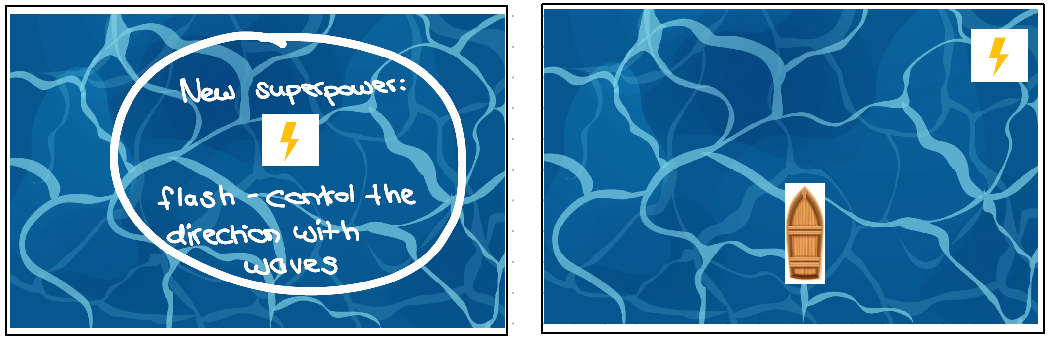
Superpower: Flash

Slide 7
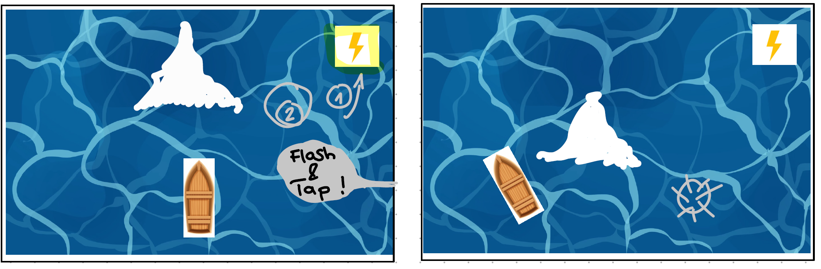
Obstacle: Iceberg. Superpower: Flash

Slide 8
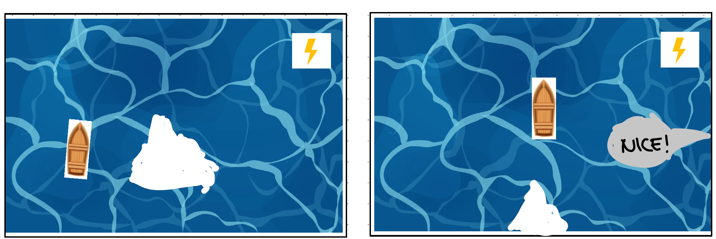
Obstacle: Iceberg. Superpower: Flash

Slide 9
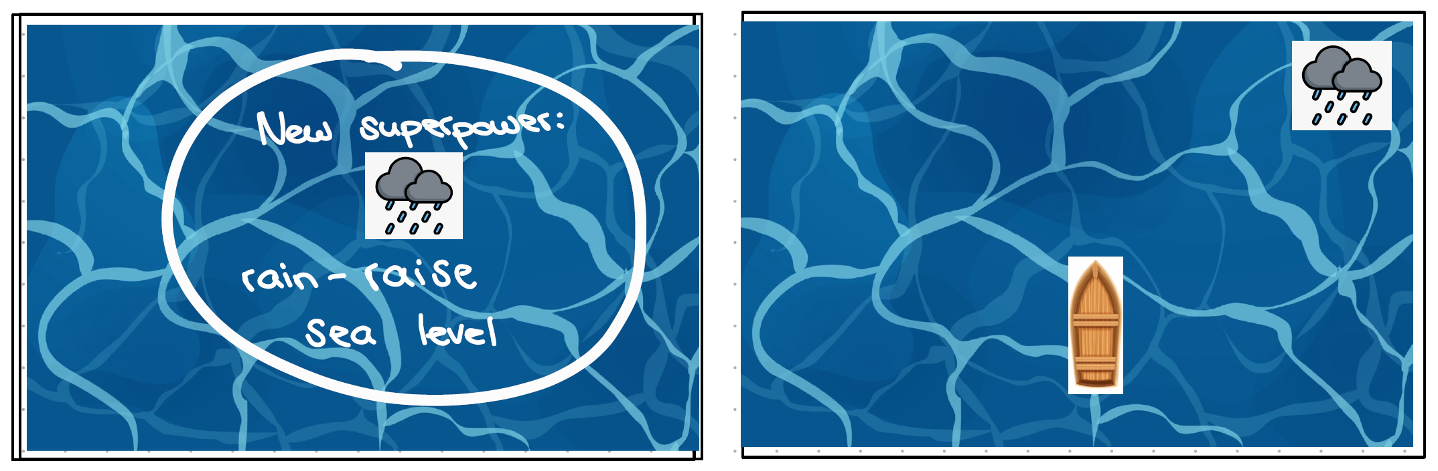
Superpower: Rain

Slide 10
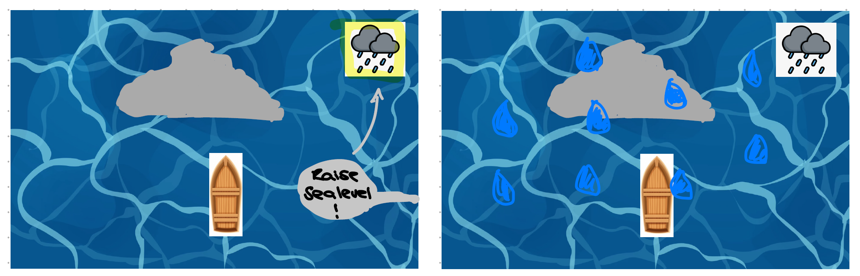
Obstacle: Big Rock. Superpower: Rain

Slide 11
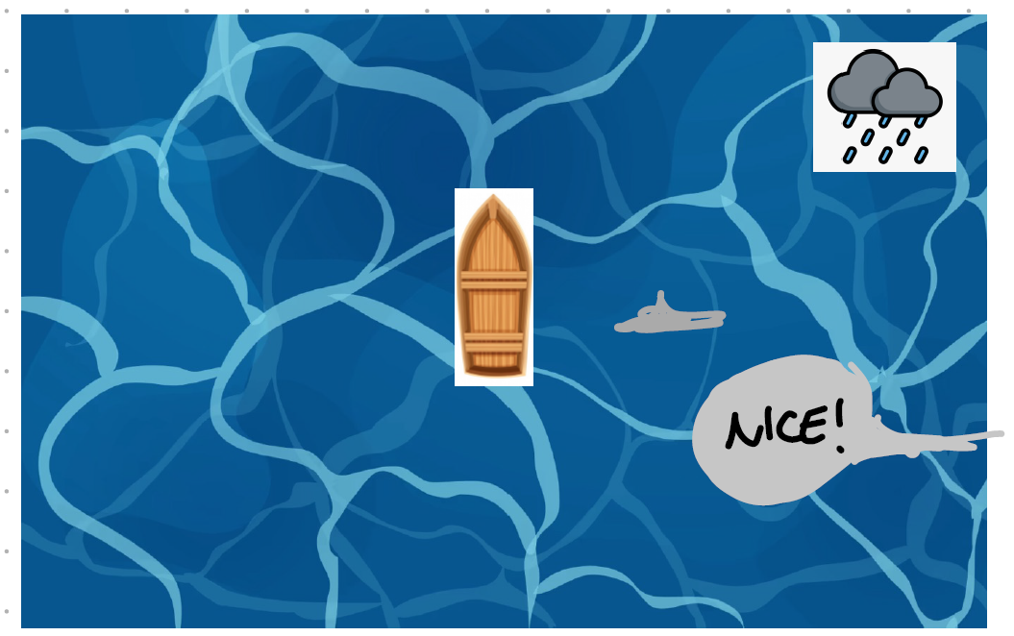

Slide 12
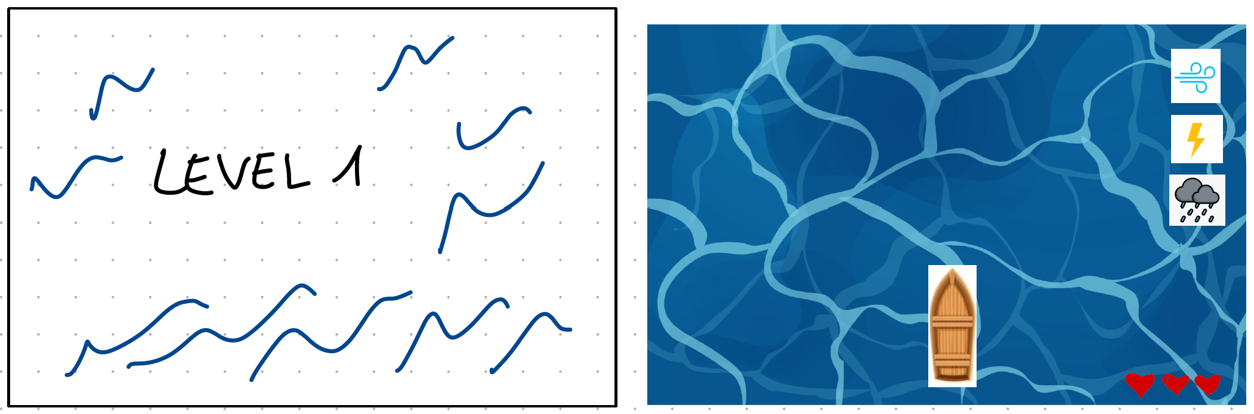
Level 1

Slide 13
Level 1
3 hearts
Crash into obstacle --> lose 1 heart
All of the hearts gone --> dies

Slide 14
Level 1
one obstacle comes after another
After a few obstacles, more stressful and they come shortly after eachother

Slide 15
Level 2
?
Maybe collecting some coins, food, …

Slide 16
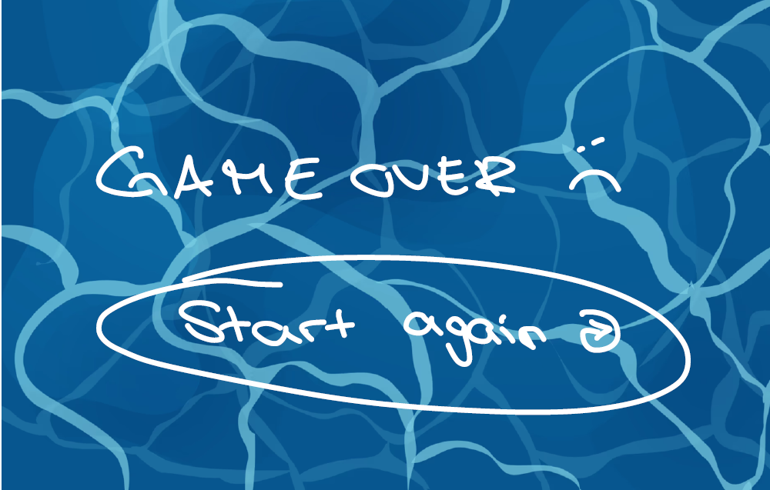
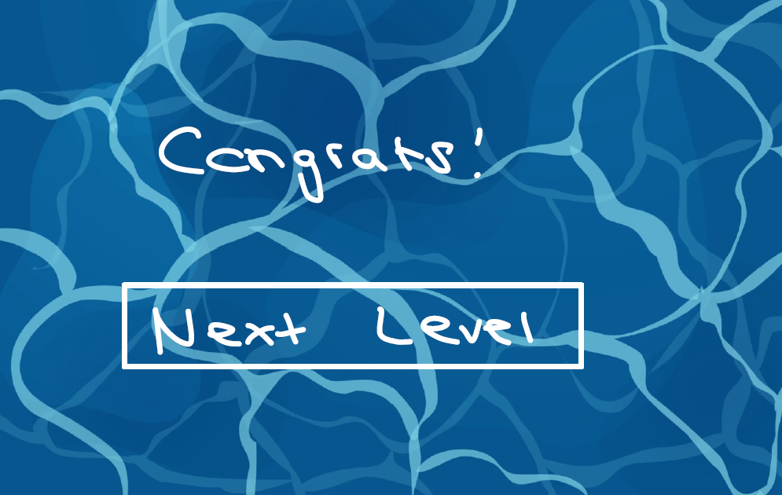
Game Over // Congrats

