Slide 1





02/07/2024
OPERATING SYSTEM
SCHEDULER

Slide 2

SYSTEM OVERVIEW
Our presentation explores a basic operating system scheduler made with C++. We built three main scheduling tools: First Come First Serve (FCFS), Shortest Remaining Time First (SRTF), and Non-Preemptive Priority.
The scheduler is user-friendly, showing schedules visually and handling errors smartly. We made each algorithm its part for easy tinkering.

Slide 3
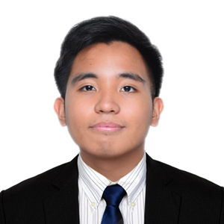


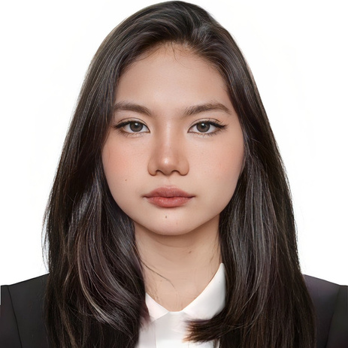
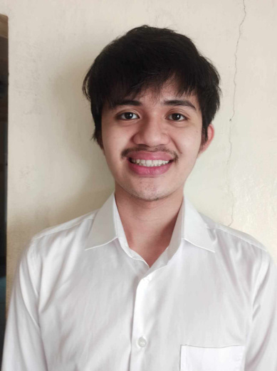
MEMBERS
Alec Godwin Almirañez
Jan Leo Egamen
Ellyza Teniero
Emma Marie Hechanova
Vince Razon

Slide 4
PRESENTATION OVERVIEW
01
02
Output and Results
03
Table Interface
Conclusion
04
Future Improvements
05
Questions and Answers

Slide 5
BASIC FUNCTIONS
01
02
History/Clear History
CPU Scheduling
03
Task Management
04
Gantt Chart

Slide 6

TABLE INTERFACE

Slide 7
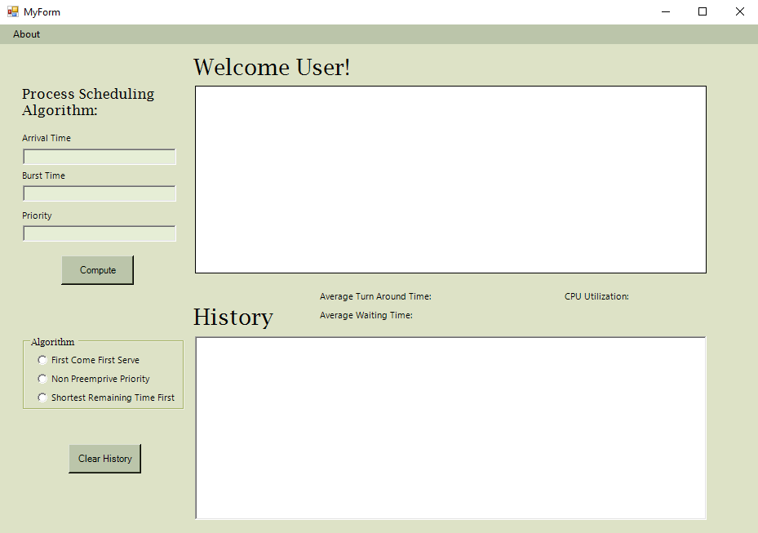

Input Boxes
Calculation Display
Compute Button
Results
Display
History Display
Algorithm Choices
Clear Hisotry Button

Slide 8
NOTE
Clicking the compute button without inputting any arrival time, burst time, or priority for Non-Preemptive would result in an error.

Slide 9
RESULTS AND OUTPUTS

Slide 10
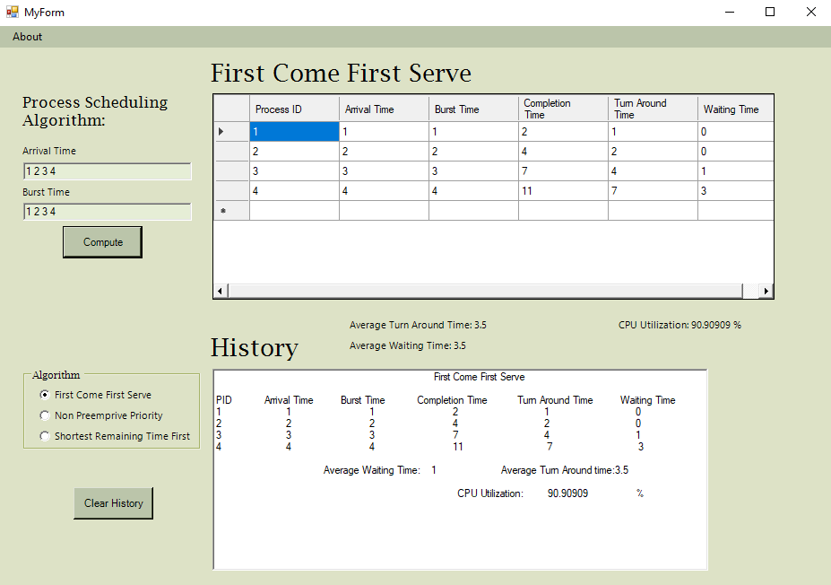
FCFS

Slide 11
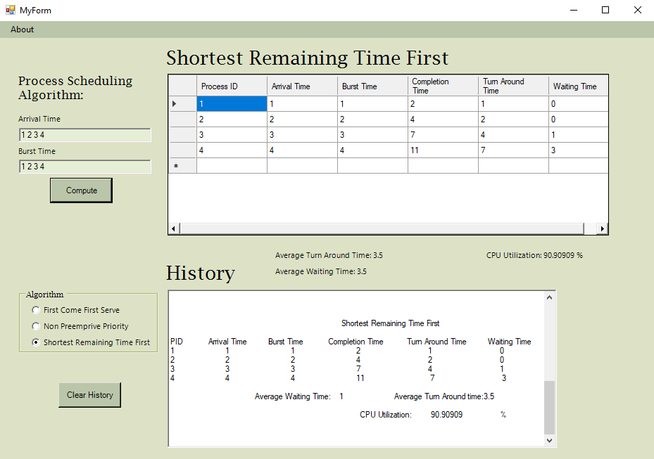
SRTF

Slide 12
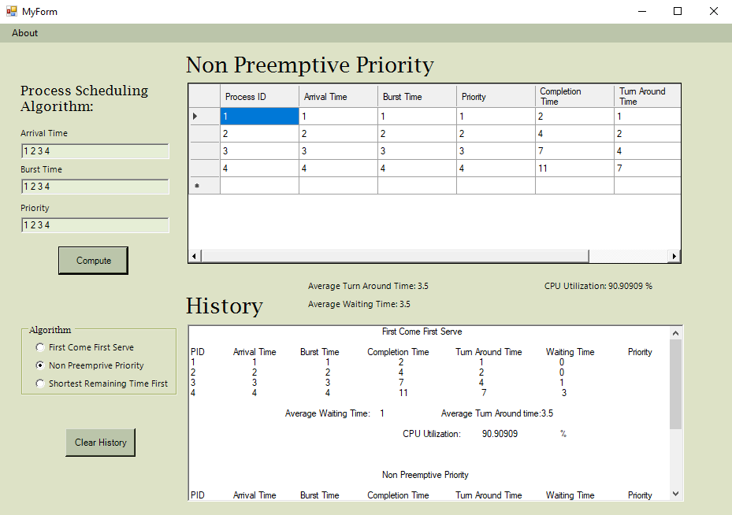
NON-PREEMPTIVE PRIORITY

Slide 13
CONCLUSION
Our system program highlights FCFS, SRTF, and Non-Preemptive scheduling, showcasing efficient task management.
Contributing to optimized system performance and streamlined task execution.

Slide 14
FUTURE IMPROVEMENTS
User Interface Enhancement
Additional Scheduling Algorithms
Help Features
Feedback Mechanism

Slide 15
QUESTIONS AND ANSWERS

Slide 16
THANK YOU!

