Slide 1
Graph neural networks for identifynding robust biomarkers in multiomics data
CTU FEL, Department of Computer Science
by Jan Lubojacký
supervisor Doc. Ing. Jiří Kléma, Ph.D.
30.1.2024

Slide 2
Task
- disease subtype classification
- survival prediction
- drug response prediction
- we want explainable models, that can hint at the underlying biomarkers

Slide 3
Multi-omic data includes
- expression data
- mRNA, miRNA, circRNA
- DNA methylation
- Copy number variations (CNV)
- TE counts

Slide 4
Datasets
- Breast invasive carcinoma (BRCA)
- Myelodysplastic syndromes (MDS)
- Others, for future work
- Liver cancer (KIPAN)
- Lower grade glioma (LGG)
- Alzheimer disease (ROSMAP)

Slide 5
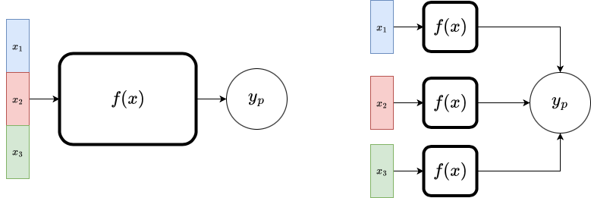
Integrating data

Slide 6
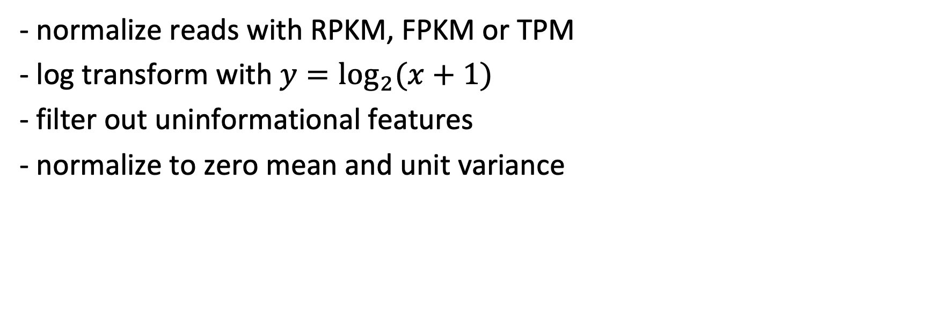
Data preprocessing
- normalize reads with RPKM, FPKM or TPM
- log transform with $y=\log_{2}{(x+1)}$
- filter out uninformational features
- normalize to zero mean and unit variance

Slide 7
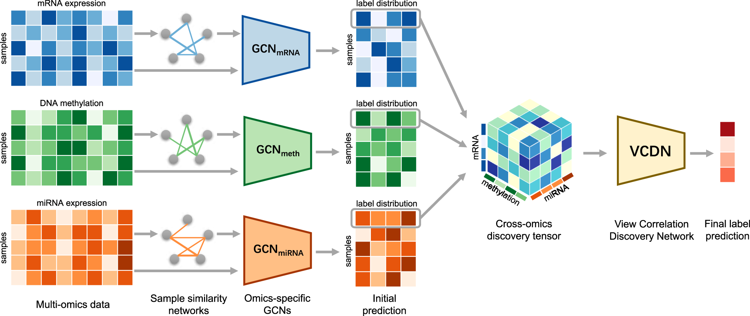
Mogonet

Slide 8
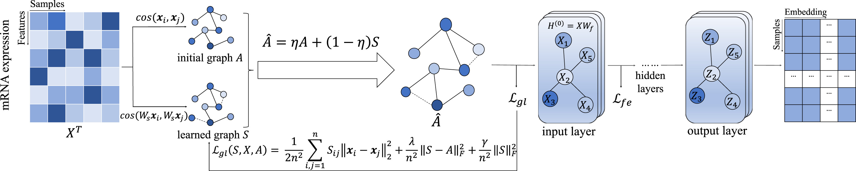
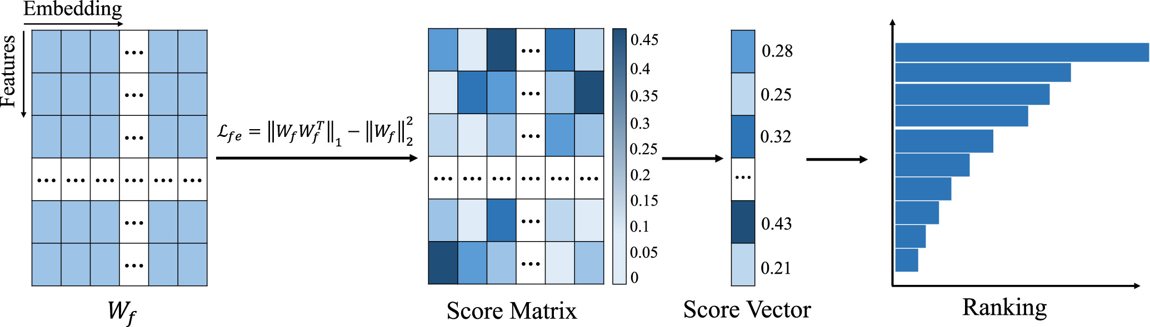
Moglam
Notes:
Where the learned graph S is regularized to be smooth and sparse

Slide 9
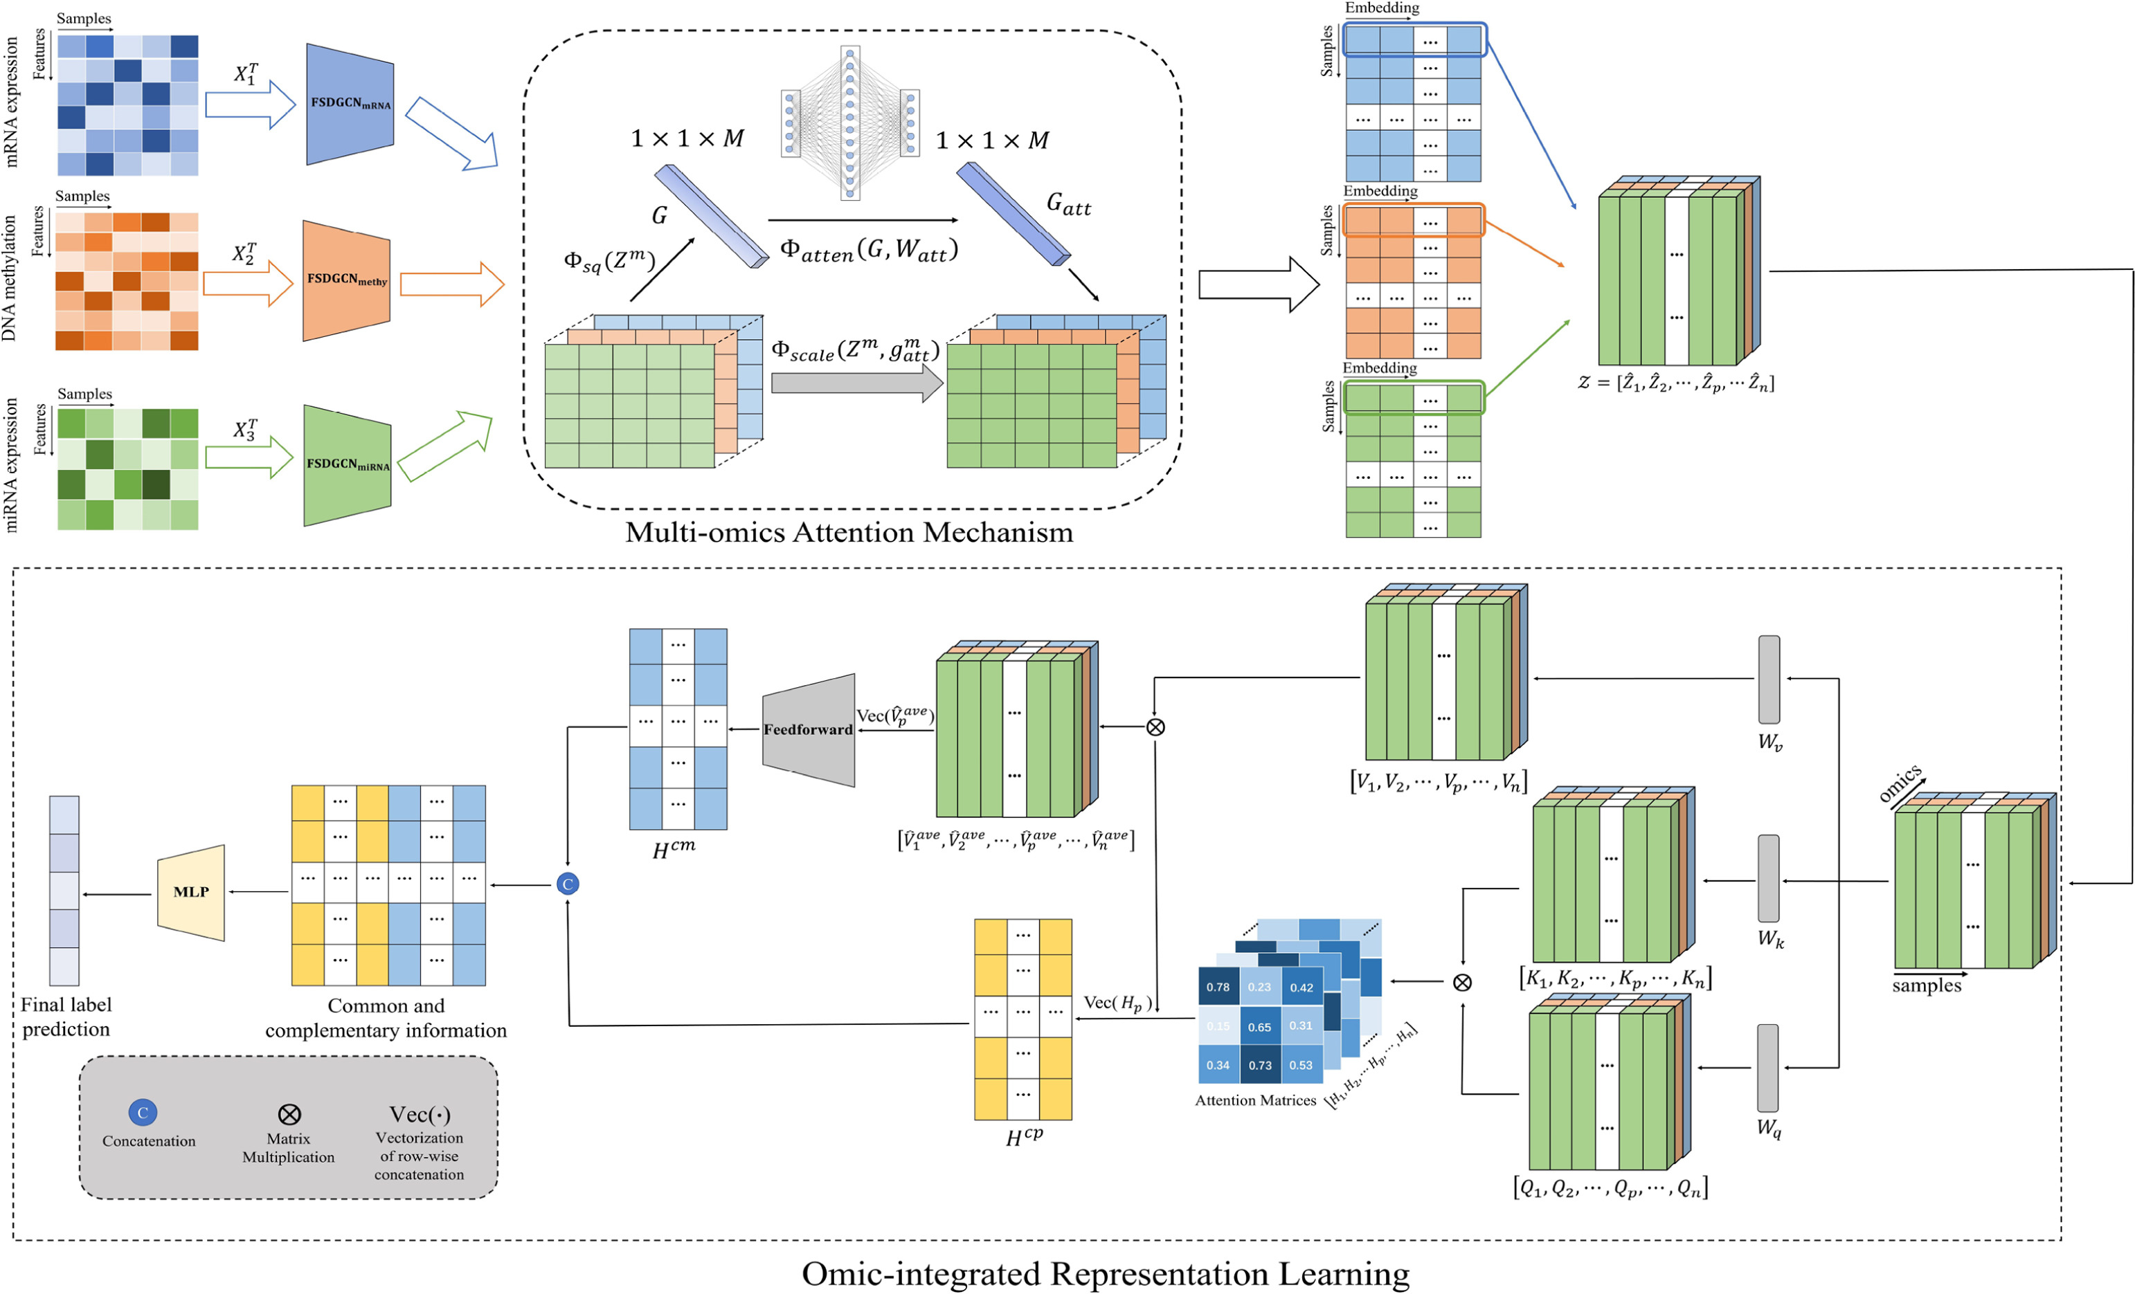

Slide 10
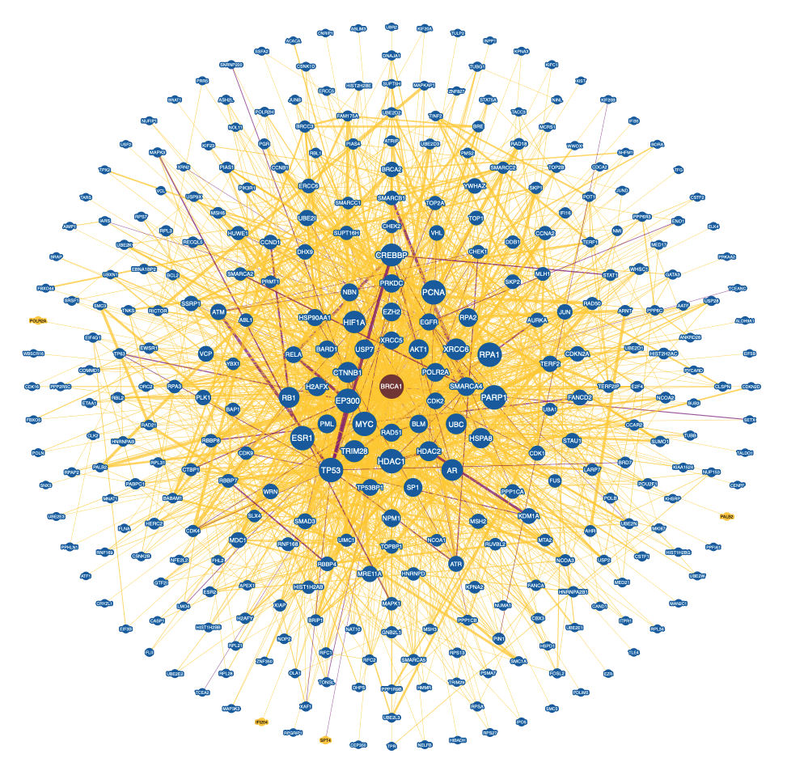
Feature interactions
- gene - gene interactions
- protein - protein interactions
- miRNA - gene interactions

Slide 11
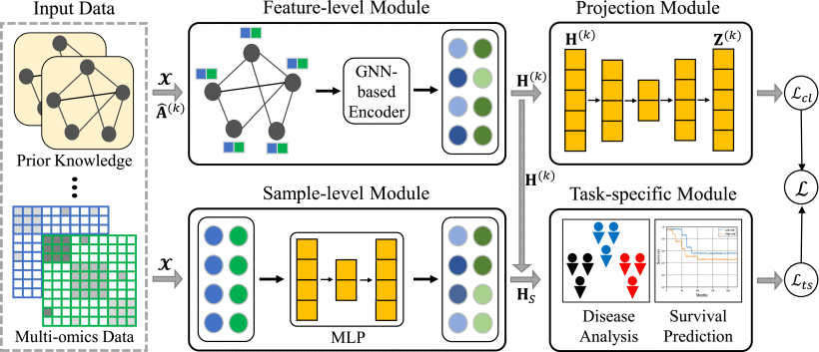
MPK-GNN

Slide 12
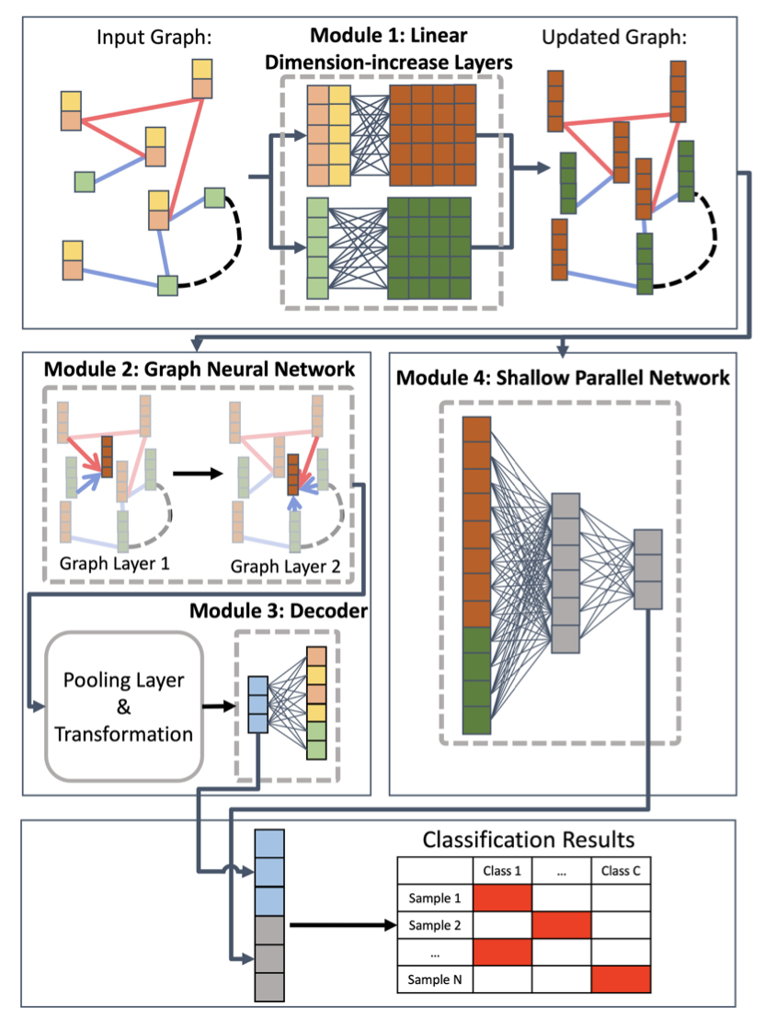
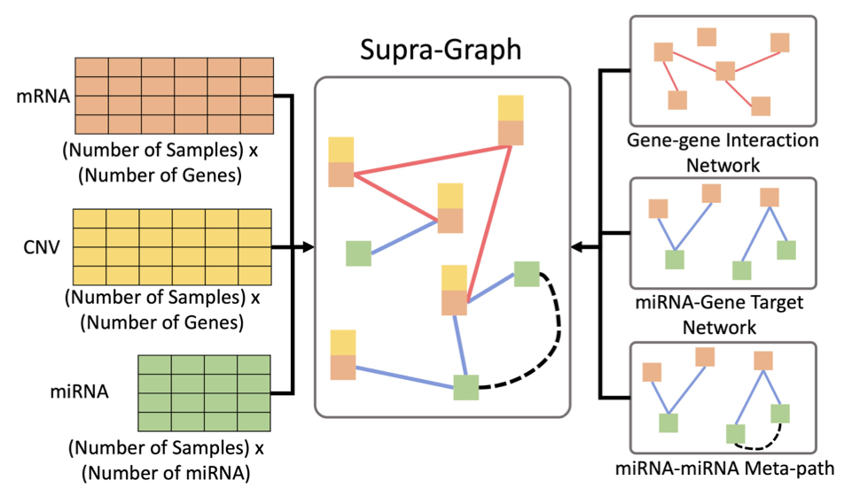
Li and Nabavi

Slide 13
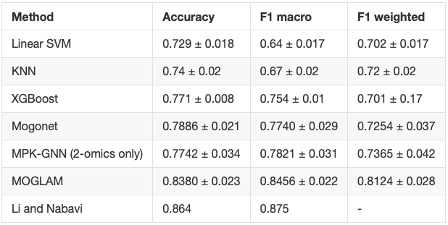
Performance comparision on BRCA dataset
Notes:
Mogonet june 2021, Li and Nabavi january 2024

Slide 14
What is next
- Expand the review, go into detail and find which methods work and which do not
- Provide a validation across several datasets for all the methods
- Utilize ideas from different methods and come up with one what will work better and find new biomarkers

Slide 15

Thank you for your $softmax\left(\frac{QK^{T}}{\sqrt{d_{k}}}\right)⋅V$

